Slide 1



Update on NERC
IBR-Related Activities
ERCOT IBRWG Meeting
Eric Newnam
August 15, 2025

Slide 2
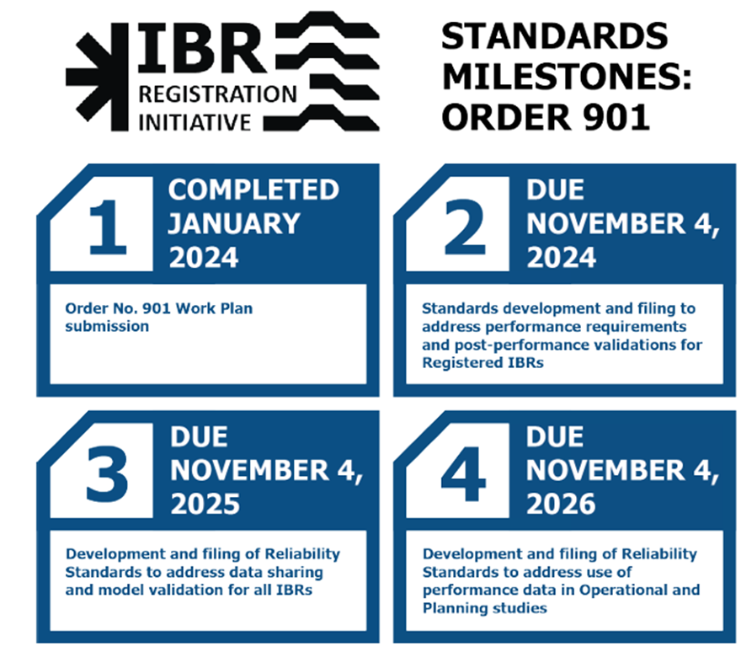
Standards Development Update
ORDER 901
Milestone 2
The Federal Energy Regulatory Commission (FERC) approved PRC-029 on July 24, 2025, with an effective date of October 1, 2026 (see Docket RM25-3-000). PRC-028-1 Implementation Plan and PRC-030-1 Implementation Plan approved by FERC earlier in 2025 are now also effective with PRC-029 approval
Milestone 3
Project 2020-06 – Verification of Models and Data for Generators
Model Validation and Model Verification Definitions adopted by the NERC Board on August 14, 2025.
MOD-026 Verification of Dynamic Models & Data, comment period open through 8 p.m. Eastern, September 10, 2025.
Project 2021-01 – System Model Validation with Inverter-Based Resources (IBRs)
Posted for comment and ballot through September 10, 2025.
Project 2022-02 – Uniform Modeling Framework for IBR.
Posted for comment and ballot through September 10, 2025.
Milestone 4 – Posting SARS and drafting team nomination solicitation week of August 25
Project 2025-03 Operational Studies
Project 2025-04 901 Planning Studies

Slide 3
Other NERC Activity
NERC issued ​Essential Actions to Industry: Inverter-Based Resource Performance and Modeling​ on May 20. Question responses are due midnight, August 18, 2025, covering these essential actions:
Each TO Transmission Owner (TO) and Transmission Planner (TP), in coordination with their Planning Coordinator (PC), should enhance existing criteria and policies in their generator interconnection and planning activities respectively, with additional technical details and IBR specific performance criteria
Each TP and PC should enhance their modeling and study practices to ensure sufficient study work and model quality verification is performed and documented to reflect models that are representative of equipment
TOs, TPs, or PCs, where applicable, should perform a detailed review of currently operating IBRs on their system to understand the real-world performance and accuracy of their models
Each Generator Owner (GO) should create and implement processes to help ensure models used for the evaluation of their design and submitted to TPs and PCs for use in generator interconnection and planning processes are—to the extent possible based on the available information—accurate and high-fidelity representations
Standard Project 2022-04 EMT Modeling. Formal comment period and initial ballot, target posting mid-August for FAC-002-5, Facility Interconnection Studies

Slide 4


Questions?
information@texasre.org

