Slide 1
ERCOT IBRWG: Other Industry Updates
Julia Matevosyan
Associate Director and Chief Engineer
ESIG
08/15/2025

Slide 2
G-PST/ESIG Webinar: Requirements and Verification Procedures for Grid-Forming Units – The German Approach to Ensuring Power System Stability
Featured Speaker: Dr.-Ing. Kaveh Malekian Boroujeni, Professor for Decentralized Energy Systems and Electrical Networks at the Brandenburg University of Technology Cottbus–Senftenberg
Core question: How and to what extent can grid-forming inverters support stability in systems with very high shares of inverter-based generation?
Current challenge: Need for clear methodologies to determine, quantify, and validate grid-forming capability.
Germany’s two-stage strategy:
  Stage 1 (2025): Launch of a temporary market-based ancillary service for “instantaneous reserve” provided by transmission system operators.
  Stage 2 (2027/28): Mandatory minimum “instantaneous response” capability for new large-scale plants under the revised EU RfG2.0 code.
Instantaneous reserve market role: Accelerates deployment of grid-forming technologies by incentivizing key capabilities (voltage source behavior, phase jump power) and securing reserves for balancing generation deficits and surpluses (positive/negative “instantaneous response”).
Technical focus: Translation of the grid-forming concept into measurable instantaneous reserve products, including definitions, quantification methods, and verification procedures for market participation.
https://www.esig.energy/event/german-approach-stability/

Slide 3
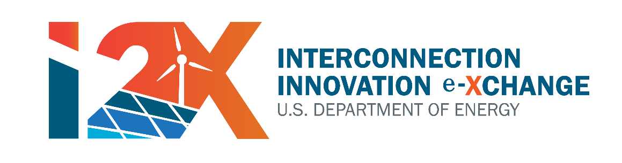
DOE Forum for the Implementation of Reliability Standards for Transmission (i2X FIRST) – Season 2
May 27, 2025, 11 a.m. - 1 p.m. ET – Season 2 Kick-Off
June 24, 2025, 11 a.m.- 1 p.m. ET – NERC Milestone 3 Standards
July 22, 2025, 11 a.m.- 1 p.m. ET – IBR Plant Design Evaluation with Applicable Requirements I
August 26, 2025, 11 a.m.- 1 p.m. ET – IBR Plant Design Evaluation with Applicable Requirements II
September 23, 2025, 11 a.m.- 1 p.m. ET – IBR Plant Modeling Requirements and Best Practices
October 21, 2025, 11 a.m.- 1 p.m. ET – Challenges with IEEE2800-2022, Planned Revisions
November 25, 2025, 11 a.m.- 1 p.m. ET – Change of Management during IBR Plant Interconnection Process and Commissioning, How to Maintain Conformity
December 16, 2025, 11 a.m.- 1 p.m. ET – IBR Plant Commissioning Best Practices I
January 27, 2026, 11 a.m.- 1 p.m. ET – IBR Plant Commissioning Best Practices II
February 24, 2026, 11 a.m. - 1 p.m. ET – Grid Forming IBR Specifications and Testing Requirements I
March 16, 2026, hybrid event during ESIG Spring Workshop: Grid Forming IBR Specifications, Testing Requirements, Lessons Learned
Sign up for all future i2X FIRST Season 2 Meetings here
Follow ESIG i2X FIRST website https://www.esig.energy/i2x-first-forum/ for meeting materials & recordings and for future meeting details & agendas

Slide 4
IBR Plant Design Evaluation with Applicable Requirements I – July 22, 2025
Agenda:
IEEE P2800.2, IBR Plant Design Evaluation – Overview: Jens Boemer, EPRI
IBR Plant Design Evaluation – Developer Perspective: Rishi Maharaj, Engie
IBR Plant Design Evaluation – EPC Perspective: Patrick Hart, Mortenson
Key Takeaways:
Cross-Party Coordination – Align scopes across developers, OEMs, EPCs, and consultants to avoid non-conformity.
Proactive Approach – Bake high-bar compliance into contracts and processes to prevent missed requirements.
Standardization – Use consistent data formats, simulation procedures, and model verification to reduce errors and enable automation.
PPC Risks – Deliver and validate PPCs early; improve product-level certification and integration.
Continuous Evaluation – Combine simulation-based assessments with field commissioning tests throughout the project lifecycle.
Enforcement – Require design evaluations pre-energization and “as-built” verification before commissioning.
Internal Expertise – Build in-house capability for design evaluations, supported by external specialists as needed.
Recording and presentations are available here: https://www.esig.energy/i2x-first-forum/

Slide 5
IBR Plant Design Evaluation with Applicable Requirements II – August 26, 2025
Agenda:
IBR Plant Design Evaluation – ISO Perspective: Alan Urban, MISO
IBR Plant Design Evaluation – Utility Perspective: Alan Urban, MISO
IBR Plant Design Evaluation Leaning on Documentation Review: Jens Boemer, EPRI
Putting IEEE P2800.2 Concepts to Action – IBR Performance and Modeling Requirements: Ryan Quint, Elevate
Sign up for all future i2X FIRST Season 2 Meetings here https://www.esig.energy/i2x-first-forum/

Slide 6
NASPI Webinar: Post-Commissioning Monitoring Aspects of IEEE P2800.2
– August 20, 2025
Featured Speaker: Julia Matevosyan, ESIG, IEEE 2800.2 SG5 chair
Abstract:
IEEE P2800.2 (in draft) outlines recommended practices for verifying plant-level conformity with IEEE Std 2800 for IBR plants on the bulk power system.
Conformity should be assessed during interconnection, commissioning, and throughout the plant’s lifetime—not just at the start.
Today, post-commissioning conformity assessments are rare, creating reliability concerns.
Actual disturbance events are critical for true model validation and performance evaluation.
Webinar will focus on post-commissioning model validation, monitoring, and periodic testing proposed in IEEE P2800.2.
Post-Commissioning Monitoring is also relevant in light of recently approved NERC PRC-030 and upcoming MOD-026 update
Webinar info: https://www.naspi.org/node/1017

Slide 7
Two ESIG Trainings – Nov and Dec 2025
ESIG Interconnection Studies Short Course WHEN: November 17-19, 2025 WHERE: Manatee Lagoon, 6000 N Flagler Dr, West Palm Beach, FL 33407 MORE DETAILS: This 3-day in-person training is intended to enhance the knowledge and ability of the current workforce through coursework focused on best practices for performing the study work necessary to interconnect inverter-based resources to the bulk power system reliably. Training participants will learn practical methods and best practices that can be leveraged into enhanced study practices across the industry. These training modules will focus on the expected day-to-day needs of engineers performing interconnection studies, model quality tests, or inverter-based resource model and simulation work as well as managing study practices within their organization.
ESIG Electromagnetic Transient Training WHEN: December 16 - 19, 2025 WHERE: Texas RE's Rio Grande Room, Austin, Texas MORE DETAILS: This 3-day in-person training is intended to enhance the knowledge and ability of the current workforce through coursework focused on performing EMT simulations in the current interconnection and planning paradigm. Training participants will learn practical methods and best practices that can be leveraged into enhanced study practices across the industry. These training modules will focus on the expected day-to-day needs of engineers performing EMT analysis as well as managing EMT study practices within their organization.
EXPRESS INTEREST - INTERCONNECTION STUDIES SHORT COURSE
EXPRESS INTEREST - EMT TRAINING
Thanks to NextEra and Texas RE for hosting at their facilities!

Slide 8
Julia Matevosyan
julia@esig.energy

