Slide 1
Initial Capability Reports
Mario A. de la Garza
August 8, 2025

Slide 2
Initial Capability Reports Discussion
This presentation provides examples of the kinds of information Resource Entities (REs) and Interconnecting Entities (IEs) should enter into DocuSign based on information required in NOG §§ 2.11.1(1) and 2.11.2(1) (use Initial Frequency Ride-Through Capability Report (IFRTCR) and Initial Voltage Ride-Through Capability Report (IVRTCR) templates from ERCOT website to assist in preparation for DocuSign)
Examples are intended as a guide to assist REs/IEs in submitting acceptable information and documentation
Other acceptable language is possible

Slide 3
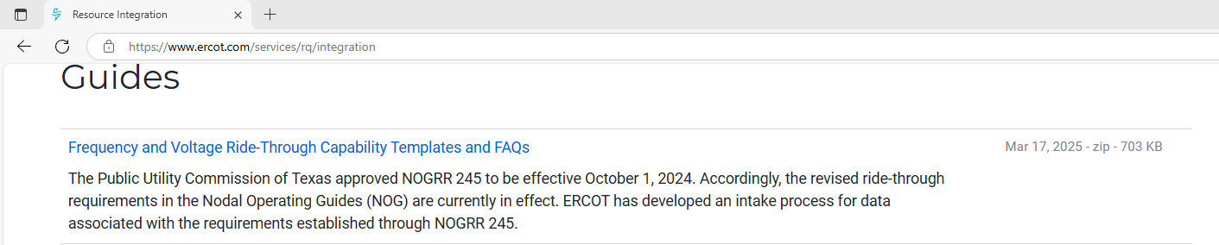
Initial Capability Reports
IFRTCR / IVRTCR
  Nodal Operating Guide (NOG) Section 2.6.2.1(7)
  NOG Section 2.11.1
  NOG Section 2.11.2
IFRTCR / IVRTCR Files: Resource Integration

Slide 4
IFRTCR/IVRTCR Items (a) – (c)
(a) Resource Entity or Interconnecting Entity Data Universal Numbering System (DUNS) Number:
(b) IBR/WGR Site Name:
(c) IBR/WGR Unit Name(s):
Substation ERCOT Code either from RIOO-RS or Substation Details in RIOO-IS
ERCOT Resource Mnemonic from RIOO-RS or unit name under Substation Details in RIOO-IS

Slide 5
IFRTCR/IVRTCR Item (d) – NOG Sections Resource Cannot Meet
(d) Nodal Operating Guide Section(s) with which the Resource cannot comply.
What is required: Specify distinct requirements in sub-sections Resource cannot meet
Acceptable:
  FRT: NOG § 2.6.2.1(1); NOG § 2.6.2.1(3); NOG § 2.6.2.1(4); NOG § 2.6.2.1(5); NOG § 2.6.2.1(6)
  VRT Legacy: NOG § 2.9.1.2(1); NOG § 2.9.1.2(3); NOG § 2.9.1.2(4); NOG § 2.9.1.2(5); NOG § 2.9.1.2(6); 2.9.1.2(7)

Slide 6
IFRTCR/IVRTCR Item (d) – NOG Sections Resource Cannot Meet
Deficient:
  Specific sub-sections not identified
  Reference to separate file
  No response
Examples:
NOG § 2.6.2.1(7) (section is not a requirement)
NOG § 2.9.1.1(8)
NOG § 2.9.1.2(9) (section is not a requirement)
See file named Consultant_Report_Final.pdf

Slide 7
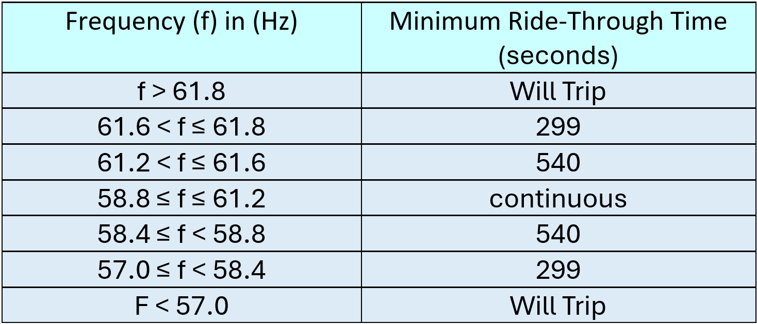
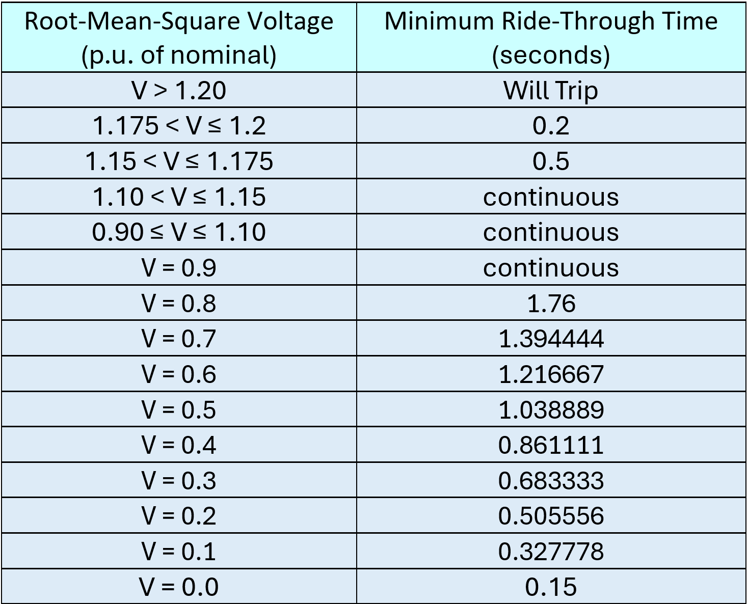
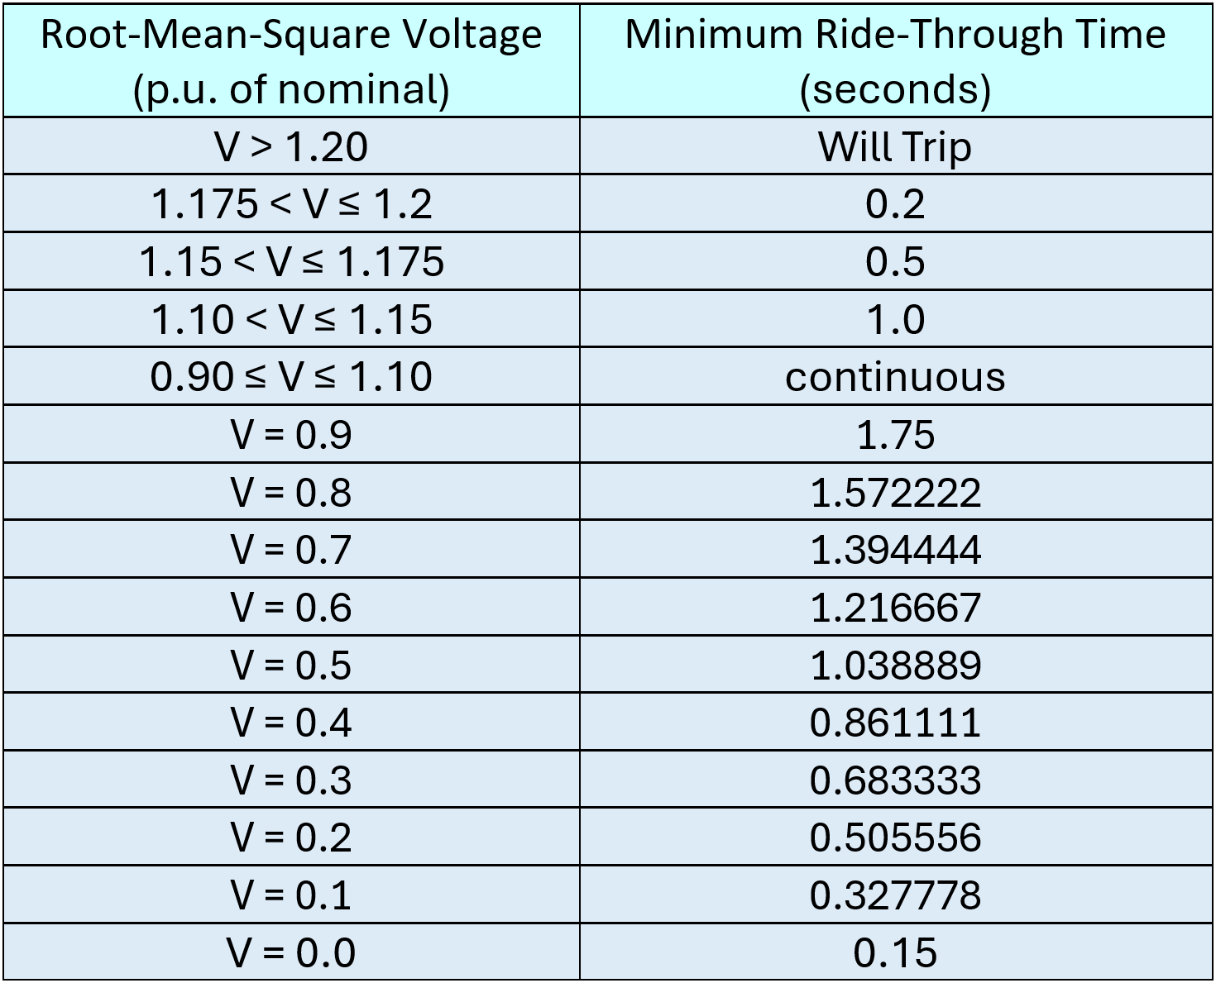
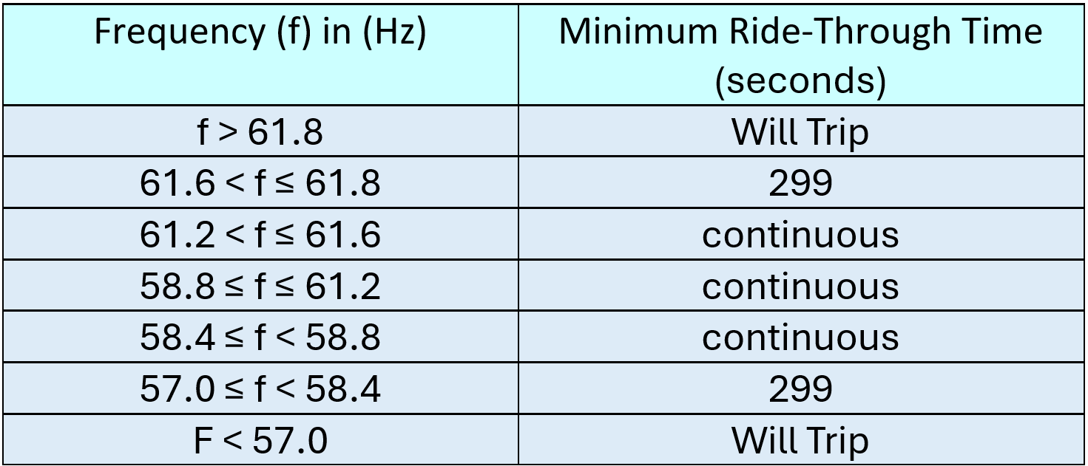
IFRTCR/IVRTCR Item (e) – Current FRT/VRT Capability
(e) Current frequency / voltage ride-through capability in a format similar to the table in paragraph (1) of Section 2.6.2.1 | 2.9.1.2
What is required: Current ride-through capability relative to Point of Interconnect (POI) not at inverter/turbine – you can attach table to the DocuSign envelope
Acceptable:

Slide 8
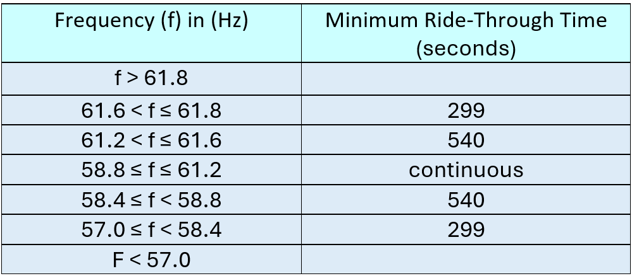
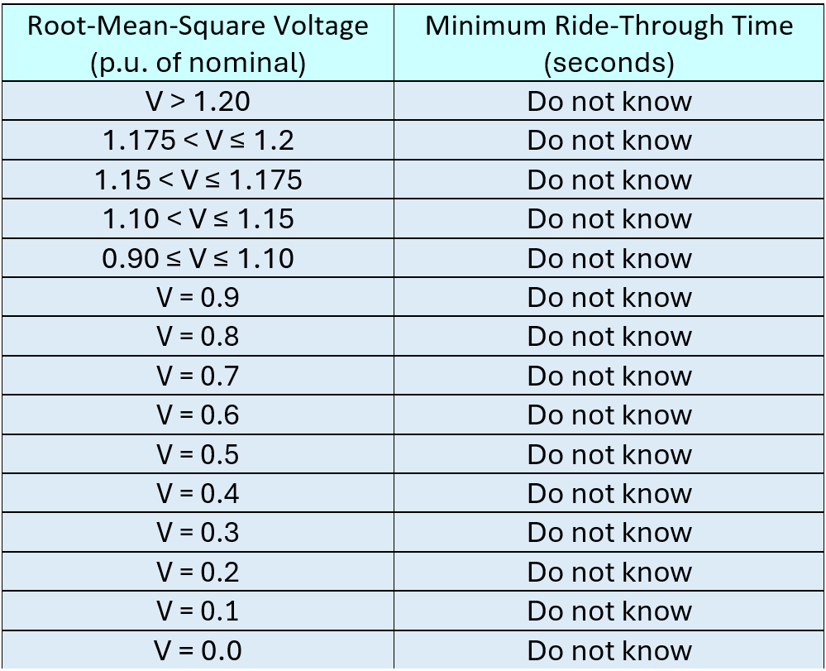
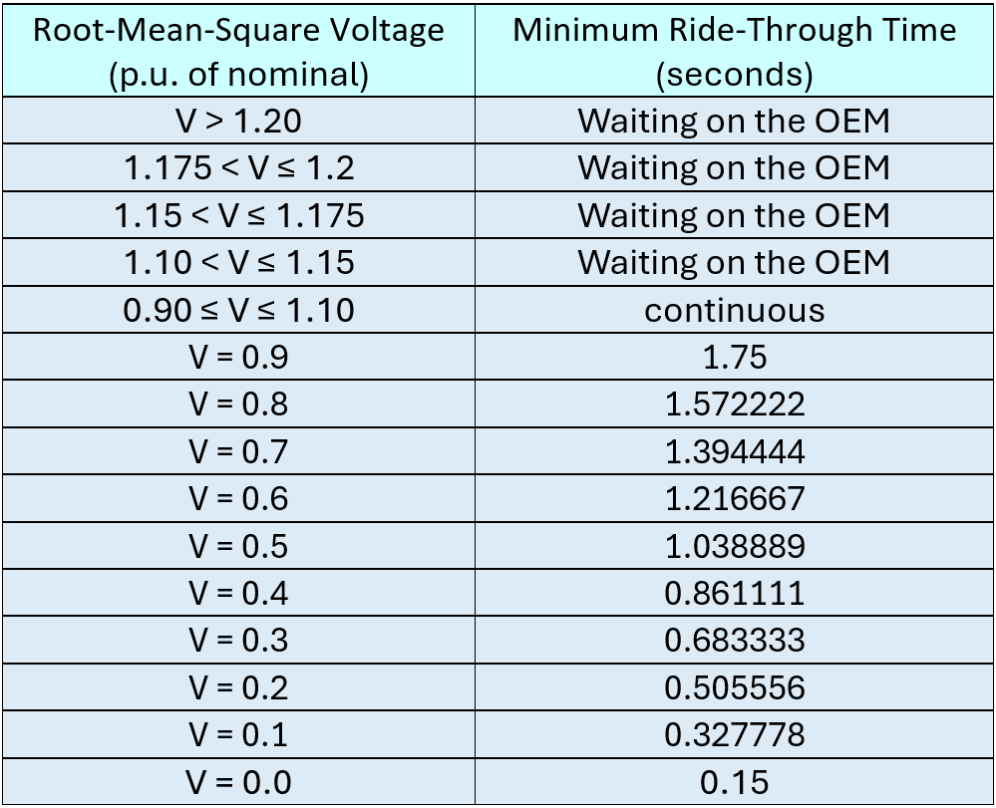
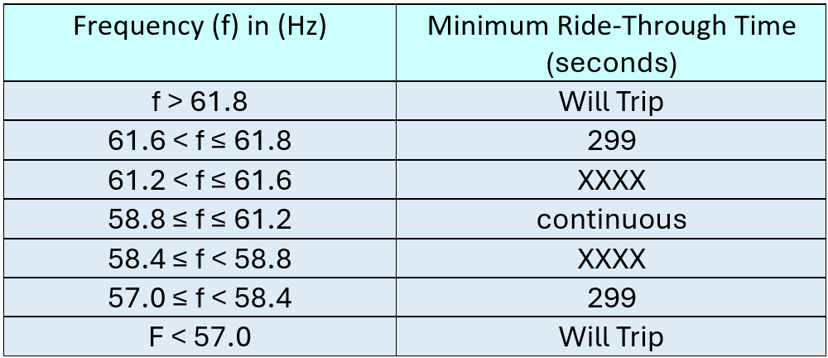
IFRTCR/IVRTCR Item (e) – Current FRT/VRT Capability
Deficient:
  Not current capability
  Unknown or blank
  Waiting on OEM
Examples:

Slide 9
IFRTCR/IVRTCR Item (f) – Known Ride-Through Limitations
(f) Known frequency / voltage ride-through limitations of the IBR, Type 1 WGR or Type 2 WGR as compared to the requirements in Section 2.6.2.1(1) - (5) | Section 2.9.1.2(1) - (7)
What is required: Identify specific limitation(s) preventing Resource from meeting NOG section
Acceptable:
Resource cannot meet ROCOF requirement in § 2.6.2.1(3)
Resource cannot meet phase angle jump requirement in § 2.6.2.1(3)
Resource cannot meet requirement in § 2.6.2.1(5) that the turbine controls not disconnect the plant or any individual inverter/turbine or prevent current exchange between the Resource and the ERCOT Transmission Grid during frequency conditions where ride-through is required.

Slide 10
IFRTCR/IVRTCR Item (f) – Known Ride-Through Limitations
Deficient: Missing, vague, or incomplete descriptions of limitations - including no response or references to external documents lacking necessary information
Examples:
See document Consultant_Report_Final.pdf
Balance of plant voltage protection relay settings need to be extended beyond the turbine ride-through capability, which requires a protection coordination study from a qualified protection engineer
Due to equipment limitations of the Type 1 WGR, the [Resource] plant control is not configured for voltage and frequency control
Due to equipment limitation, VRT cannot be expanded beyond current capability
Blank

Slide 11
IFRTCR/IVRTCR Item (g) – Technical Limitations with OEM Letter
(g) A detailed description of the technical limitation preventing the Resource from meeting the ride-through requirement(s), including a letter signed by an officer or executive of the original equipment manufacturer (or subsequent support company if the original equipment manufacturer is no longer in business) or an engineering consulting firm verifying the limitations
What is required: Detailed description of technical limitation(s) preventing Resource from meeting ride-through requirements with attached letter signed by officer or executive of OEM or representative of engineering consulting firm verifying the limitation(s)
Acceptable:
Resource cannot meet ROCOF requirement in § 2.6.2.1(3) because the protection system is hard coded and cannot be changed. See, OEM letter in file named OEM_technical_limitations.pdf.
Resource cannot meet phase angle jump requirement in § 2.6.2.1(3) because the protection system is hard coded and cannot be changed. See, OEM letter in file named OEM_technical_limitations.pdf.
Resource cannot meet phase angle jump requirement in § 2.6.2.1(5) because inverter controls currently disconnect individual turbines during frequency conditions where ride-through is required and cannot be modified because doing so would damage equipment. See, OEM letter in file named OEM_technical_limitations.pdf.

Slide 12
IFRTCR/IVRTCR Item (g) – Technical Limitations with OEM Letter
Deficient: No response; No file; no signature; document does not address technical limitations preventing compliance with ride-through requirements
Examples:
Resource requires an exemption for 2.9.1.2(4) and (5) because it is possible the turbine may use current blocking with the voltage ride-through requirements. The OEM has stated there are no software-based upgrades to address this limitation – but RE did not provide documentation from OEM or consulting firm verifying the limitation
Please see attached letter from XYZ Engineering, Inc. - but neither RE nor consultant provided documentation from OEM or consulting firm verifying the limitation

Slide 13
IFRTCR/IVRTCR Item (g)(i) – Letter from OEM or Consulting Firm
  (i) If RE cannot address entire plant design with letter required in Section 2.6.2.1(1)(g), RE must supplement a letter from OEM for its equipment (or subsequent support company if the original equipment manufacturer is no longer in business) or engineering consulting firm by providing a notarized attestation sworn to by RE’s highest-ranking representative, official, or officer with binding authority over the entity attesting to the efforts made to obtain the letter, why those efforts failed, and which parts of the plant design is attested to. Attestation shall also include a detailed description of the technical limitation(s) preventing the Resource from meeting the ride-through requirement, including any information on technical limitations on all or part of the Resource which the RE is able to obtain from OEMs or engineering consulting firm.
What is required: If applicable, attach notarized attestation by highest-ranking official with binding authority describing: (i) efforts made to obtain letter, (ii) why efforts failed, (iii) which parts of plant design are covered, and (iv) detailed description of technical limitations preventing compliance with ride-through requirements
Acceptable:
[RE] could not obtain a letter from the OEM addressing the entire plant. Attached is a notarized letter from [RE’s] V.P. of Operations attesting to the efforts [RE] made to obtain the letter, why those efforts failed, which parts of the plant design is attested to, and a detailed description of the technical limitations preventing [Resource] from meeting the ride-through requirements
Not Applicable because [RE] provided the information required in item (g), above.

Slide 14
IFRTCR/IVRTCR Item (g)(i) – Letter from OEM or Consulting Firm
Deficient: No response; no file; no signature; document does not describe technical limitations preventing compliance with ride-through requirement(s)
Examples:
Please see attached attestation – but attestation is not notarized
Please see attached file named Consultant Report on NOGRR245.pdf – document is not an attestation and is not from a qualified executive of RE

Slide 15
IFRTCR/IVRTCR Item (h) – Available Software, Firmware, Settings, Parameterization Modifications
(h) Available software, firmware, settings or parameterization modifications the Resource Entity will implement to maximize the frequency ride-through capability of the IBR, Type 1 WGR or Type 2 WGR within known equipment limitations, to the greatest extent possible
What is required: Clear explanation of modifications and their intended purpose
Acceptable:
[RE] will upgrade its Power Plant Controller software from V 2.11 to V 3.4 which will change anti-islanding capabilities to enable the Resource to ride through frequency conditions beyond those defined in NOG § 2.6.2.1(1) to the maximum level the equipment allows
[RE] will upgrade its inverter firmware from V 1.6 to V 1.8 which will allow the Resource to not reduce active current injection during frequency conditions requiring ride-through

Slide 16
IFRTCR/IVRTCR Item (h) – Available Software, Firmware, Settings, Parameterization Modifications
Deficient: No response; generic response failing to explain modifications or how they support compliance with requirements
Examples:
RE is working with OEM to determine what modifications are possible
RE is working on maximization activities
Blank

Slide 17
IFRTCR/IVRTCR Item (i) – Changes to Existing Equipment
(i) To the extent the Resource Entity chooses to implement changes to existing equipment other than software, firmware, settings or parameterization modifications that increase the frequency/voltage ride-through capability, identification of any such equipment modifications
What is required: Clear description of planned equipment modifications (other than SFSP)
Acceptable:
[Resource Entity] intends to replace its existing Uninterruptible Power Supply which will allow the Resource to not experience momentary cessation.

Slide 18
IFRTCR/IVRTCR Item (i) – Changes to Existing Equipment
Deficient: No response or response includes modifications to Software, Firmware, Settings or Parameterization
Examples:
[RE] will upgrade its Power Plant Controller software from V 2.11 to V 3.4 which will change anti-islanding capabilities to enable the Resource to ride through frequency conditions beyond those defined in NOG § 2.6.2.1(1) to the maximum level the equipment allows
[RE] will upgrade its inverter firmware from V 1.6 to V 1.8 which will allow the Resource to not reduce active current injection during frequency conditions requiring ride-through

Slide 19
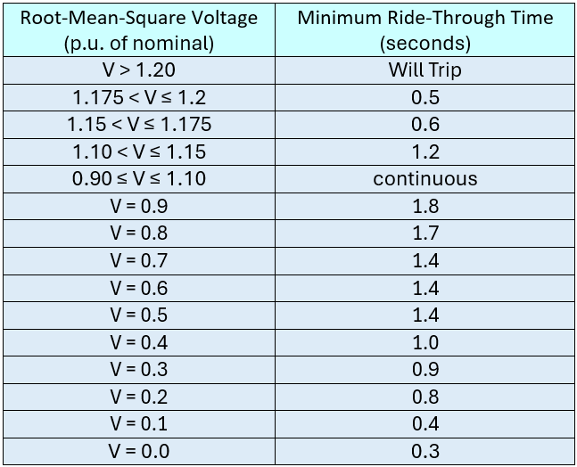
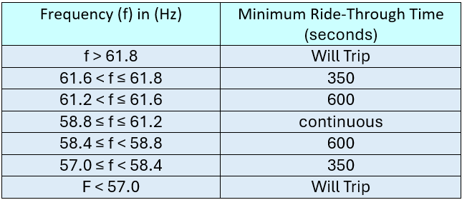
IFRTCR/IVRTCR Item (j) – Post-Modification Capability Table
(j) Expected post-modification Resource capability in a format similar to the table in Section 2.6.2.1(1) and documentation of any expected remaining limitation(s) following implementation of such modifications
What is required: Resource’s complete post-maximization capability curve referenced to POI and covering 0–600 second interval superimposed on applicable minimum requirements and with a clearly defined legend – you can attach table to the DocuSign envelope
Acceptable:

Slide 20
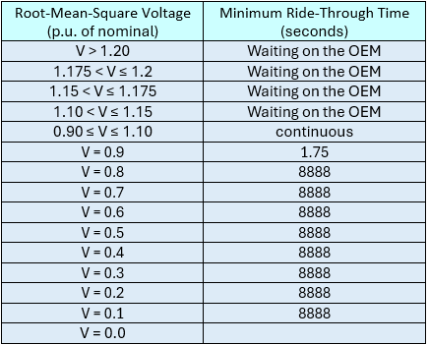
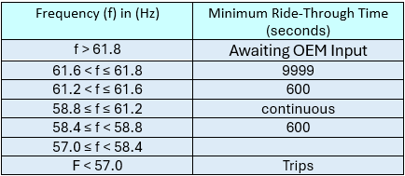
IFRTCR/IVRTCR Item (j) – Post-Modification Capability Table
Deficient: Capability table missing; data not provided in table similar to table in NOG; presented at component level rather Resource level; not referenced to POI
Examples:
No legend
Blank

Slide 21
IFRTCR/IVRTCR Item (k) – Implementation Schedule
(k) A schedule for implementing the modification(s)
What is required: Detailed implementation schedule with specific actions RE will take to meet new requirements with associated timelines for each milestone
Acceptable:
9/30/25: Submit model with modified settings and parameters to ERCOT and TSP for review/approval pursuant to Planning Guide § 5.5(6)
10/1/25 – 10/25/25: ERCOT review/approval of model
10/25/25 – 11/30/25: Upgrade inverter firmware from v1.6 to v1.8
11/15/25 – 12/15/25: Upgrade Power Plant Controller software from v2.11 to v3.2
12/1/25 – 1/15/26: Change protection system settings
1/15/26: Submit as-built data to ERCOT pursuant to Planning Guide
Q1 2025: Submit model with modified settings and parameters to ERCOT and TSP for review/approval pursuant to Planning Guide § 5.5(6)
Q2 2025: ERCOT review/approval of model
Q3 2025: Schedule on-site work with OEM/contractor
Q1 2026: Implement field work to implement modifications [NOTE: OEM has 6-month backlog that may impact schedule]
Q3 2026: Complete field setting changes

Slide 22
IFRTCR/IVRTCR Item (k) – Implementation Schedule
Deficient: No schedule; schedule falls outside timeframes in NOG
Examples:
[RE] is currently exploring the most effective and feasible way to meet the ride-through requirements. Once the path forward is decided, a schedule will be developed. [RE] will work with the OEM to determine the most feasible approach prior to December 31, 2025
April 1, 2025 to October 1, 2025: Contract with engineering consultant to perform voltage coordination study for the overall plant

Slide 23
IFRTCR/IVRTCR Item (l) – Model Accurately Representing Expected Performance
(l) A model accurately representing expected performance reflecting all technical limitations, or a statement that there are no new models available other than what is currently submitted to ERCOT that already reflect all technical limitations in frequency ride-through capability
What is required: Model meeting all requirements of Planning Guide:
Dynamics data includes data to represent dynamic and transient response of devices when connected to ERCOT System, including data for privately owned transmission system or collection system to connect Resource to ERCOT System [PG § 6.2(3)]
Provide statement indicating whether new model will be submitted or has already been submitted (include RIOO Change Request number, if applicable) - if no new model is planned because no changes can be made to improve the capability of the Resource that would change the existing model, confirm the model currently with ERCOT is accurate and valid
  Acceptable:
  Model containing all post-modification data
  If RE is requesting an exemption, RE can state “There are no new models other than what is currently submitted to ERCOT, which contains all post-modification data”

Slide 24
IFRTCR/IVRTCR Item (l) – Model Accurately Representing Expected Performance
(l) A model accurately representing expected performance reflecting all technical limitations, or a statement that there are no new models available other than what is currently submitted to ERCOT that already reflect all technical limitations in frequency ride-through capability
  Acceptable:
  [RE] has submitted the post-maximization model for NOGRR245 on [XX/XX/20XX] via RIOO-RS Change Request #YYYYY. It was approved by ERCOT on [XX/XXX/20XXX], please see attached email.
  [RE] is requesting an Exemption for the Resource X. The current model that was submitted on [XX/XX/XXXX] and approved on by ERCOT on [XX/XX/XXXX] is our accurate and valid model. The model represents all technical limitations and capability of the Resource.

Slide 25
IFRTCR/IVRTCR Item (l) – Model Accurately Representing Expected Performance
Deficient: Response either fails to clearly indicate whether a new model will be provided or RE submitted no response
Examples:
[RE] is working with [OEM] to develop a model
OEM is not cooperating
OEM has not provided [RE] a model
NOTE: If not requesting an exemption, RE cannot state, “There are no new models other than what is currently submitted to ERCOT, which contains all post-modification data” – NOG required post-modification model by 4/1/25

Slide 26
IFRTCR/IVRTCR Item (m) –Limitations that Cannot be Represented in Model
(m) A description of any limitation that cannot be accurately represented in a model
What is required: Clear explanation of system behaviors or limitations RE cannot accurately represent in a model or confirm all relevant behaviors and limitations are fully captured
Acceptable:
[RE] cannot accurately represent phase angle jump technical limitation in the model because the method for inverter controls to disconnect individual turbines during frequency conditions where ride-through is required cannot be shown in PSCAD because [explain]

Slide 27
IFRTCR/IVRTCR Item (m) –Limitations that Cannot be Represented in Model
Deficient:
No response or response not specific to limitations that cannot be represented in model
Response either fails to clearly indicate whether a new model will be provided or RE submitted no response
Examples:
The post-maximization ride-through settings will not be represented in the model until final design has been completed
[RE] is working with OEM to develop a model
OEM will provide limitations in Q2 2026

Slide 28
Before Submitting
To get Resources a head start, templates are available at: Resource Integration
Do not substitute consultant or OEM version of capability report - will be rejected
Complete the fields in DocuSign

Slide 29

Questions?

