Slide 1
Data Center Inside ERCOT
Observations and Patterns
Sam Morris
Load Forecasting and Analysis
LLWG 8/14/2025

Slide 2
Background
ERCOT researched all loads connected at a transmission bus and classified loads by use type, including cloud storage, cloud compute, and crypto currency mining data centers
  Includes loads that have gone through the Large Load Interconnection (LLI) process and others that were operational before the LLI process and/or are smaller than 75 MW
The following slides show aggregate load profile and growth information for these data centers

Slide 3
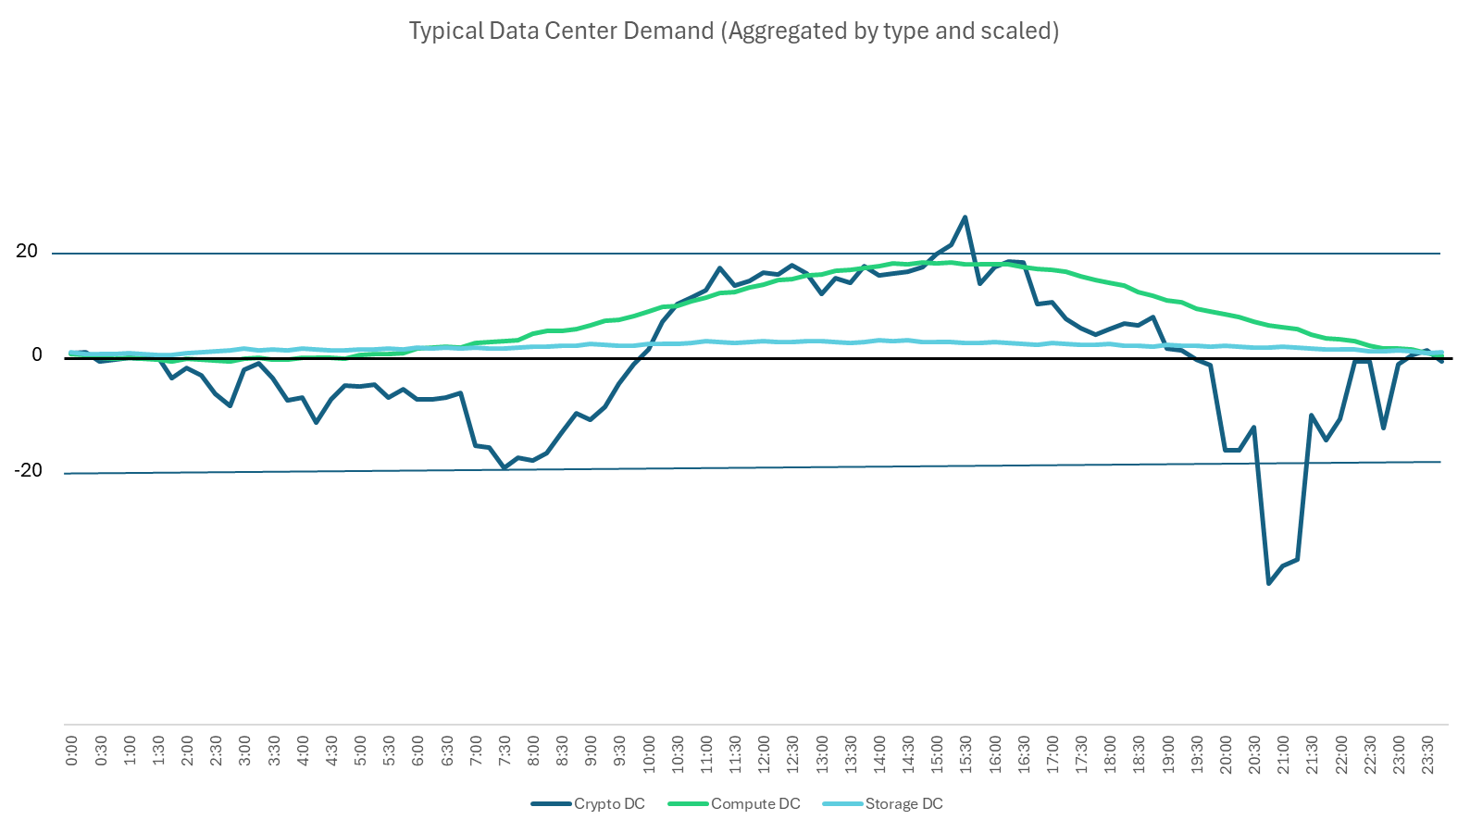
Three Data Center Daily Shapes
MW

Slide 4
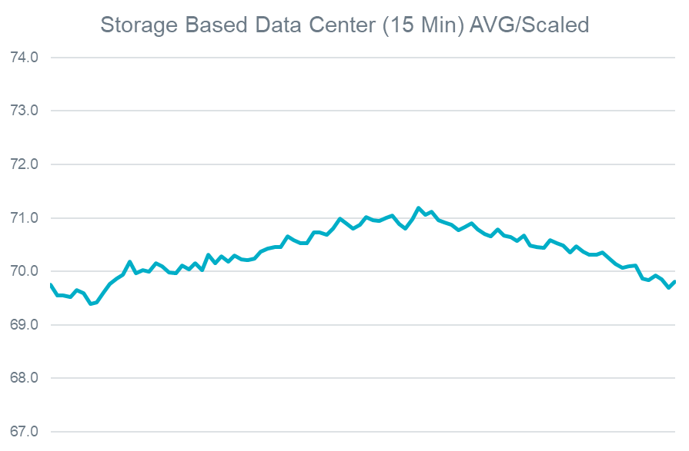
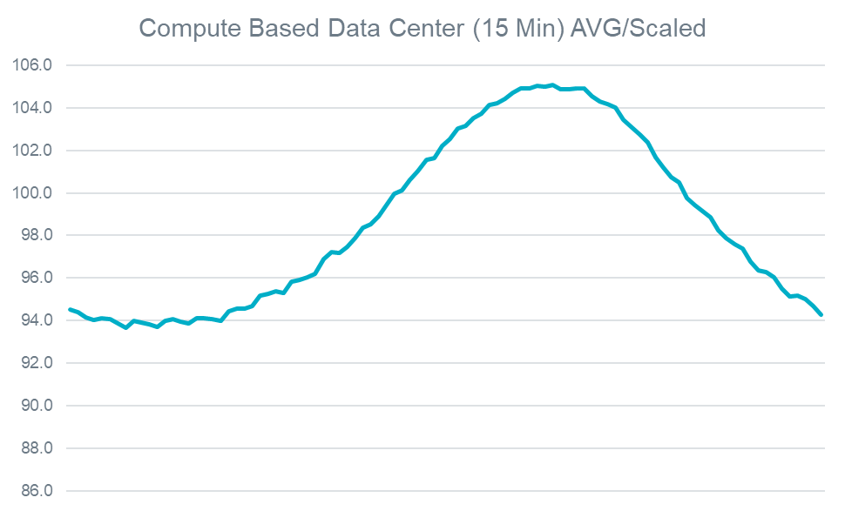
Cloud Based Data Centers Daily Pattern
ERCOT has approximately 380 storage/compute data centers.
Of those, 54 are considered Med/Large (>25MW).

Slide 5
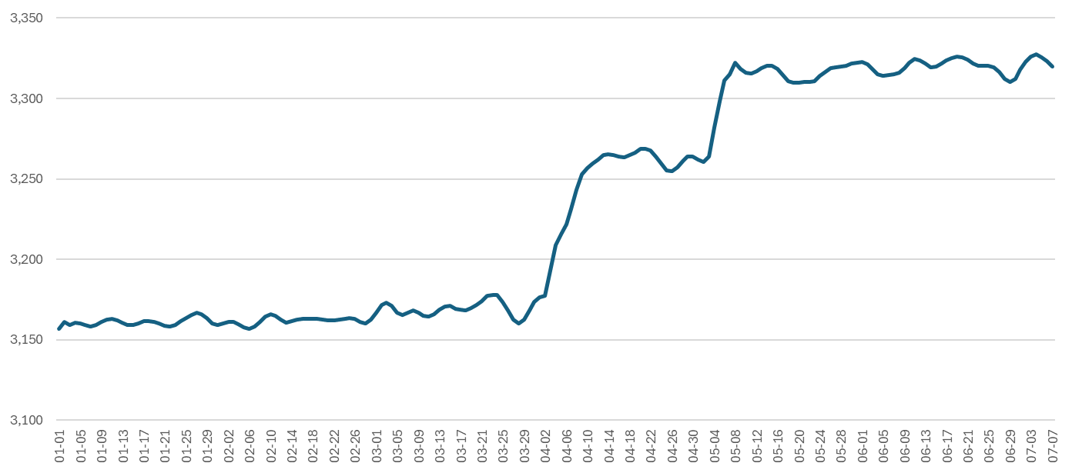
Cloud Based Data Center Growth (YTD)
MW
In the first half of 2025 Traditional Data Centers load grew by about 5%
Most of this was observed from April 1 to May 10. (3.9%)
Current installed capacity = 6,400MW Approved to Energize (LLI) + Operational (non-LLI)

Slide 6
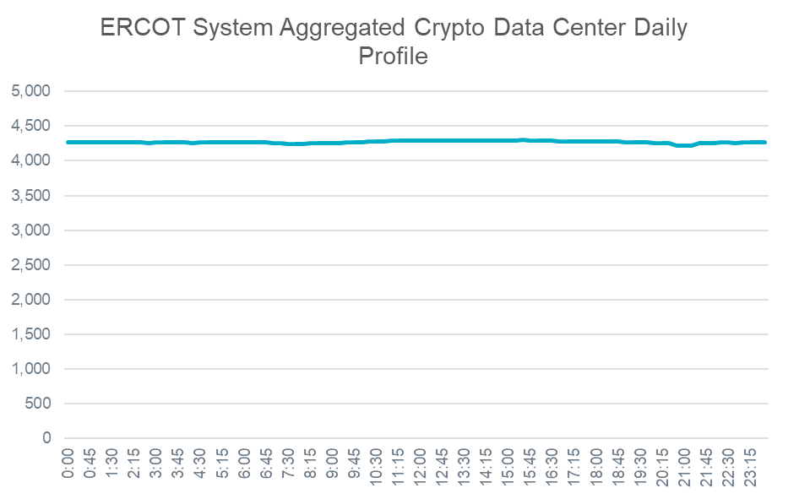
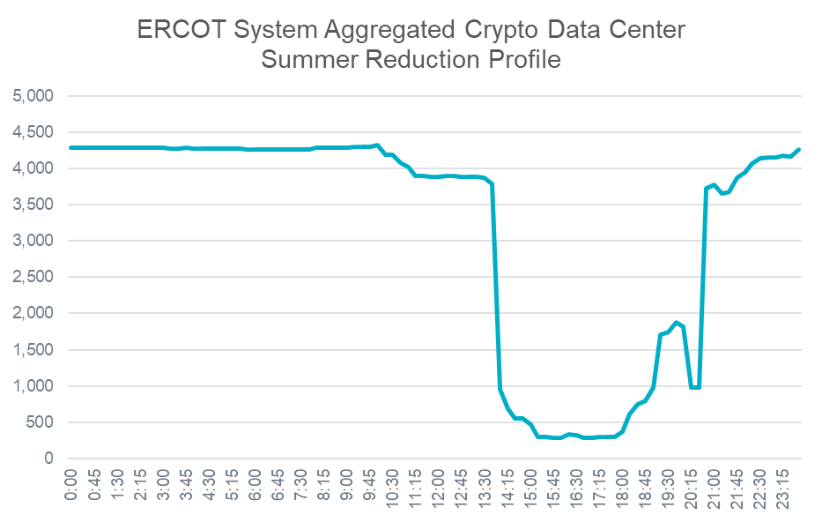
Crypto Currency Mining Data Center
ERCOT has approximately 75-80 crypto currency mining sites
Of these, 44 sites are considered Med/Large (>25MW)

Slide 7
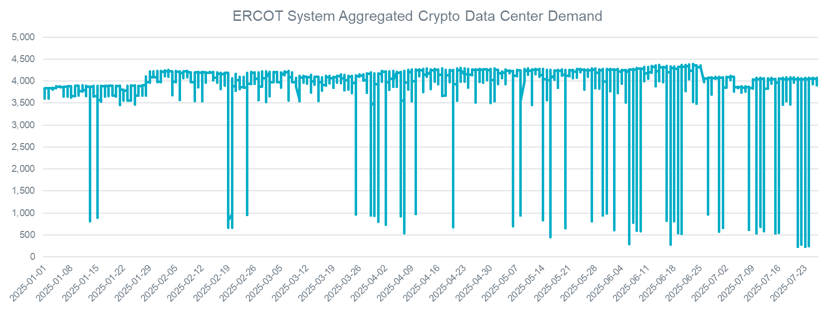
Crypto Currency Mining Data Center Growth (YTD)
Crypto mining data center demand has had some additions and some subtractions over the past year
Overall, the growth has been flat. ERCOT expects that to again ramp up starting this fall based on LLI additions
Installed capacity = 5,600MW Approved to Energize (LLI) + Operational (non-LLI)

Slide 8
Helpful Links
PUCT Virtual Currency Mining Facility Registration
https://www.puc.texas.gov/industry/electric/business/vcm/
Texas Comptroller Registered Qualifying Data Centers List
https://comptroller.texas.gov/taxes/data-centers/
Thank You!

