Slide 1
Large Load Voltage Ride-Through Related Studies
LLWG
August 14, 2025
Jeff Billo
ERCOT Operations Planning

Slide 2
Background
ERCOT is conducting the following studies related to Large Load voltage ride-through:
  Large Load Voltage Ride-Through System Operating Limit Study (LL VRT SOL)
  Large Load Frequency Limit Study
  Benefit of Transmission Improvements Study
  Large Load Voltage Ride-Through Proposal Study (LL VRT)
The following slides will describe the purpose and scope of each of these studies
For more background information see previous LL Workshop and LLWG presentations:
  https://www.ercot.com/files/docs/2025/06/13/COMBINED_June-2025-Large-Load-Workshop.pptx
  https://www.ercot.com/files/docs/2025/07/11/ERCOT-LEL-Ride-Through-Criteria_LLWG-final.pptx

Slide 3
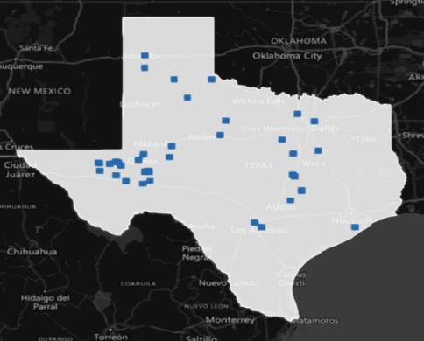
1. LL VRT SOL
Questions to Answer:
What areas have frequency or voltage stability limits due to lack of Large Load VRT? What is the control room plan to keep the system within limits?
Scope:
DWG Flat Start case with updated grid conditions and stability models from RFI responses (see 6/13 workshop)
Include existing loads initially; loads approved to energize on ongoing basis
Simulate planning events at various locations with high penetration of Large Electronic Loads (LELs)
3,055 MW of Large Loads in WTX study case
Outcome (expected Q4 2025):
List of faults causing total load loss to exceed values established by the Frequency Limit Study or causing instability and list of impacted loads [ECEII, not publicly posted]
SOL list with identification of SOLs that are Interconnection Reliability Operating Limits (IROLs) [ECEII, not publicly posted]
Mitigation Plan to keep the system within limits for each IROL [ECEII, not publicly posted]

Slide 4
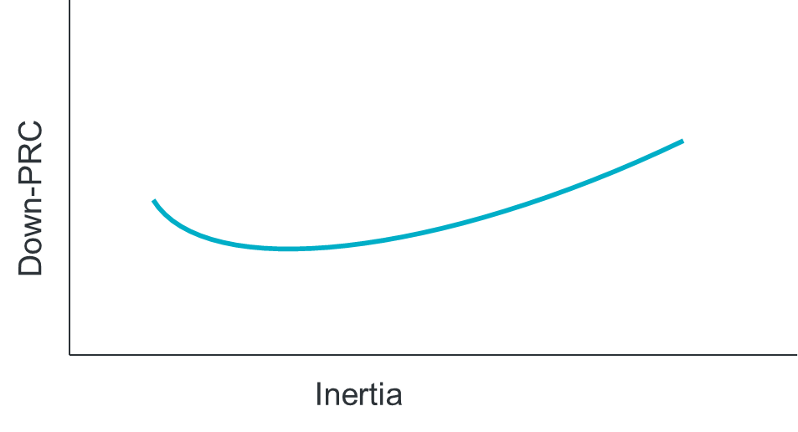
2. LL Frequency Limit Study
Questions to Answer:
How do different inertia and down-PRC conditions impact the previously-identified¹ 2,600 MW loss of load frequency stability limit?
What would be the benefit of a down-frequency response Ancillary Service?
Scope:
TSAT snapshot cases for various inertia and down-PRC conditions
Identify load loss level that causes steady-state frequency to exceed 60.4 Hz for each case
Outcome (expected Q4 2025):
Table showing load loss limit for various inertia and down-PRC conditions [Public]
  This will serve as input into SOL monitoring criteria (see LL VRT SOL Study)
Identification of amount of down-PRC needed to increase loss of load frequency stability limit at various inertia levels [Public]
1. https://www.ercot.com/files/docs/2025/05/19/Large_Load_Loss_Analysis_051625_LLWG.pptx

Slide 5
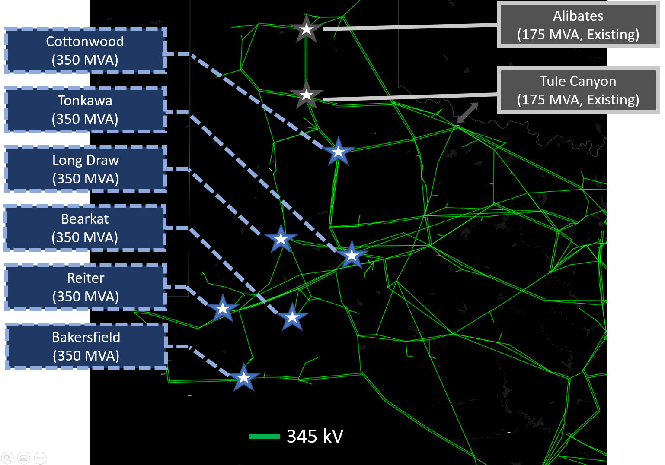
3. Benefits of Transmission Improvements Study
Questions to Answer:
What are the benefits in terms of loss of load reduction from the implementation of the 6 West Texas synchronous condensers?
What would be the benefit of transmission projects, including synchronous condensers and GFM STATCOMs?
Scope:
DWG Flat Start case with updated grid conditions and stability models from RFI responses and future Large Electronic Loads (LELs)
Simulate planning events at key representative locations in the West, Far West, and Panhandle regions with large concentration of LELs, incorporating transmission improvements
Outcome (Q4 2025):
Table showing relative loss of load reduction benefits of various transmission improvements [Public]

Slide 6
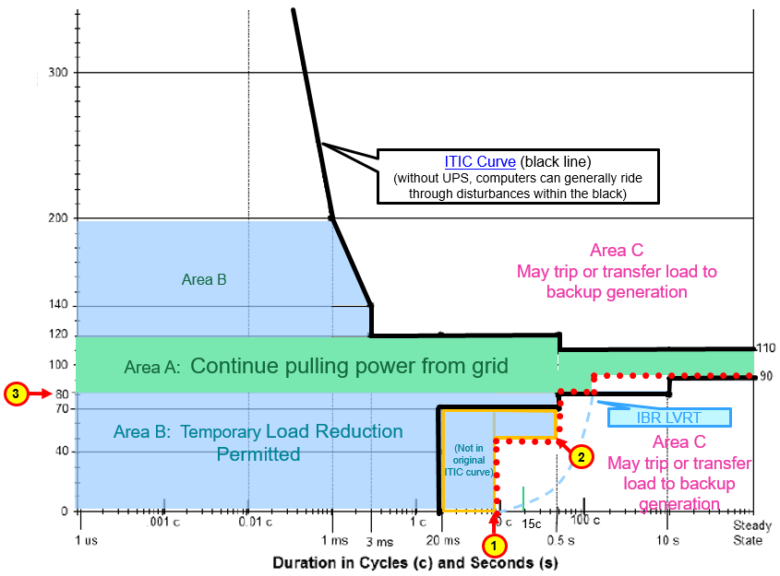
4. LL VRT Proposal Study
Question to Answer:
If Large Electronic Loads meet the LL VRT requirements proposed in ERCOT’s July 11 presentation, will that mitigate the frequency stability issues without causing voltage stability issues?
Scope:
DWG Flat Start case with updated grid conditions and stability models from RFI responses
Simulate planning events at various locations with high penetration of Large Electronic Loads (LELs)
Sensitivities with LL VRT parameter adjustments
Outcome (TBD date):
Table showing comparison of total load loss using 1. existing LL stability models, and 2. stability models with proposed VRT requirements [Public]
Potential recommendations for LL VRT parameter changes [Public]

Slide 7
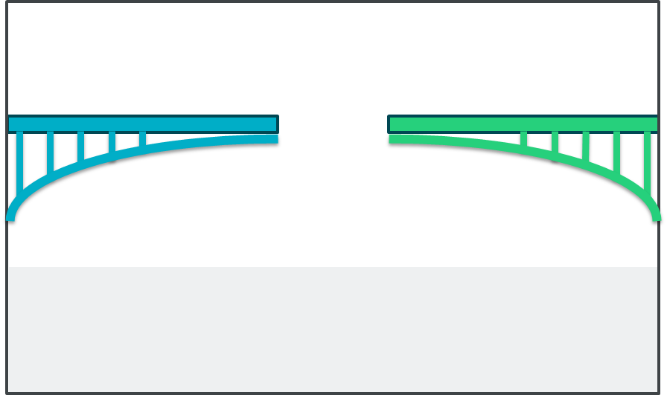
Summary
1. LL VRT SOL
2. LL Frequency Limit
3. Benefits of Transmission Improvements
4. LL VRT Proposal
These four stability studies address the Large Load VRT issue by examining operational solutions, grid solutions, and load-side solutions.

Slide 8
Questions?

