Slide 1
PDCWG Report to ROS
Chair: Chad Mulholland, NRG
Vice Chair: N/A
ROS
August 7th, 2025

Slide 2
Report Overview & Notes
Report Overview
  Meeting Minutes
    Ancillary Service Methodology for 2026 (Update)
    NOGRR Update – Turbine Governor Control Range
  BAL-001-TRE-2 FMEs and IMFR
    No FMEs in the month of May
  Frequency Control Report

Slide 3
Frequency Measurable Events Performance

Slide 4
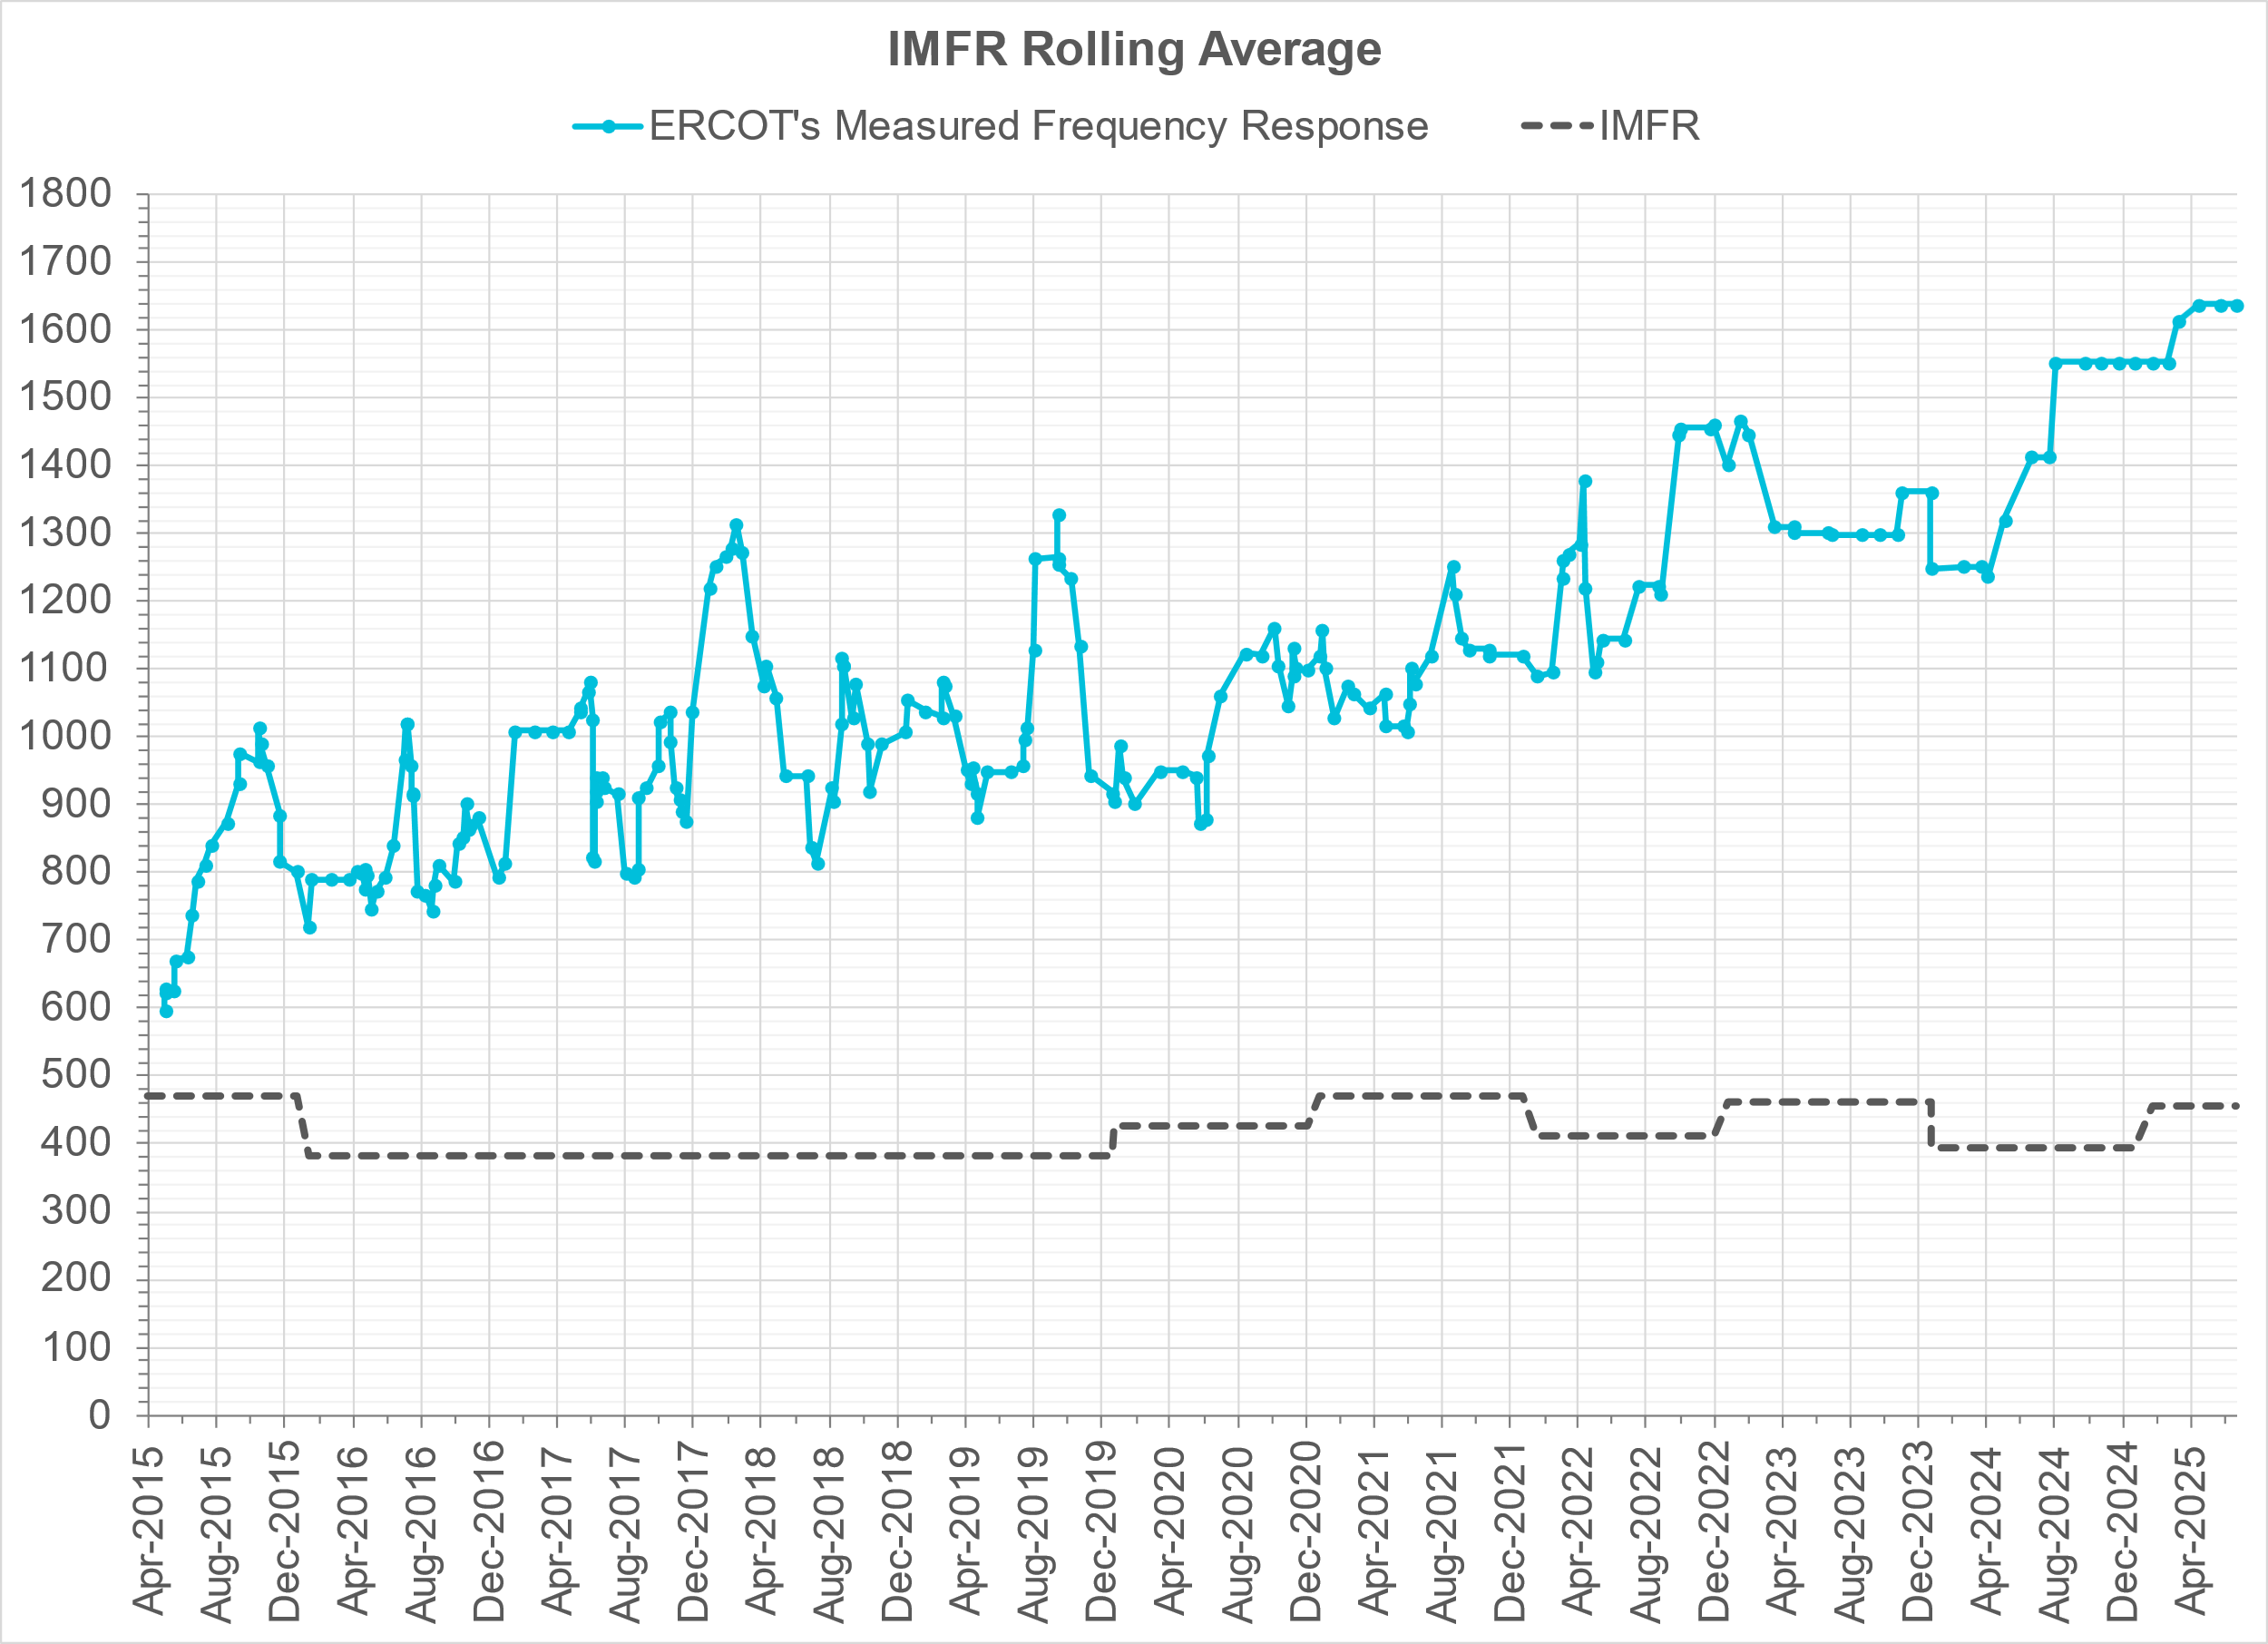
Interconnection Minimum Frequency Response (IMFR) Performance
IMFR Performance currently
1638.33 MW/0.1HZ
Frequency Response Obligation (FRO): 455 MW/0.1 Hz

Slide 5
Questions?

Slide 6
Frequency Control Report
June 2025

Slide 7
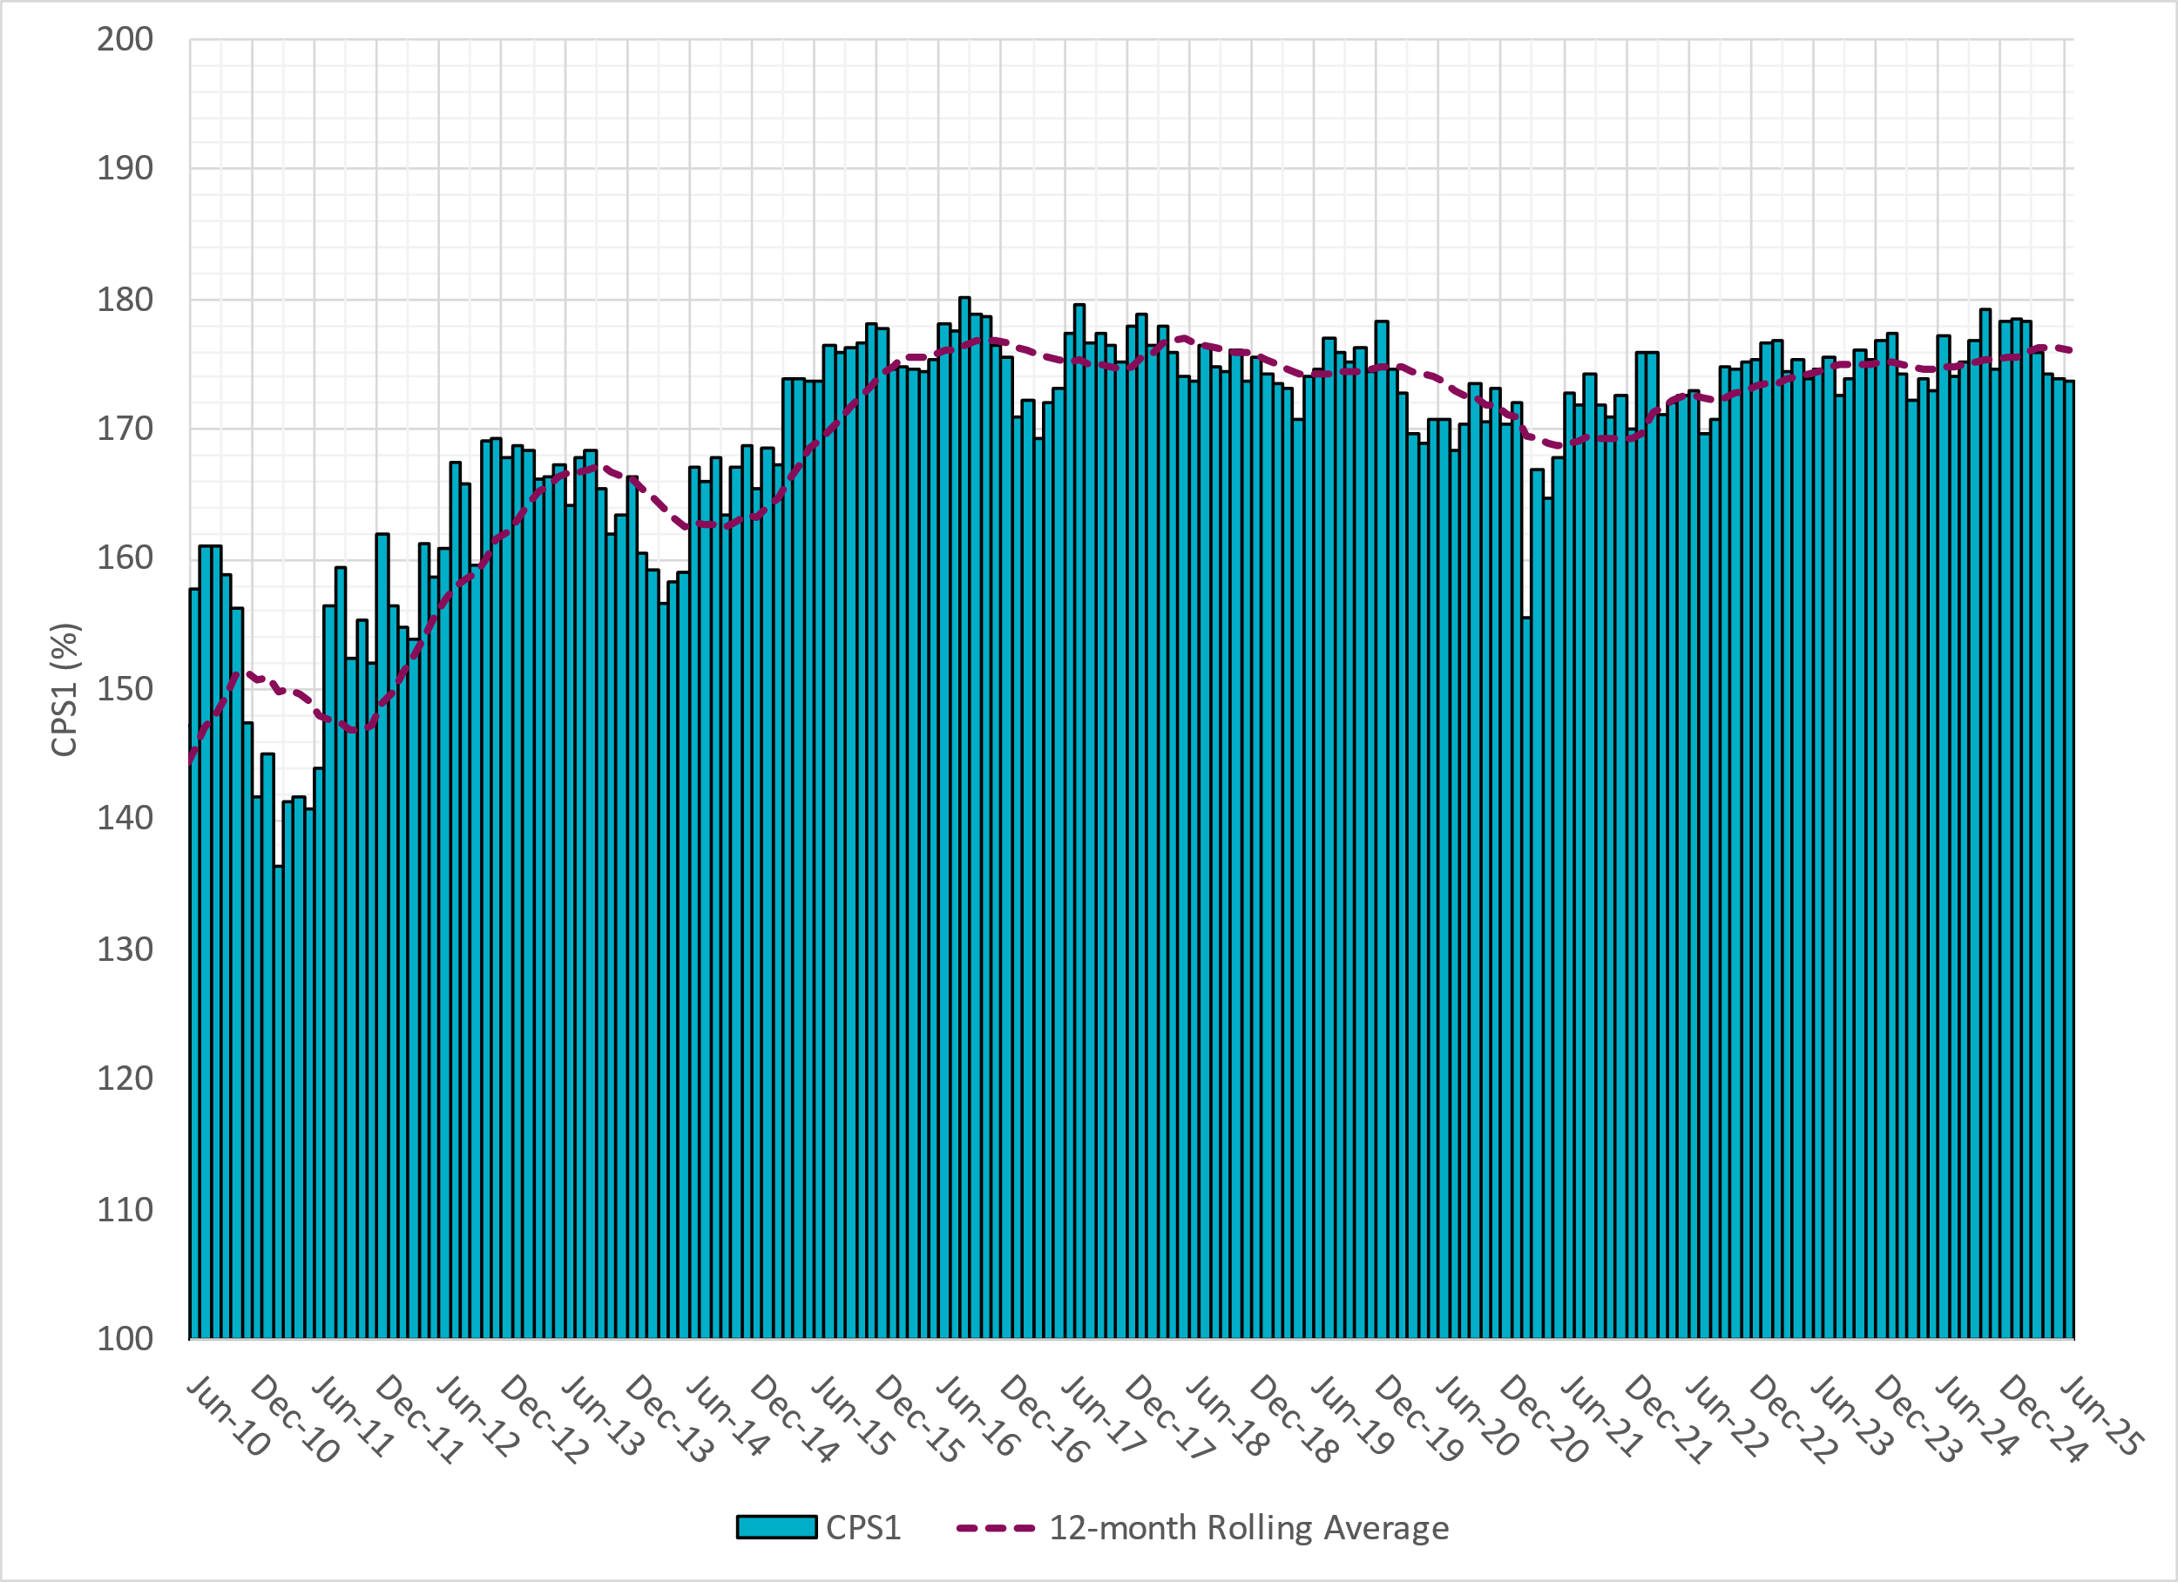
CPS1 Performance

Slide 8
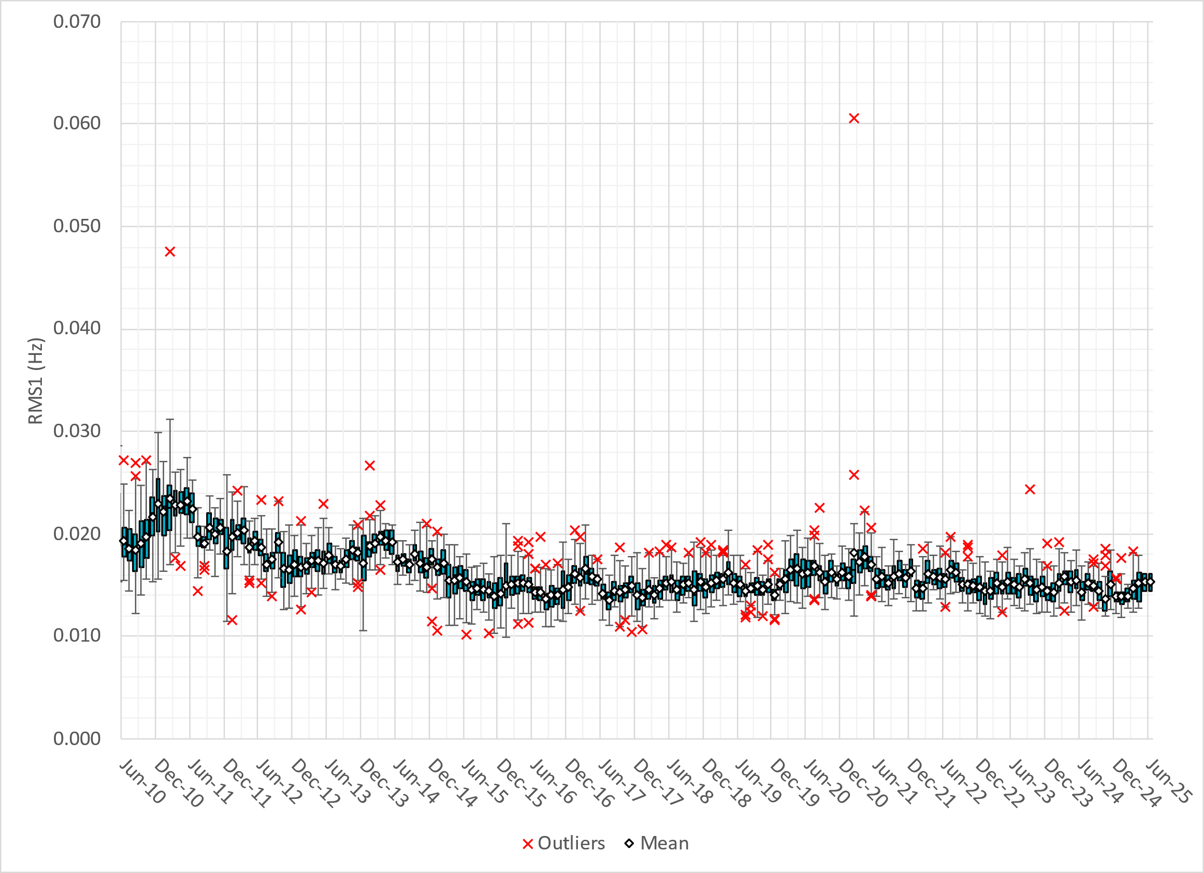
RMS1 Performance of ERCOT Frequency
Notes:
15.50 mHz on avg for June 2025

Slide 9
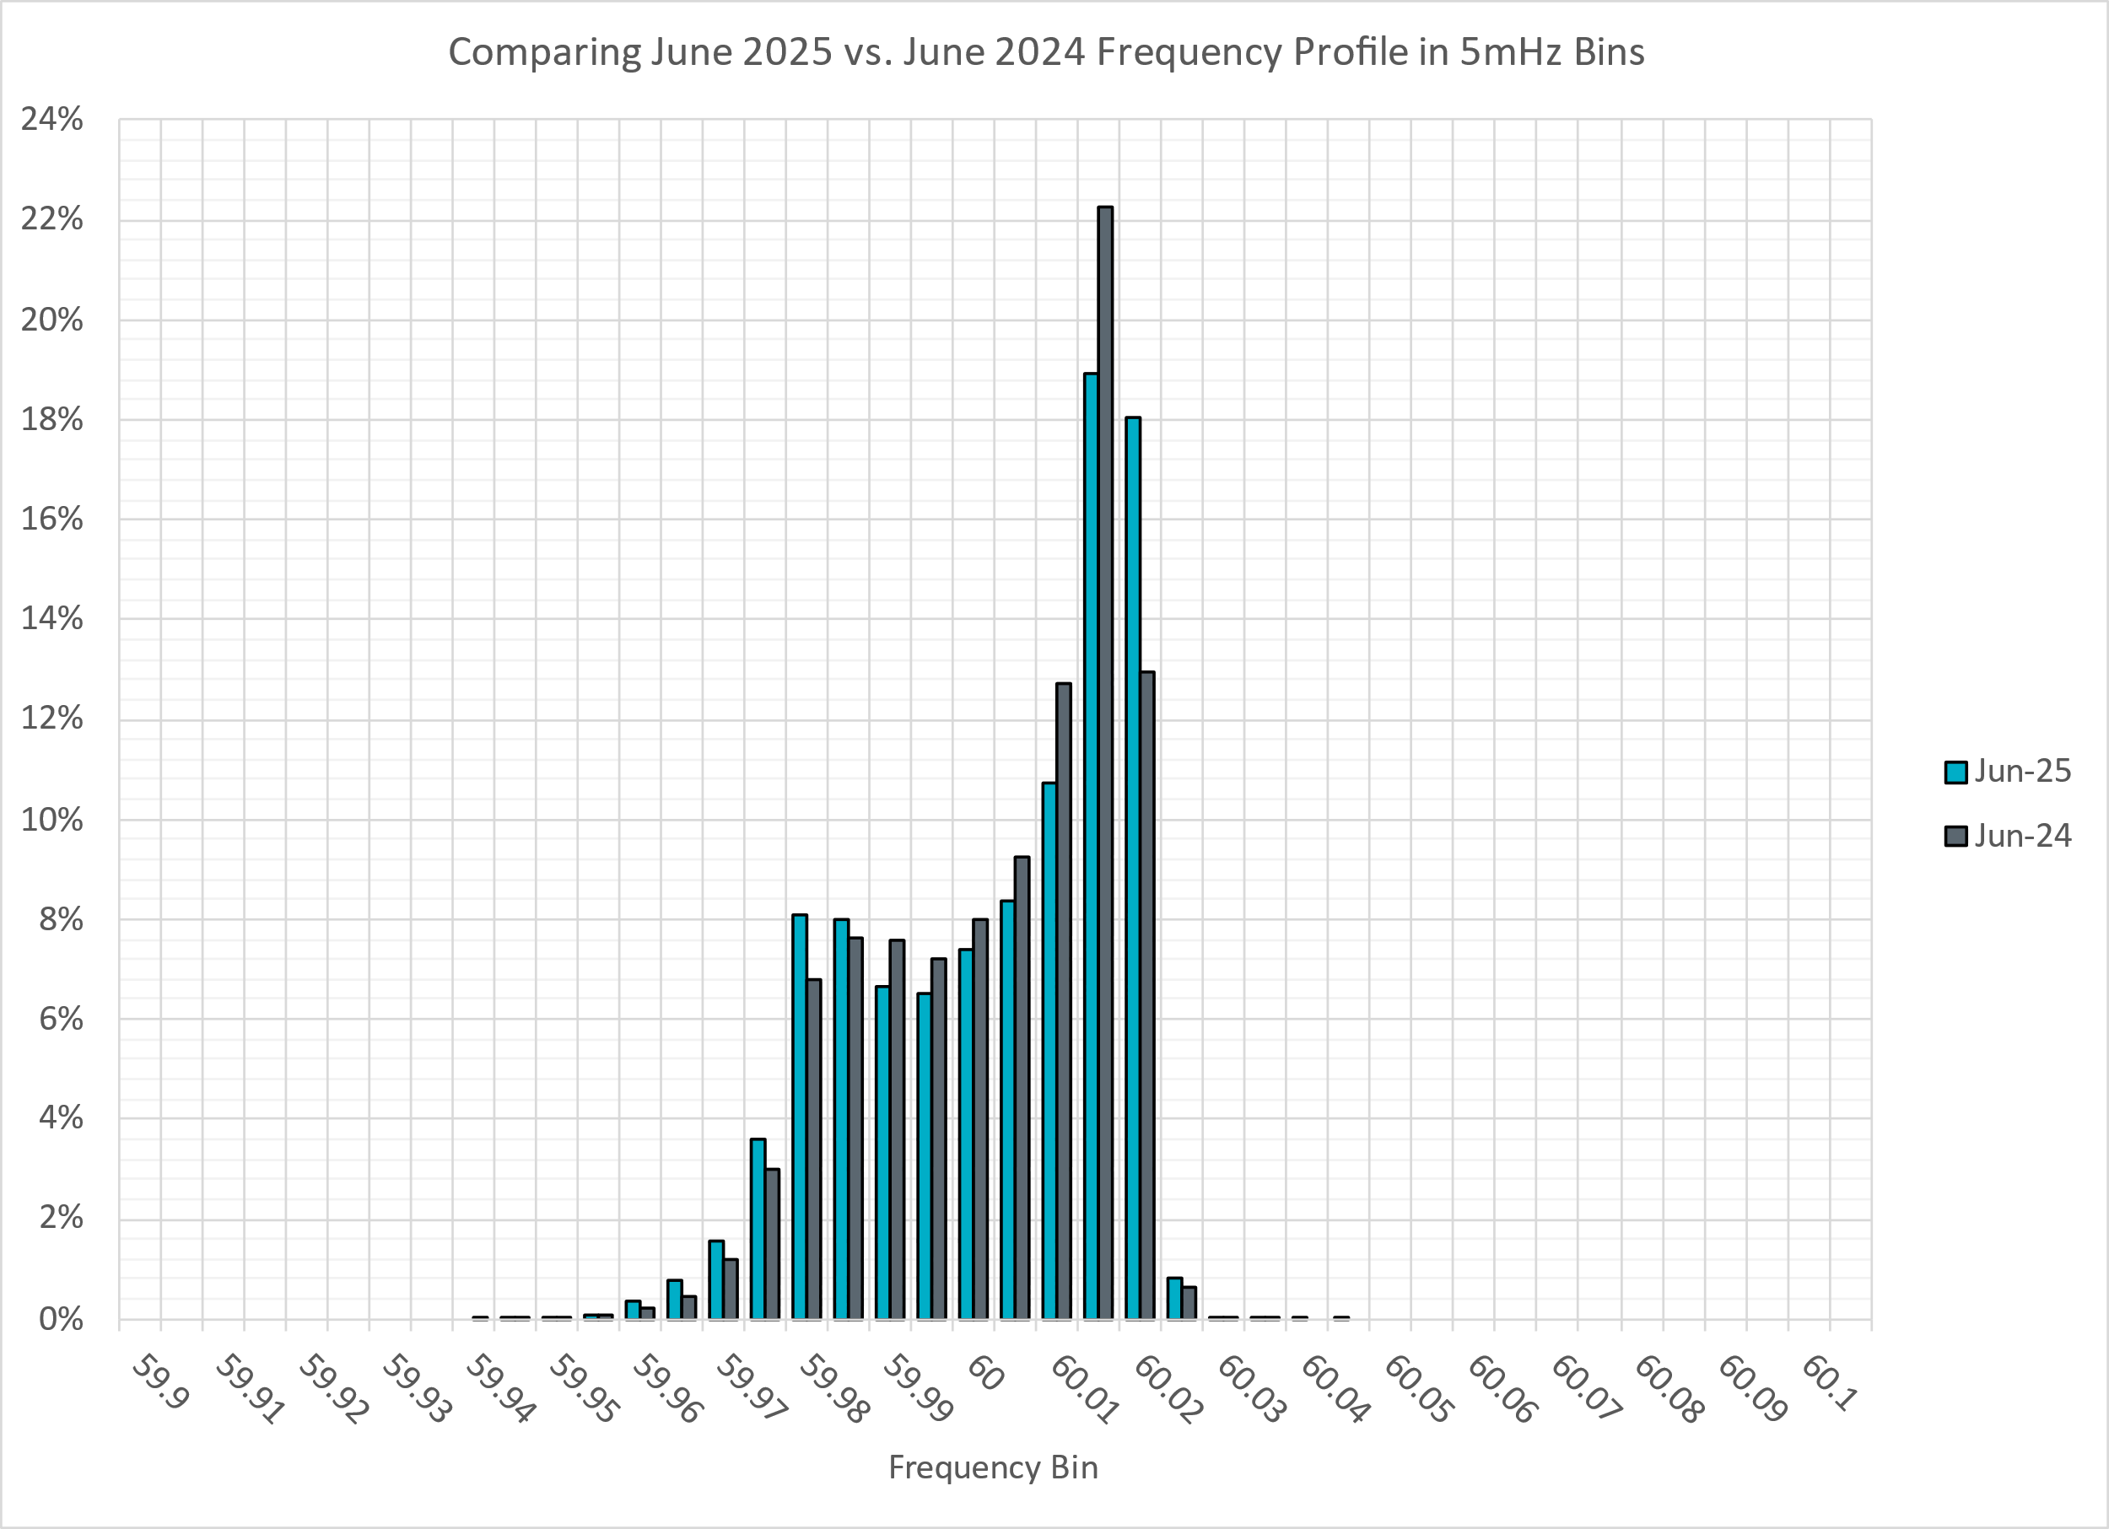
Frequency Profile Analysis

Slide 10
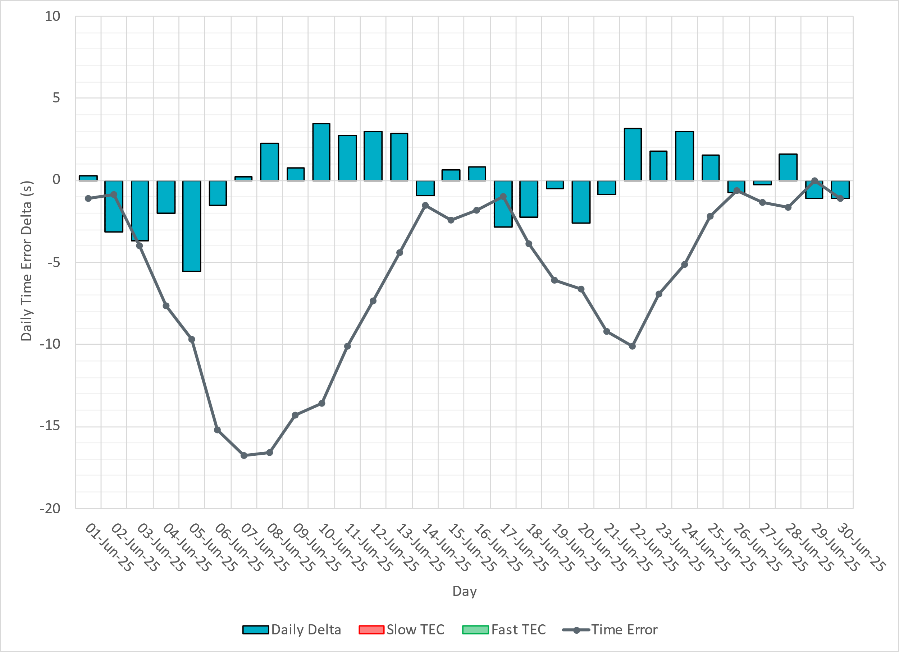
Time Error Corrections

Slide 11
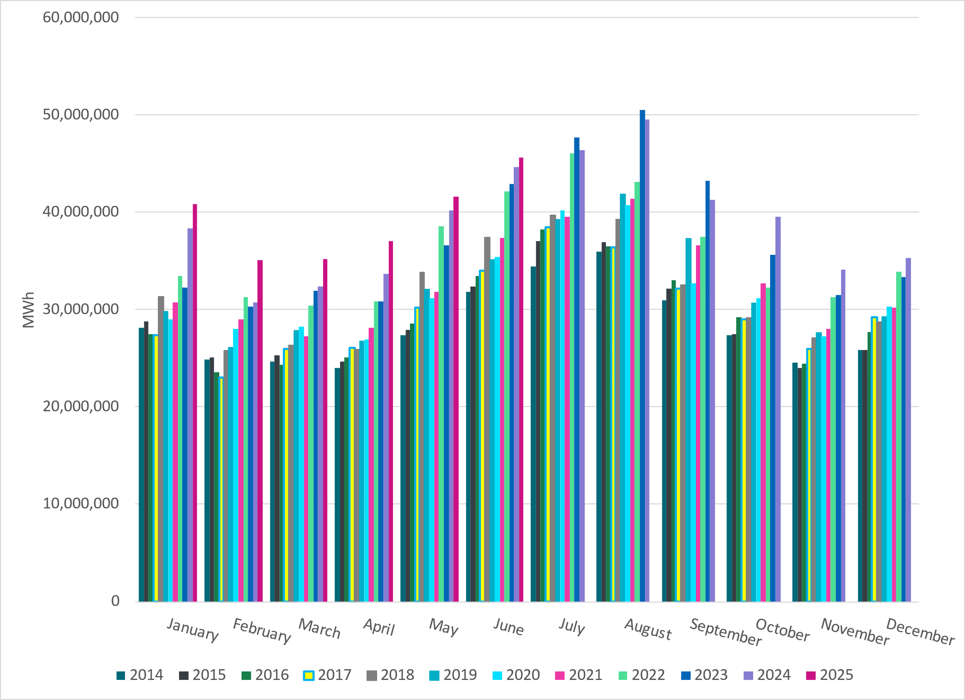
ERCOT Total Energy
Notes:
45,650,658 MWh

Slide 12
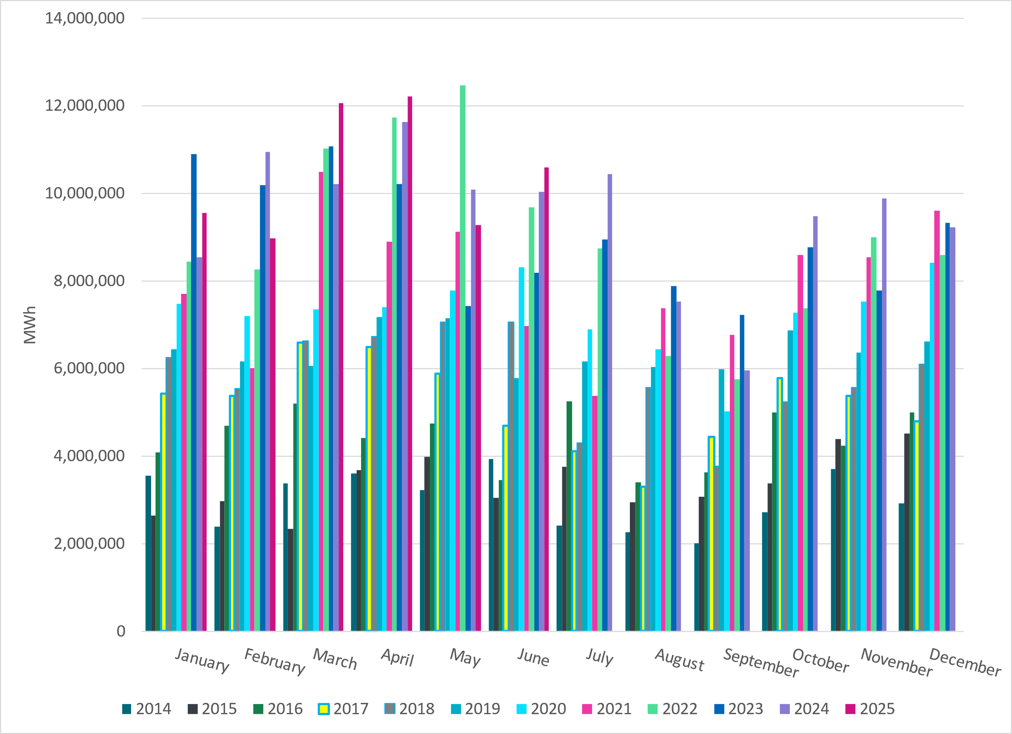
ERCOT Total Energy from Wind Generation
Notes:
10,604,250 MWH – Increase in total energy from wind compared to last month

Slide 13
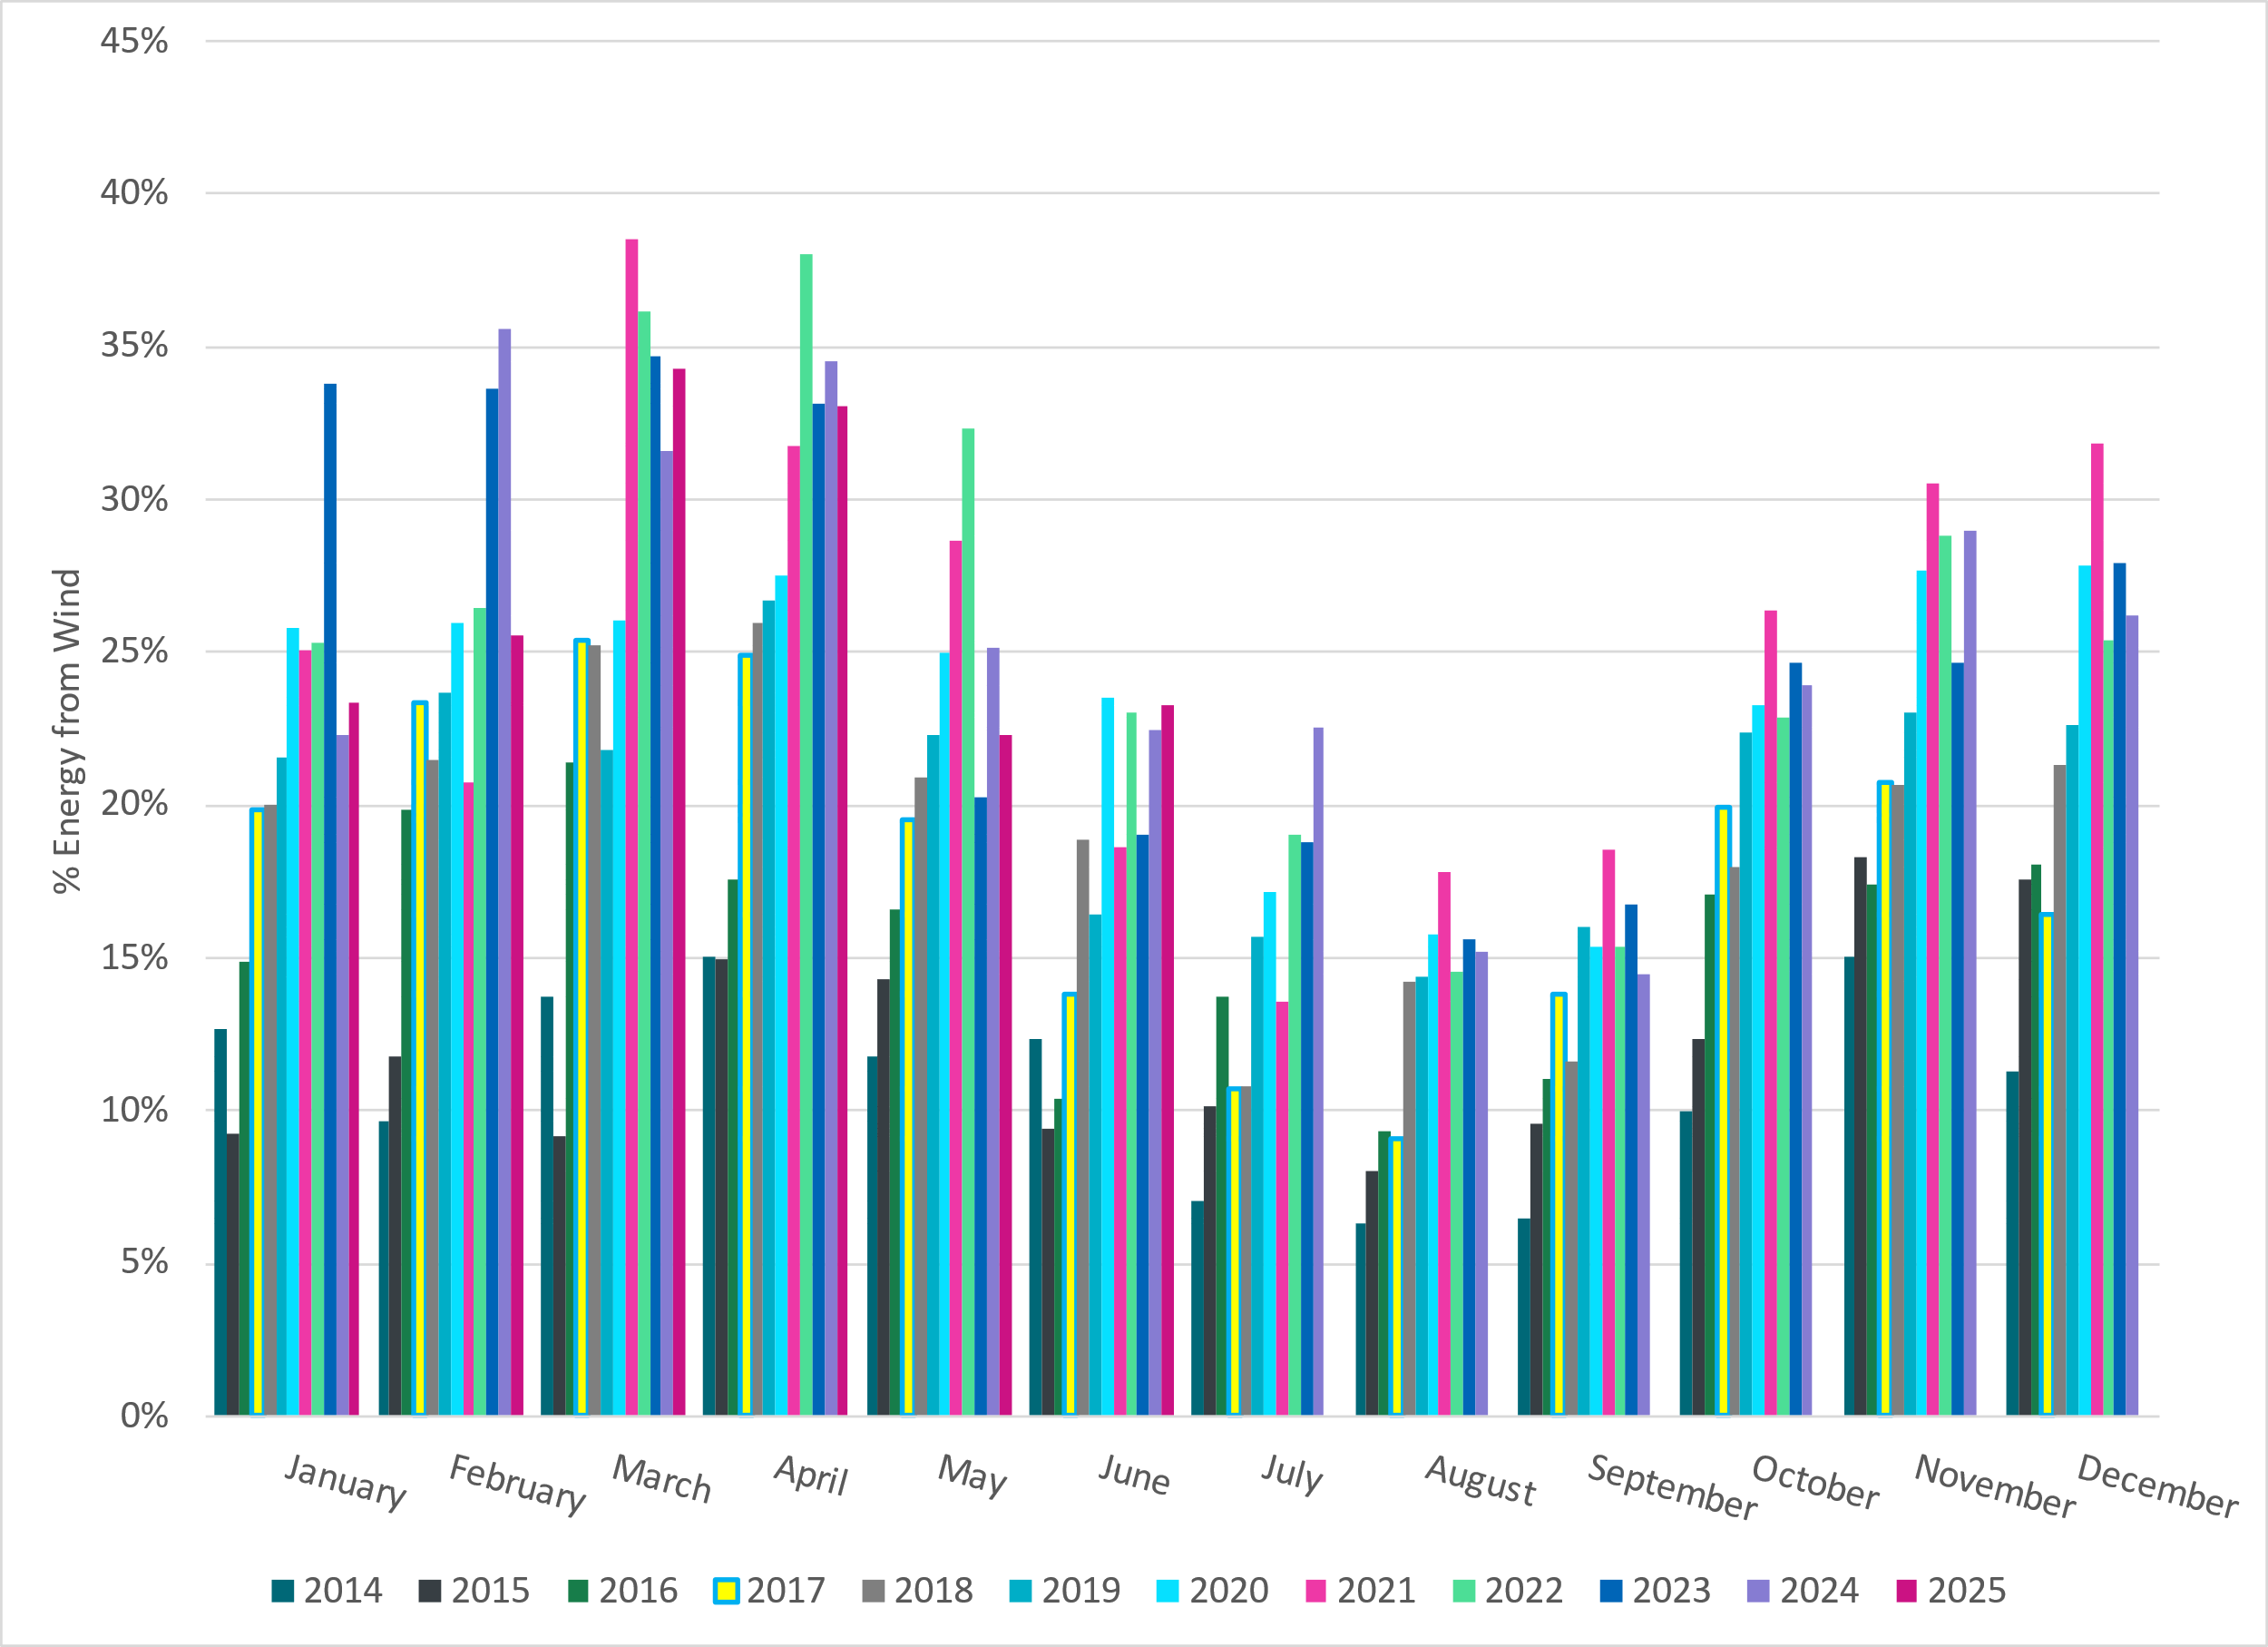
ERCOT % Energy from Wind Generation
Notes:
23.23% of total energy was provided by wind generation

Slide 14
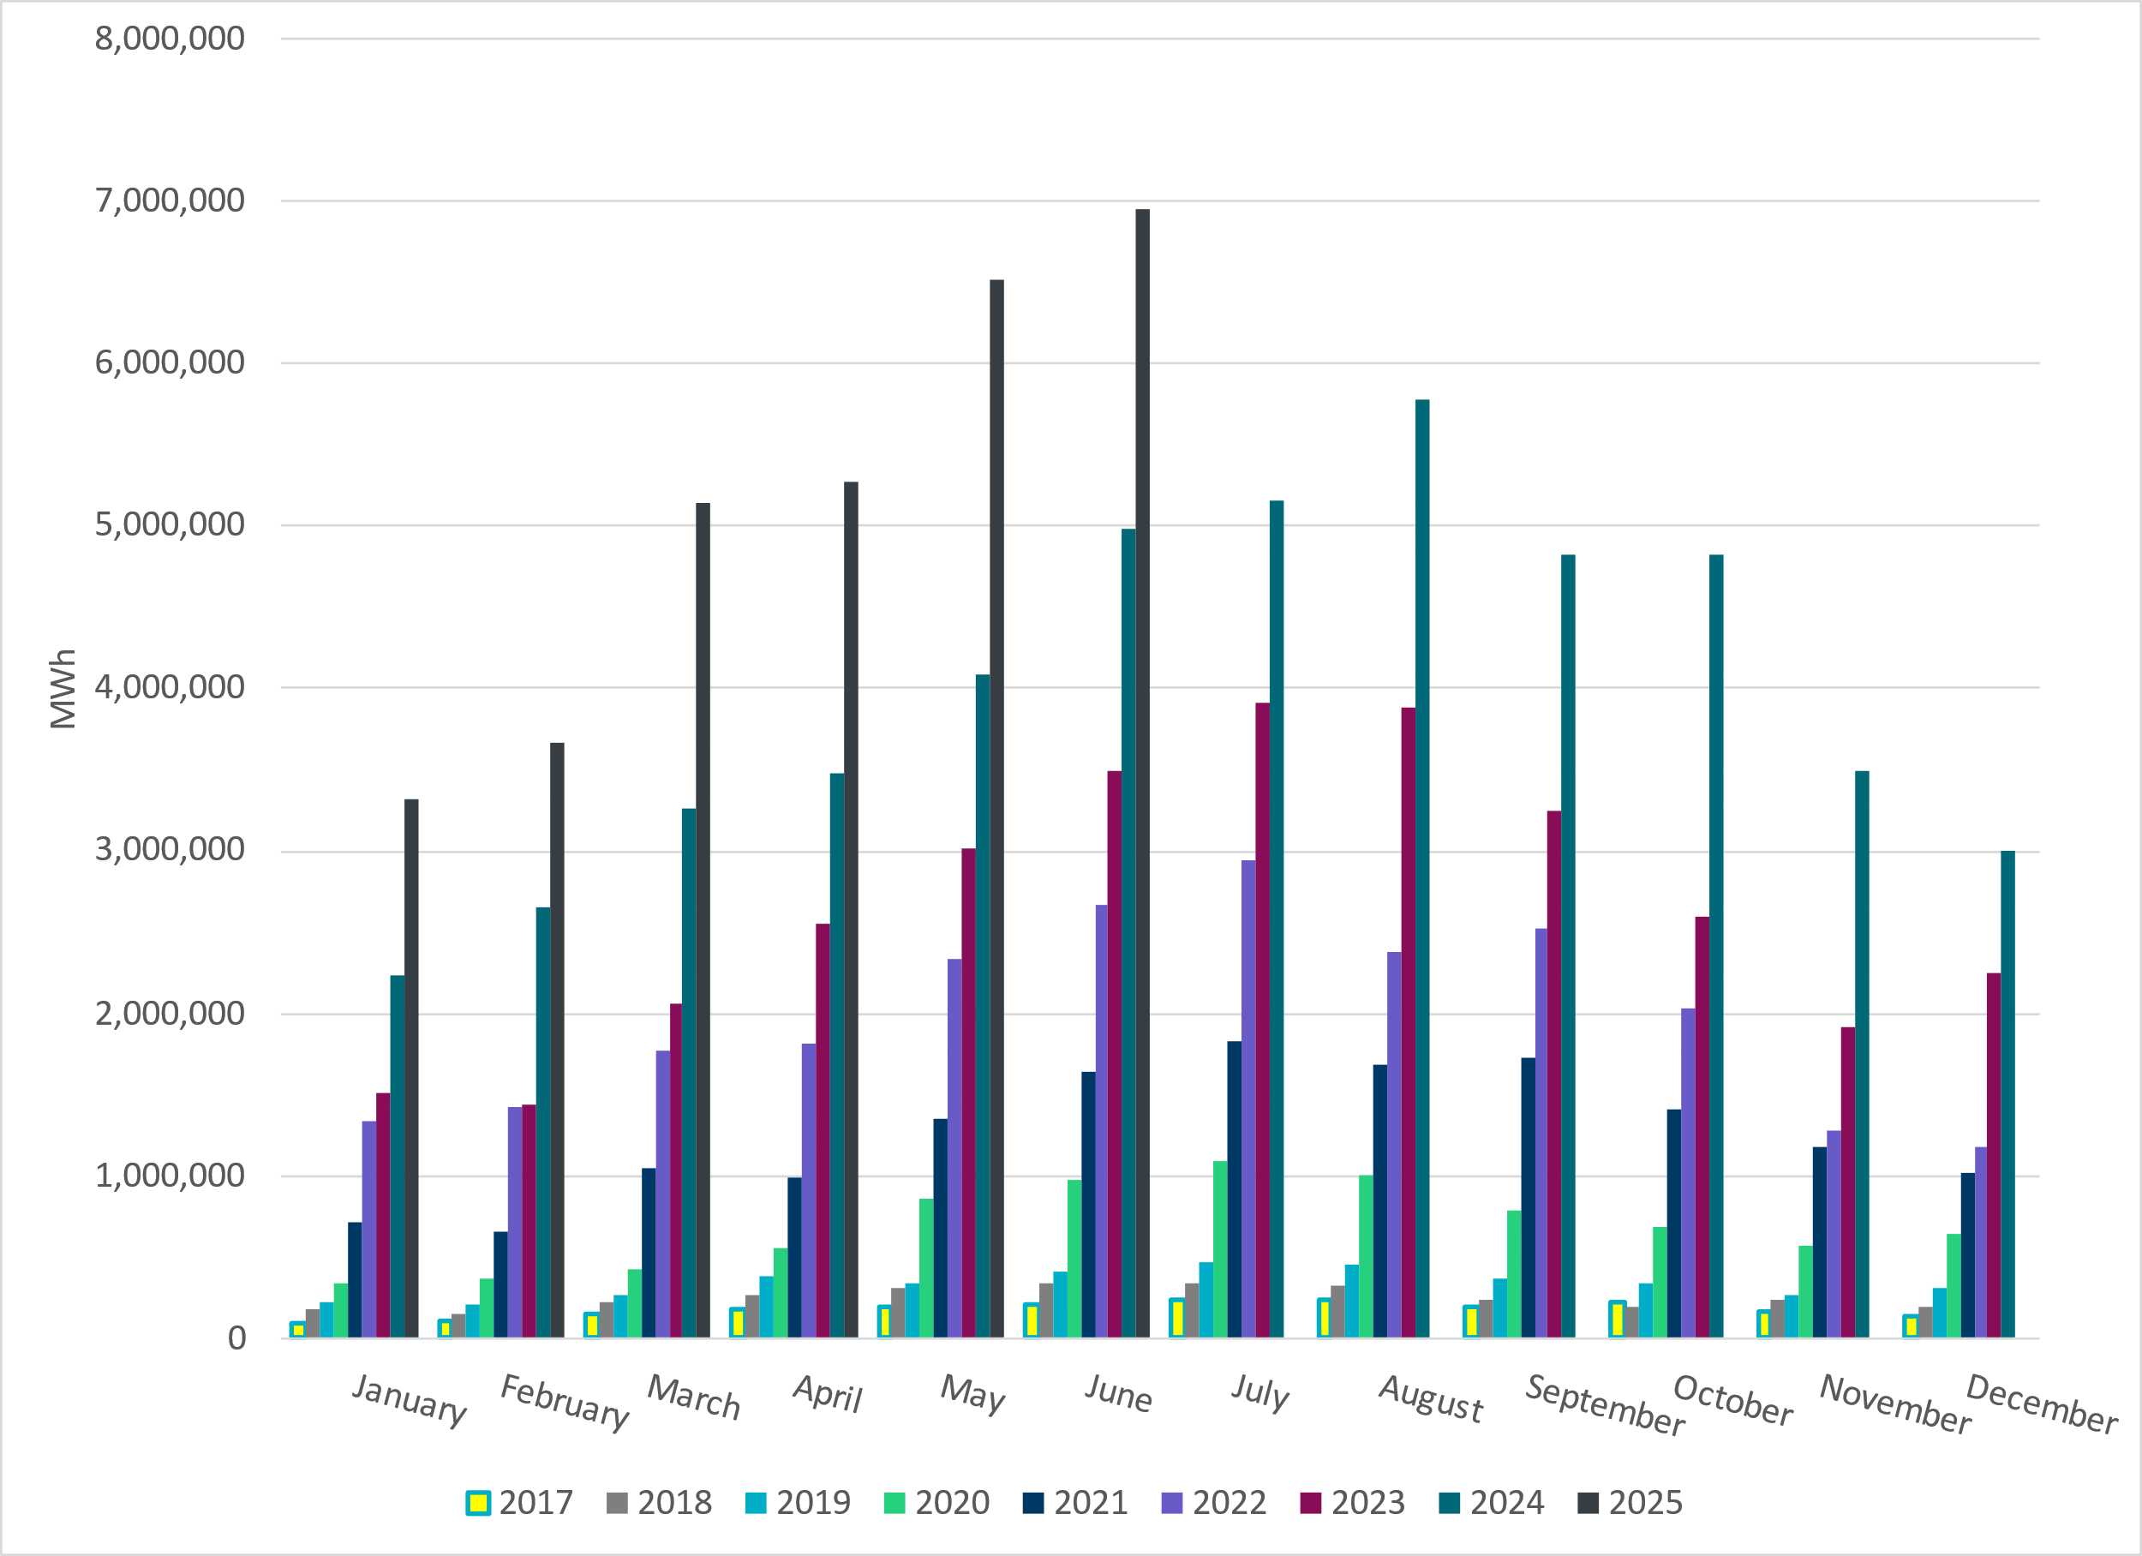
ERCOT Total Energy from Solar Generation
Notes:
6,948,383 MWh

Slide 15
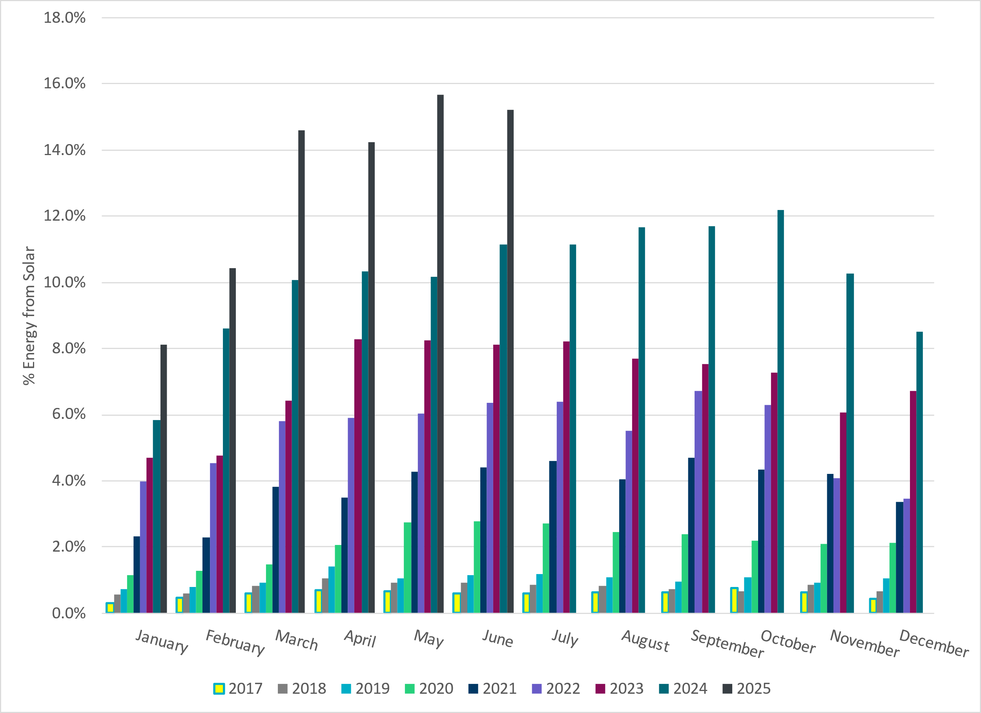
ERCOT % Energy from Solar Generation
Notes:
15.22% of total energy was provided by solar generation

Slide 16
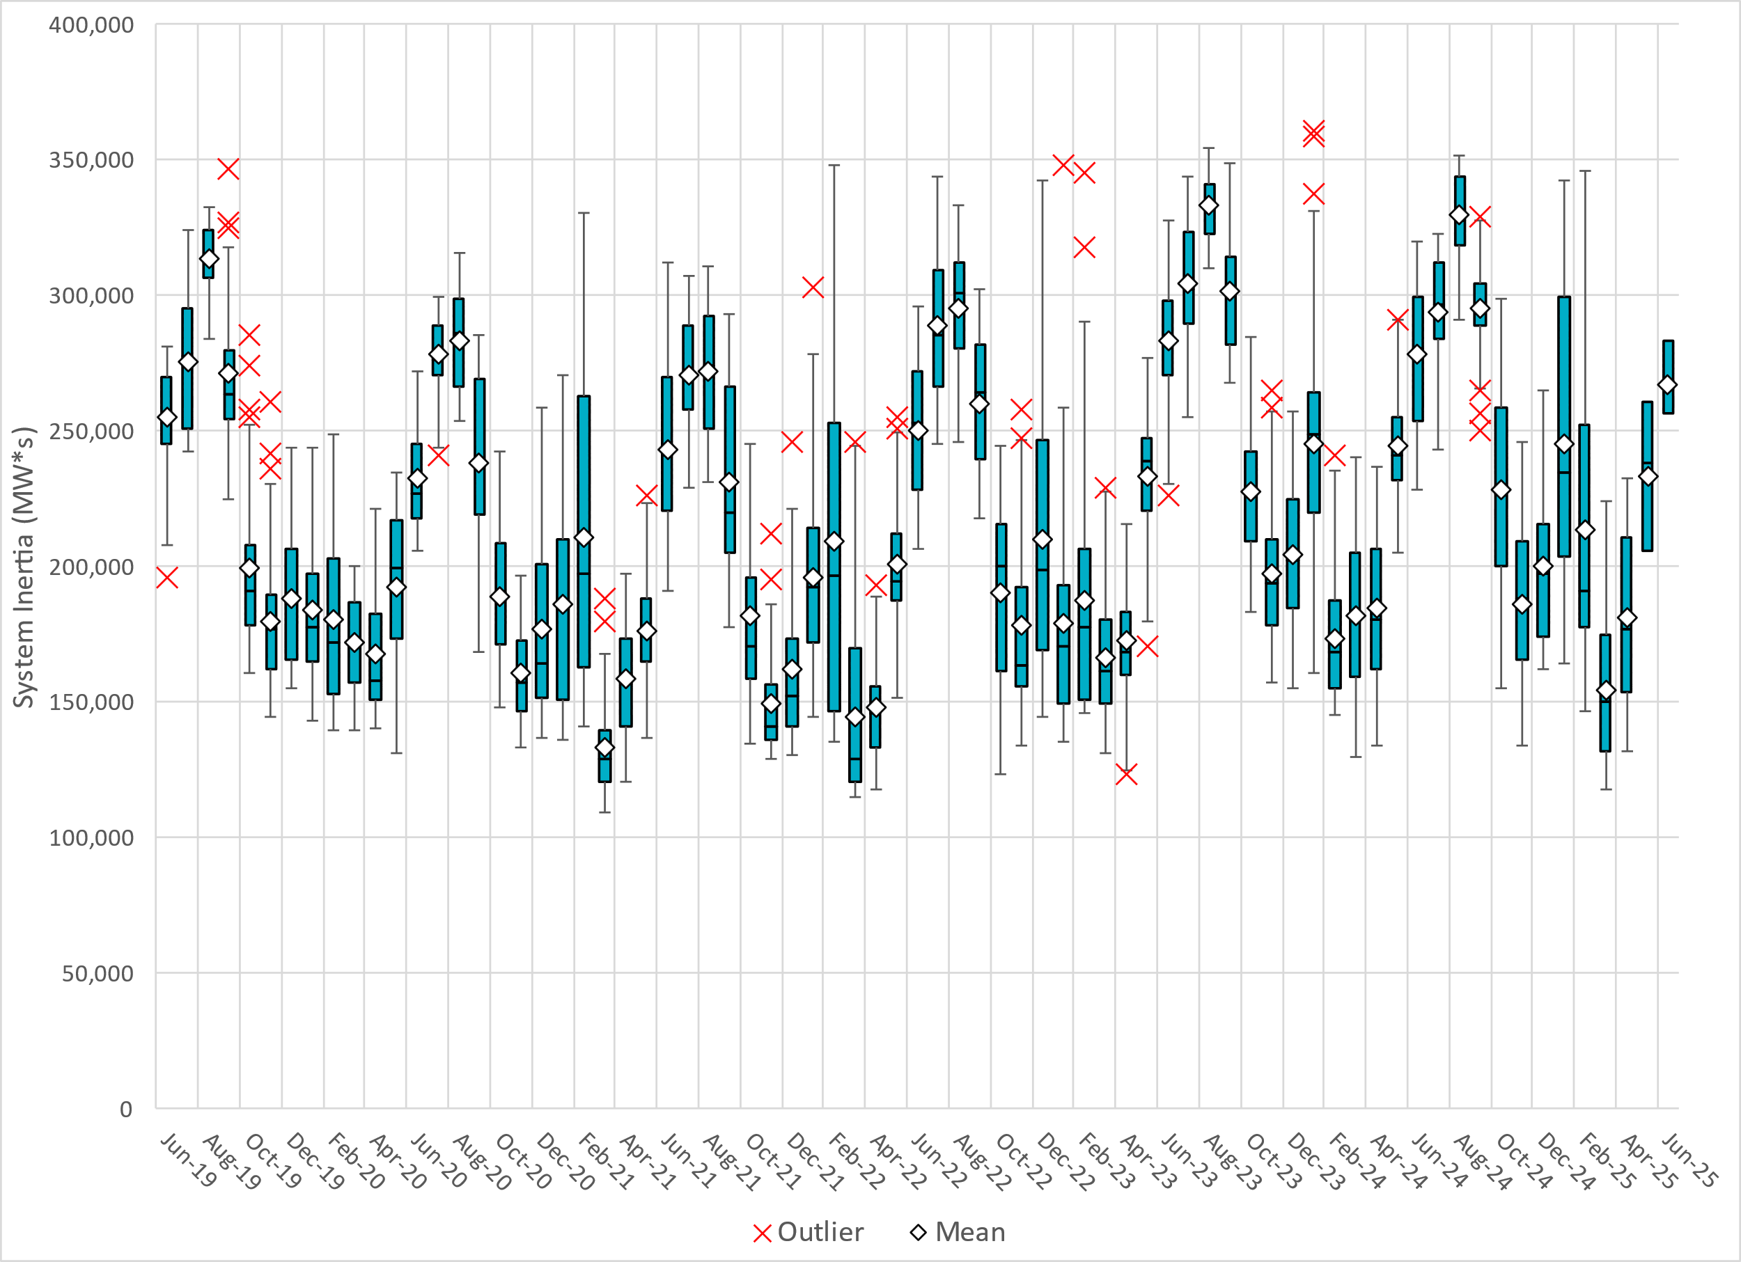
ERCOT Daily Minimum System Inertia
Notes:
Minimum Inertia in June 2025 = 209,684 MW*s on June 17th
Historical Overall Minimum was 109,029 MW*s on 3/22/2021
June Data:
Mean: 266,883 MW*s
Max: 300,140 MW*s on June 30th
Min: 209,684 MW*s on June 17th

Slide 17
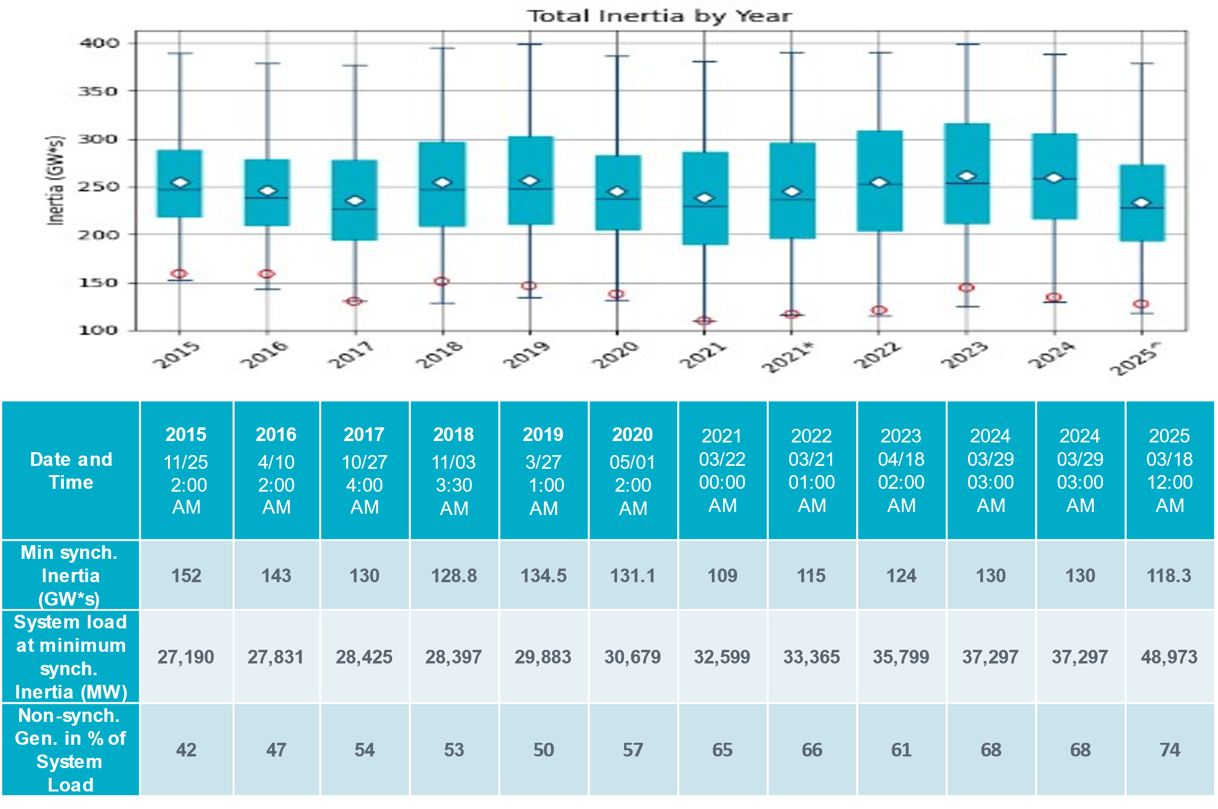
ERCOT Inertia Trend
Notes:
Summary of ERCOT inertia for the previous 10 years. Lowest inertia this year was on March 18th.
For each box, the central mark (red line) is the median, the edges of the box (in blue) are the 25th and 75th percentiles, the whiskers correspond to +/- 2.7 sigma (i.e., represent 99.3% coverage, assuming the data are normally distributed. The corresponding lowest inertia in each year is given in the table.
The circle on each boxplot is showing inertia during time when highest portion of load was served by wind/solar generation in that year.

