Slide 1
SSWG Report to ROS
August 7, 2025
Chair: Zach Walker (Zachary.Walker2@oncor.com)
Vice Chair: Chris Ramirez (cramirez@wettllc.com)

Slide 2
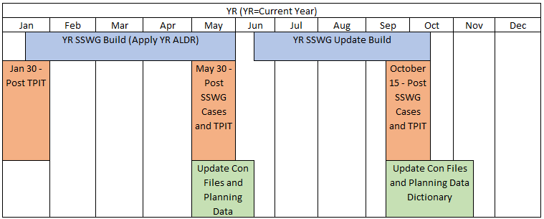
SSWG Report
Key Updates
SCR 831
  SSWG agreed to recommend approval of SCR 831
25SSWG Case Build #1
  25SSWG Power Flow Base Cases posted to ERCOT MIS:
    SSWG Cases
    Contingency Files
SSWG Procedure Manual Revisions
  Minor language updates to reflect current processes and Planning Guide requirements (PGR115) to be submitted for approval by September ROS Meeting
  Review still ongoing for Peak Net Load & Maintenance Outage cases to be added to biannual SSWG case builds
SSWG Report to ROS External

Slide 3
SSWG Report
Key Updates
PGRR127 - Addition of Proposed Generation to the Planning Models
  Introduced at last week’s SSWG meeting
  Further discussion needed
  At least one TSP planning to file comments
SSWG Report to ROS External

