Slide 1
Review of 2026 AS Methodology Probabilistic Quantities and Sensitivities
ERCOT Staff
ERCOT Operations Analysis
Probabilistic Workshop # 3
August 04, 2025

Slide 2
Background and Introduction
Purpose of today’s workshop is to review the proposed AS Methodology for 2026.
  ERCOT developed a probabilistic methodology to compute ERCOT Contingency Reserve Service (ECRS) and Non-Spinning Reserve Service (Non-Spin) requirements in 2026.
  Regulation and RRS quantities were calculated using similar 2025 AS Methodology
Agenda for Today
  Recap/Overview from previous workshops
    PUC’s AS Study and their findings as they apply to AS Methodology
    Probabilistic Framework and additional details on concepts
  Review Probabilistic Framework, discuss updates, ERCOT's recommended parameters
    Inputs, data conditioning, Criteria to determine reserves, the optimization engine and reserve determination approach.
    Review and discuss comments received on methodology
  Review Regulation and RRS recovery preliminary quantities which are calculated using similar 2025 AS Methodology.
  Summary and What to expect at the next round of meetings.

Slide 3
Stakeholder Discussion Timeline
April 23, 2025 – TAC Kickoff
May 19, 2025 – Workshop #1
June 20, 2025 – PDCWG
June 30, 2025 – Workshop #2
July 07, 2025 – WMWG (Proposed)
July 15, 2025 – OWG (Proposed)
July 22, 2025 – PDCWG (Proposed)
August 04, 2025 – Workshop #3
August 06, 2025 – WMS
August 07, 2025 – ROS
August 28, 2025 – TAC
September 23, 2025 – BoD
Oct, Nov, Dec 2025 – PUC

Slide 4
Background on Probabilistic Framework
The Public Utility Commission of Texas (PUCT) initiated the Ancillary Services Study (Study) to meet the requirements of PURA § 35.004(g) (enacted in Senate Bill 3 (87 R.S.)).
ERCOT was asked to review the existing Ancillary Service products, including an analysis of the purpose for each of the products and a more thorough review of the methodologies used to determine Ancillary Service quantities. ERCOT was also asked to evaluate if any additional Ancillary Service products are needed.
  ERCOT produced a white paper that responds to those requests
The PUCT’s 2024 Ancillary Services Study included the following finding (Topic 5):
  ERCOT should develop a suitable probabilistic, forward-looking modeling capability, provide regular updates to TAC, and present options that can be incorporated no later than the 2027 AS Methodology.

Slide 5
PUC’s Findings Related To AS Methodology
Topic | Finding | Next Steps
PROVIDING ADEQUATE INCENTIVES FOR DISPATCHABLE GENERATION | The reliability standard rule (16 TAC § 25.508) has defined a process for assessing and ensuring resource adequacy. | The first holistic reliability standard assessment in 2026 will include an assessment of whether incentives are adequate to support a sustainable level of dispatchable generation, and ERCOT should incorporate the impact of new market features such as Texas Energy Fund, DRRS, and real-time co-optimization plus batteries (RTC+B) into this assessment.
APPROPRIATE CRITERION FOR AS PROCUREMENT QUANTITIES | ERCOT's current posture of maintaining AS quantities that minimize the chance of Entering the pre-emergency operational condition of an Operational Watch should be maintained in order to balance system improvements made since Winter Storm Uri until additional data is available to support further Commission evaluation of this operating posture. | ERCOT should develop the capability to provide current estimates of costs and probabilities of experiencing a Watch, Emergency Alert, and Load Shed for several potential alternative target reserve levels as soon as practicable and no later than to support the Commission setting an objective, data-based procurement criteria for the 2027 AS Methodology.
PROBABALISTIC MODELING TO DETERMINE AS QUANTITIES | ERCOT's current practice to determine AS quantities relies on a statistical analysis using historical operating conditions and outcomes. This methodology is no longer sufficient as myriad changes to the wholesale markets and operating conditions continue to impact reasonable forecasting needs. Changes such as incorporation of an unknown amount of TEF-supported capacity, how new large loads are integrated into grid operations, or the impact of new market designs present uncertainty for forecasting tools based exclusively on historical data. | ERCOT should develop a suitable probabilistic, forward-looking modeling capability, provide regular updates to TAC, and present options that can be incorporated no later than the 2027 AS Methodology.
DYNAMIC DETERMINATION OF AS QUANTITIES | Tradeoffs exist between the certainty provided to market participants by calculating AS quantities primarily on an annual basis (as is done currently) and the efficiency of calculating some portion of AS quantities closer to the operating day. | ERCOT should work with stakeholders to explore a dynamic AS methodology that best Balances these trade-offs.

Slide 6
Recap: Full Statistical Analysis OPEN Questions
How should the available headroom/capacity that is not providing AS be accounted in this analysis? | For example, weather forecast errors typically cause corresponding errors in load, wind, and solar forecasts, but are generator trips correlated to forecast errors, also? Further, should historic headroom capacity be accounted for in this analysis? If so, is the historic headroom capacity of the online generation fleet correlated to other factors?
How should increases in variability and uncertainty due to wind, solar, and load growth, as well as future changes in generator commitment patterns be accounted for in the methodology? | Historically, as the Intermittent Renewable Resource (IRR) fleet’s installed capacity has increased, both variability and uncertainty in net load have increased, and relying on historic error alone may not sufficient.
What event/criteria should each AS be setup to cover? | Is the criteria simply a matter of avoiding loss of load? Or should there be criteria related to avoid entering into an Energy Emergency Alert (EEA) or a Watch due to insufficient reserves? How should avoiding the need for manual operator actions be included in the criteria?
How should temporal constraints and cumulative factors be accounted? | The possibility of multiple generator trips across multiple hours (as occurred on May 13, 2022, for example) presents a risk that needs to be covered by AS. (Cumulative forced outages) AS is needed until other generators can be started or until the conditions causing the need for the reserves from AS change. How should this be considered in the analysis? (Event duration/temporal constraints) Increasingly, AS is being provided by duration-limited resources (battery energy storage). There is some risk that battery energy storage resources providing AS deplete their storage capacity during a multi-hour forecast error event, even if they are meeting all applicable requirements. Should not being able to charge be accounted as a risk in this analysis? (lack of energy considerations)
How much can other types of AS reserves be counted on to address risks for a given AS product? | For example, should some or all of ECRS be counted towards meeting the reserve needs covered by Non-Spin?
Key Takeaway: ERCOT is generally supportive of doing a “full statistical” probabilistic analysis to determine AS quantities. Several key questions that have to be carefully considered to setup the appropriate model for this analysis. Responses to these questions directly impact the volume of reserves procured and operational actions needed to continue operations. As an example, setting reserves too low could result in lower self commitment and tools like Unit Commitment may be necessary to cover the overall expected operational risk on such days. For proper balance Stakeholder and potentially policymaker input on these is essential.

Slide 7
Probabilistic Framework Overview

Slide 8
Flow Diagram for Probabilistic Methodology
⁺Convergence Criteria = 𝐸𝐶𝑅𝑆+𝑁𝑆𝑅𝑆<𝑁𝑒𝑡𝑅𝑖𝑠𝑘+𝑀𝑎𝑥(𝑅𝑒𝑔+𝑅𝑅𝑆,ZZ) with probability of 1 in XX year.

Slide 9
Risk and Risk Credits Details
Risk
  Net Load Forecast Error (NLFE) (2022-2025)
    X hour ahead
    30 min ahead
    Accounting for Solar Capacity Growth
  Forced Outages (2022-2025)
    New method developed pull X hour ahead rolling forced outage of conventional resources
Risk Credits
  Online Headroom Capacity Sustainable for 4 hours
    Conventional unit headroom that is available to SCED, but excluding Ancillary Service Capacity (2022-2025)
    System Hourly ESR Capability is calculated using historical Real-Time telemetered hourly average ESR data (SOC, MNOS, AS Responsibility). (2023-2025)
    Reliability Unit Commitment (RUC) Capacity excluded
  Offline Capacity (2022-2025)
    Conventional unit capacity that can be started within 30 minutes excluding any capacity reserved for Ancillary Services
Net Risk = Risk – Risk Credit*Y where the variable is configurable
Notes:
Data excludes Weather Events such as Elliot, Beryl, and URI

Slide 10
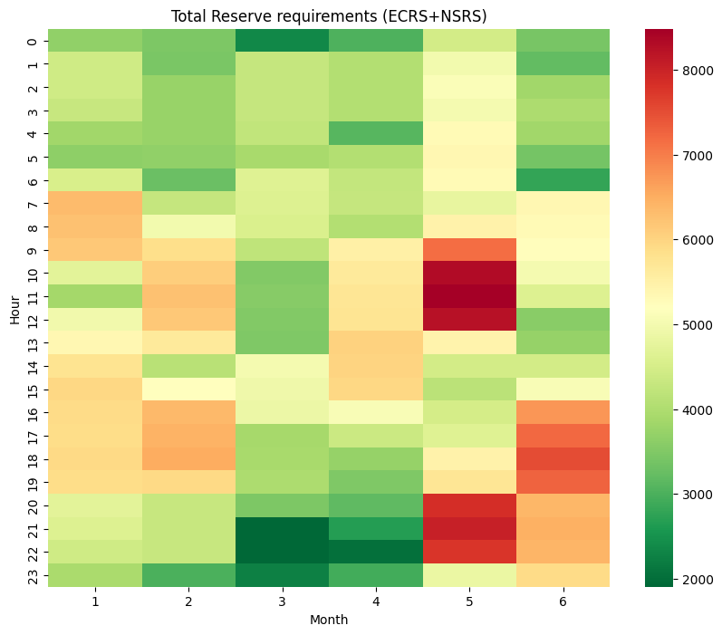
Optimization Workflow for Total (ECRS + NSRS) Reserve
Iterative process - Least Reserves for Target Reliability
If Current Violation meets Convergence Criteria
Reserve Requirements
(ECRS+NSRS)
Analysis
  Using the current reserve values, the process identifies the hours with the highest number of violations.
  If these reserve levels fail to meet the criteria, the process proceeds to the reserve adjustment phase.
If Current Violation rate does not meet Convergence Criteria
  To initiate the optimization process, set initial reserve values which are allocated to cover the identified net risk
  If Violation rate falls short of the criteria, reserves are proportionally increased during the hours with the highest violation rates.
  If Probability is better than the criteria, the required reserve values are proportionally reduced.
Initial Reserve
Proceed to Analysis with Adjusted Reserves
Reserve Adjustment

Slide 11
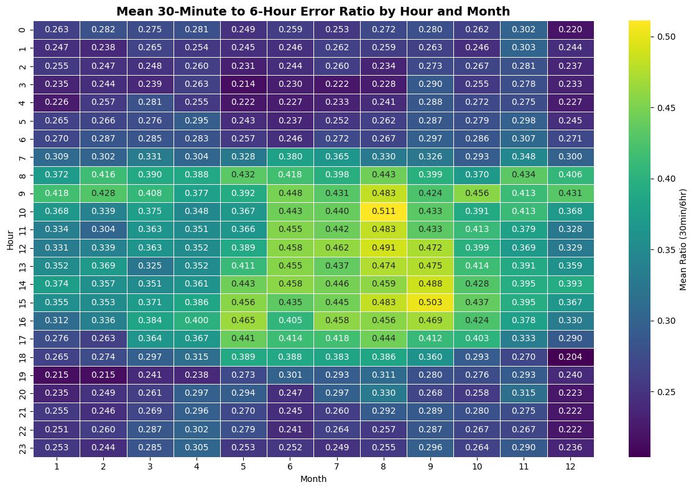
Allocating Individual ECRS and NSRS quantities from Total Reserves
Each hour has 12 five-minute X-min ahead errors and one Y-hour ahead error
For each X-min under-forecast error, calculate the ratio to the Y-hour ahead under-forecast error for that same hour
Group results by Month-Hour to compute average ratio for each Month-Hour
ECRS should be reserved to restore frequency following the trip of a large generator and/or provide supply during intra-hour net load forecast errors.
ECRS = max(ECRS Frequency Recovery Requirement, Total Reserves * ECRS Ratio %)
NSRS = Total Reserves * (1-ECRS Ratio %)
Key Takeaway: Using the described ratio method allocates higher amounts of ECRS during daytime hours, while leaning on ECRS frequency requirement through night hours.

Slide 12
Probabilistic Quantities and Sensitivities for ECRS and NSRS

Slide 13
Probabilistic Methodology Input & Criteria Recommendations
ERCOT Recommends the following Parameters:
  Risk: X = 6 Hour ahead NLFE and 6 hour ahead rolling forced outage of conventional resources.*
  Risk Credit: Y = 60% for each risk credit from historic availability in night hours (HE23-HE5) and Y = 25% in day hours (HE6-HE22) as capacity that is available to cover the risk for which these products are designed.
  Convergence Criteria: ZZ = Max(Reg+RRS, 3000) indicating the avoidance of a due to lack of reserves with a 1 in XX = 10-year probability and should be sufficient to restore procured regulation and responsive reserves.
Additional details provided on the following slides.
*the method is also aware and analyzing the 30 min ahead NLFE

Slide 14
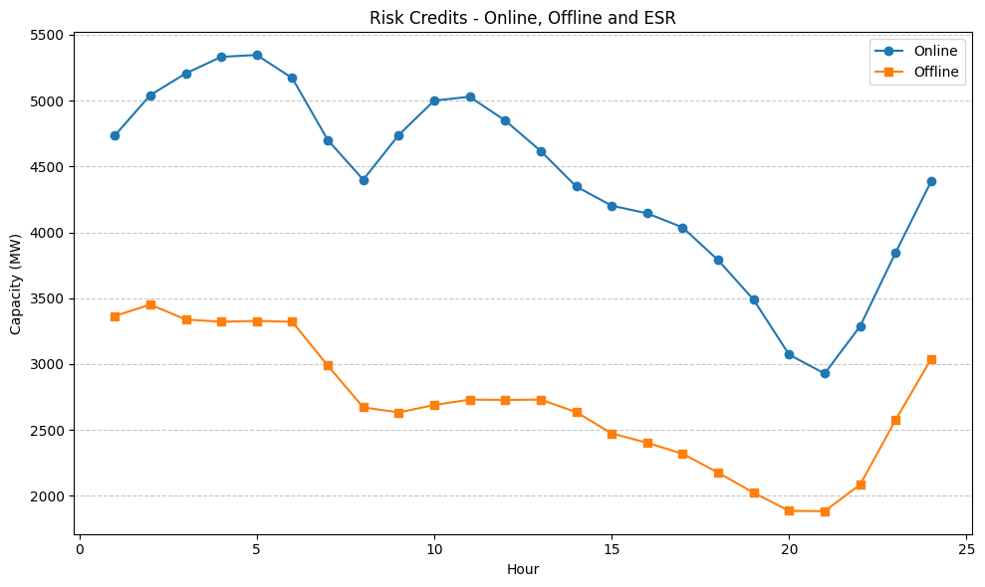
Capacity Trends by Season: Offline and Online
ERCOT accepts that the magnitude of headroom trends may change, but we do believe there will be consistent amounts of offline and online capacity available through night hours compared to daytime hours. As a result, we recommend taking a higher credit for night hours vs day hours.
*shaded area identifying night hours

Slide 15
Allocating ECRS and NSRS Quantities
Utilizing the under-forecast error in 30 min NLFE, calculate the ratio to the under-forecast 6-hour ahead NLFE for that same hour and compute average ratio for each Month-Hour.
Additionally, ECRS should be reserved to restore frequency following the trip of a large generator and/or provide supply during intra-hour net load forecast errors.
ECRS = max(ECRS Frequency Recovery Requirement, Total Reserves * ECRS Ratio %)
NSRS = Total Reserves * (1-ECRS Ratio %)
ECRS+NSRS Requirements |  |  |  |  |  |  |  |  | ECRS Requirements |  |  |  |  |  |  |  |  | NSRS Requirements
 | Jan | Feb | Mar | Apr | May | Jun | Jul* |  |  | Jan | Feb | Mar | Apr | May | Jun | Jul* |  |  | Jan | Feb | Mar | Apr | May | Jun | Jul*
1 | 3224 | 2794 | 2022 | 2390 | 4132 | 2952 | 2168 |  | 1 | 1293 | 1083 | 794 | 826 | 1132 | 1127 | 1173 |  | 1 | 1931 | 1711 | 1228 | 1564 | 3000 | 1825 | 996
2 | 3662 | 2867 | 3639 | 3335 | 4474 | 2311 | 1827 |  | 2 | 1261 | 1026 | 1008 | 917 | 1215 | 1050 | 1064 |  | 2 | 2401 | 1841 | 2631 | 2419 | 3259 | 1262 | 763
3 | 3828 | 3105 | 3928 | 3330 | 4323 | 2981 | 1967 |  | 3 | 1280 | 1021 | 1027 | 937 | 1101 | 1027 | 1069 |  | 3 | 2548 | 2083 | 2901 | 2393 | 3221 | 1954 | 898
4 | 3682 | 3156 | 3742 | 3335 | 4208 | 3170 | 2982 |  | 4 | 1268 | 1020 | 947 | 940 | 927 | 1002 | 1050 |  | 4 | 2413 | 2137 | 2795 | 2395 | 3281 | 2168 | 1932
5 | 3718 | 3295 | 3429 | 2498 | 4469 | 3026 | 2981 |  | 5 | 1316 | 1054 | 999 | 766 | 1022 | 1001 | 1026 |  | 5 | 2402 | 2240 | 2431 | 1731 | 3446 | 2025 | 1955
6 | 4265 | 3350 | 4282 | 4649 | 5547 | 3666 | 4655 |  | 6 | 1472 | 1175 | 1249 | 1409 | 1408 | 1049 | 1282 |  | 6 | 2794 | 2175 | 3033 | 3240 | 4139 | 2617 | 3373
7 | 5164 | 3948 | 4765 | 4746 | 5910 | 3870 | 4955 |  | 7 | 1646 | 1302 | 1473 | 1375 | 1523 | 1081 | 1433 |  | 7 | 3518 | 2646 | 3292 | 3372 | 4387 | 2789 | 3522
8 | 6659 | 5083 | 4855 | 4693 | 5423 | 6095 | 5940 |  | 8 | 2087 | 1620 | 1663 | 1464 | 1865 | 2459 | 2321 |  | 8 | 4572 | 3463 | 3192 | 3229 | 3558 | 3637 | 3619
9 | 6928 | 5537 | 4846 | 4672 | 6078 | 6355 | 6304 |  | 9 | 2808 | 2597 | 2003 | 2008 | 2794 | 2704 | 2625 |  | 9 | 4120 | 2941 | 2843 | 2664 | 3284 | 3651 | 3679
10 | 6505 | 6364 | 4742 | 6360 | 7946 | 6285 | 6089 |  | 10 | 2864 | 2936 | 2170 | 2502 | 3267 | 2822 | 2683 |  | 10 | 3642 | 3428 | 2572 | 3858 | 4679 | 3463 | 3405
11 | 5150 | 6775 | 4152 | 6379 | 9027 | 5862 | 5394 |  | 11 | 2017 | 2502 | 1658 | 2316 | 3468 | 2675 | 2428 |  | 11 | 3133 | 4273 | 2494 | 4062 | 5559 | 3188 | 2966
12 | 4779 | 6530 | 4187 | 6381 | 9730 | 5527 | 4549 |  | 12 | 1628 | 2187 | 1672 | 2224 | 3628 | 2431 | 1963 |  | 12 | 3151 | 4343 | 2515 | 4157 | 6102 | 3096 | 2586
13 | 5787 | 6772 | 4077 | 6381 | 9062 | 4140 | 3726 |  | 13 | 1913 | 2435 | 1540 | 2259 | 3493 | 1846 | 1699 |  | 13 | 3873 | 4337 | 2537 | 4122 | 5569 | 2294 | 2027
14 | 6260 | 6347 | 4072 | 6618 | 6115 | 4476 | 3580 |  | 14 | 2346 | 2479 | 1461 | 2382 | 2546 | 2007 | 1595 |  | 14 | 3914 | 3869 | 2611 | 4236 | 3570 | 2469 | 1985
15 | 6867 | 4894 | 5625 | 6951 | 5269 | 4308 | 4040 |  | 15 | 2742 | 1997 | 2153 | 2546 | 2328 | 1993 | 1883 |  | 15 | 4125 | 2897 | 3472 | 4405 | 2941 | 2315 | 2157
16 | 6934 | 6151 | 5611 | 6591 | 4786 | 4288 | 4364 |  | 16 | 2740 | 2495 | 2317 | 2604 | 2183 | 1918 | 2026 |  | 16 | 4194 | 3656 | 3293 | 3988 | 2602 | 2370 | 2339
17 | 6967 | 6896 | 5602 | 5826 | 4938 | 7094 | 5044 |  | 17 | 2595 | 2530 | 2329 | 2502 | 2338 | 3055 | 2496 |  | 17 | 4372 | 4366 | 3273 | 3324 | 2601 | 4039 | 2549
18 | 6550 | 6903 | 4414 | 4976 | 5099 | 7513 | 5196 |  | 18 | 2077 | 2005 | 1783 | 1978 | 2390 | 3338 | 2335 |  | 18 | 4473 | 4898 | 2631 | 2998 | 2709 | 4175 | 2861
19 | 6720 | 6940 | 4431 | 4124 | 5990 | 7680 | 5377 |  | 19 | 1799 | 2028 | 1558 | 1531 | 2439 | 3189 | 2154 |  | 19 | 4921 | 4912 | 2873 | 2593 | 3551 | 4491 | 3223
20 | 6486 | 6172 | 4455 | 4001 | 6426 | 7286 | 5422 |  | 20 | 1562 | 1498 | 1291 | 1236 | 2041 | 2562 | 1869 |  | 20 | 4924 | 4674 | 3164 | 2765 | 4385 | 4723 | 3553
21 | 5684 | 5339 | 3773 | 3784 | 7925 | 6652 | 5196 |  | 21 | 1513 | 1406 | 1131 | 1302 | 2516 | 2020 | 1893 |  | 21 | 4170 | 3933 | 2642 | 2482 | 5409 | 4632 | 3303
22 | 5425 | 5633 | 2822 | 3170 | 8409 | 7132 | 3589 |  | 22 | 1484 | 1552 | 1032 | 1133 | 2331 | 1845 | 1696 |  | 22 | 3941 | 4080 | 1789 | 2037 | 6078 | 5287 | 1893
23 | 5084 | 5448 | 2694 | 2413 | 7863 | 6681 | 3297 |  | 23 | 1394 | 1507 | 988 | 1032 | 2319 | 1808 | 1519 |  | 23 | 3691 | 3940 | 1706 | 1380 | 5543 | 4872 | 1778
24 | 3493 | 3218 | 1910 | 2375 | 4513 | 5031 | 2502 |  | 24 | 1326 | 1166 | 833 | 872 | 1313 | 1428 | 1297 |  | 24 | 2166 | 2052 | 1077 | 1503 | 3201 | 3603 | 1205

Slide 16
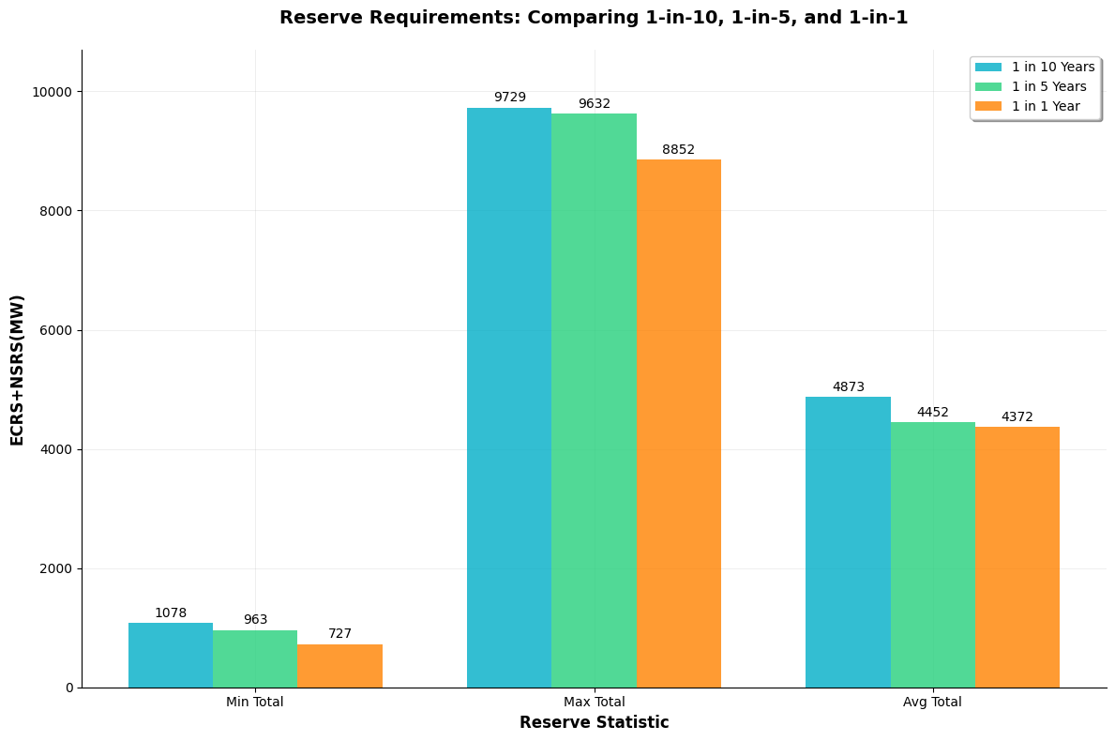
1 in (10 Vs 5 VS 1) - Impact to the ECRS+NSRS Quantities avoiding
We ran additional probability sensitivities while maintaining avoiding Watch threshold and identified that 1 in 10 Years will produce the highest reserve quantity but there is not a large change overall amongst the sensitivities.

Slide 17
Cost Analysis of AS Requirements
Using Historical Market Clearing Price for Capacity (MCPC) we can see impacts of sensitivities in Risk Credits and Threshold based on 7 months of quantities calculated.
Case: Watch for 1 in 10 Years | ECRS Total Cost | NSRS Total Cost
A - 100% Credit | $737,801 | $1,458,435
B - ERCOT Recommended | $869,367 | $1,957,046
C - 0% Credit | $939,276 | $2,257,735
Case: Load Shed for 1 in 10 Years | ECRS Total Cost | NSRS Total Cost
B - ERCOT Recommended | $862,249 | $1,939,558
Delta - Watch to Load Shed | -$7,118 | -$17,488

Slide 18
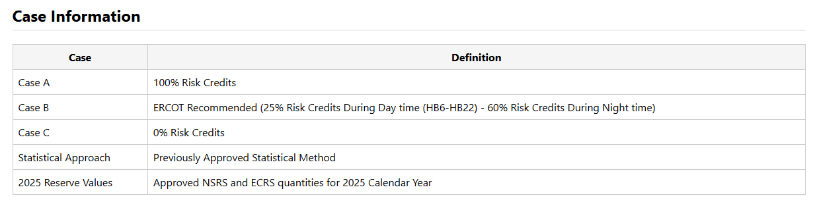
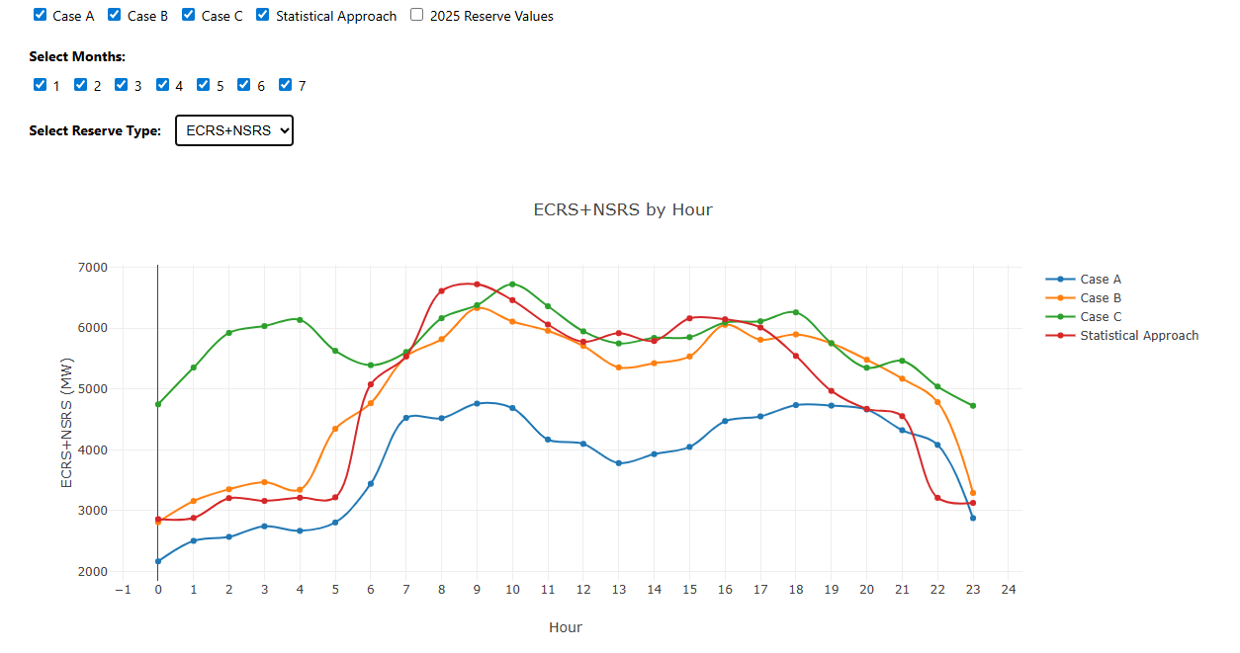
Impacts of differing Risk Credits on ECRS+NSRS

Slide 19
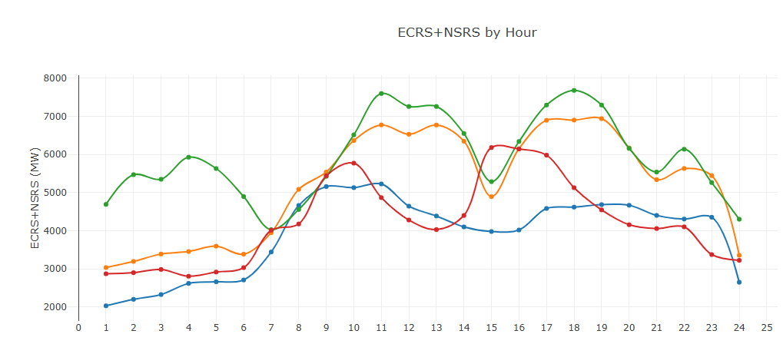
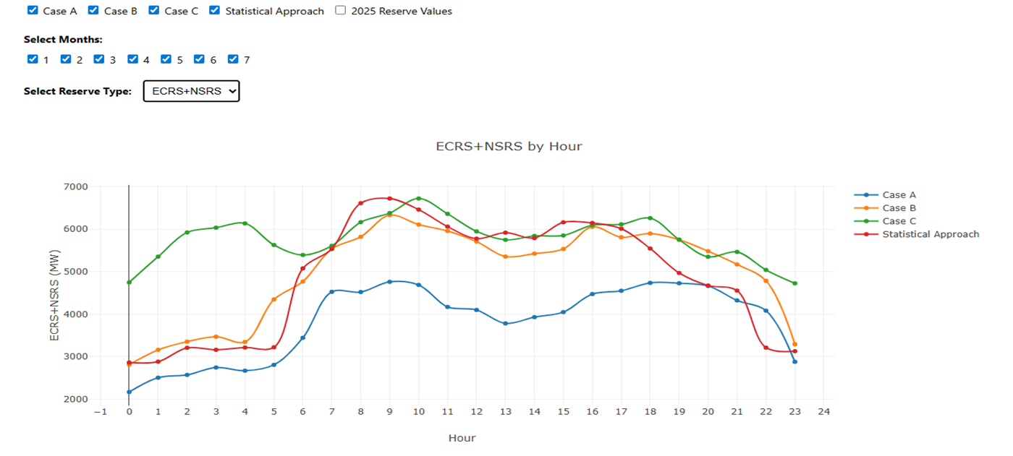
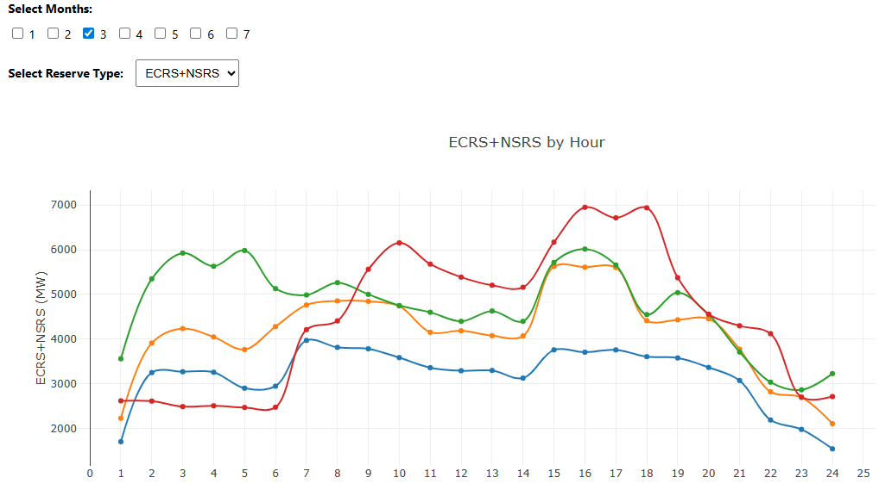
Overall impact of probabilistic method
Probabilistic Methodology allows for the ability to tailor quantities to highest risk times while achieving similar average quantities.

Slide 20
Review of Regulation and RRS

Slide 21
Regulation and RRS Methodologies
Review of methodology for Regulation and RRS for Ancillary Service (A/S) quantities for 2026. These will continue to use the statistical method approved in Dec 2024.
  ERCOT is proposing one change in the methodology used to compute the Regulation requirements.
    Remove the FRRS component as it will retire with the implementation of RTC.
  ERCOT is not proposing any changes in the methodology used to compute RRS requirements
    Updated NERC’s BAL-003 IFRO for minimum RRS-PFR limit of from 1,365 MW when provided by NERC for 2026.

Slide 22
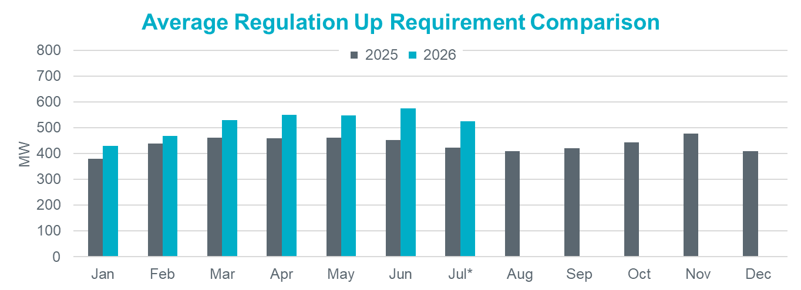
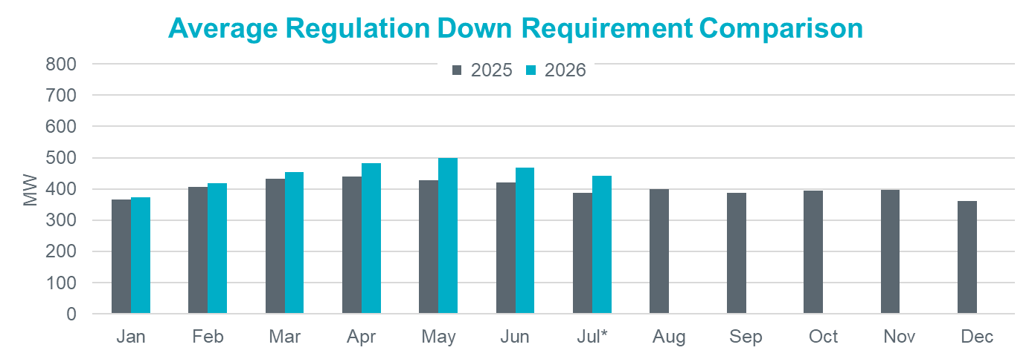
Hourly Average Regulation Comparison
Reg-Up 2026:
On avg. 78 MW increase from prev. year
Largest increase is in Jun by 120 MW
Reg-Down 2026:
On avg. 36 MW increase from prev. year
Largest increase is in May by 70 MW

Slide 23
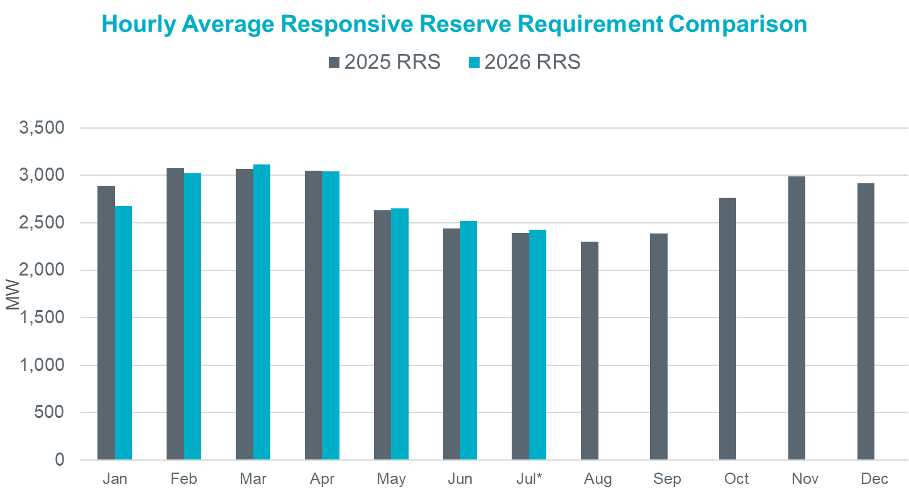
Hourly Average RRS Comparison
2026 RRS:
On avg. 26 MW decrease from prev. year
Largest increase is in Jun by 78 MW
Largest decrease is in Jan by 212 MW
*2026 RRS quantities are calculated using the 2025 minimum RRS-PFR limits (to be updated).

Slide 24
Next Steps
April 23, 2025 – TAC Kickoff
May 19, 2025 – Workshop #1
June 20, 2025 – PDCWG
June 30, 2025 – Workshop #2
July 07, 2025 – WMWG (Proposed)
July 15, 2025 – OWG (Proposed)
July 22, 2025 – PDCWG (Proposed)
August 04, 2025 – Workshop #3
August 06, 2025 – WMS
August 07, 2025 – ROS
August 28, 2025 – TAC
September 23, 2025 – BoD
Oct, Nov, Dec 2025 – PUC

Slide 25

Questions
?

Slide 26
Appendix

Slide 27
Monte Carlo Resampling
  Monte Carlo Resampling is a statistical technique for estimating distribution of a statistic (e.g. mean)
  It resamples from original data with replacement and statistic is calculated using the resample
  Distribution of the statistic is formed by the calculated statistics from the resamples
  forms distribution of avg

Slide 28
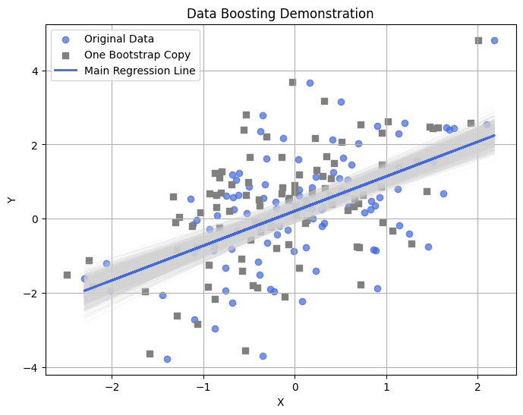
Monte Carlo Resampling (cont'd...)
another example
  A single dataset (scatter) with a best-fit regression line (in blue).
  Each gray line is a regression line created from a resampled data
  The spread of the gray lines illustrates how the best fit line can vary
  The grey points represent a copy of the simulated points, showing a similar spread to the original data (blue points). All such copies (not shown) collectively form a boosted sample of the original dataset.

Slide 29
Monte Carlo Resampling for Data Boosting
  The resamples (before calculating the stats) can be used to “boost” the parent sample
  However, it will not eliminate the choppiness and repetitive problem as same data points will show up in the boosted distribution
  To handle this, the original algorithm was slightly modified
    For the parent sample, z-scores were calculated using mean and standard deviation
    From each resample, mean and standard deviation (std) were calculated
    Using z-scores from the parent sample and mean and std from resample, new data points were synthesized
  The technique was tested for different kinds of distributions

Slide 30
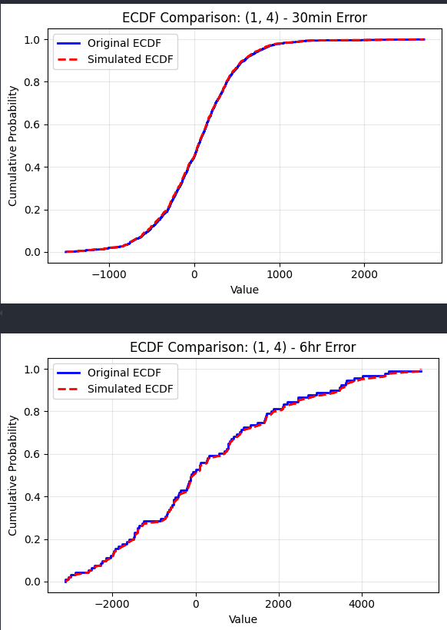
Monte Carlo Resampling
Historical Data:
  Pull Empirical Distributions for risk and risk credits by month-hour
ECDF Resampling:
  Generate 10,000 new synthetic samples per variables to create similar distributions
  Sampled each variable separately due to low correlation.
Risk Assessment:
  Calculate net risk to cover from 10,000 Monte Carlo samples drawn from empirical distributions of forecast errors and available risk credits

Slide 31
Impact of Load and Renewable Growth on Forecast Error Trends (cont’d)
Monthly forecast errors over multiple years were analyzed.
Monthly forecast errors were summarized as standard deviation (SD), mean absolute error (MAE).
Monthly summaries were modeled as linear function of time (year).
From the model, we extracted
    R-squared – to assess model fit
    p-value of the year variable – to evaluate the strength of trend
      high R² + low p-value is desired – indicates strong, reliable model
The goal is to determine whether there is a meaningful trend in forecast error over time.

Slide 32
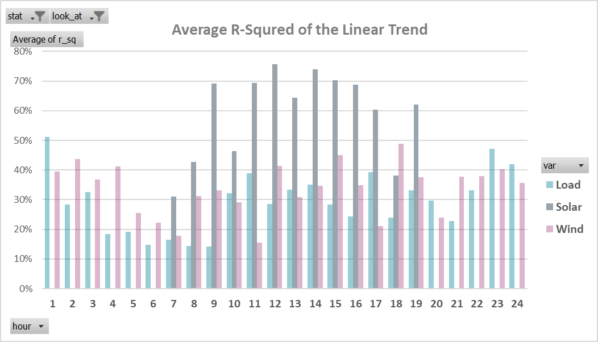
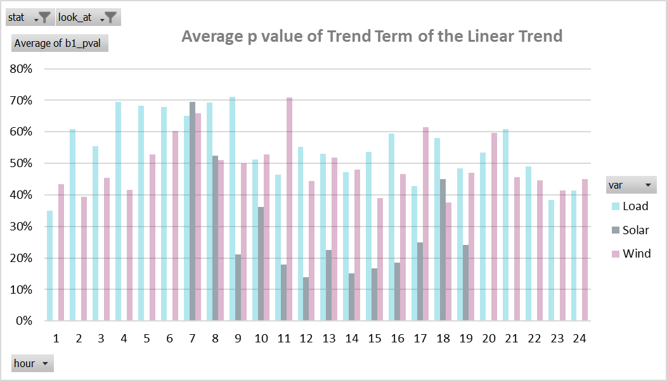
Impact of Load and Renewable Growth on Forecast Error Trends (cont’d)
Solar forecast errors show stronger trends, with high R² and low p-values during sunlight hours.
Load and wind errors show weak or inconsistent trends, with low R² and high p-values
Adjustment was applied only to solar forecasts, based on statistical significance; no adjustment made for load or wind
Note: The initial linear models were used primarily to identify any significant trends and to support visual observations. For the solar adjustment process, a more detailed model was applied to capture both trends and seasonality.

Slide 33
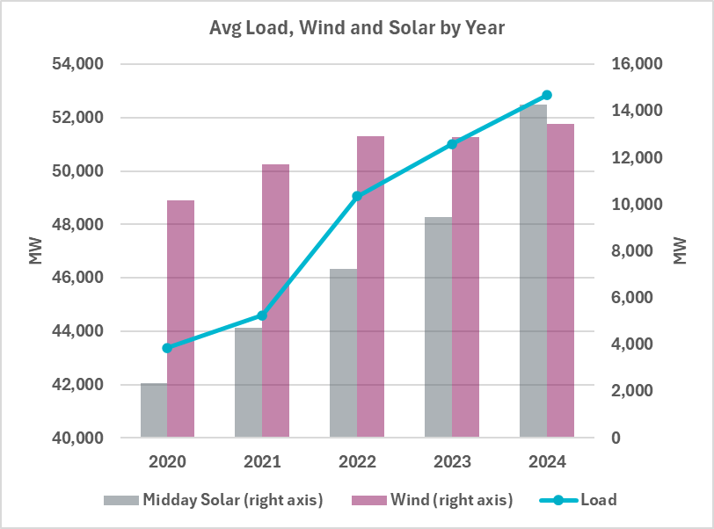
Impact of Load and Renewable Growth on Forecast Error Trends
Installed capacity for solar and wind is increasing over time.
Electric load is also growing consistently.
Intuition: As the base value (capacity or load) increases, so might the forecast error
Key Question:
Does the growth in load or renewables affect the magnitude of forecast errors?

Slide 34
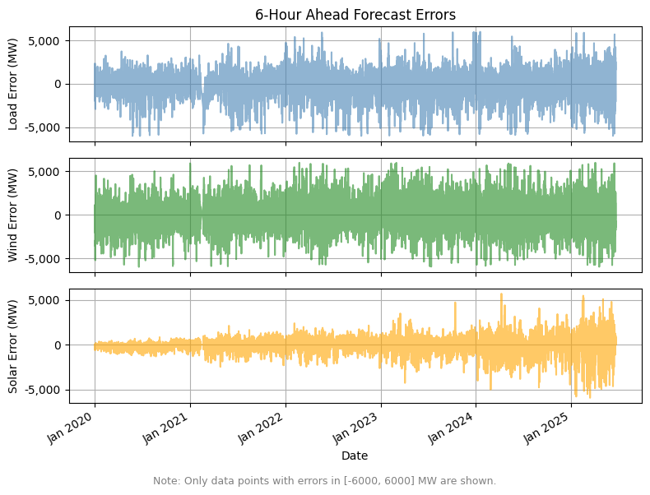
Impact of Load and Renewable Growth on Forecast Error Trends (cont’d)
Errors for Load and Wind remain relatively stable in both magnitude and spread over time.
Solar forecast errors display a noticeable increase in variability throughout the period.

Slide 35
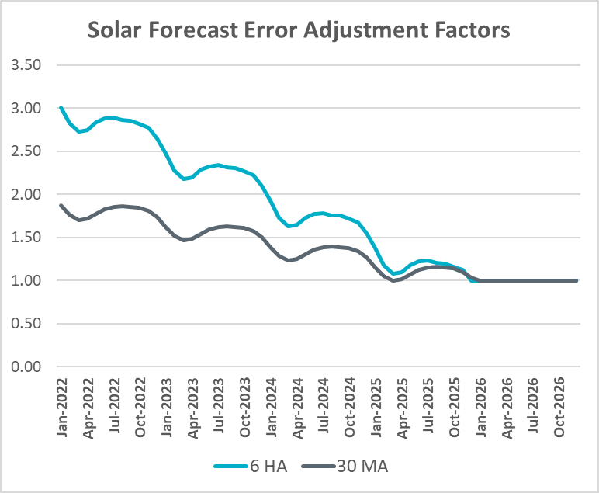
Solar Adjustment Factors Derivation
Monthly forecast error (standard deviation) is modeled against capacity
  Separate models are used for different times of the day
  Seasonality is incorporated into the modeling process
Only stable, well-performing models (based on an R² threshold) are retained for further analysis
The error trend is calculated from the models and extended through 2026
Forecast quality trend is derived from historical Mean Absolute Percentage Error (MAPE) and a smoothed MAPE trend is computed
The error trend and MAPE trend are combined to produce solar error adjustment factors relative to projected 2026 solar capacity

Slide 36
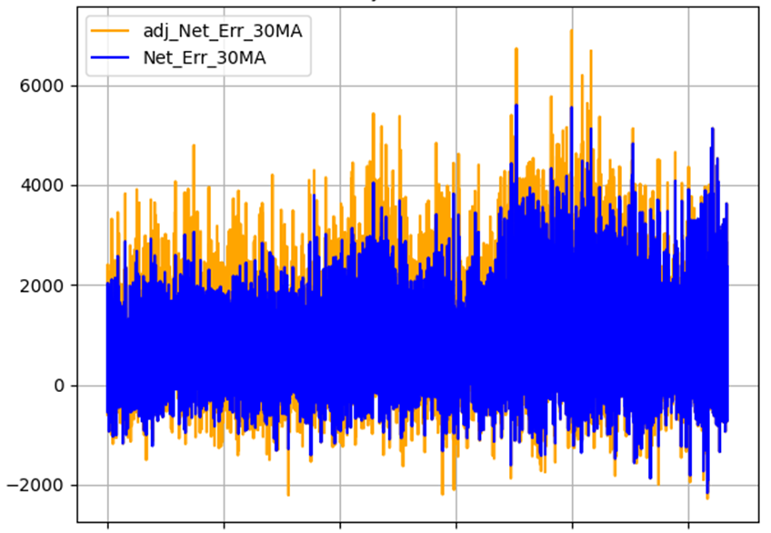
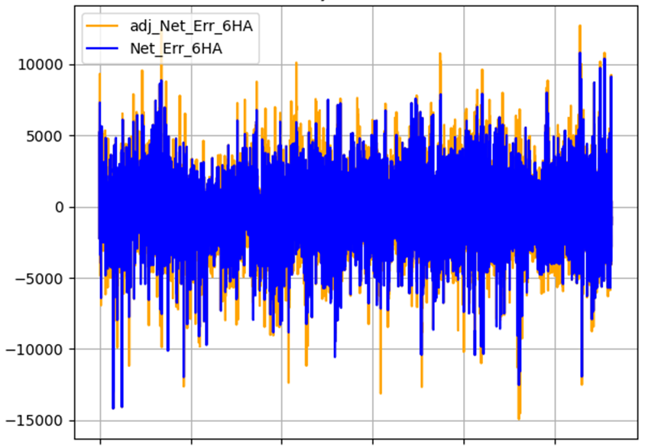

Solar Adjustment Net Error
Charts show Raw and Solar Adjusted Net Error from 1/1/2022 to 6/20/2025
Adjusted Net Error = Raw Net Forecast Error + Raw Solar Forecast Error – Adjusted Solar Forecast Error
Raw Load Forecast Error – Raw Solar Forecast Error – Raw Wind Forecast Error

Slide 37
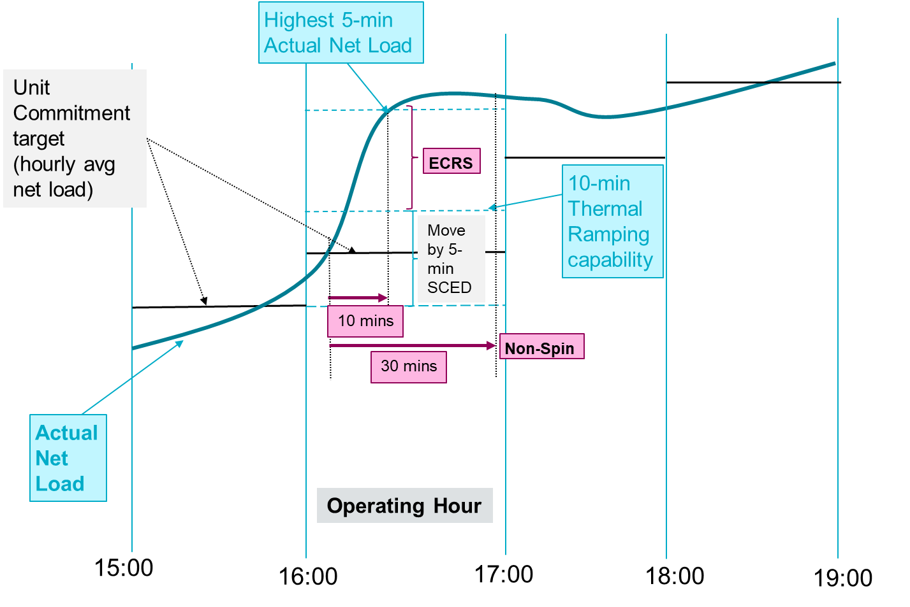
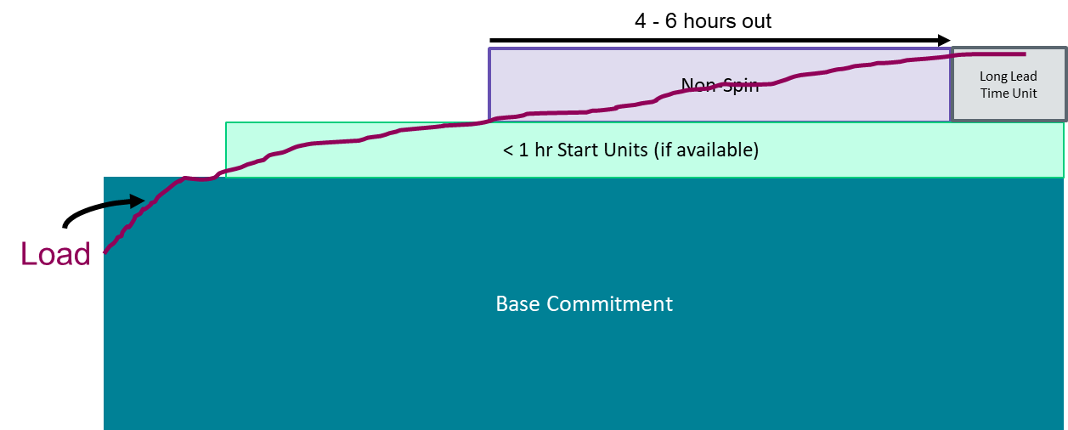
Managing Uncertainty
On days when there is a sustained under-forecast in net load and there is some available capacity (assess these are not scarcity days) the typical approach used is,
The 10-minute reserve ECRS, is relied upon first to respond to the additional energy need created by the under-forecast in net load.
The 30-minute reserve Non-Spin, is relied upon next to relieve/restore the deployed ECRS.
The deployed Non-Spin is relied upon till offline unit(s) can turn on to relieve/restore the deployed AS.
As a result of the above when considering duration needs, it is important to assess
The historical uncertainty in consistently under-forecasting net load
  in 30 minute Ahead timeframe.
  in post RUC timeframe
Duration of historic ECRS and offline Non-Spin deployment events
Use ECRS till Non-Spin supplements the deployed ECRS capacity.
Use Non-Spin till offline unit turns on and supplements the capacity needs
Setup: Consider operating on a day with moderate forecasted load during shoulder months with a portion of the generation fleet on outage. A fast-moving weather front causes a large net-load under-forecast error (ex. load picks up significantly, wind drops). Then a large thermal unit gets forced out.

Slide 38
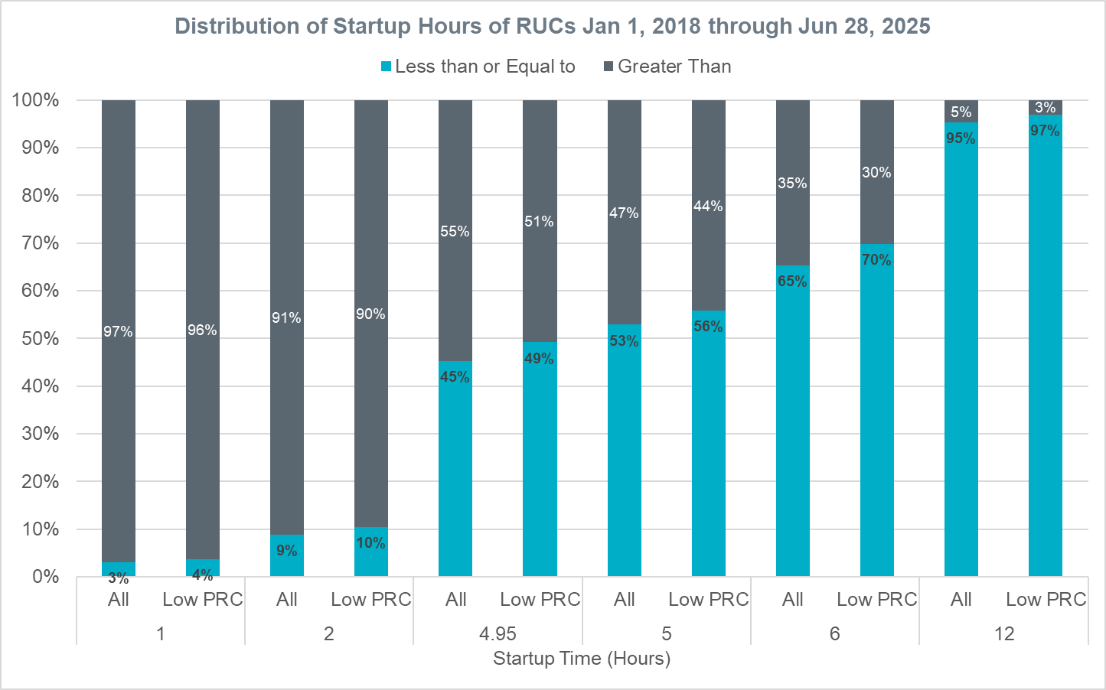
Distribution of Startup Hours of RUCs Jan 1, 2018, through Jun 28, 2025 (Excluding Extensions & RUCs for Congestion)
Between 2018-2025, based on the data analyzed,
  9% of RUCs (for capacity) had a startup time of 2 hours or less
  45% of RUCs (for capacity) had a startup time of 4.95 hours or less
  53% of RUCs (for capacity) had a startup time greater than 4.95 hours
  51% of RUCs (for capacity) during low PRC days had a startup time greater than 4.95 hours.
  *The following approach was used to identify low PRC days
    Between Jan 1, 2018, and Oct 13, 2021, Operating Days with minimum PRC value below 3,500 MW.
    Beginning Oct 14, 2021, Operating Days with minimum PRC value below 5,000 MW.

Slide 39
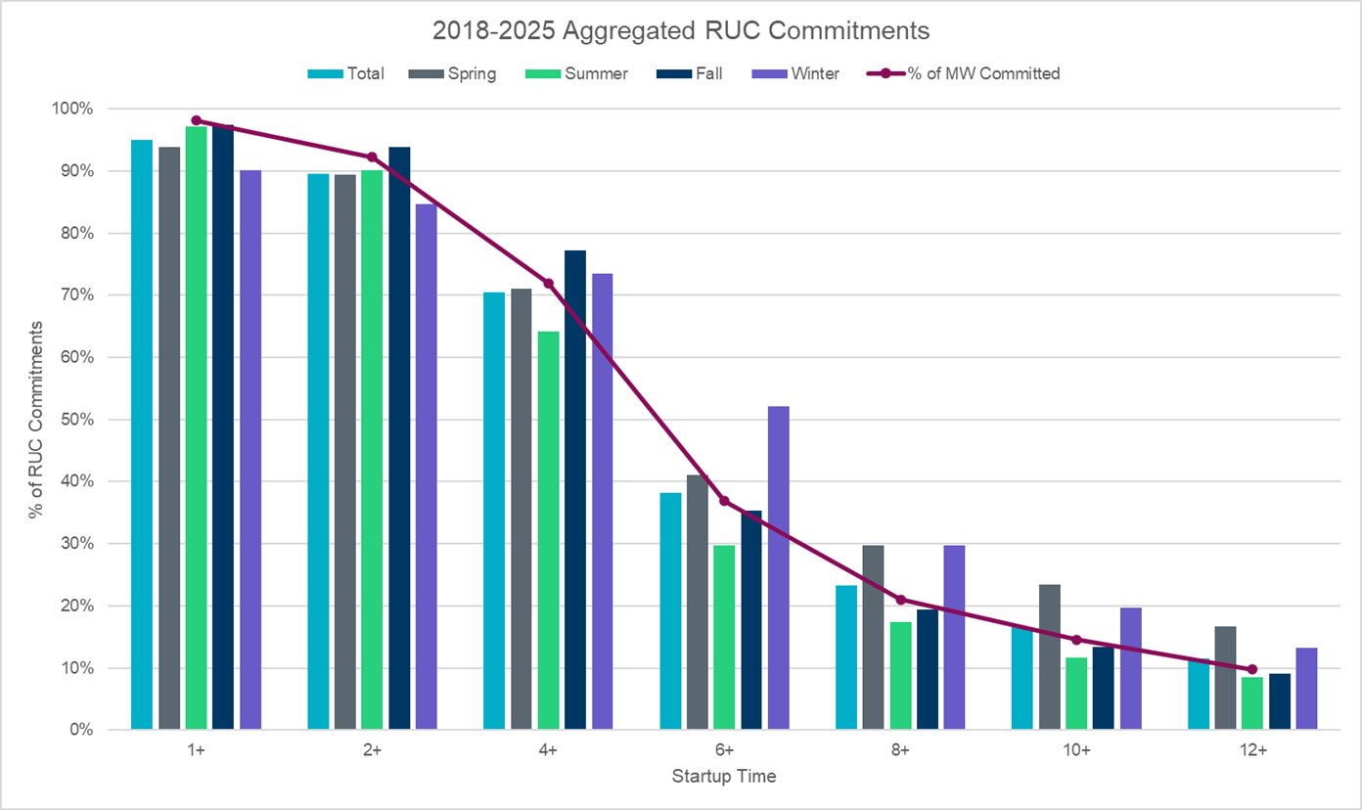
Why 6 Hour is still appropriate for NSRS based on RUCs

Slide 40
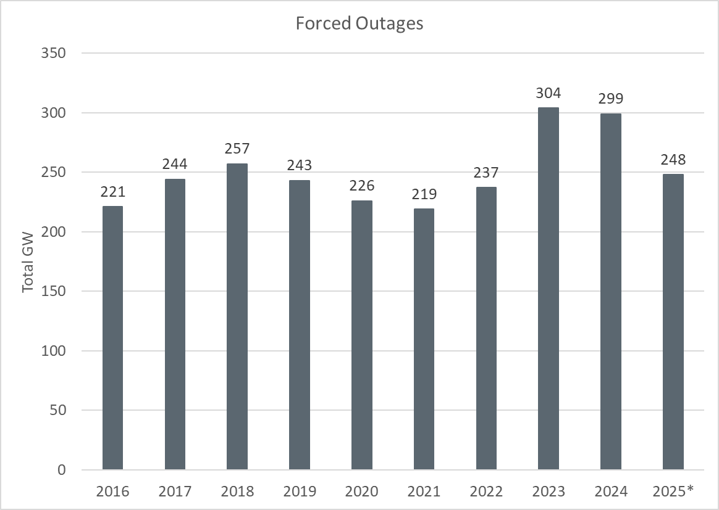
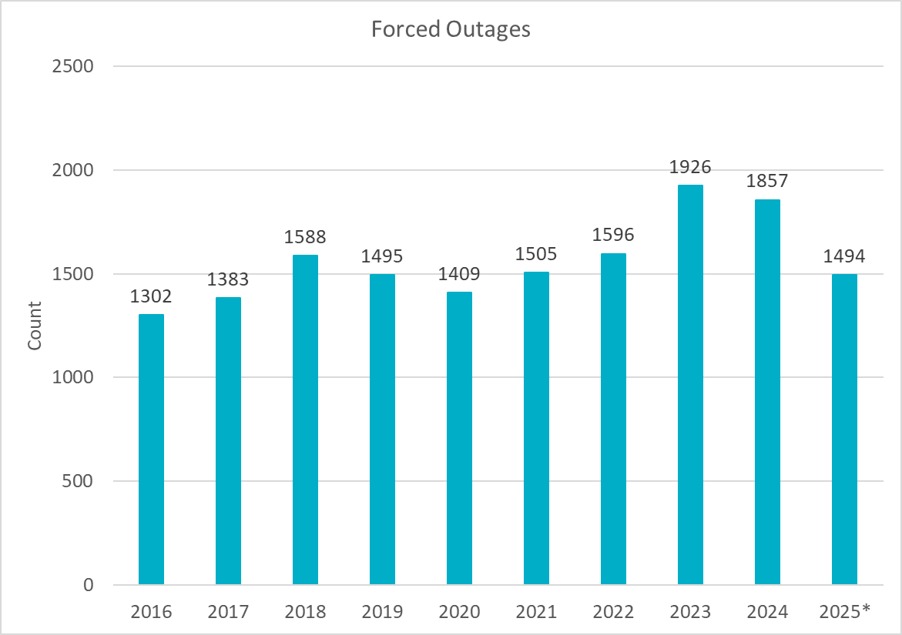
Outage Analysis
Review of outages from 2016 – 2025 doesn’t show a significant change in outages. 2023 and 2024 did show a small increase, but we need more data to ensure an increase trend will continue. This analysis will be reviewed again in the future methodologies.

Slide 41
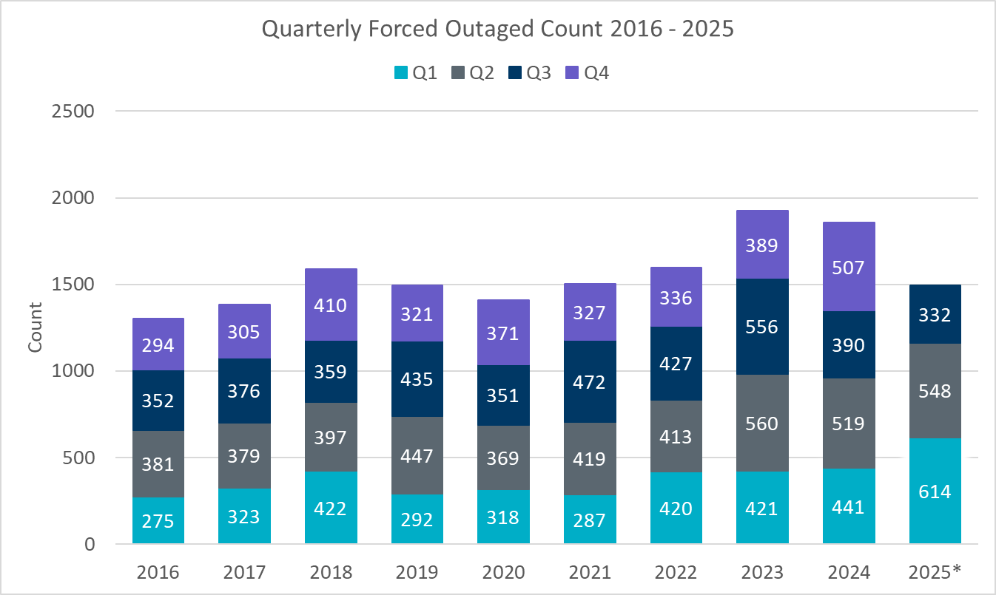
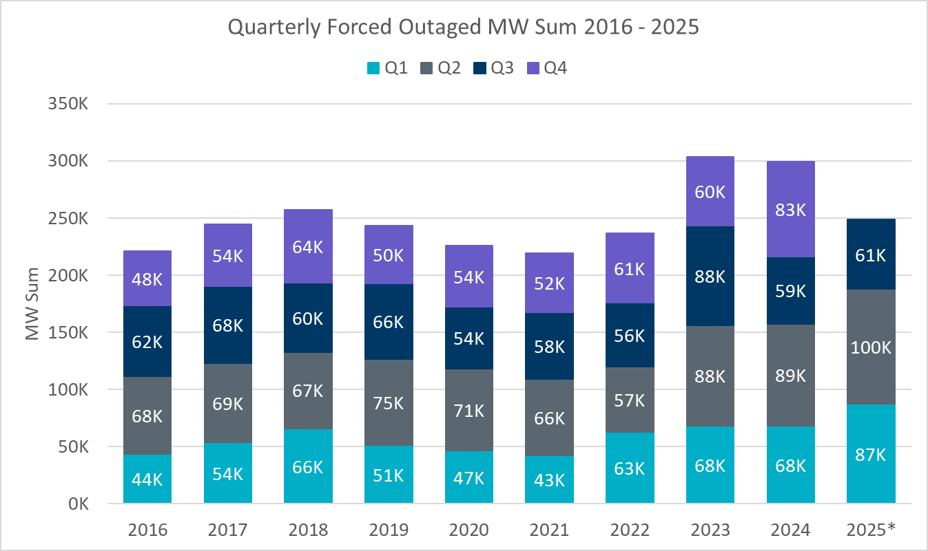
Outage Analysis
Year | 2016 | 2017 | 2018 | 2019 | 2020 | 2021 | 2022 | 2023 | 2024 | 2025*
Count | 1302 | 1383 | 1588 | 1495 | 1409 | 1505 | 1596 | 1926 | 1857 | 1494
Average MW | 170 | 177 | 162 | 163 | 160 | 146 | 148 | 158 | 161 | 166
Median MW | 148 | 150 | 108 | 132 | 101 | 83 | 85 | 139 | 116 | 130

Slide 42
Seasonal Average Inertia by Hour 2019-2025*
Inertia (GW*s)
Hour

Slide 43
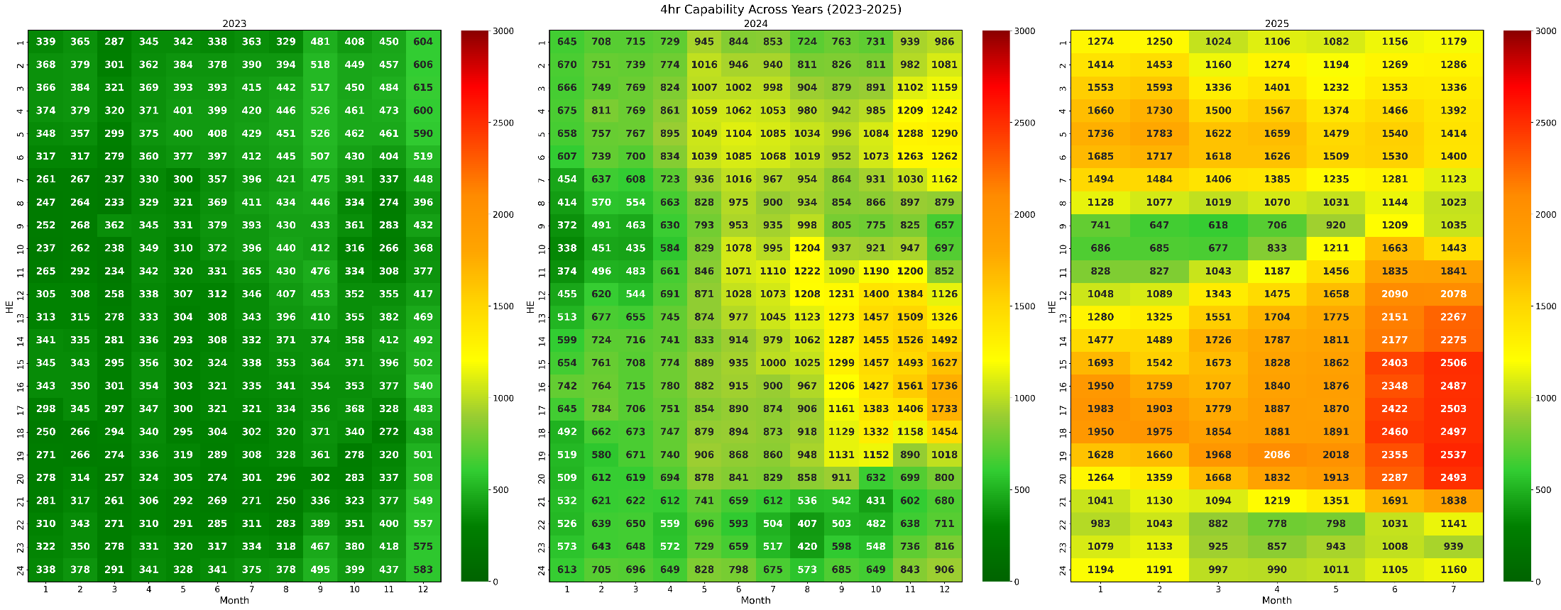
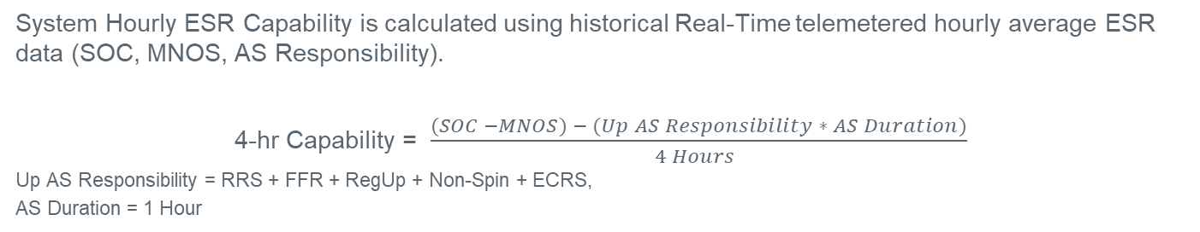
ESR Energy Capability
System Hourly ESR Capability is calculated using historical Real-Time telemetered hourly average ESR data (SOC, MNOS, AS Responsibility).
4-hr Capability = $\frac{(SOC −MNOS) − (Up AS Responsibility ∗ AS Duration)}{4 Hours }$
Up AS Responsibility = RRS + FFR + RegUp + Non-Spin + ECRS,
AS Duration = 1 Hour

Slide 44
2-Hour ESR Capability

Slide 45
6-Hour ESR Capability

Slide 46
8-Hour ESR Capability

Slide 47
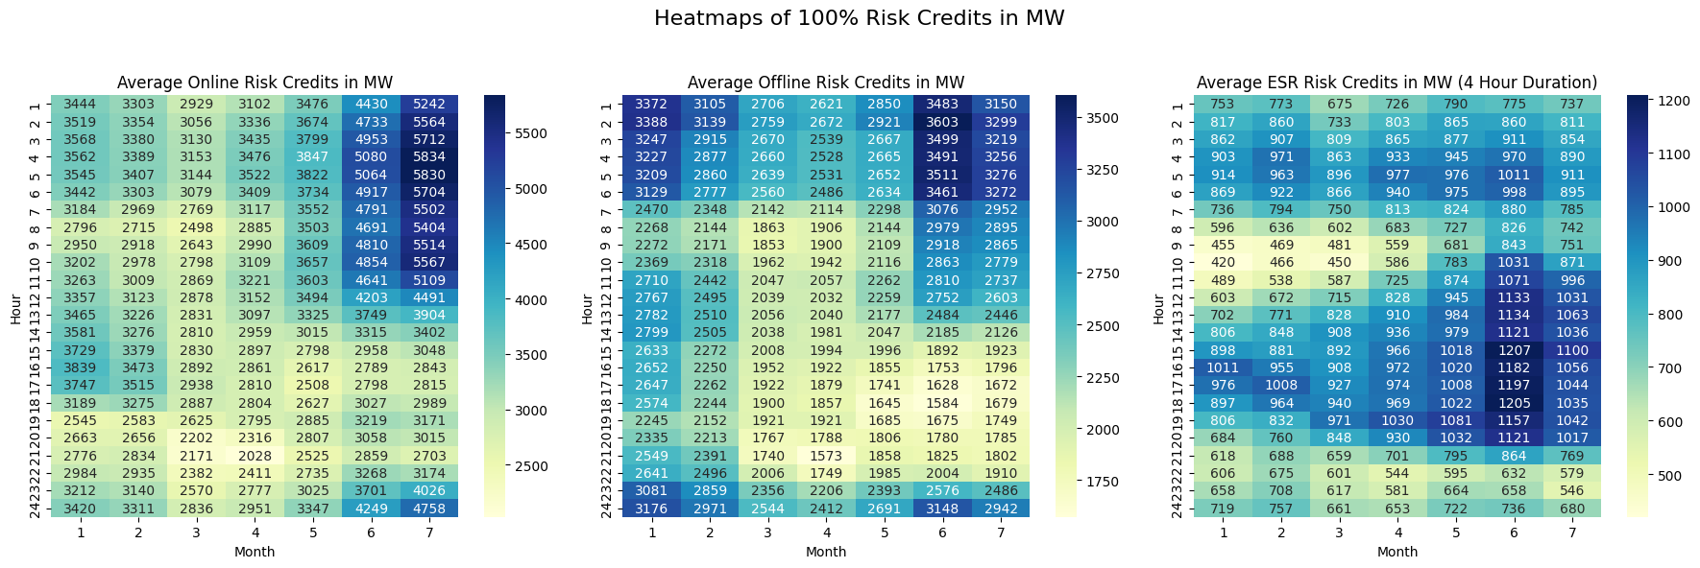
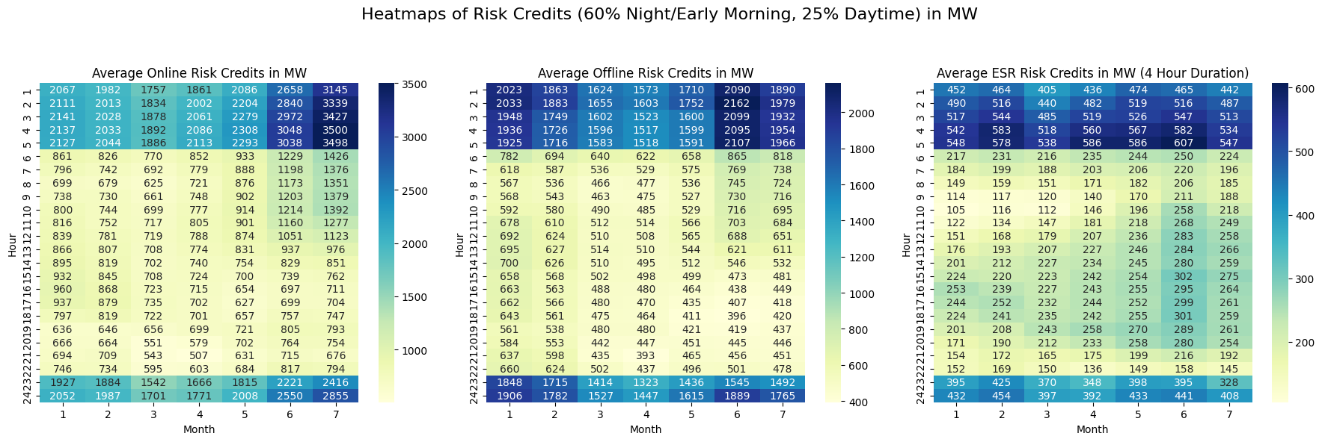
Risk Credit Accounting Heatmaps

Slide 48
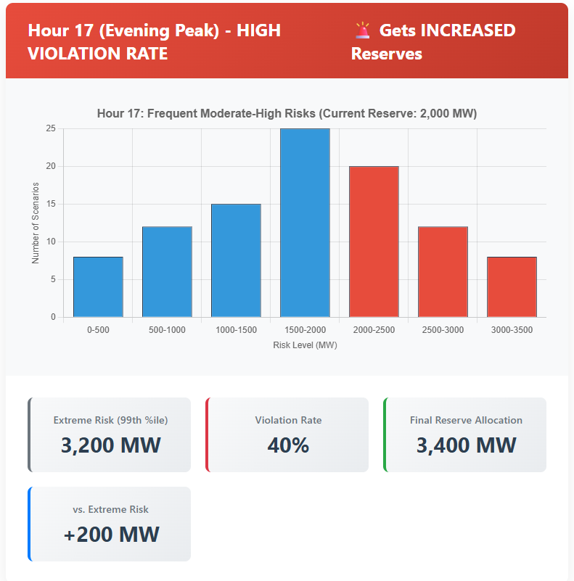
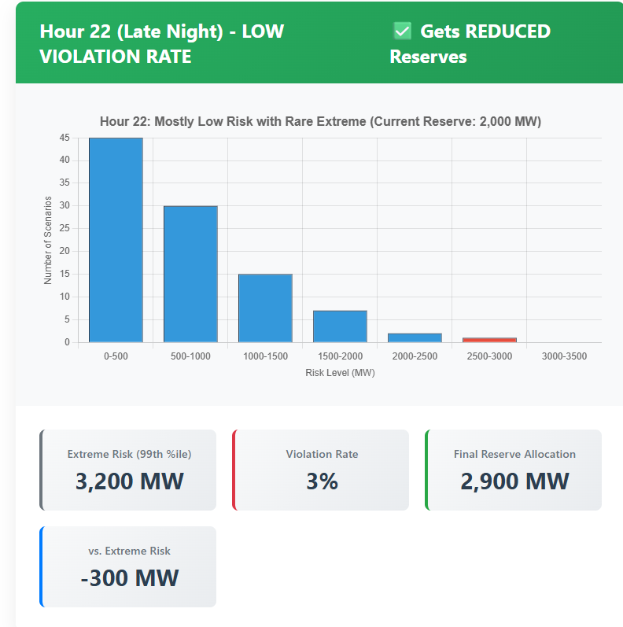
Simplified Optimization Example – Identical Maximum Risk Across Two Hours
Both hours have identical worst-case scenarios
Hour 17 Risk level frequently exceeds reserves;
Hour 22 rarely does
Reserves get increased for Hour 17 while Hour 22 Reserve either stays the same or gets decreased
Not a real example

Slide 49
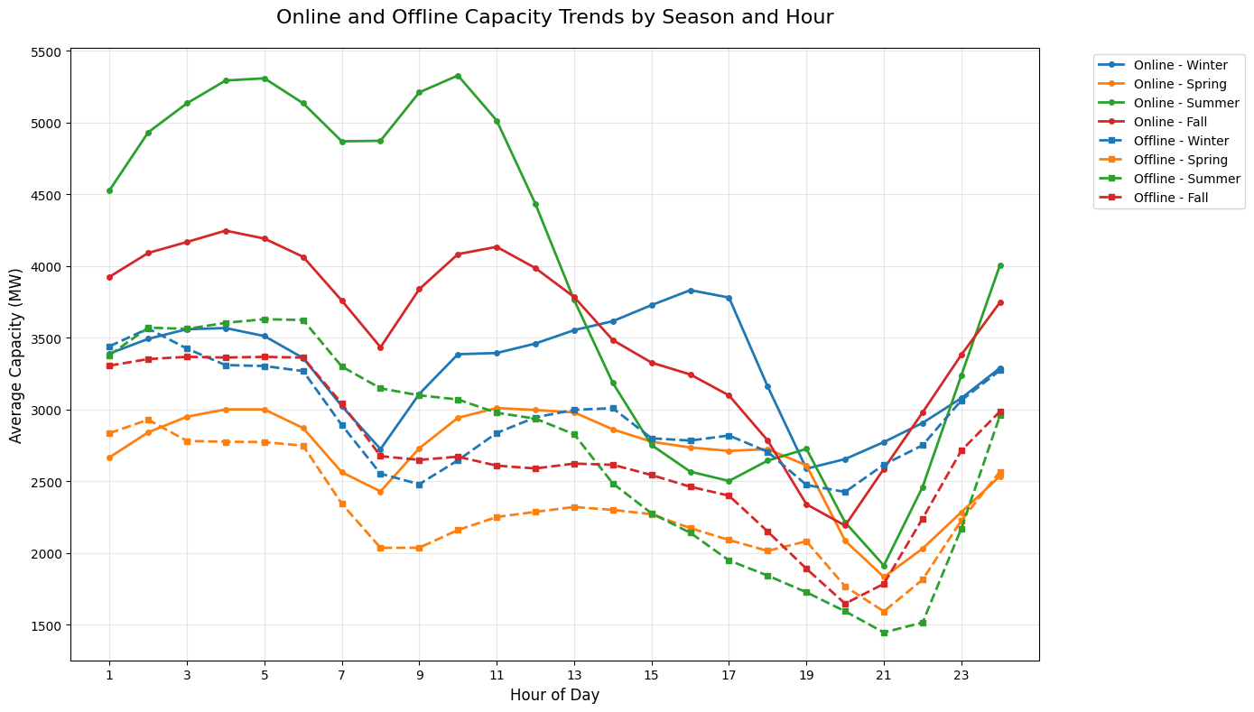
Capacity Trends by Season: Offline and Online
ERCOT accepts that the magnitude of headroom trends may change, but we do believe there will be consistent amounts of offline and online capacity available through night hours compared to daytime hours. As a result, we recommend taking a higher credit for night hours vs day hours.
*shaded area identifying night hours

Slide 50
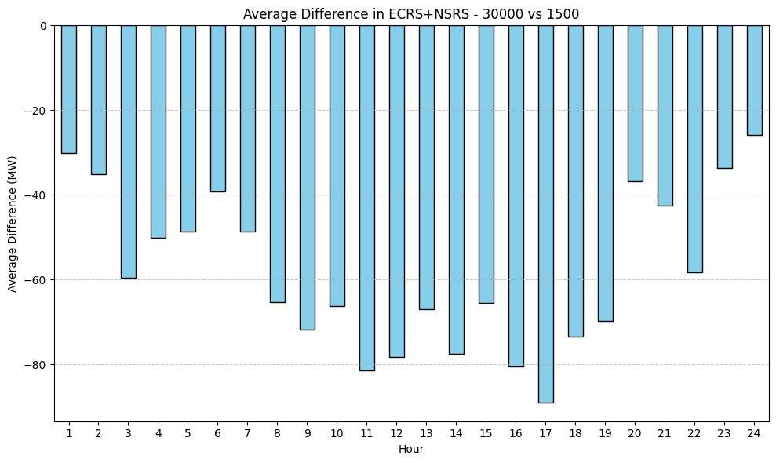
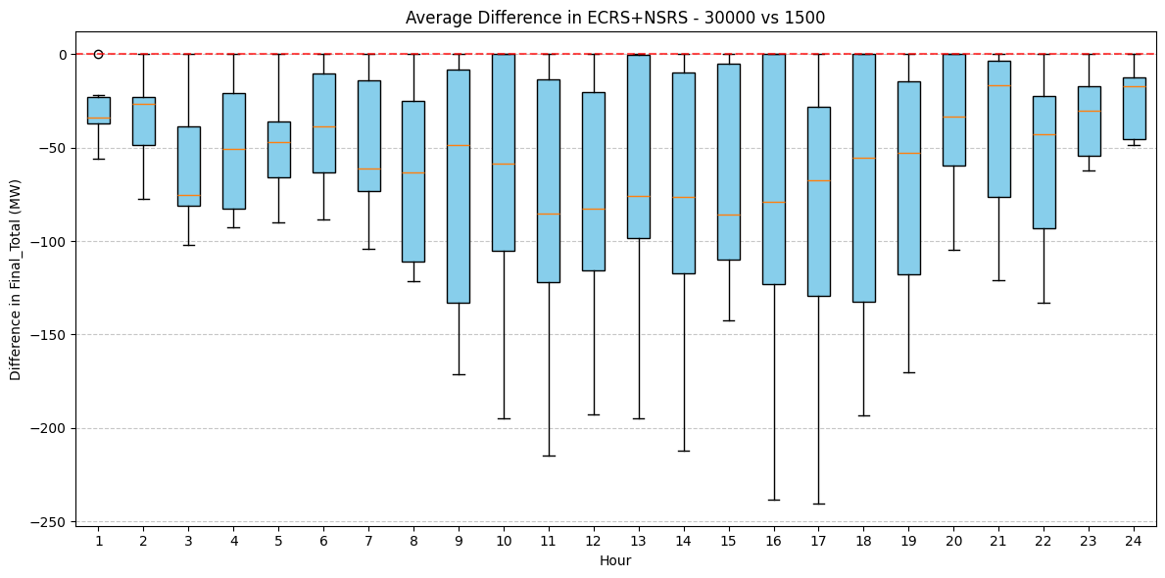
Sensitivity on Threshold (Watch to Load Shed)
Analysis showing impact on AS quantities for threshold change for 7 months of quantities calculated.

Slide 51
Regulation Service

Slide 52
Regulation Up/Down Methodology 2026
 | 2025 Methodology | 2026 Methodology
Data Input | 5-min SCED Netload Forecast Error (2- yr) | No Change
Calculation Method | 95th of 5-min SCED Netload Forecast Error | No Change
Wind/Solar Adjustment | GE Table - Increased wind/solar forecast error per 1,000 MW installed capacity increase | No Change
FRRS Component | 95th of historical FRRS Deployment (2-yr) | Remove
ACE Integral Component | Average of ACE Integral Change (2-yr) | No Change
Load Adjustment (LFL Ramps) | No Adjustment | No Change

Slide 53
Generation To Be Dispatched (GTBD)
ERCOT has incorporated intra-hour wind/solar forecast- based ramp into GTBD to give SCED an indication of how renewables may ramp.
  Predicted Wind Ramp Rate (PWRR) was incorporated in GTBD in Dec.2018
  Predicted Solar Ramp Rate (PSRR) was incorporated in GTBD in Jun.2021
In absence of PSRR/PWRR, SCED dispatches uncurtailed solar/wind units to their max output (HSL).
  This means that SCED assumes output of uncurtailed solar/wind units will persist for the next 5-min at the unit’s HSL that was telemetered at the start of the interval.
GTBD = Total Gen
+K3*5*PLDRR
+K4*Regulation Deployed
+ K5*ACE Integral
– K6*5*PWRR
+ K7*5*DCTRR
– K8*5*PSRR
5-min Load Ramp Forecast
Previous Reg Deployment
Historical Accumulated ACE
5-min Wind Ramp Forecast
5-min DC Tie Ramp Forecast
5-min Solar Ramp Forecast

Slide 54
Recap – Dynamic PSRR Threshold in GTBD
ERCOT started to apply a dynamic PSRR threshold in GTBD calculation on 6/12/2023
PSRR thresholds change with 4 pre-defined day periods - Night, Sunrise, Sunset and Other
ERCOT started with a threshold of 80MW/min for Sunrise and Sunset periods on 6/12/23 and subsequently increased it to 100MW/min. Today, the threshold is set to 225MW/min.
ERCOT continues to update the thresholds and the definition of day periods seasonally*
Night
* Seasons will be defined by shift in solar ramping patterns

Slide 55
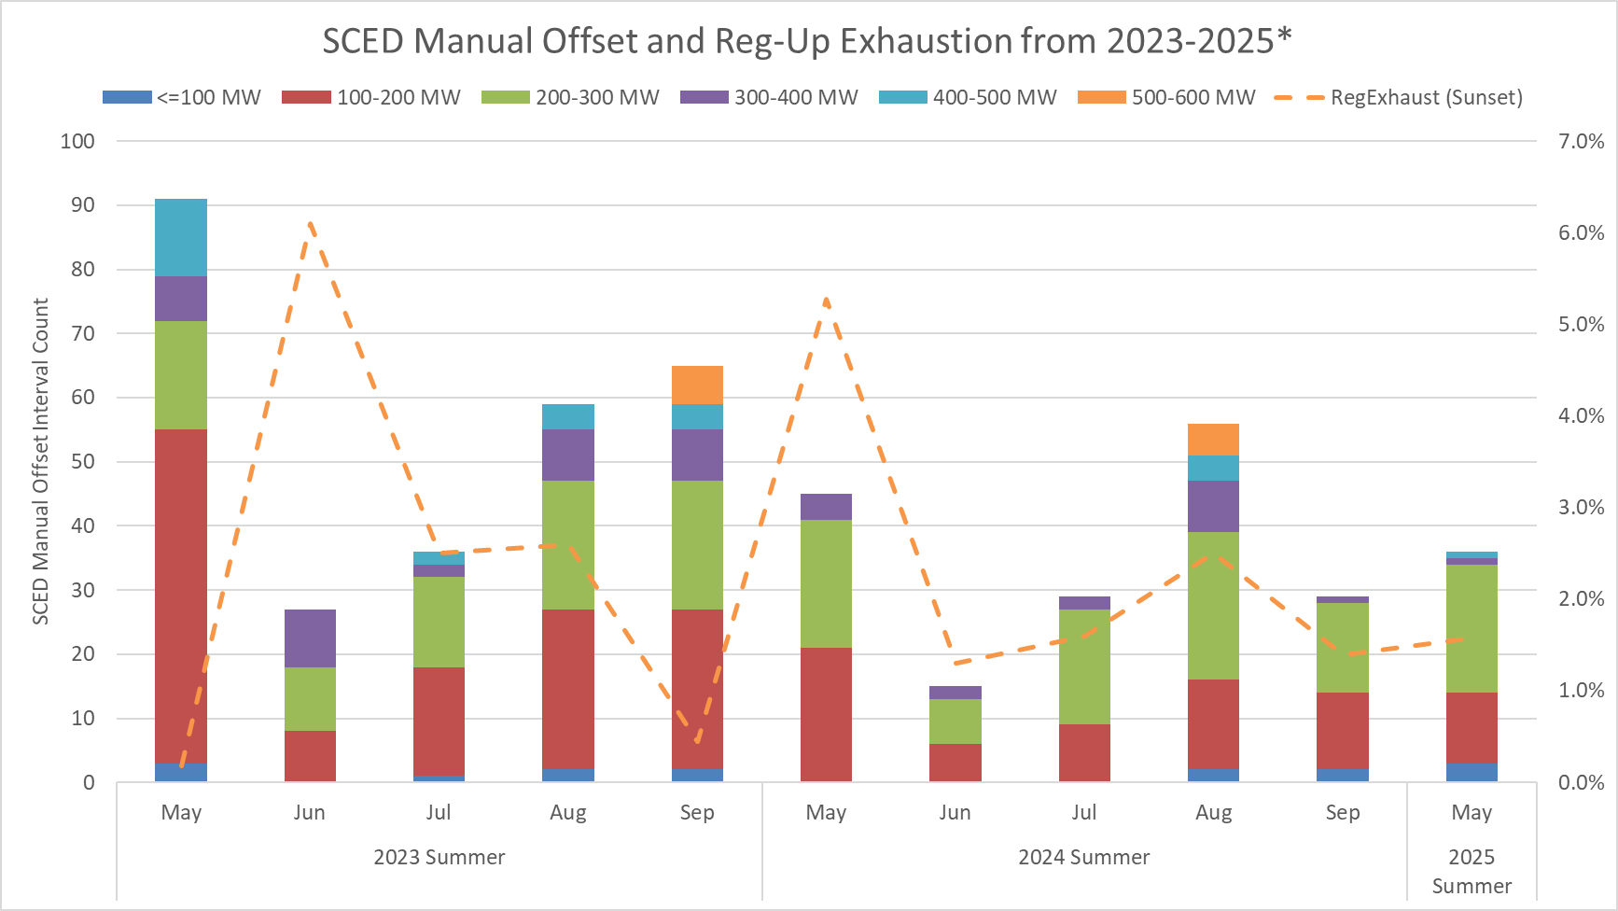
SCED Manual Offset and Reg-Up Exhaustion
This chart combines both the number of Operator Manual Offsets entered along with a focus on Reg-Exhaustion during sunset hours.
Sunset hours: HE 19 - 21

Slide 56
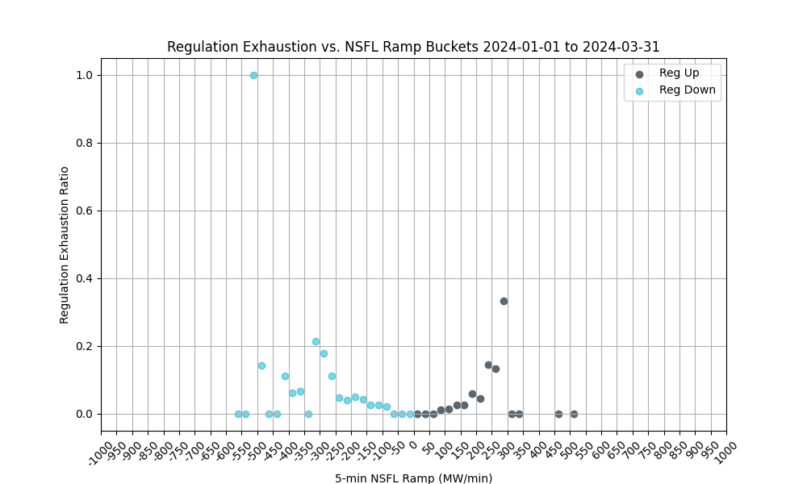
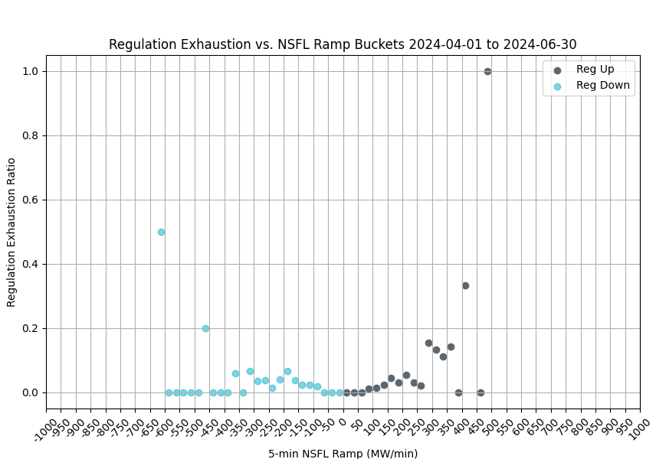
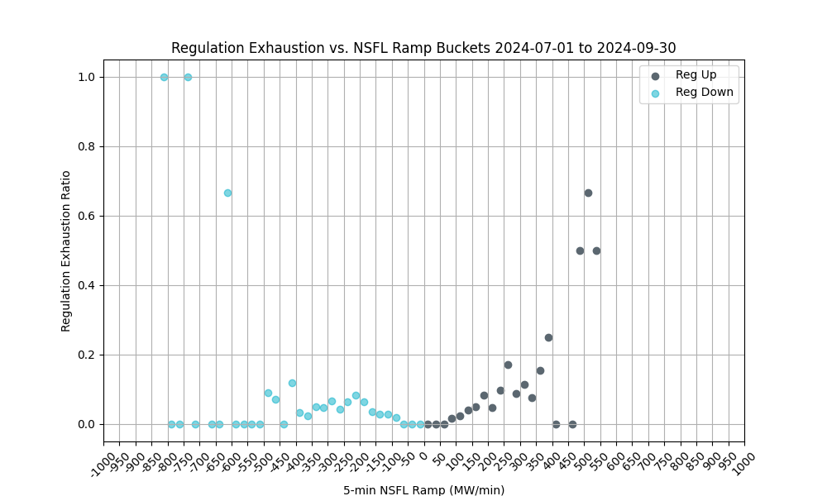
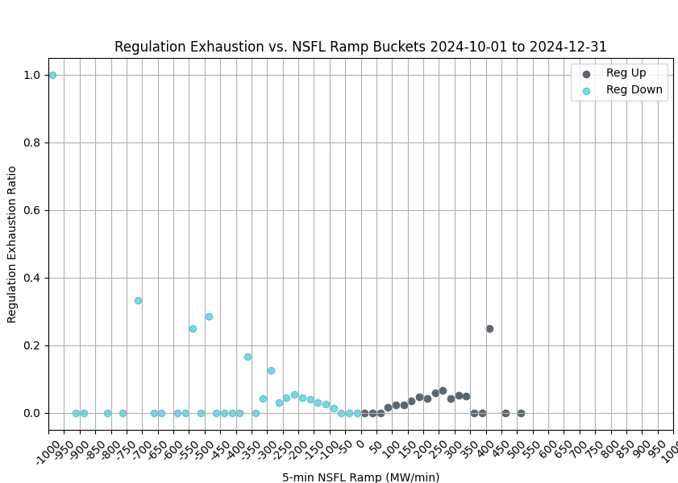
Regulation Exhaustion by Quarter - 2024
These charts use 1-minute data to evaluate regulation exhaustion from 5-minute NSFL* ramps. 5-minute ramps of 75 MW or larger are considered.
Reg exhaustion is flagged using the PDCWG criteria, less than 5 MW reg remaining over a 5-minute average.
Reg exhaustion is evaluated between 5 and 10 minutes from the time of the ramp.
*NSFL = Large Loads and steel mill loads that are not following SCED dispatch.

Slide 57
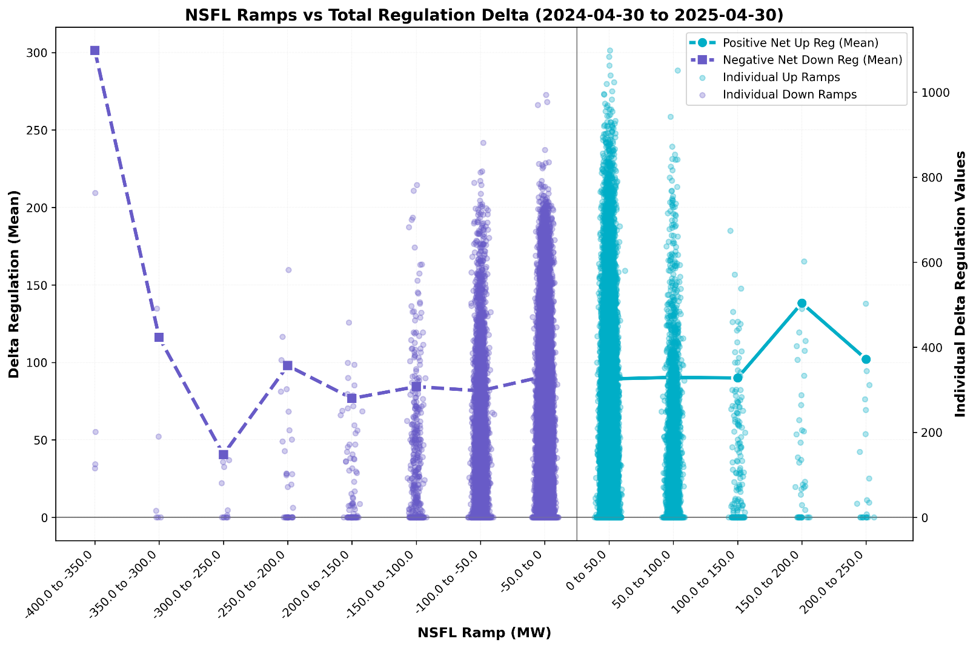
Large Load Ramping vs Total Regulation Deployment
This chart plots the 10-minute total regulation deployment corresponding with 1-minute NSFL Ramp buckets.
The change in regulation deployment (Delta Reg) can be used as an indicator of regulation usage for NSFL Ramps.
Delta Reg Down Ramps = Reg Up Recall + Reg Down Deployment
Delta Reg Up Ramps = Reg Down Recall + Reg Up Deployments
Key Takeaway: The largest Delta Regulation values fall in the smaller ramp buckets. There many factors on the grid which may cause regulation usage, but NSFL ramping can be one component.

Slide 58
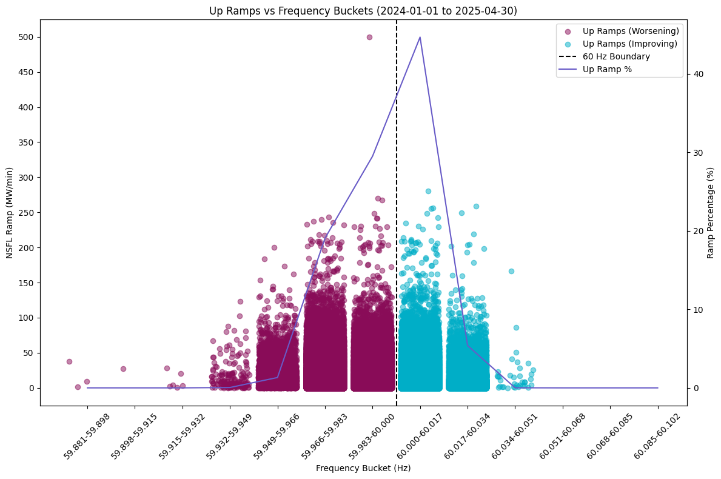
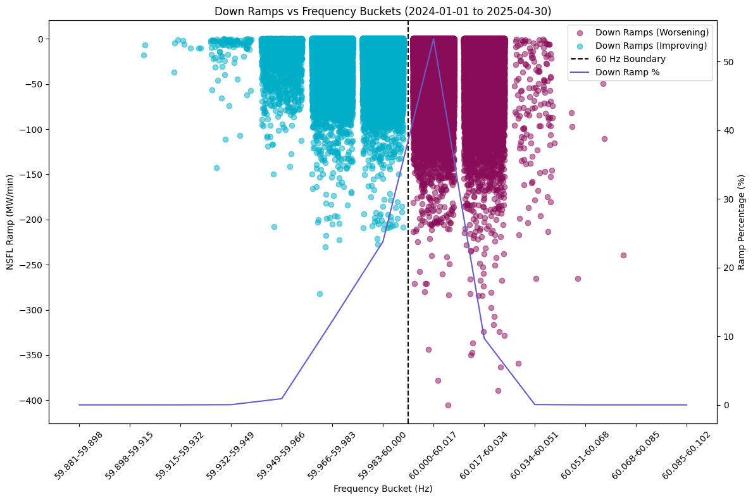
NSFL Ramp by Frequency Bins
These charts show 1-minute NSFL Ramps in both directions plotted in frequency buckets representing the system frequency at the time of the ramp.
Ramps in the opposite direction of frequency will impact regulation usage.
Smaller ramps are generally less of a reliability risk but may consume regulation intended for net load ramping.

Slide 59
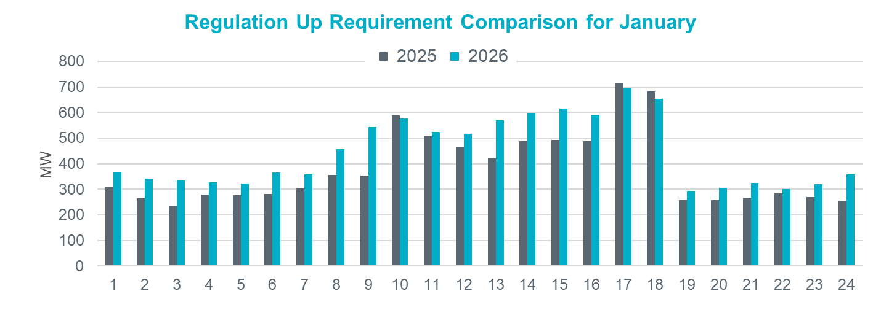
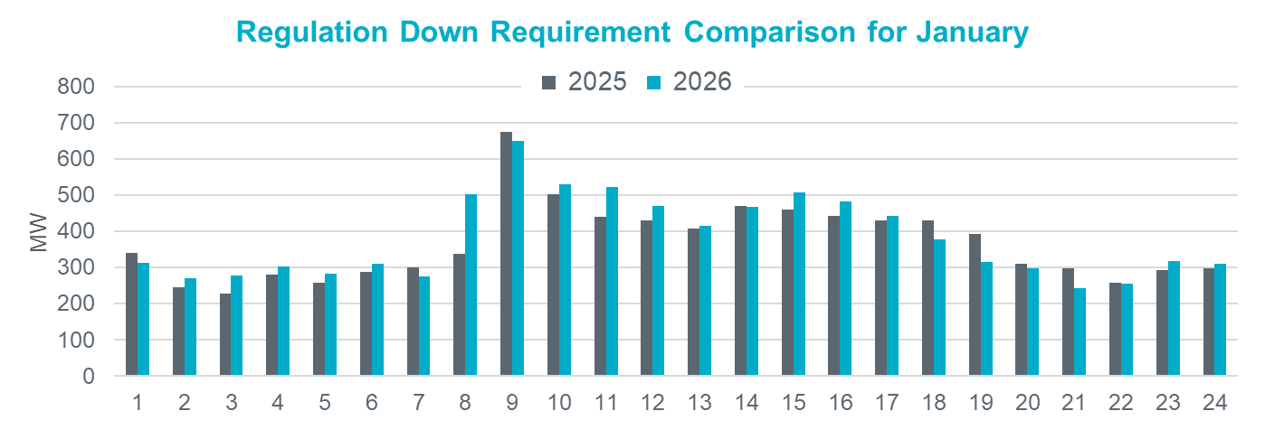
Regulation Comparison January
2026 Reg-Up:
Range: 294 – 694 MW;
Avg: 445 MW (66 MW increase from prev. year)
2026 Reg-Down:
Range: 243 – 649 MW;
Avg: 381 MW (14 MW increase from prev. year)

Slide 60
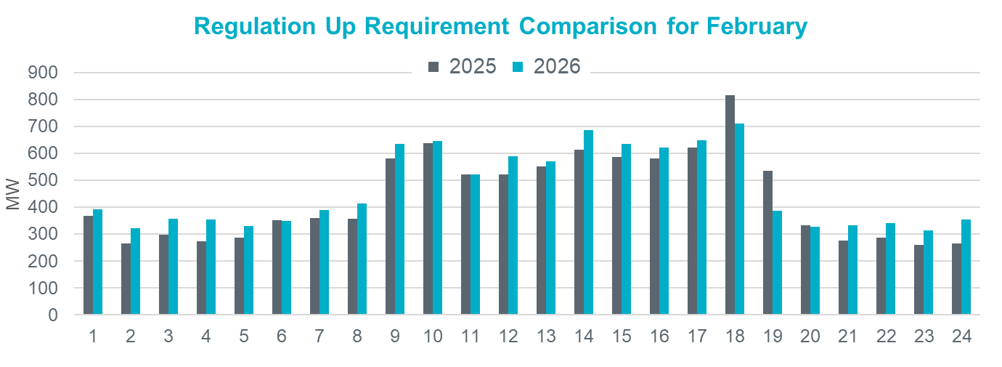
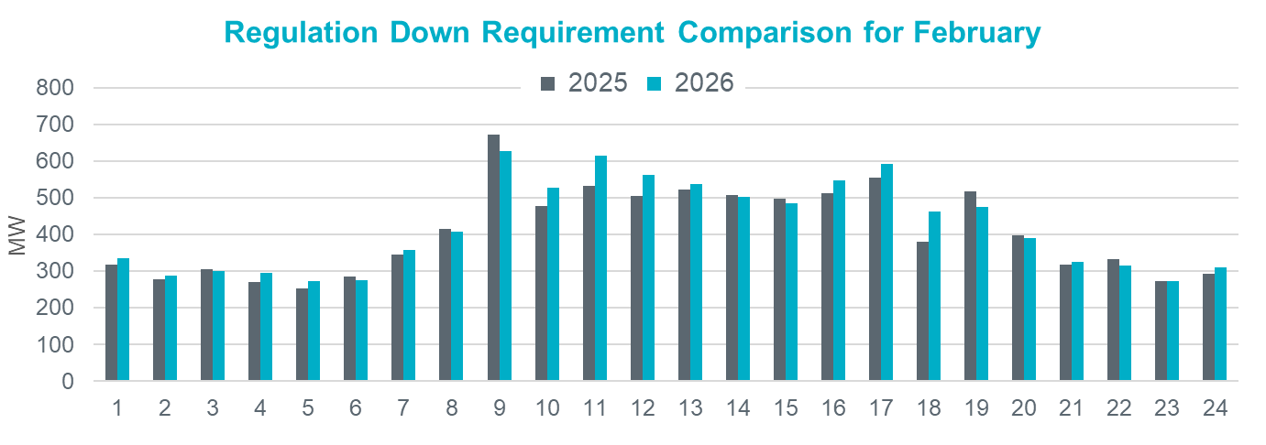
Regulation Comparison February
2026 Reg-Up:
Range: 313 – 711 MW;
Avg: 468 MW (28 MW increase from prev. year)
2026 Reg-Down:
Range: 272 – 627 MW;
Avg: 420 MW (14 MW increase from prev.
year)

Slide 61


Regulation Comparison March
2026 Reg-Up:
Range: 292 – 896 MW;
Avg: 540 MW (78 MW increase from prev. year)
2026 Reg-Down:
Range: 286 – 687 MW;
Avg: 453 MW (21 MW increase
from prev. year)

Slide 62


Regulation Comparison April
2026 Reg-Up:
Range: 314 – 891 MW;
Avg: 551 MW (93 MW increase
from prev. year)
2026 Reg-Down:
Range: 279 – 657 MW;
Avg: 483 MW (42 MW increase
from prev. year)

Slide 63


Regulation Comparison May
2026 Reg-Up:
Range: 304 – 944 MW;
Avg: 546 MW (84 MW increase from prev. year)
2026 Reg-Down:
Range: 261 – 728 MW;
Avg: 497 MW (68 MW increase
from prev. year)

Slide 64


Regulation Comparison June
2026 Reg-Up:
Range: 367 – 857 MW;
Avg: 576 MW (124 MW increase from prev. year)
2026 Reg-Down:
Range: 234 – 694 MW;
Avg: 467 MW (47 MW increase
from prev. year)

Slide 65


Regulation Comparison July*
2026 Reg-Up:
Range: 336 – 820 MW;
Avg: 526 MW (102 MW increase from prev. year)
2026 Reg-Down:
Range: 218 – 659 MW;
Avg: 442 MW (53 MW increase
from prev. year)

Slide 66
Responsive Reserve Service

Slide 67
Responsive Reserve Service (RRS) Methodology
NERC’s preliminary BAL-003 Interconnection Frequency Response Obligation (IFRO) assessment for ERCOT for the 2026 Operating Year (OY) has not yet been published. Therefore, this analysis used the minimum RRS-PFR limit of 1,365 MW for 2025.
The preliminary RRS quantities for January 2026 through May 2026 in subsequent slides have been computed using 2024 and 2025 system inertia conditions and 2025 RRS table.
  The RRS table tracks RRS requirements for different inertia conditions. This table uses a minimum RRS-PFR limit of 1,365 MW for 2025, and the table will be updated for 2026.

Slide 68
2025 RRS Table
Scenario | 1 | 2 | 3 | 4 | 5 | 6 | 7 | 8 | 9 | 10 | 11 | 12
LR/PFR | 2.35:1 | 2.2:1 | 2.06:1 | 1.94:1 | 1.83:1 | 1.74:1 | 1.65:1 | 1.58:1 | 1.51:1 | 1.44:1 | 1.39:1 | 1.33:1
Inertia (GW∙s) | 130 | 140 | 150 | 160 | 170 | 180 | 190 | 200 | 210 | 220 | 230 | 240
PFR Req. (no LR) (MW) | 5,960 | 5,563 | 5,200 | 4,892 | 4,622 | 4,329 | 4,114 | 3,920 | 3,744 | 3,522 | 3,314 | 3,139
*RRS Curr IFRO (MW) | 3,320 | 3,273 | 3,227 | 3,183 | 3,145 | 3,068 | 3,031 | 2,982 | 2,941 | 2,863 | 2,767 | 2,699
**RRS Upd IFRO (MW) | - | - | - | - | - | - | - | - | - | - | - | -
Scenario | 13 | 14 | 15 | 16 | 17 | 18 | 19 | 20 | 21 | 22 | 23 | 24 | 25
LR/PFR | 1.28:1 | 1.24:1 | 1.19:1 | 1.15:1 | 1.12:1 | 1.08:1 | 1.04:1 | 1.01:1 | 1:1 | 1:1 | 1:1 | 1:1 | 1:1
Inertia (GW∙s) | 250 | 260 | 270 | 280 | 290 | 300 | 310 | 320 | 330 | 340 | 350 | 360 | 370
PFR Req. (no LR) (MW) | 3,004 | 2,890 | 2,784 | 2,686 | 2,595 | 2,510 | 2,421 | 2,353 | 2,290 | 2,230 | 2,173 | 2,119 | 2,068
*RRS Curr IFRO (MW) | 2,645 | 2,595 | 2,558 | 2,514 | 2,463 | 2,425 | 2,380 | 2,343 | 2,290 | 2,230 | 2,173 | 2,119 | 2,068
**RRS Upd IFRO (MW) | - | - | - | - | - | - | - | - | - | - | - | - | -
*RRS quantity is calculated for RCC of 2,805 with limit of 60% limit on LRs and min RRS-PFR limit of 1,365 MW.
**The 2026 IFRO assessment has not yet been reported back from NERC, preventing the calculation of RRS quantity.
***Red font in table above identifies study scenario where RRS needed < 2,300 MW. RRS requirement during these is based on the applicable floor.

Slide 69

Total Inertia (2015 – 2025.07*)
The average inertia in 2024 and 2025 is comparable to 2023.
[Total inertia for 2015 - 2025.07*]

Slide 70

RRS Comparison January
2026 RRS:
Range: 2,558 – 2,767 MW;
Avg: 2,680 MW (212 MW decrease from prev. year)
*2026 RRS quantities are calculated using the 2025 minimum RRS-PFR limits (to be updated).

Slide 71

RRS Comparison February
2026 RRS:
Range: 2,941 – 3,068 MW;
Avg: 3,020 MW (53 MW decrease from prev. year)
*2026 RRS quantities are calculated using the 2025 minimum RRS-PFR limits (to be updated).

Slide 72

RRS Comparison March
2026 RRS:
Range: 2,982 – 3,183 MW;
Avg: 3,111 MW (46 MW increase from prev. year)
*2026 RRS quantities are calculated using the 2025 minimum RRS-PFR limits (to be updated).

Slide 73

RRS Comparison April
2026 RRS:
Range: 2,863 – 3,145 MW;
Avg: 3,039 MW (6 MW decrease from prev. year)
*2026 RRS quantities are calculated using the 2025 minimum RRS-PFR limits (to be updated).

Slide 74

RRS Comparison May
2026 RRS:
Range: 2,558 – 2,699 MW;
Avg: 2,649 MW (14 MW increase from prev. year)
*2026 RRS quantities are calculated using the 2025 minimum RRS-PFR limits (to be updated).

Slide 75

RRS Comparison June
2026 RRS:
Range: 2,425 – 2,595 MW;
Avg: 2,518 MW (78 MW increase from prev. year)
*2026 RRS quantities are calculated using the 2025 minimum RRS-PFR limits (to be updated).

Slide 76

RRS Comparison July*
2026 RRS:
Range: 2,380 – 2,463 MW;
Avg: 2,430 MW (34 MW increase from prev. year)
*2026 RRS quantities are calculated using the 2025 minimum RRS-PFR limits (to be updated).

