Slide 1

TDTMS Update
Leadership 2025:
Chair - Sheri Wiegand, Vistra
Co-Vice Chairs – Monica Jones, CNP
Sam Pak, Oncor
RMS
August 5th, 2025

Slide 2
TDTMS
ERCOT Report
System Instances – All Retail market SLAs for June met. MarkeTrak performance remains well within SLO. MarkeTrak volumes remain relatively flat.
ERCOT Projects
MIS API – still early stages of development; consolidation of operations; consistent “look and feel” with ERCOT platforms; retail API and MT API will be impacted; expected development by EOY
NAESB upgrade – ERCOT will be contacting service providers and trading partners requesting 1 ‘dummy’ file and 1 large file (IDR) to be sent as a test
MT & Siebel upgrade – all internal upgrade; nothing external to market partners

Slide 3
TDTMS
Biennial TAC Structural and Review
The working group performed an assessment of our scope and procedures to see if efficiencies could be found, along with TAC leadership, in an effort ensure the working group can be more effective.
TDTMS performed a review of the questions posed by TAC as part of the biennial review process and as a result will be updating TDTMS’ scope.

Slide 4
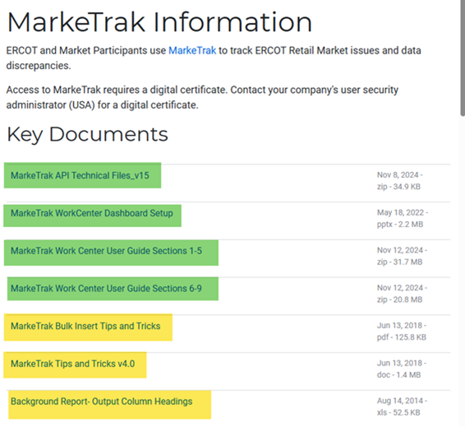
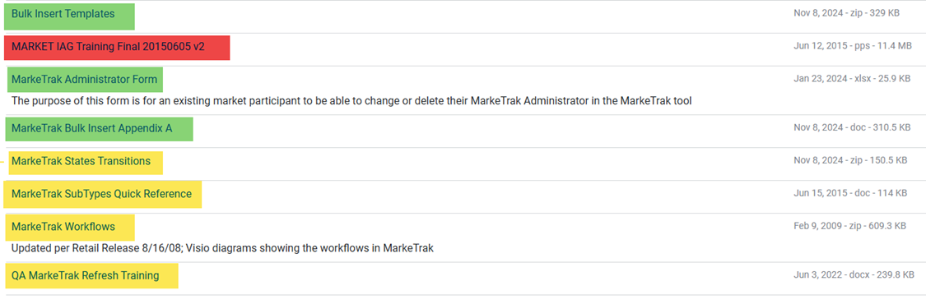
TDTMS
MarkeTrak Information Page
TDTMS will determine the documents to remain, those to be reviewed/revised, and those to be removed.
Additionally, we requested the following be removed:
• MarkeTrak Tips and Tricks v4.0 dated 6/13/2018
• MARKET IAG Training Final 20150605 v2 dated 6/12/2015

Slide 5
TDTMS
Next Meeting – August 19, 2025
DRAFT Agenda:
System Instances & MT Performance
Extended Release - July
MIS – Retail API & UI
MarkeTrak Information Page
ERCOT Reports
Listserv
Enhancements – reject code listing in MIS, ESI in MT escalation email
Follow up on Action Items
TDTMS Scope – review of draft revisions
•Bulk Insert Tips and Tricks
Background Reporting Column Headings
Subtype Quick Reference Guide
MarkeTrak Subtype Volumes – further deep dive

