Slide 1
RTC+B Task Force &
Market Trials Update
Matt Mereness
TWG
July 31, 2025

Slide 2
Outline
Update on RTCBTF Issues List
Update on RTC NPRRs
Scope of RTC+B
Market Trials Update
  Phase 1 Scorecards (3 slides)
  Phase 2 began 7/7/25 (18 slides in 10-minute flyover)
Next Steps

Slide 3
RTCBTF Issues List
Revisions- Final Clean-Up NPRR1290 & NOGRR278 (September)
Implementation - Handbooks complete and initiating transition plan details
Market Trials

Slide 4
Summary and Timeline of NPRRs
NPRRs approved at PUCT May 15 Open Meeting
  NPRR1268 for ASDC Modifications (IMM sponsor)
  NPRR1269 for 3 Parameter/Policy Changes (ERCOT sponsor)
  NPRR1270 for AS Qualification details (ERCOT sponsor)
AS Duration / State of Charge (NPRR1282 / NOGRR277)
  Began discussion March 25 June Board approval
  PUCT July 31 consideration
Final Clarifying Revisions – NPRR1290/NOGRR278 (Sept Board)
  NPRR1290 included Hunt Energy revisions for post go-live and approved at PRS (unanimous)
  Sept Board meeting consideration
Remaining Stakeholder path to Board Meetings before Go-Live:
  PRS Aug 13 > TAC Aug 27 > Board Sep 23
Note that ERCOT filed Good Cause Exception with PUCT for Closed-Loop LFC Test(s)
  Exception for ERCOT to not charge for Base Point Deviation Charges during RTC+B LFC test

Slide 5
RTC+B Scope
Final 2025 Refinements for Go-Live
Related NPRRs
within Program

Slide 6
Sequence and Dates for Market Trials to Go-Live
Market trials are a progression of activities to mitigate the risk for Go-Live on new systems and processes for both the Market Participants & ERCOT.
30-day Market Notice
11/5/25
March/April
2025
Start
5/5/25
Start
7/7/25
Start
9/2/25
Go-Live
12/5/25*
May 2025
June 2025
July 2025
Aug 2025
Sep 2025
Oct 2025
Nov 2025
Dec 2025
QSE Scorecards & Exit Criteria for each Trial Phase
#1 RTC QSE Submission Testing
(Submit COP, RT AS Offers,
DAM Virtual AS, Outages for ESRs)
#3 Open-loop RTC SCED
(QSE offers, SCED non-binding award/dispatch)
#5 Ongoing Open-Loop
& Periodic Closed-loop SCED/LFC
(QSE RTC offers and telemetry to support closed-loop frequency control test 2-3 tests of 2-4 hour durations)
Transition to Go-Live
Upon completion of testing, confirmation of ERCOT and market readiness for Go-Live.
QSE/Vendor Submission Sandbox and Telemetry Points added Prod EMS model.
#2 RTC QSE Telemetry Checkout (QSEs add/verify new telemetry points for UDSP, New ramp rates, ESR telemetry)
#4 QSE Telemetry Tests
(Individual QSE to follow UDSP and support new ramp rate and ESR telemetry)
#6 Day-Ahead Market
(Non-binding DAM using QSE offers for at least 2 tests)
* Go-Live date reflects 12/5/2025 as first Operating Day
where 12/4/2025 is planned software migration.

Slide 7
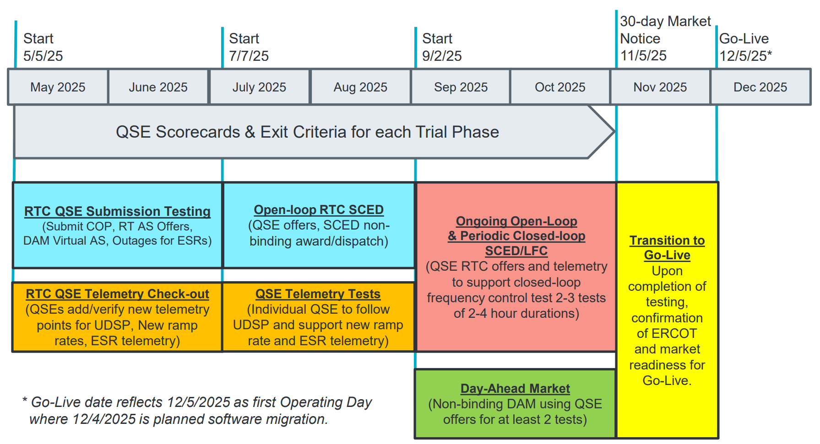
May & June:
Establishing Connectivity
QSE will test their market submissions for defined subset transactions that are new or modified by RTC+B.
Scorecard goal is for 95% of QSEs to demonstrate successful submissions and have mitigation plans in place for remaining 5% to address in next trial phase.
QSE will add telemetry points for Energy Management System (EMS) system interface with ERCOT (such as Updated Desired Set Points (UDSP), New Ramp Rates, and ESR Telemetry)
Scorecard goal is for 98% of QSEs to demonstrate successful telemetry additions, and mitigation plans in place for remaining 2% to address in next trial phase. (Note 3-week lag in telemetry migrating through network model validation and into trials environment).

Slide 8
July & August:
Initial Real-Time Market execution and verify QSE ability to follow ERCOT frequency signals
QSE will support “parallel production” 2days/week by entering $bids/offers for non-binding RTC energy and A/S awards and dispatch (Open-loop test)
Scorecard goal for 100% of QSEs to demonstrate successful submissions and telemetry reflective of production, and mitigation plans in place for any outliers.
Coordination of individual QSE tests on subset of resources to ensure resources can follow new UDSP telemetry point from ERCOT.
Scorecard goal is for 98% of QSEs to successfully demonstrate, and mitigation plans in place for remaining 2% to address in next trial phase.

Slide 9
Sep & Oct:
Required live-production test to ensure effective frequency dispatch and control.
Sep & Oct:
Optional Day-Ahead Market
Voluntary Day-Ahead Market for all QSEs will be conducted at least 2 times.
QSE can test their market submissions for Day-Ahead AS Self-Arrangement, AS Only Offers, Trades and normal submissions.
DAM participation is strongly encouraged but not required in Readiness metrics since RTC procures AS in Real-Time.
Participation includes much broader QSE population (marketers and load-only QSEs).
ERCOT and QSEs will conduct live-production tests of RTC-SCED and Load Frequency Control (LFC) prior to go-live.
RTC-SCED and frequency control dispatch during the tests will be binding to manage the reliable operations of the grid for2-4 hours.
ERCOT will coordinate with QSEs on how to submit RTC offers and telemetry for Energy and AS for the two systems (current and RTC system).
ERCOT will provide a summary of the test and use analysis and engineering judgement to assess if the test was successful in controlling frequency.

Slide 10
Weekly Market Trials update
Trials meeting every Monday 10-10:30am until December
  Standalone calendar page each week with WebEx
    RTCBTF Home Page houses all market trials documentation
  Averaging 150-175 participants
  Weekly presentation walk-through with Q&A
Highlights of weekly Market Trials on following slides
  Phase 1 May/June Scorecards (next 4 slides)
  Phase 2 July/Aug began 7/7/25 (next 18 slides in 10-minute flyover)

Slide 11
MAY AND JUNE TRIALS WERE COMPLETED SUCCESSFULLY
Thank you! (next 3 slides)

Slide 12
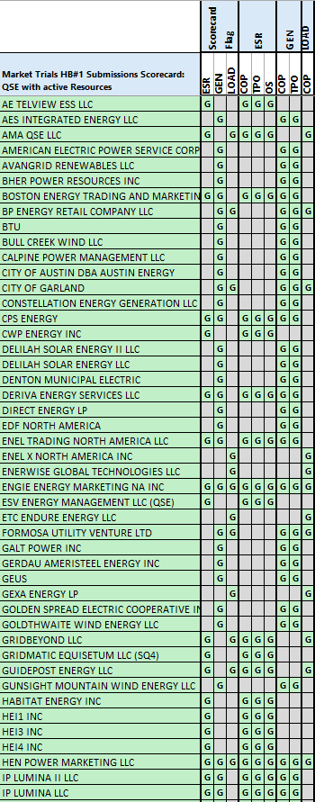
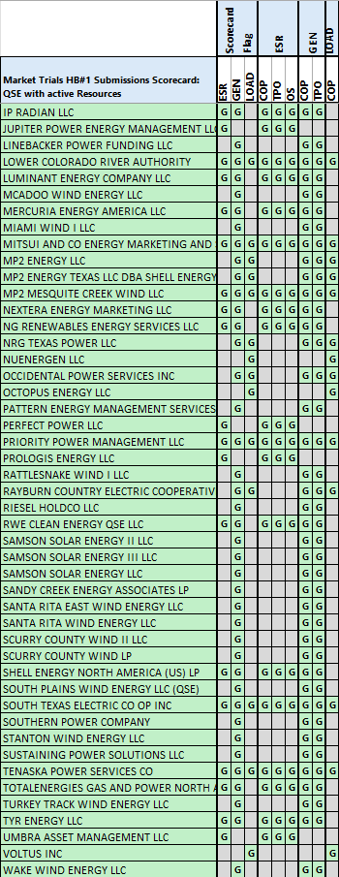
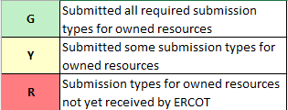
Scorecard 1 for
Handbook 1-
Market submissions:
7/3 Scores for QSEs with Resources – successful submissions for resource types specified in Handbook 1
Scoring: Complete
Complete

Slide 13
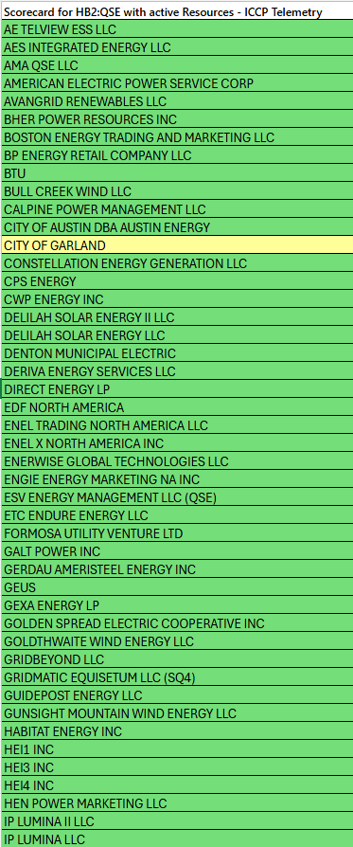
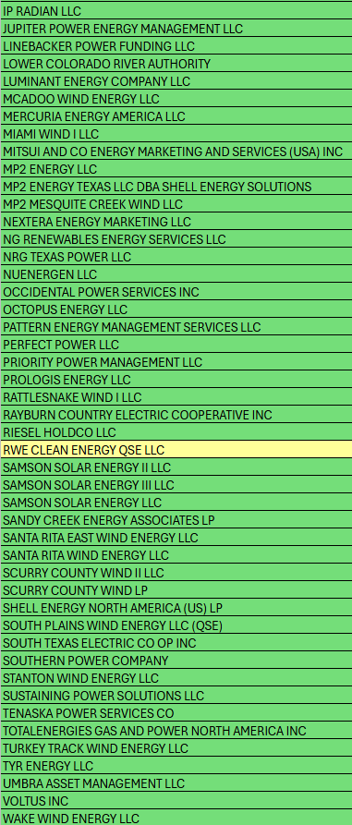
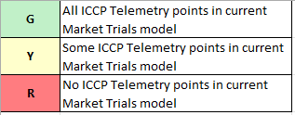
Scorecard 2A for
Handbook 2-
100% of ICCP Telemetry points added by QSE:
7/21 Scores for QSE with Resources - ICCP Telemetry points added in current model.
99.5% of 26k points complete
Last points are identified and are being worked on.
Scoring:

Slide 14
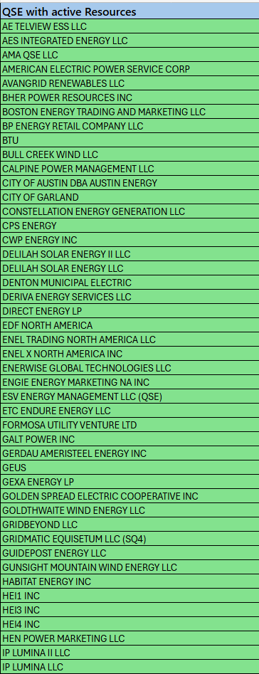
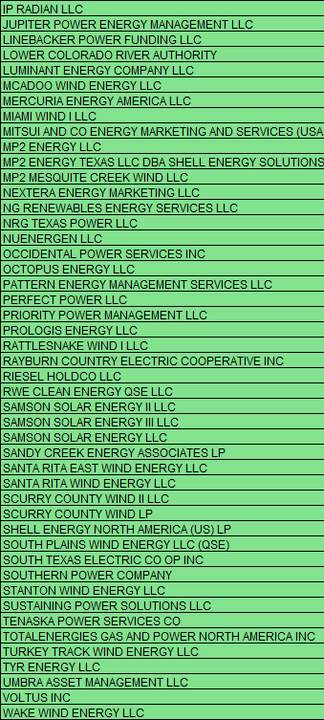
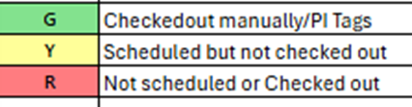
Scorecard 2B for
Handbook 2-
Telemetry checkout meetings completed with ERCOT staff for sample of live data transfer capability
Complete
7/3 Scores for QSEs with Resources – Scheduling Check-out and Check-out complete
Scoring: Complete

Slide 15
JULY/AUGUST TRIALS ARE SUCCESSFULLY UNDERWAY

Slide 16
July/August Market Trials Summary
Handbook #3 - Dual “production-like” data Tue/Thu 9am-5pm
  Market Trials ERCOT/QSE support required for:
    Submissions (TPO/COP/ASOffer etc.) – No outage submissions required
    Telemetry (current and new telemetry points)
    To assist RUC studies, please submit COP, 3PSO, ASOffer through end of OD (midnight)
    Systems will be running 7x24, so submissions encouraged but not required on all days.
Scoring for QSE submissions & telemetry as 2 scorecards for Handbook #3
  All QSEs for all Resources on Monitored Operating Days July 22– Aug 28 every Tue/Thu 9-5
  Green is > 95%
  Yellow is 85% - 95%
  Red is < 85%
  Also an “ERCOT-wide score”
12 OpDays scored in 3a
for market submissions
12 OpDays scored in 3b
for accurate telemetry

Slide 17
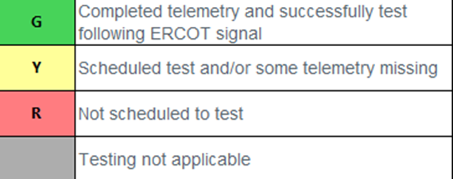
July/August Market Trials Summary
Handbook #4 - Coordinated Individual QSE Tests to follow UDSP
  ERCOT will schedule meetings with QSEs
    Meeting and test not required for “NCLR-only” QSEs
  Please contact ERCOT if you are ready to test in the trials window
  Single successful test for QSE to complete.
    Green is successfully tested
    Yellow is scheduled but not complete
    Red is not scheduled for test
  Also tracking an “ERCOT-wide score” to achieve 98% testing completed by end of August

Slide 18
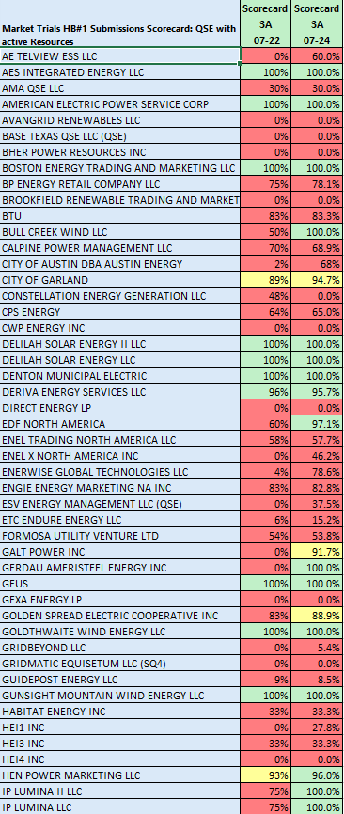
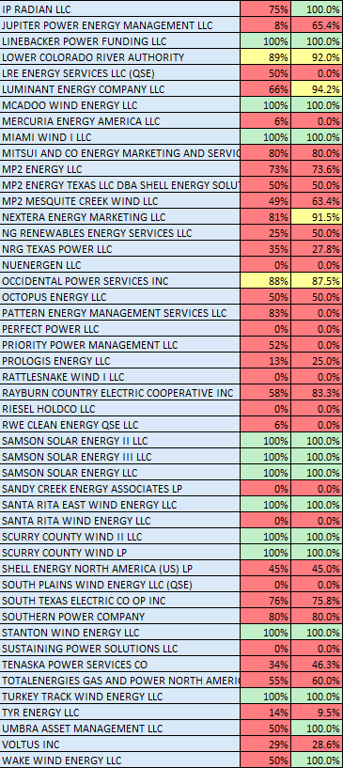
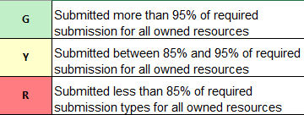
Scorecard 3A for
Handbook 3-
Market submissions:
Scores for QSEs with Resources – Appropriate submissions made for each owned resources.
COP – ALL
TPO – Gen, ESR, CLR
ASO – AS Qualified Resources
Scoring:

Slide 19
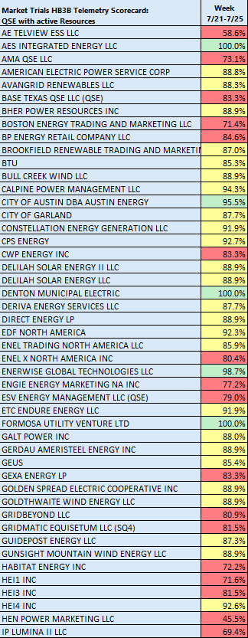
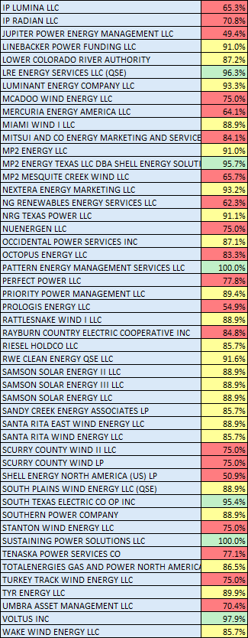
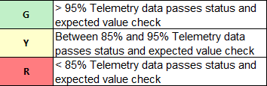
Scorecard 3B for
Handbook 3-
Acceptable Telemetry point values received by ERCOT for active resources.
7/28 Scores for QSE with Resources – Accurate telemetry data sent to ERCOT
Scoring:

Slide 20
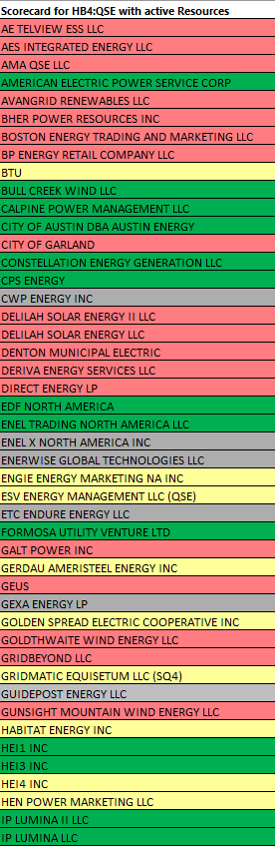
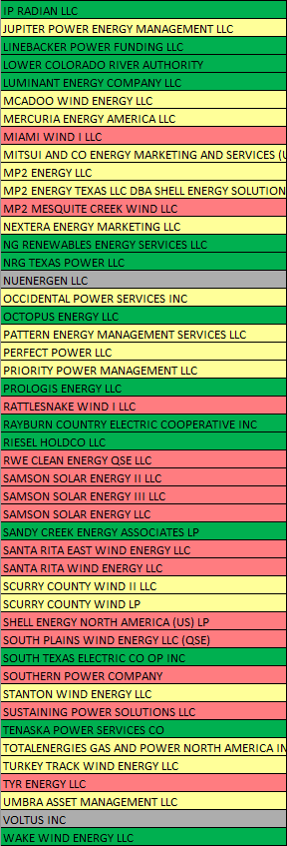

Scorecard 4 for
Handbook 4-
QSEs demonstrate ability to follow UDSP in coordinated test with ERCOT
7/28 UDSP following tests
Scoring:

Slide 21
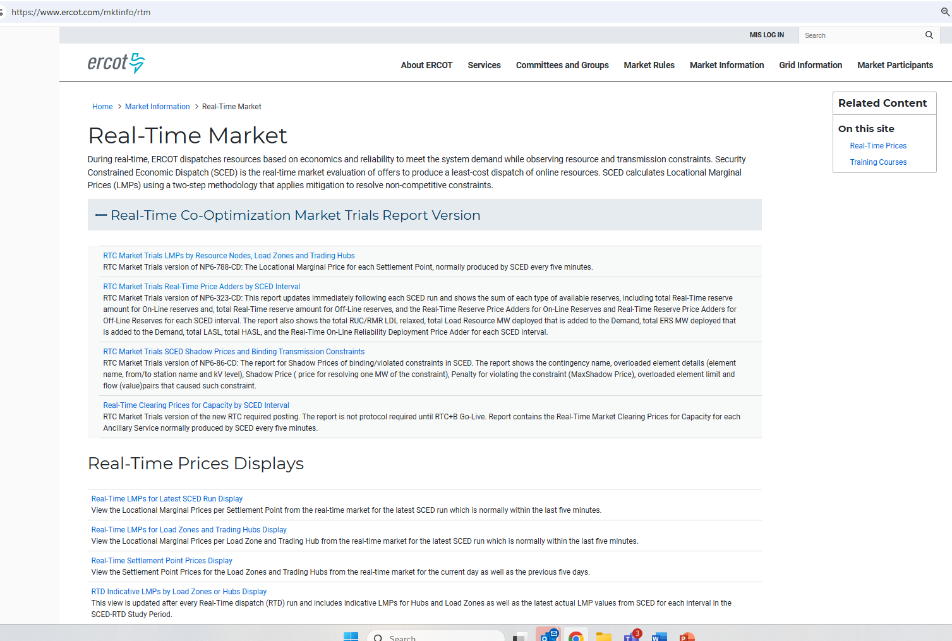
RTC+B New Reports Posted to the ERCOT Website
Links to the available RTC+B versions of Real-Time reports posted on Real-Time Market Information page.

Slide 22
Market Trials OD Summary
07-22-2025 (9am – 5pm)

Slide 23
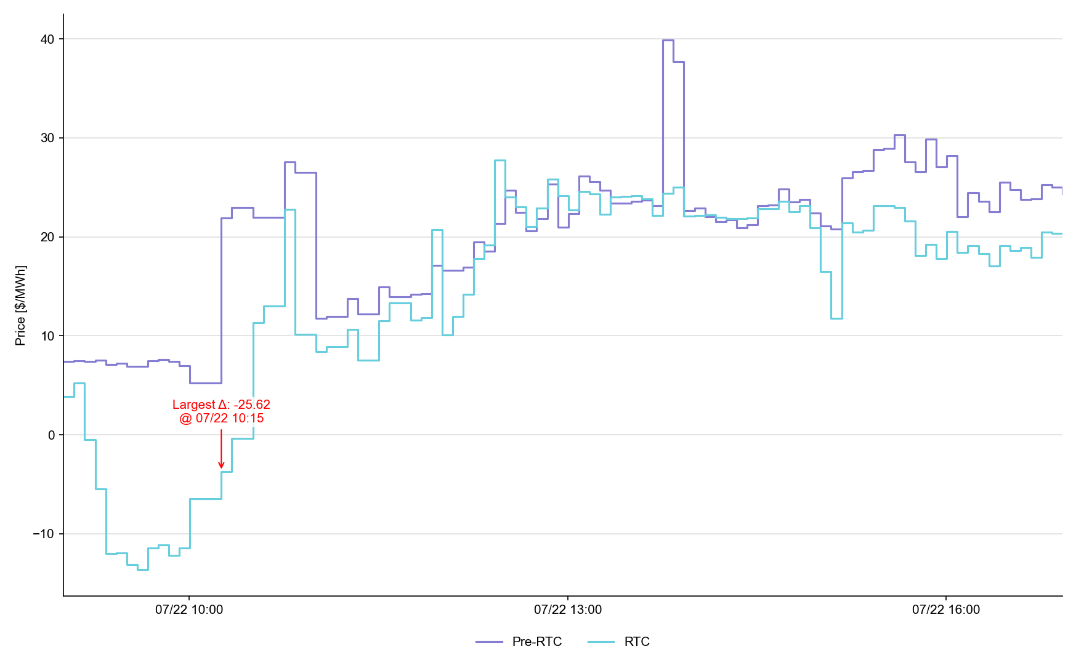
System Lambda (plus Adders)

Slide 24
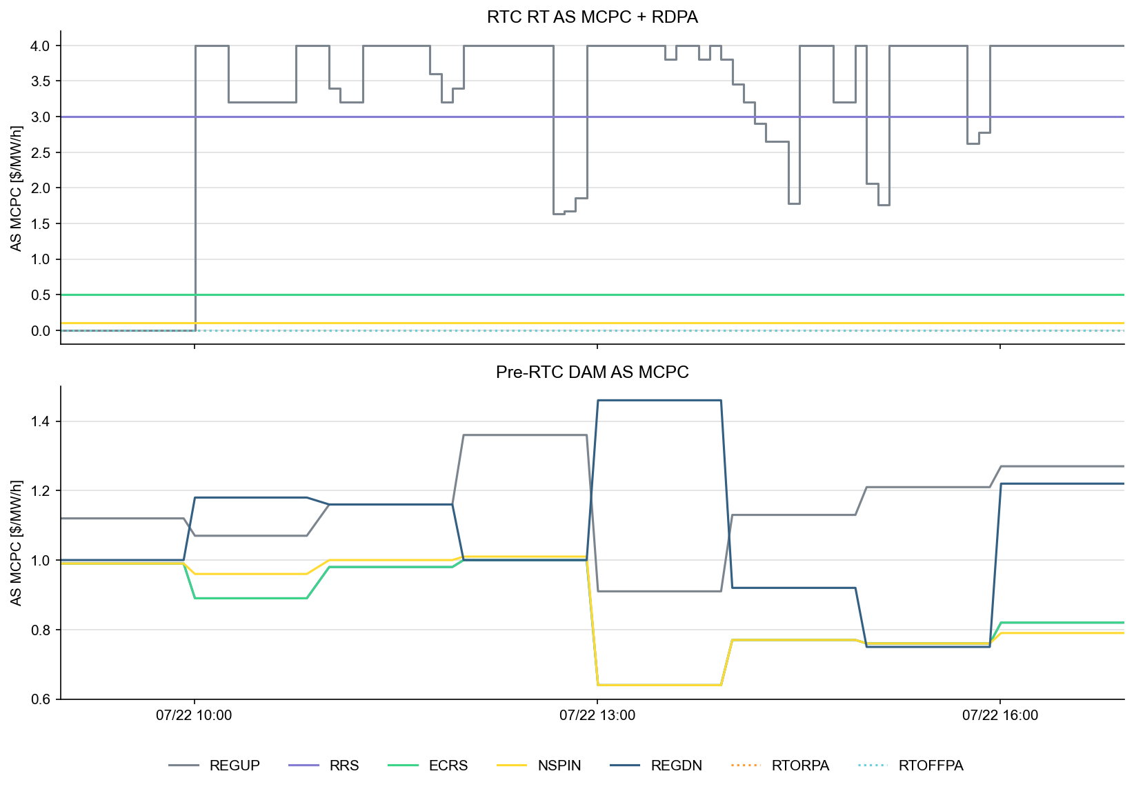
Ancillary Service Prices

Slide 25
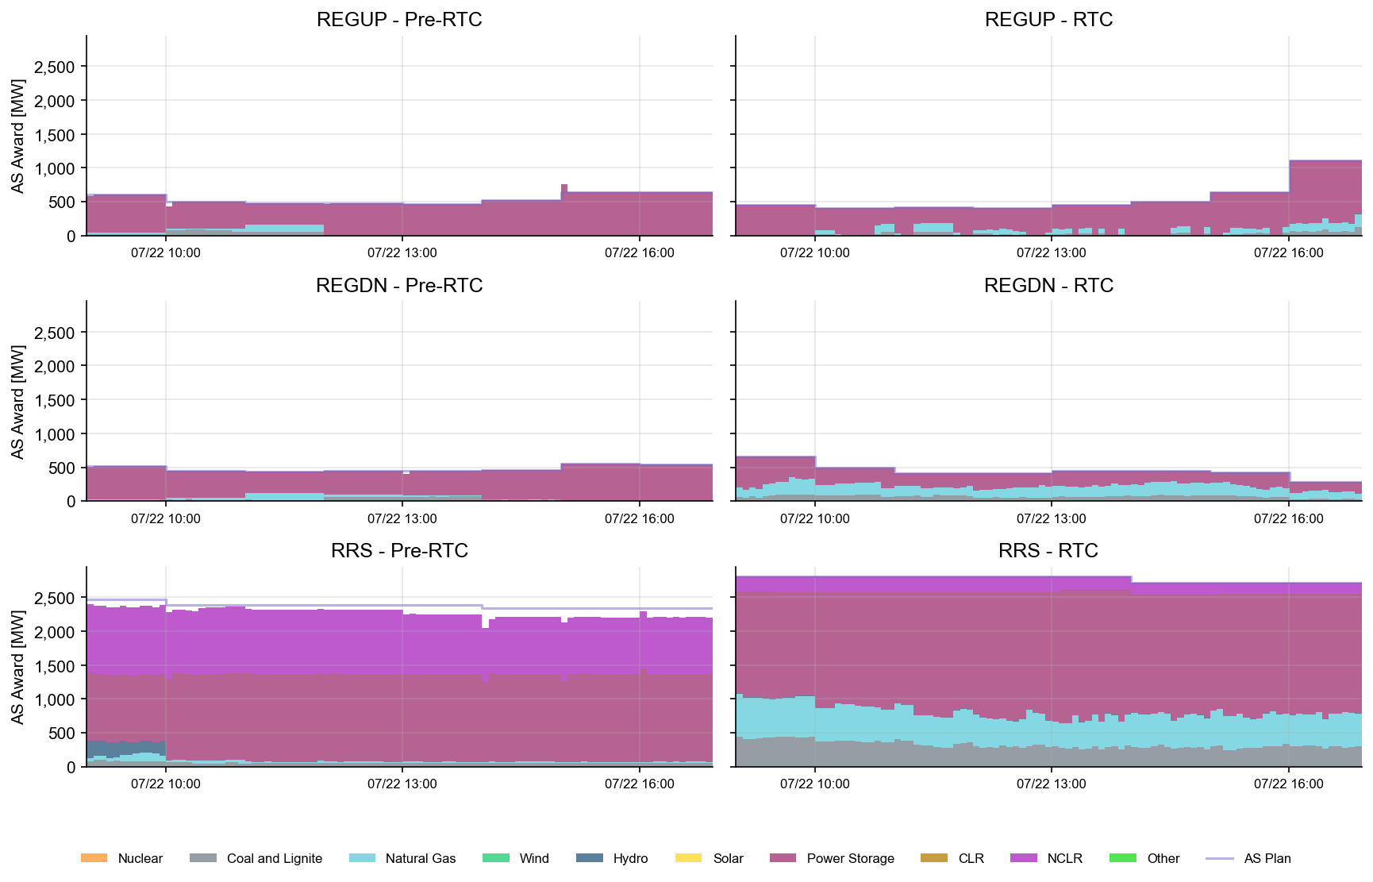
AS Awards* Summary by Resource Type
* Pre-RTC (RTM AS Schedule)

Slide 26
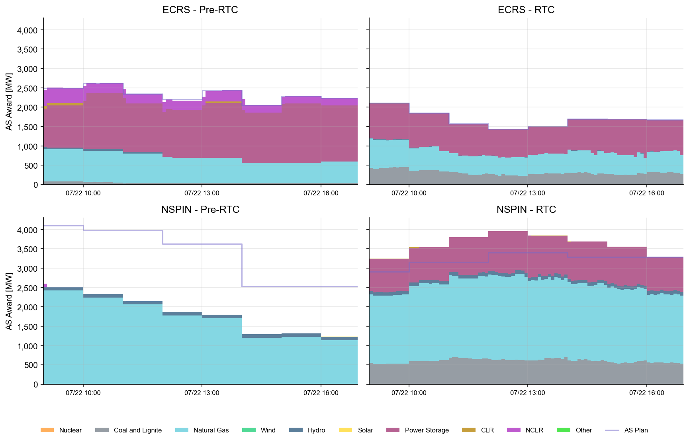
AS Awards* Summary by Resource Type
* Pre-RTC (RTM AS Schedule)

Slide 27
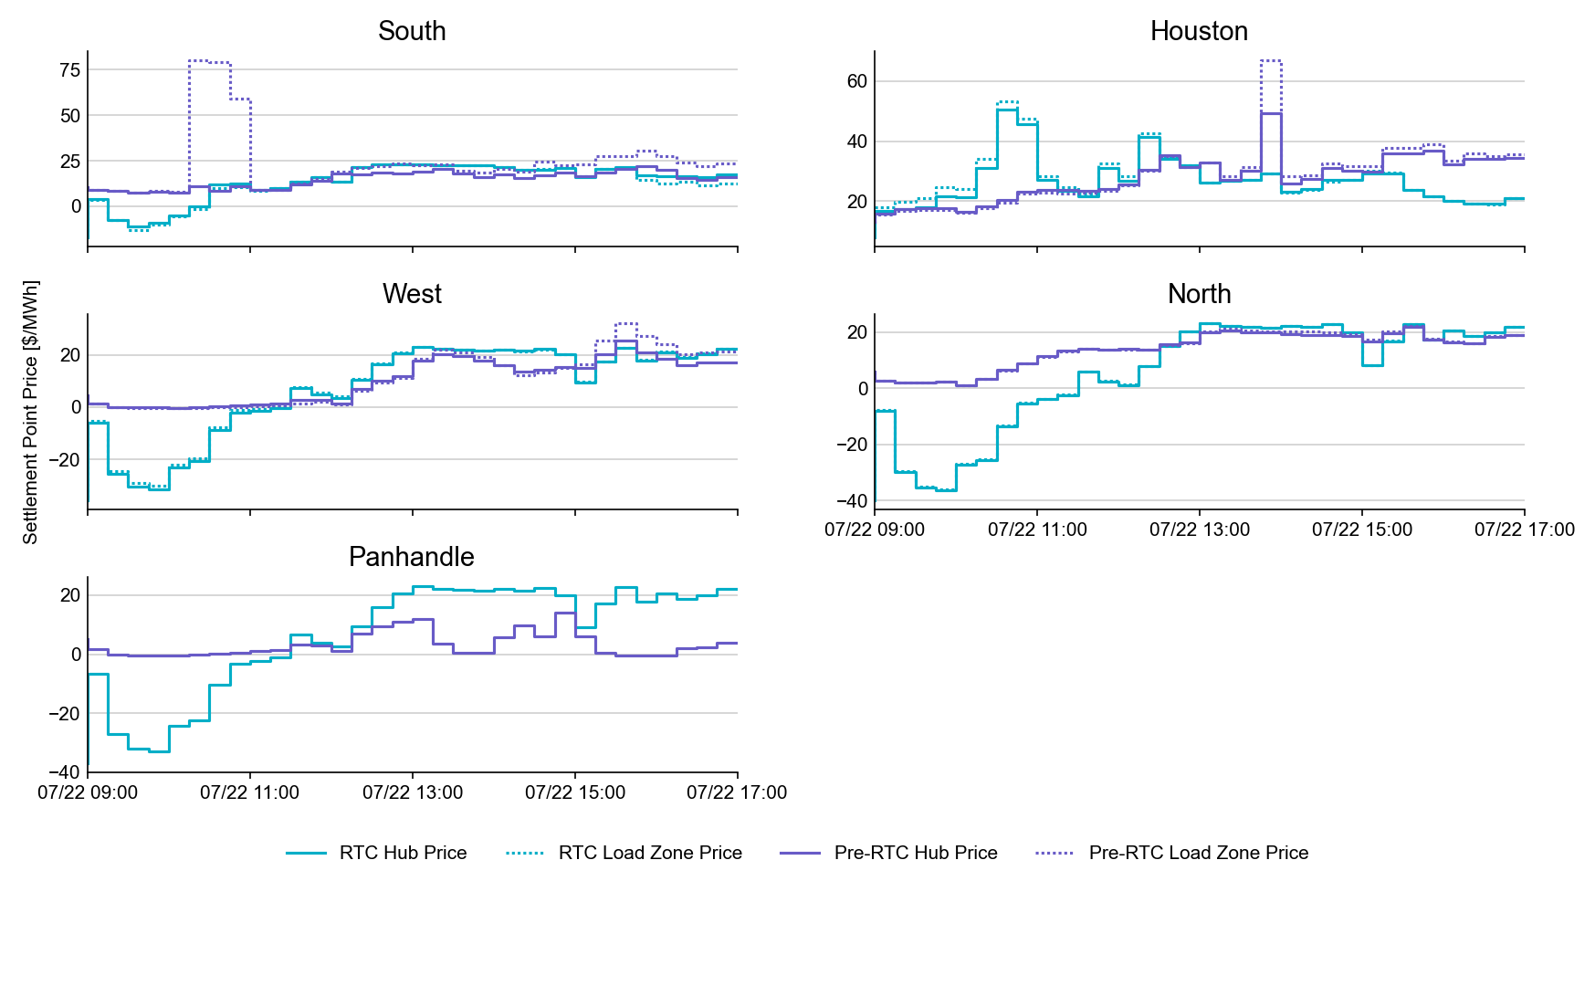
SPP by Hub and Competitive Load Zone

Slide 28
Market Trials OD Summary
07-24-2025 (9am – 5pm)

Slide 29
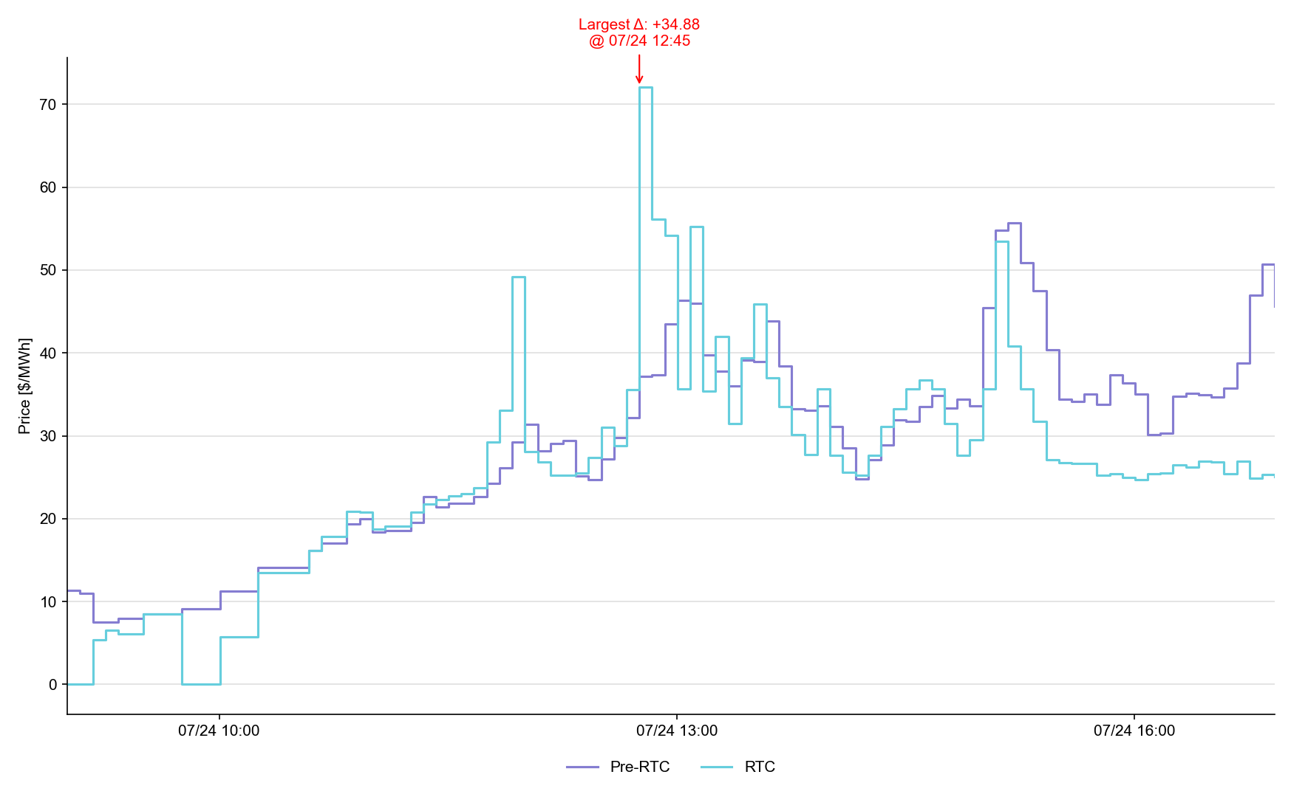
System Lambda (plus Adders)

Slide 30
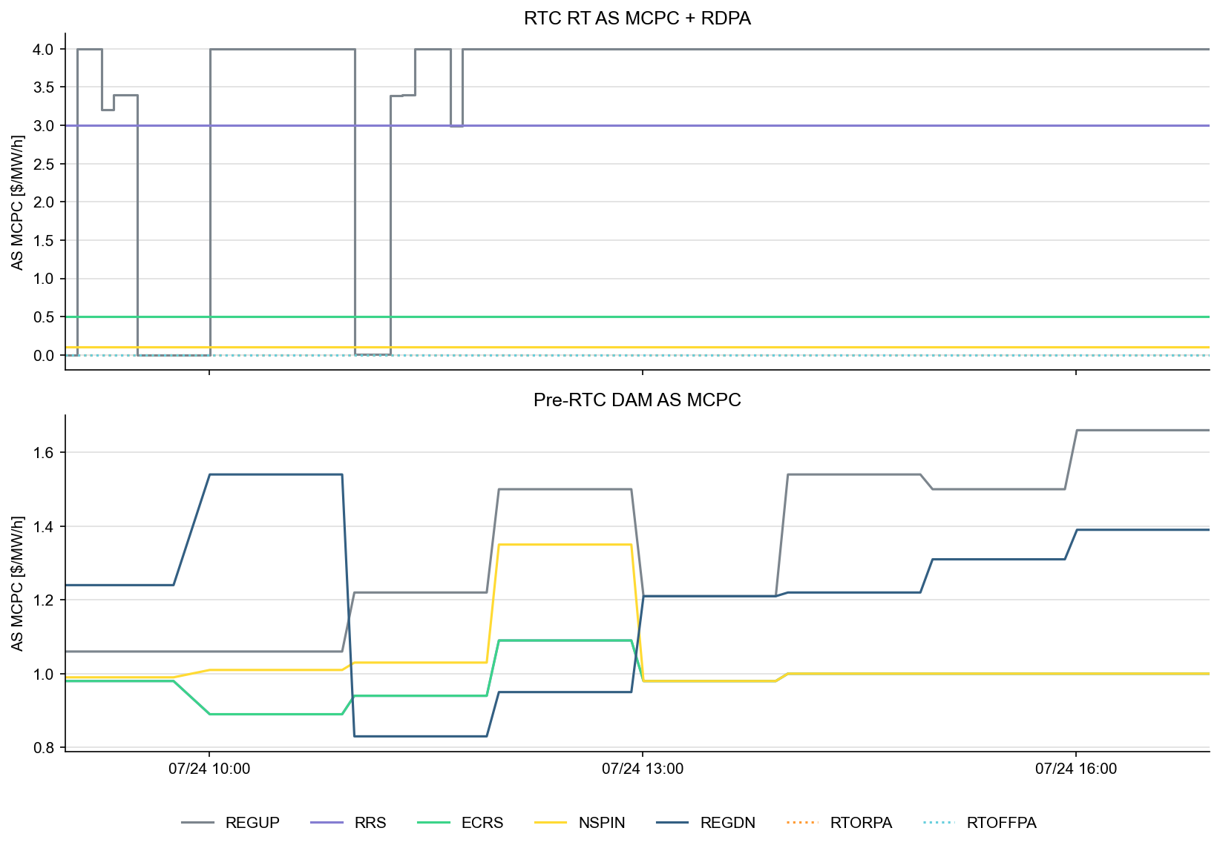
Ancillary Service Prices

Slide 31
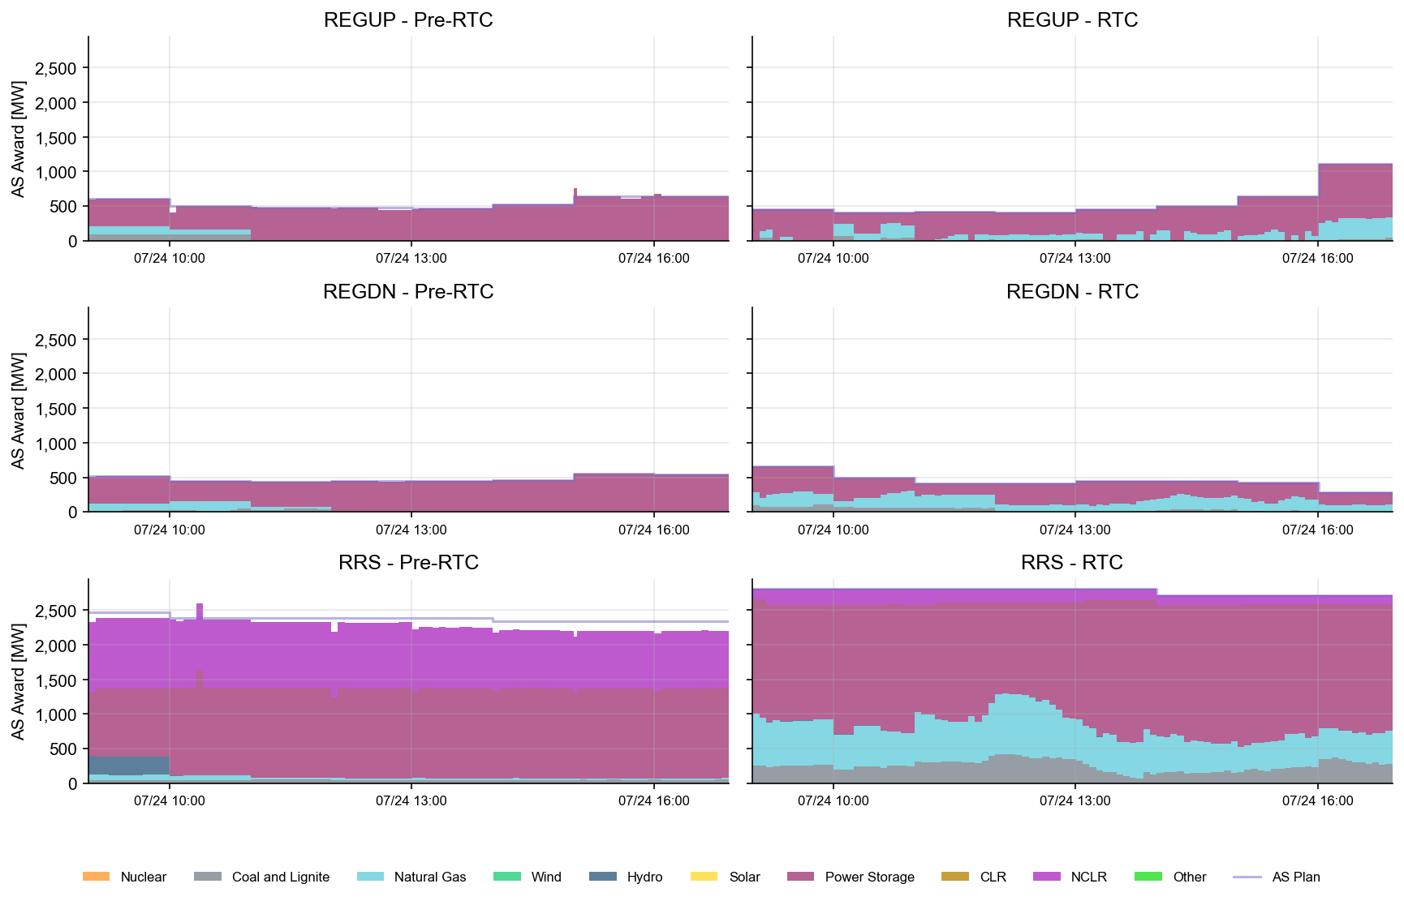
AS Awards* by Resource Type
* Pre-RTC (RTM AS Schedule)

Slide 32
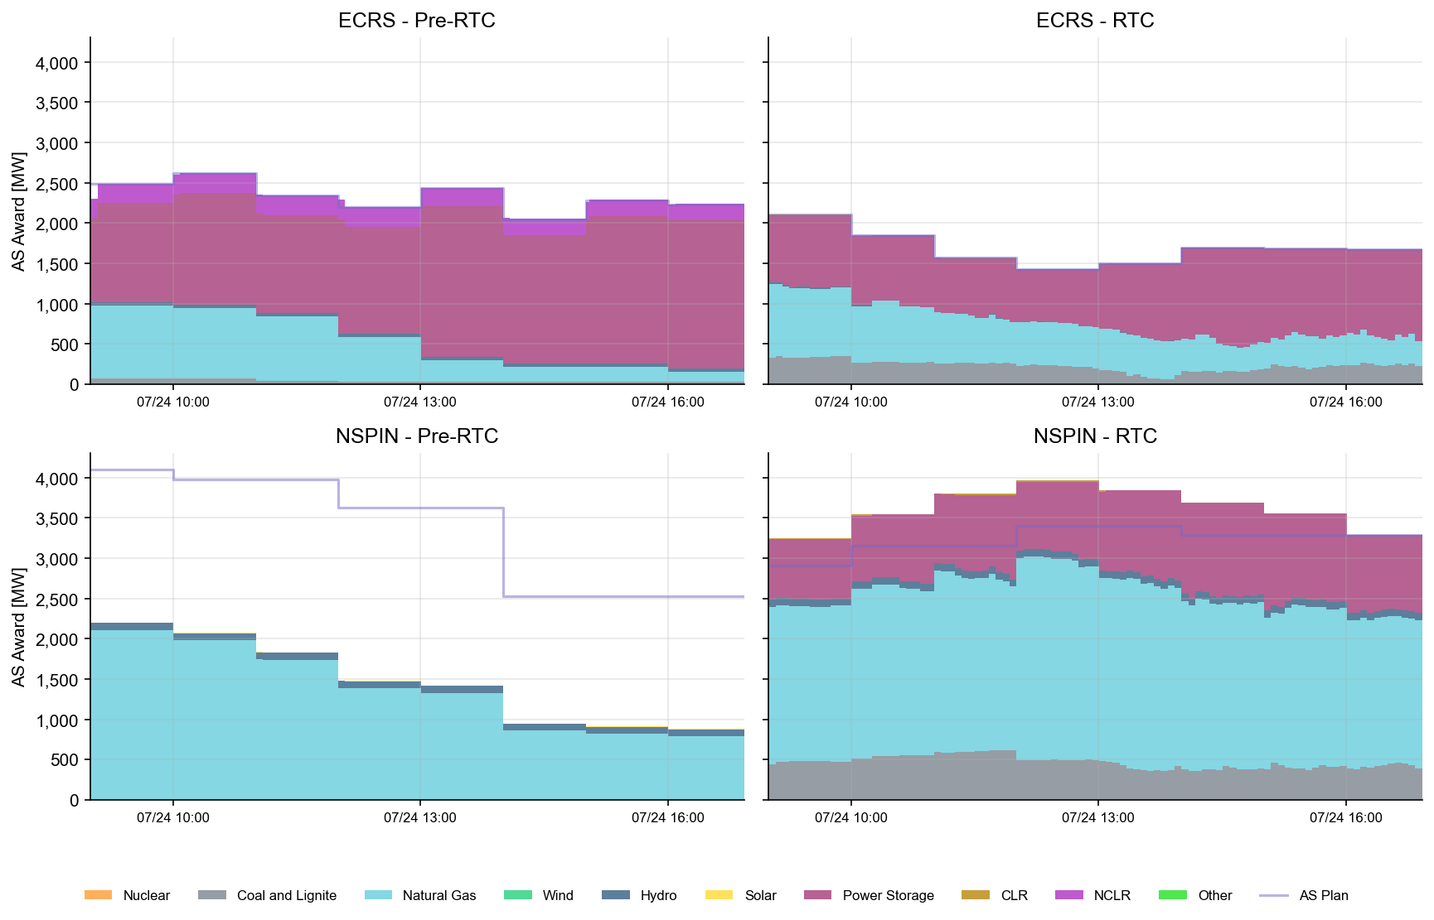
AS Awards* by Resource Type
* Pre-RTC (RTM AS Schedule)

Slide 33
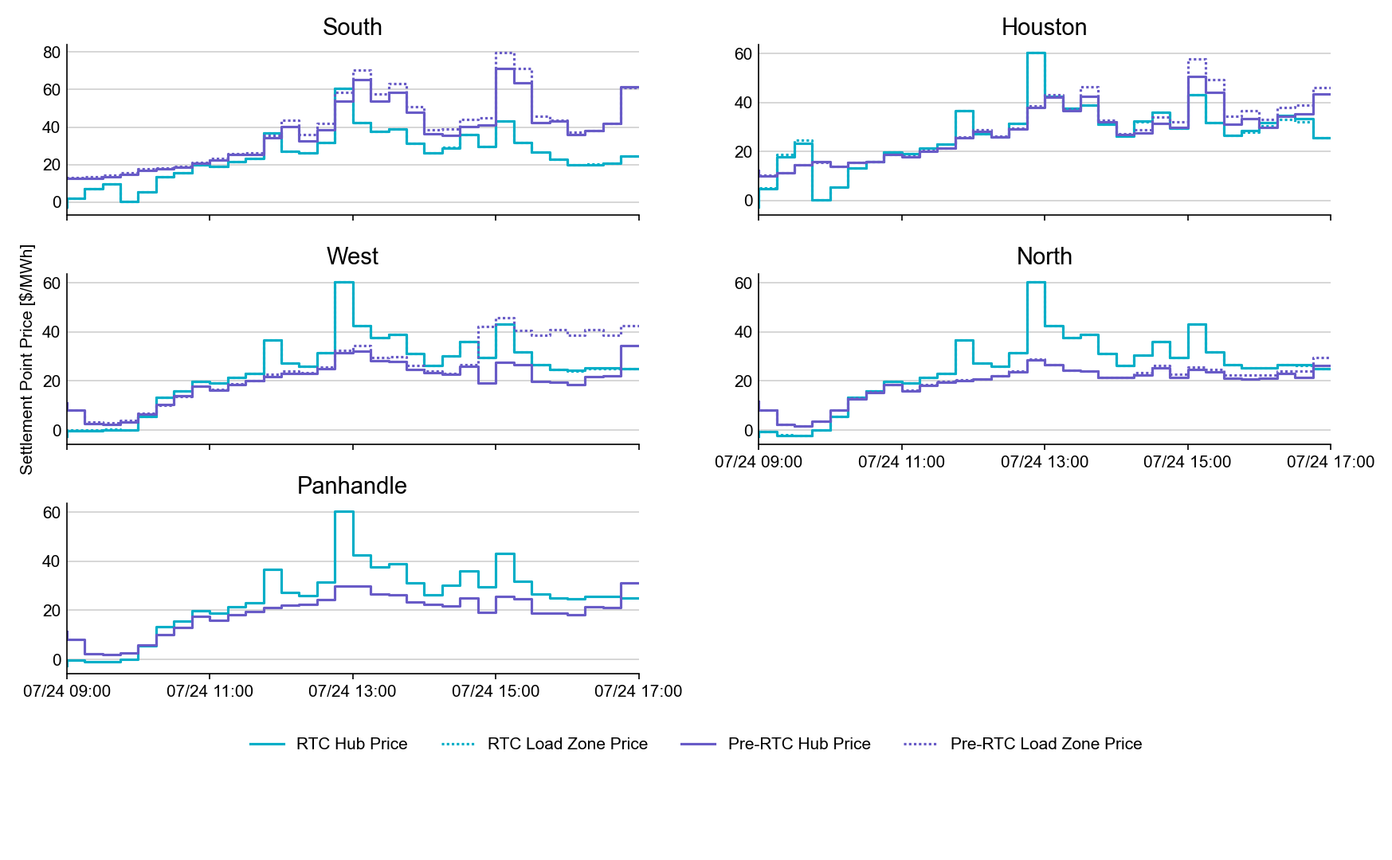
SPP by Hub and Competitive Load Zone

Slide 34
Market Trials known issues/updates
First week Open Loop issues/updates:
SCED sometimes crashing on ESR proxy curve being created by ERCOT
  Fix identified- 7/31 migration this week
  Impact of UDSP becomes stale
COP issue due to IRR forecast synchronization
  Different load forecast than production rejecting COP
  ERCOT manually fixing Tues/Thursday, and will still occur until fix in place for other ODs
COP issue for OFFQS status
  Occurs where ECRS+NSPIN capability is being checked against HSL.
  Removing this validation rule for AS responsibility. Planned release date (7/31).
Several NCLRs and CLRs that don’t have the updated NSPIN qualification
  Load Resource Qualification fixed
Enhancement - MMS UI Banner to differentiate from Production
  Target Thursday release (7/31)
Day-Ahead submission for Monitored Op Day window
  Submissions will be closed from 10AM-11AM on the day prior to OD test windows.
  Day-ahead Submissions window (normally 7AM-10AM) for OD 7/23 will remain open on 7/22 until 6pm for those wanting to test their Day Ahead submissions validation. Not required.

Slide 35
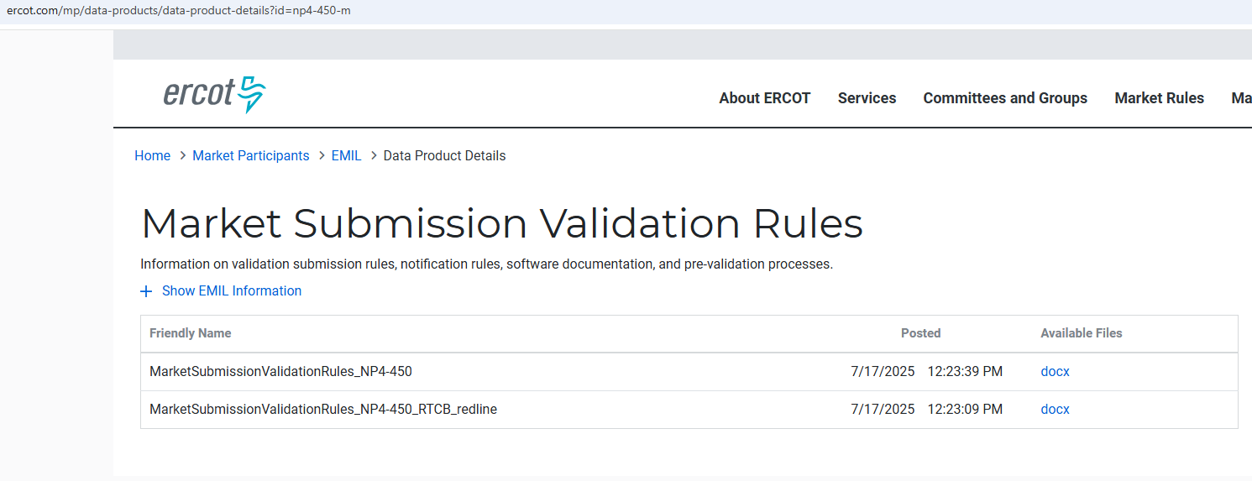
Submission validation update - PROD vs RTC+B
Structure is the same, but validation change
NPRR1290 :
  cleaned up protocol language around submitting offer curves and bid curves
  disallows having more than 2 price/quantity points in a flat/vertical segment of the curve.
Impacts to QSEs during dual-submission – some submissions accepted in Production will be rejected in Market Trials environment:
RTM Energy bids – protocol requiring “increasing quantities” now enforced.
  Example: Bid with Q1=0mw, Q2=10mw, Q3=10mw will be rejected as Q3 does not increase from Q2.
TPO & RTM Bid – more than 2 price/quantity pairs with same price or quantity will be rejected
  TPO: Q1=10mw, Q2=15mw, Q3=15mw, Q4=15mw, Q5=25mw – rejected
  TPO/RTM Bid: P1 = $5, P2 = $8, P3 = $8, P4 = $8, P5=$10 – rejected
Market Submission Validation
Rules document updated
with NPRR1290 changes.

Slide 36
WRAP-UP OF RTCBTF

Slide 37
RTCBTF Discussions:
NPRR1290 and NOGRR278 discussion
ESR Droop Settings and RFI Follow-up
AS Deployment Factors Discussion (more discussion to come)
Fast Frequency Response Follow-up
Market Readiness
  Settlement Artifacts- RT Statement (including RUC) and Extracts and Settlement Matrix
  Transition/Cutover Handbook: Initial Draft and Discussion (link)
Closed Loop LFC Workshop (2-4pm)
  220 Participants and will have follow-up meeting in August
  Semi-scripted 2-hour test Sept 11 between 10am-1pm
    Handbook #5 for details (link)

Slide 38
What is upcoming to August:
Completing July/August Objectives:
Successful and consistent dual submissions and telemetry 2days/week
Successful control tests of QSEs (ie following UDSP)
These activities lead up to first Closed-Loop LFC Test on Sept 11
Another LFC Workship in late August
Also in September, ERCOT to begin running RTC Day-Ahead Market
All QSEs can participate in DAM
Any Questions on RTCBTF or Trials activities?
Question here or later can always be directed to RTCB@ERCOT.com

