Slide 1
ERCOT Technology Working Group (TWG)
July 31, 2025

Slide 2
ERCOT TWG
WELCOME

Slide 3
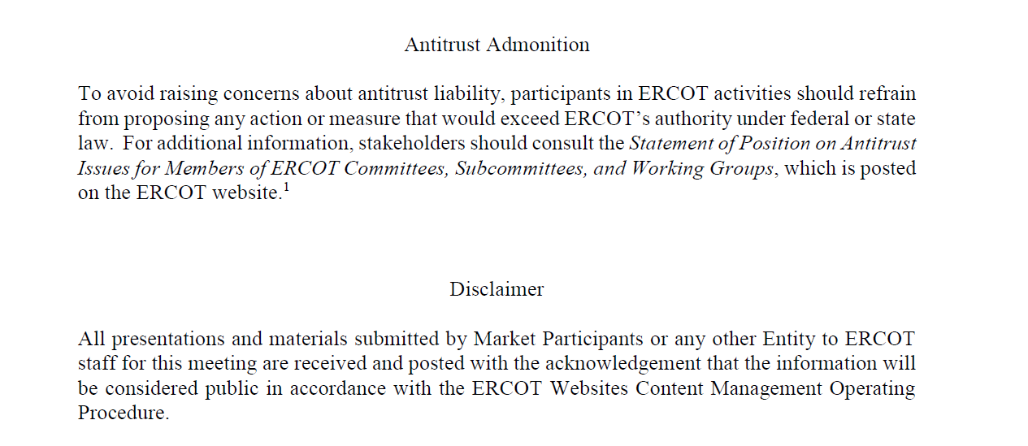
ERCOT TWG

Slide 4
ERCOT TWG Agenda
Item # | Item Description | Presenter | Start Time
1 | Antitrust admonition | Tanner Holder | 2:00 PM
2 | Project Updates | Troy Anderson | 2:02 PM
3 | RTC+B Updates Program/RTCBTF Updates and Market Trials Testing Status Open Loop Testing Telemetry Validation Market-Trials-Market-Submissions – Go live URLs update Closed Loop Testing – High level Cutover/Cutback Plan Review Group2 CDR changes overview NDCRC – MOTE Testing | Matt Mereness/ERCOT Staff | 2:10 PM
4 | CIM16 Schema Upgrade Project - status update | Joel Koepke | 3:10 PM
5 | DPC Process Automation – Implementation Approach technical discussion | Karthik Gopinath | 3:20 PM
6 | Secure API status update | Brandon Johnson | 3:40 PM
7 | Round Table Discussion | Sreenivas Badri | 3:50 PM
8 | Adjourn | Sreenivas Badri | 4:00 PM

Slide 5
RTC+B Updates
Program/RTCBTF Updates and Testing Status – Matt Mereness
Open Loop Testing Telemetry Validation – Karthik Gopinath
Market-Trials-Market-Submissions – Go live URLs update – Sreenivas Badri
Closed Loop Testing – High level Cutover/Cutback Plan Review – Sreenivas Badri
  Group2 CDR changes overview – Jamie Lavas
  NDCRC – MOTE Testing – Nick Barbas

Slide 6
CIM16 Schema Upgrade Project
CIM16 Schema Upgrade Project - status update– Joel Koepke

Slide 7
DPC Process Automation
DPC Process Automation – Implementation Approach technical discussion – Karthik Gopinath

Slide 8
Secure API
Secure API status update – Brandon Johnson

Slide 9
ERCOT TWG – Round Table Discussion
ERCOT TWG – Round Table Discussion
  Future Topics of Interest
  Topics and presentations from TWG members

Slide 10
ERCOT TWG
Thank You
You can reach Sreenivas at
Sreenivas.Badri@ercot.com and Tanner at tholder@tnsk.com

