Slide 1
RTC+B – LFC/SCED Closed Loop Testing – Draft Cutover and Cutback Plan
Sreenivas Badri
July 31, 2025

Slide 2
QSEs RTC+B Systems Configurations
ERCOT met with QSEs and their EMS and Market System vendors to gain insights into their RTC+B system design and software implementation to support Open Loop Testing, Closed Loop Testing and Go-Live.
Below are the high-level details of QSEs’ RTC+B system setup and software implementation:
  EMS AGC/SCADA
    Existing EMS AGC was modified, and a flag/switch was implemented to separate RTC+B code and database changes.
    This switch is available at Unit level and at System level to transition AGC between current production and RTC+B.
    In some cases, new RTC+B AGC instance was created, and a flag/switch is used to transition AGC between current production and RTC+B.
    QSEs who do not have AGC, use SCADA Calc or Scripts (developed on SCADA) to send the dispatch instructions to plants. These SCADA Calcs/Scripts can switch between current production and RTC+B at Unit level as well as at System level.
    Developed Market Interface between their RTC+B Market System and AGC/SCADA Calc/Scripts to get RTC+B COP etc. periodically and send production quality RTC+B telemetry to ERCOT ICCP system continuously starting from Open Loop Testing.

Slide 3
QSEs RTC+B Systems configurations
Market Submissions and Notifications
  QSEs are utilizing parallel RTC+B Market Systems to submit real-time market submissions (COP, TPO, ASO, ESR Energy Bid/Offer Curves, Output Schedules etc.) into RTC+B Market Trials System in parallel to current production.
  Some QSEs setup parallel RTC+B Market System to support both real-time and Day-Ahead market submissions into ERCOT RTC+B Market Trials system in parallel to current production.
  Some QSEs are using current production to support dual real-time market submissions into ERCOT RTC+B Market Trial Production System in parallel to Current Production starting from Open Loop Testing till Go Live.
  QSEs are utilizing parallel RTC+B Market Notifications system to support Market Trials.

Slide 4
QSEs RTC+B Systems configurations for Open Loop Testing
Open Loop Testing
  Controlled and Coordinated UDSP Testing
    QSEs will utilize Unit level switch in their EMS/AGC to operate selected generating unit in RTC+B mode.
    QSEs who do not have AGC will use SCADA Calc or Scripts (developed on SCADA) to send the dispatch instructions to plants. These SCADA Calcs/Scripts can operate the selected generating unit in RTC+B mode.
    Once testing is completed, QSEs will put back generating unit in current production mode by turning off the unit level switch.
  Market Submissions and Notifications
    QSEs are utilizing parallel RTC+B Market Systems to submit real-time market submissions for Monitoring Days (Tuesday/Thursday).
    Some QSEs are using current production to support dual real-time market submissions into ERCOT RTC+B Market Trial Production System in parallel to Current Production starting from Open Loop Testing till Go-Live.
  Dual submission of Outages is not required for Open Loop Testing.

Slide 5
QSEs RTC+B Systems configurations for Closed Loop Testing
Closed Loop Testing
  EMS/AGC/SCADA Calc/Scripts
    QSEs will utilize System level switch of their EMS/AGC/SCADA Calc/Scripts to switchover their entire system to RTC+B mode. Switchover time must be within 30-60 seconds.
    At the end of the closed loop testing, QSEs must switchback to current production mode by turning off the system level switch. Switchback time must be within 30-60 seconds.
  Market Submissions and Notifications
    QSEs are utilizing parallel RTC+B Market Systems Production system to submit real-time market submissions into ERCOT RTC+B Market Trial Production System in parallel to current production. No systems switchover is required.
    Some QSEs are using current production to support dual real-time market submissions into ERCOT RTC+B Market Trial Production System in parallel to Current Production starting from Open Loop Testing till Go Live. No systems switchover is required.
  For the Closed Loop Testing, QSEs are expected to perform dual real-time market submissions from 5:00PM of the day prior to the closed loop testing until the completion of the test.
  Dual submission of Outages is not required for Closed Loop Testing.

Slide 6
Closed Loop Testing – Key Pre Cutover Steps for QSEs
One of the key goal of the Closed Loop Testing is to ensure that QSEs RTC+B ICCP/SCADA/EMS/Interfaces system changes are designed and setup correctly and can respond to UDSP signals.
Key Pre Cutover Steps
  QSEs to verify all their resources UDSP telemetry point in their ICCP/SCADA is setup correctly and receiving good quality UDSP signal from ERCOT ICCP.
  QSEs to verify that their RTC+B EMS AGC/SCADA Calcs/Scripts and Interfaces are setup and ready for Closed Loop Testing.

Slide 7
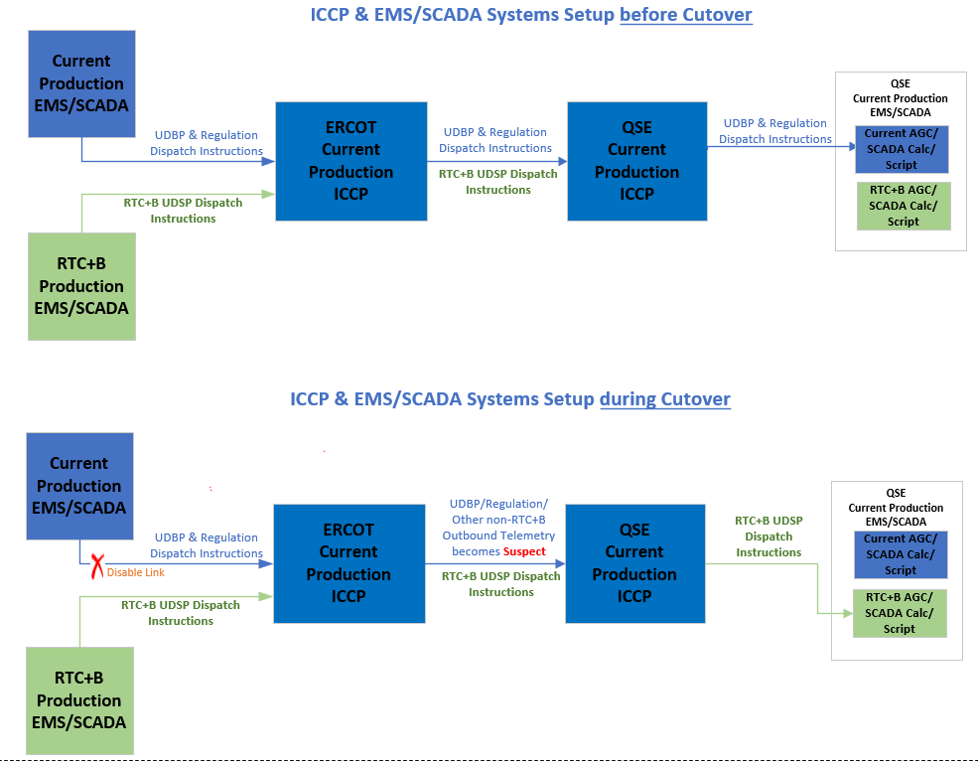
Closed Loop Testing – Draft EMS/ICCP Cutover Plan

Slide 8
Closed Loop Testing – Key Cutover Steps
Control room gives the final approval for closed loop testing few minutes before start of the test.
  Start/End Times of Closed Loop Testing is subjected to change based on Grid conditions.
ERCOT will host a Webex call with Market participants for cutover and cutback coordination and status updates.
Control Room makes hotline call to Market approximately 15 minutes before ERCOT ICCP/EMS systems cutover to RTC+B.
Approximately 10:34:30 AM, ERCOT will perform QSE ICCP systems fail over (similar to weekly model loads) to cutover to RTC+B EMS. It takes around 30-60 seconds to complete the failover.
  Cutover 30 seconds before 10:35 AM ensures that 10:35 AM UDBP is not sent out to QSEs.
During ICCP systems failover, current Production UDBP, Regulation and other non-RTC outbound telemetry to QSEs will be disabled. These points will become suspect for the duration of this test. This means these telemetry points value will be stale with suspect quality for duration of test with a UDBP value approximately from 10:34:30 AM.

Slide 9
Closed Loop Testing – Key Cutover Steps
The following outbound telemetry points common to both current and RTC+B systems will be updated from the RTC+B EMS during this test. Similarly, all existing system level points will be telemetered from RTC+B EMS for the duration of the test.
  BP/LMP/SBBH/SCCT/NDPL/RDPL/MMEC/KVM/KVT
After ERCOT ICCP systems failed over to RTC+B EMS, ERCOT gives go ahead to QSEs to cutover to RTC+B through Webex Call.
  ERCOT prefers QSEs do not automate the Cutover to RTC+B based on UDBP quality.
QSEs must cutover to their RTC+B EMS AGC/SCADA Calc/Script within 30-60 seconds.
QSEs to update cutover status to ERCOT through Webex call.
After all QSEs are cutover to RTC+B, Control Room makes hotline call to Market announcing ERCOT is operating under RTC+B.

Slide 10
Closed Loop Testing – Key Cutback Steps
In preparation for cutback, good quality current production UDBP/Regulation and other non-RTC outbound telemetry to QSEs will be enabled 10-15 minutes before completion of the closed loop test. It ensures smooth cutback to current production.
Control Room makes hotline call to Market approximately 15 minutes before ERCOT ICCP/EMS systems cutback to current production.
Around 12:34:30 PM, ERCOT will perform QSE ICCP systems fail over (similar to weekly model loads) to cutback to current production. It takes around 30-60 seconds to complete the failover.
The following outbound telemetry points common to both current and RTC+B systems will start getting updated again from the current production EMS. Similarly, all existing system level points will be telemetered again from current production EMS.
  BP/LMP/SBBH/SCCT/NDPL/RDPL/MMEC/KVM/KVT

Slide 11
Closed Loop Testing – Key Cutback Steps
After ERCOT ICCP systems failed over to current production EMS, ERCOT gives go ahead to QSEs to cutback to current production through Webex Call.
QSEs must cutback to their current production EMS AGC/SCADA Calc/Script within 30-60 seconds.
QSEs to update cutback status to ERCOT through Webex call.
After all QSEs are cutback to current production, Control Room makes hotline call to Market announcing ERCOT is operating under current production.

Slide 12
Closed Loop Testing – Current Production EMS/SCED State
  ERCOT Current Production EMS and SCED/HRUC will continue to run normally without any down time during Closed Loop Testing (except UDBP/Regulation Signals and other Non-RTC Outbound telemetry is NOT sent out to QSEs). It ensures
    smooth transition back to current production at the end of closed loop testing and
    current production SCED can continue to create prices during closed loop testing.
  It is critical for Market participants to
    continue to send production quality telemetry to current production ICCP/EMS (e.g. Current production resource status codes, Regulation participation factors, combo model telemetry for batteries etc.,) and
    continue to submit real-time market submissions into current production Market System before and during closed loop testing without any down time.

Slide 13
QSEs RTC+B Systems configurations for Go-Live
Go-Live
  EMS/AGC/SCADA Calc/Scripts
    QSEs will utilize System level switch of their EMS/AGC/SCADA Calc/Scripts to switchover their entire system to RTC+B mode. Switchover time must be within 20-60 seconds.
  Market Submissions and Notification
    QSEs to deploy RTC+B code into Current Production few days before Go-Live, add new RTC+B Go-Live Production Systems API URLs and disable RTC+B code & URLs.
    At the time of Go-Live – QSEs to enable the RTC+B code, activate RTC+B Go-Live Production systems API URLs.
    QSEs to provide Go-Live system listener URLs to ERCOT before Go-Live to configure RTC+B Go-Live Production Systems and enable these URLs at the time of Go-Live.
  Outage Scheduler Go-Live details will be provided later. Dual submissions of outages is not required for Go-Live.

