Slide 1
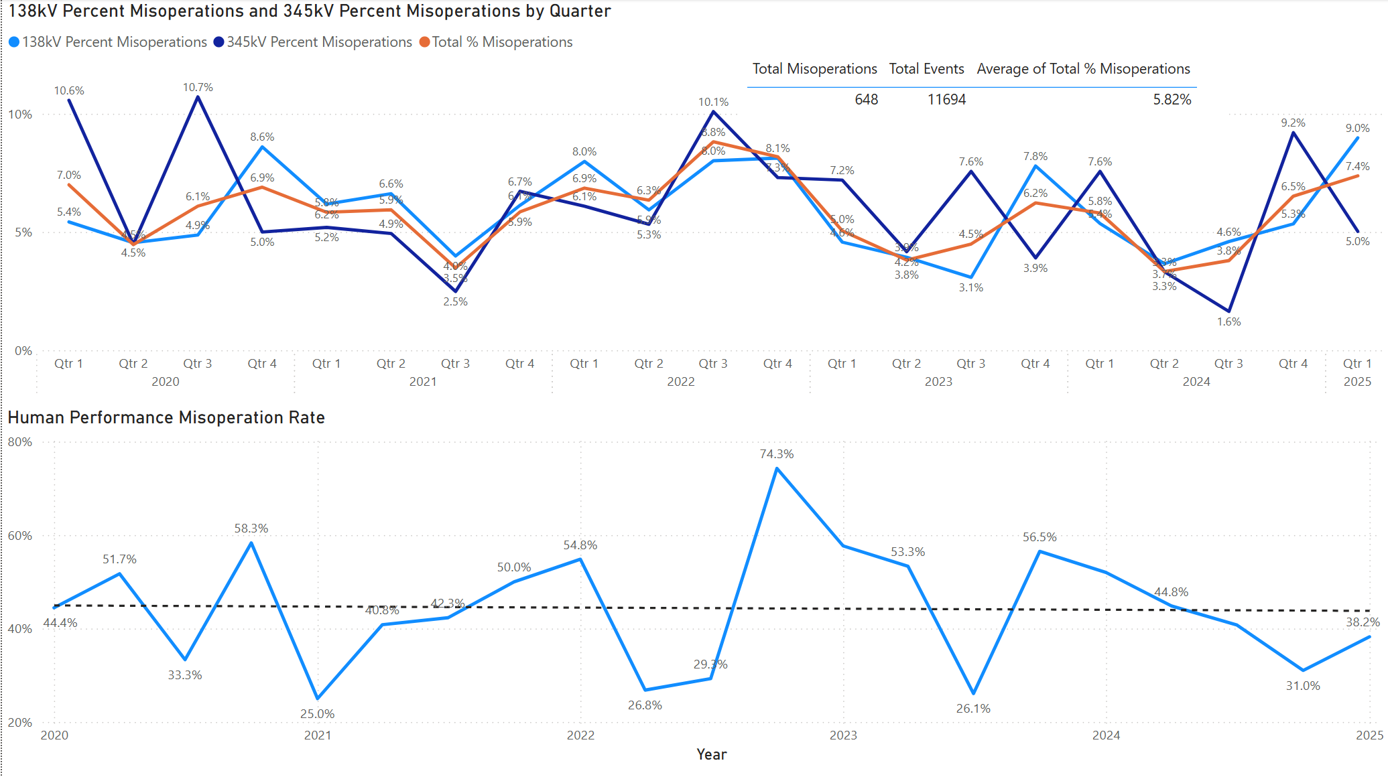
Protection System Misoperations: 2020-2025 Q1
2025 Q1 misoperation rate of 7.4%

Slide 2
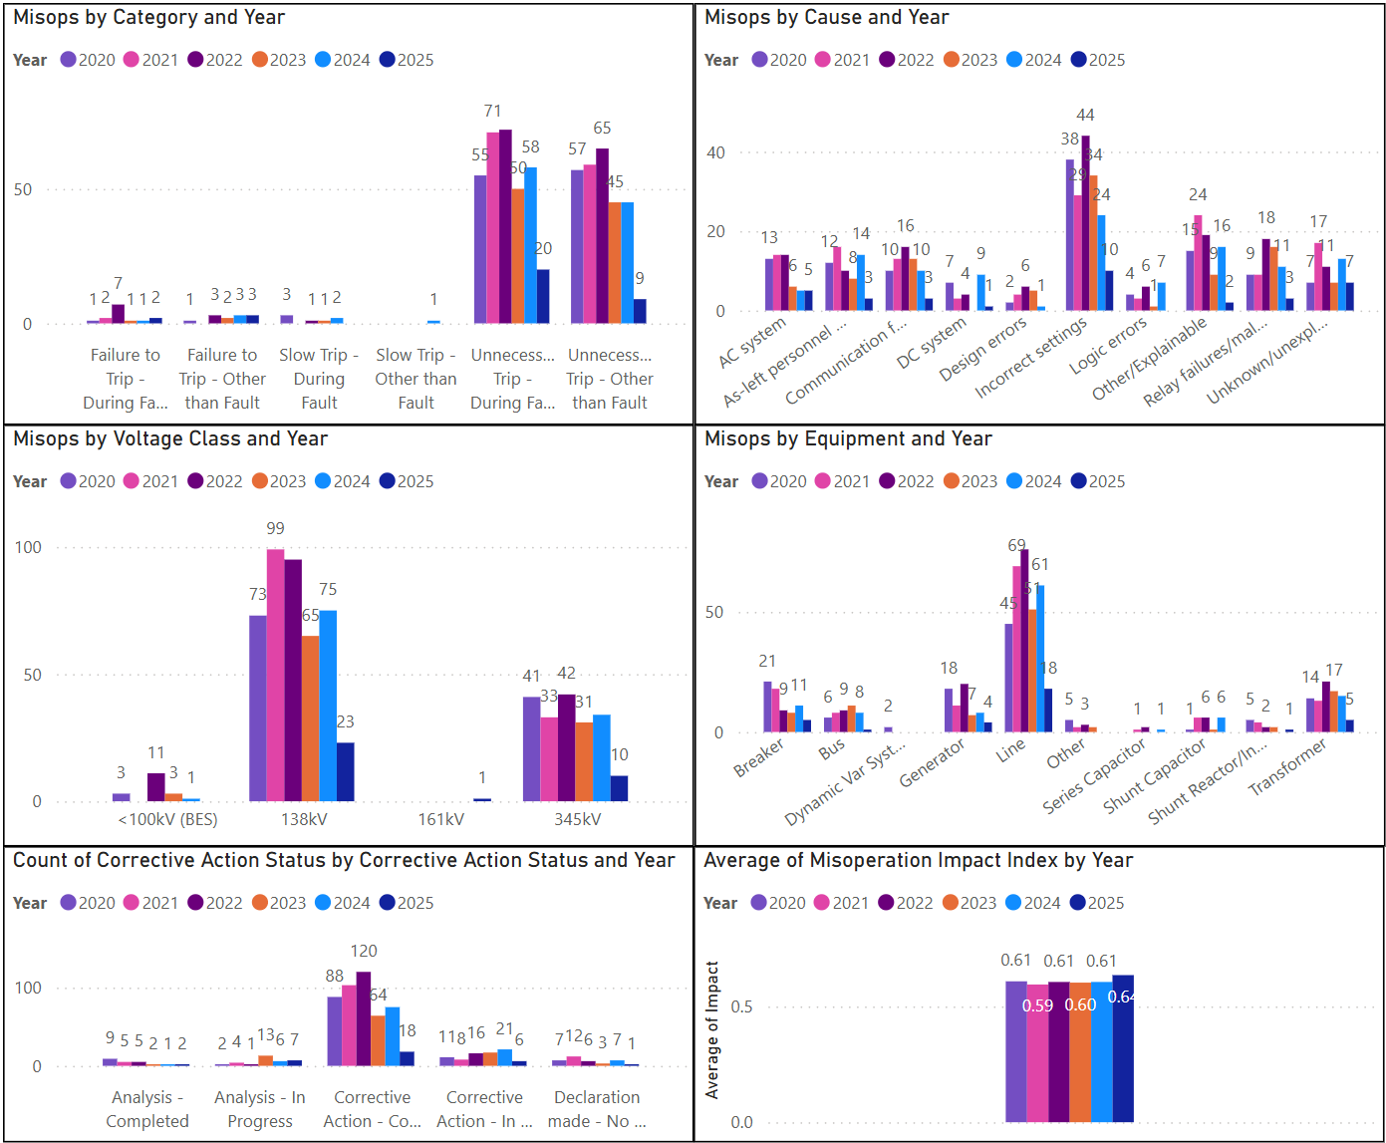
Protection System Misoperations: 2020-2025 Q1

Slide 3
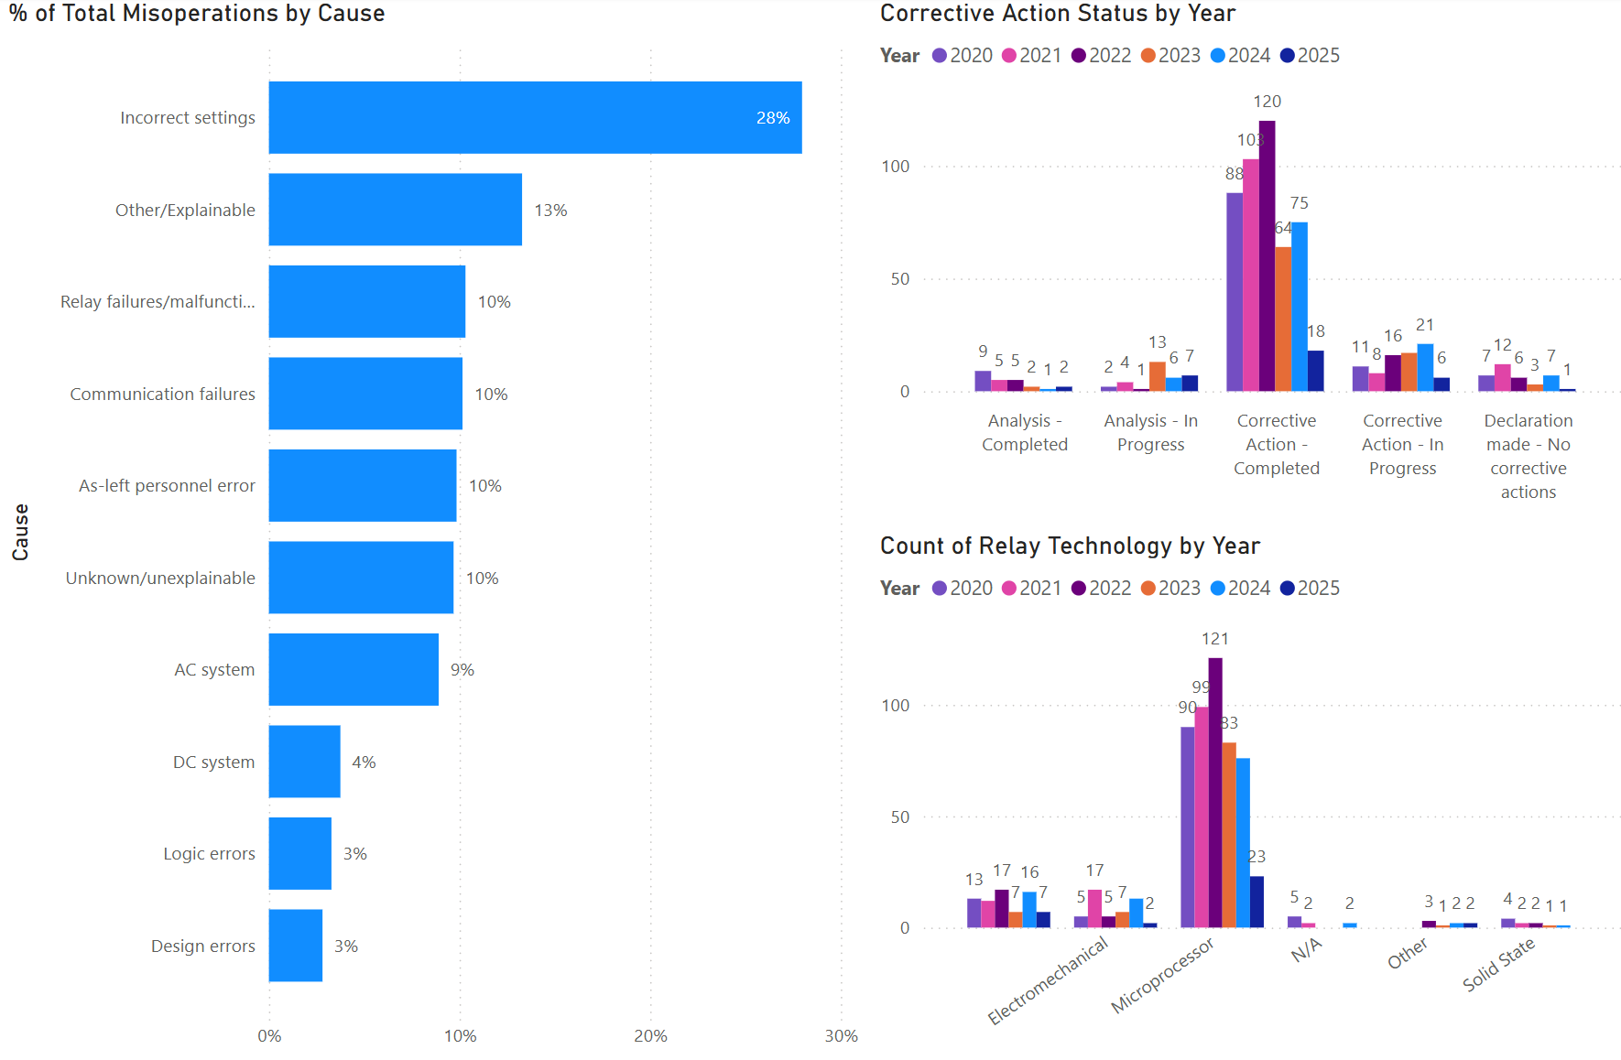
Protection System Misoperations: 2020-2025 Q1

Slide 4
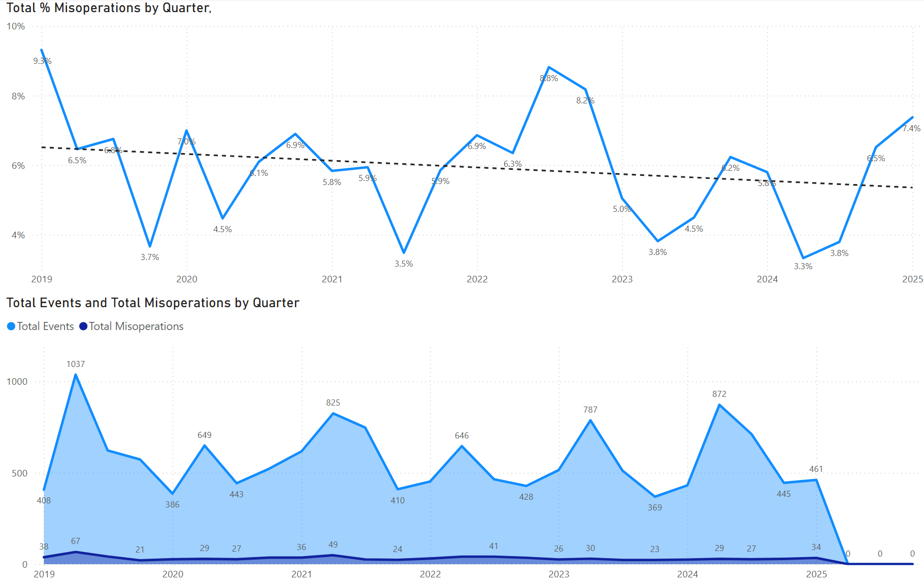
Protection System Misoperations: 2020-2025 Q1

Slide 5
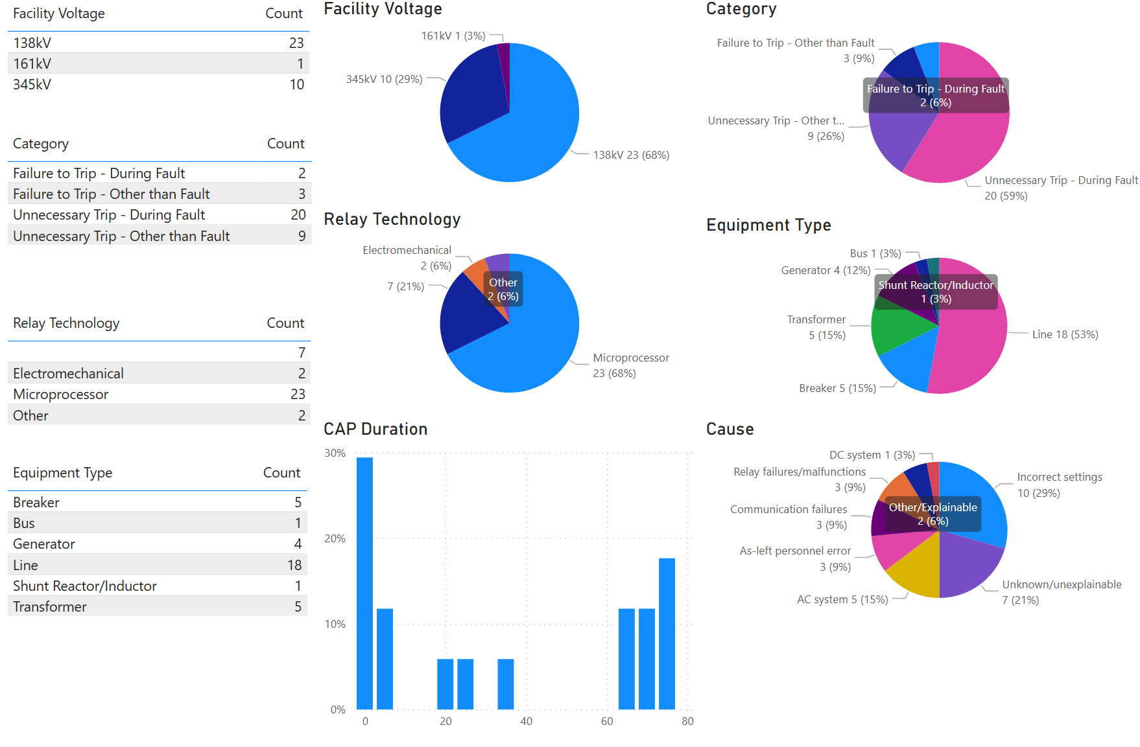
Protection System Misoperations – 2025 YTD

Slide 6
Human Performance - 2025 Q1
Summary of Human Performance Issues noted for 2025 Q1:
138kV bus differential misoperation due to improperly isolated CT wiring on a spare breaker
GSU transformer misoperation due to incorrect ground overcurrent element setting. Issued settings for torque control of the ground overcurrent element were not applied to the relay.
138kV line misoperation due to incorrect CT wiring
345kV line misoperation due to incorrect directional element settings
138kV line misoperation due to incorrect DCB block settings
138kV line misoperation due to incorrect Z1 ground reach settings
138kV line misoperation due to incorrect polarization settings
Failure to Trip/Slow Trip Misoperations in 2025 Q1:
Generator breaker failed to open during normal shutdown due to incorrect position of 43 local/remote switch, resulting in breaker failure operation
138kV line misoperation due to incorrect settings associated with programmable outputs
Several others pending analysis

Slide 7
Definitions
Protection System –
  Protective relays which respond to electrical quantities,
  Communications systems necessary for correct operation of protective functions
  Voltage and current sensing devices providing inputs to protective relays,
  Station dc supply associated with protective functions (including station batteries, battery chargers, and non-battery-based dc supply), and
  Control circuitry associated with protective functions through the trip coil(s) of the circuit breakers or other interrupting devices

Slide 8
Definitions
Composite Protection System - The total complement of Protection System(s) that function collectively to protect an Element. Backup protection provided by a different Element’s Protection System(s) is excluded.
Misoperation – The failure a Composite Protection System to operate as intended for protection purposes. Any of the following is a Misoperation:
  Failure to Trip – During Fault – A failure of a Composite Protection system to operate for a Fault condition for which it is designed.
  Failure to Trip – Other than Fault - A failure of a Composite Protection system to operate for a non-Fault condition for which it is designed, such as a power swing, undervoltage, overexcitation, or loss of excitation.

Slide 9
Definitions
Misoperation – The failure a Composite Protection System to operate as intended for protection purposes. Any of the following is a Misoperation:
  Slow Trip – During Fault – A Composite Protection system that is slower than required for a Fault condition if the duration of its operating time resulted in the operation of at least one other Element’s Composite Protection System.
  Slow Trip – Other than Fault - A Composite Protection system that is slower than required for a non-Fault condition, such as a power swing, undervoltage, overexcitation, or loss of excitation, if the duration of its operating time resulted in the operation of at least one other Element’s Composite Protection System.

Slide 10
Definitions
Misoperation – The failure a Composite Protection System to operate as intended for protection purposes. Any of the following is a Misoperation:
  Unnecessary Trip – During Fault – An unnecessary Composite Protection system operation for a Fault condition on another Element.
  Unnecessary Trip – Other than Fault - An unnecessary Composite Protection system operation for a non-Fault condition. A Composite Protection System operation that is caused by personnel during on-site maintenance, testing, inspection, construction, or commissioning activities is not a Misoperation.

