Slide 1
NDCRC – RTC+B Changes and Market Testing
Nick Barbas
July 31, 2025

Slide 2
NDCRC – RTC+B
  NDCRC RTC+B release planned for production in December 2025 to incorporate changes supporting the submission of test data for single model ESRs
  Project is in execution phase with a release candidate currently deployed to test environment at ERCOT
  New – NDCRC MOTE environment was built for RTC+B market testing
    MOTE environment will be available for market testing from early August
    Requesting MPs start utilizing NDCRC MOTE for testing RTC+B changes
    USA can request client certificates through MOTE MPIM for RE/QSE roles
  After RTC+B go live, this new NDCRC MOTE environment will be used for market testing of any market facing changes before changes are deployed into production.

Slide 3
NDCRC – RTC+B – MOTE Access
MOTE NDCRC RTC+B URL – https://testmis.ercot.com/ndcrc/Home.do
MOTE MPIM URL – https://testmis.ercot.com/midm
  USA can request certificates here for use with NDCRC’s MOTE environment
  NDCRC_RE role is required for RE level access (all RTC+B changes will be tested using this role)
  QSE_W/QSE_R role is required for QSE level access (needed to access Test Request dashboard)

Slide 4
NDCRC – RTC+B
Unit Changes - Database
  Units with the designation “PWRSTR” (power storage) representing the generation side of a combo model ESR will be removed (units commonly end with _BES/_BESS)
  Units with the designation “CLR” (controllable load resource) representing the load side of a combo model ESR will be removed, but other CLRs outside of combo model ESRs will remain in the database (units commonly end with _LD)
  New units with the designation “ESR” (energy storage resource) will be added to the database to replace the removed “PWRSTR”/”CLR” combo model units
  Naming convention for “ESR” units are “STATION_ESR1”, “STATION_ESR2”…

Slide 5
NDCRC – RTC+B
Unit List Changes Only
  CT Freq. Resp. – exclude single model ESRs from unit list
  ESR Freq. Resp. – only show single model ESRs in unit list
  CLR Freq. Resp. – only show CLRs that aren’t part of a combo model ESR
  Turbine Mech-Hydr. – exclude single model ESRs from unit list
  Turbine Electro-Hydr. – exclude single model ESRs from unit list
  Historical Freq. Resp. – exclude single model ESRs from unit list
  ESR Historical Freq. Resp. – only show single model ESRs in unit list
  Unannounced Seasonal HSL – exclude single model ESRs from unit list
New and Existing Form Changes
  Reactive ESR – A new version of the reactive form specific to ESR units is launching for RTC+B with separate charging/discharging CURL points, modified test labels, and two new VSS validation fields (“Max Net Discharge Power”, “Max Net Charge Power”)
  AVR - New field added to existing form called “AVR Test Category” with values “ESR Charging”, “ESR Discharging”, and “Normal”

Slide 6
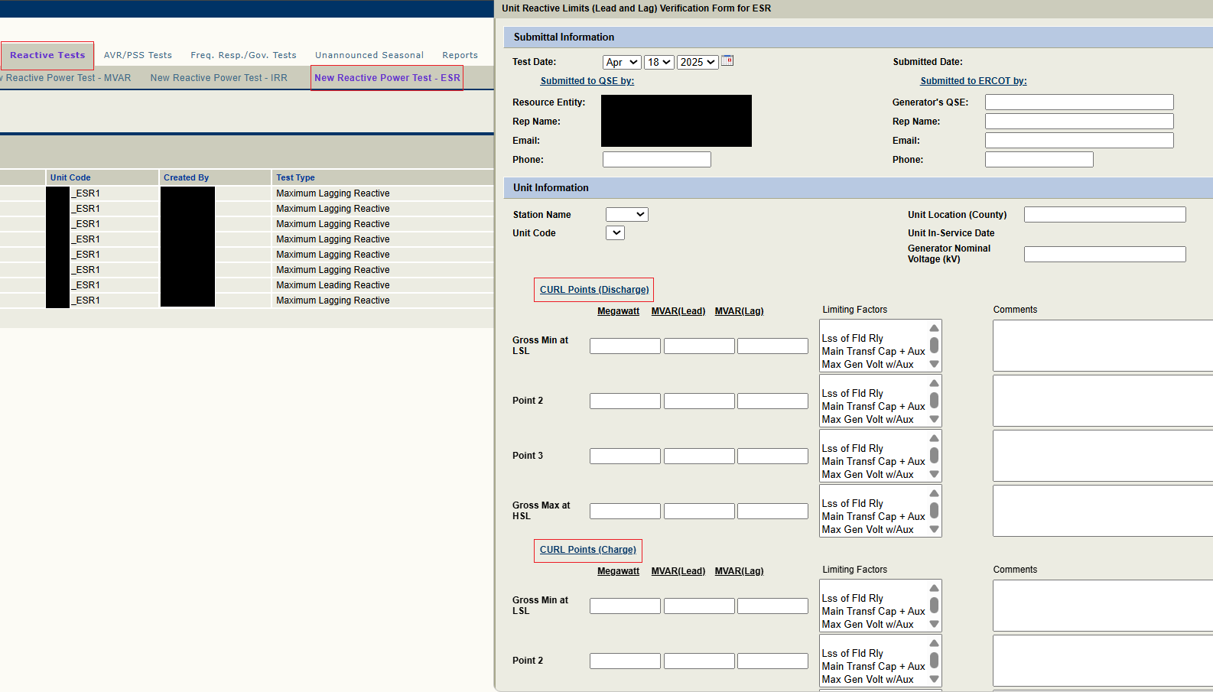
NDCRC – RTC+B

Slide 7
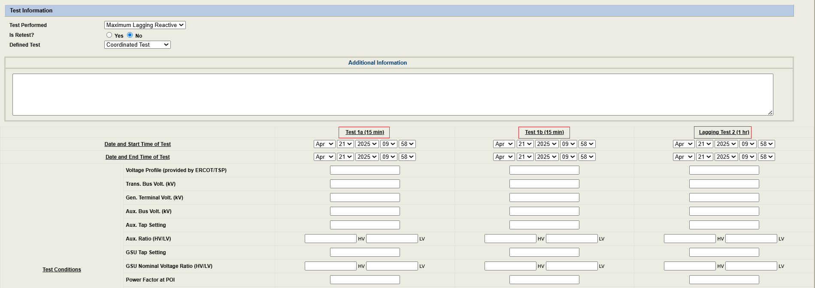
NDCRC – RTC+B

Slide 8
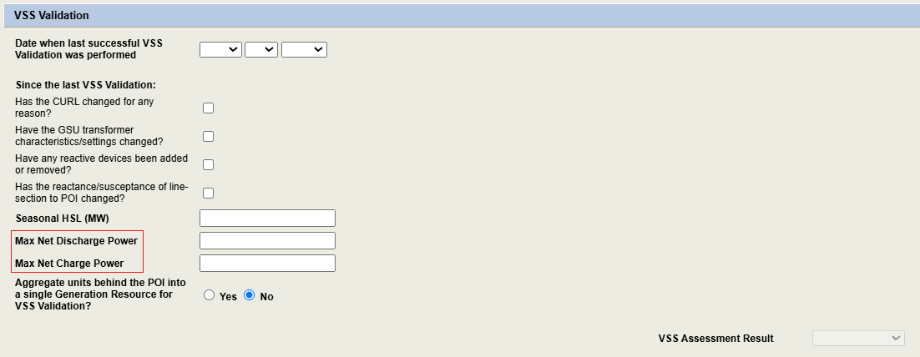
NDCRC – RTC+B

Slide 9
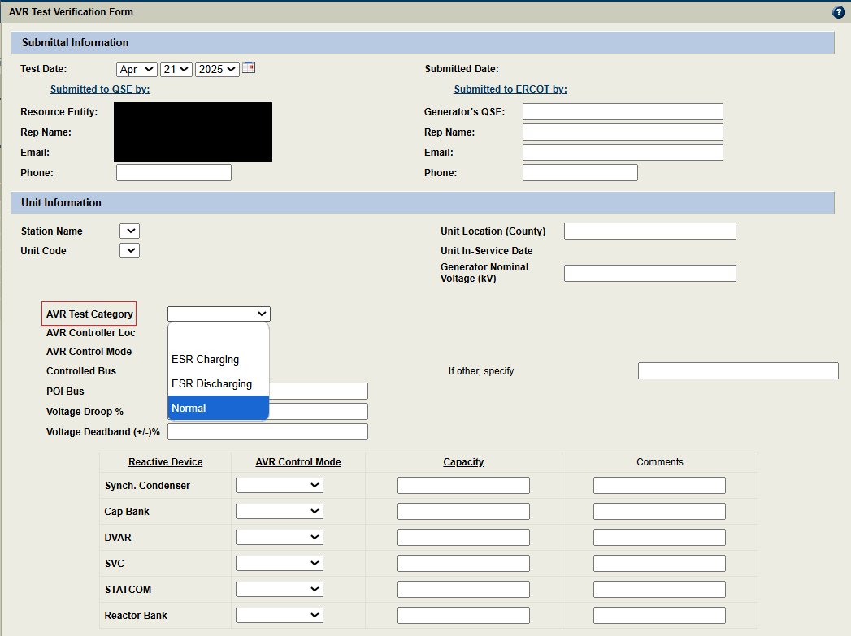
NDCRC – RTC+B

