Slide 1
Settlement Stability
2025 Q2 Update to WMS
Settlements Group
ERCOT
08/06/2025

Slide 2
8.2(2)(c)(i) Track number of price changes
Reporting Period: 2025 Q2
Operating Day | # of Corrected Prices |  |  |  |  |  | # of Intervals Affected |  |  |  |  |  | Market Notice
 | DASPP | MCPC | RTSPP | RTRMPR | ORDC Adders | RTESOGPR | DASPP | MCPC | RTSPP | RTRMPR | ORDC Adders | RTESOGPR
8/12/2024 | — | — | 72977 | 78384 | 0 | 32578 | — | — | 85 | 85 | 0 | 85 | M-A050625-01
8/13/2024 | — | — | 51972 | 55649 | 0 | 23388 | — | — | 66 | 69 | 0 | 66
8/14/2024 | — | — | 70108 | 75134 | 0 | 31109 | — | — | 82 | 83 | 0 | 80 | M-A050625-02
8/15/2024 | — | — | 61382 | 65755 | 5 | 26894 | — | — | 75 | 78 | 5 | 74
8/16/2024 | — | — | 58627 | 62768 | 0 | 25649 | — | — | 87 | 88 | 0 | 84 | M-A050625-03
8/17/2024 | — | — | 75434 | 80771 | 6 | 32999 | — | — | 96 | 96 | 6 | 96
8/19/2024 | — | — | 75879 | 81449 | 6 | 33514 | — | — | 93 | 93 | 3 | 92 | M-A050625-04
8/20/2024 | — | — | 63777 | 68378 | 11 | 27963 | — | — | 79 | 79 | 7 | 79
8/21/2024 | — | — | 74491 | 79829 | 25 | 33068 | — | — | 95 | 95 | 22 | 94 | M-A050625-05
8/22/2024 | — | — | 58248 | 62529 | 0 | 25418 | — | — | 90 | 93 | 0 | 89
8/23/2024 | — | — | 55988 | 60471 | 0 | 24598 | — | — | 88 | 87 | 0 | 85 | M-A050625-06
8/24/2024 | — | — | 71521 | 76664 | 0 | 31444 | — | — | 93 | 95 | 0 | 94
8/25/2024 | — | — | 55983 | 59968 | 12 | 24618 | — | — | 84 | 87 | 12 | 83 | M-A050625-07
8/27/2024 | — | — | 65928 | 70054 | 16 | 28994 | — | — | 85 | 88 | 16 | 84
Notes:
The price changes reported on this slide display the price corrections that have been done after the Settlement Statement has posted for the Operating Day.
** Additional Operating Days listed on next slide.

Slide 3
8.2(2)(c)(i) Track number of price changes
Reporting Period: 2025 Q2
Operating Day | # of Corrected Prices |  |  |  |  |  | # of Intervals Affected |  |  |  |  |  | Market Notice
 | DASPP | MCPC | RTSPP | RTRMPR | ORDC Adders | RTESOGPR | DASPP | MCPC | RTSPP | RTRMPR | ORDC Adders | RTESOGPR
8/29/2024 | — | — | 28776 | 30523 | 0 | 12736 | — | — | 38 | 45 | 0 | 36 | M-A050625-08
8/30/2024 | — | — | 59318 | 63631 | 8 | 26119 | — | — | 69 | 72 | 8 | 68
8/31/2024 | — | — | 51314 | 55153 | 13 | 22544 | — | — | 58 | 63 | 13 | 58 | M-A050625-09
9/1/2024 | — | — | 45030 | 48307 | 0 | 19783 | — | — | 54 | 56 | 54 | 0
9/3/2024 | — | — | 30037 | 32117 | 0 | 13127 | — | — | 36 | 37 | 35 | 0 | M-A050625-10
9/5/2024 | — | — | 62220 | 67573 | 0 | 27065 | — | — | 79 | 79 | 79 | 0
9/6/2024 | — | — | 61050 | 66345 | 0 | 26566 | — | — | 77 | 78 | 77 | 0 | M-A050625-11
9/7/2024 | — | — | 53370 | 58256 | 0 | 22812 | — | — | 65 | 67 | 62 | 0
9/8/2024 | — | — | 79382 | 86161 | 0 | 34631 | — | — | 96 | 96 | 95 | 0 | M-A050625-12
9/9/2024 | — | — | 75243 | 81862 | 3 | 32702 | — | — | 91 | 92 | 91 | 3
9/10/2024 | — | — | 57552 | 62978 | 2 | 24951 | — | — | 81 | 81 | 80 | 2
Notes:
** Table is a continuation from previous slide.
The price changes reported on this slide display the price corrections that have been done after the Settlement Statement has posted for the Operating Day.

Slide 4
8.2(2)(c)(iv) Track number of resettlements due to non-price errors
Reporting Period: 2025 Q2
Operating Day(s) Resettled | Reason for Resettlement | Affected Charge Types | Market Notice Number
- | - | - | -
Notes:
There were no resettlements due to non-price errors in Q2 2025.

Slide 5
8.2(2)(c)(ii) Track number and types of disputes submitted
8.2(2)(c)(iii) Compliance with timeliness of response to disputes
YEAR | 2025 |  | 100% of dispute resolutions were timely.
CALENDAR QUARTER REPORTED | Q1-Q2
Disputed Charge Sub-Type | Submitted | Resolved | Denied | Granted | Granted with Exceptions
Ancillary Services-RTM | 5 | 3 | 3 | 0 | 0
Emergency Operations | 3 | 0 | 0 | 0 | 0
Energy-RTM | 21 | 19 | 7 | 12 | 0
Firm Fuel Supply Service | 3 | 3 | 3 | 0 | 0
Gene. Res. Base Pt Deviation | 2 | 3 | 2 | 1 | 0
Reliability Unit Commitment | 55 | 49 | 2 | 47 | 0
TOTAL | 89 | 77 | 17 | 60 | 0
Submitted but not resolved disputes may be:
Not started
Open
Rejected
Withdrawn

Slide 6
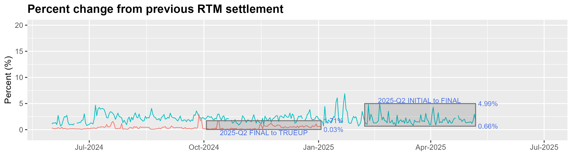
8.2(2)(c)(v) Other Settlement metrics
NOTE: ERS Final settlement OD data is not represented in graph.
Average percent change
 | 2016 | 2017 | 2018 | 2019 | 2020 | 2021 | 2022 | 2023 | 2024 | 2025
FINAL | 2.57 | 3.01 | 2.93 | 2.66 | 3.09 | 3.53 | 3.36 | 2.90 | 2.32 | 1.98
TRUEUP | 0.28 | 0.27 | 0.26 | 0.20 | 0.26 | 0.46 | 0.99 | 0.83 | 0.41 | 0.60

Slide 7
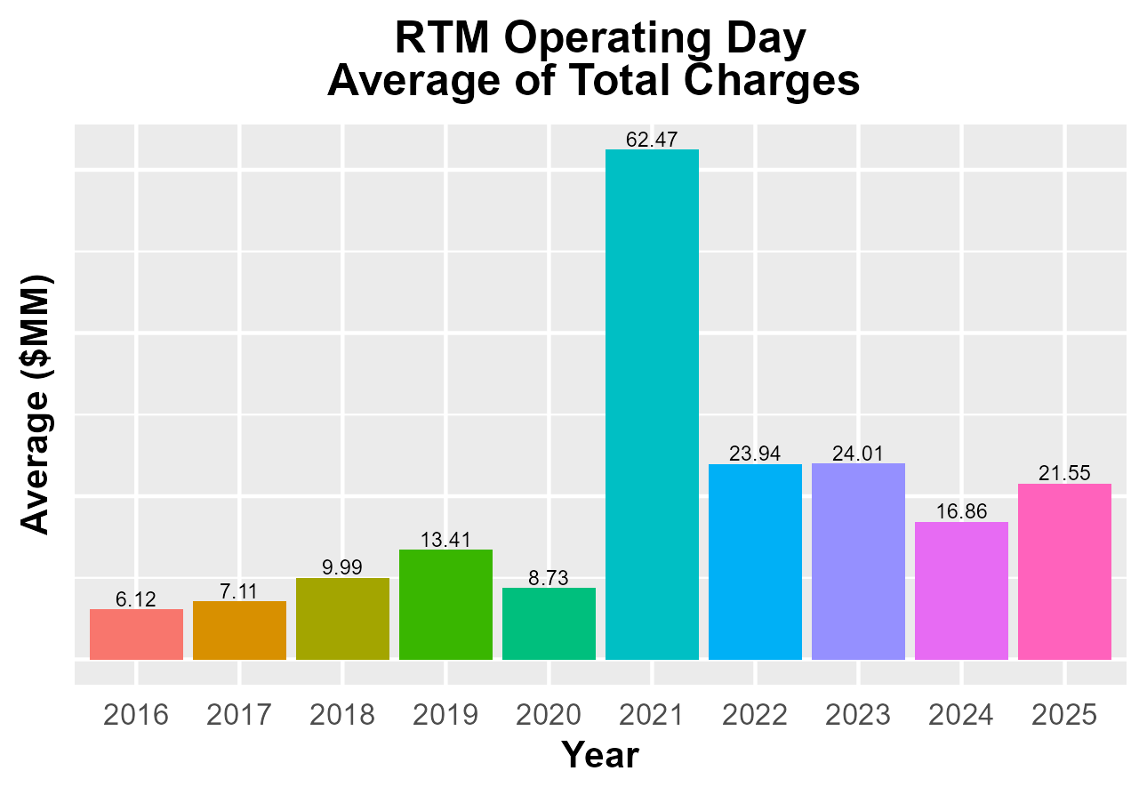
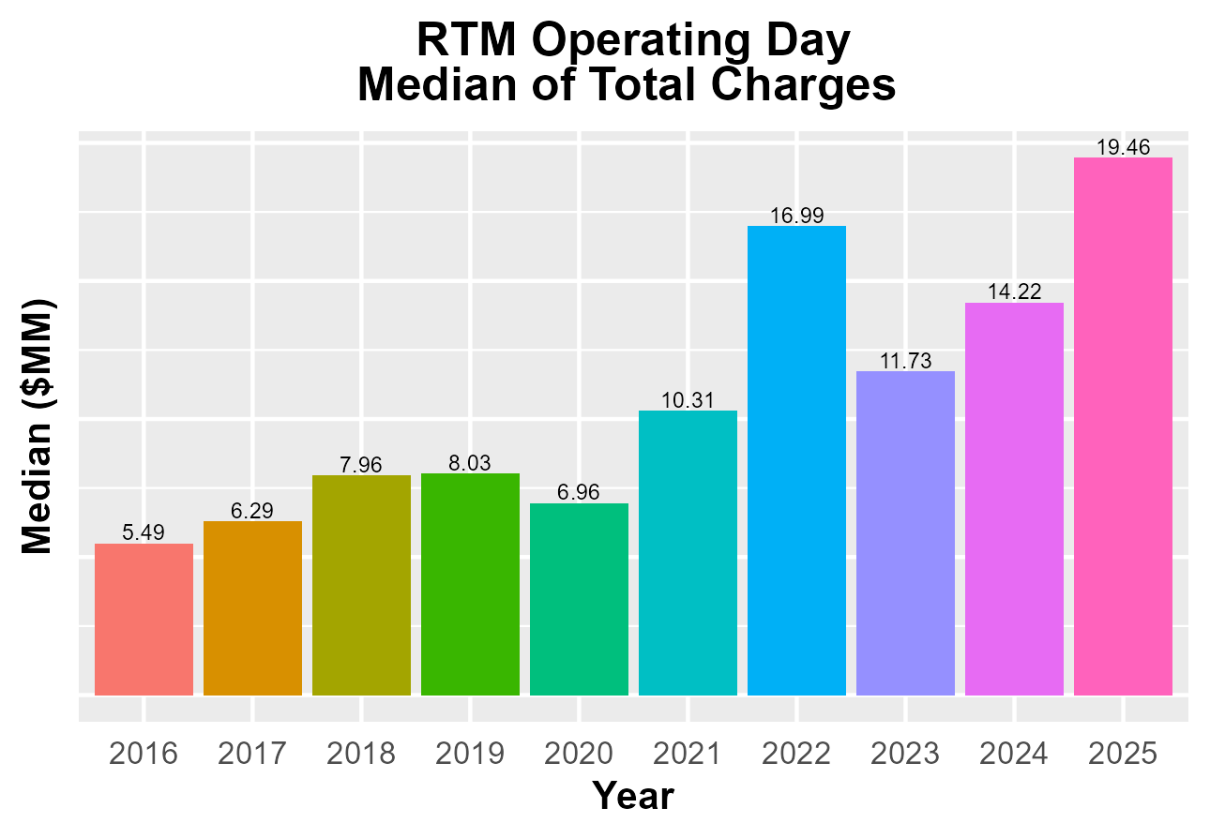
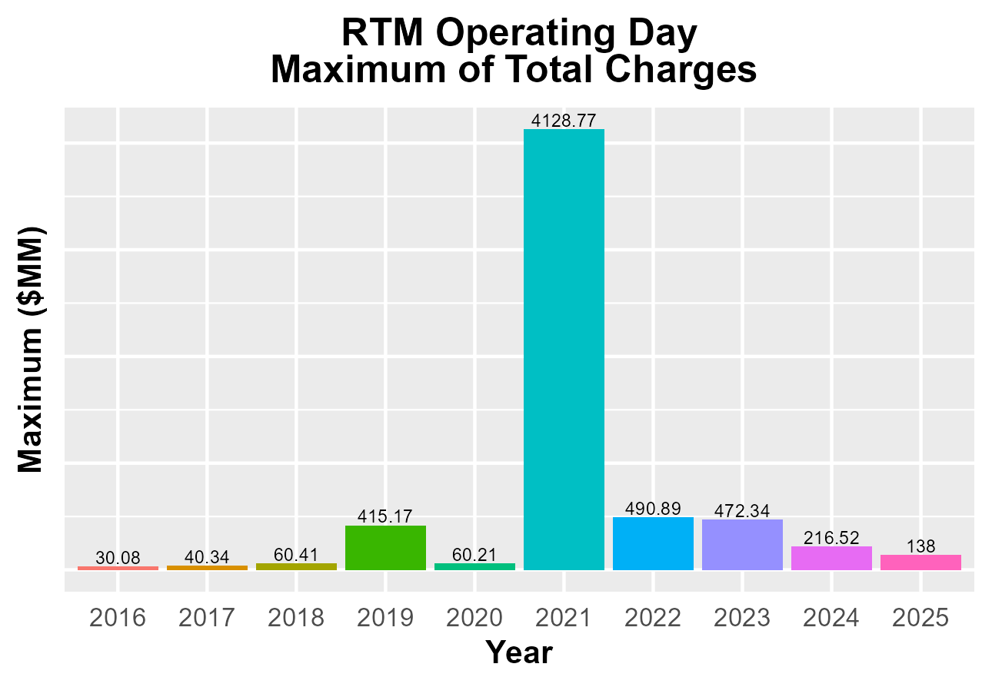
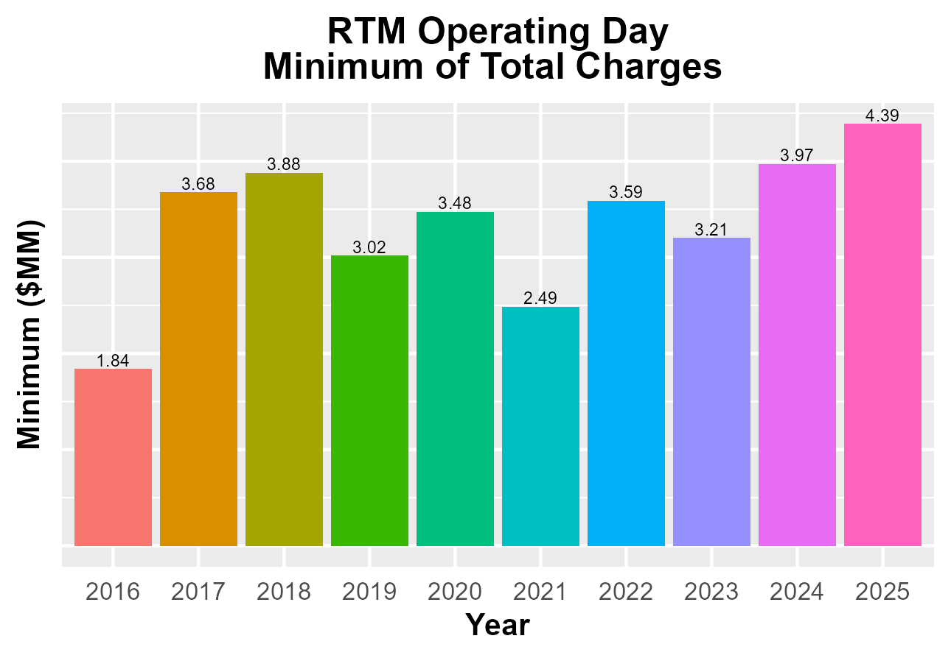
8.2(2)(c)(v) Other Settlement metrics

Slide 8
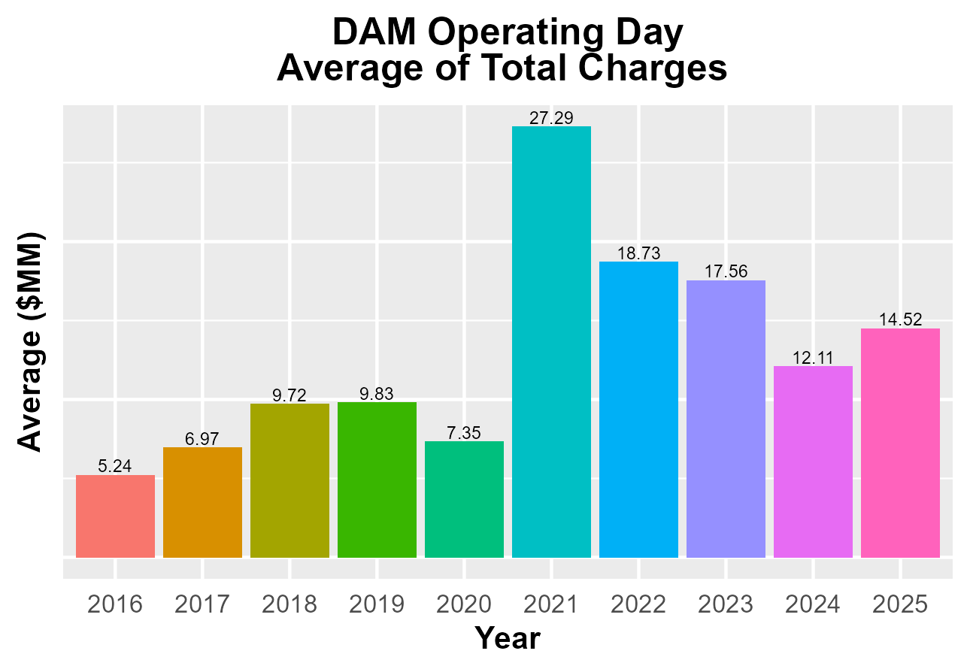
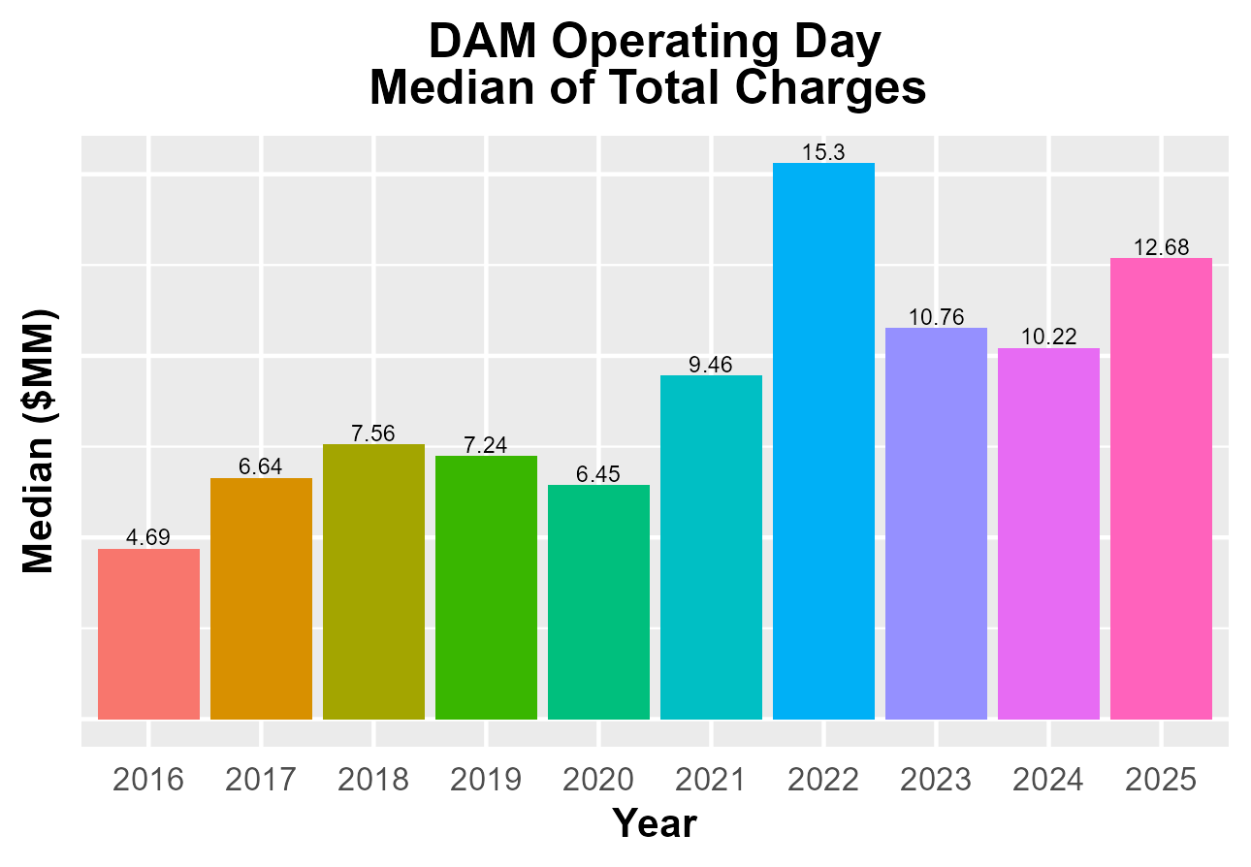
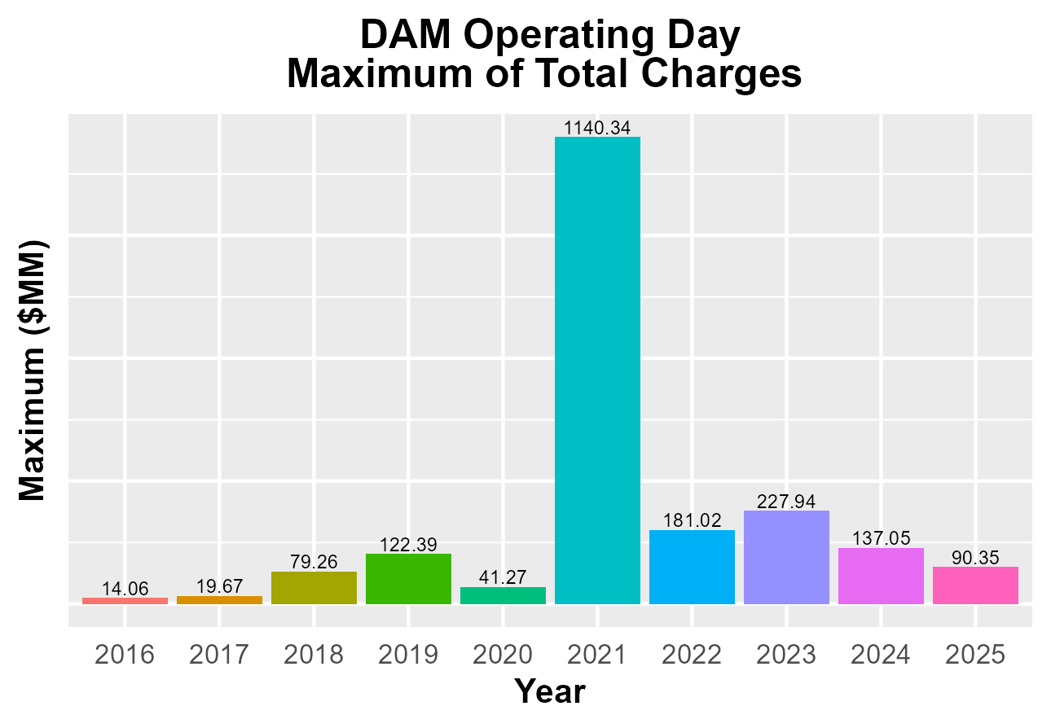
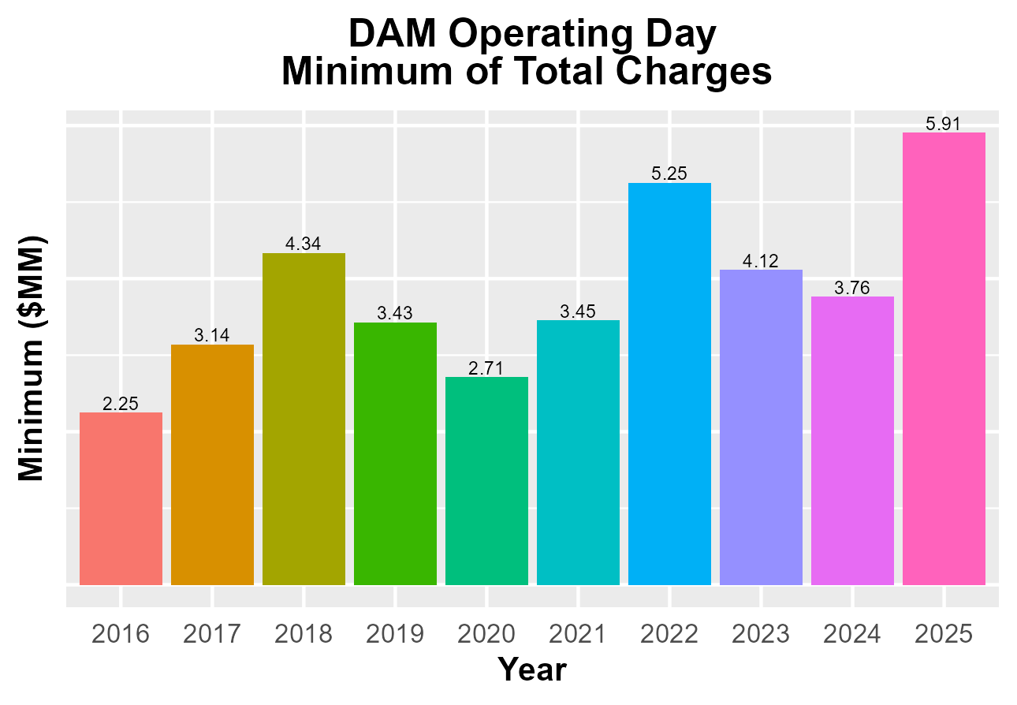
8.2(2)(c)(v) Other Settlement metrics

Slide 9
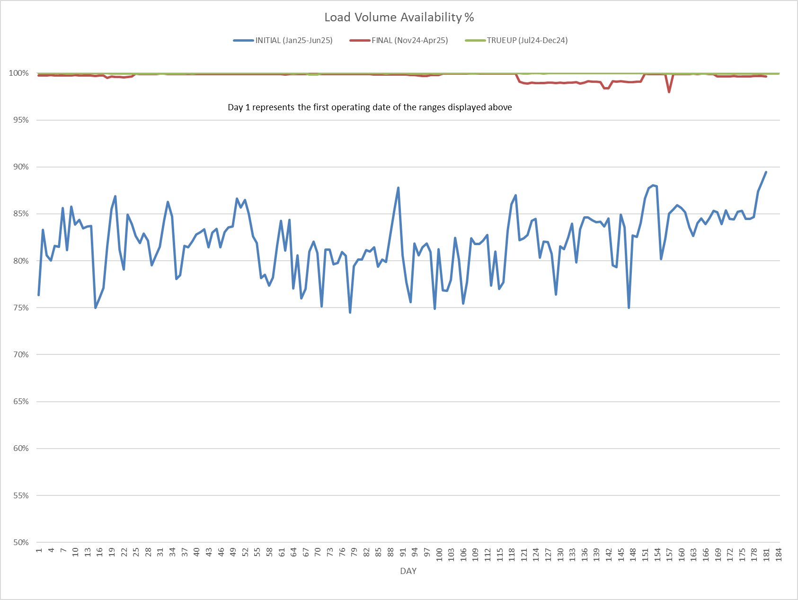
8.2(2)(c)(vi) Availability of ESIID consumption data

Slide 10
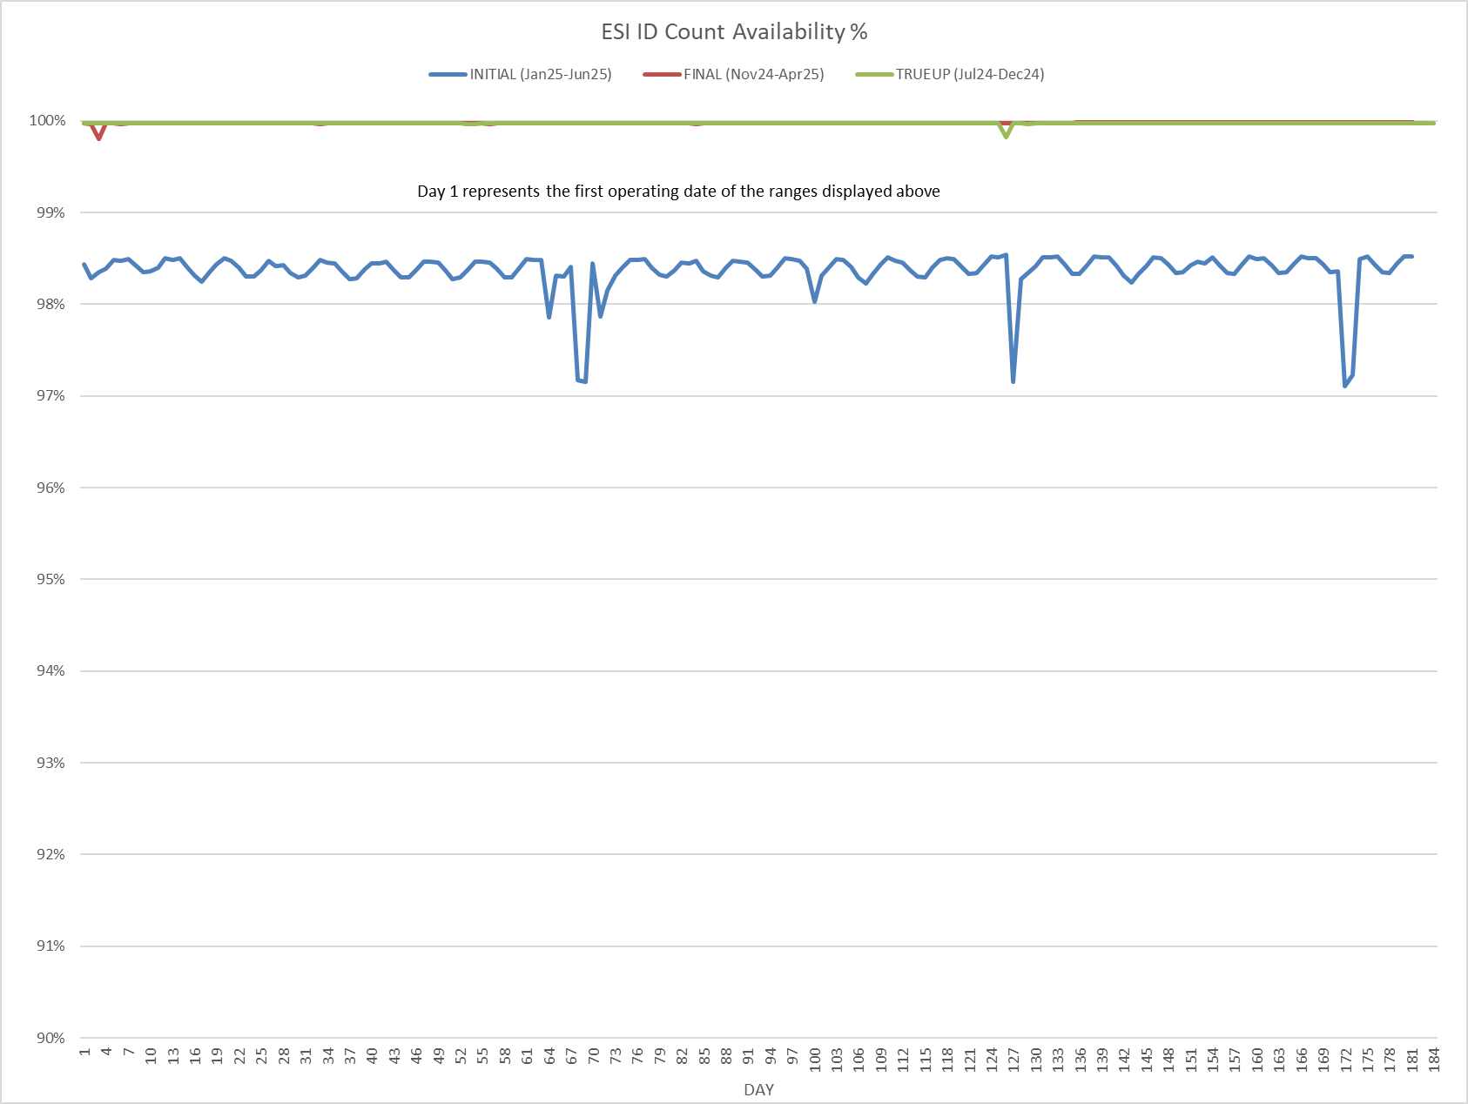
8.2(2)(c)(vi) Availability of ESIID consumption data

Slide 11
8.2(2)(g) Net Allocation to Load - Totals and $/MWh
NET ALLOCATION TO LOAD ($M)
 | Jun 2024 | Jul 2024 | Aug 2024 | Sep 2024 | Oct 2024 | Nov 2024 | Dec 2024 | Jan 2025 | Feb 2025 | Mar 2025 | Apr 2025 | May 2025 | Jun 2025
Ancillary Service Settlement | 30.1 | 13.0 | 36.6 | 9.6 | 22.4 | 15.3 | 7.9 | 9.6 | 14.5 | 14.1 | 15.0 | 49.0 | 14.7
Balancing Account Payout to Load | -29.9 | -24.6 | -27.6 | -16.8 | -4.3 | -24.5 | -13.4 | -40.9 | -32.1 | -7.5 | -18.4 | -37.0 | -34.6
Base Point Deviation Payments | -0.6 | -0.7 | -1.0 | -0.5 | -0.7 | -0.6 | -0.7 | -0.9 | -0.6 | -0.7 | -0.8 | -0.6 | -0.7
Black Start Service Settlement | 0.6 | 0.6 | 0.6 | 0.6 | 0.7 | 0.6 | 0.7 | 0.7 | 0.6 | 0.7 | 0.6 | 0.6 | 0.6
Block Load Transfer Settlement | 0.0 | 0.0 | 0.0 | 0.0 | 0.0 | 0.0 | 0.0 | 0.0 | 0.0 | 0.0 | 0.0 | 0.0 | 0.0
Emergency Energy Charges | 0.1 | 0.1 | 2.1 | 1.0 | 0.0 | 0.0 | 0.0 | 0.0 | 0.1 | 0.5 | 0.0 | 0.0 | 0.0
ERCOT Admin Fee Settlement | 28.1 | 28.2 | 31.1 | 25.9 | 24.8 | 21.3 | 22.0 | 25.6 | 21.9 | 21.9 | 23.0 | 26.0 | 28.5
ERO Pass-Through Fee⁵ | 2.3 | 2.3 | 2.3 | 2.3 | 2.3 | 2.3 | 2.3 | 2.5 | 2.5 | 2.5 | 2.5 | 2.5 | 2.5
ERS Settlement¹ | 7.6 | 7.6 | 7.6 | 7.6 | 2.1 | 2.1 | 8.5 | 8.5 | 8.5 | 8.5 | 0.0 | 0.0 | 0.0
Firm Fuel Service Settlement | 0.0 | 0.0 | 0.0 | 0.0 | 0.0 | 4.9 | 10.2 | 11.9 | 11.8 | 6.2 | 0.0 | 0.0 | 0.0
High Dispatch Limit Override | 0.0 | 0.0 | 0.0 | 0.0 | 0.0 | 0.0 | 0.0 | 0.0 | 0.0 | 0.0 | 0.0 | 0.0 | 0.0
Non-Zonal Auction Distribution | -46.5 | -30.8 | -28.8 | -32.5 | -48.8 | -49.1 | -41.3 | -27.7 | -29.1 | -48.6 | -50.7 | -45.6 | -42.9
ORDC Settlement | 0.2 | 0.1 | -0.3 | 0.4 | 0.9 | 0.7 | 1.5 | 3.8 | 7.7 | 3.7 | 1.3 | 1.1 | 1.4
Revenue Neutrality Total | 9.4 | 9.3 | 9.0 | 15.5 | 9.4 | 10.2 | 17.7 | 23.0 | 22.0 | 14.6 | 11.8 | 13.3 | 14.3
RMR/Mobile Gen Settlement | 0.0 | 0.0 | 0.0 | 0.0 | 0.0 | 0.0 | 0.0 | 0.0 | 0.0 | 1.9 | 1.9 | 1.9 | 16.8
RUC Settlement | 0.0 | 0.0 | -0.1 | -0.1 | -0.2 | -1.8 | -0.1 | -1.0 | -3.3 | -0.5 | -1.0 | -0.6 | -0.2
Voltage Services Settlement | 0.0 | 0.0 | 0.0 | 0.0 | 0.0 | 0.0 | 0.0 | 0.0 | 0.0 | 0.0 | 0.0 | 0.0 | 0.0
Zonal Auction Distribution² | -103.4 | -120.5 | -119.8 | -98.4 | -95.6 | -84.0 | -96.5 | -109.8 | -100.8 | -117.7 | -108.5 | -116.2 | -126.8
Total Allocation to Load | -102.0 | -115.4 | -88.3 | -85.4 | -87.0 | -102.6 | -81.2 | -94.7 | -76.3 | -100.4 | -123.3 | -105.6 | -126.4
Adjusted Metered Load (TWh) | 44.6 | 44.7 | 49.4 | 41.1 | 39.4 | 33.8 | 34.9 | 40.6 | 34.8 | 34.8 | 36.6 | 41.3 | 45.2
$/MWh³ | -2.3 | -2.6 | -1.8 | -2.1 | -2.2 | -3.0 | -2.3 | -2.3 | -2.2 | -2.9 | -3.4 | -2.6 | -2.8
Note: The Net Allocation to Load amounts provided in this presentation are for informational purposes only and cannot be relied upon for accurate measurements or forecasts of individual QSE charges and payments.
¹The total ERS charges have been evenly allocated across the contract period.
²Zonal Auction Distribution by 2003 Congestion Management Zone, shown below.
³The $/MWh value as calculated per PR 8.2 (2) g
⁴The $/MWh value by 2003 Congestion Management Zone, as calculated per PR 8.2(2) g
⁵Allocated to load from two years prior per the Electric Reliability Organization Fee Assessment and Collection Guide

Slide 12
8.2(2)(g) Net Allocation to Load - Totals and $/MWh
ZONAL AUCTION DISTRIBUTION PER CONGESTION MANAGEMENT ZONE ($M)
 | Jun 2024 | Jul 2024 | Aug 2024 | Sep 2024 | Oct 2024 | Nov 2024 | Dec 2024 | Jan 2025 | Feb 2025 | Mar 2025 | Apr 2025 | May 2025 | Jun 2025
HOUSTON | -13.1 | -12.1 | -11.9 | -9.8 | -9.8 | -7.7 | -6.9 | -10.1 | -8.4 | -10.1 | -12.0 | -12.8 | -11.6
NORTH | -21.0 | -28.2 | -29.5 | -21.4 | -13.9 | -13.2 | -15.8 | -21.0 | -18.8 | -16.6 | -15.5 | -19.8 | -26.3
SOUTH | -35.9 | -42.4 | -41.7 | -33.5 | -34.3 | -29.9 | -29.6 | -33.2 | -29.3 | -33.8 | -33.2 | -33.7 | -38.6
WEST | -33.3 | -37.9 | -36.7 | -33.6 | -37.5 | -33.2 | -44.2 | -45.5 | -44.3 | -57.1 | -47.7 | -50.0 | -50.4
TOTAL | -103.4 | -120.5 | -119.8 | -98.4 | -95.6 | -84.0 | -96.5 | -109.8 | -100.8 | -117.7 | -108.5 | -116.2 | -126.8
REAL-TIME ADJUSTED METERED LOAD BY CONGESTION MANAGEMENT ZONE (TWh)
 | Jun 2024 | Jul 2024 | Aug 2024 | Sep 2024 | Oct 2024 | Nov 2024 | Dec 2024 | Jan 2025 | Feb 2025 | Mar 2025 | Apr 2025 | May 2025 | Jun 2025
HOUSTON | 11.7 | 10.5 | 12.6 | 10.7 | 10.2 | 8.7 | 8.3 | 9.1 | 8.1 | 8.8 | 9.5 | 10.8 | 11.6
NORTH | 14.3 | 15.3 | 16.8 | 12.9 | 12.1 | 10.0 | 10.9 | 13.7 | 11.4 | 10.2 | 10.7 | 12.1 | 14.4
SOUTH | 12.0 | 11.9 | 12.9 | 11.0 | 10.3 | 8.7 | 8.7 | 10.6 | 9.0 | 8.9 | 9.6 | 11.2 | 11.9
WEST | 6.6 | 7.0 | 7.1 | 6.5 | 6.7 | 6.4 | 7.0 | 7.2 | 6.3 | 6.8 | 6.8 | 7.2 | 7.3
TOTAL | 44.6 | 44.7 | 49.4 | 41.1 | 39.4 | 33.8 | 34.9 | 40.6 | 34.8 | 34.8 | 36.6 | 41.3 | 45.2
ZONAL AUCTION REVENUE PER CONGESTION MANAGEMENT ZONE ($/MWh)
 | Jun 2024 | Jul 2024 | Aug 2024 | Sep 2024 | Oct 2024 | Nov 2024 | Dec 2024 | Jan 2025 | Feb 2025 | Mar 2025 | Apr 2025 | May 2025 | Jun 2025
HOUSTON | -1.1 | -1.2 | -0.9 | -0.9 | -1.0 | -0.9 | -0.8 | -1.1 | -1.0 | -1.1 | -1.3 | -1.2 | -1.0
NORTH | -1.5 | -1.8 | -1.8 | -1.7 | -1.1 | -1.3 | -1.4 | -1.5 | -1.6 | -1.6 | -1.4 | -1.6 | -1.8
SOUTH | -3.0 | -3.6 | -3.2 | -3.0 | -3.3 | -3.4 | -3.4 | -3.1 | -3.3 | -3.8 | -3.5 | -3.0 | -3.2
WEST | -5.0 | -5.4 | -5.2 | -5.2 | -5.6 | -5.2 | -6.3 | -6.3 | -7.0 | -8.4 | -7.0 | -6.9 | -6.9
TOTAL | -2.3 | -2.7 | -2.4 | -2.4 | -2.4 | -2.5 | -2.8 | -2.7 | -2.9 | -3.4 | -3.0 | -2.8 | -2.8
NET ALLOCATION TO LOAD PER CONGESTION MANAGEMENT ZONE ($/MWh)⁴
 | Jun 2024 | Jul 2024 | Aug 2024 | Sep 2024 | Oct 2024 | Nov 2024 | Dec 2024 | Jan 2025 | Feb 2025 | Mar 2025 | Apr 2025 | May 2025 | Jun 2025
HOUSTON | -1.1 | -1.1 | -0.3 | -0.6 | -0.8 | -1.5 | -0.4 | -0.7 | -0.3 | -0.6 | -1.7 | -0.9 | -1.0
NORTH | -1.5 | -1.7 | -1.2 | -1.4 | -0.9 | -1.9 | -1.0 | -1.1 | -0.9 | -1.1 | -1.8 | -1.3 | -1.8
SOUTH | -3.0 | -3.5 | -2.6 | -2.7 | -3.1 | -4.0 | -3.0 | -2.7 | -2.6 | -3.3 | -3.9 | -2.7 | -3.2
WEST | -5.0 | -5.3 | -4.6 | -4.9 | -5.4 | -5.8 | -5.9 | -5.9 | -6.3 | -7.9 | -7.4 | -6.6 | -6.9
TOTAL | -2.3 | -2.6 | -1.8 | -2.1 | -2.2 | -3.0 | -2.3 | -2.4 | -2.2 | -2.9 | -3.4 | -2.6 | -2.8

Slide 13
26.2 Securitization Default Charge
27.3 Securitization Uplift Charge
Subchapter M Invoice Month | Reference Month (RTM_FINAL data) | Monthly Uplift ($) (TSDCMA) | SDCMMATOT (MWh)
Jun-24 | Mar-24 | 1,926,208 | 239,187,399
Jul-24 | Apr-24 | 1,926,208 | 225,048,389
Aug-24 | May-24 | 1,926,208 | 241,905,226
Sep-24 | Jun-24 | 1,926,208 | 242,555,565
Oct-24 | Jul-24 | 1,926,208 | 265,253,998
Nov-24 | Aug-24 | 2,234,826 | 261,274,635
Dec-24 | Sep-24 | 2,234,826 | 254,909,036
Jan-25 | Oct-24 | 2,234,826 | 267,243,422
Feb-25 | Nov-24 | 2,234,826 | 259,296,832
Mar-25 | Dec-24 | 2,234,826 | 271,342,237
Apr-25 | Jan-25 | 2,234,826 | 269,652,704
May-25 | Feb-25 | 2,393,201 | 245,496,350
Jun-25 | Mar-25 | 2,393,201 | 266,900,167
Subchapter N¹ Invoice Month | Monthly Uplift ($) (MTSUCDA) | Non-Optout RTAML (MWh) | $/MWh
Jun-24 | 10,692,892 | 22,942,646 | 0.47
Jul-24 | 12,602,337 | 28,219,082 | 0.45
Aug-24 | 11,538,720 | 28,316,487 | 0.41
Sep-24 | 11,923,344 | 25,097,865 | 0.48
Oct-24 | 11,923,344 | 22,191,513 | 0.54
Nov-24 | 10,430,100 | 17,570,047 | 0.59
Dec-24 | 13,134,200 | 21,319,230 | 0.62
Jan-25 | 11,975,300 | 22,875,302 | 0.52
Feb-25 | 10,965,136 | 19,727,370 | 0.56
Mar-25 | 12,139,972 | 19,101,078 | 0.64
Apr-25 | 11,748,360 | 20,188,395 | 0.58
May-25 | 11,780,760 | 22,701,165 | 0.52
Jun-25 | 12,173,452 | 26,581,390 | 0.46
¹The data provided is grouped by the month the amount was invoiced.

