Slide 1
Unregistered Distributed Generation Report:
2025 Q2 Update
Resource Adequacy
8/6/2025

Slide 2
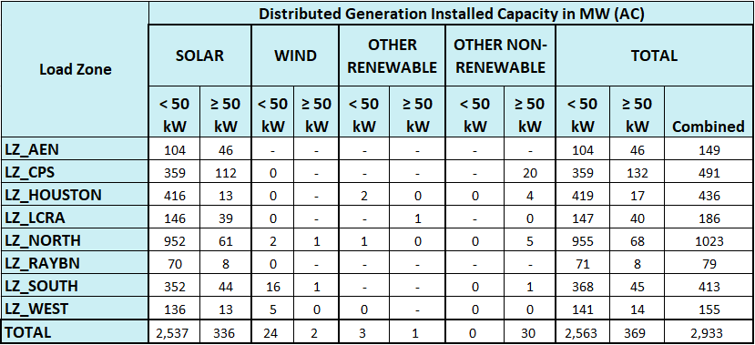
2025 Q2 Unregistered Distributed Generation Report
DG Battery Energy Storage not included in the table above
(64.44 MW Competitive, 18.87 MW NOIEs, 83.31 MW Total)
Totals may not match the sum of their columns/rows due to rounding
Notes:
Competitive and NOIE breakdown:
Competitive: 1,696 MW
NOIE: 1,237 MW
For the quarterly report, NOIE capacity below 50 kW only includes information from NOIEs that have more than two MW of aggregate capacity from those sites.

Slide 3
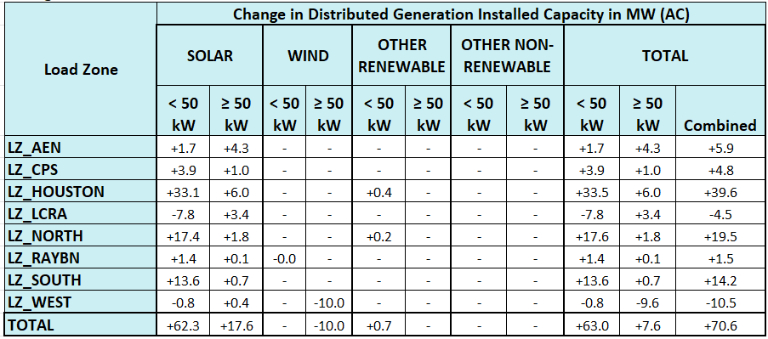
2025 Q1 → 2025 Q2 Change
Decreases in “LZ_West, Wind” due to the removal of City of Lubbock from NOIE totals to avoid counting after moving it to competitive category. Totals may not match the sum of their columns/rows due to rounding.

Slide 4
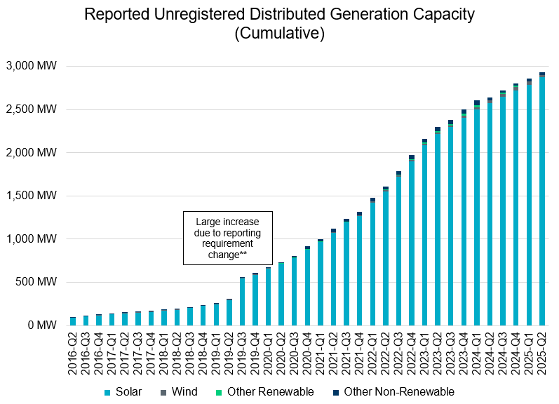
Unregistered DG Growth: 2016-Q2* to 2025-Q2
* 2016-Q2 was the first report published after implementation of report changes per NPRR794/COPMGR044
** 2019-Q3 was the first report published after implementation of report changes per NPRR891

