Slide 1
NPRR 1286 Joint Commenters
EDF power solutions, Invenergy, Pattern Energy
PLWG 7/29/2025

Slide 2
Resolving GTCs Would Improve Resiliency
The ongoing proliferation of GTCs highlights a need for more resiliency across the system, as GTCs add bottlenecks where the grid is fragile.
Joint commenters propose
  Improving transparency on the impact to GTCs of RTP and RPG projects
  Including an additional resiliency benefit in evaluations when GTCs will be resolved by projects
  Explicitly allowing for stakeholder sponsorship of upgrades, which is currently an option but not clearly presented in the protocols
  Quantifying and including the value of releasing generation trapped behind GTCs to serve load during emergency conditions
Combining the remaining concept from NPRR 1070 into NPRR 1286 will facilitate resolution of these complex topics simultaneously rather than continuing with two NPRRs editing the same section with overlapping issues.

Slide 3
Proposed Language Addition in NPRR 1286
(8) In order to improve system stability and resiliency by resolving identified Generic Transmission Constraints (GTCs) and/or improving Generic Transmission Limits (GTLs) ERCOT will:
(a) Show for all transmission project evaluations whether the project provides exit solutions for resolving nearby GTCs or increases any GTLs;
(b) Endorse any GTC solution option that is within $20 million of meeting the cost-to-benefit criteria when there are more than five GTCs, in order to reflect the intangible resiliency value of reducing the number of GTCs impacting system operations; and
Allow individual stakeholder(s) to pay for the additional difference above the threshold in paragraph (8)(b) above. ERCOT will endorse that option when stakeholder(s) demonstrate commitment to pay the additional cost.
(9) When evaluating the economic benefits of GTC exit solutions or projects that improve GTLs, in addition to the savings described in paragraphs (5) and (6) above, the impact of GTCs on generation available to serve system load during Emergency Conditions may be evaluated. Any information available from generation adequacy studies or resiliency studies that consider a range of system conditions may be used to estimate the value of improved deliverability of generation due to relieving GTCs.

Slide 4
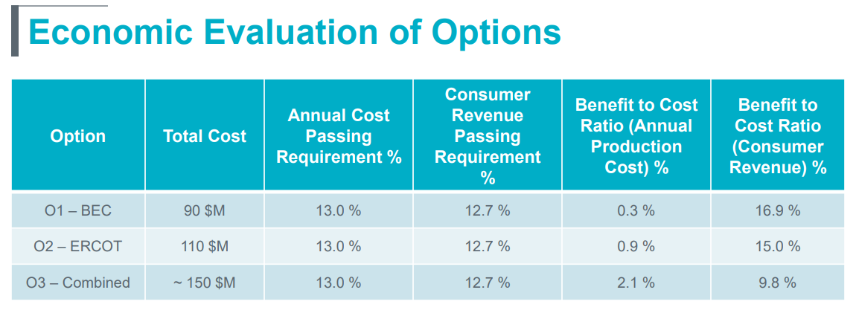
BEC Hamilton County Conversion Project
Option 1 BEC proposed option
Option 2 ERCOT GTC Exit Plan

Slide 5
Example using the Hamilton Conversion Project
8a – ERCOT GTC Exit Plan was prepared by ERCOT
8b – The cost difference from the proposed plan is $20 million (which was the driver of the proposed value in the NPRR comments)
8c – If the difference is greater than $20 million, stakeholders would have the option to pay the difference.

