Slide 1
ESR Ancillary Service SOC Shortfall Analysis Report
For June 2025
Balancing Operations Planning Staff
August 4, 2025

Slide 2
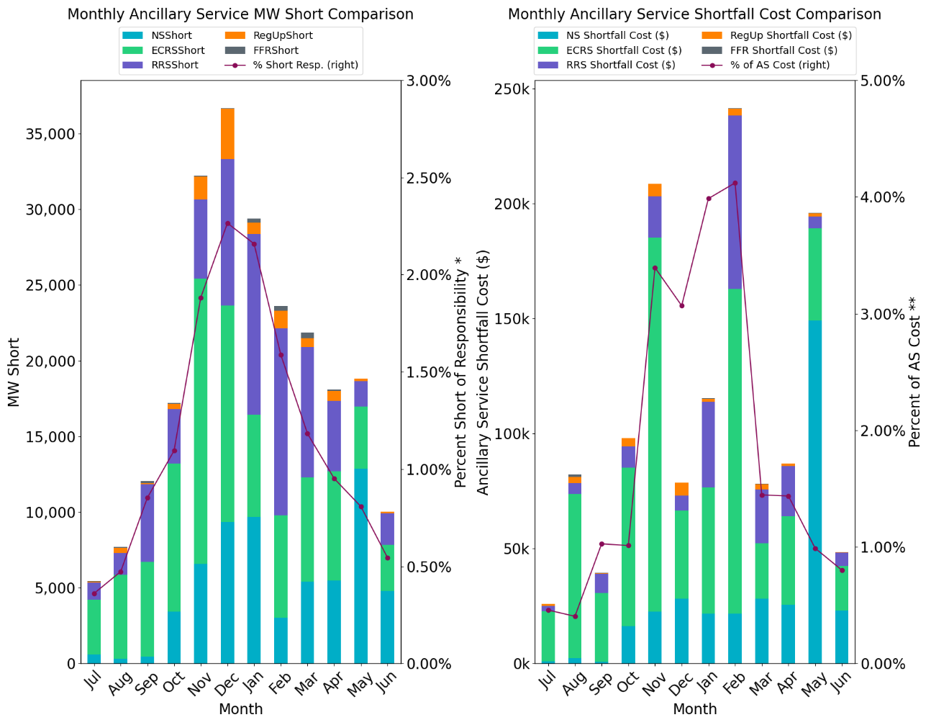
Insufficient SOC to provide Ancillary Service Obligations if system conditions require (Month over Month)
An ESRs Shortfall is converted a to MW value and system-wide AS MW Short is computed for every hour (referred to as MW Short). Ancillary Service Shortfall costs are determined using MW Short and historical MCPC.
* % Short of AS Responsibility = (Monthly ESR MW Short / Monthly ESR AS Responsibility)*100
** % of AS Cost = (Monthly AS Shortfall Cost from ESRs / Monthly Total MCPC of the AS Carried by ESRs) * 100
Observation: In June, ESRs were approximately 0.54% Short of AS Responsibility, resulting in approximately 0.80% of the Total AS Cost carried by ESRs.

Slide 3
Inadequate response from ESRs during unit trips when carrying RRS with low SOC^
  This data is sourced from the ERCOT BAL-TRE-001 FME tool. Low SOC is determined using telemetered SOC, MXOS, MNOS. SOC % = ((SOC-MNOS)/MXOS)*100.
  * RRS-FFR performance is determined solely on sufficient MW response being provided.
  ** FMEs and Non-FMEs which were reported to PDCWG.
  ^ Low SOC is set to 20% for this analysis, this is a configurable parameter.
 | RRS-PFR | RRS-FFR |  | RRS-FFR
Event Date | Evaluated ESRs | Low SOC ESRs |  | Evaluated ESRs | Low SOC ESRs |  | Frequency Events**
 |  | Evaluated | Failed |  | Evaluated | Failed*
4/3/2025 21:47 | 64 | 1 | 1 | 0 | 0 | 0 | Non-FME
4/5/2025 22:19 | 57 | 1 | 1 | 0 | 0 | 0 | Non-FME
4/15/2025 7:13 | 65 | 3 | 0 | 0 | 0 | 0 | Non-FME
4/23/2025 5:17 | 45 | 1 | 0 | 0 | 0 | 0 | Non-FME
4/24/2025 1:03 | 37 | 8 | 1 | 0 | 0 | 0 | FME
5/6/2025 10:44 | 70 | 1 | 0 | 0 | 0 | 0 | Non-FME
5/15/2025 16:59 | 57 | 0 | 0 | 0 | 0 | 0 | Non-FME
5/29/2025 23:47 | 47 | 1 | 0 | 0 | 0 | 0 | Non-FME
6/2/2025 2:49 | 51 | 7 | 1 | 0 | 0 | 0 | Non-FME
6/5/2025 2:25 | 37 | 2 | 0 | 0 | 0 | 0 | Non-FME
6/14/2025 19:35 | 98 | 0 | 0 | 0 | 0 | 0 | Non-FME
6/17/2025 16:19 | 83 | 0 | 0 | 0 | 0 | 0 | Non-FME
Observation: In June, 9 ESRs carrying RRS evaluated during unit trips had low SOC, 1 of which failed.
Notes:
RRS-PFR is evaluated on ERCOT-RRS metric (1% droop).

Slide 4
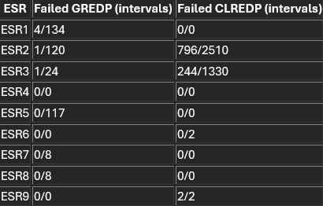
Inadequate output following dispatch setpoints when carrying AS with high/low SOC^
GREDP and CLREDP formulas from Protocols are used to compute how closely an ESR providing Ancillary Services followed its setpoints* in low and high SOC intervals. SOC % is determined using telemetered SOC, MXOS, MNOS. SOC % = ((SOC-MNOS)/MXOS)*100.
* Setpoint is calculated as Base Point + regulation instruction + expected PFR.
^ Low SOC is set to 20% and high SOC is set to 80% for this analysis, this is a configurable parameter.
Month | ESR GREDP Interval Failures | ESR CLREDP Interval Failures | Total Intervals on Low SOC with Up AS | Total Intervals on High SOC with Down AS
June 2025 | 6 | 1042 | 411 | 3844
Observation: In June, there are 6 interval where ESRs failed GREDP with low SOC and AS Responsibility, and 1042 intervals where ESRs failed CLREDP with high SOC and AS Responsibility.
Notes:
^ Low/high SOC is configurable.
Low SOC is considered in intervals with Up AS
High SOC is considered in intervals with Down AS

Slide 5
Appendix

Slide 6
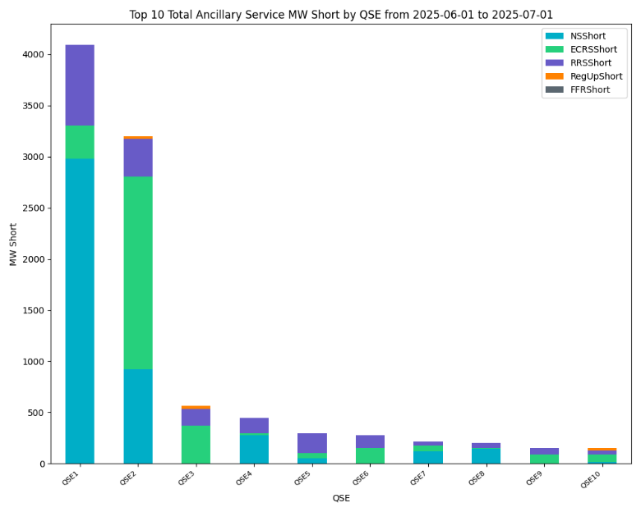
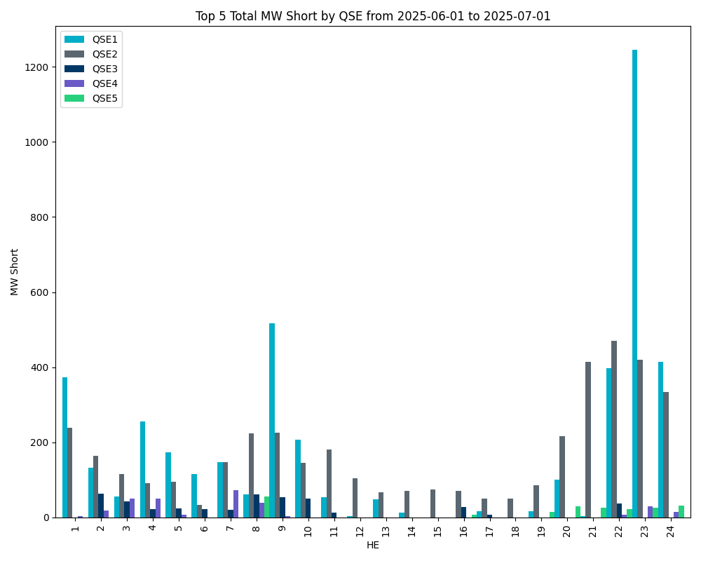
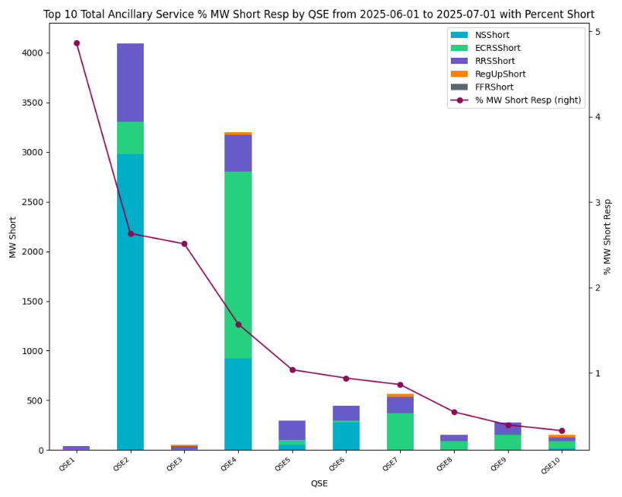
Insufficient SOC to provide Ancillary Service Obligations if system conditions require
Observation: The QSEs with the most MW Short in June tend to be short in HE22, HE23, and HE24.
* The QSE labels may represent different QSEs in different charts.

Slide 7
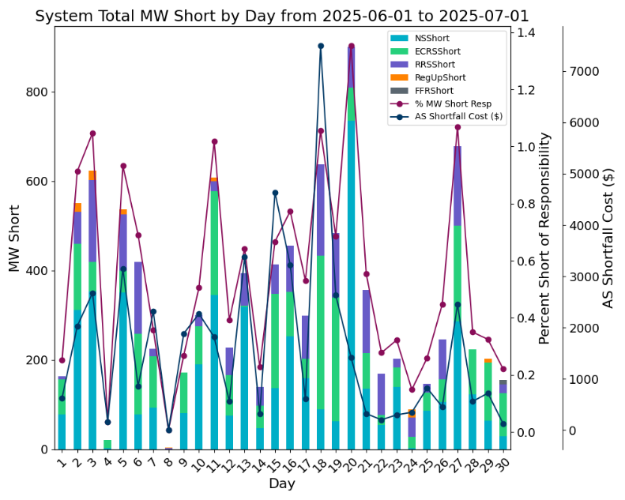
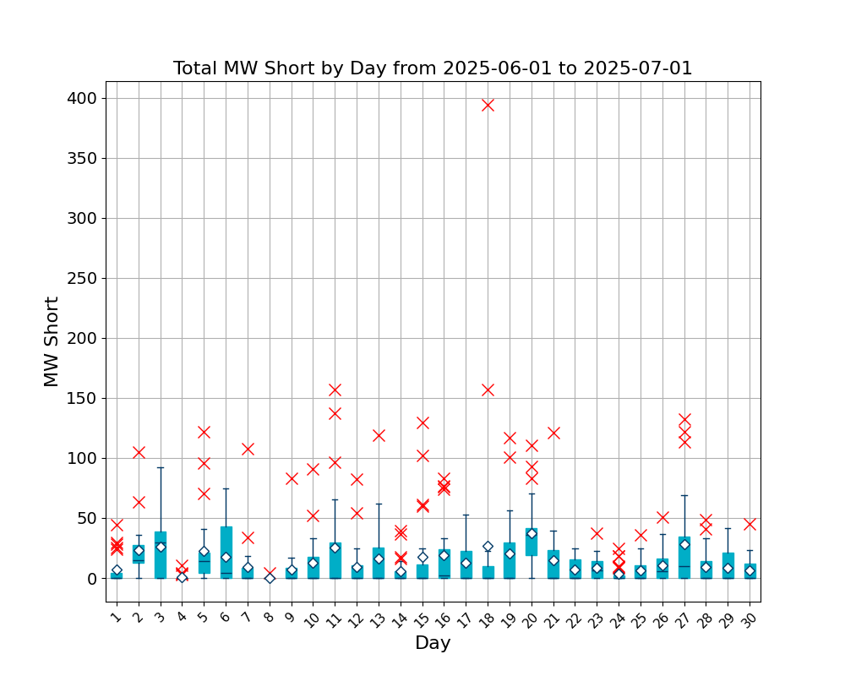
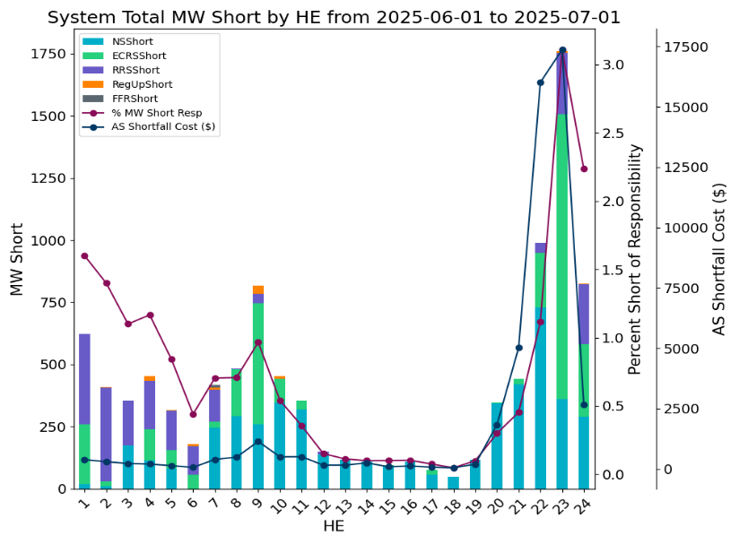
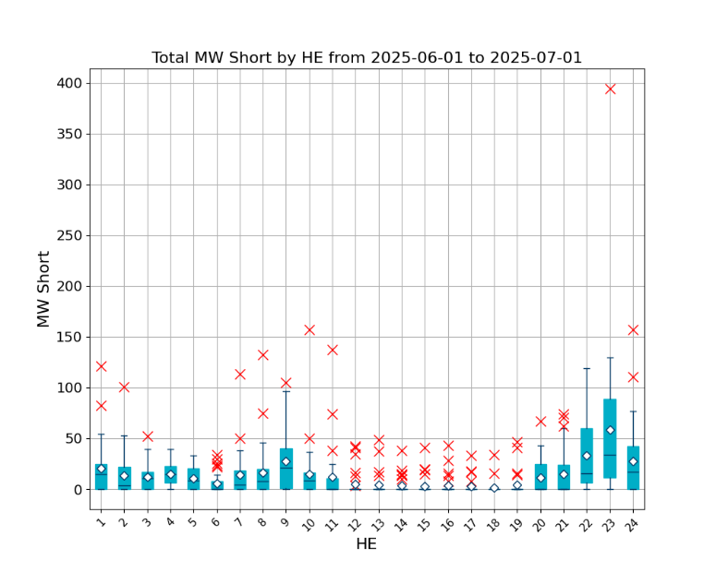
Insufficient SOC to provide Ancillary Service Obligations if system conditions require
Shortfalls are converted to MW values (referred to as MW Short) and grouped by HE and Day of the month. Ancillary Service Shortfall costs are determined using MW Short and historical MCPC.
Observation:
Top 3 days with largest AS MW short due to SOC: June 20, June 27, June 18
Top 3 days with largest AS $ short due to SOC: June 18, June 15, June 13
Top 5 Hours with AS MW short due to SOC: HE23, HE22, HE24, HE9, HE1

Slide 8
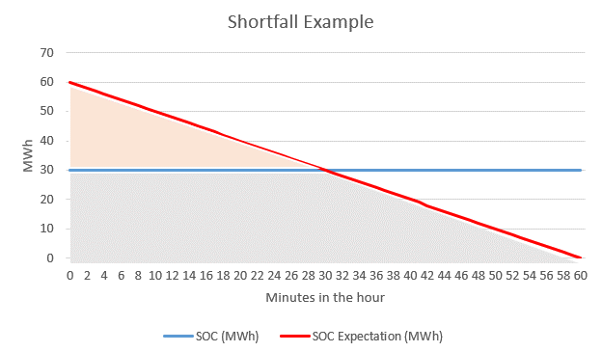
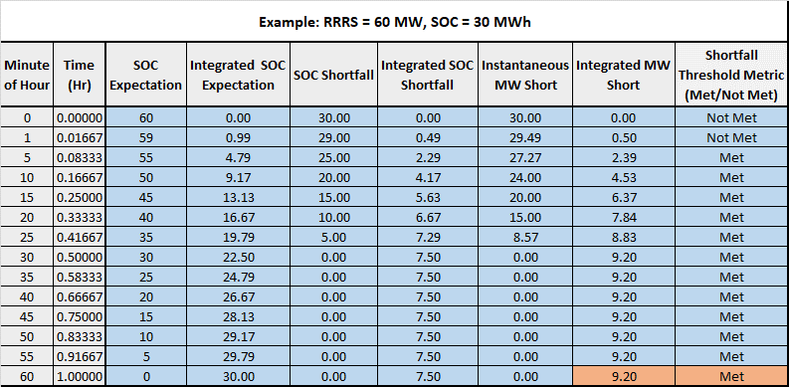
Insufficient SOC to provide Ancillary Service Obligation Example
Example: AS Responsibility of 60 MW while only telemetering 30 MWh of SOC throughout the hour.
This ESR would contribute 9.2 MW RRS Short for this hour.
This hour would be considered a Shortfall Hour due to meeting the proposed NPRR1186 shortfall threshold metric at the end of the hour. (Integrated SOC shortfall exceeds the greater of 2MWhh or the lower of 8MWhh or 20% of the integrated SOC expectation)
Attached is an excel workbook that can be used to explore shortfall scenarios in more detail.
This slide is sourced from mock data to demonstrate report capabilities.
Notes:
For a given ESR in an hour:
SOC Shortfall = SOC Expectation – SOC
Instantaneous MW Short = SOC Shortfall / (1-Time)
Integrated MW Short = Integration of Instantaneous MW Short over the hour
MW Short for the hour = Integrated MW Short at the final interval of the hour
The MW Short for the hour is aggregated for all ESRs across all hours in the month. It is referred to as MW Short in this slide deck.

