Slide 1
RTC+B Task Force
Update
Matt Mereness
RTCBTF
July 23, 2025

Slide 2
Outline
Discussion today:
  Update on RTCBTF Issues List
  Update on NPRRs
  Market Trials Update
  Rest of Today’s Agenda

Slide 3
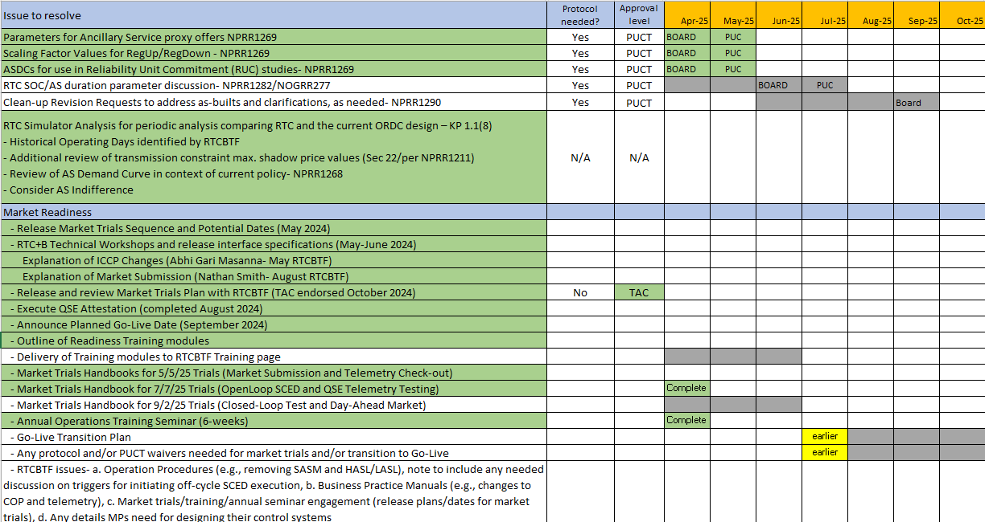
RTCBTF Issues List
Revisions- Final Clean-Up NPRR1290 & NOGRR278 (September)
Implementation - Handbooks complete and initiating transition plan details
Market Trials

Slide 4
Summary and Timeline of NPRRs
NPRRs set for PUCT May 15 Open Meeting (PUCT approved)
  NPRR1268 for ASDC Modifications (IMM sponsor)
  NPRR1269 for 3 Parameter/Policy Changes (ERCOT sponsor)
  NPRR1270 for AS Qualification details (ERCOT sponsor)
AS Duration / State of Charge NPRR1282 & NOGRR277)
  Approved at June Board
  PUCT July approval pending
Final Clarifying NPRR1290 & NOGRR278 - Sep Board
  Discussion today of NOGRR278
Remaining Stakeholder path to Board Meetings before Go-Live:
  PRS May 14 > TAC May 28 > Board June 24
  PRS Aug 13 > TAC Aug 28 > Board Sep 23

Slide 5
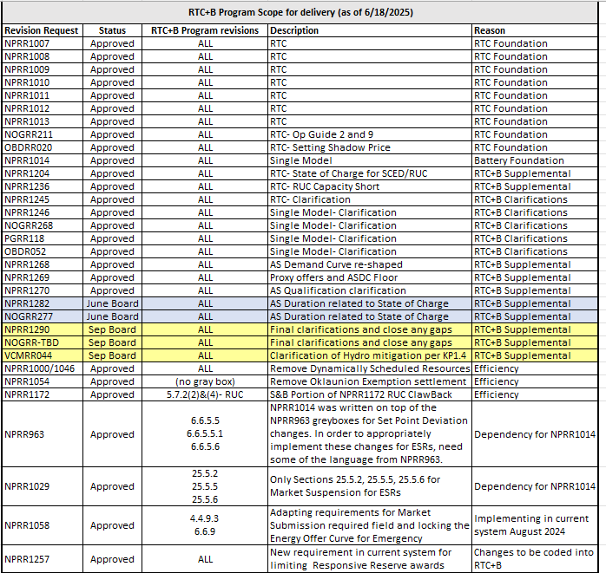
RTC+B Scope
Final 2025 Refinements for Go-Live
Related NPRRs
within Program

Slide 6
Sequence and Dates for Market Trials to Go-Live
30-day Market Notice
11/5/25
March/April
2025
Start
5/5/25
Start
7/7/25
Start
9/2/25
Go-Live
12/5/25*
May 2025
June 2025
July 2025
Aug 2025
Sep 2025
Oct 2025
Nov 2025
Dec 2025
QSE Scorecards & Exit Criteria for each Trial Phase
RTC QSE Submission Testing
(Submit COP, RT AS Offers,
DAM Virtual AS, Outages for ESRs)
Open-loop RTC SCED
(QSE offers, SCED non-binding award/dispatch)
Ongoing Open-Loop
& Periodic Closed-loop SCED/LFC
(QSE RTC offers and telemetry to support closed-loop frequency control test 2-3 tests of 2-4 hour durations)
Transition to Go-Live
Upon completion of testing, confirmation of ERCOT and market readiness for Go-Live.
QSE/Vendor Submission Sandbox and Telemetry Points added Prod EMS model.
RTC QSE Telemetry Check-out (QSEs add/verify new telemetry points for UDSP, New ramp rates, ESR telemetry)
QSE Telemetry Tests
(Individual QSE to follow UDSP and support new ramp rate and ESR telemetry)
Day-Ahead Market
(Non-binding DAM using QSE offers for at least 2 tests)
* Go-Live date reflects 12/5/2025 as first Operating Day
where 12/4/2025 is planned software migration.

Slide 7
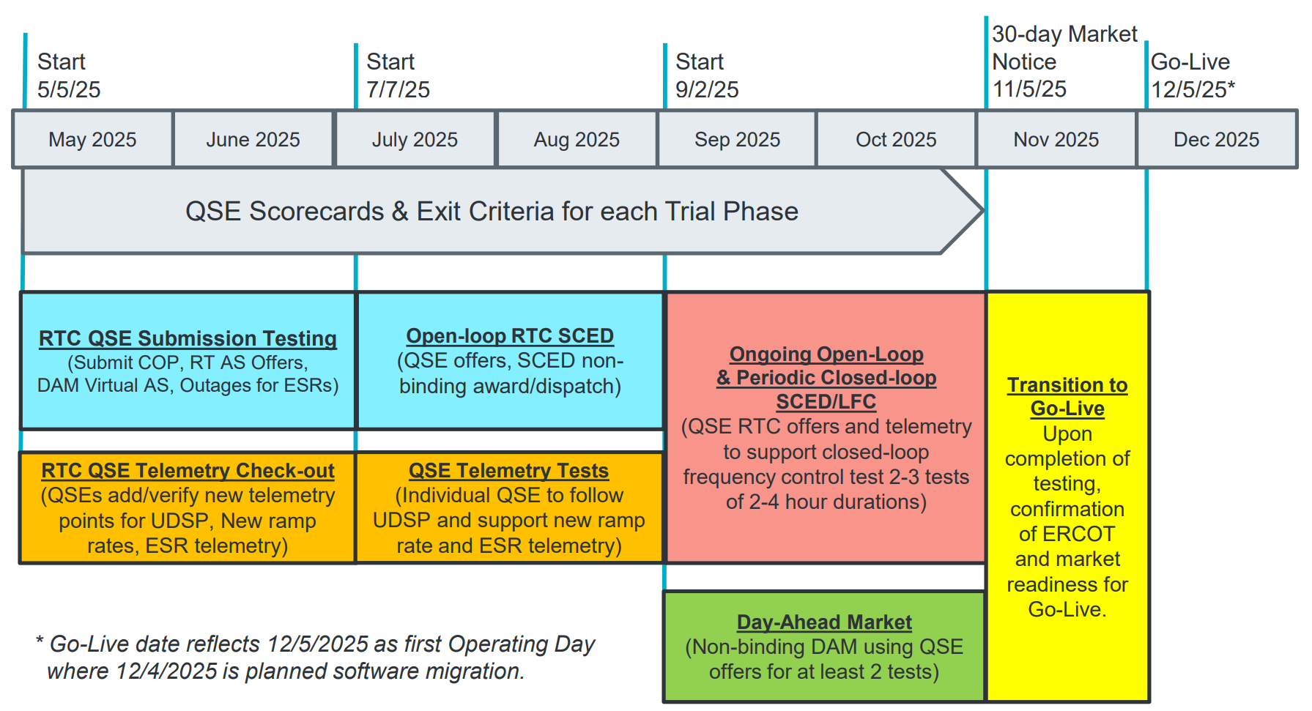
May & June:
Establishing Connectivity
QSE will test their market submissions for defined subset transactions that are new or modified by RTC+B.
Scorecard goal is for 95% of QSEs to demonstrate successful submissions and have mitigation plans in place for remaining 5% to address in next trial phase.
QSE will add telemetry points for Energy Management System (EMS) system interface with ERCOT (such as Updated Desired Set Points (UDSP), New Ramp Rates, and ESR Telemetry)
Scorecard goal is for 98% of QSEs to demonstrate successful telemetry additions, and mitigation plans in place for remaining 2% to address in next trial phase. (Note 3-week lag in telemetry migrating through network model validation and into trials environment).

Slide 8
July & August:
Initial Real-Time Market execution and verify QSE ability to follow ERCOT frequency signals
QSE will support “parallel production” 2days/week by entering $bids/offers for non-binding RTC energy and A/S awards and dispatch (Open-loop test)
Scorecard goal for 100% of QSEs to demonstrate successful submissions and telemetry reflective of production, and mitigation plans in place for any outliers.
Coordination of individual QSE tests on subset of resources to ensure resources can follow new UDSP telemetry point from ERCOT.
Scorecard goal is for 98% of QSEs to successfully demonstrate, and mitigation plans in place for remaining 2% to address in next trial phase.

Slide 9
Sep & Oct:
Required live-production test to ensure effective frequency dispatch and control.
Sep & Oct:
Optional Day-Ahead Market
Voluntary Day-Ahead Market for all QSEs will be conducted at least 2 times.
QSE can test their market submissions for Day-Ahead AS Self-Arrangement, AS Only Offers, Trades and normal submissions.
DAM participation is strongly encouraged but not required in Readiness metrics since RTC procures AS in Real-Time.
Participation includes much broader QSE population (marketers and load-only QSEs).
ERCOT and QSEs will conduct live-production tests of RTC-SCED and Load Frequency Control (LFC) prior to go-live.
RTC-SCED and frequency control dispatch during the tests will be binding to manage the reliable operations of the grid for2-4 hours.
ERCOT will coordinate with QSEs on how to submit RTC offers and telemetry for Energy and AS for the two systems (current and RTC system).
ERCOT will provide a summary of the test and use analysis and engineering judgement to assess if the test was successful in controlling frequency.

Slide 10
Weekly Market Trials update
Trials meeting every Monday 10-10:30am until December
  Standalone calendar page each week with WebEx
    RTCBTF Home Page houses all market trials documentation
  Averaging 150-175 participants
  Weekly presentation walk-through with Q&A
    Heavy use of RTCB@ercot.com email -> FAQ
Quick walk-through of this week’s meeting

Slide 11
Other Updates
Readiness engagement update:
  Developed new folders on RTCBTF home page (done)
    Market Trials folder: Handbooks and supporting materials
    Technical Support folder: Key TWG technical materials
  RTCB@ercot.com mailbox for support of stakeholder implementation questions
  Established FAQ document and posted on RTCBTF home page
  Completed additional training videos
    Load Resources / RTC Worksheet Solver Walkthrough
    Day-Ahead Market / Battery
  Following guidance from RTCBTF to engage DSWG separately (4/17/25, 7/14/25)
  Operator Training Seminar and Spring GCPA (complete)
Closed-Loop LFC Workshop (later today 2-4pm)
ERCOT working with PUCT staff to protocol exemptions for LFC Test (and eventually Transition/Cutover)
Internal work on Transition/Cutover Plan Handbook (review initial today)
Weekly Market Trials in flight
Next TWG meeting is July 31 (technical side of RTCBTF)
  Next 2 slides are key to upcoming access changes

Slide 12
Focus for remainder of RTCBTF today:
3. NPRR1290 and NOGRR278 discussion
4. ESR Droop Settings and RFI Follow-up
5. AS Deployment Factors Discussion
6. Fast Frequency Response Follow-up
7. Market Readiness
Settlement Artifacts- RT Statement (including RUC) and Extracts and Settlement Matrix
Transition/Cutover Handbook: Initial Draft and Discussion
Note-
LFC Closed Loop LFC Workshop after Meeting (2-4pm) - Separate Meeting
Initial subset of Operating Procedures changes (at August RTCBTF)

