Slide 1
Settlement Statements, Extracts and Matrix
Magie Shanks
ERCOT
RTCBTF Working Group
July 23, 2025

Slide 2
DAM and RTM Statements and Extracts
A sample DAM and RTM Initial Statement have been provided with the corresponding DAM and RTM MODE/CODE extracts.
  The formatting of LSTIME to include leading zeros, stop time to include seconds in CSV files, and correction of the DAM Statement file name is the only thing that has changed in the DAM Statement and extract files since initially posted in May.
  RTM Statement and Extracts now includes RUC data.
Data in the statements and extracts has been created manually and for a single, generic QSE.
All MODE/CODE extracts have been provided in both XML and CSV formats.
Statements have been provided in XML and HTML format.
Only tables that contain data used in the Settlement calculations are provided in MODE/CODE extracts.
Provided data is test data; data may not be realistic in value.

Slide 3
DAM and RTM Statements and Extracts Cont.
Only charge types that were impacted by the RTC+B project have been provided in the Statements and Extracts.
  For input data provided that is used in charge types that were not impacted by the project, those charge types were not included in the output. Ex. some data that is used in the calculation of Real-Time Energy Imbalance is available in the extracts, but the output was not calculated.

Slide 4
Public Reference Data Extract (PRDE)
Public Reference Data Extract (PRDE) has also been provided in XML and CSV format.
The relationship data between the generic QSE and its generic Resources has been provided in both a separate excel file (Generic Relationship Key file) and added to the associated, necessary tables in the PRDE. Those include:
  QSE
  RESOURCENODAL
  GENERATOR, GENERATORHIST, GENHISTSETTLEMENT
  LOADRESOURCE
  RESOURCEID
  SETTLEMENTPOINT
  STATION, STATIONSERVICEHIST
Single model ESR’s with a start date prior to April 4, 2025 are modelled in the PRDE.
New Factor/FactorValues and Bill Determinants are available.

Slide 5
Settlement Matrix
Format of the Settlement Matrix has changed, reducing the Settlement Matrix from 312 pages to 112 pages.
Removed outdated equations that are no longer eligible for Resettlements or disputes.
Combined the bill determinant columns to provide more space for the Protocol equations.
Since the Ancillary Service equations in DAM and in RTM are the same for each Ancillary Service type, we have condensed the equation to one with “XX” to be replaced with the applicable Ancillary Service type (RU, RD, RR, NS, ECR).
Calculations impacted by RTC+B will either have an effective date of “Effective 12/05/2025 to Present” or an end date of 12/04/2025 in the “Effective Dates” column.
Calculation changes for Default Uplift are not included in the matrix as this charge is not on a Settlement Statement.

Slide 6
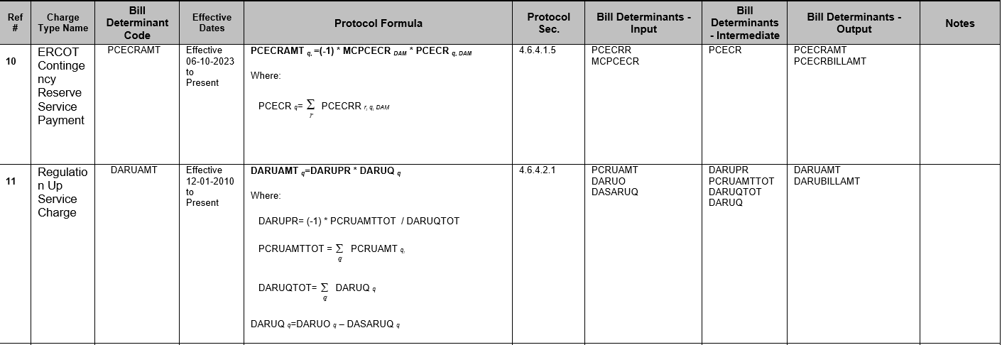
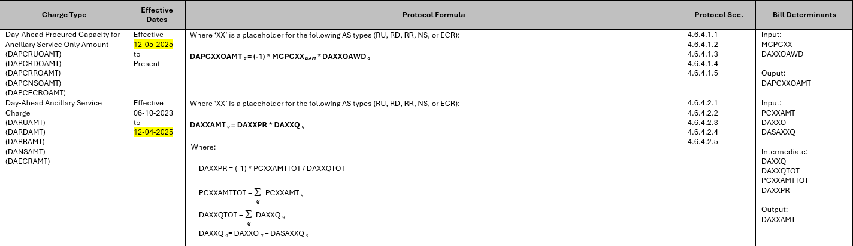
Settlement Matrix Cont.
Previous Version Sample:
New Version Sample:

Slide 7
Additional Information
For any additional questions or issues, please send an email to RTCB@ercot.com.

