Slide 1
CRR Technology Update
Sreenivas Badri
July 21, 2025

Slide 2
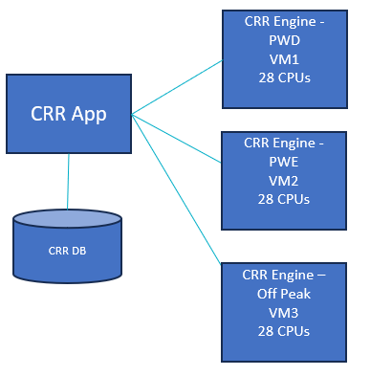
Current State
CRR High Level Architecture
Hardware changes implemented April 2024
  Increased CRR Engine Servers (Virtual Machines – VMs) CPUs to 28 from 16.
  Tuned Hardware Parameters
  CRR performance improved by around 20% due to hardware changes
Why can’t we add more CPUs or more VMs to improve the CRR auction performance?
  Adding more CPUs beyond 28 did not improve the CRR performance further due to saturation of CPU/RAM bus with current hardware configuration (DDR4 Memory configuration).
  CRR Engine supports multi threading but due to the sequential and interlinked nature of budget constraints across all months in a long-term auction, using multiple VMs or servers for parallel processing is not viable.

Slide 3
Testing CRR Performance with New Hardware Configurations
New DDR5 Hardware POC (On-Prem) – Completed
  Built a Sandbox Environment with new hardware configuration – DDR5 Memory
    Faster Memory access with DDR5 hardware configuration
  CRR system was built, and performance testing was performed
  Observed 25-40% performance improvement
CRR Auctions in Cloud - POC - In Progress
  Setup cloud environment with secure access – Completed
  Identify servers in cloud environment with various chipsets - Completed
  Setup CRR standalone auction in Cloud - Completed
  Vendor is actively working on identifying the optimal chipset/hardware configurations.
    CRR software changes are being made in parallel to make it compatible with new chipset/hardware.
  CRR performance tests will be performed with various chipsets and compiler options
  CRR performance testing results will include selected CRR longer auction cases run time with each chipset identified, memory/processors configuration, average cost to run the auction in cloud.
  Plan to complete the POC by end of August 2025.
Evaluate CRR performance improvements from POCs and plan for next steps.

Slide 4
CRR Technology Road Map
Project – ERCOT Cloud Foundations
  In Progress
  Established Cloud Foundations connectivity components including Governance, Platform landing zones and secure connectivity to cloud.
  Activation of hardware and circuits from ERCOT data center to Cloud is expected to happen in Q4 2025
  Available to other projects to move any identified applications to Cloud from late Q4 2025.
CRR Long Term Auctions in Cloud
  Will look at options to run CRR long term auctions in cloud if CRR performance improvement is significant in Cloud (based on Cloud PoC results).
  Tentative start date of this effort is late Q4 2025.

Slide 5
CRR Technology Road Map
Project – CRR Tech Refresh
  Key drivers: Upgrading Oracle DB and Operating system, 3rd party software
  Tentatively scheduled to start Q3 2026
  Upgrade to newer CRR software versions
  Containerize CRR Apps

