Slide 1
Stress testing framework:
Exposures vs Financial Strength
Sanchir Dashnyam
ERCOT Market Credit Manager
ERCOT Public
July 23, 2025

Slide 2
Exposure to RTM for load and load & gen MP’s
Exposure at default is a function of the following:
  Volume
  Prices
  Duration/time
Load volume exposure to RTM is hedged via
  Self generation, if available
  QSE to QSE net purchases
  Net purchases in DAM

Slide 3
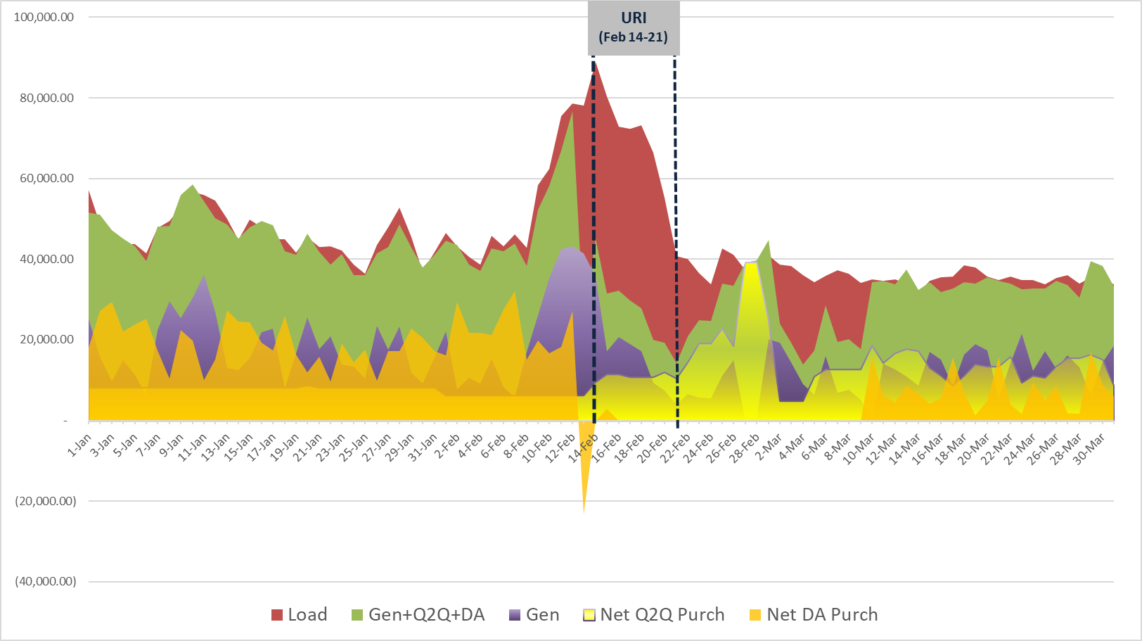
Example 1: Load & Gen with load covered through self-generation, bilaterals and purchases in DAM
Prior to URI, a CP was covering 94% of its load through a combination of self-generation (56%), Q2Q net purchases (10%) and net purchases in DAM (27%). During URI, 70% of load was exposed to RTM due to the CP losing 83% of its generation as well as 100% of its DAM hedges due to a credit constraint (zero ACL).

Slide 4
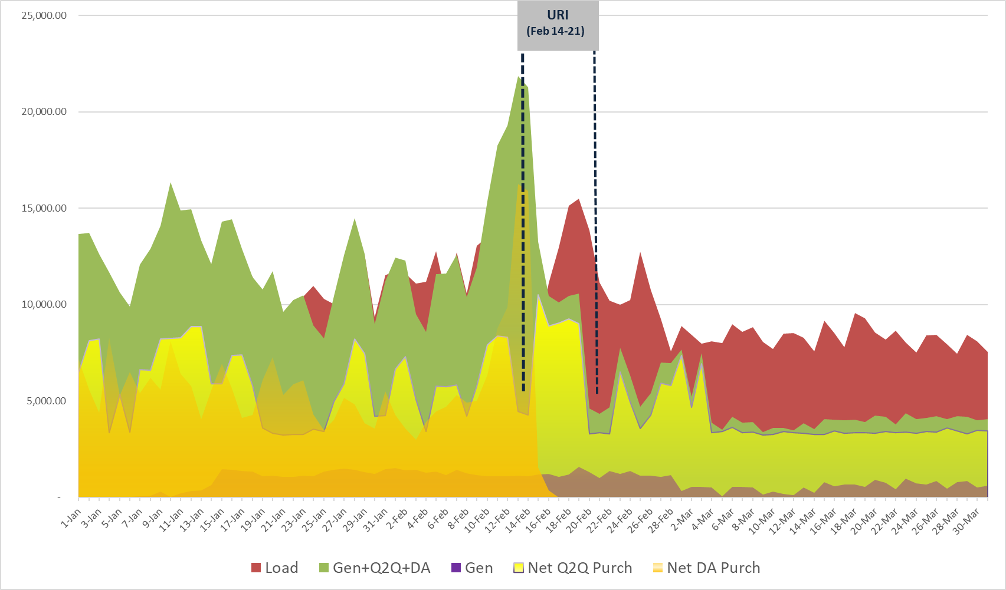
Example 2: Load & Gen with load covered through self-generation, bilaterals and purchases in DAM
Just prior to URI, a CP was covering 184% of its load through a combination of net purchases in DAM (138%), self-generation (10%) and Q2Q net purchases (37%). During URI, 31% of load was exposed to RTM mostly due to the CP getting locked out of DAM due to a credit constraint (zero ACL).

Slide 5
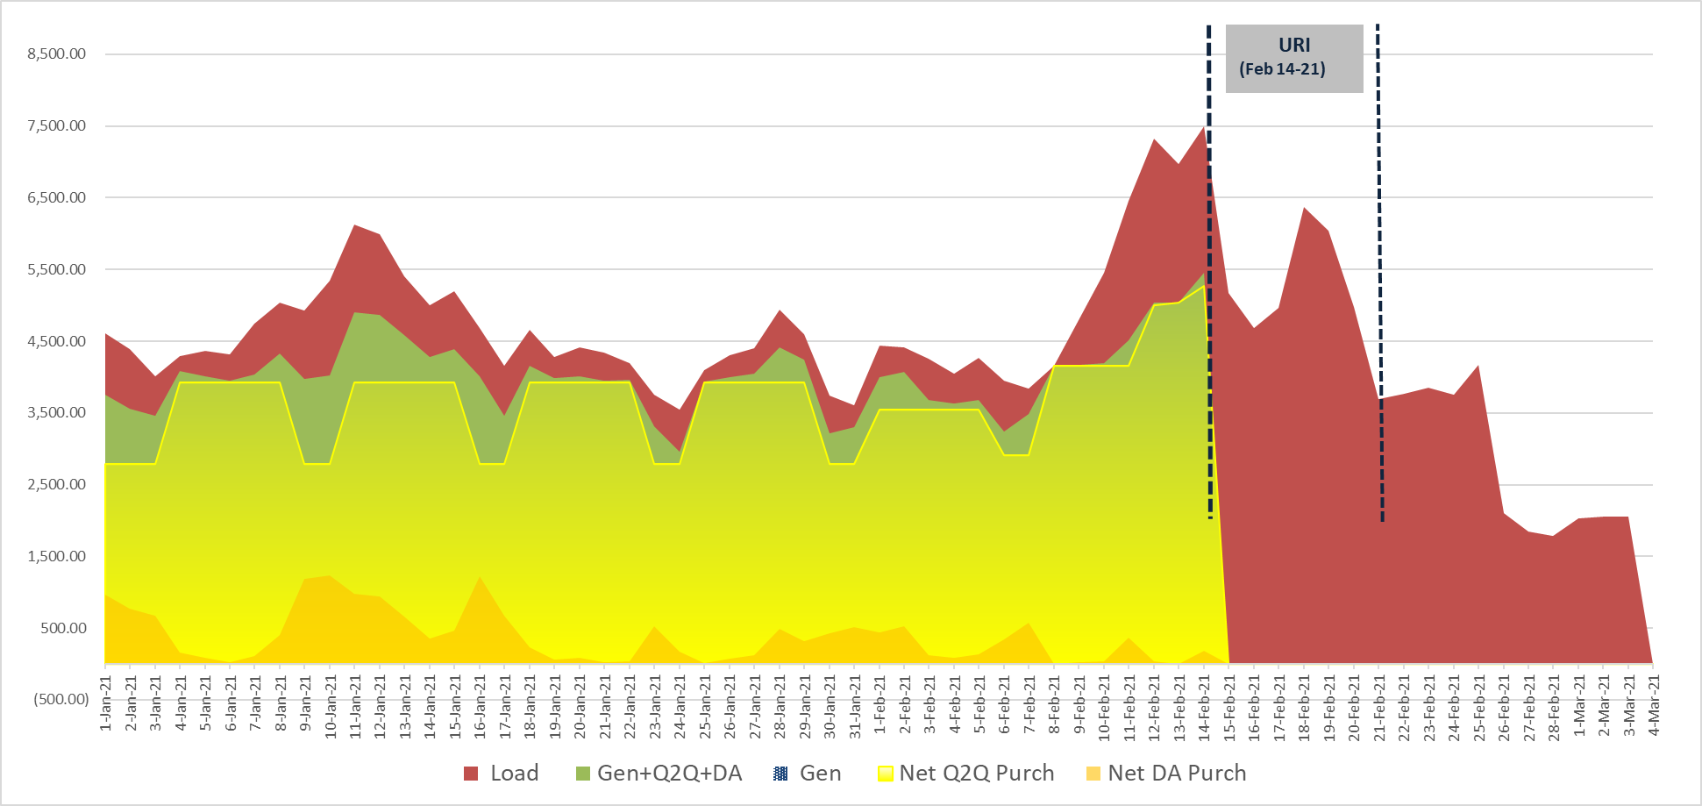
Example 3: REP with 90% coverage through bilaterals and purchases in DAM
Prior to URI, CP was covering 80-90% of its load through a combination of Q2Q (80%) and DA (10%). During URI, load was fully exposed to RT (100%) as bilateral hedges came off and a CP was not able to hedge in DAM due to a credit constraint (zero ACL).

Slide 6
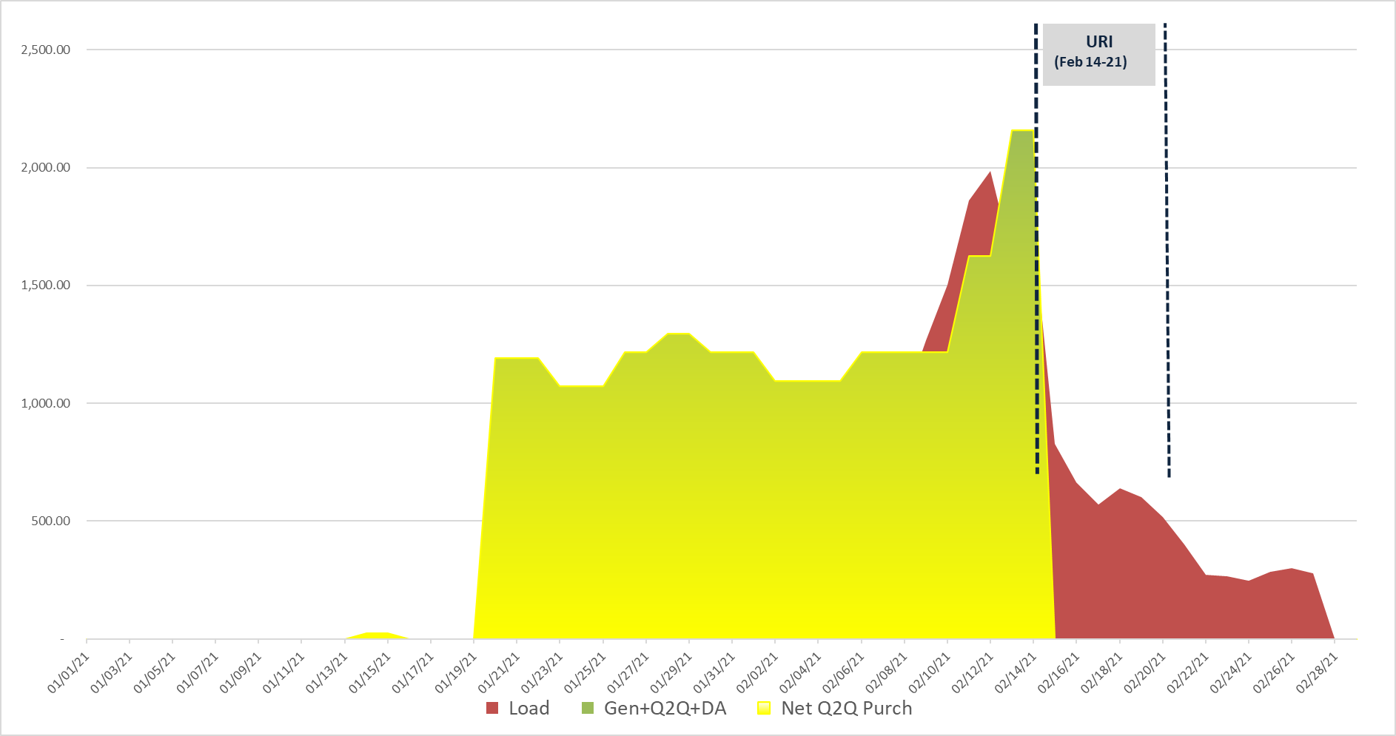
Example 4: REP with full coverage through bilateral hedges
Prior to URI, a CP was covering all of its load 100% through bilateral hedges. During URI, load was fully exposed to RTM (100%) as bilateral hedges came off completely.

Slide 7
Exposure assumptions
Volume assumptions:
For Load entities: assume 100% of load will be exposed to RTM. This is based on experience during winter storm Uri as well as other historical defaults of load only entities.
For Load & Gen entities: assume 20-30% of load will be exposed to RTM.
Price assumption: based on EPP scenario applied universally.
Duration assumption: based on EPP scenario applied universally

Slide 8
Financial Strength assumptions
Cash or access to liquidity: what percentage of available liquidity is assumed to be available to cover the RTM exposure - assume 80% of liquidity is available?
Based on this to calculate exposure coverage ratio.
Other quantitative factors:
  Capital/tangible net worth,
  Other parameters.
Qualitative factors:
  Access to capital markets
  Robustness of risk management practices (policies, procedures, risk appetite, internal controls, book structure)
  Quality and sophistication of risk management framework

