Slide 1
Primary Frequency Response and PPC Interaction Issues During Ride-Through Events
Patrick Gravois – Operations Engineer
IBRWG July 18, 2025

Slide 2
Background
ERCOT continues to see IBR units reduce output during ride-through events due to high frequency calculations or PPC interactions during fault conditions
These high frequency spikes are very short duration (a few msecs or often single sample) and often seen in PMU/DFR data from facilities close to the fault, and are not indicative of system frequency
Inverters/turbines “ride-through” initial voltage disturbance but PPC reduces output during low system frequency
First observed in Panhandle event in March 2022
NERC Panhandle Wind Disturbance report
Section Wind Plant Controller Active Power-Frequency Response Interactions
“Plant controller active power-frequency response controls are incorrectly sending dispatch signal to individual turbines immediately following LVRT condition”
Appendix A – Plant B, Plant C, Plant E are examples of PPC/PFR/VRT interactions
Lack of high-resolution frequency data likely impeded analysis
Issue observed a few times in 2023 and 2024
Multiple occurrences in 2025 – one of the most common root causes of potential Apparent Performance Failures

Slide 3
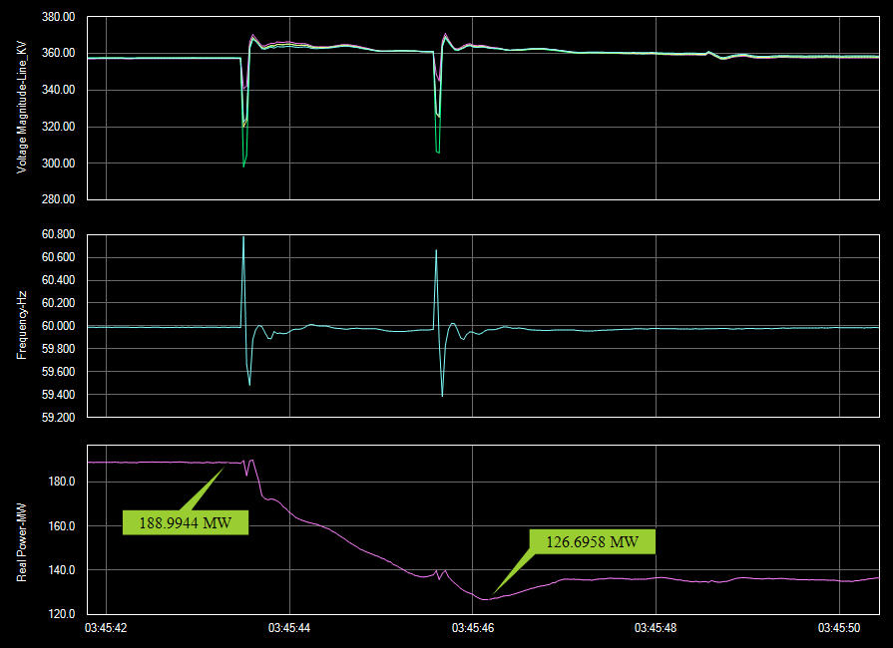
Wind Farm – 1/16/2024 South Texas Wind Event
Plant dropped ~62 MW
33% of pre-disturbance output
PMU data show very high frequency spikes during the two faults (60.8Hz and 60.7 Hz)
System frequency dropped to 59.958 Hz
RE never confirmed root cause of MW loss until similar event in 2025
Confirmed overresponse to frequency event in May 2025
Suggesting 3 second reaction time to frequency events (not approved by ERCOT)
Why such high frequency spikes? (not very close to fault)

Slide 4
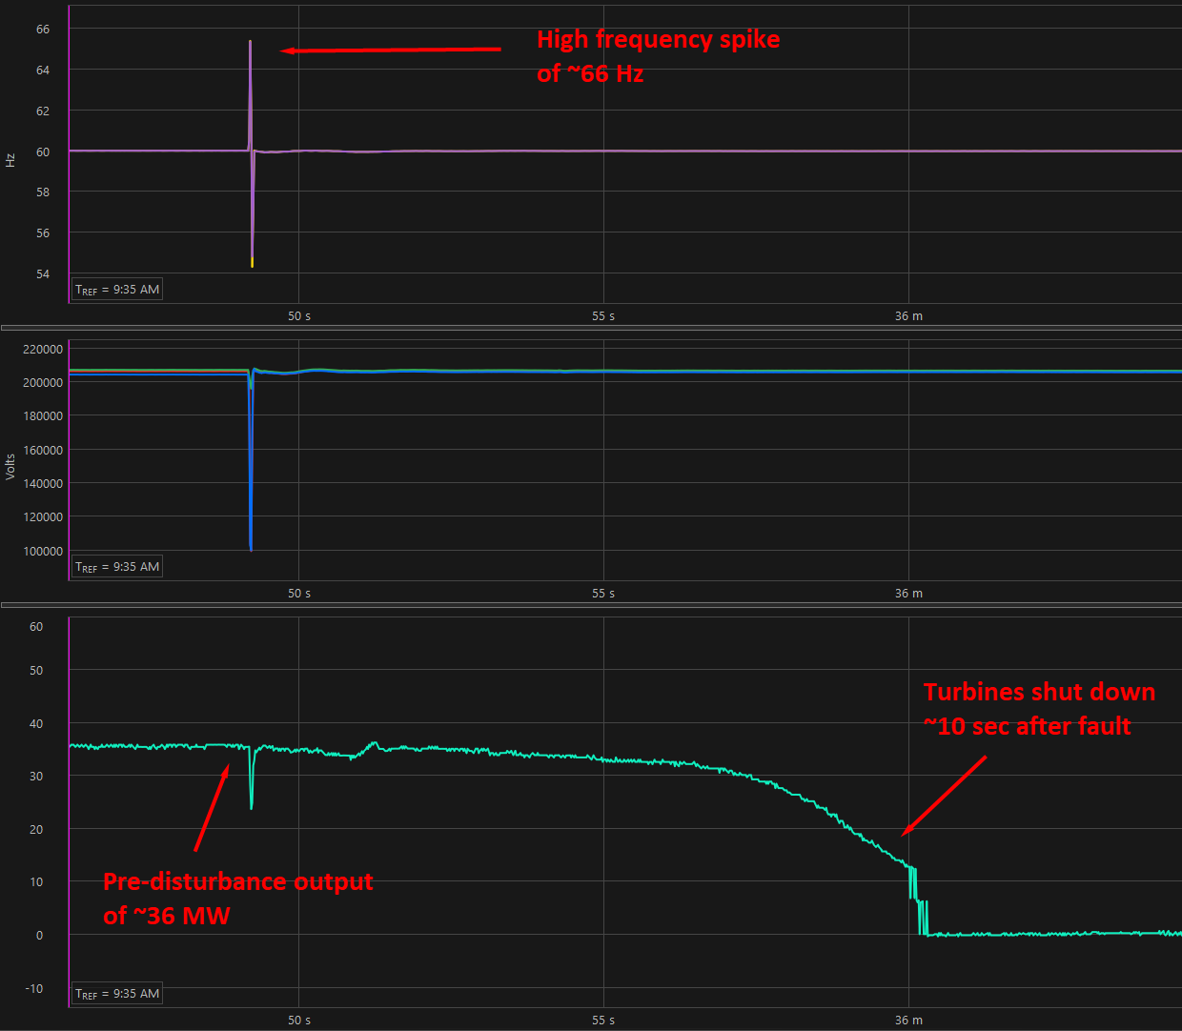
Wind Farm – 1/21/2025 South Texas Event
Turbines were at minimum output at time of the fault
PPC gave command for turbines to go to zero active power
Unknown if high frequency spike caused the PPC command
OEM still investigating root cause of the turbine pauses

Slide 5
Wind Farm – 03/04/2025 West Texas Event
RE Root Cause: Behavior appears to be the result of an unexpected interaction between turbine level voltage ride through and the park controller level frequency droop response functions.
Order of Events:
Measured Active Power dropped instantaneously in response to the Voltage drop in the grid.
Within milliseconds difference, measured Frequency spiked to ~ 60.55 Hz.
Frequency Response snapped the Power Demand to the Measured Active Power which in that millisecond was 240 MW still. Then applied 5% droop.
The Frequency Response released less than half a second later before the site could even fully respond, but Power Demand then follows ramp rate (20%/min) up from the setpoint it had frozen to. So that is where the site was caught and pulled down.

Slide 6
Solar Farm - 03/04/2025 West Texas Event
RE Root Cause: PPC assigned new setpoint to inverters by looking at current output, which was during the low active power output during LVRT.
Investigating potential solutions with OEM.

Slide 7
Solar Farm - 03/04/2025 West Texas Event
RE Root Cause: Pending.

Slide 8
Solar Farm – 4/14/25 Panhandle Event
RE Root Cause: The power plant controller (PPC) provided a response to the Frequency event (exceeding 60.017 Hz) and reduced the setpoint to the inverters accordingly. We are working on a scope with the PPC OEM to include a logic and freeze inverter setpoint during and post a voltage event which generally coincides with a frequency event to eliminate a PFR response during VRT event. We expect to have the logic finalized and implemented within 90 days.
System frequency increased above deadband due to loss of Large Load
High system frequency was 60.031 Hz
Frequency data from PPC show high frequencies during the fault
31 MW Drop from PFR
Expected PFR for 60.31 Hz system frequency would be < 2 MW

Slide 9
Wind Farm – 4/14/25 Panhandle Event
RE Root Cause: During the event, the wind-controller changed the power setpoint to the turbines as reaction to a frequency event. As a result, power reduction of approximately 45 MW was realized.
After an internal investigation, RE submitted a trouble-shooting ticket with OEM to analyze the frequency event and wind-control settings and expect a reply within 1-2 weeks.

Slide 10
Frequency Measurement and PFR Considerations for Discussion
NOG Section 2.6.2 (3) addresses frequency measurements for protection schemes but not for PFR:
(3) If frequency protection schemes are installed and activated to trip a Generation Resource or ESR, they shall use filtered quantities or add sufficient time delays to prevent misoperations while providing the desired equipment protection. Protection schemes shall not trip a Generation Resource or ESR based on an instantaneous frequency measurement.
IEEE 2800 provides guidance on reaction time to PFR
SEL recommends at least 5 cycle measurement window for frequency protections schemes
Frequency element time delays are best set to no less than five cycles. The relay requires at least three cycles to measure frequency

Slide 11
Next Steps
Further discussion at IBRWG
SMEs and OEMs to present on frequency measurement/calculations
Develop best practices to share with Stakeholders
ERCOT to continue working with REs/OEMs to develop acceptable corrective action plans for this performance when observed
Incorporate IBRWG feedback

Slide 12
Questions/ Discussion

