Slide 1
CRR Updates
Samantha Findley
CMWG
July 21, 2025

Slide 2
Agenda
LTAS transactions and solution times
CRR auction limits table updates
What’s next

Slide 3
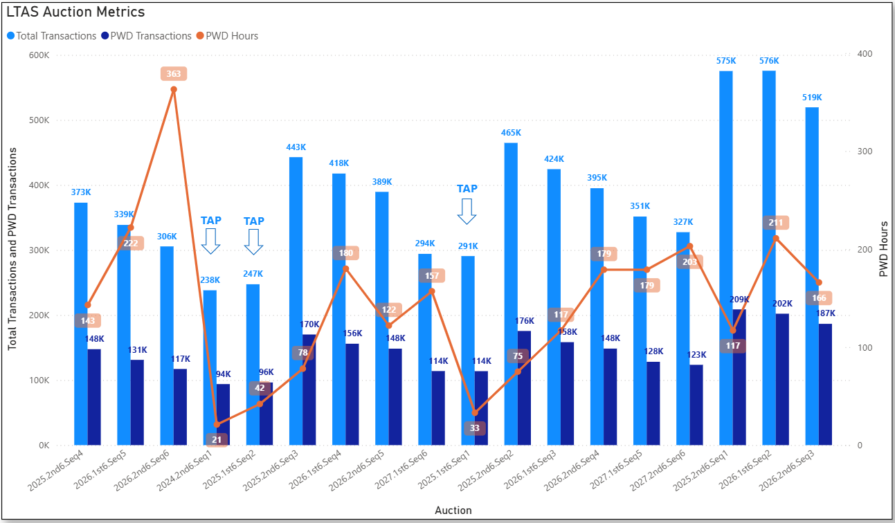
Historical LTAS transactions and solution times

Slide 4
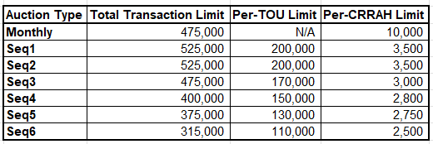
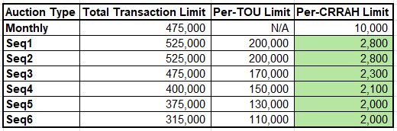
Update to CRR auction limits
  Continued increases in submitting CRRAHs and submitted transactions are driving the decrease in the per-CRRAH limits.
  Previous limits:
  Updated limits:

Slide 5
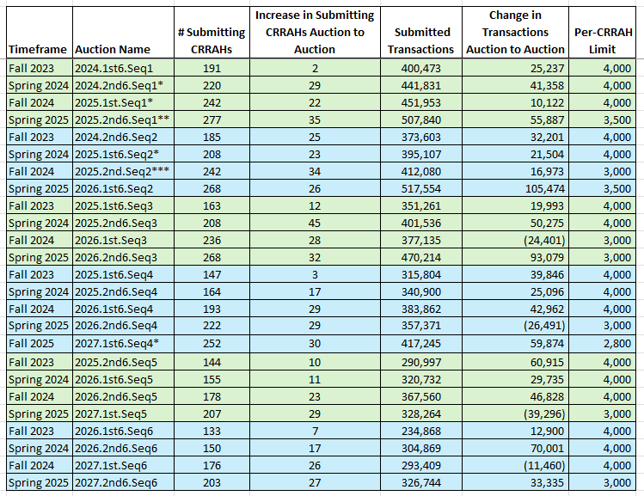
Increasing Submitting CRRAHs and Transactions
*Initial bid window transactions from Transaction Adjustment Periods
**First LTAS that used NPRR 1261 limits
***TAC approved lowering to 3,000 on 10/30/2024

Slide 6
What’s next
Bid fee discussion reboot from October 2024
  Minimum Option Bid Price - Increasing existing min bid price from $0.01 to TAC approved value (example, $0.25) would create downward pressure on volume of CRR Option bids – ERCOT-sponsored NPRR
  Unawarded Bid fee for Options - Introduce bid fee for unawarded Options to create downward pressure on bid levels- NPRR and system change
Planning to bundle NPRRs 1288 and 936 for a project to start early 2026. With implementation, the bid limit will change to the Counter-Party level rather than the CRRAH level.
SCR833, Increase CRR Transaction Capability 600K transactions not feasible with current software/hardware.

