Slide 1
NDSWG Meeting
July 2025

Slide 2
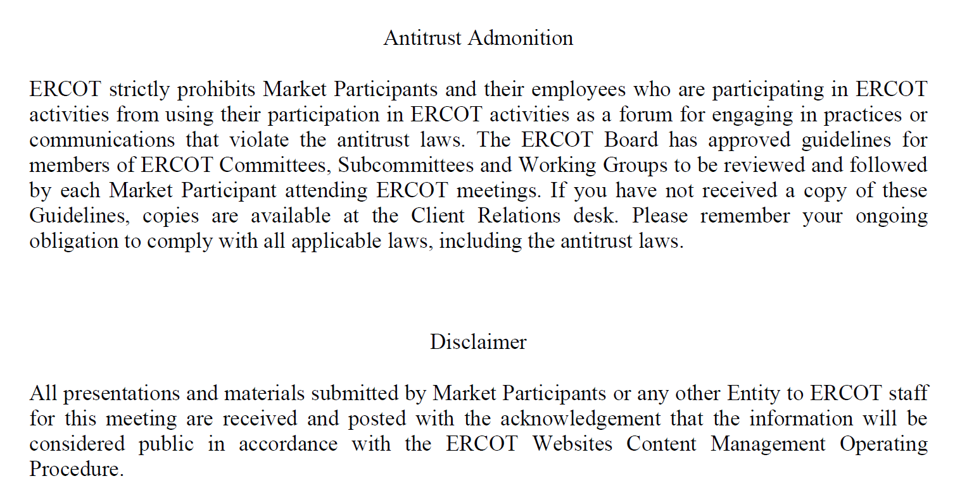
Antitrust Admonition

Slide 3
Topics
PGRR115 / NPRR1234 – Load End Use Industry Classification
SCR 831 Discuss Draft Comments
No Large Load Interim Update model changes
CIM 16 Workshop
DGR Load Transfer
Proposed NPRR for updated timeline table

Slide 4
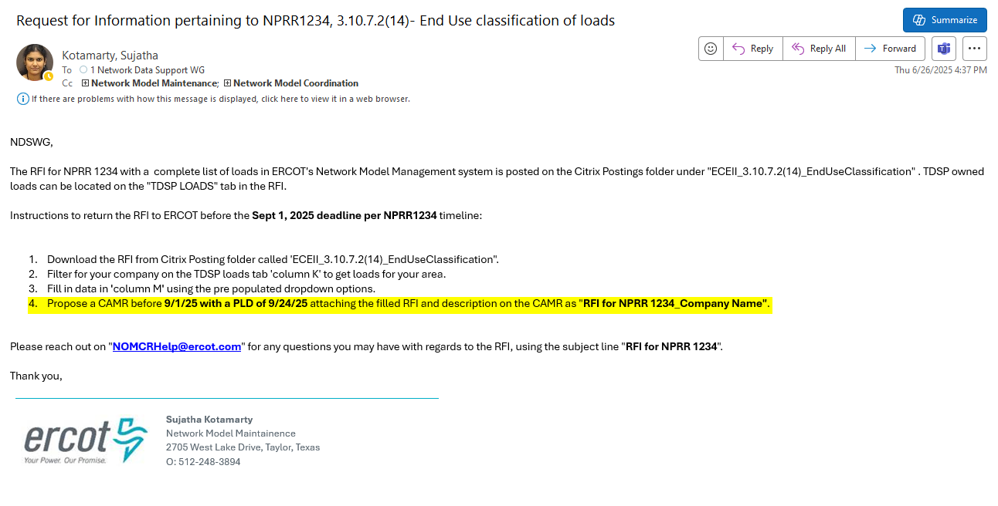
NPRR 1234 Load End Use Classification Categories
  Email sent on June 26 2025
Correction: Propose an ICR instead of CAMR. Market Notice will be updated.

Slide 5
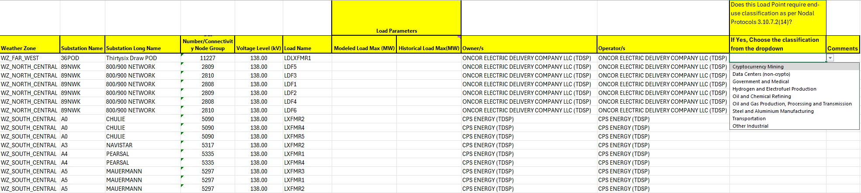
NPRR 1234 Load End Use Classification Categories
  Spreadsheet example:

Slide 6
NPRR 1234 Load End Use Classification Categories
  Load End-Use Classification Categories.
    Cryptocurrency Mining
    Data Centers (non-crypto)
    Government and Medical
    Hydrogen and Electrofuel Production
    Oil and Chemical Refining
    Oil and Gas Production, Processing, and Transmission
    Steel and Aluminum Manufacturing
    Transportation
    Other Industrial

Slide 7
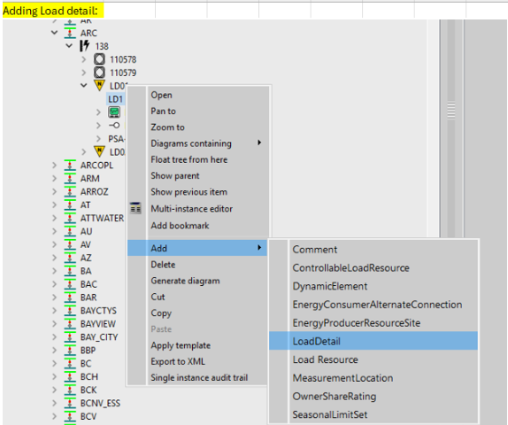
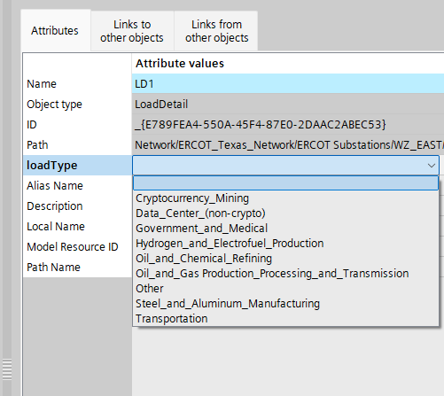
How to add Load Details
Right click on the load you want to add load details to. Pick Add-> Load details instance.
Name the load details instance
Pick from the loadType attribute on the load details dropdown to add the end use classification of the load
Save

Slide 8
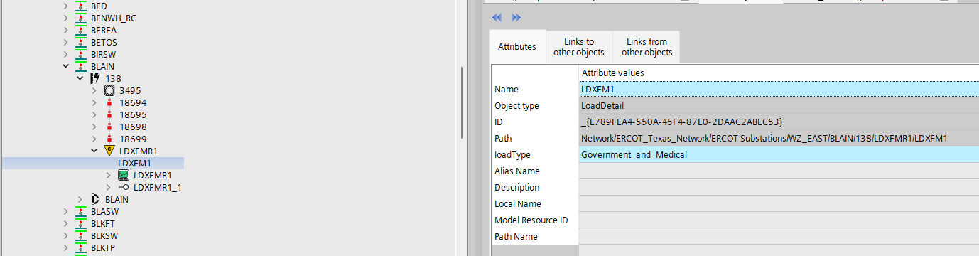
How to add Load Details Cont’d

Slide 9
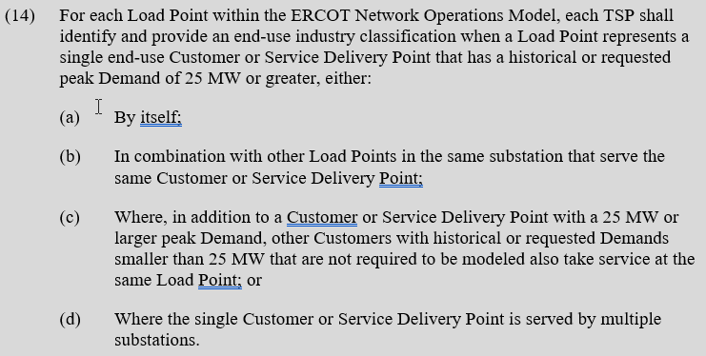
NPRR 1234 Load End Use Classification
Nodal Protocols 3.107.2(14)

Slide 10
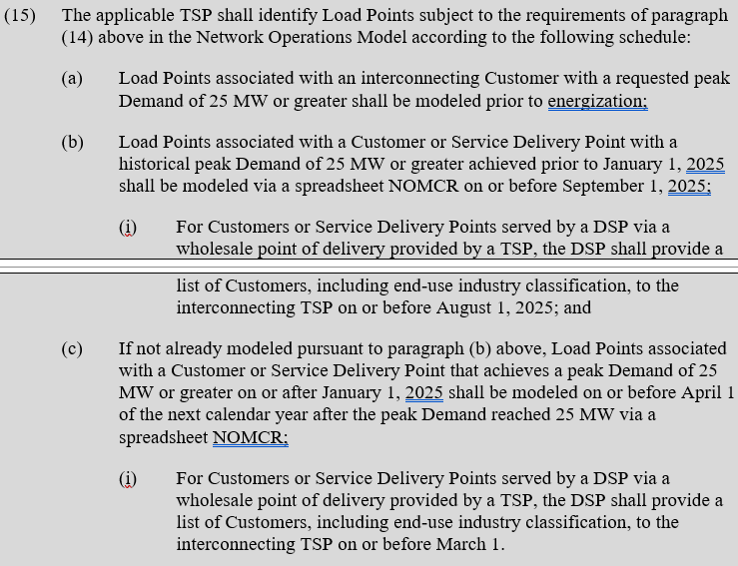
NPRR 1234 Load End Use Classification
Nodal Protocols 3.107.2(15)

Slide 11
Topics
PGRR115 / NPRR1234 – Load End Use Industry Classification
SCR 831 Discuss Draft Comments
No Large Load Interim Update model changes
CIM 16 Workshop
DGR Load Transfer
Proposed NPRR for updated timeline table

Slide 12
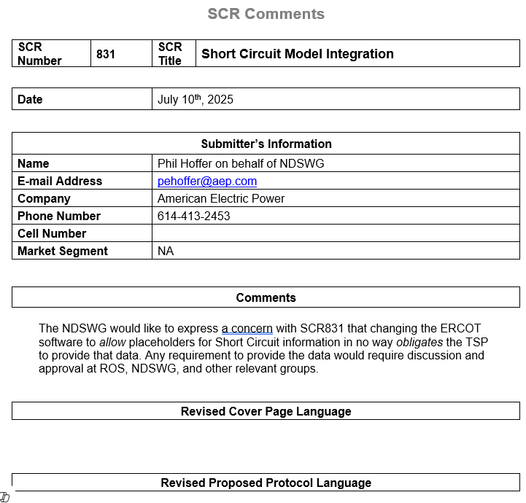
SCR 831 Draft Comment

Slide 13
Topics
PGRR115 / NPRR1234 – Load End Use Industry Classification
SCR 831 Discuss Draft Comments
No Large Load Interim Update model changes
CIM 16 Workshop
DGR Load Transfer
Proposed NPRR for updated timeline table

Slide 14
No Large Load Interim Update model changes
Large Load addition must follow the Large Load Interconnection process and should be submitted as a standard model change(90+ days)

Slide 15
Topics
PGRR115 / NPRR1234 – Load End Use Industry Classification
SCR 831 Discuss Draft Comments
No Large Load Interim Update model changes
CIM 16 Workshop
DGR Load Transfer
Proposed NPRR for updated timeline table

Slide 16
ERCOT Hosting Initial CIM16 Workshop on September 18th
First CIM16 Workshop to Be Held at Austin MET on September 18th
Tentative Agenda:
  Project overview and timeline
  Discussion on Redacted CIM16 Model
  Review of key schema changes
Prior to workshop, ERCOT will provide:
  CIM16 schema file
  CIM10 to CIM16 Mapping Document
  Redacted CIM16 Model (to be posted here)
https://www.ercot.com/calendar/09182025-ERCOT-CIM-16-Workshop

Slide 17
Topics
PGRR115 / NPRR1234 – Load End Use Industry Classification
SCR 831 Discuss Draft Comments
No Large Load Interim Update model changes
CIM 16 Workshop
DGR Load Transfer
Proposed NPRR for updated timeline table

Slide 18
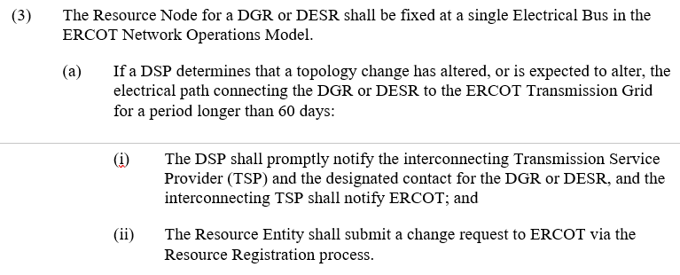
DGR Load Transfer : NP3.8.6(3)(a)
3.8.6

Slide 19
Topics
PGRR115 / NPRR1234 – Load End Use Industry Classification
SCR 831 Discuss Draft Comments
No Large Load Interim Update model changes
CIM 16 Workshop
DGR Load Transfer
Proposed NPRR for updated timeline table

Slide 20
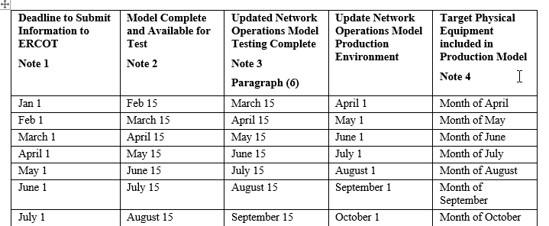
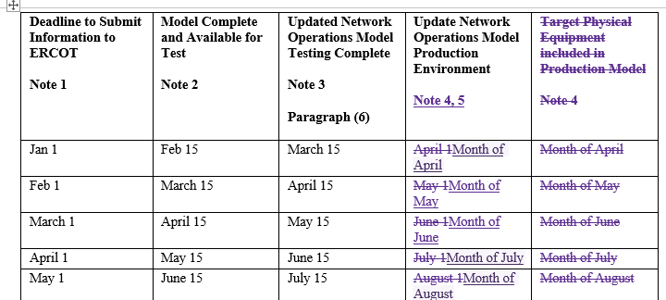
Upcoming NPRR – Clarification of “Time Line for Network Operations Model Changes” Table in NP3.10.1(3)
Before
After
Not all rows shown
Not all rows shown
This upcoming NPRR is not intended to change the database load schedule. This change ensures the table in 3.10.1(3) matches the current process.
https://www.ercot.com/gridinfo/transmission/opsys-change-schedule

Slide 21
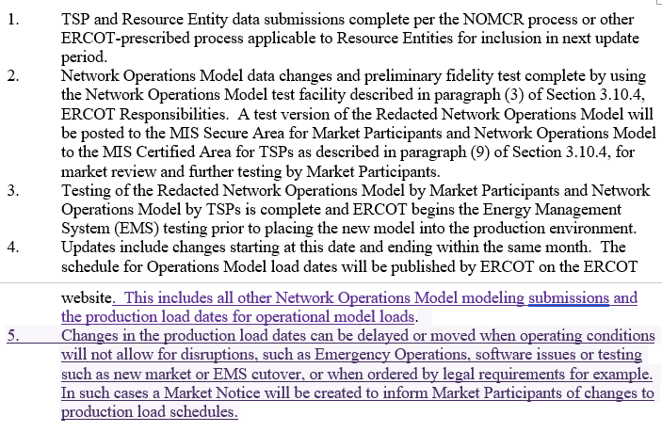
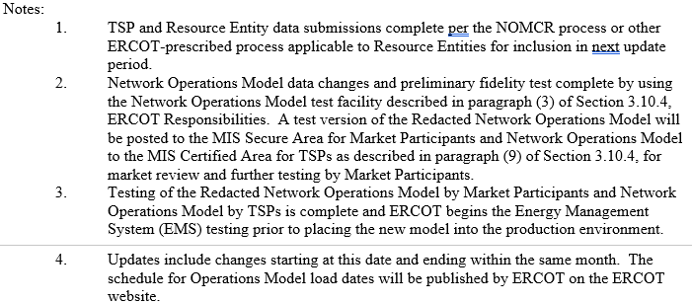
Upcoming NPRR – Clarification of “Time Line for Network Operations Model Changes” Table in NP3.10.1(3)
After
Before
Footnote 5 has been added to allow for changes in database load schedule due to emergency conditions, application issues, or as required by legal requests (bankruptcies).
https://www.ercot.com/gridinfo/transmission/opsys-change-schedule

Slide 22
Other Topics
Open Discussion…

