Slide 1
ERCOT Staff Presentation
DSWG Meeting
July 14, 2025

Slide 2
Weekly
RTC+B Market Trials Update

Slide 3
Outline
Antitrust Admonition
Reminder of Key Document Postings
Expectations of QSEs for the Week
Provide Update of Cumulative QSE Scorecards for May/June
Communicate any known Issues within On-going Trial
Discuss Transition to July 7th Activities
Support any Technical and/or Business Questions

Slide 4
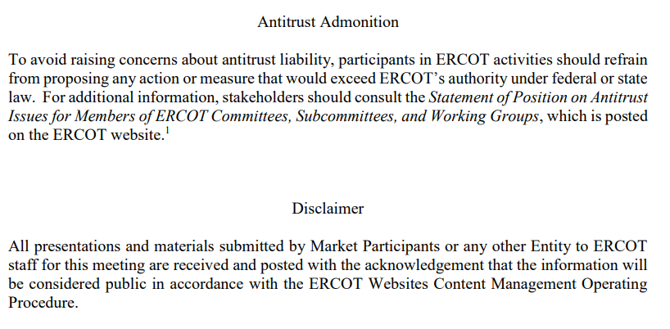
WebEx Meeting reminders (same as other ERCOT forums):
Please keep line muted
If you have a question, please use the chat feature to either:
  Type in your question, or
  Type in “Question” and wait to be recognized to state question

Slide 5
Sequence and Dates for Market Trials to Go-Live
Market trials are a progression of activities to mitigate the risk for Go-Live on new systems and processes for both the Market Participants & ERCOT.
30-day Market Notice
11/5/25
March/April
2025
Start
5/5/25
Start
7/7/25
Start
9/2/25
Go-Live
12/5/25*
May 2025
June 2025
July 2025
Aug 2025
Sep 2025
Oct 2025
Nov 2025
Dec 2025
QSE Scorecards & Exit Criteria for each Trial Phase
#1 RTC QSE Submission Testing
(Submit COP, RT AS Offers,
DAM Virtual AS, Outages for ESRs)
#3 Open-loop RTC SCED
(QSE offers, SCED non-binding award/dispatch)
#5 Ongoing Open-Loop
& Periodic Closed-loop SCED/LFC
(QSE RTC offers and telemetry to support closed-loop frequency control test 2-3 tests of 2-4 hour durations)
Transition to Go-Live
Upon completion of testing, confirmation of ERCOT and market readiness for Go-Live.
QSE/Vendor Submission Sandbox and Telemetry Points added Prod EMS model.
#2 RTC QSE Telemetry Checkout (QSEs add/verify new telemetry points for UDSP, New ramp rates, ESR telemetry)
#4 QSE Telemetry Tests
(Individual QSE to follow UDSP and support new ramp rate and ESR telemetry)
#6 Day-Ahead Market
(Non-binding DAM using QSE offers for at least 2 tests)
* Go-Live date reflects 12/5/2025 as first Operating Day
where 12/4/2025 is planned software migration.

Slide 6
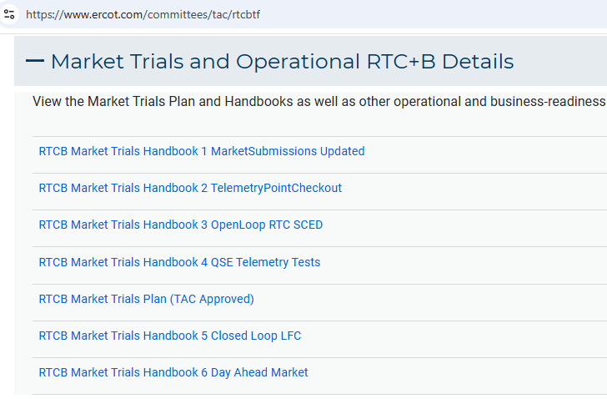
Market Trials Framework:
TAC Approved the Market Trials Plan in October 2024
Discussions with RTC+B Task Force have shaped the Handbooks
Handbook #1- QSE Submission Testing
Handbook #2- QSE Telemetry Tests
Handbook #3- Open Loop SCED
Handbook #4- QSE Telemetry Tests
Handbook #5- Close-Loop LFC Tests (draft)
Handbook #6- Day-Ahead Market Tests (draft)
All are posted on the
RTCBTF Homepage
under Market Trials banner

Slide 7
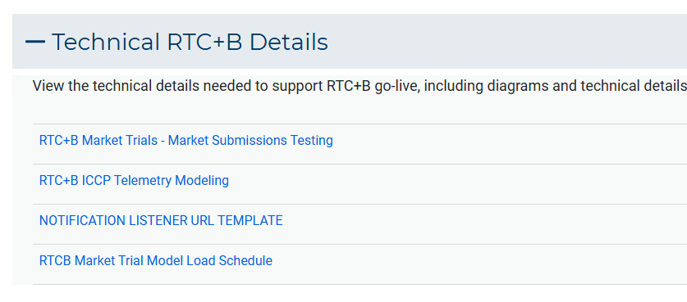
Market Trials Technical Details
Detailed discussions with TWG have provided technical content details
Digital Certificate details
Connectivity/URL details to User Interfaces and APIs
Reminder of how to submit new ICCP requests
RTC and Production Telemetry connectivity
Network Model Load Schedule
All are posted on the
RTCBTF Homepage
under Technical Details banner

Slide 8
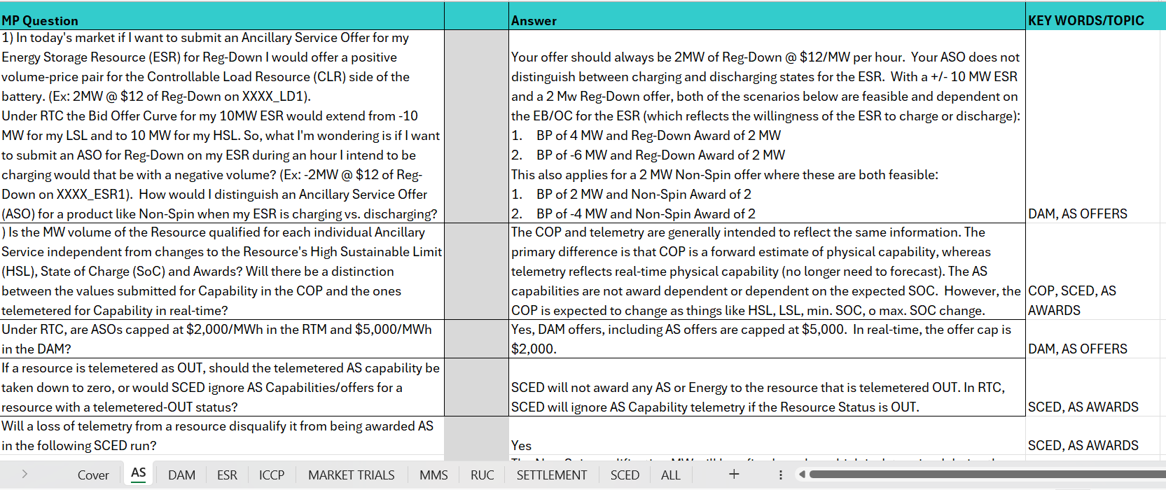
Reminder of RTC+B FAQ (updated 7/3/2025)
Posted on RTCBTF Home Page under Key Documents
Common questions/responses in Excel Workbook (target weekly updates)
Search workbook for Key Words
Worksheets for categories

Slide 9
Resources for May-June Market Trials
Everything needed for current market trials is on RTCBTF home page
May/June
July/Aug

Slide 10
Summary of Market Trial activities for May-June
WRAP-UP
Handbook 1- QSE connectivity and market submissions
  Submit to Market Management System and Outage Scheduler
  Goal to submit at least one successful transaction for each requested transaction type per QSE once during the 8-week period
Handbook 2- QSE telemetry set-up and check-out
  Submit all ICCP requests to ERCOT to add telemetry points
  Check-out will be for a sampling of resources within the QSE portfolio to ensure data flowing between ERCOT/QSE
Scoring continues into July to accommodate 3-week processing of new telemetry into systems.

Slide 11
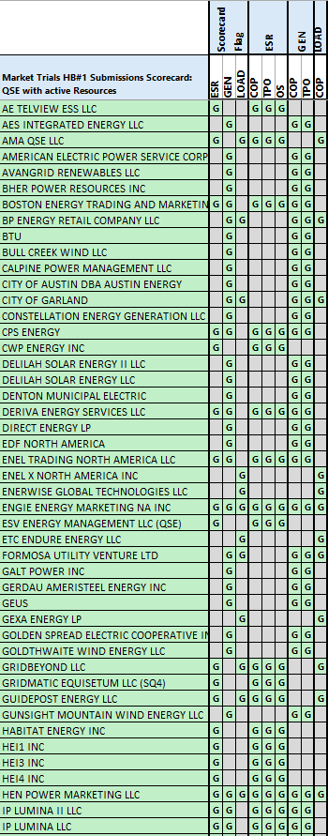
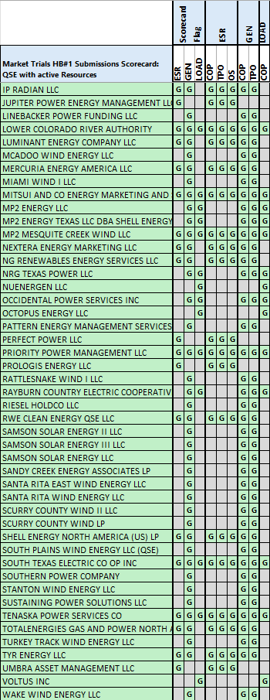
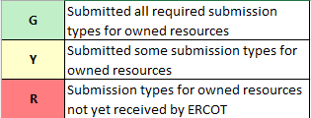
Scorecard 1 for
Handbook 1-
Market submissions:
7/3 Scores for QSEs with Resources – successful submissions for resource types specified in Handbook 1
Scoring: Complete

Slide 12
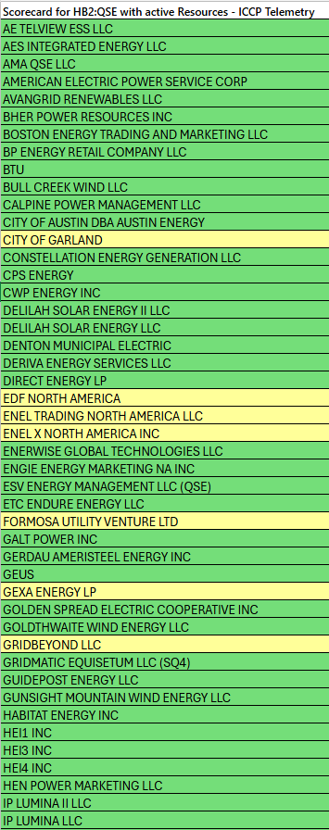
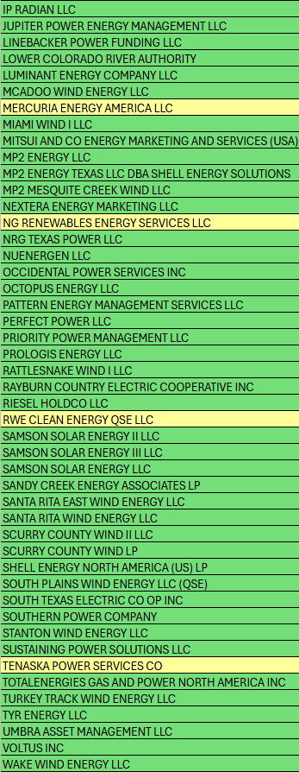
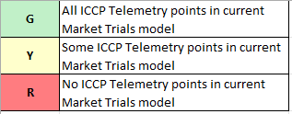
Scorecard 2A for
Handbook 2-
100% of ICCP Telemetry points added by QSE:
7/3 Scores for QSE with Resources - ICCP Telemetry points added in current model.
98% of 26k points complete
Scoring:

Slide 13
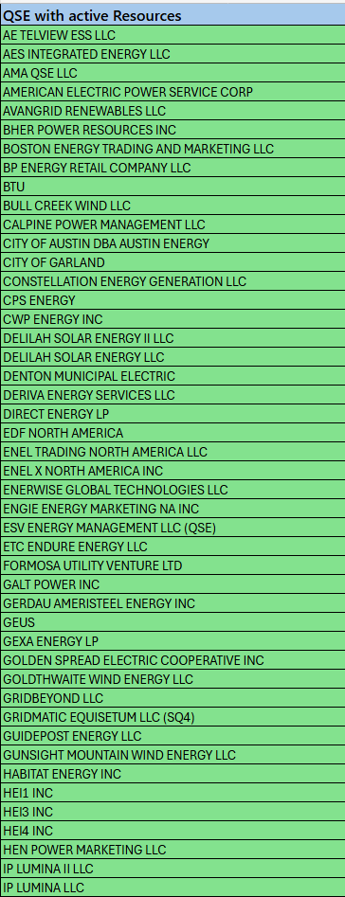
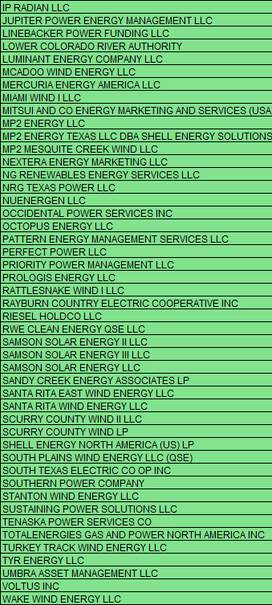
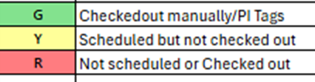
Scorecard 2B for
Handbook 2-
Telemetry checkout meetings completed with ERCOT staff for sample of live data transfer capability
7/3 Scores for QSEs with Resources – Scheduling Check-out and Check-out complete
Scoring: Complete

Slide 14
This Week in Market Trials for July-August
Current topics:
No current software issues
Reminder of Outage Schedule details for ESR / Single Model Battery
  Single model resources have new Equipment IDs. For outage submissions on the OSUI, only equipment name is needed and Equipment ID is not needed. If the Equipment ID is unknown and needed for API submission testing, use the Outage Scheduler UI (OSUI) to submit an outage for the ESR, and on the outage details/history file, the Equipment ID can be seen. If still experiencing issues, request help from RTCB@ercot.com.

Slide 15
Transitioning to July 7 – August 30 Market Trials
Thank you for getting us to this point successfully!
Starting today, what the next 2 months will look like…..

Slide 16
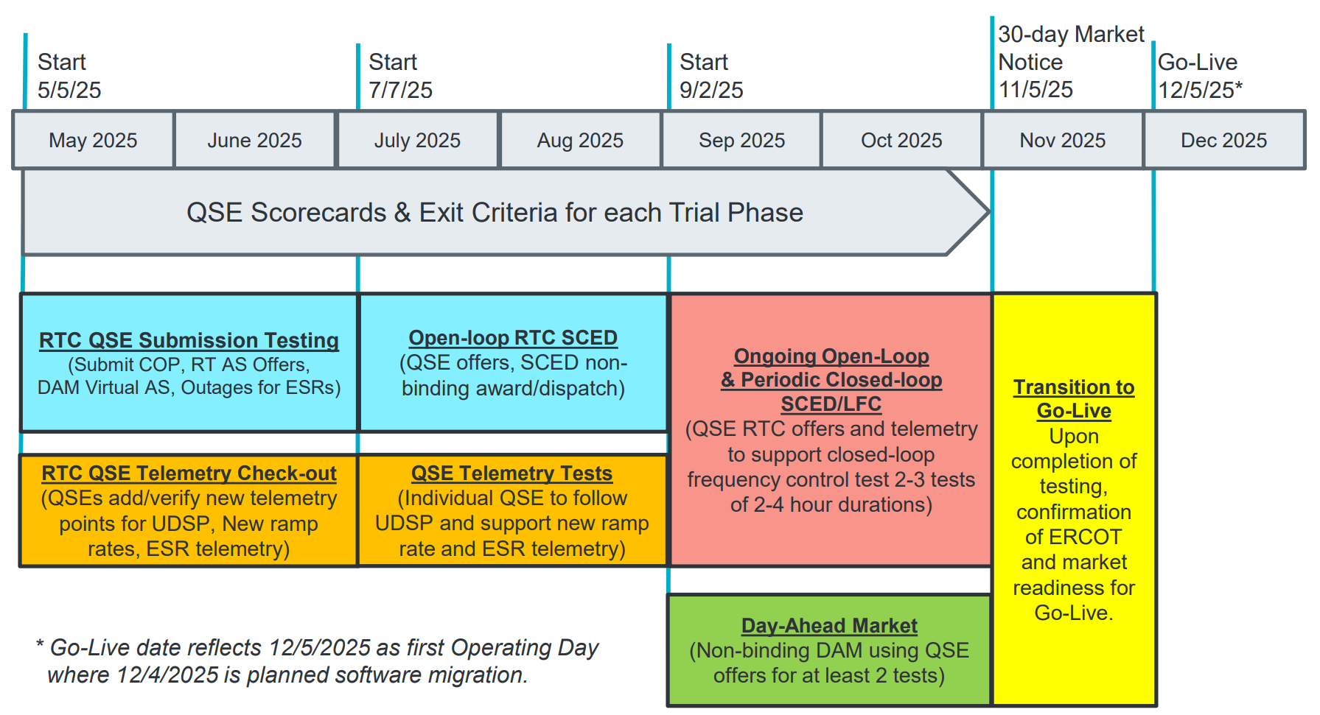
July & August:
Initial Real-Time Market execution and verify QSE ability to follow ERCOT frequency signals
QSE will support “parallel production” 2days/week by entering $bids/offers for non-binding RTC energy and A/S awards and dispatch (Open-loop test)
Scorecard to demonstrate successful submissions and telemetry reflective of production, and mitigation plans in place for any outliers.
Coordination of individual QSE tests on subset of resources to ensure resources can follow new UDSP telemetry point from ERCOT.
Scorecard goal for QSEs to successfully demonstrate, and mitigation plans in place to address in next trial phase.

Slide 17
July/August Market Trials Summary
Handbook #3 - Dual “production-like” data entry two days per week
  Market Trials environments for
    Submissions (TPO/COP/ASOffer etc.)
    Telemetry (current and new telemetry points)
  Tuesdays/Thursdays 9AM – 5PM Required Activities
  Systems will be running 7x24 so submissions encouraged all days
Scoring data submissions all QSEs for all Resources each day starting Operating Day 7/22 – 8/28
Handbook #4 - Coordinated QSE Tests for following UDSP
  ERCOT will schedule meetings with all QSEs
  Please contact ERCOT if you are ready to test early in the trials window
  Single successful test to complete.
10 OpDays Scored

Slide 18
RTC+B Market Submissions - Systems configurations
Start
03/2025
Start
05/2025
Start
07/2025
Start
09/2025
Go-Live
12/5/25*
Feb 2025
Mar 2025
Apr 2025
May 2025
June 2025
July 2025
Aug 2025
Sep 2025
Oct 2025
Nov 2025
Dec 2025
Optional: RTC QSE/Vendor Developer
Submission Testing
RTC QSE
Submission Testing
Open-loop
RTC SCED
Ongoing Open-Loop
& Periodic Closed-loop SCED/LFC
Certificate: Current MOTE
Env: ERCOT RTC Market Trial
URL: RTC MIS MOTE URL
Certificate: Current Production
Env: ERCOT RTC Market Trial
URL: RTC MIS Market Trial
Cert: Production
Env: Prod
URL: MIS Prod
QSE/Vendor developer can use MOTE certificates & RTC MIS MOTE API URL to test the submissions until end of submission testing phase (end of June) as needed. At the start of the Open Loop testing, RTC MOTE MIS URLs will be disabled.
URL links: RTC MOTE and Market Trial URL links to be used for MMSUI, OSUI and API submissions. Actual links are provided in next slide.
For notifications/responses to MPs from RTC Market Trials environment, MP will need to provide the listener URL to ERCOT

Slide 19
RTC+B Market Submissions - Systems configurations
(Updated with URLs)
RTC+B Market Trials and Go-live
RTC Phase | Digital Certificate | MMSUI / OSUI URL | API / WAN URL
Vendor/QSE Submissions Testing | Current MOTE | RTC MOTE MIS URLs https://testmarkettrials.ercot.com/mmsui/mmsui/displayTradesLanding.action https://testmarkettrials.ercot.com/osrui/osrui/Summary.action | RTC MOTE API/WAN URL https://testmarkettrialsapi.ercot.com/NodalAPI/EWS/ https://testmarkettrialsapi.wan.ercot.com/NodalAPI/EWS/
Open Loop and Closed Loop Testing | Current Production | RTC Market Trial URL https://markettrials.ercot.com/mmsui/mmsui/displayTradesLanding.action https://markettrials.ercot.com/osrui/osrui/Summary.action | RTC Market Trial API/WAN URL https://markettrialsapi.ercot.com/NodalAPI/EWS/ https://markettrialsapi.wan.ercot.com/NodalAPI/EWS/
From RTC Go-live onwards | Current Production | Current Prod MIS URL mis.ercot.com/mmsui mis.ercot.com/osui | New Production API/WAN URL

Slide 20
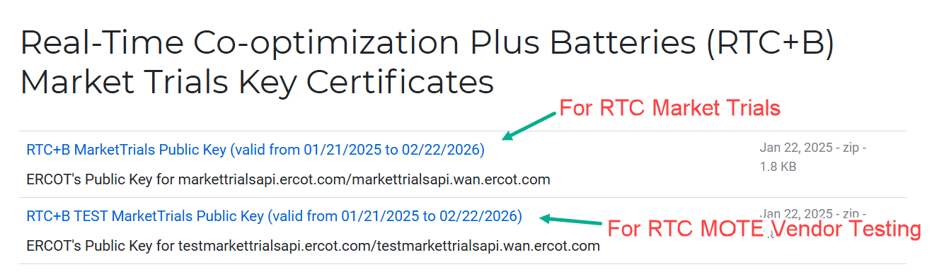
RTC+B Market Submissions - Systems configurations
Public Key Update for WAN/API submissions
For API/WAN submissions into Market Trials environments, need to download public keys and place into the keystore location in system being used for RTC+B submissions.
No change to digital user certificates – continue to use existing MOTE and Production Certificates
Market Trial API Public key location: https://www.ercot.com/services/mdt/webservices

Slide 21
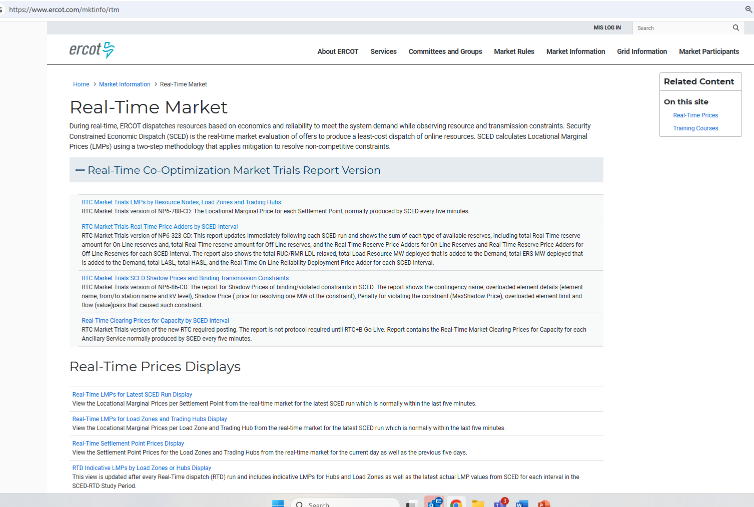
RTC+B New Reports Posted to the ERCOT Website
Links to the available RTC+B versions of Real-Time reports posted on Real-Time Market Information page.

Slide 22
Wrap-Up and Questions
Remainder of meeting for questions-
First round of questions specifically about July/Aug
Last round of questions for more general RTC+B as time allows
Can always email the RTC+B Program mailbox: RTCB@ercot.com
FAQ is also a resource for questions that other have asked.
Announcement- Tentative plan for Closed-Loop LFC Workshop WebEx Thursday July 23rd from 2-4pm (same day as RTCBTF but a deep dive focused on Closed Loop LFC Testing expectations and details to address any questions, details, and concerns for September test)
Thanks for your support!

Slide 23
Load Resource Overview and Changes Introduced With the Real-Time Co-Optimization

Slide 24
Introduction
Key changes implemented with the RTCB project affecting Load Resources (LRs), their Resource Entities, and Qualified Scheduling Entities (QSEs)
New Terms and Concepts
Introduction to Self-Provision
Day-Ahead Market (DAM) Changes
Telemetry Changes for NCLRs and CLRs
Real-Time Market (RTM) and Operational Changes
Deployment and Recall of Load Resources
Performance Analysis
Monthly Reports
Real Time Self-Provision Examples
This is not an all-encompassing review of changes – Focus is on LRs

Slide 25
Introduction to Self-Provision
What is self provision?
  Self-provision is a new concept in RTC+B where QSEs have the option to cover their Ancillary Service (AS) position with load resources that operate with an Under Frequency Relay (UFR)
    If the QSE has a responsibility at the end of the adjustment period, the QSE can telemeter self-provision amount to ensure AS responsibility are awarded/met in real time
    (Day Ahead AS Awards + Day Ahead Self Arranged AS + net of AS Trades Sold – AS Trades Purchased)
  *Different than self-arrangement*
Who does self-provision apply to?
  NCLRs that are qualified for AS that operate utilizing an armed UFR:
    RRS UFR
    RRS FFR
    ECRS resources with a UFR
When can a Load Resource that is not a Controllable Load Resource (CLR) self-provide AS?
  Self-provision is resource-specific and managed in real time through telemetry, which is set by the QSE.
Why was self-provision created?
  Self-provision was introduced in response to Market Participant concerns about frequent AS reassignments during real-time operations. It was developed to prevent the constant arming and disarming of UFRs

Slide 26
Self-Arrangement vs Self-Provision
Self-Arrangement
  Applies to the Day-Ahead Market (DAM)
  Allows QSEs with Ancillary Service (AS) obligations to procure AS on their own
  Prevents ERCOT from purchasing AS on their behalf in DAM
  Process remains unchanged under Real-Time Co-Optimization (RTC)
Self-provision
  Self-provision in the Real-Time Market (RTM) applies to AS suppliers using under-frequency relays
  Intended to reduce AS reassignments during real-time operations
  Helps avoid the need to frequently arm or disarm relays
  New concept under Real-Time Co-optimization (RTC)

Slide 27
Day-Ahead Market (DAM) Changes
Existing qualification limits to provide AS will be retained for all LRs, but new Resources will be required to demonstrate their capability through a qualification test
  No additional testing for existing LRs
ASDCs will be added to the DAM optimization and will be used in the determination of the AS quantities procured and the MCPCs
QSEs then prepare COPs to show projected Resource availability and their AS capability for each AS Type coming out of DAM
  AS Responsibility field is replaced by AS Capability by each AS Type
No Changes Required
  AS Plan posted by 06:00 in the Day-Ahead for LSE QSEs
  After DAM runs, AS Awards are published based on the DAM AS procurement
  Participation of CLRs in DAM will be similar to Generation Resources

Slide 28
Telemetry Changes for NCLRs and CLRs
Resource status for NCLRs or CLRs will either be ONL or OUTL.
  Eliminated Statuses
    ONRGL, FRRSUP, FRRSDN, ONCLR, ONRL, ONECL, and ONFFRRRSL.
Resource specific AS Responsibility and AS Schedule will be eliminated
QSE telemeters current capability to provide Reg Up, Reg Down, RRS, ECRS and Non-Spin:
  Self-provided capacity for RRS-UFR and ECRSM w/ UFR showing as Armed
  NCLR telemeters its RRS capability as a MW value
  NCLR telemeters its ECRS capability in the form of a 10-minute blended ramp rate measured as MW/min
    i.e. 6.0 MW/min = 60 MW of capability
  NCLR telemeters its Non-Spin capability in the form of a blended 30-minute Ramp Rate measured as MW/min
    i.e. 2.0 MW/min = 60 MW of capability
ERCOT sends AS Awards via ICCP after every SCED execution
For CLRs, the UDBP is replaced by the UDSP
  Updated Desired Set Point (UDSP)—UDSP will be a single value that is the sum of two components: Base Ramp and Resource-specific Regulation Service instruction.
See RTC Telemetry Changes on RTC+B Training webpage
ERCOT Nodal ICCP Communications Handbook RTC+B v4.03

Slide 29
Self-Provision Achieved via Telemetry Points for NCLRs
LEGEND
QSEs will be able to self-provide in real-time via telemetered ICCP points
ICCP Change Request Example RTC+B V1.4 on RTC ERCOT webpage

Slide 30
RTC Dispatch of Ancillary Services by Resource Type
Current AS Qualification for Resources will carry over into RTC
All AS Dispatch will be Resource Specific
Resource abbreviations:
Gen = Generation
CombCycle = Combined Cycle
Sync Cond = Synchronous Condenser
ESR = Energy Storage Resource (Battery)
CLR = Controllable Load Resource
NCLR = Non-Controllable Load Resource

Slide 31
RTM and Operational Changes for CLRs
NPRR1244 - All Controllable Load Resources capable of providing Primary Frequency Response(PFR) shall provide PFR, i.e., the CLRs that are qualified for Regulation and/or RRS
Need to submit offers for real-time to cover telemetered AS capabilities if showing ONL status, otherwise ERCOT calculates and will use a proxy offer for energy and AS
Awards and deployments will respect operating limits including MPC, LPC and ramp rates
In general, participate like a conventional Generator
No Deployment or Recall Changes for CLRs

Slide 32
RTM and Operational Changes for NCLRs
Telemetry is critical
  NPC, LPC, Resource Status and Ramp Rates are key input data used in the procurement process.
Awards for AS will be subject to limits/constraints for each service type; e.g. additional awards for RRS-UFR
Supplemental Ancillary Service Market Process or SASM has been eliminated
NCLRs may self-provide RRS and ECRS subject to validation rules:
  Under-frequency relays must be armed
  Load Resources are validated against telemetered AS capabilities
  The amount of RRS and ECRS a QSE self-provides must not be more than the QSEs total Ancillary Service position (including awards, self-arranged amounts, and trades)
Note that awards can be partial amounts of AS (e.g. 20 MW offer; 20 MW capability; 10 MW award)
QSEs can update AS offers for the operating hour in the operating hour
SCED will use a proxy offer for AS if NCLR is showing status of ONL, has headroom, and no offer submitted or offer does not cover the amount of AS available from the NCLR
AS Awards published is the sum of self provided AS and any extra AS Award subject to headroom availability

Slide 33
Deployment and Recall for NCLRs
No Group Assignments for deployment or recall
Manual deployment for Non-Spin, ECRS and RRS is done similarly today:
  Operator dials in a MW value, e.g. 500 MW, and then the AS Deployment manager issues resource specific instructions:
    Non-Spin
    ECRSM – No relay or relay not armed, then
    ECRSM – UFR armed, then
    ECRSM and RRS-UFR – both deployed at the same time when NCLR has an armed UFR, then
    RRS-UFR
The 3-hour return to service was a compliance metric that has been eliminated
  AS positions for future hour are financial, so this compliance metric is no longer applicable
Conditions not affected by RTC:
  Deployment instructions are resource specific and done by XML instruction
  NCLRs need to remain deployed until recalled
  Once deployed, NCLRs are subject to an Imbalance charge similar to today
  Once recalled, it’s important to cover AS financial position by returning to service or covering any shortage thru allowed substitution or market trades

Slide 34
Performance Analysis for CLRs
CLR is evaluated against UDSP instead of UDBP
Performance is based on CLREDP methodology in Section 8 of the Protocols (no change)
Evaluated for PFR response to FMEs if qualified for RRS and/or Regulation (no change)
No change to compliance metrics

Slide 35
Performance Analysis for NCLRs Overview
No Change with RTC but reminder:
Evaluate QSE level and Resource Specific event performance from time of deployment to recall instruction
Baseline capacity uses a 5 min average of NPF prior to instruction date/time stamp
Instructed capacity is part of the XML instruction
Resource deployment performance must be greater than 95% of instructed value
Evaluation also looks at over-performance and should be less than 150% of instructed value
Failures fall into the following categories
  Fail to deploy based on ramp time limit
  Fail to meet the 95% minimum requirement
  Exceed the 150% limit particularly for RRS and ECRS (excess UFR response)
  Fail to remain deployed/return to service prior to getting a recall instruction
Suspensions remain the same (2 failures with 365 days and the NCLR may be suspended)

Slide 36
Reports
NCLR Deployment Performance Report for AS (NSRS, ECRS and RRS) are done monthly
  QSE Level Report is done on a pass/fail basis for each event– secure report
    Individual report for all QSEs for RRS and ECRS and then a 2nd Report for Non-Spin
  Resource specific report done for each QSE on a pass/fail basis – certified report
    Individual report for each QSE for RRS and ECRS and then a 2nd report for each QSE showing all NCLRs providing Non-Spin
CLR Deployment Performance Report for AS (NSRS, ECRS and RRS) are done monthly
  Monthly report on CLREDP performance
  Event Performance for FMEs and PFR response from CLRs (if required)
Market Participation Report for all Load Resource
  Monthly report for LR Awards in RTM providing AS, broken down by type (NCLR and CLRs), CMZ and Delivery Hour

Slide 37
Self-Provision Scenarios
For the next few example scenarios, please assume the following:
  All load resources are fully qualified for RRS UFR, RRS FFR and ECRS operating with a UFR
  All load resources have standard/acceptable offers submitted to SCED in real time
  All ECRS Awards in this set of scenarios are for ECRS operating with a UFR

Slide 38
Scenario 1
NCLR_1 has a 15 MW RRS AS Position, 10 MW from DAM award and 5 MW from RRS Trade
Scenario ** Assume AS qualified for All Headroom (NPF-LPC) | MPC | NPF | LPC | RST | UFR | Self-provided RRS UFR(MW) | Self-provided ECRS (MW) | Current Capability to provide UFR (MW) | ECRS (10min) Ramp Rate (MW/min) | RRS UFR AS Award | ECRS AS Award | Notes
NCLR_1 is qualified to provide 15 MW. DAM awards NCLR_1 with 10MW RRS. QSE also has additional 5MW RRS Position via RRS Trades. | 15 | 15 | 0 | ONL | Arm | 15 | 0 | 15 | 0 | 15 | 0 | NCLR_1 Telemetry needs to show: Status = ONL, MPC >= NPF >= 15 MW, NPF-LPC >= 15 MW, RRS capability >= 15 MW, RRS self-provided telemetry = 15 MW SCED will respect the 15 MW self-provided RRS and award the resource 15 MW RRS UFR.
QSE to ERCOT Telemetry
ERCOT to QSE ICCP

Slide 39
Scenario 2 and 3
NCLR_2 has AS Positions of 25 MW RRS and 10 MW of ECRS with no additional room to provide AS.
NCLR_3 has AS Positions of 10 MW RRS and 25 MW of ECRS with additional headroom to provide AS.
Scenario ** Assume AS qualified for All Headroom (NPF-LPC) | MPC | NPF | LPC | RST | UFR | Self-provided RRS UFR(MW) | Self-provided ECRS (MW) | Current Capability to provide UFR (MW) | ECRS (10min) Ramp Rate (MW/min) | RRS UFR AS Award | ECRS AS Award | Notes
NCLR_2 has NO HEADROOM and the following AS positions: 25 MW of RRS 10 MW of ECRS | 35 | 35 | 0 | ONL | Arm | 25 | 10 | 25 | 1 | 25 | 10 | NCLR_2 is telemetering enough capability (NPF-LPC) to cover its self-provided amounts, and enough capability to meet its self-provided telemetered amounts. The resource is awarded 25 MW of RRS and 10 MW of ECRS.
NCLR_3 HAS headroom and the following AS positions: 10 MW of RRS 25 MW of ECRS | 50 | 50 | 0 | ONL | Arm | 10 | 25 | 25 | 2.5 | 10~25 | 25 | NCLR_3 has 15 additional MW of capacity. The resource will be awarded at least 10 MW of RRS as it is self-providing 10 MW. In this scenario the resource is awarded 10-25 MW of RRS due to additional capacity telemetered. NCLR_3 is awarded 25 MW of ECRS as it is telemetering 25 MW of capability and self-providing 25 MW of ECRS.
QSE to ERCOT Telemetry
ERCOT to QSE ICCP

Slide 40
Scenario 4
QSE 1 is awarded 50 MW of RRS UFR in the Day Ahead. QSE 1 has 3 Load Resources with 100 MW of capability in its portfolio to spread the 50 MW obligation across.
Scenario ** Assume AS qualified for All Headroom (NPF-LPC) | MPC | NPF | LPC | RST | UFR | Self-provided RRS UFR(MW) | Self-provided ECRS (MW) | Current Capability to provide UFR (MW) | ECRS (10min) Ramp Rate (MW/min) | RRS UFR AS Award | ECRS AS Award | Notes
NCLR_4 carries 30 MW of self-provision | 45 | 45 | 5 | ONL | Arm | 30 | 0 | 30 | 0 | 30 | 0 | NCLR_4 was awarded 30 MW of RRS while self-providing 30 MW. The resource has additional headroom, but the capability to provide RRS UFR is set to 30 MW. The resource will be awarded 30 MW.
NCLR_5 does not self-provide RRS | 15 | 15 | 0 | ONL | Dis-Arm | 0 | 0 | 15 | 0 | 0 | 0 | Despite telemetering 15 MW RRS capability, NCLR_5 is not awarded RRS due to UFR status set to dis-armed.
NCLR_6 carries 20 MW of self-provision | 40 | 40 | 10 | ONL | Arm | 20 | 0 | 30 | 0 | 20~30 | 0 | NCLR_6 telemetered a RRS capability of 30MW and self-provided 20MW of RRS. The resource will be awarded at least 20 MW, due to self-provided telemetry of 20 MW, and up to 30 MW as its capability to provide RRS UFR is set to 30 MW and has ample capacity.
QSE to ERCOT Telemetry
ERCOT to QSE ICCP

Slide 41
Questions and for more info contacts
Demand Integration
ERCOTLRandSODG@ercot.com
Mark Patterson
Anthony Pataray
Donald House
Franky Wong

Slide 42
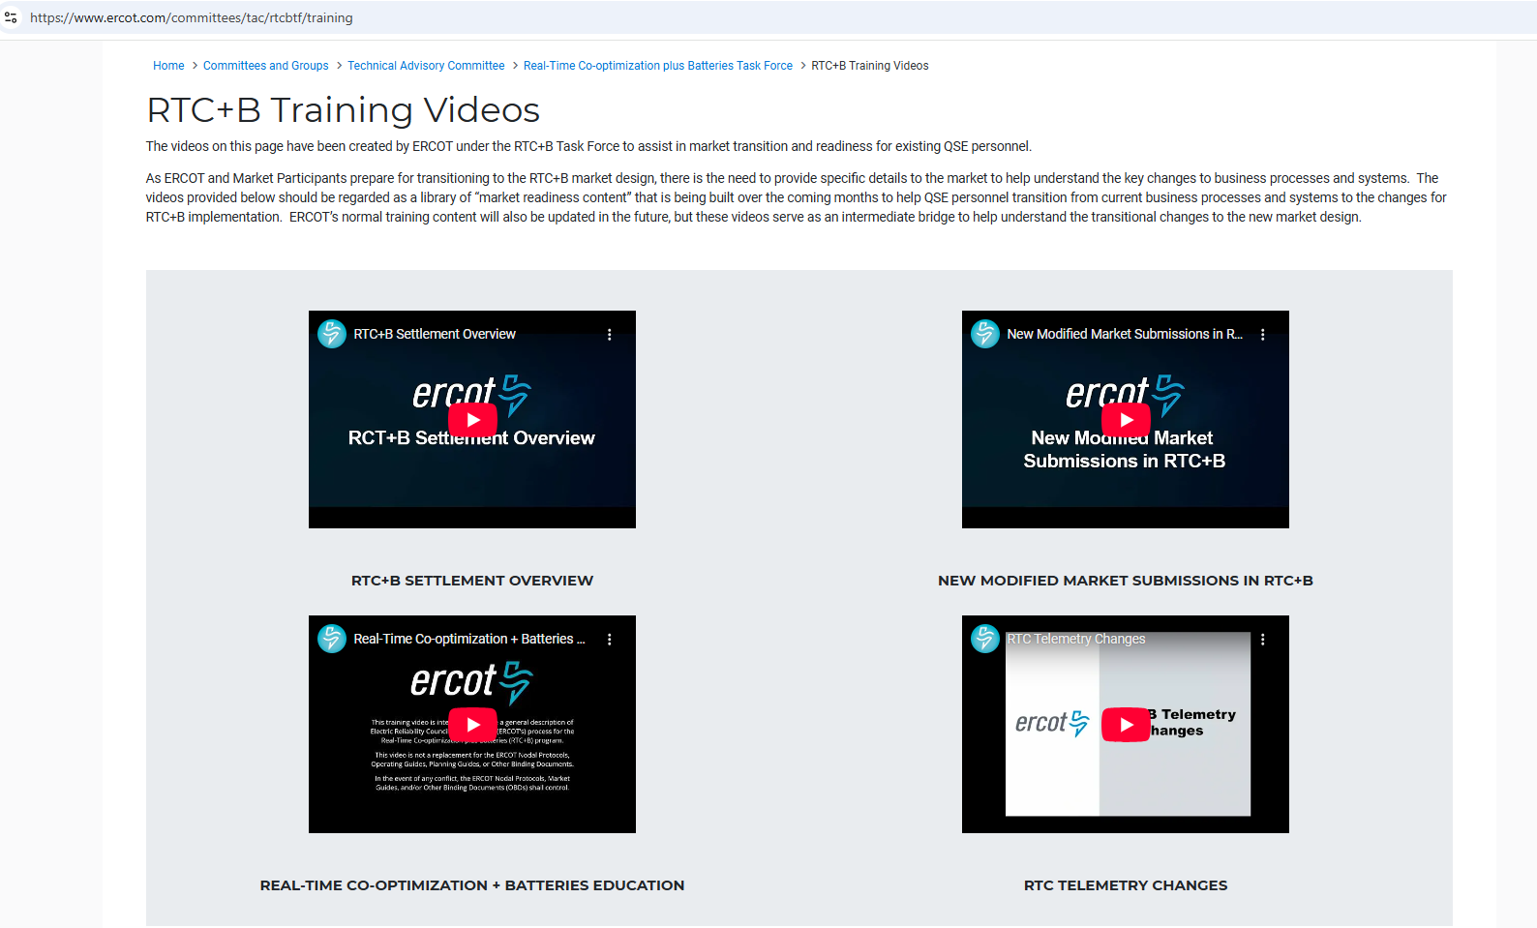
RTC+B Training videos
See RTC Training Webpage

Slide 43
Appendix - Acronyms
Ancillary Services (AS)
Ancillary Service Demand Curve (ASDC)
Controllable Load Resource (CLR)
Current Operating Plan (COP)
Day-Ahead Market (DAM)
ERCOT Contingency Reserve Service (ECRS)
High Sustained Limit (HSL)
Load Frequency Control (LFC)
Load Resource (LR)
Load Serving Entity (LSE)
Locational Marginal Price (LMP)
Low Power Consumption (LPC) = (LSL in EMS)
Low Sustained Limit (LSL)
Max Power Consumption (MPC) = (HSL in EMS)
Market Clearing Price for Capacity (MCPC)
Net Power Consumption (NPC)
Nodal Protocol Revision Request (NPRR)
Non-Spinning Reserve Service (Non-Spin)
Operating Reserve Demand Curve (ORDC)
Qualified Scheduling Entity (QSE)
Real-Time Co-optimization (RTC)
Real-Time Market (RTM)
Regulation Down (Reg-Down)
Regulation Up (Reg-Up)
Resource Limit Calculator (RLC)
Responsive Reserve Service (RRS)
Security-Constrained Economic Dispatch (SCED)
Supplemental Ancillary Service Market (SASM)
System-Wide Offer Cap (SWOC)
Under-Frequency Relay (UFR)
Value of Lost Load (VOLL)

Slide 44
Self-Provision and AS Offers blocks

Slide 45
Self-Provision & AS Offering Best Practices
Offer as if you are not self-providing
  If self-provision drops off and the QSE is not offering in this way, SCED will create and use a proxy offer — which you likely want to avoid.
Self-provision MWs are accepted first by SCED
  Remaining Ancillary Service (AS) awards when AS capability exceeds self-provision amounts are filled using block offers, starting with the lowest priced block (i.e., awards based on self-provision do not consume AS offer blocks).
Best Practice (ERCOT Recommended):
  Create your self-provision first, then offer your full resources capability
  Offer full capability, regardless of how much is self-provisioned
Why this matters:
  Without full offers, SCED fills gaps using proxy logic, which may not reflect your preferred pricing or operational strategy

Slide 46
Scenario 1 with Offer Structure
QSE to ERCOT Telemetry
ERCOT to QSE ICCP
NCLR_1 has a 15 MW RRS AS Position, 10 MW from DAM award and 5 MW from RRS Trade
Scenario ** Assume AS qualified for All Headroom (NPF-LPC) | MPC | NPF | LPC | RST | UFR | Self-provided RRS UFR(MW) | Self-provided ECRS (MW) | Current Capability to provide UFR (MW) | ECRS (10min) Ramp Rate (MW/min) | RRS UFR AS Award | ECRS AS Award | Notes
NCLR_1 is qualified to provide 15 MW. DAM awards NCLR_1 with 10MW RRS. QSE also has additional 5MW RRS Position via RRS Trades. | 15 | 15 | 0 | ONL | Arm | 15 | 0 | 15 | 0 | 15 | 0 | NCLR_1 Telemetry needs to show: Status = ONL, MPC >= NPF >= 15 MW, NPF-LPC >= 15 MW, RRS capability >= 15 MW, RRS self-provided telemetry = 15 MW SCED will respect the 15 MW self-provided RRS and award the resource 15 MW RRS UFR.
Offer Blocks
Qualified MW Capability | MPC | Self-Provision | Extra Capability available and offered in RT | Block 1 (MW/Price) | Block 2 (MW/Price) | Block 3 (MW/Price) | Block 4 (MW/Price) | Block 5 (MW/Price)
15 | 15 | 15 | 0 | 5mw @ $5 | 5mw @ $10 | 5mw @ $50
Outcome: SCED will award 15 MW due to self-provision regardless of block pricing.

Slide 47
Scenario 4 (Resource 6) with Offer Structure
QSE to ERCOT Telemetry
ERCOT to QSE ICCP
NCLR_6 has AS Positions of 20 MW RRS and with additional headroom to provide AS.
Scenario ** Assume AS qualified for All Headroom (NPF-LPC) | MPC | NPF | LPC | RST | UFR | Self-provided RRS UFR(MW) | Self-provided ECRS (MW) | Current Capability to provide UFR (MW) | ECRS (10min) Ramp Rate (MW/min) | RRS UFR AS Award | ECRS AS Award | Notes
NCLR_6 carries 20 MW of self-provision | 40 | 40 | 10 | ONL | Arm | 20 | 0 | 30 | 0 | 20~30 | 0 | NCLR_6 telemetered a RRS capability of 30MW and self-provided 20MW of RRS. The resource will be awarded at least 20 MW, due to self-provided telemetry of 20 MW, and up to 30 MW as its capability to provide RRS UFR is set to 30 MW and has ample capacity.
Offer Blocks
Qualified MW Capability | MPC | Self-Provision | Extra Capability available and offered in RT | Block 1 (MW/Price) | Block 2 (MW/Price) | Block 3 (MW/Price) | Block 4 (MW/Price) | Block 5 (MW/Price)
30 | 40 | 20 | 10 | 5mw @ $5 | 5mw @ $10 | 20mw @ $50
Outcome: SCED will award the first 20 MW due to self-provision and may award additional capacity for the first 5 MW at $5, and the next 5 MW at $10 for a total RRS award up to 30 MW.

Slide 48
AS DART Settlement and Load Resource Deployment Imbalance Scenarios

Slide 49
Load Resource Imbalance Settlement Calculation - Pre Deployment
NCLR_LD1 RRS HE12 DA Award: 10 MW at an MCPC $20
  NCLR_LD1 has 15MW of capability
  NCLR_LD1 is self-providing 10 MW RRS in RT with a RT price currently $10
  NCLR_LD1 is awarded 15MW in RT (assumes additional 5MW of capability was economic)
  Exceeding DA position with RT price lower than DA
The RRS Imbalance Payment or Charge to the QSE during the HE12 will be:
(-1)*(RT RRS award * RTMCPC - DA position * RTMCPC) = (-1)*(15MW *10 $/MW - 10 MW * 10 $/MW) = $50,
Payment in RT for RRS of $50. Net Outcome across DAM and RT for RRS is $250 (+$200 + $50) Payment.

Slide 50
Load Resource Imbalance Settlement Calculation - During Deployment
NCLR_LD1 RRS HE13 DA Award: 10 MW at an MCPC $20
  NCLR_LD1 has 15MW of capability but is deployed 10 MW RRS in RT (assumes additional 5MW of capability was not economic)
  NCLR_LD1 is self-providing 10 MW RRS in RT leading up to deployment the with a RT price currently $10
  NCLR_LD1 is awarded 5MW in RT based on post deployment consumption level (assumes load can deploy without reducing consumption to zero)
  RT award during deployment is less than the DA position with RT price lower than DA
The RRS Imbalance Payment or Charge to the QSE during the HE13 will be:
(-1)*(RT RRS award * RTMCPC - DA position * RTMCPC) = (-1)*(5MW *10 $/MW - 10 MW * 10 $/MW) = -$50,
Charge in RT for RRS of $50. Net Outcome across DAM and RT for RRS is $150 (+$200 + -$50) Payment.

Slide 51
Load Resource Imbalance Settlement Calculation - Post Deployment
NCLR_LD1 RRS HE14 DA Award: 10 MW at an MCPC $20
  NCLR_LD1 has 15MW of capability and is recalled from its previous deployment in HE13. The resource is returning to service and currently has 6 MW of NPF.
  NCLR_LD1 is awarded 6MW in RT
  Short DA position by 4MW with RT price lower than DA
The RRS Imbalance Payment or Charge to the QSE during the HE14 will be:
(-1)*(RT RRS award * RTMCPC - DA position * RTMCPC) = (-1)*(6MW *10 $/MW - 10 MW * 10 $/MW) = -$40,
Charge in RT for RRS of $40. Net Outcome across DAM and RT for RRS is $160 (+$200 + -$40) Payment.

Slide 52
QSE Imbalance Settlement Calculation - Post Deployment
SQSE45 has 2 LRs, LD4 and LD5. DA awards RRS HE14 DA Award: 10 MW (total) at an MCPC $20. Total DAM Award Payment = $200
  LD4 has 15MW of capability and is recalled from its previous deployment in HE13. The resource is returning to service and currently has 6 MW of NPF.
  LD5 had 10 MW of capability with no self-provided amount.
  SQSE45 moves the self-provided RRS to LD5. SCED Awards LD5 10 MW of RRS based on updated self-provision
  LD4 now has zero self-provision. 6 MW from LD4 is not award based on QSE’s RRS offer and economics.
  Exactly meeting DA position with RT price lower than DA
The RRS Imbalance Payment or Charge to the QSE during the HE14 will be:
(-1)*(RT RRS award * RTMCPC - DA position * RTMCPC) = (-1)*(10MW *10 $/MW - 10 MW * 10 $/MW) = -$0,
No Charge in RT for RRS. Net Outcome across DAM and RT for RRS is $200 (+$200 + -$0) Payment.

Slide 53
ADER Pilot Project Update

Slide 54
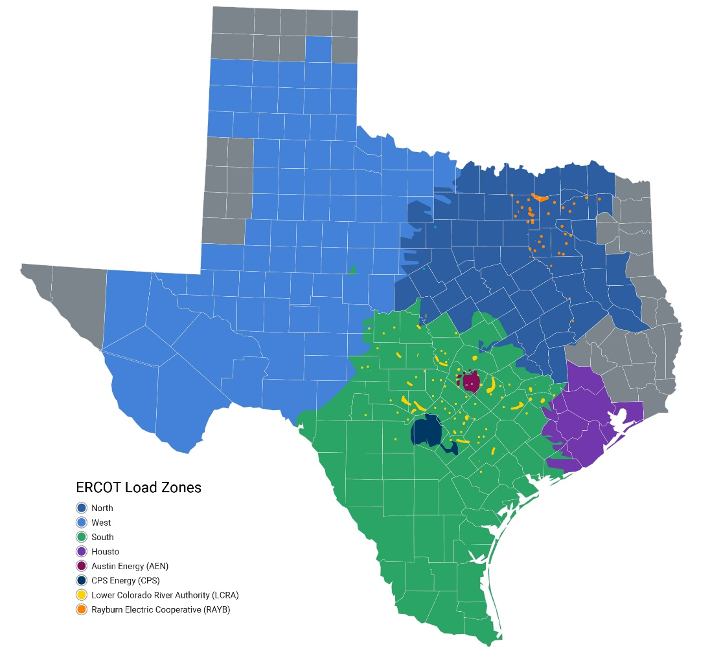
Overview of Current Status
3 resources participate in the ADER program within these capabilities:
  15.5 MW capability for energy
  8.6 MW capability for Non-Spinning Reserve Service (Non-Spin)
  8.8 MW capability for ERCOT Contingency Reserve Service (ECRS)
ERCOT has accepted 9 additional resources' Details of the Aggregation (DOTA) forms.
  These potential ADERs are in various stages of registration and qualification and cannot fully participate at this time.
Total ADER capacity (qualified and potential):
  38.3 MW capability for energy
  11 MW capability for Non-Spin
  8.8 MW capability for ECRS
15.9 MW (2)
1.0 MW (1)
7.1 MW (3)
14.3 MW (6)
MWs for energy and count of ADERs by Load Zone for all 12 ADER

Slide 55
Pilot Participation as of May 2025
 |  | LZ_AEN | LZ_CPS | LZ_HOUSTON | LZ_LCRA | LZ_NORTH | LZ_RAYBN | LZ_SOUTH | LZ_WEST | ERCOT-WIDE
Energy | Limit (MW) | 2.8 | 5.3 | 20.3 | 3.1 | 28.7 | 1.2 | 10.3 | 8.2 | 80.0
 | Approved (MW) | 0.0 | 0.0 | 14.3 | 1.0 | 15.9 | 0.0 | 7.1 | 0.0 | 38.3
 | Unused (MW) | 2.8 | 5.3 | 6.0 | 2.1 | 12.8 | 1.2 | 3.2 | 8.2 | 41.7
 | % Full | 0% | 0% | 71% | 32% | 55% | 0% | 69% | 0% | 48%
Non-Spin | Limit (MW) | 1.4 | 2.7 | 10.1 | 1.6 | 14.3 | 0.6 | 5.2 | 4.1 | 40.0
 | Approved (MW) | 0.0 | 0.0 | 6.0 | 0.0 | 4.6 | 0.0 | 0.4 | 0.0 | 11.0
 | Unused (MW) | 1.4 | 2.7 | 4.1 | 1.6 | 9.7 | 0.6 | 4.8 | 4.1 | 29.0
 | % Full | 0% | 0% | 59% | 0% | 32% | 0% | 8% | 0% | 28%
ECRS | Limit (MW) | 1.4 | 2.7 | 10.1 | 1.6 | 14.3 | 0.6 | 5.2 | 4.1 | 40.0
 | Approved (MW) | 0.0 | 0.0 | 4.0 | 0.2 | 4.6 | 0.0 | 0.0 | 0.0 | 8.8
 | Unused (MW) | 1.4 | 2.7 | 6.1 | 1.3 | 9.7 | 0.6 | 5.2 | 4.1 | 31.2
 | % Full | 0% | 0% | 39% | 15% | 32% | 0% | 0% | 0% | 22%
Key Takeaway: Introduction of ECRS in Phase 2. While the Pilot Project is making progress, participation is not yet pushing up against system-wide or Load Zone-specific participation limits.

Slide 56
Phase 3 –Approved by ERCOT Board (June 23, 2025)
Alternative Participation Model for ADERs
Premise-Level telemetry validation requirements
DOTA Form updates
Participation Limits updates
Key Takeaway: Phase 3 introduces a more flexible participation model, improved telemetry validation, and increased participation limits.

Slide 57
A-NCLR Model
Aggregations of devices/premises will be allowed to participate as Aggregate Non-Controllable Load Resources (A-NCLRs).
  Aggregations will be registered and modeled like other ADERs but using NCLR categories for Resource parameters in ERCOT’s Resource Integration an Ongoing Operations (RIOO) system.
  Real-time 2-second telemetry will still be required from the QSE to ERCOT using all NCLR attributes.
  These ADERs will be dispatched by the Ancillary Service Deployment Manager like other NCLRs. No Energy Bids or dispatch through Security-Constrained Economic Dispatch (SCED) in Real-Time.
NCLR model will allow third-party QSEs to aggregate >100 kW premises, even if the LSE is represented by a different QSE.
  Require an LSE Acknowledgement Form to confirm coordination between entities and to avoid cross-settlement processes.
  ERCOT to verify QSE-LSE relationships during review.
Key Takeaway: The A-NCLR model provides a pathway for broader ADER participation by enabling aggregations without requiring SCED dispatchability.

Slide 58
A-NCLR Telemetry Validation
For A-NCLR ADERs:
  For device-level telemetry validation, ERCOT will require 5-minute interval data from each device (1-minute data will still be required for SCED dispatchable ALR-ADERs)
  Validation Metric change: Of these intervals being evaluated, the telemetered value must be within 50% of the aggregate device-level data averaged over each 15-minute Settlement interval when the Total Expected Registered Capacity is less or equal to 1 MW, or within 10% of the aggregate device-level data averaged over each 15-minute Settlement interval when the Total Expected Registered Capacity is greater than 1 MW.
Deployment performance will use the meter-before/meter-after baseline methodology, like other NCLRs
  “Baseline” capacity calculated by measuring the average of the real power consumption for five minutes before the Dispatch Instruction if the Load level of a Load Resource had not been affected by a Dispatch Instruction from ERCOT

Slide 59
Premise-Level Telemetry Validation
Condition 1: Only intervals where the aggregate Premise-level 15-minute Settlement interval meter data meets one of the following will be evaluated:
  When the aggregate Premise-level 15-minute interval Settlement meter data shows as net withdrawing, the Resource’s metered withdrawals must equal or exceed 0.1 MW
  When the aggregate Premise-level 15-minute interval Settlement meter data shows as net injecting (negative value in the meter data), the Resource’s metered injections must equal or exceed -0.1 MW
Condition 2: Of these intervals being evaluated, the telemetered NPC value minus the Resource specific assigned offset must be within 10% of the aggregate Premise-level 15-minute interval Settlement meter data
Condition 3: During the 8-hour evaluation period, at least 50% of the intervals must meet condition 1 above.
Key Takeaway: Telemetry validation conditions have been refined to ensure data accuracy and resource performance.

Slide 60
DOTA Form Updates
Once a DOTA form has been approved by ERCOT, any conflicts with premises participating in subsequent Emergency Response Service (ERS) Standard Contract Terms will be resolved through the ERS procurement processes and will not require the DOTA to be edited for those conflicts.
  i.e., the premise would not be allowed to participate in ERS for subsequent terms
Transmission and Distribution Service Providers (TDSP) will continue to be required to review DOTA forms for any participation conflicts with TDSP Load Management Programs.
Key Takeaway: Streamline the DOTA process and clarify TDSP role to resolve conflicts efficiently.

Slide 61
Participation Limits Update and Utilization of ERCOT’s Governing Document Discretion
Phase 1 and 2 of the pilot limited the total registered MW capacity of all ADERs to 80 MWs for energy and 40 MWs for each of Non-Spin and ECRS.
Under Phase 3 ERCOT has increased these limits to 160 MWs and 80 MWs respectively to allow the pilot to continue to grow and evolve in Phase 3.
Additionally, under existing Governing Document language, ERCOT staff has discretion to update system-wide pilot participation limits without needing approval of a new Governing Document.
Key Takeaway: Increase MW limits and exercise discretion to adjust participation thresholds immediately.

Slide 62
Next Steps
Following a period of at least six months of Phase 3, ERCOT plans to work with stakeholders to prepare an NPRR to move the Pilot Project into the protocols.

Slide 63
Upcoming ERS Weather-Sensitive Changes
Weather-Sensitive ERS will no longer be to offer into AprMay or OctNov SCTs.
For DecMar and JunSep SCTs Weather-Sensitive will be limited to the High-Risk Time Periods.

