Slide 1
ERCOT Large Electronic Load
Voltage Ride-Through Performance Requirements (Proposal)
Patrick Gravois
Operations Engineer – ERCOT Event Analysis
LLWG July 11, 2025

Slide 2
Disclaimer
The following presentation describes potential voltage ride-through performance requirements for Large Electronic Loads (LEL) that ERCOT is still evaluating.
  Additional studies may be required to assess system impacts under the proposed requirements.
  Information presented today is intended to initiate discussions with LEL owners/operators and Original Equipment Manufacturers and help define what ERCOT considers acceptable ride-through of LELs.
ERCOT is not requiring existing Large Loads to meet proposed voltage ride-through requirements to remain operational or receive Approval to Energize.
  Final requirements will be used to determine if LELs can ride-through common system disturbances and if they will be included in mitigation plans to maintain potential System Operating Limits for grid reliability.
Future LELs will need to meet voltage ride-through requirements.

Slide 3
Large Electronic Load Ride-Through Background
ERCOT has observed many recent events in which Large Electronic Loads (LEL) do not ride-through common voltage disturbances on the grid
Other LLs have been able to ride-through similar events
ERCOT has performed the following studies to evaluate the reliability risk of these events
  Study 1: Determined that 2,600 MW of instant load loss under certain system conditions could cause system frequency to increase to 60.4 Hz with RoCoF reaching above 5 Hz/sec; potentially causing cascading generation outages
  Study 2: Determined potential loss of operational LELs could reach up to 1,500 MW in West Texas with 3-phase fault in certain locations
  If the quantity of LELs that cannot ride-through a fault in the area affected by the fault exceeds 2,600 MW under worst-case inertia and foot-room conditions, it could cause system-wide frequency instability if not mitigated.
To address reliability risk, ERCOT is evaluating options, including System Operating Limit (SOL), to maintain the reliability
Ride-through capability for LELs is critical to ensure reliable integration of LELs
June 13 LEL Workshop slides

Slide 4
Evaluation of Current LEL Ride-Through Capabilities
ERCOT proposed LL voltage ride-through requirements in NOGRR 256 which was submitted August 2023
  NOGRR was withdrawn in May 2024 due to Stakeholder feedback
ERCOT has met with multiple data center owner/operators to discuss current ride-through capabilities and UPS designs
  ERCOT identified common practices that would disconnect LELs almost immediately from the grid for several seconds or longer during common voltage disturbances
ERCOT/NERC/TRE teams have met with multiple owner/operators of cryptocurrency mining facilities involved in observed events
  Team discovered a wide variance of electrical and protection system designs that may be improved to increase ride-through capabilities during single-line-to-ground fault events (Δ-Y transformer windings, balance of phase protections, VFD ride-through settings, etc.)
  Due to lack of UPS, facilities have limited ride-through capability during phase-to-phase or 3ph faults; will likely trip or reduce consumption when voltage drops outside of ITIC curve
ERCOT has observed that all LELs could potentially not ride-through phase-to-phase faults or 3ph faults with shallow voltage sags at POI

Slide 5
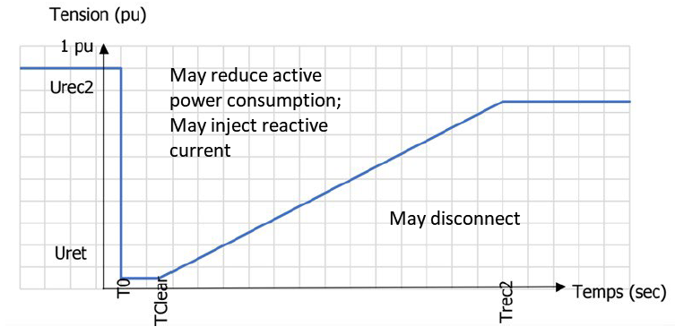
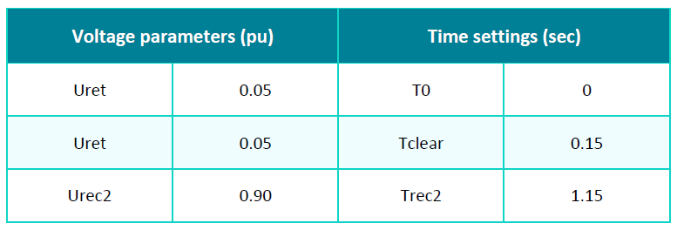
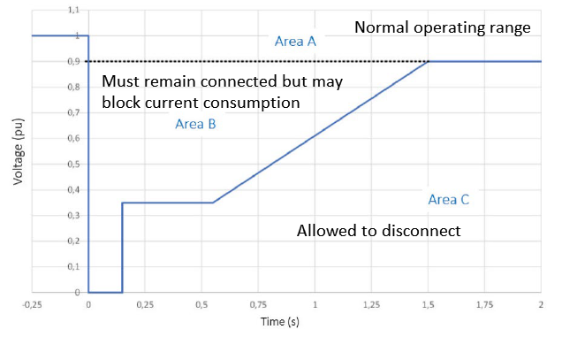
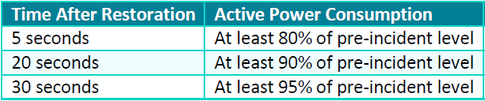
European Large Load LVRT Requirements
RTE (France) and Energinet (Denmark) have implemented ride-through requirements for LLs. EirGrid (Ireland) has a proposed requirement.
All allow temporary reduction of consumption above respective voltage ride-through curves although loads MUST remain connected
  RTE: active power consumption may decrease during voltage dip and load shall regain at least 90% of nominal load; begin ramping 300ms after voltage recovery and ramp at 0.5 Pmax/sec
  Energinet: may block their current consumption and restore to the following:
                Energinet restoration times for Area B
RTE Grid Code Section 3.12
Energinet Grid Code Part 3
Figures c/o EPRI

Slide 6
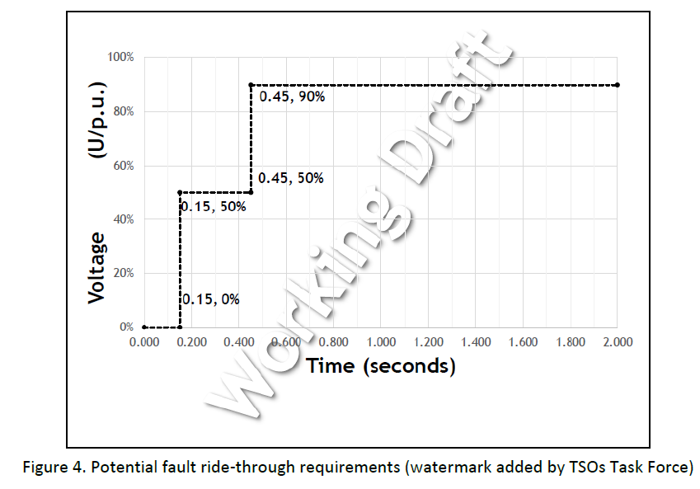
European Large Load LVRT Requirements
  EirGrid (proposed): after the fault disturbance is cleared, the demand facility should return to pre-fault conditions above 95% of the pre-fault value
    EirGrid is currently considering restoration time after fault is cleared
Restoration times in RTE and Energinet requirements are not sufficient for ERCOT
  ERCOT should determine acceptable ride-through performance above vrt curve in which LLs must remain connected
  Partial temporary reduction in consumption vs. full reduction
  ERCOT is considering restoration time of less than one second after voltage recovery
  Further studies needed to determine system impacts of previous bullets
Figures c/o EPRI

Slide 7
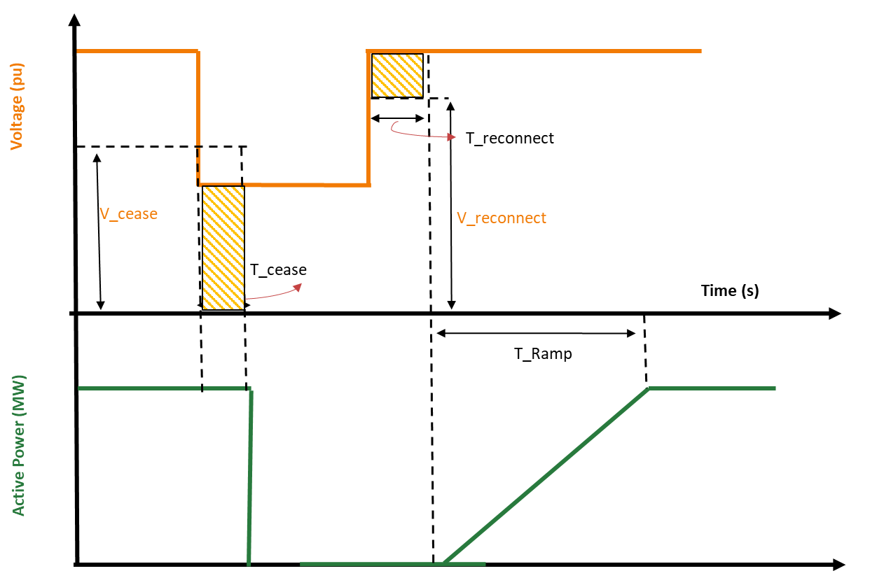
Typical Data Center Ride-Through Capability (w/ UPS)
Switch to ES logic
If (V<V__{cease} for T>T__{cease})
Start Delay Timer
If Delay Timer >T_{delay}
P_{out} = 0
Return to BES logic
If V> V__{reconnect} for T>T__{reconnect}
P_{out} = P_{out} + ΔΤ∗T_{ramp}
where T_{ramp} is the ramp time
V_cease/T_cease: voltage below V_cease value for duration of T_cease results in load transferring to UPS (e.g. 0.70 pu for 20 msec)
V_reconnect/T_reconnect: grid voltage returns to V_reconnect for duration of T_reconnect results in load ramping back to grid
Data center designs often deploy a delay of multiple seconds before checking grid voltage recovery
If grid voltage does not recover within certain period of time, load transfers to backup generation
Same ramp rate used for transfer back to grid or backup generation
Figures c/o EPRI

Slide 8
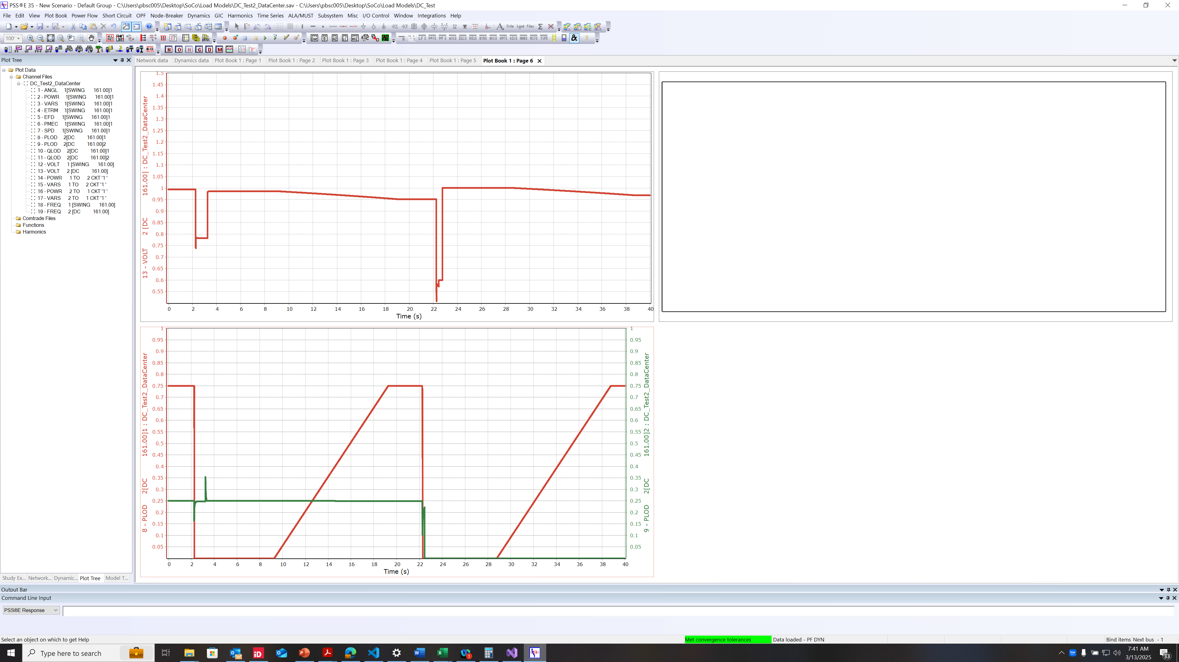
Example Model Response
Voltage (pu)
Data Load
Power (pu on 10 MVA base)
Motor Cooling Load
c/o EPRI

Slide 9
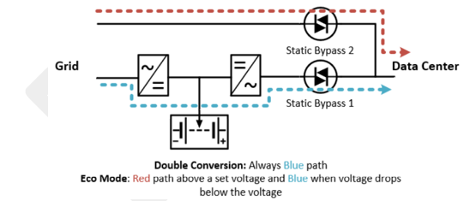
Common Data Center UPS Practices
Data centers most commonly use double-conversion UPS
May operate in Eco mode to reduce losses during normal operation; Static Bypass 2 would open and Static Bypass 1 would close when voltage drops below defined threshold (e.g. 0.9pu)
For deeper voltage sags (e.g. <0.75 pu), an additional static switch would transfer IT load from grid power to battery power during the event
It may be possible for data center to pull from grid and battery simultaneously, thus reducing the consumption drop seen from the grid
  For example, grid voltage drops to 0.70pu, power from grid reduces 30% (or less depending on cooling load and rectifier current headroom); remaining power supplied by battery
  Full consumption could return to grid once fault is cleared within msecs, but data centers often implement a configurable delay for multiple seconds
  At least one UPS vendor indicated a hard rectifier cutoff at 0.5 pu. Below this, UPS ceases pulling power from the grid and may take a second for the load to return after the fault is cleared

Slide 10
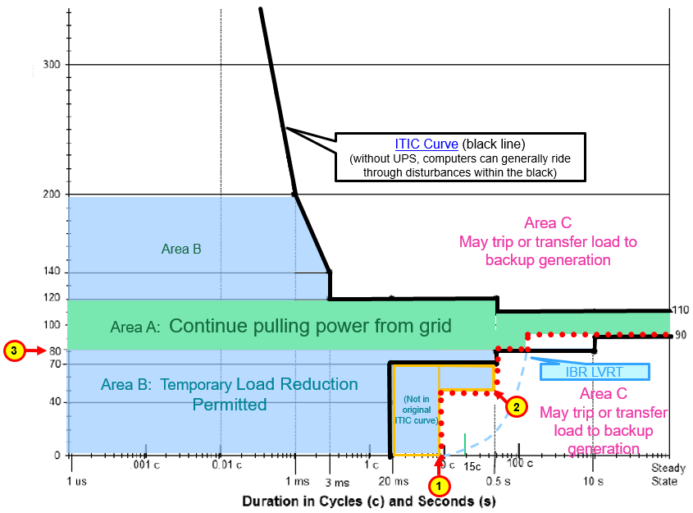
Proposed LEL Voltage Ride-Through (Concept)
Fault ride through (9 cycles, 0.15 sec, similar to IBRs)
Reduced voltage ride through (e.g. delayed clearing events)
Sustained power breakpoint (some electronic loads can do 0.7 pu or lower, but might hinder grid voltage recovery)
1
2
3
Percent of Nominal Voltage at POI
(details on slide 12)

Slide 11
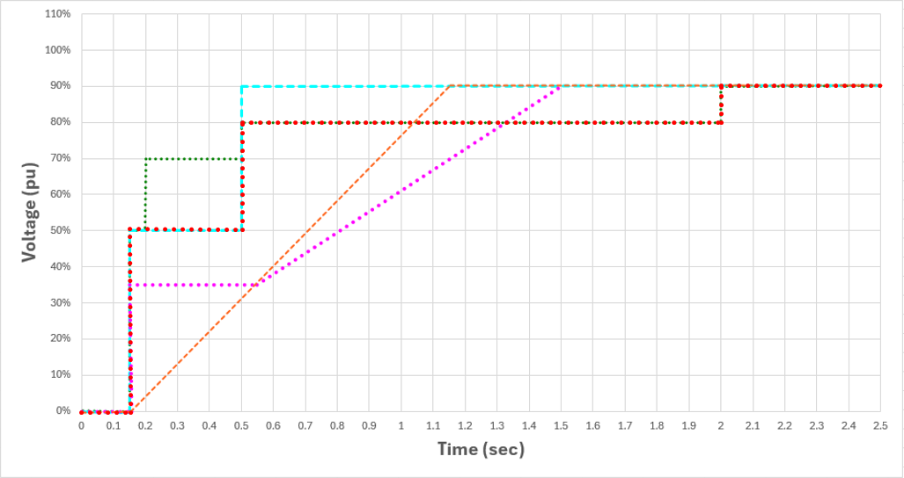
LL LVRT RTO Comparison
Proposed
(ERCOT Legacy LVRT for IBRs)
(withdrawn)
(proposed)

Slide 12
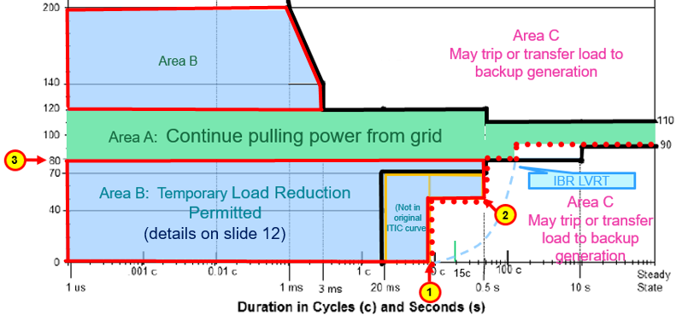
Ride-Through Performance Requirements for Area B
Area B – Load may reduce consumption from grid but MUST remain connected
  Preferable for load to remain consuming power from grid during shallow voltage sags between 0.5 and 0.8 pu; load reduction should be proportional to voltage dip
  Load may transition fully to UPS for deep voltage sags in which rectifier can no longer deliver active power; e.g. less than 0.5 pu
  Load shall return to at least 90% pre-disturbance consumption from grid within one second of voltage recovery (0.9pu or greater)
  Load shall not operate in constant power mode in this region; should operate in constant current mode with reasonable current limitation (TBD)
Percent of Nominal Voltage at POI

Slide 13
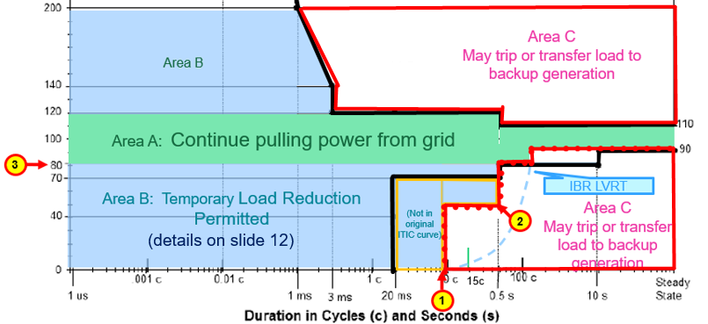
Ride-Through Performance for Area C
Area C – Load may disconnect from grid and/or transfer to backup generation
  Restoration times following disconnection and/or transfer to backup generation will need to be coordinated (TBD)
  Restoration of multiple LELs will likely need to be staggered over a period of time exceeding several minutes
  Above bullets are not included in ride-through requirement but will need further discussion to ensure reliable restoration of potential large amount of LEL
Percent of Nominal Voltage at POI

Slide 14
Reasoning/Justification of Specific RT Requirements
Allowance of temporary reduction of consumption in Area B
  Reduced consumption during voltage sags can improve voltage recovery
  More important that load returns as quickly as possible upon voltage recovery
Restoration of load within one second in Area B
  If load is restored within one second, impact to system frequency will likely be minimal (needs further study)
  Similar requirement and performance for IBRs; observed performance has shown minimal impact to system frequency
  Full vs. partial reduction of consumption from grid needs further study
LVRT curve in which load may disconnect – Area C
  < 0.5 pu for 9 cycles or 150 msec: LELs close to the fault will see deeper voltage sags, but should ride-though normally cleared faults (4-7 cycles); exceptions may be needed for delayed clearing with deep voltage sag
  < 0.8 pu and >0.5 pu for 0.5 sec: LELs further away from the fault will see voltage sags in this range and should be able to ride-through delayed fault clearing which may be up to 30 cycles or 0.5 sec.

Slide 15
Other Considerations
“Three Strikes Rule”: Some UPS designs count the number of disturbances per minute, may switch to backup after 3
  May be unnecessary for transmission connected LELs – preferable if this design was not used
  If needed, should be closely coordinated with Interconnecting TSP so it does not conflict with reclosing schemes and transfer to backup unnecessarily
  Unknown if existing LELs in ERCOT are using this practice; will be identified in Large Load Model Survey
Frequency Ride-Through Requirements: Careful consideration needed if implementing any frequency ride-through protection. If implemented, should be set to maximum capability

Slide 16
Next Steps
Gather Stakeholder feedback
  DWG feedback
  Large Load Model Surveys
  Additional feedback from LEL owners/operators and OEMs
Perform additional studies as needed
  Impact of temporary reductions (partial vs. full reduction)
  Impact of restoration times after temporary reduction
  Impact of restoration after disconnection
  Timing of studies depends on model capabilities
Draft ride-through requirements (NOGRR)
  End of Q3/ Beginning of Q4
Additional work
  Develop frequency ride-through requirements for LELs
  Identify typical voltage/frequency ride-through capabilities of VFDs

Slide 17
Questions?

