Slide 1
UPS Fault Dynamics
Brett Ross
Electrical Engineer
Notes:
Stock Image

Slide 2
Double Conversion UPS Topology
All power electronics active, bidirectional
Rectifier, inverter, chopper generally on “hot standby” for seamless transfers
Mechanical contacts are for maintenance/lock-out
Battery Converter (“chopper”)
Primary power source
Rectifier
Inverter
Load
Bypass power source
Bypass Switch
N.O.
Notes:
The purpose of this slide is just to clearly label all the components I am going to refer to in the subsequent slides and explain what they are.
Going to use Eaton UPS terminology: https://www.nerc.com/comm/RSTC/LMWG/lmwg_m2_2025_all_presentations.pdf
I’ll use UPS oscillography for some cases but mostly generate results with my PSCAD model so things can be nicely controlled and legible.

Slide 3
Basic Operation
Normal
Eco/Bypass
Battery
Primary
Load
Primary
Load
Primary
Load
Bypass
Bypass
Bypass
OFF
ON
OFF
Notes:
The purpose of this slide is to illustrate the UPS operating in the two “pre-event” operating modes we often discuss, normal mode and eco mode.

Slide 4
UPS Protection Functions
Objectives:
  Protect rectifier (normal mode), load (eco mode)
  Prevent abnormal input voltage from affecting load voltage output
Common functions:
Function | Normal Mode |  | Eco Mode
 | Pickup, pu | Time Delay, ms | Pickup, pu | Time Delay, ms
Overvoltage | 1.15 | 75 | 1.1 | 10
Undervoltage | 0.8 | 75 | 0.9 | 10
Voltage Unbalance | 0.1 | 150 | 0.05 | 50
Sequential sag | 0.9 | 10 ms per sag; 3-minute window | N/A | N/A
Notes:
List out common protection functions, tripping points for reference in fault ride-through discussions
Refine, trim down, correct based on EPRI materials

Slide 5
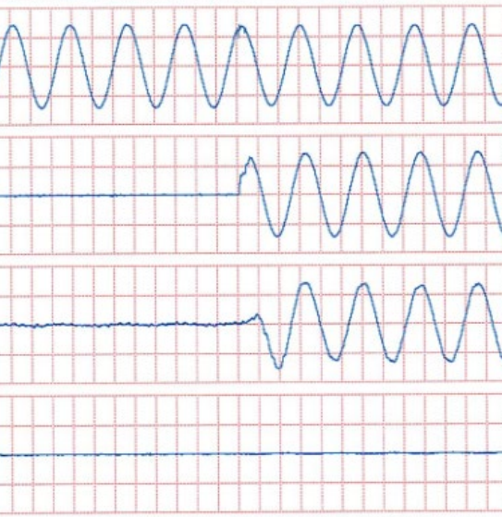
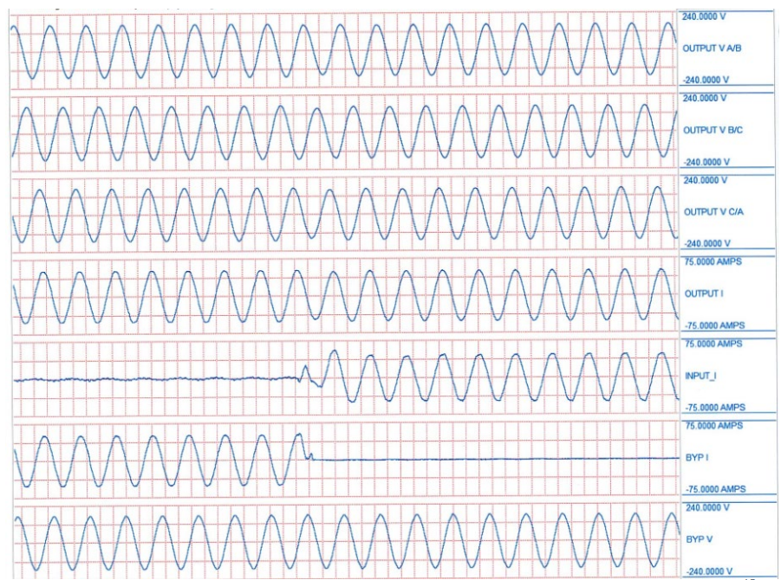
Load Switching
Normal Mode: 0 to 100% load step
Bypass Mode to Normal Mode
Output voltage
Output voltage
Output Current
Output Current
Rectifier Current
Rectifier Current
Bypass Current
Bypass Current

Slide 6
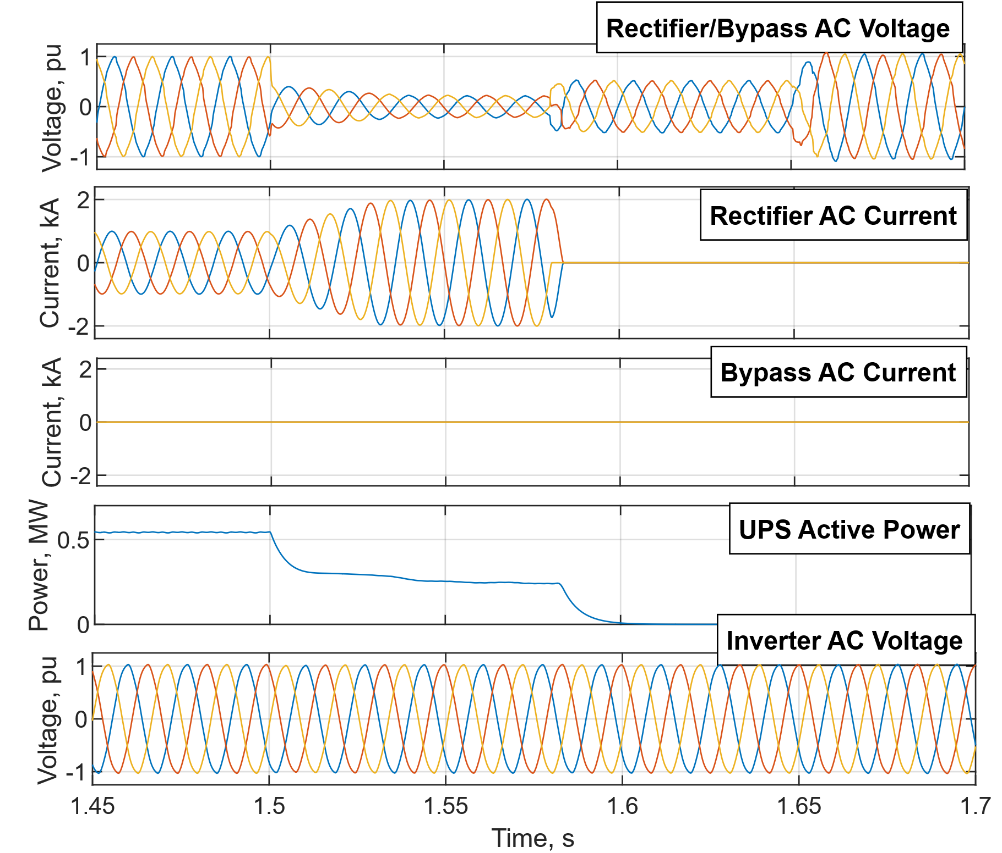
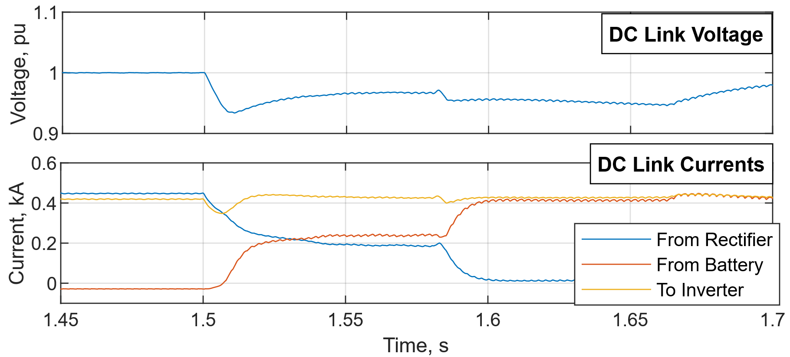
Fault Response (Normal Mode)
Nearby 3 PH Fault
Rectifier hits current limit, rapidly trips due to undervoltage

Slide 7
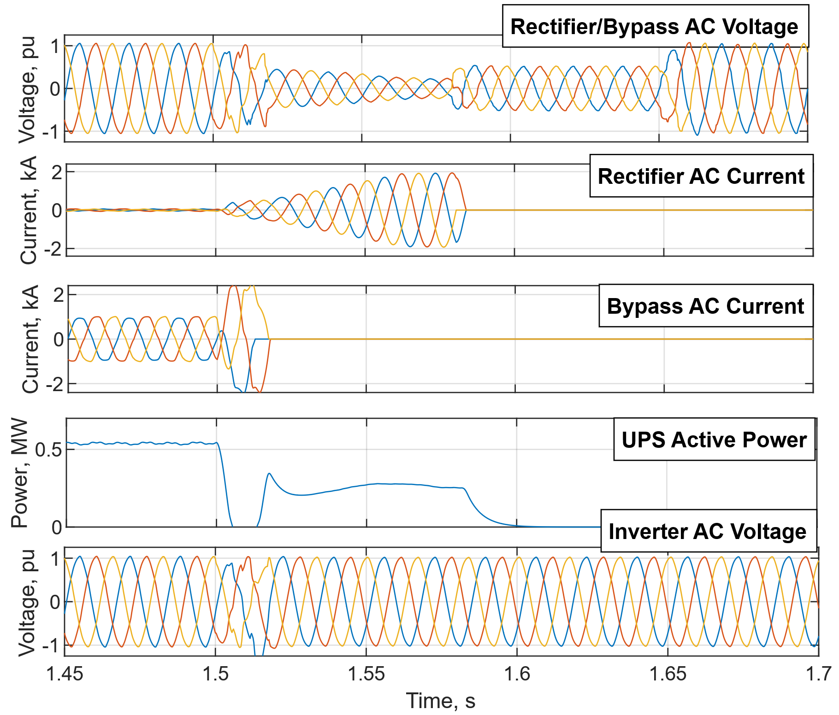
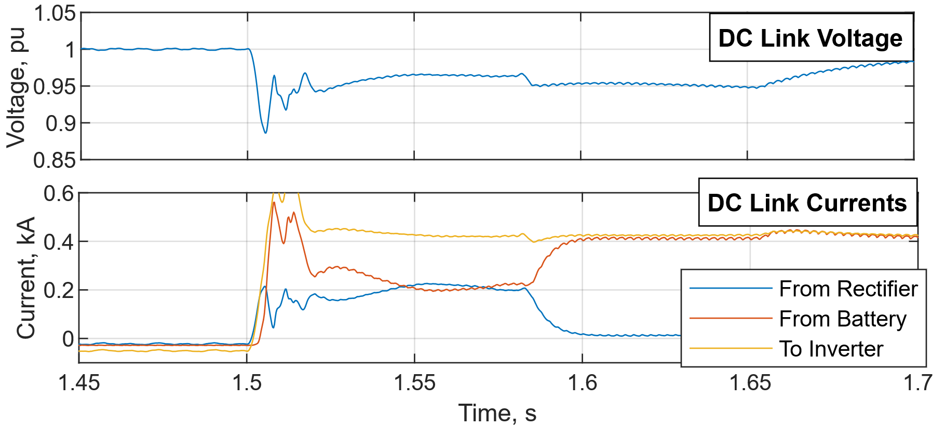
Fault Response (Eco Mode)
Bypass must trip very rapidly since output affected
Rectifier will trip simultaneously or shortly after

Slide 8
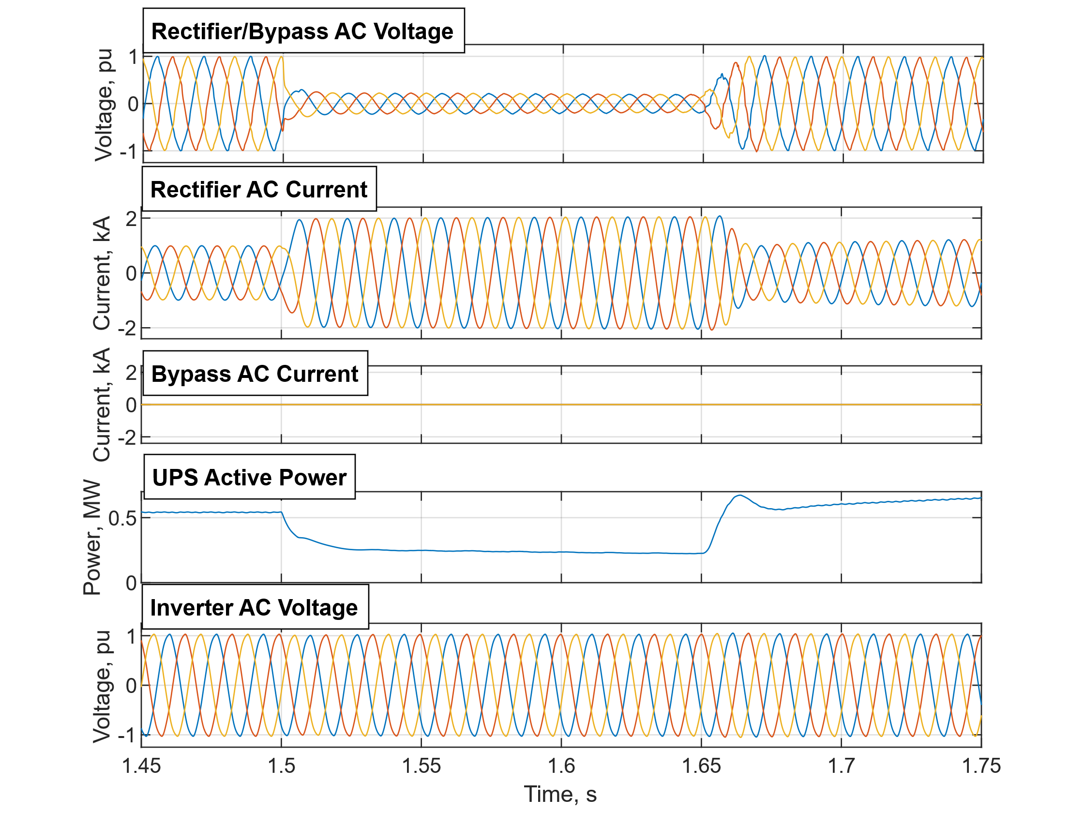
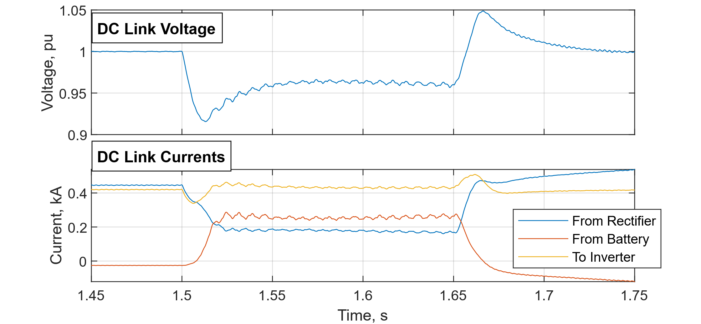

Ride-Through, Normal Mode
Undervoltage protection disabled
Heavy battery support required to regulate $V_{dc}$ for close-in faults
AC System Measurements
DC Link Measurements

Slide 9
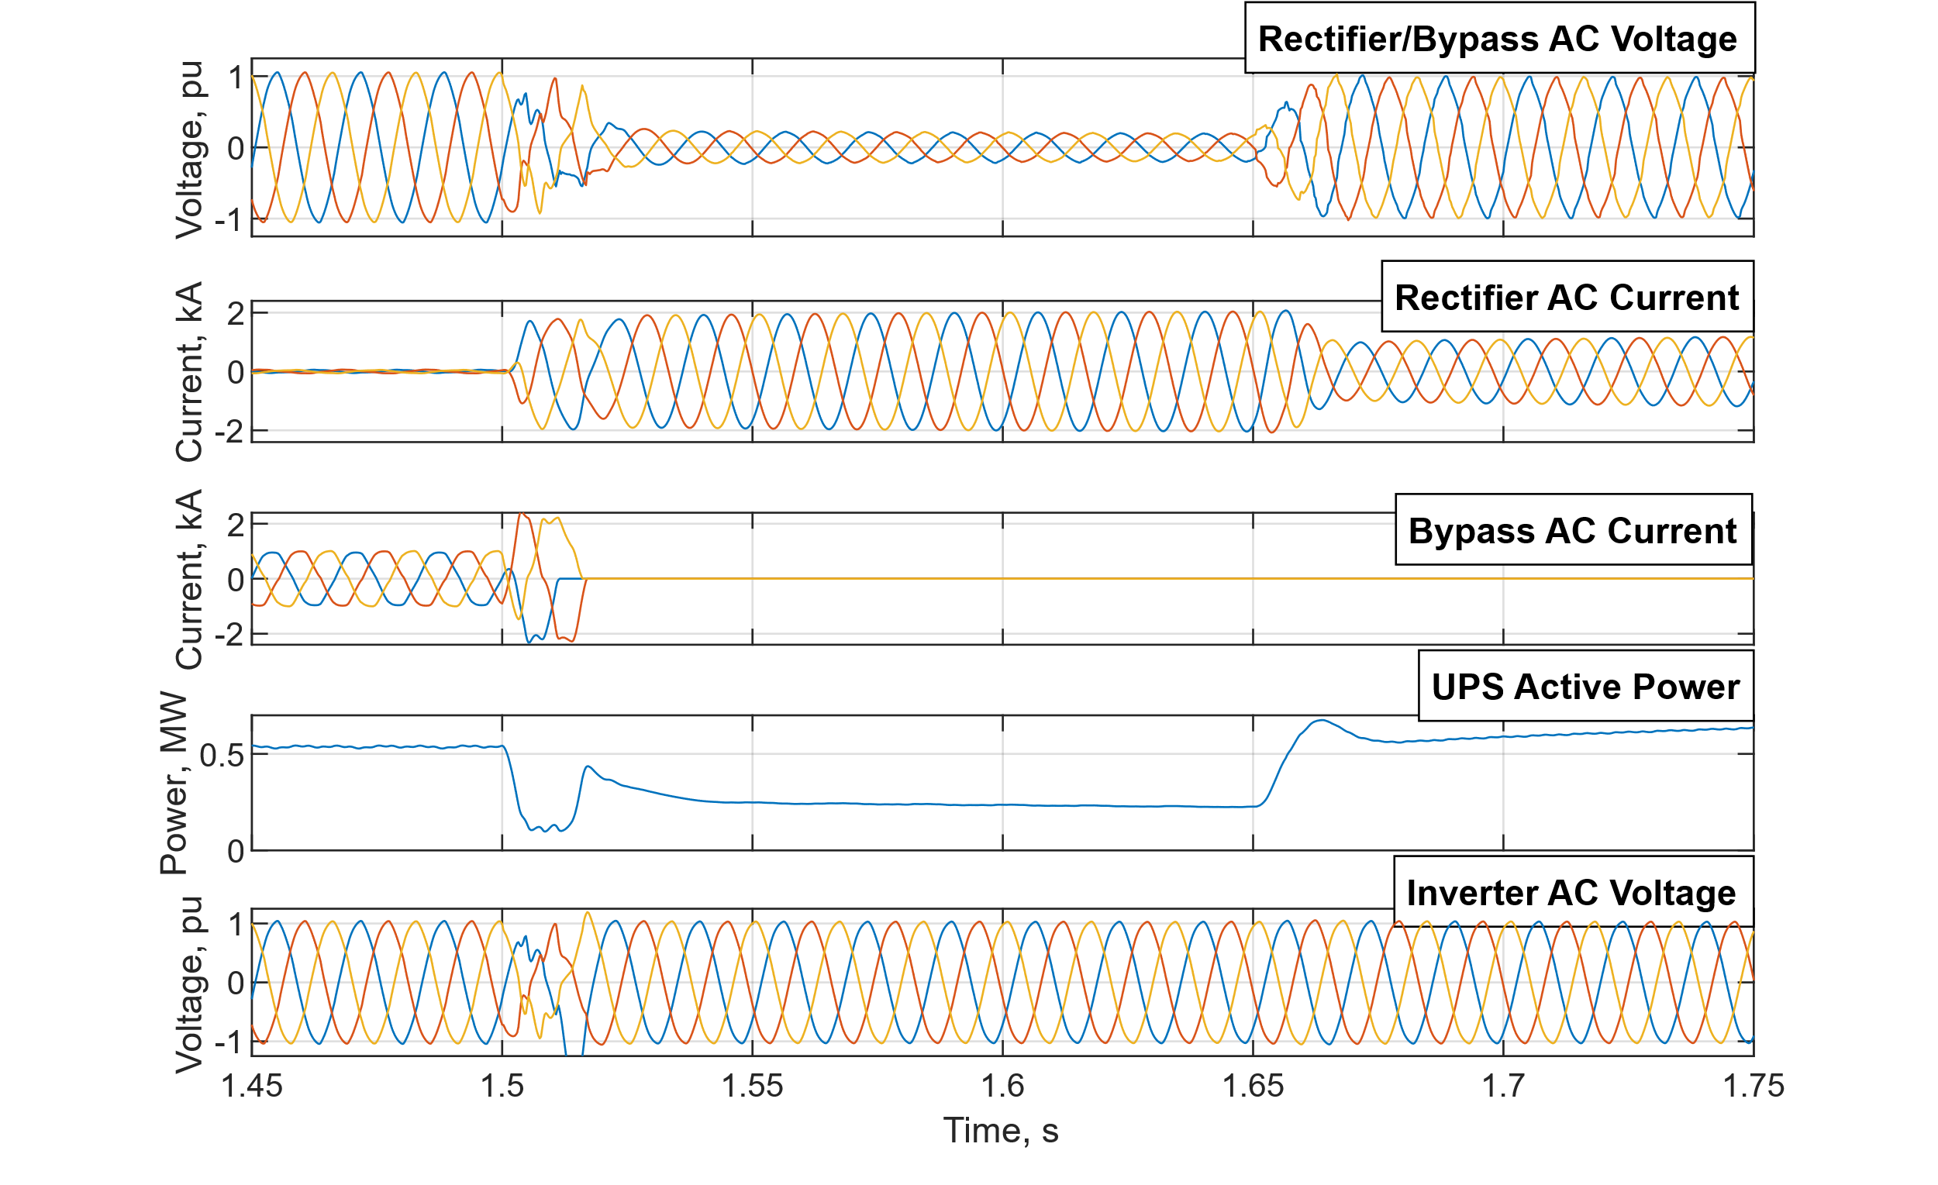
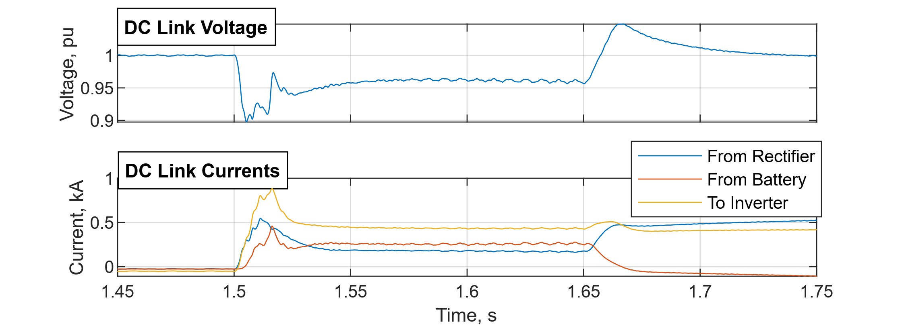
Ride-Through, Eco-Mode
Rapid bypass trip still required, but otherwise similar to normal mode
Load subject to fault voltages for ~1 cycle
AC System Measurements
DC Link Measurements

Slide 10
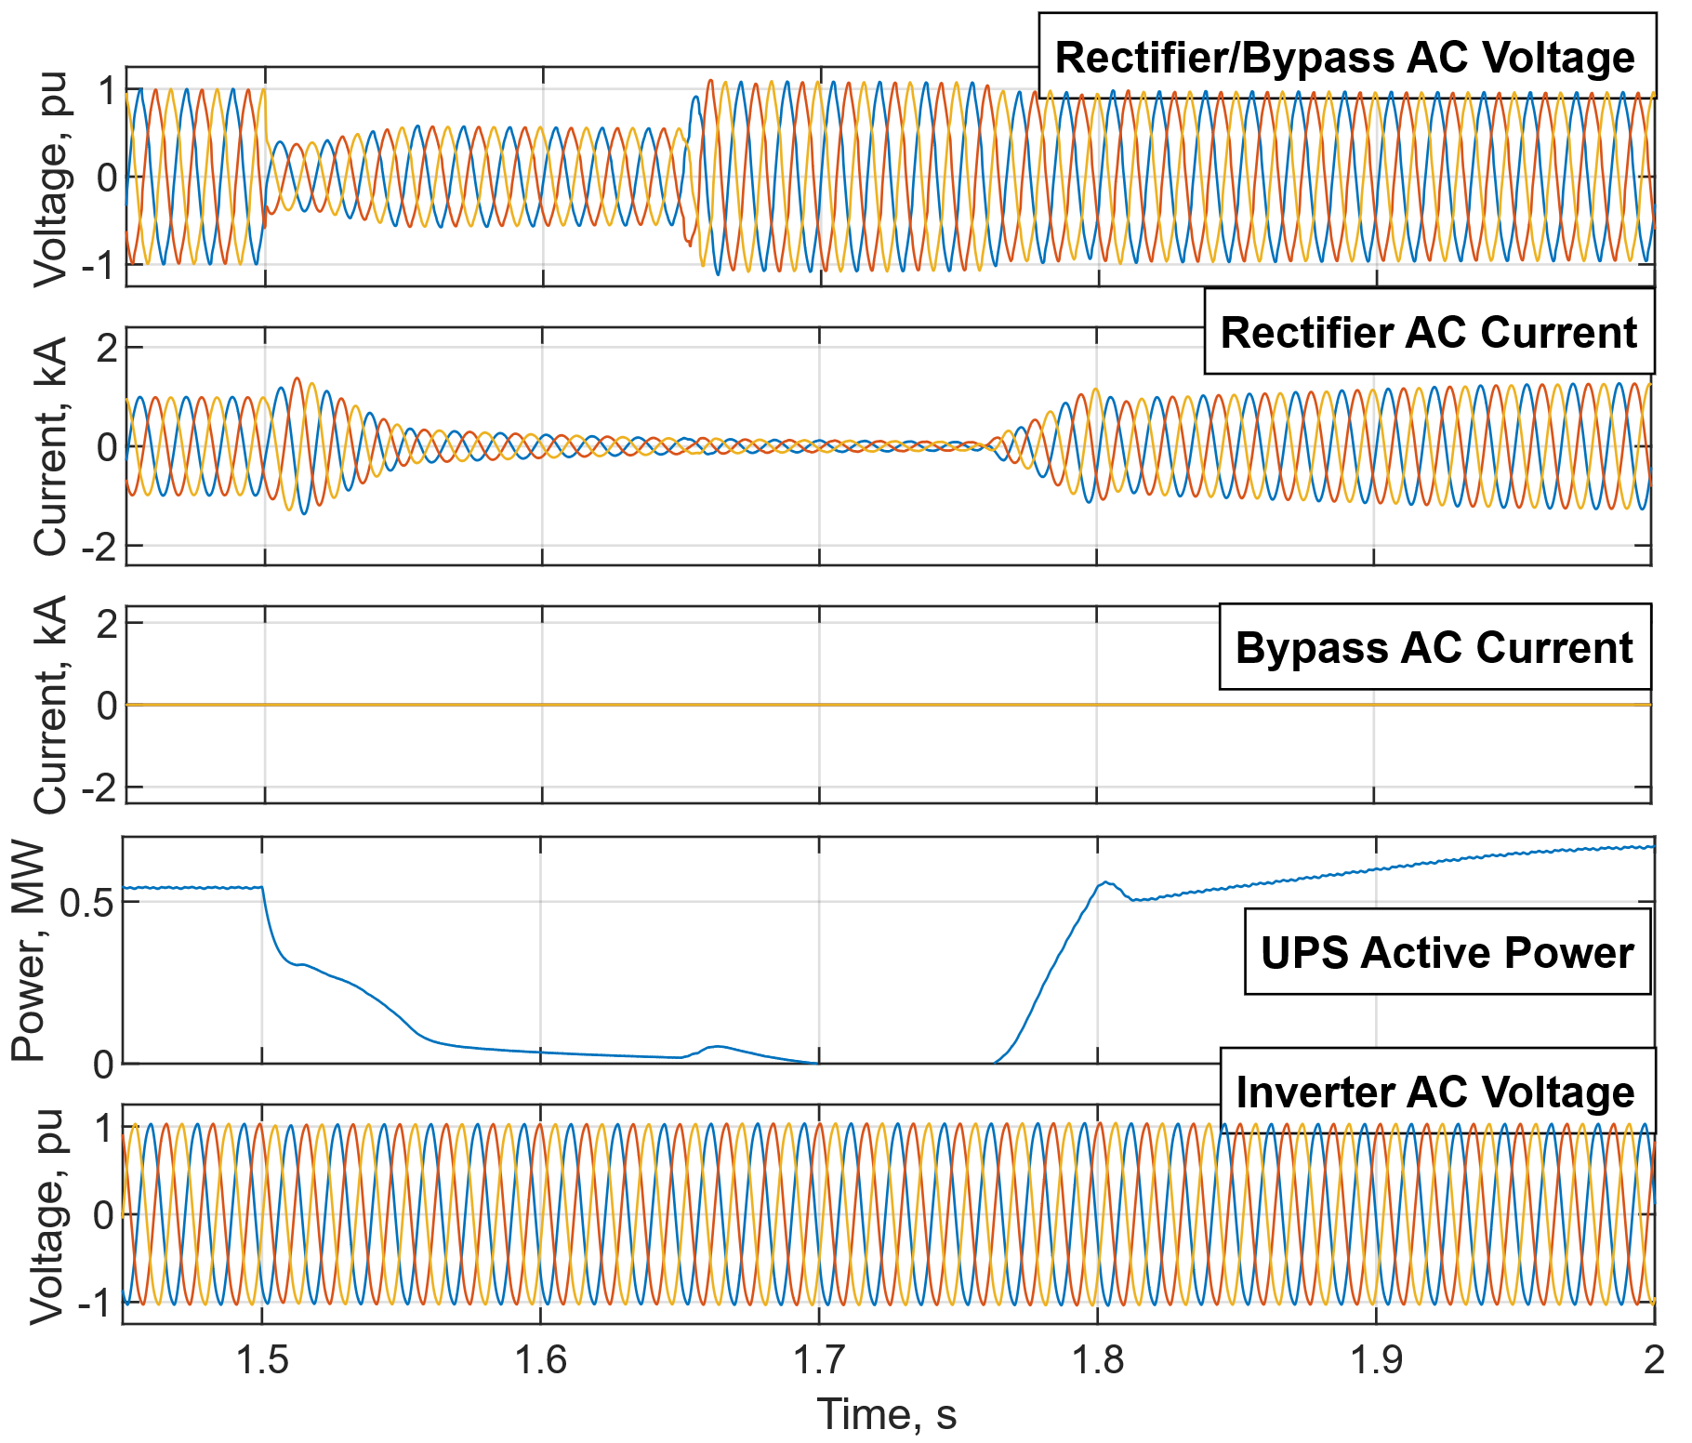
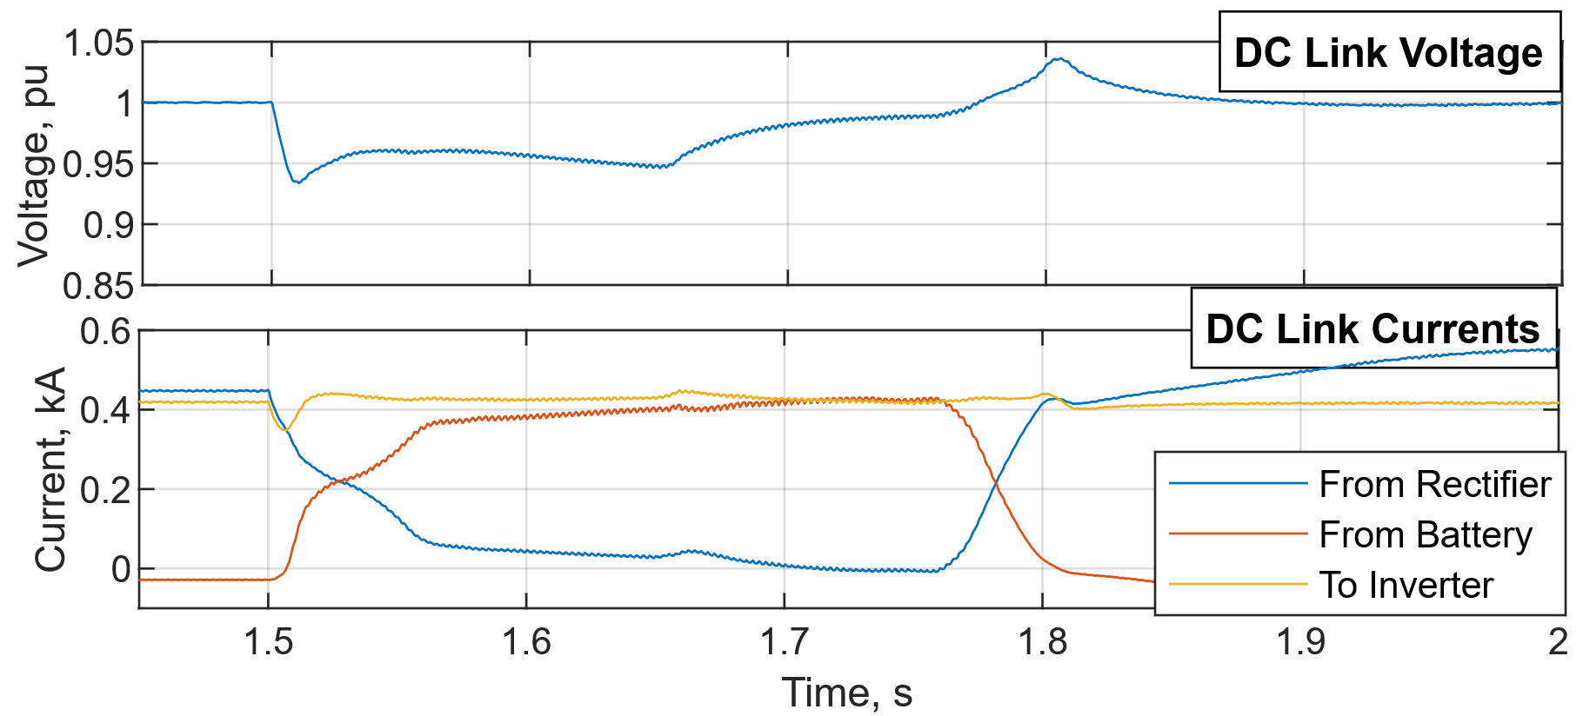
Momentary Cessation, Normal Mode
Drawing maximum current during fault can cause voltage stability, protection concerns
Momentary cessation one solution to this

