Slide 1
Data Center Modeling for Transmission Planning Studies
Parag Mitra
Principal Technical Leader

Slide 2
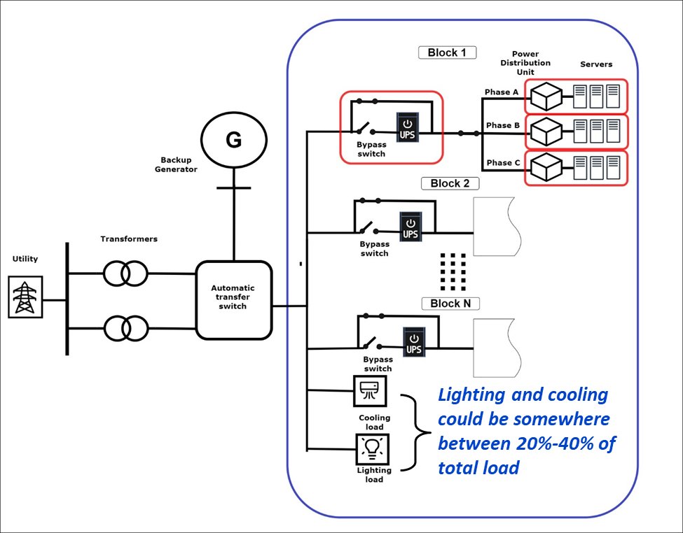
Data Center Electrical Distribution
About 90% of the total load is electronically driven (Switched Mode Power Supplies and Electronic Drives)
The main electrical equipment that interfaces with the grid are:
Uninterruptible power supply
Single phase power supply units (*)
Variable speed drives/direct connected motors
Lighting (LED)
Battery Energy Storage/Power Conditioning Equipment (*)

Slide 3
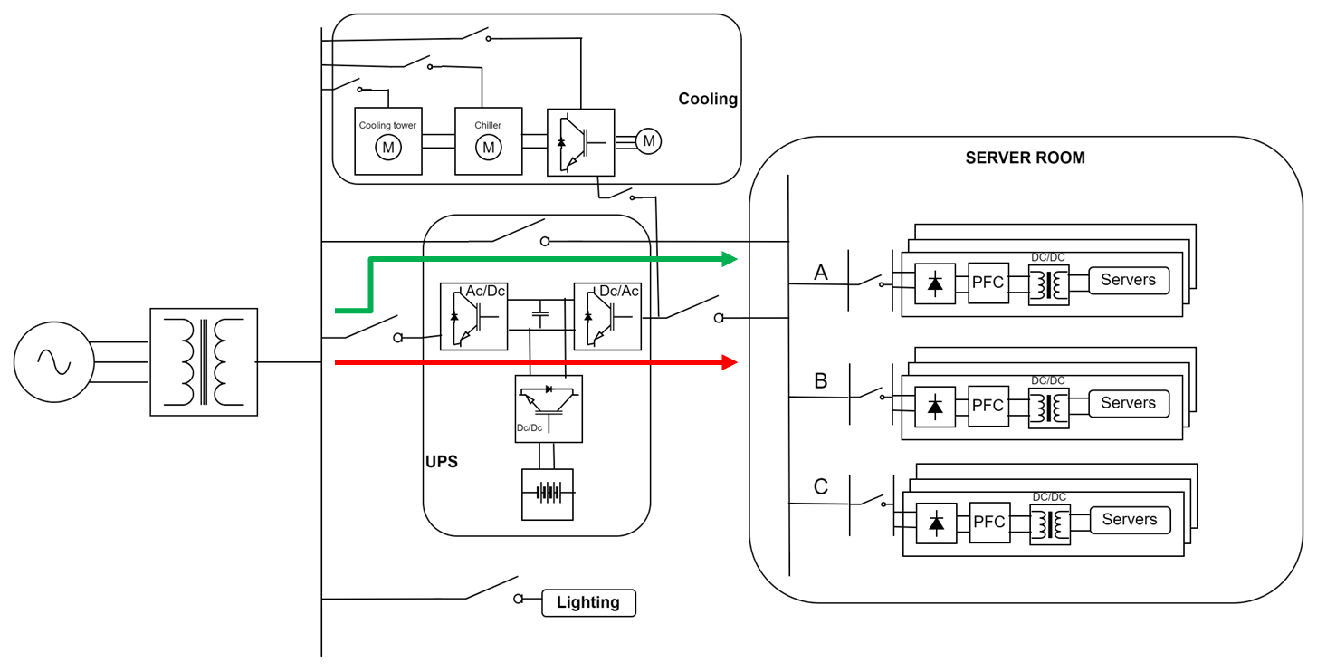
Main Electrical Components – Double Conversion UPS
UPS operation mode | Conditions
Eco | Normal
Double conversion | Degraded
Double conversion | Always
Important to understand the operation mode of the UPS
Not critical for PSS®E assessment
Important for small signal assessment when such analysis is needed.
If in ECO mode, the controls of the single-phase power supply unit would matter
All transfers happen using static switches (4-5 ms)
Sun, Jingjing, "Data Center Power System Emulation and GaN-Based High-Efficiency Rectifier with Reactive Power Regulation. " PhD diss., University of Tennessee, 2022. https://trace.tennessee.edu/utk_graddiss/7200

Slide 4
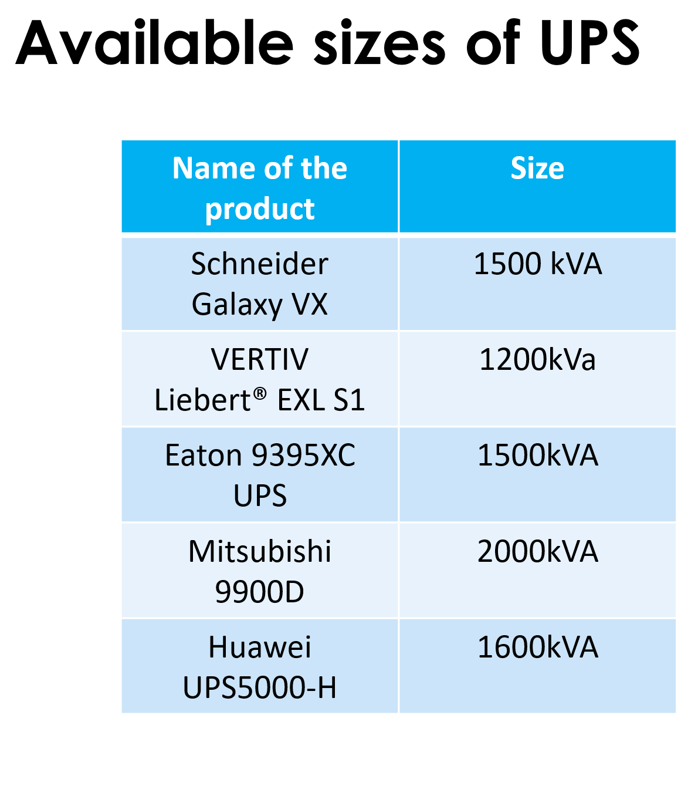
Main Electrical Components – Double Conversion UPS
Front end of the UPS controls the voltage at the dc bus and maintains power factor
  Id command generated to follow Vdref
  Iq generally set to 0 to maintain unity PF
  Conventional dq control
Back end of the UPS would operate in constant V and F-droop mode- similar to GFM
Battery is always connected to the dc bus, floating and charging using the dc-dc converter in buck mode. Operates in constant I or V mode
As grid voltage drops, dc bus voltage drops as well. If dc bus voltage drops below a Vset (90%-70%), rectifier is shut off and dc-dc converter starts to control dc bus voltage in boost mode
As rectifier shuts off, data center disconnects from the grid
  Control system model useful only for voltages above 70% as of now.
As voltage recovers, UPS may switch the load back and total load for some time is data center load + batt charging
Front - Rec
Back - Inv
Utility
Dc-bus
Data Center

Slide 5


Single Phase Power Supply Unit
Load power is transmitted as a voltage setpoint to the PFC controller.
DC current is regulated by an H-band controller, where the IGBT gate is activated when the minimum/maximum hysteresis band limits are reached.
i_{dc}
L
_{gate}
C
v_{dc}
i_{ac}
R
V_{phase 1}
v_{ac}
H-band
control
-
_{gate}
Vdcref
PI
x
S/R
H-band current controller
f
$$\frac{1}{s}$$
ϴ
PLL
$$\sqrt{2}∗\left|cos⁡(θ)\right|$$
Vac and Iac PFC output

Slide 6
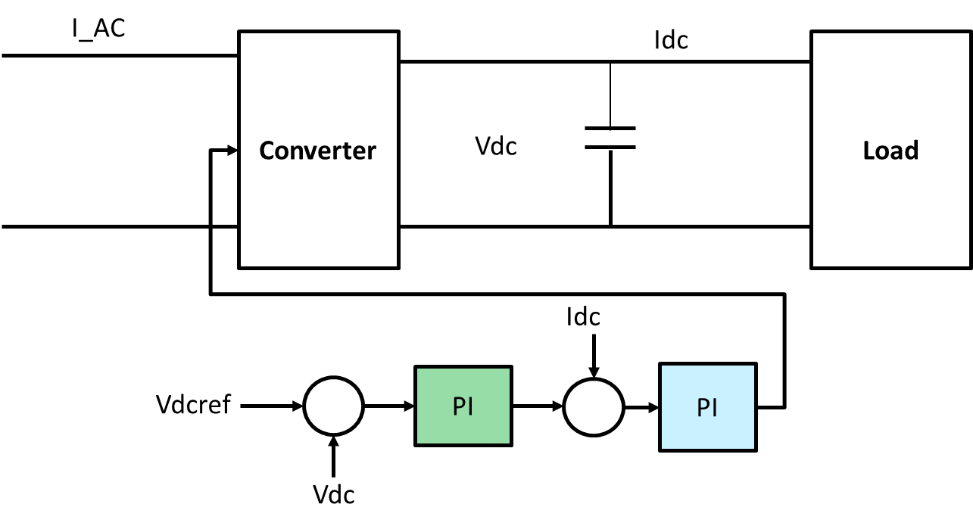
Behavior during Transient and Steady State
Constant P
Transient dip
This behavior is only applicable for V dip up to 0.7 pu as the load moves to the battery below that threshold

Slide 7
Modeling for Transmission Planning Studies
kHz range
Ferroresonance
Harmonics and switching transients
EMT simulators
Fast controller interactions
Sub-synchronous Oscillations
Lack of information
Flicker
10 -15 Hz
Slower Dynamics and Ride-Through
Phasor simulators
Lack of models and information
0.1 Hz

Slide 8
EMT vs Phasor Model – What are the needs?
 | EMT | Phasor
Generic | Develop understanding of device at hand, Screen for possible risks, Possibly use as starting point of OEM models. Not suitable for issue resolution | Long-term assessments, Bulk system reliability risks. Not suitable for equipment specific dynamics that might be of interest.
Vendor Specific | Actual risk screening, solution for issues arising at facilities. Not suitable for developing understanding of device at hand (generally) | Actual risk screening, solution for issues arising at facilities not represented by generic models. Not very suitable for long term assessments

Slide 9
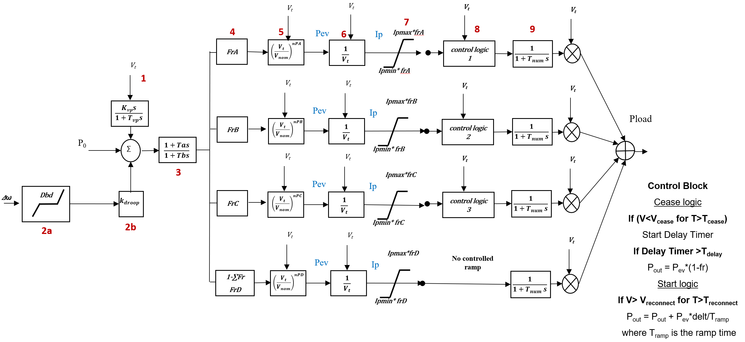
Positive Sequence Model for Data Center Load
Dynamics due to process controls (Inverter Control)
Available as dll in PSS®E V34, V35
Original created in PSLF by EPRI
Ability to model multiple protection behavior
Modeling current limits of the device
Protection logic

Slide 10
Parameterizing PSS/E data center model
(Undervoltage disconnection)
PSS/E model parameters
 | Parameter description | Parameter name
1 | UNDERVOLTAGE TRIP SETTING | LVTA
2 | UNDERVOLTAGE TIME TO TRIP SETTING | LVDTA
3 | UNDERVOLTAGE DELAY TIME TO RECONNECT SETTING | LVDRA
4 | UNDERVOLTAGE RECONNECTION SETTING | LVRA
5 | RAMP AFTER UNDERVOLTAGE DELAY TIME | RAMPUA
Voltage (pu)
3.
LVDRA
1.
LVTA
4.
LVRA
Mapping
2.
LVDTA
Time (s)
5.
RAMPUA
Active Power (MW)

Slide 11
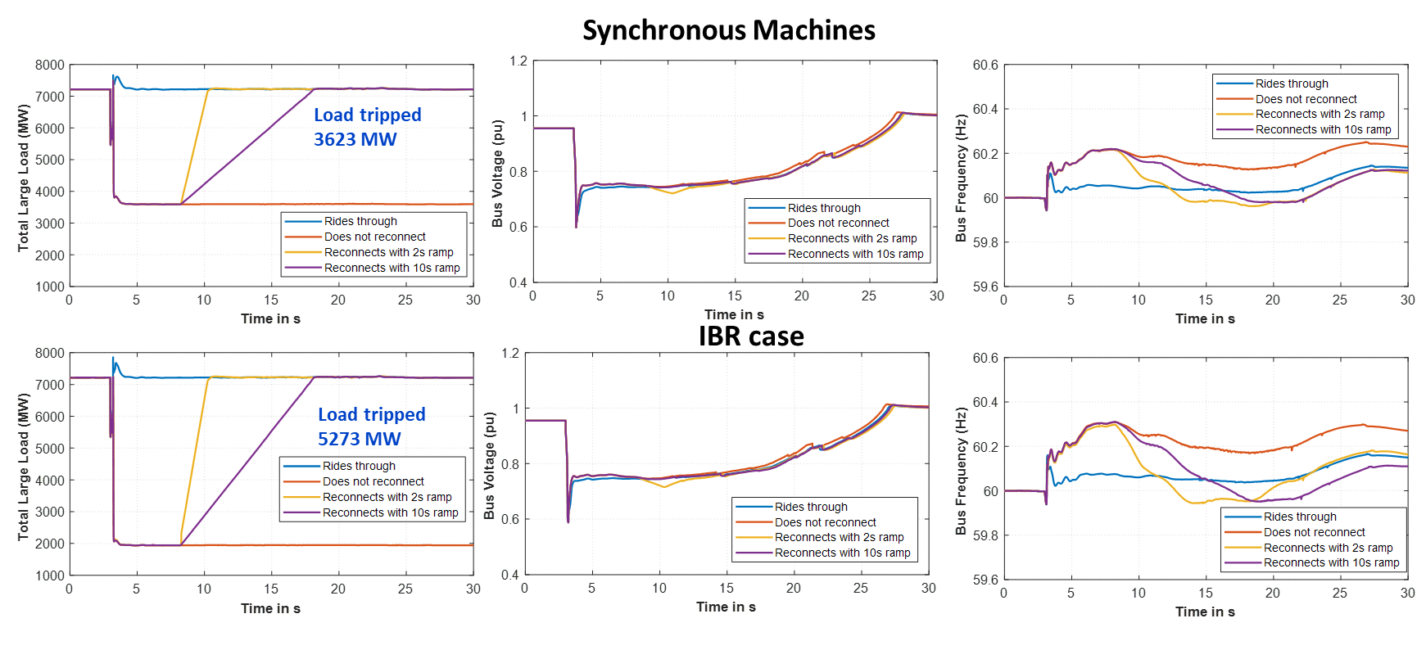
High Load (FIDVR)

Slide 12
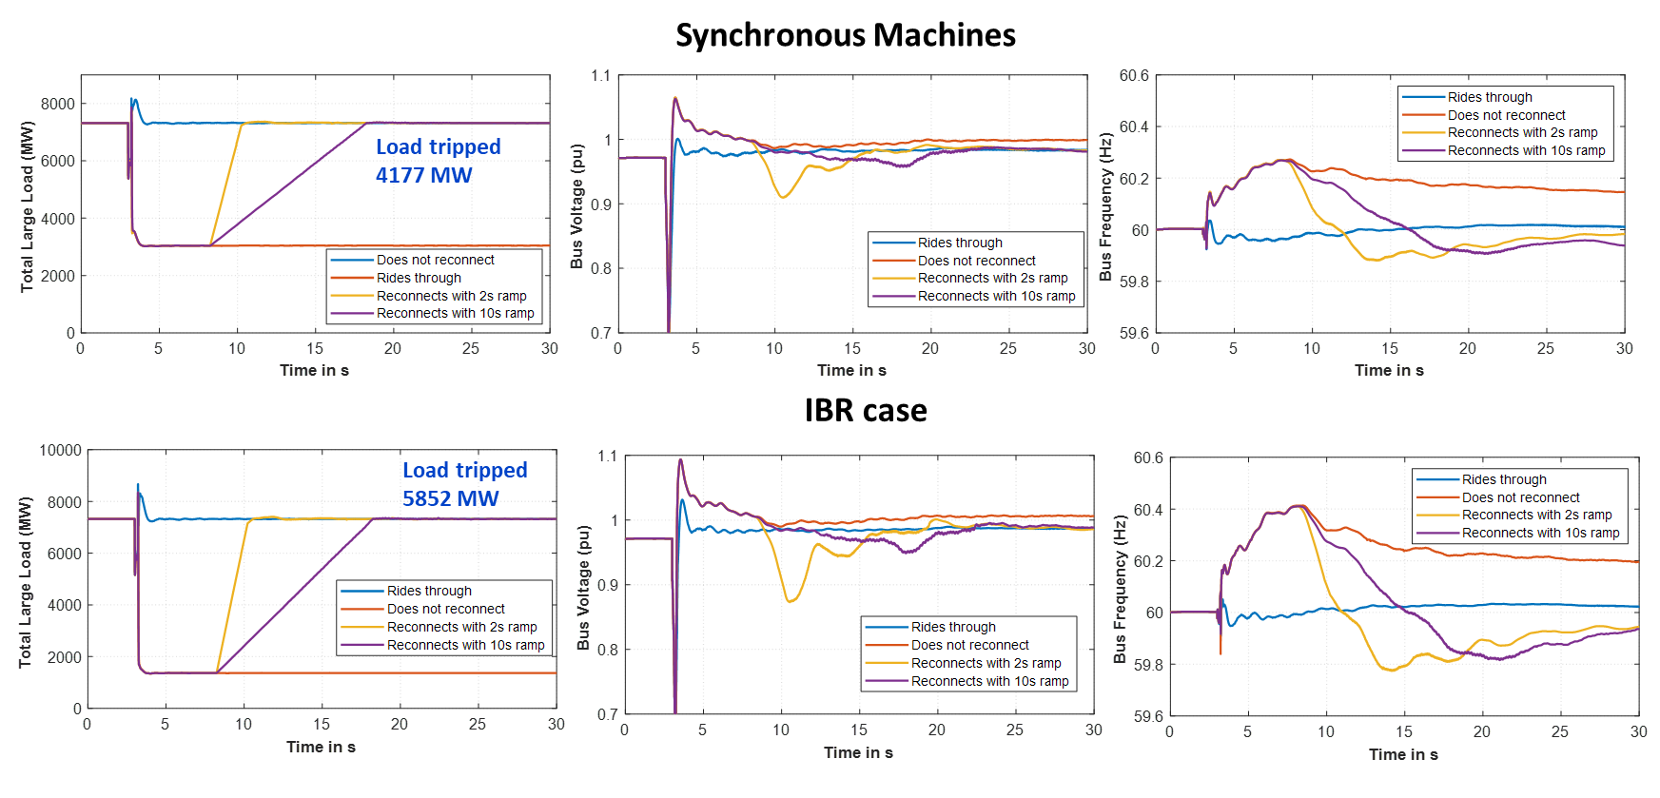
Low load

Slide 13
Other Modeling Questions

Slide 14
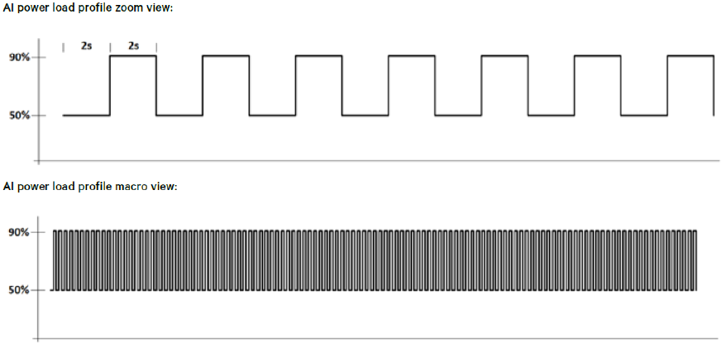
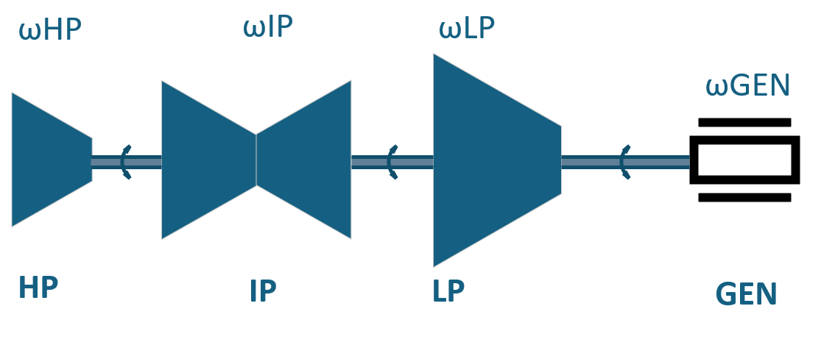
AI Training and Pulsing Load Shape
Example AI training load
Steam turbine torsional model
Conventional generators have torsional modes of oscillations in the 5-55 Hz range (oscillations between different turbine sections and the generator)
AI training creates pulsating loads which can excite these torsional modes
Over an extended period, this can cause fatigue and even damage the turbine shaft

Slide 15
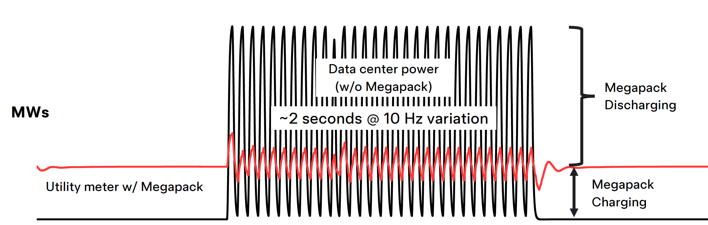
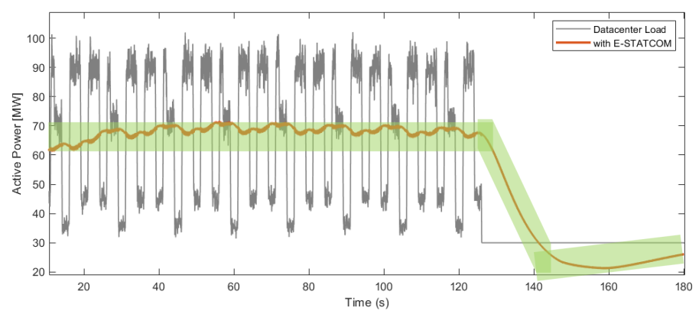
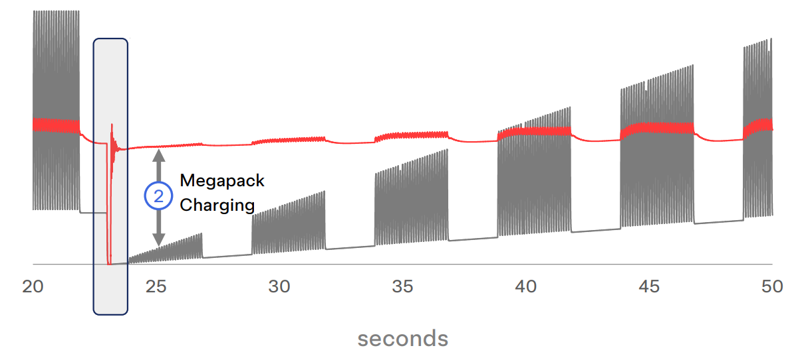
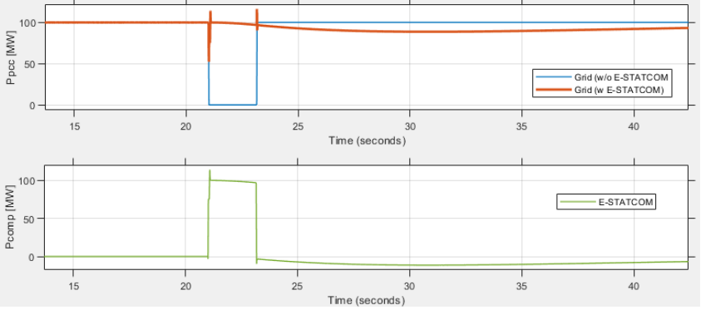
How these Facilities Need to be Modeled?
BESS used to smoothen pulsing load
E-STATCOM used to smoothen pulsing load
BESS used to mimic load ride-through
E-STATCOM used to ride-through disturbance
Compute load
Utility metered data
Tesla proposed using GFM Megapack to address both the pulsing load problem and ride-through issue (Tesla presentation at NERC LLTF 2025)
Siemens proposed using E-STATCOM (STATCOM with super capacitor or flywheel) to address both the pulsing load problem and ride-through issue (Siemens Energy Presentation at ESIG Spring Large Load Workshop 2025)

