Slide 1
PDCWG Report to ROS
Chair: Chad Mulholland, NRG
Vice Chair: N/A
ROS
July 10th, 2025

Slide 2
Report Overview & Notes
Report Overview
Meeting Minutes
Ancillary Service Methodology for 2026
Preliminary data and analysis; target TAC approval in August 2025
Large Load Threshold Analysis
Topic overview, similar to ERCOT Workshop from 6/13/25
Updated Operating Guides for RTC+B
Define Total Governor Control Capability and connect definition to ESR qualification for RRS-PFR
Examples provided for ESR AS performance expectations
BAL-001-TRE-2 FMEs and IMFR
No FMEs in the month of May
Frequency Control Report

Slide 3
Frequency Measurable Events Performance

Slide 4
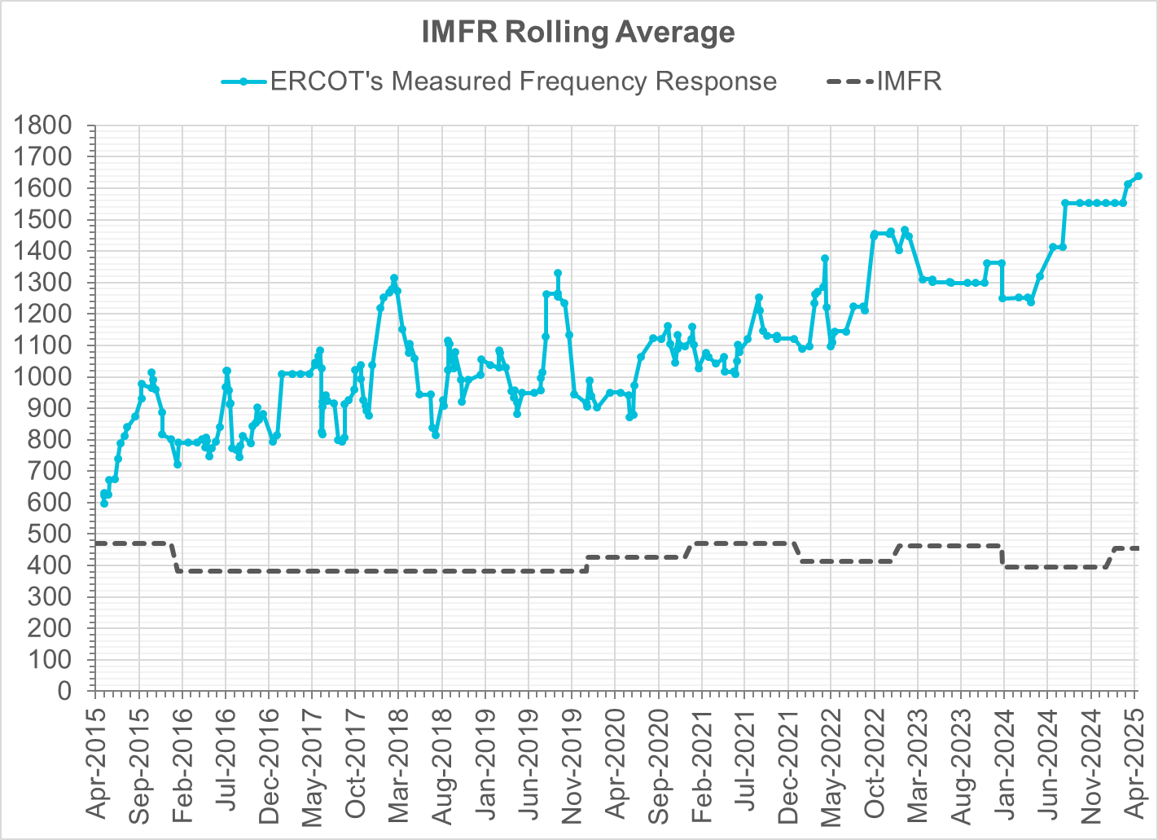
Interconnection Minimum Frequency Response (IMFR) Performance
IMFR Performance currently
1638.33 MW/0.1HZ
Frequency Response Obligation (FRO): 455 MW/0.1 Hz

Slide 5
Questions?

Slide 6
Frequency Control Report
May 2025

Slide 7
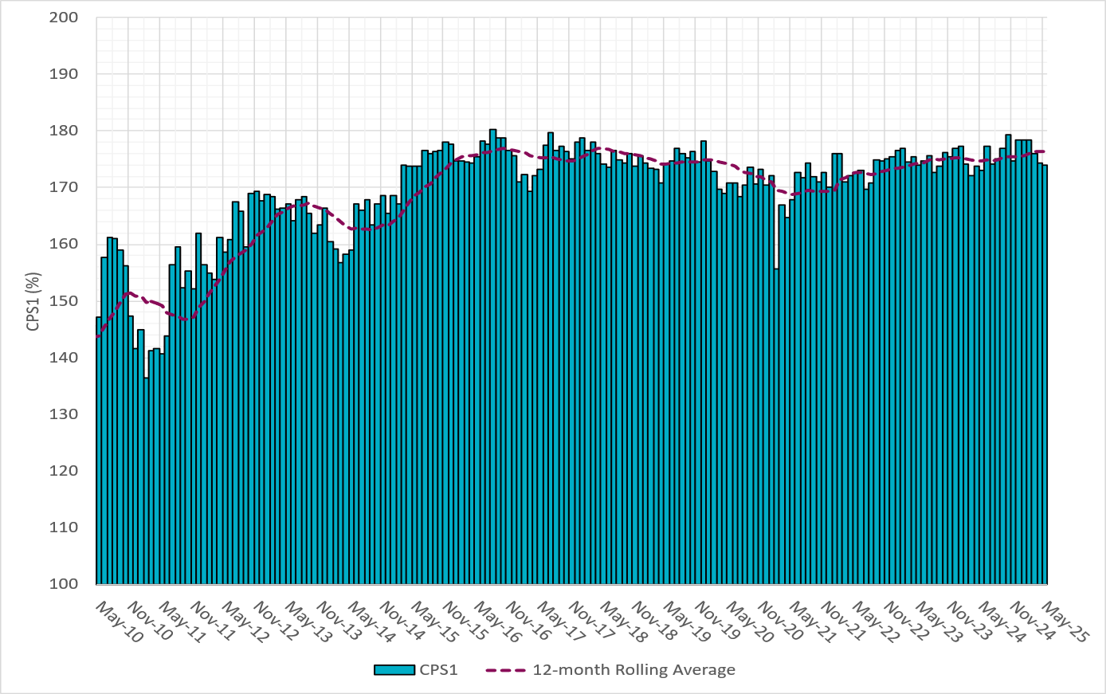
CPS1 Performance

Slide 8
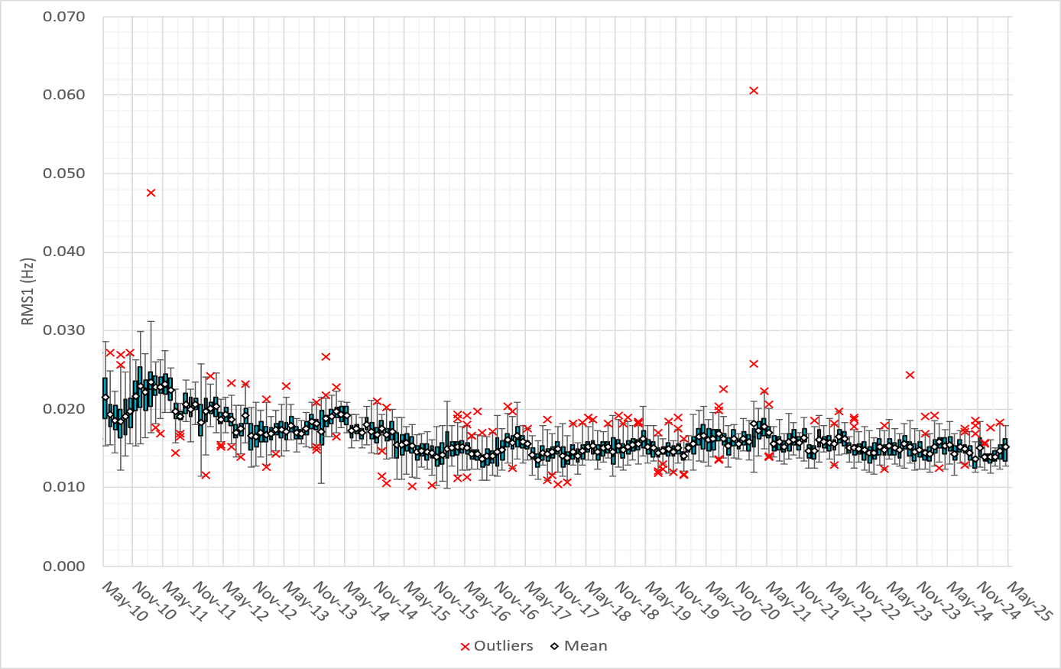
RMS1 Performance of ERCOT Frequency
Notes:
15.31 mHz on avg for May 2025

Slide 9
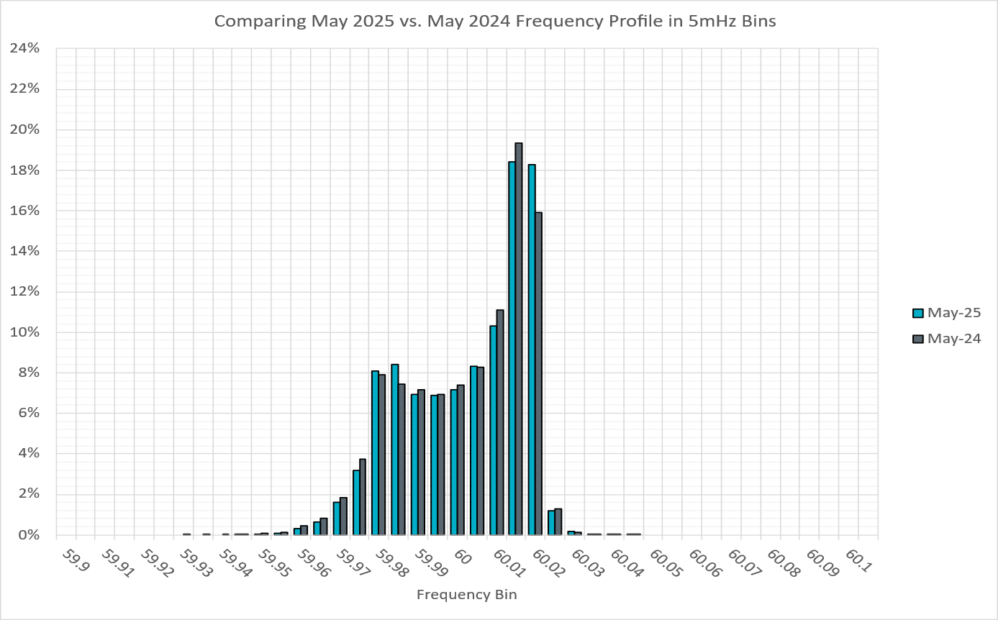
Frequency Profile Analysis

Slide 10
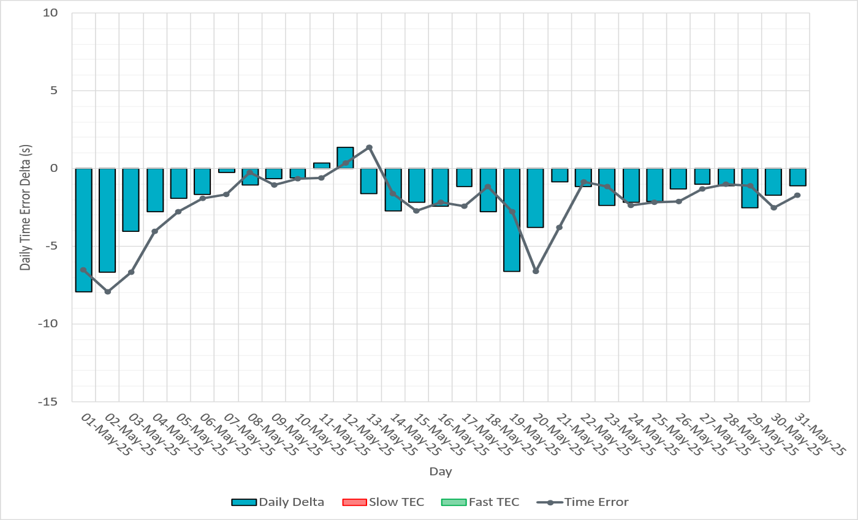
Time Error Corrections

Slide 11
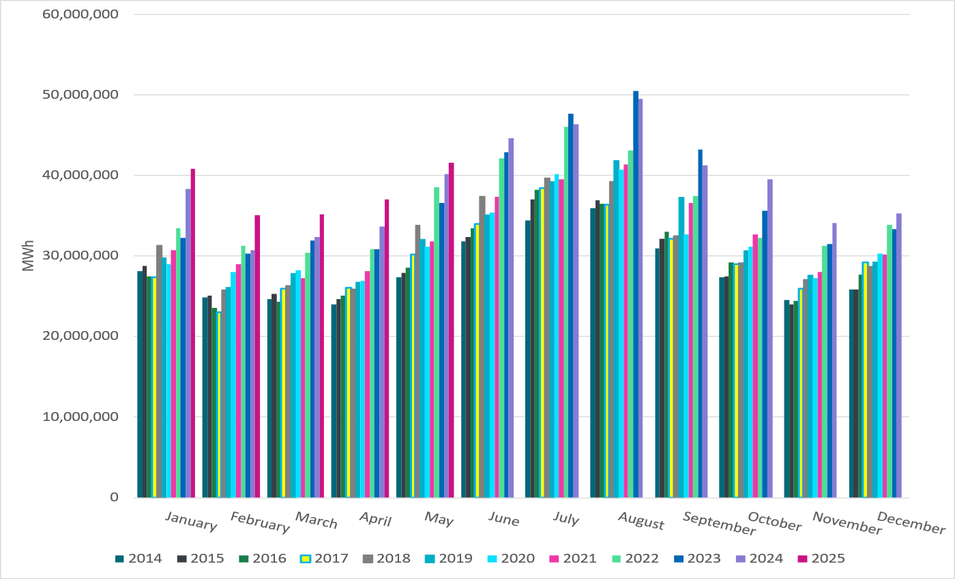
ERCOT Total Energy
Notes:
41,612,149 MWh

Slide 12
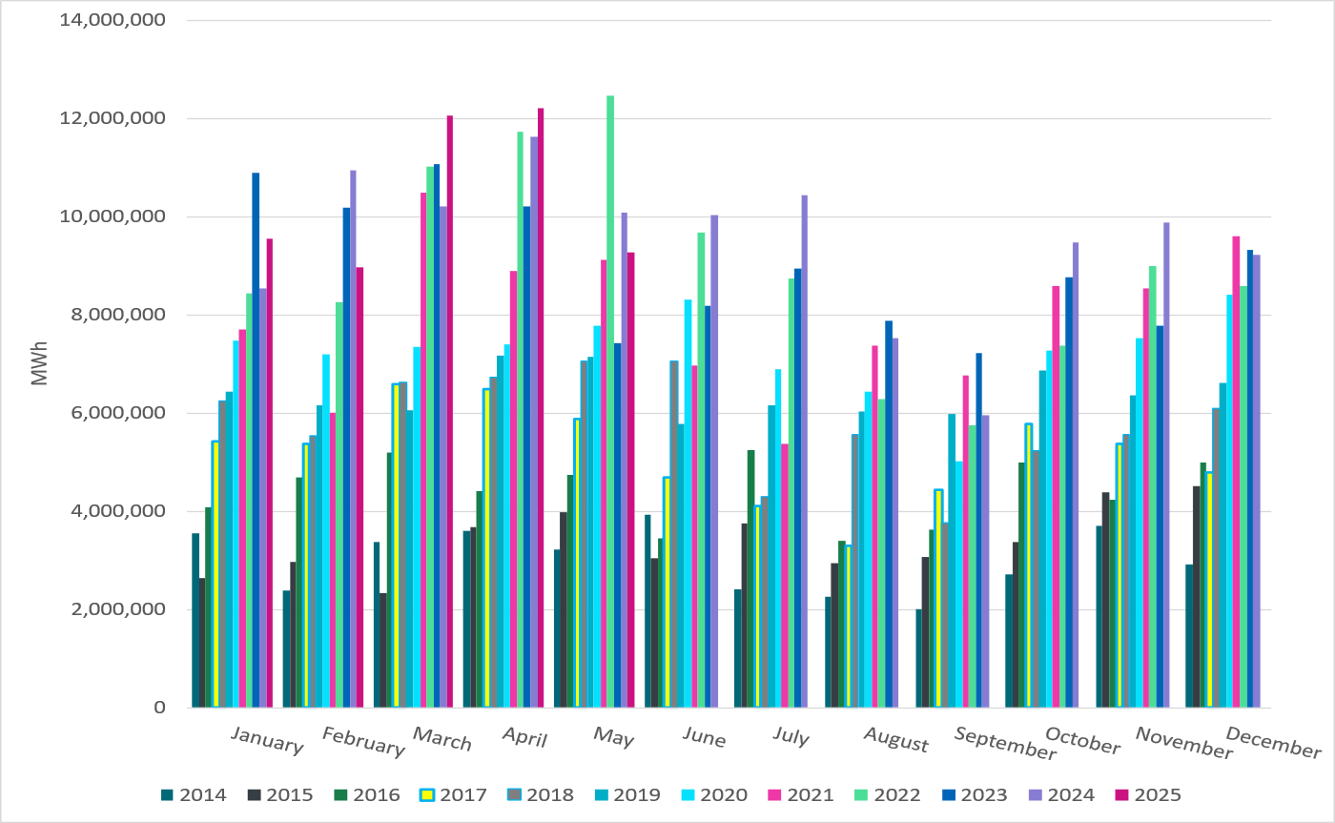
ERCOT Total Energy from Wind Generation
Notes:
9,267,483 MWh

Slide 13
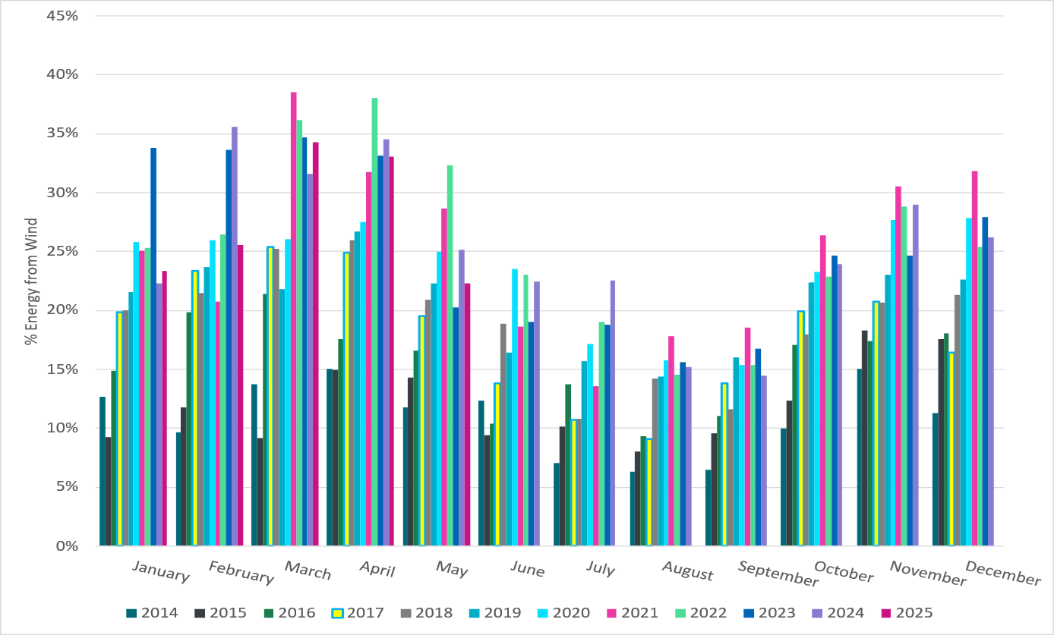
ERCOT % Energy from Wind Generation
Notes:
22.27% of total energy was provided by wind generation

Slide 14
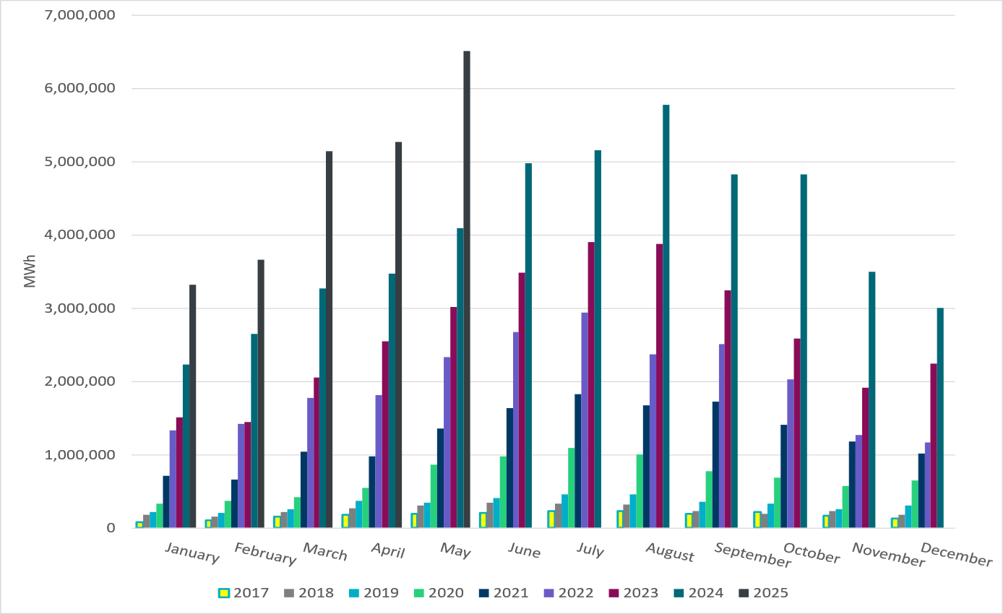
ERCOT Total Energy from Solar Generation
Notes:
6,516,996 MWh

Slide 15
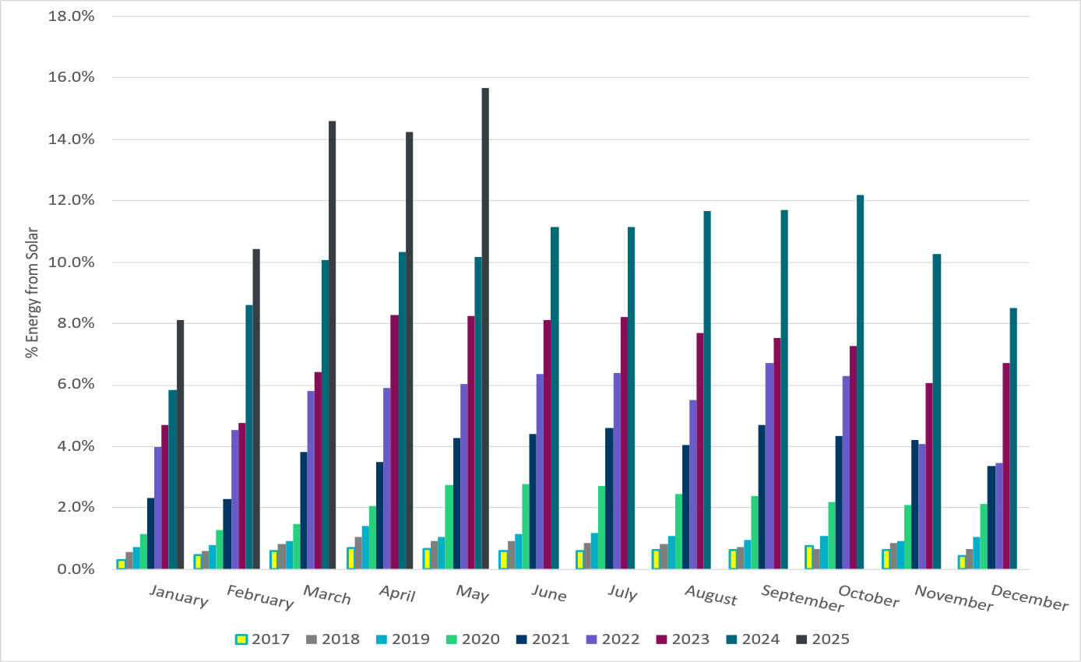
ERCOT % Energy from Solar Generation
Notes:
15.66% of total energy was provided by solar generation

Slide 16
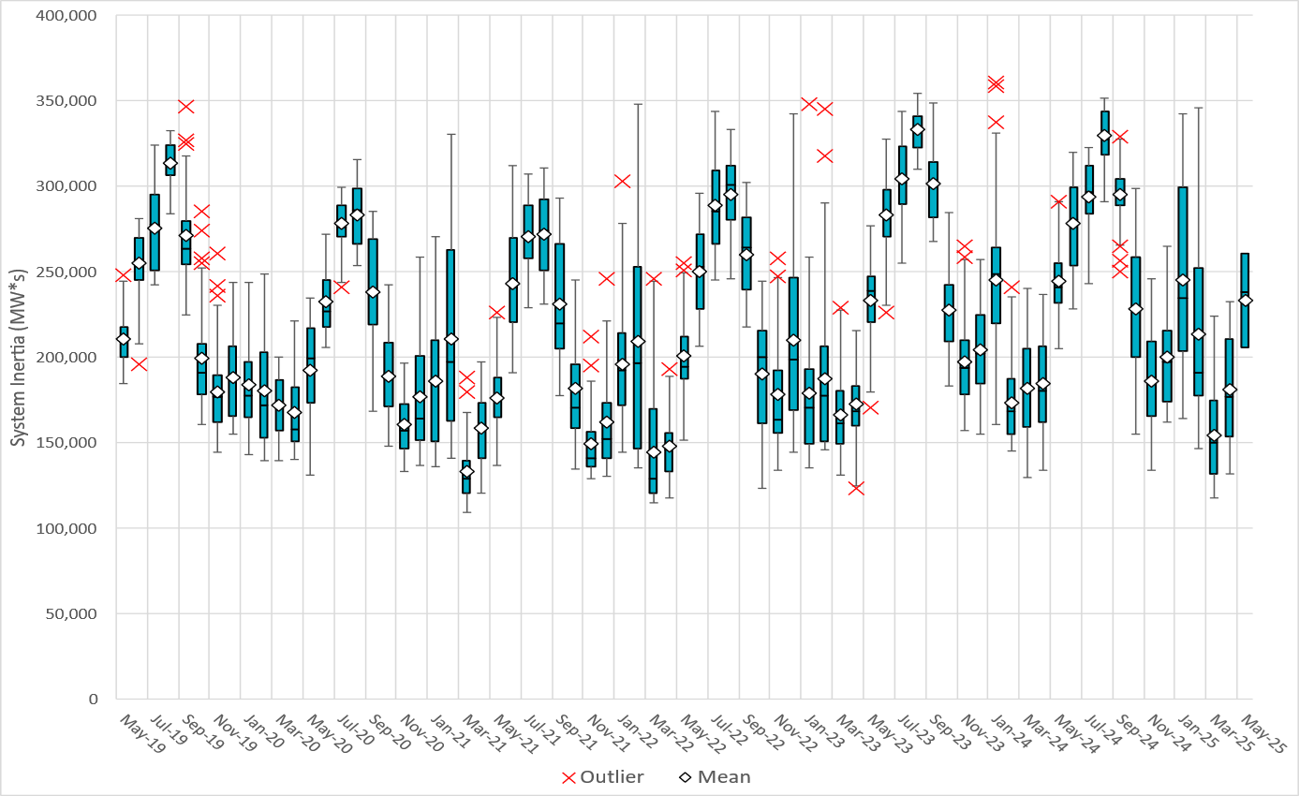
ERCOT Daily Minimum System Inertia
Notes:
Minimum Inertia in May 2025 = 156,068 MW*s on May 4th
Historical Overall Minimum was 109,029 MW*s on 3/22/2021
May Data:
Mean: 233,644 MW*s
Max: 295,647 MW*s on May 15th
Min: 156,068 MW*s on May 4th

Slide 17
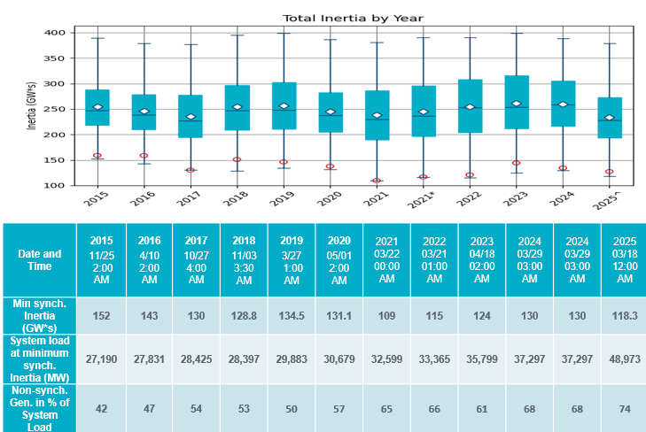
ERCOT Inertia Trend
Notes:
Summary of ERCOT inertia for the previous 10 years. Lowest inertia this year was on March 18th.
For each box, the central mark (red line) is the median, the edges of the box (in blue) are the 25th and 75th percentiles, the whiskers correspond to +/- 2.7 sigma (i.e., represent 99.3% coverage, assuming the data are normally distributed. The corresponding lowest inertia in each year is given in the table.
The circle on each boxplot is showing inertia during time when highest portion of load was served by wind/solar generation in that year.

