Slide 1
Large Load Subsynchronous Oscillation Overview
LLWG
July 11, 2025
Jeff Billo
ERCOT Operations Planning

Slide 2
Large Load Oscillations and Transients
Large Electronic Loads can vary their consumption relatively rapidly
Generally, 1 to 30 Oscillations per second.
Minutes
Seconds
Subsynchronous
Transient-Like Behavior
Can cause frequency control issues, including exhaustion of Regulation Up/Down Ancillary Services and degradation of NERC frequency control metrics
Can cause damage to grid equipment, including the shafts of synchronous generators

Slide 3
Large Load Subsynchronous Oscillations and Transients
This presentation will focus on subsynchronous oscillations (SSO) and Transients from Large Electronic Loads (LELs)
Minutes
Seconds
Subsynchronous
Transient-Like Behavior
Can cause frequency control issues, including exhaustion of Regulation Up/Down Ancillary Services and degradation of NERC frequency control metrics
Can cause damage to grid equipment, including the shafts of synchronous generators

Slide 4
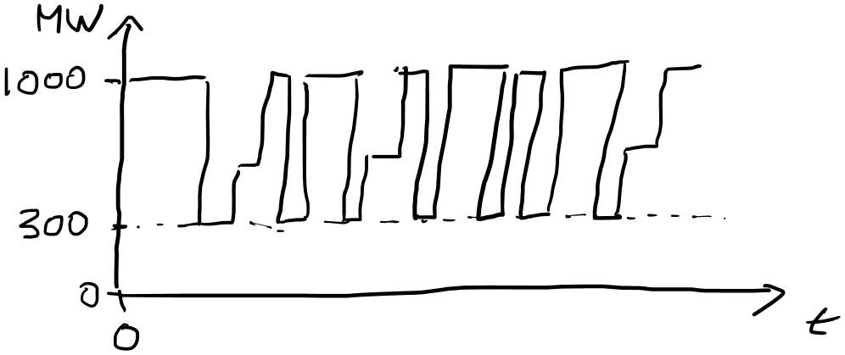
What causes Large Electronic Load oscillations?
Subsynchronous
By Design
Control System Misoperation
AI training or other computational algorithms may be designed to cycle processors subsynchronously
Bad firmware?
Not well understood

Slide 5
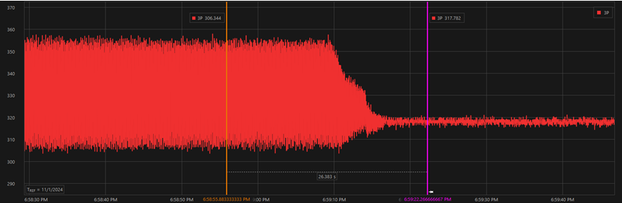
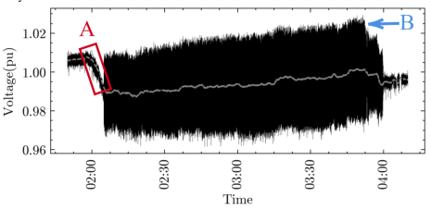
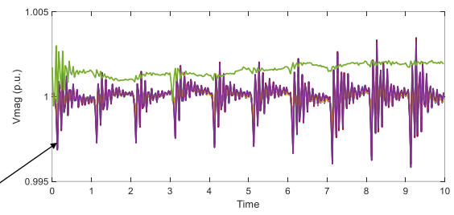
Has this occurred in the field?
Yes!
ERCOT 23 Hz Event (July-October 2024)
https://www.ercot.com/files/docs/2025/02/28/LL-Oscillation_LFLTF_Mar2025_Final.pptx
Dominion Energy 14.7-14.8 Hz Event
https://www.researchgate.net/publication/389098360_Understanding_the_Inception_of_147_Hz_Oscillations_Emerging_from_a_Data_Center
Dominion Energy 1-11 Hz Event
https://www.epri.com/events/539b60d7-57da-4252-9968-fb1754ee3b66

Slide 6
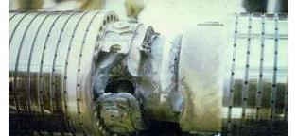
What are the potential impacts of LEL SSO?
SSO impacts have been known:
  Since the 1970s for synchronous generators (Mohave event)
  Since 2009 for inverter-based resources (South Texas event)
SSO can cause catastrophic damage or fatigue to generator equipment
  Generally, torsional vibration on the shafts of turbine generators are considered the highest risk
Based on ERCOT’s experience with series capacitor SSO impact studies, ERCOT has observed that the SSO impacts on the ERCOT system can occur in the 1 to 30 Hz range

Slide 7
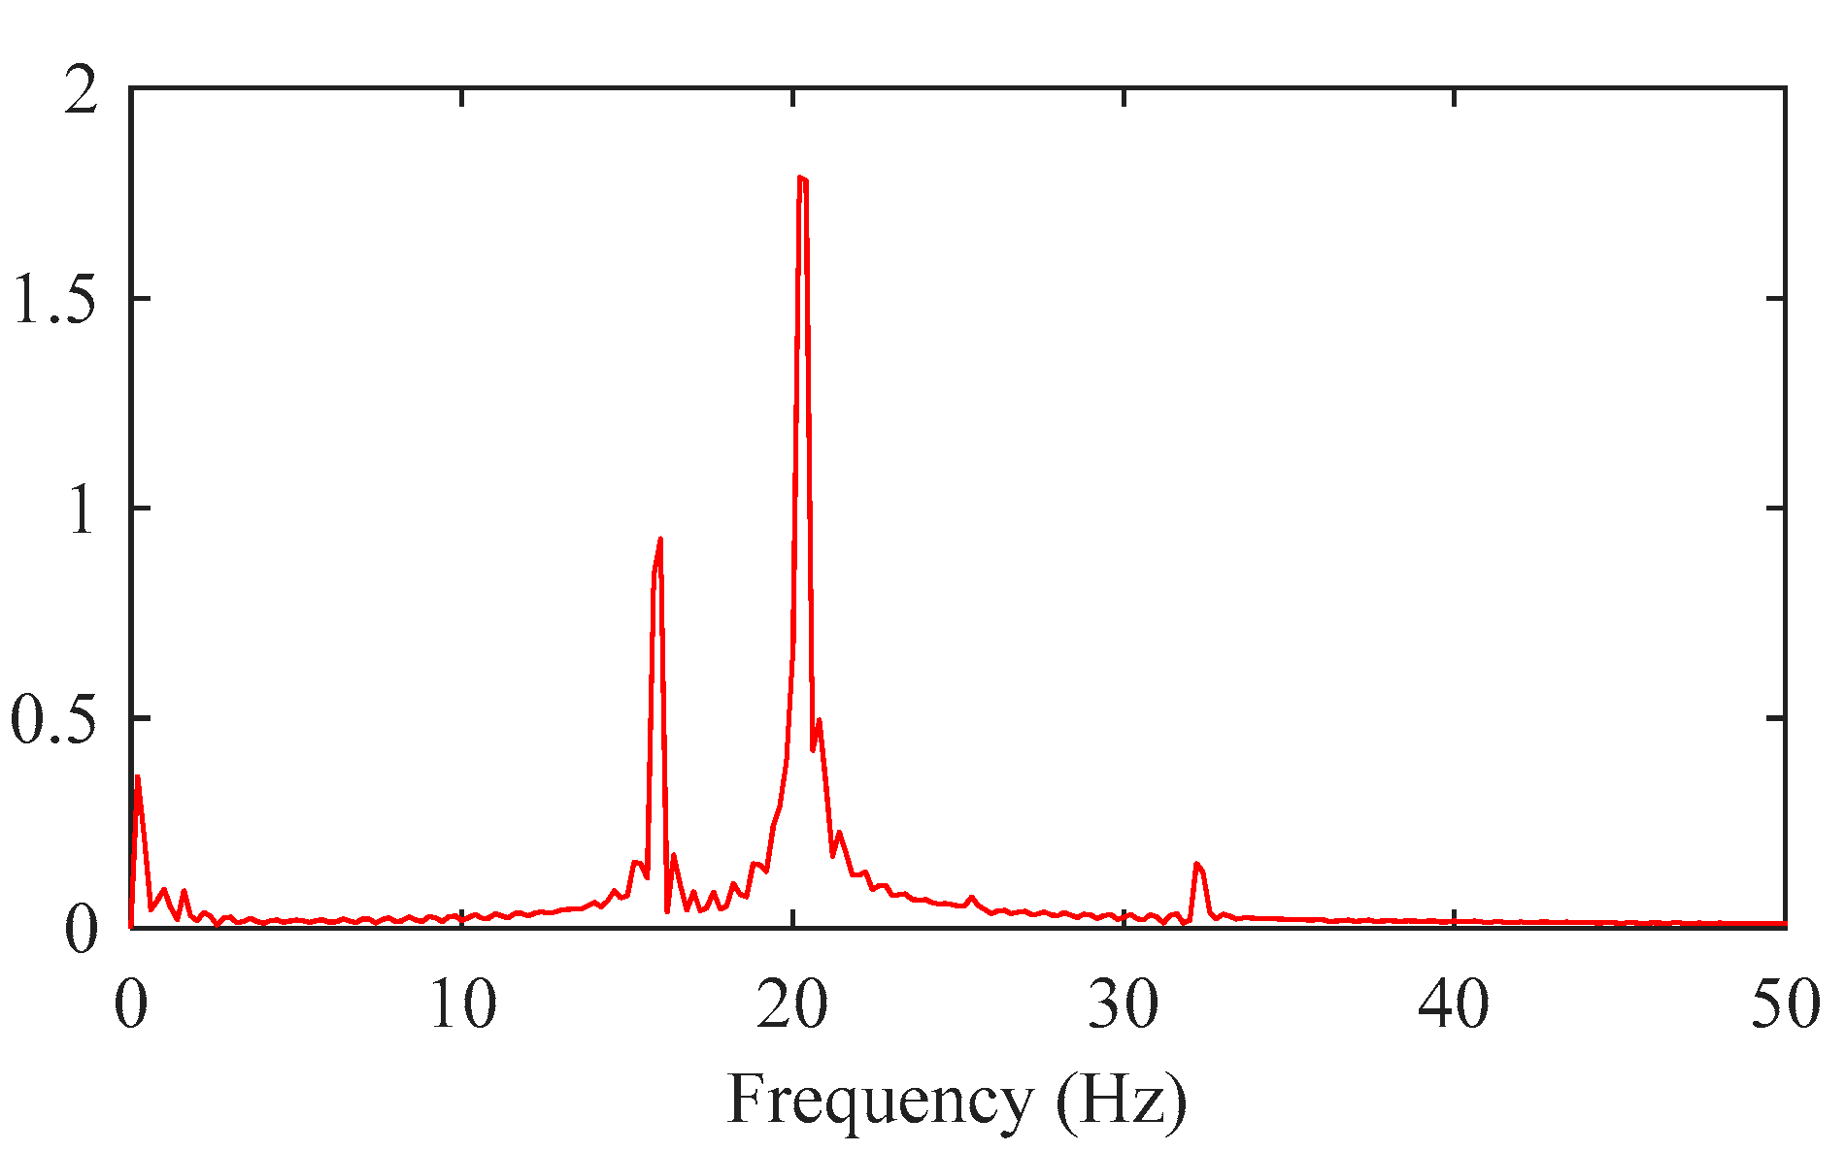
What is the likelihood that a generator may be damaged by Large Load SSO?
Two primary factors impact the risk to generators:
Proximity to source of the oscillations
  The transmission system will typically damp and disperse SSO from LELs, though some oscillations have been known to manifest over long distances
  Generators co-located with LELs are most at risk
Generator resonance modes relative to SSO frequency
  If a LEL is oscillating at or near the resonant mode of a nearby generator it is likely to cause damage to the generator
    E.g. If the resonant mode of a generator shaft is 20 Hz and a nearby Large Load is oscillating its consumption at 20 Hz, the generator shaft is likely to be damaged

Slide 8
Can SSO from LELs be detected in real-time?
Not precisely
SCADA
Primary real-time telemetry tool
Widespread across the system
PMUs
Installed at select locations
Real-time streaming at < 300 locations
DFRs
Installed at many locations
No real-time streaming due to data volume
Observations every 4-10 seconds
Observations up to 30 times per second
Observations up to 1200 times per second
Oscillations at up to 30 times per second

Slide 9
What else?
Transients: Large power oscillations, even if not at a resonant mode, can look like transients to a generator shaft
  = Generator Shaft Fatigue
Not quite “SSO” oscillations can exacerbate:
  Ordinary machine modes
  Interarea modes

Slide 10
What are the potential solutions?
Monitoring/ Detection
Prohibition
Protection
Ensure any LEL SSO is identified
Establish rules prohibiting SSO from LELs
Trip LELs that induce unacceptable SSO
Trip Generators that detect SSO (torsional stress relay)
Several vendors have recently promoted solutions to LEL oscillation

Slide 11
Next Steps
ERCOT has engaged a consultant to assist in defining the span of the reliability risk associated with LEL SSO and explore the viability of potential solutions. ERCOT will share findings with the LLWG

Slide 12
Questions?

