Slide 1
Review of 2026 AS Methodology
Ancillary Services & Operations Analytics
ERCOT Staff
WMWG
July 7, 2025

Slide 2
Stakeholder Discussion Timeline
April 23, 2025 – TAC Kickoff
May 19, 2025 – Workshop #1
June 20, 2025 – PDCWG
June 30, 2025 – Workshop #2
July 07, 2025 – WMWG (Proposed)
July 15, 2025 – OWG (Proposed)
July 22, 2025– PDCWG (Proposed)
August 04, 2025 – Workshop #3 (New)
August 06, 2025 – WMS
August 07, 2025 – ROS
August 28, 2025 – TAC
September 23, 2025 – BoD
Oct, Nov, Dec 2025 – PUC

Slide 3
Discussion Scope for Today
This presentation will discuss the proposed methodology to determine Ancillary Service (A/S) quantities for 2026.
ERCOT is proposing one change in the methodology used to compute the Regulation Service for 2026.
ERCOT is not proposing any changes in the methodology used to compute Responsive Reserve Service requirements for 2026.
NERC’s preliminary BAL-003 Interconnection Frequency Response Obligation (IFRO) assessment for ERCOT for the 2026 Operating Year (OY) has not yet been published. Therefore, this analysis used the minimum RRS-PFR limit of 1,365 MW for 2025.
ERCOT is proposing changing the methodology to calculate the ramping portion of ERCOT Contingency Reserve Service (ECRS) needed for net load forecast errors and the Non-Spinning Reserve Service (NSRS) to utilize a probabilistic framework to compute requirements for 2026.
ERCOT has hosted two AS Workshops to introduce the probabilistic framework and share preliminary quantities using the framework.
The Ancillary Service (A/S) quantities for 2026 contained in this presentation are based on the methodology that was approved in December 2024. The quantities for 2026 reflect moving forward the historic data on which these are based, unless otherwise noted.
ERCOT is seeking stakeholder feedback on these proposed changes for the 2026 A/S Methodology.

Slide 4
Background on Probabilistic Framework
The Public Utility Commission of Texas (PUCT) initiated the Ancillary Services Study (Study) to meet the requirements of PURA § 35.004(g) (enacted in Senate Bill 3 (87 R.S.)).
ERCOT was asked to review the existing Ancillary Service products, including an analysis of the purpose for each of the products and a more thorough review of the methodologies used to determine Ancillary Service quantities. ERCOT was also asked to evaluate if any additional Ancillary Service products are needed.
ERCOT produced a white paper that responds to those requests
The PUCT’s 2024 Ancillary Services Study included the following finding (Topic 5):
ERCOT should develop a suitable probabilistic, forward-looking modeling capability, provide regular updates to TAC, and present options that can be incorporated no later than the 2027 AS Methodology.

Slide 5
ERCOT Ancillary Services
Quantity Calculation
Purpose
Timeframe
Regulation Up and Down
Frequency control, normal and unexpected forced outages
Historical system response and study of system physics
Responsive Reserve
Seconds to minutes
Capacity and energy for unexpected forecast errors and forced outages
ERCOT Contingency Reserve
Statistical analysis of forecast and outage risk
Minutes to hours
Non-Spin
Key Takeaways
Methodology for Regulation, Responsive Reserve and frequency responsive portion of ECRS have minor adjustments, but overall similar to previous years
A probabilistic approach for ECRS and NSRS has been developed

Slide 6
Flow Diagram for Probabilistic Methodology

Slide 7
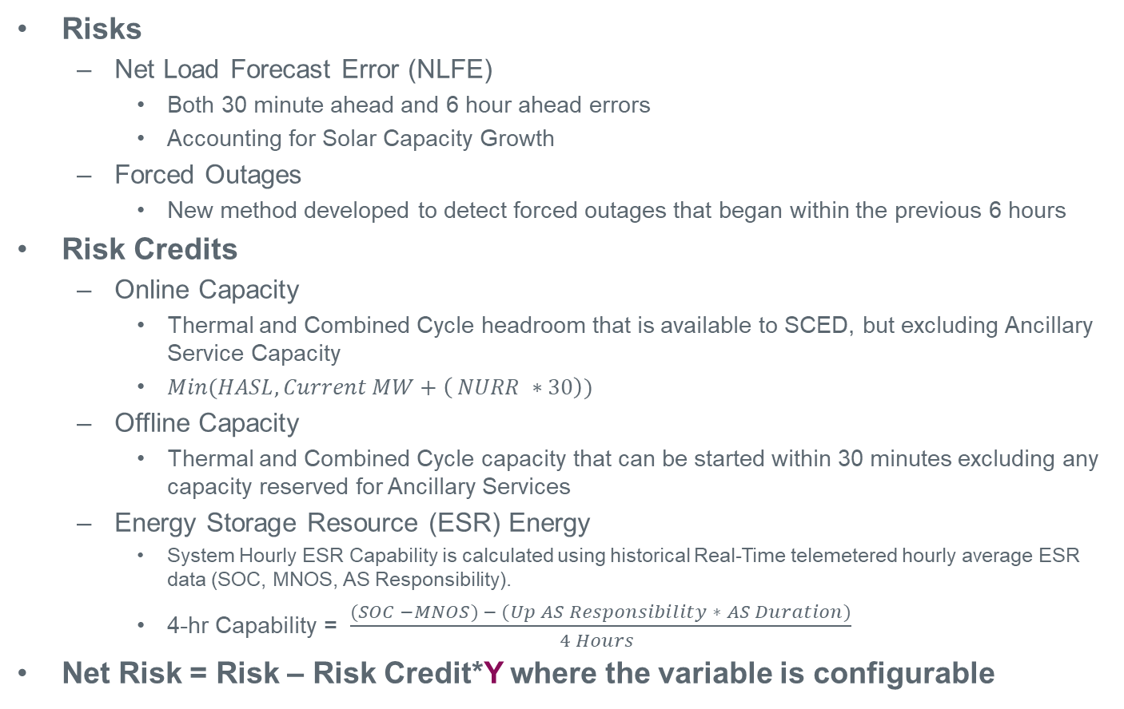
Risk and Risk Credits Overview
Risks
Net Load Forecast Error (NLFE)
Both 30 minute ahead and 6 hour ahead errors
Accounting for Solar Capacity Growth
Forced Outages
New method developed to detect forced outages that began within the previous 6 hours
Risk Credits
Online Capacity
Thermal and Combined Cycle headroom that is available to SCED, but excluding Ancillary Service Capacity
$Min(HASL, Current MW+\left( NURR ∗30\right))$
Offline Capacity
Thermal and Combined Cycle capacity that can be started within 30 minutes excluding any capacity reserved for Ancillary Services
Energy Storage Resource (ESR) Energy
System Hourly ESR Capability is calculated using historical Real-Time telemetered hourly average ESR data (SOC, MNOS, AS Responsibility).
4-hr Capability = $\frac{(SOC −MNOS) − (Up AS Responsibility ∗ AS Duration)}{4 Hours }$
Net Risk = Risk – Risk Credit*Y where the variable is configurable

Slide 8
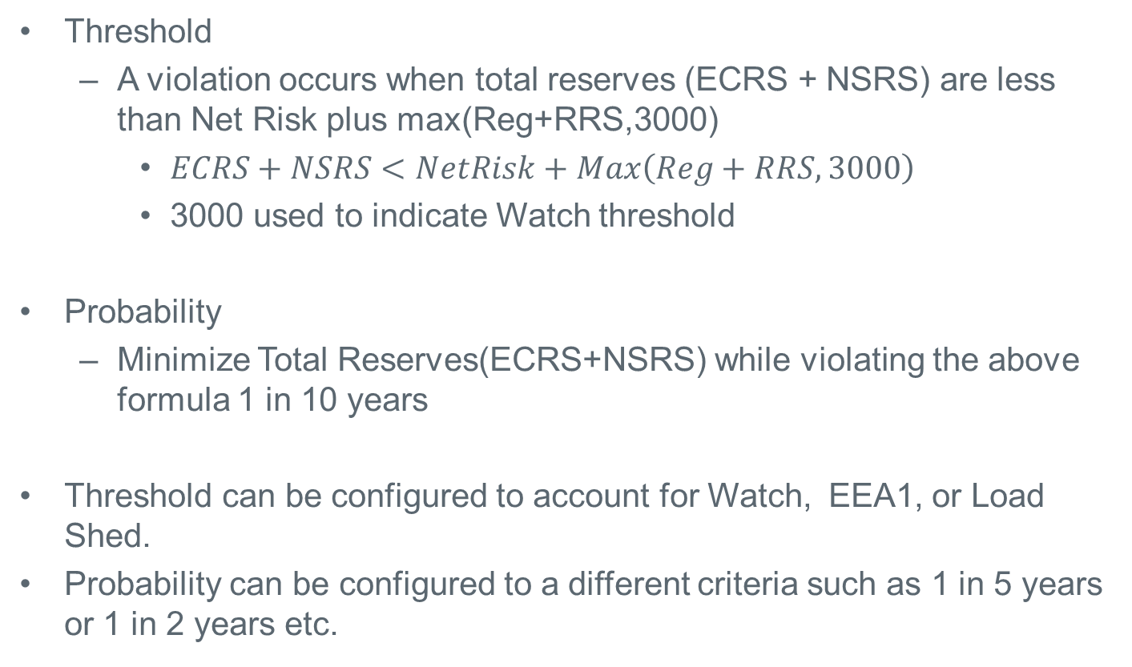
Convergence Criteria
Threshold
A violation occurs when total reserves (ECRS + NSRS) are less than Net Risk plus max(Reg+RRS,3000)
$ECRS+NSRS<NetRisk+Max\left(Reg+RRS,3000\right)$
3000 used to indicate Watch threshold
Probability
Minimize Total Reserves(ECRS+NSRS) while violating the above formula 1 in 10 years
Threshold can be configured to account for Watch, EEA1, or Load Shed.
Probability can be configured to a different criteria such as 1 in 5 years or 1 in 2 years etc.

Slide 9
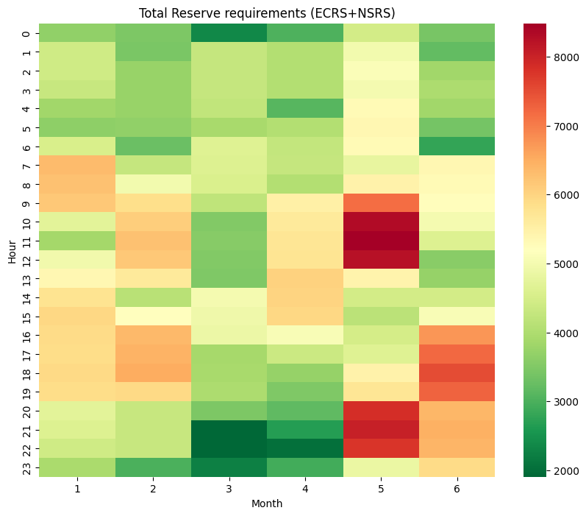
Optimization Workflow for Total (ECRS + NSRS) Reserve
Iterative process - Least Reserves for Target Reliability
If Current Violation meets Convergence Criteria
Reserve Requirements (ECRS+NSRS)
Analysis
Using the current reserve values, the process identifies the hours with the highest number of violations.
If these reserve levels fail to meet the criteria, the process proceeds to the reserve adjustment phase.
If Current Violation rate does not meet Convergence Criteria
To initiate the optimization process, set initial reserve values which are allocated to cover the identified net risk
If Violation rate falls short of the criteria, reserves are proportionally increased during the hours with the highest violation rates.
If Probability is better than the criteria, the required reserve values are proportionally reduced.
Initial Reserve
Proceed to Analysis with Adjusted Reserves
Reserve Adjustment

Slide 10
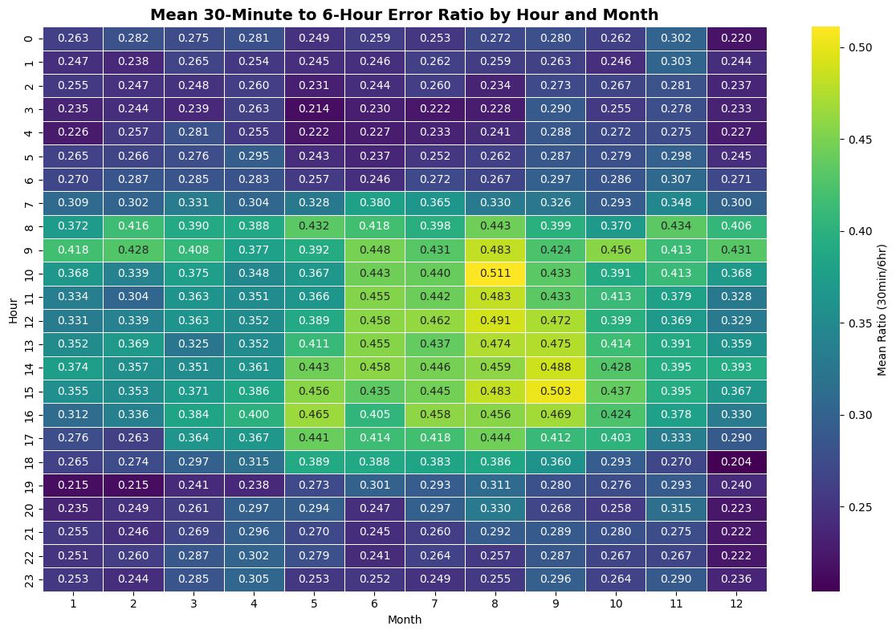
Allocating the Individual ECRS and NSRS quantities from Total Reserves
Each hour has 12 five-minute 30-min ahead errors and one 6-hour ahead error
For each 30-min under-forecast error, calculate the ratio to the 6-hour ahead error for that same hour
Group results by Month-Hour to compute average ratio for each Month-Hour
Set Initial ECRS = Frequency Recovery Requirement
Allocate Secondary ECRS:
Secondary ECRS = Total Reserves × (ECRS %)
If Total Reserves < Minimum ECRS:
ECRS = Minimum ECRS (Frequency Portion)
NSRS = Total Reserves
This Scenario only happens in only extreme cases – Excess Risk Credits
Else:
ECRS = max(Initial ECRS, Secondary ECRS)
NSRS = Total – ECRS

Slide 11
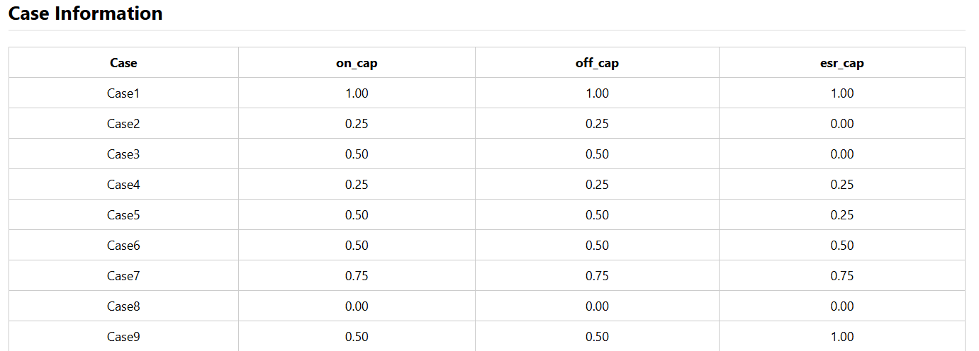
Sensitivity Study – Risk Credits
Multiple cases were run with different combinations of Online, Offline, and ESR Capacity.
Case 1: Considers all available capacity as risk credits..
Case 8: Optimization does not take risk credits into account and procures reserve quantities to account for forecast error and forced outages

Slide 12
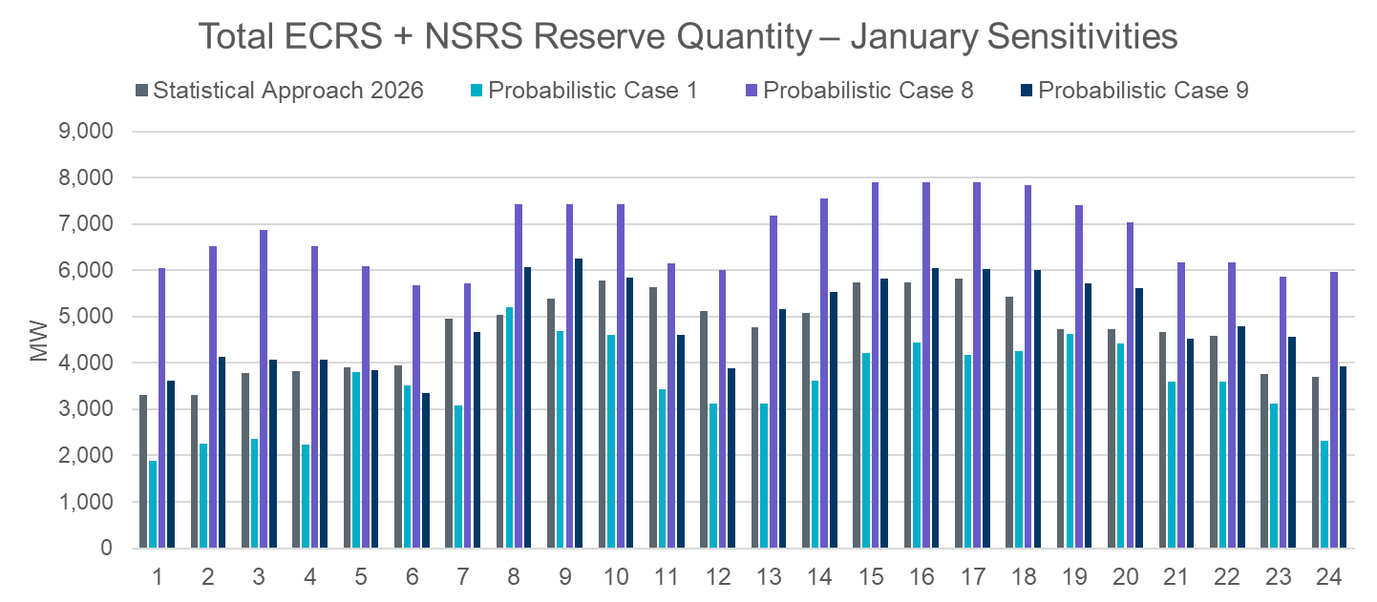
Preliminary Quantities from Probabilistic Methodology
Some sensitivities are shared on the next few slides related to the probabilistic approach. Additionally, an HTML file has been posted along with the slides with additional sensitivities.

Slide 13
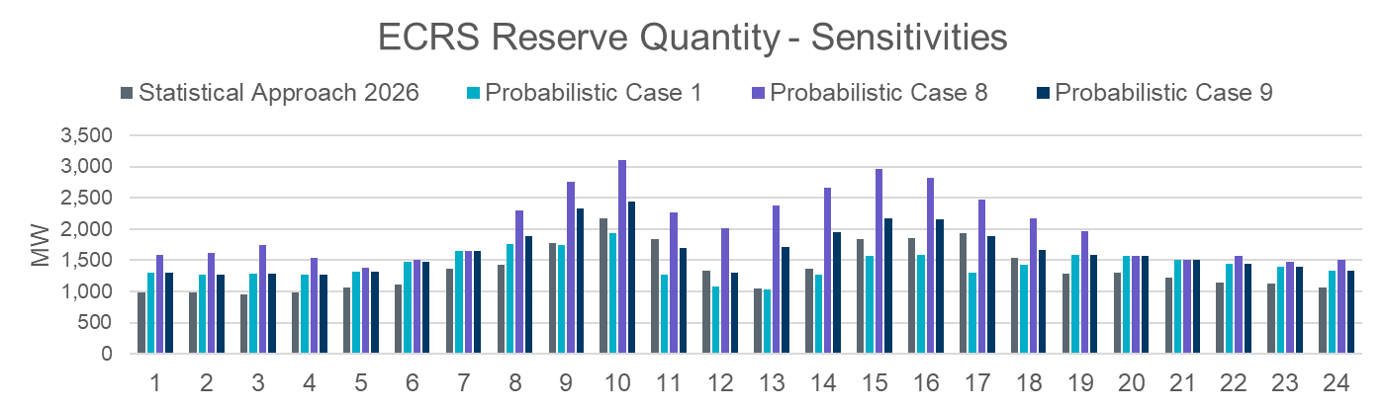
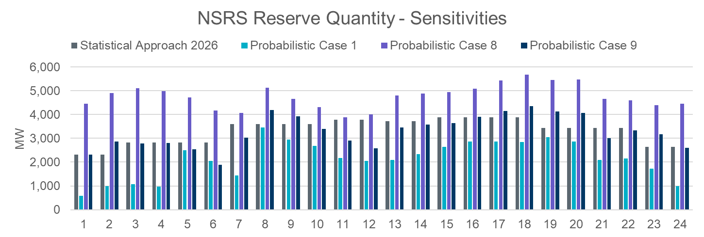
ECRS and NSRS Reserves - January

Slide 14
Regulation Service

Slide 15
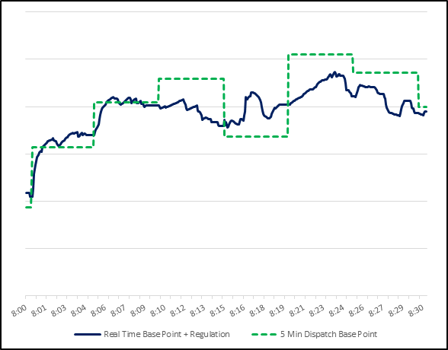
Regulation Service Methodology
ERCOT is proposing one change to the methodology used to compute the minimum Regulation Service requirements in 2026.
Specifically, ERCOT is proposing to set regulation quantities based on the error in forecasting the net load forecast that is used in to set dispatch target for SCED (i.e. GTBD).
The preliminary Regulation quantities for January 2026 through June 2026 in subsequent slides have been computed using proposed methodology (with 2023 to 2025* five minute ahead Net load forecast error) and updated Wind and Solar Over Forecast Adjustment tables.
Regulation
Regulation Service is reserved capacity that is deployed every 4 seconds to balance supply and demand and maintain frequency close to 60Hz between 5-minute SCED runs.

Slide 16
Regulation Up/Down Methodology: Summary of changes
 | 2025 Methodology | 2026 Methodology
Data Input | 5-min SCED Netload Forecast Error (2- yr) | No Change
Calculation Method | 95th of 5-min SCED Netload Forecast Error | No Change
Wind/Solar Adjustment | GE Table - Increased wind/solar forecast error per 1,000 MW installed capacity increase | No Change
FRRS Component | 95th of historical FRRS Deployment (2-yr) | Remove
ACE Integral Component | Average of ACE Integral Change (2-yr) | No Change
Load Adjustment (LL Ramps) | No Adjustment | No Change

Slide 17
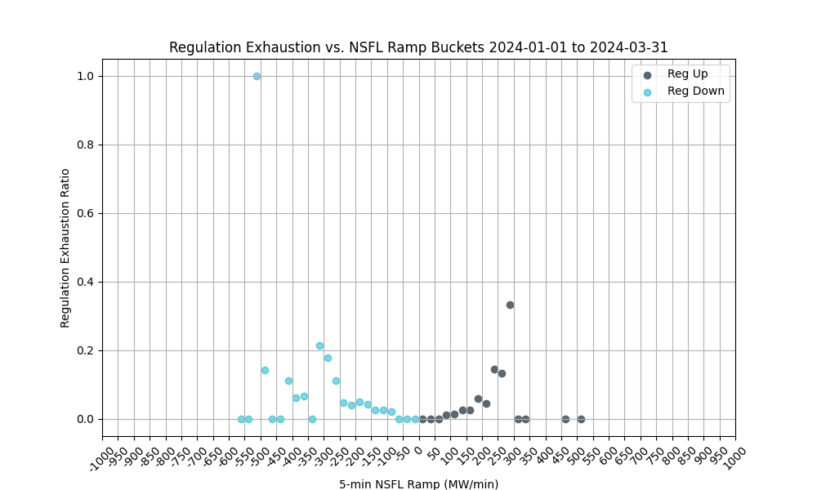
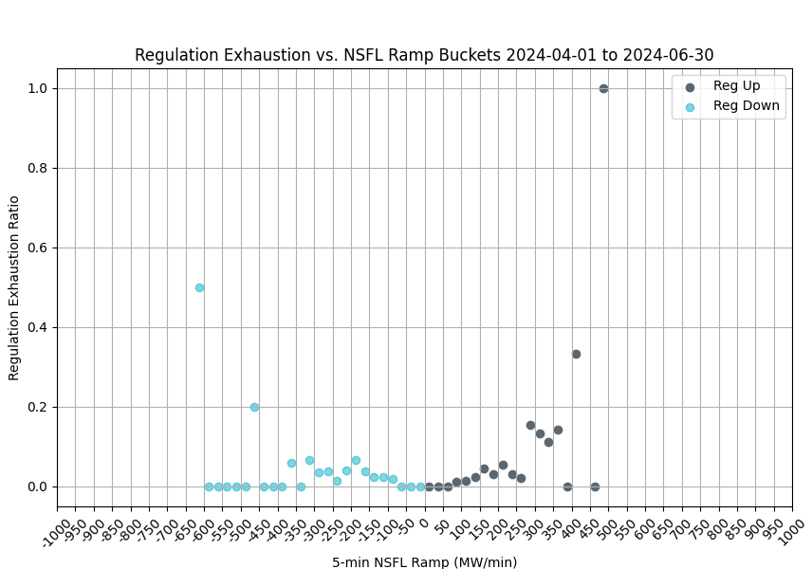
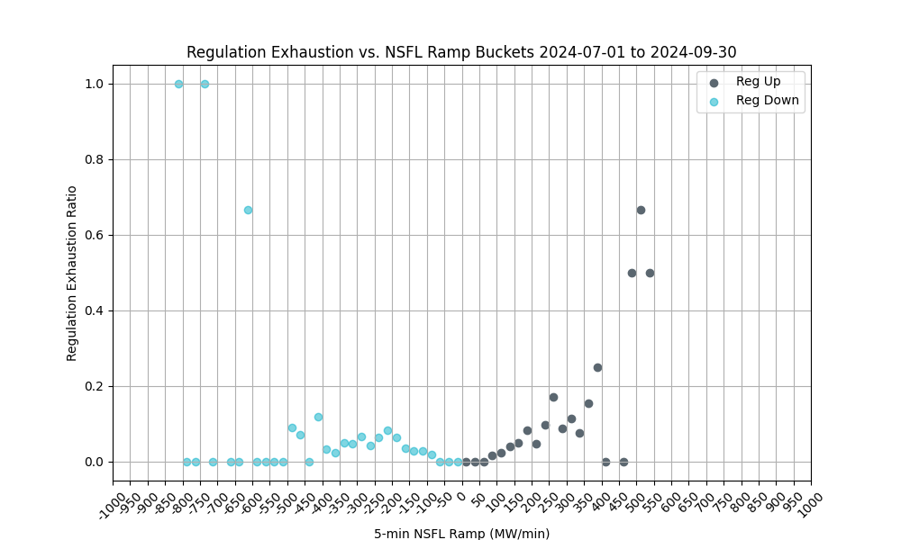
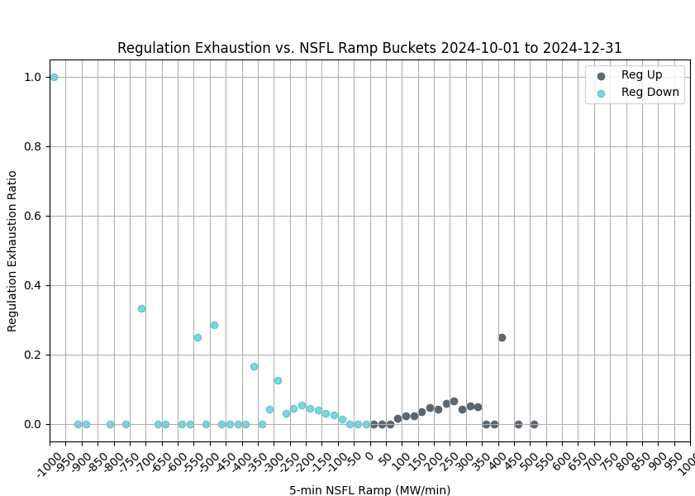
Regulation Exhaustion by Quarter - 2024
These charts use 1-minute data to evaluate regulation exhaustion from 5-minute NSFL* ramps. 5-minute ramps of 75 MW or larger are considered.
Reg exhaustion is flagged using the PDCWG criteria, less than 5 MW reg remaining over a 5-minute average.
Reg exhaustion is evaluated between 5 and 10 minutes from the time of the ramp.
*NSFL = Large Loads and steel mill loads that are not following SCED dispatch.

Slide 18
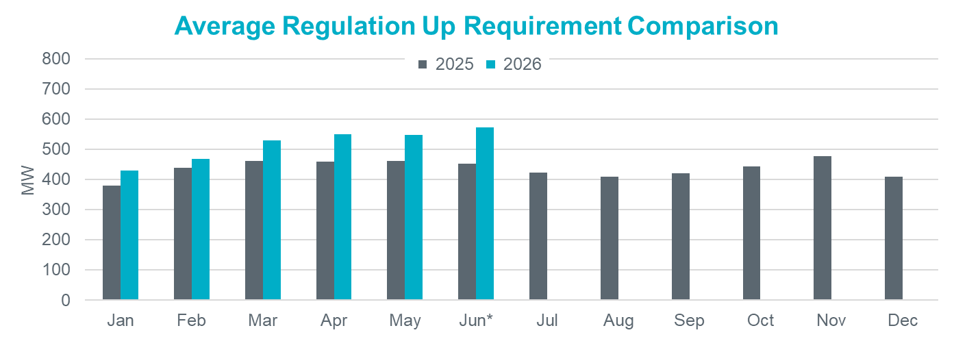
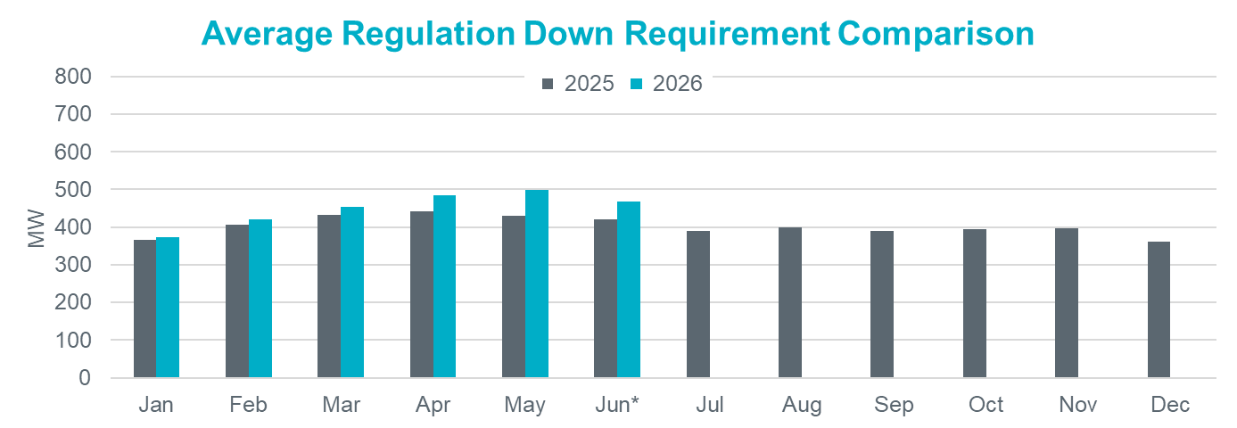
Hourly Average Regulation Comparison
Reg-Up 2026:
On avg. 74 MW increase from prev. year
Largest increase is in Jun* by 120 MW
Reg-Down 2026:
On avg. 33 MW increase from prev. year
Largest increase is in May by 70 MW

Slide 19
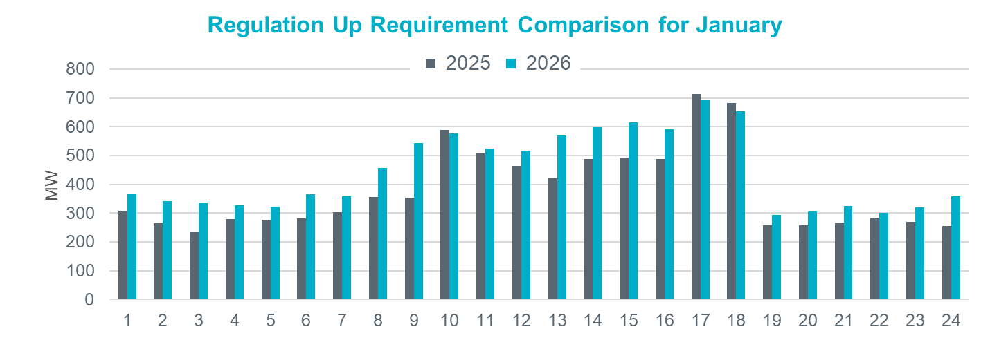
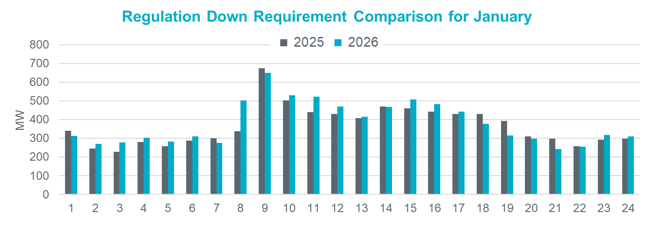
Regulation Comparison January
2026 Reg-Up:
Range: 294 – 694 MW;
Avg: 445 MW (66 MW increase from prev. year)
2026 Reg-Down:
Range: 243 – 649 MW;
Avg: 381 MW (14 MW increase from prev. year)

Slide 20
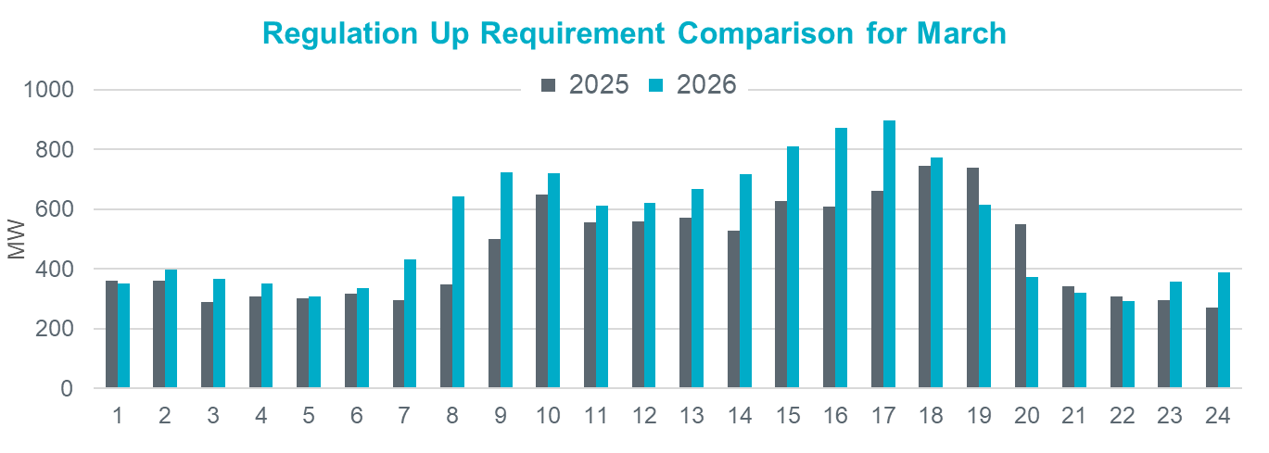
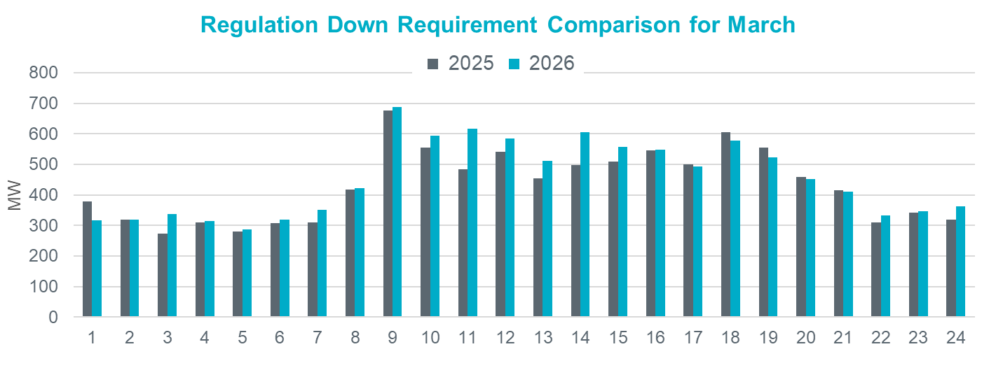
Regulation Comparison March
2026 Reg-Up:
Range: 292 – 896 MW;
Avg: 540 MW (78 MW increase from prev. year)
2026 Reg-Down:
Range: 286 – 687 MW;
Avg: 453 MW (21 MW increase
from prev. year)

Slide 21
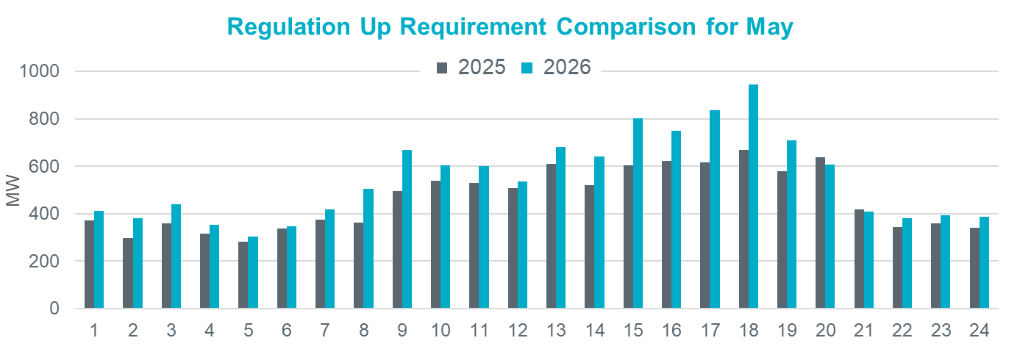
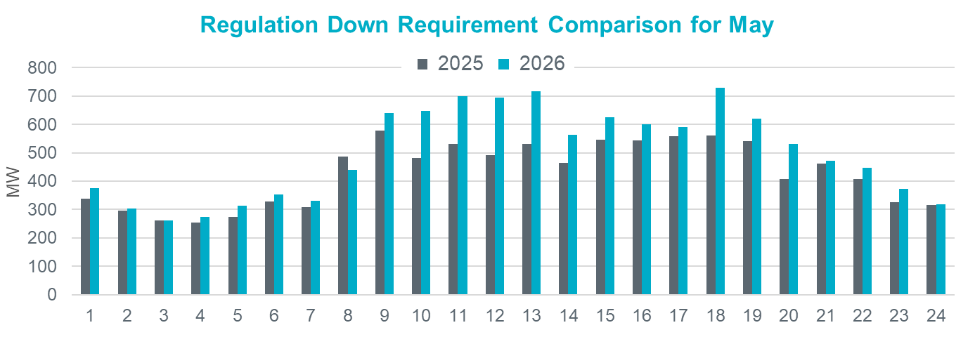
Regulation Comparison May
2026 Reg-Up:
Range: 304 – 944 MW;
Avg: 546 MW (84 MW increase from prev. year)
2026 Reg-Down:
Range: 261 – 728 MW;
Avg: 497 MW (68 MW increase
from prev. year)

Slide 22
Responsive Reserve Service

Slide 23
Responsive Reserve Service (RRS) Methodology
NERC’s preliminary BAL-003 Interconnection Frequency Response Obligation (IFRO) assessment for ERCOT for the 2026 Operating Year (OY) has not yet been published. Therefore, this analysis used the minimum RRS-PFR limit of 1,365 MW for 2025.
The preliminary RRS quantities for January 2026 through May 2026 in subsequent slides have been computed using 2024 and 2025 system inertia conditions and 2025 RRS table.
The RRS table tracks RRS requirements for different inertia conditions.

Slide 24
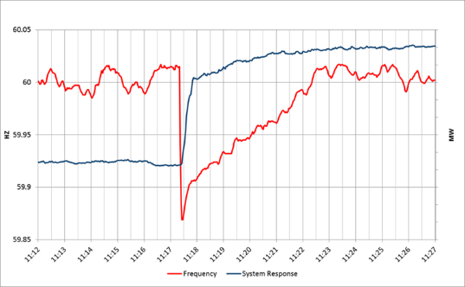
Responsive Reserve Service (RRS) Methodology
ERCOT is not proposing any change to the methodology used to compute RRS requirements in 2026.
The preliminary RRS quantities for January 2026 through June 2025 in subsequent slides have been computed using 2024 and 2025* system inertia conditions and updated RRS table.
Updates to RRS Table:
The RRS table tracks RRS requirements for different inertia conditions.
NERC’s preliminary BAL-003 Interconnection Frequency Response Obligation (IFRO) for Operating Year (OY) 2026 has not yet been published. Therefore, this analysis used the minimum RRS-PFR limit of 1,365 MW for 2025.
The RRS table will be updated for 2026 to when the minimum RRS-PFR limit is published.
Responsive
Responsive Reserve Service (RRS) is reserved capacity that is procured to respond to low frequency events typically triggered by generating unit trips.
Notes:
OY2022 IFRO – 412 MW/0.1 Hz | Limit 1,240 MW
OY2023 IFRO – 463 MW/0.1 Hz | Limit 1,390 MW
OY2024 IFRO – 395 MW/0.1 Hz | Limit 1,185 MW
OY2025 IFRO – 455 MW/0.1 Hz | Limit 1,365 MW

Slide 25
2025 RRS Table
Scenario | 1 | 2 | 3 | 4 | 5 | 6 | 7 | 8 | 9 | 10 | 11 | 12
LR/PFR | 2.35:1 | 2.2:1 | 2.06:1 | 1.94:1 | 1.83:1 | 1.74:1 | 1.65:1 | 1.58:1 | 1.51:1 | 1.44:1 | 1.39:1 | 1.33:1
Inertia (GW∙s) | 130 | 140 | 150 | 160 | 170 | 180 | 190 | 200 | 210 | 220 | 230 | 240
PFR Req. (no LR) (MW) | 5,960 | 5,563 | 5,200 | 4,892 | 4,622 | 4,329 | 4,114 | 3,920 | 3,744 | 3,522 | 3,314 | 3,139
*RRS Curr IFRO (MW) | 3,320 | 3,273 | 3,227 | 3,183 | 3,145 | 3,068 | 3,031 | 2,982 | 2,941 | 2,863 | 2,767 | 2,699
**RRS Upd IFRO (MW) | - | - | - | - | - | - | - | - | - | - | - | -
Scenario | 13 | 14 | 15 | 16 | 17 | 18 | 19 | 20 | 21 | 22 | 23 | 24 | 25
LR/PFR | 1.28:1 | 1.24:1 | 1.19:1 | 1.15:1 | 1.12:1 | 1.08:1 | 1.04:1 | 1.01:1 | 1:1 | 1:1 | 1:1 | 1:1 | 1:1
Inertia (GW∙s) | 250 | 260 | 270 | 280 | 290 | 300 | 310 | 320 | 330 | 340 | 350 | 360 | 370
PFR Req. (no LR) (MW) | 3,004 | 2,890 | 2,784 | 2,686 | 2,595 | 2,510 | 2,421 | 2,353 | 2,290 | 2,230 | 2,173 | 2,119 | 2,068
*RRS Curr IFRO (MW) | 2,645 | 2,595 | 2,558 | 2,514 | 2,463 | 2,425 | 2,380 | 2,343 | 2,290 | 2,230 | 2,173 | 2,119 | 2,068
**RRS Upd IFRO (MW) | - | - | - | - | - | - | - | - | - | - | - | - | -
*RRS quantity is calculated for RCC of 2,805 with limit of 60% limit on LRs and min RRS-PFR limit of 1,365 MW.
**The 2026 IFRO assessment has not yet been reported back from NERC, preventing the calculation of RRS quantity.
***Red font in table above identifies study scenario where RRS needed < 2,300 MW. RRS requirement during these is based on the applicable floor.

Slide 26
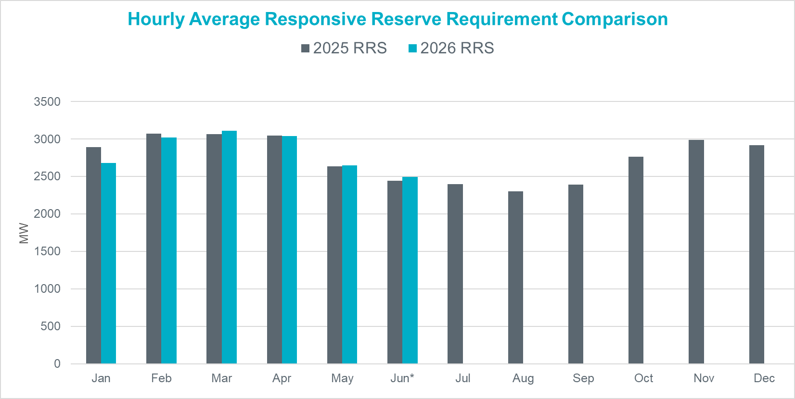
Hourly Average RRS Comparison
2026 RRS:
On avg. 26 MW decrease from prev. year
Largest increase is in Mar by 46 MW
Largest decrease is in Jan by 212 MW
*2026 RRS quantities are calculated using the 2025 minimum RRS-PFR limits (to be updated).

Slide 27
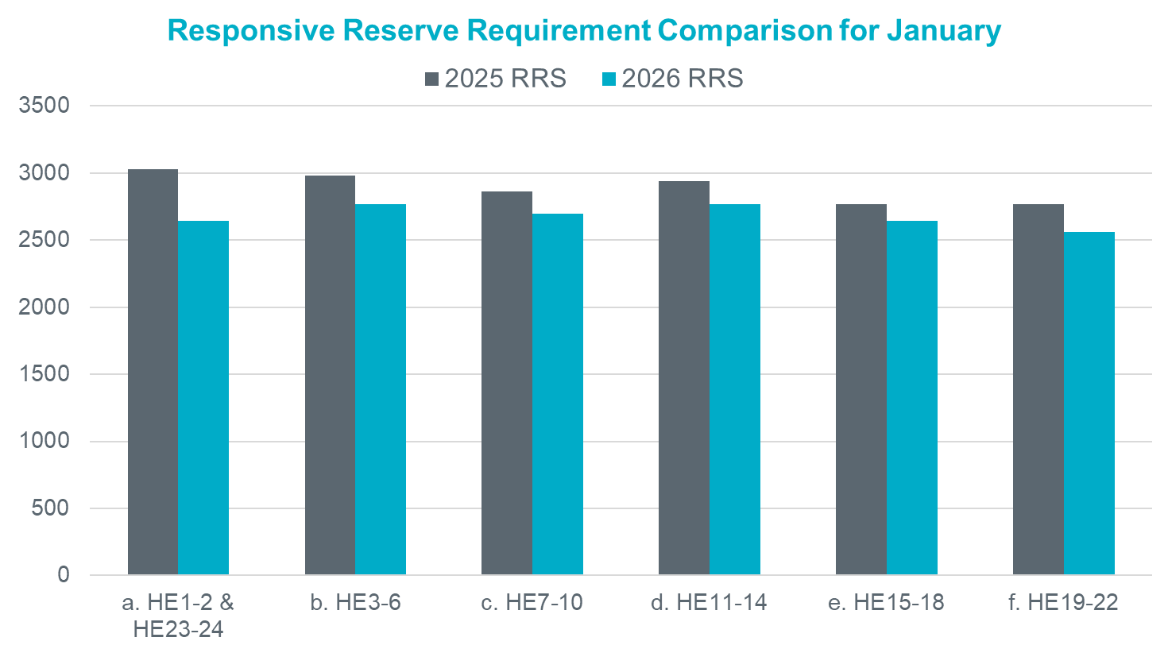
RRS Comparison January
2026 RRS:
Range: 2,558 – 2,767 MW;
Avg: 2,680 MW (212 MW decrease from prev. year)
*2026 RRS quantities are calculated using the 2025 minimum RRS-PFR limits (to be updated).

Slide 28
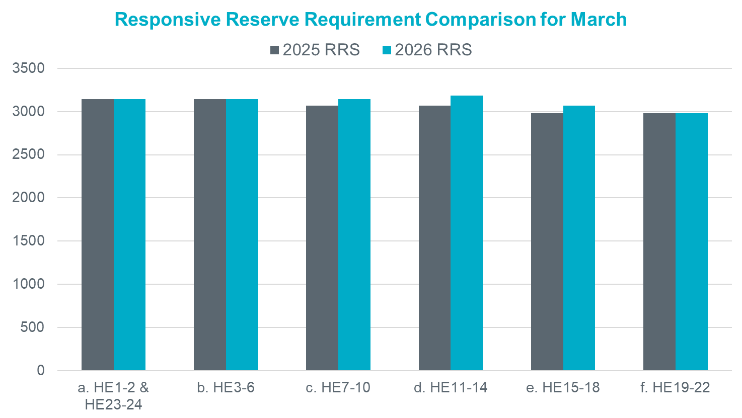
RRS Comparison March
2026 RRS:
Range: 2,982 – 3,183 MW;
Avg: 3,111 MW (46 MW increase from prev. year)
*2026 RRS quantities are calculated using the 2025 minimum RRS-PFR limits (to be updated).

Slide 29
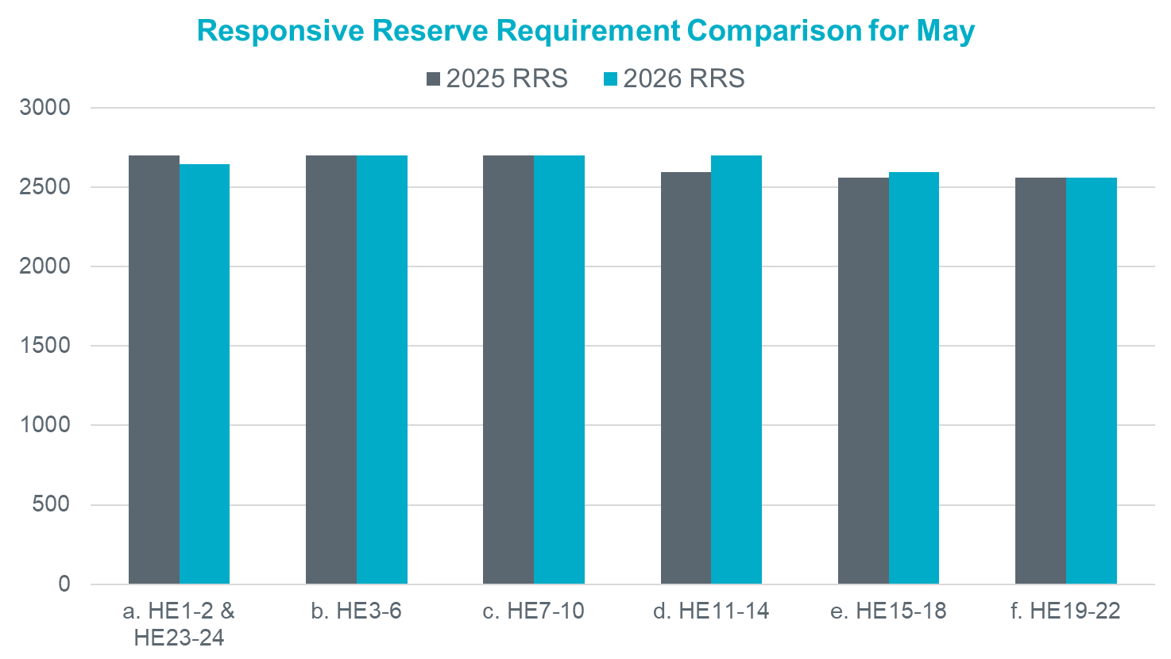
RRS Comparison May
2026 RRS:
Range: 2,558 – 2,699 MW;
Avg: 2,649 MW (14 MW increase from prev. year)
*2026 RRS quantities are calculated using the 2025 minimum RRS-PFR limits (to be updated).

Slide 30
Summary
Potential 2026 Methodology Review Timeline
April 23, 2025 – TAC Kickoff
May 19, 2025 – Workshop #1
June 20, 2025 – PDCWG
June 30, 2025 – Workshop #2
July 07, 2025 – WMWG (Proposed)
July 15, 2025 – OWG (Proposed)
July 22, 2025– PDCWG (Proposed)
August 04, 2025 – Workshop # 3 (New)
August 06, 2025 – WMS
August 07, 2025 – ROS
August 28, 2025 – TAC
September 23, 2025 – BoD
Oct, Nov, Dec 2025 – PUC
ERCOT shared proposed changes to the AS Methodology which includes the use of a probabilistic method for quantifying AS as discussed in 2024. ERCOT has now hosted two workshops related to the new framework.
The proposed timeline for this review is included alongside.
ERCOT plans to provide all relevant details on the proposed methodology during the workshops and working group discussions and provide just a summary of the proposed changes during the August/September discussions.
Interested Stakeholders are requested to attend the workshop and working group meetings to provide any feedback on the AS Methodology.

Slide 31

Questions
?

Slide 32
PUC’s Ancillary Service Study: Summary
The Public Utility Commission of Texas (PUCT) initiated the Ancillary Services Study (Study) to meet the requirements of PURA § 35.004(g) (enacted in Senate Bill 3 (87 R.S.)).
The PUCT collaborated with ERCOT and the Independent Market Monitor (IMM) on this effort.
ERCOT was asked to review the existing Ancillary Service products, including an analysis of the purpose for each of the products and a more thorough review of the methodologies used to determine Ancillary Service quantities. ERCOT was also asked to evaluate if any additional Ancillary Service products are needed.
ERCOT produced a white paper that responds to those requests
PUCT used inputs from stakeholders, ERCOT, IMM and PUC Commissioners. PUC filed its findings and final report on January 14, 2025.
The PUCT has also included it in their biennial agency report to the Texas State Legislature in January 2025.
PUC’s Findings are summarized in slides # to #

Slide 33
PUC’s Findings Related To AS Methodology
Topic | Finding | Next Steps
PROVIDING ADEQUATE INCENTIVES FOR DISPATCHABLE GENERATION | The reliability standard rule (16 TAC § 25.508) has defined a process for assessing and ensuring resource adequacy. | The first holistic reliability standard assessment in 2026 will include an assessment of whether incentives are adequate to support a sustainable level of dispatchable generation, and ERCOT should incorporate the impact of new market features such as Texas Energy Fund, DRRS, and real-time co-optimization plus batteries (RTC+B) into this assessment.
APPROPRIATE CRITERION FOR AS PROCUREMENT QUANTITIES | ERCOT's current posture of maintaining AS quantities that minimize the chance of Entering the pre-emergency operational condition of an Operational Watch should be maintained in order to balance system improvements made since Winter Storm Uri until additional data is available to support further Commission evaluation of this operating posture. | ERCOT should develop the capability to provide current estimates of costs and probabilities of experiencing a Watch, Emergency Alert, and Load Shed for several potential alternative target reserve levels as soon as practicable and no later than to support the Commission setting an objective, data-based procurement criteria for the 2027 AS Methodology.
PROBABALISTIC MODELING TO DETERMINE AS QUANTITIES | ERCOT's current practice to determine AS quantities relies on a statistical analysis using historical operating conditions and outcomes. This methodology is no longer sufficient as myriad changes to the wholesale markets and operating conditions continue to impact reasonable forecasting needs. Changes such as incorporation of an unknown amount of TEF-supported capacity, how new large loads are integrated into grid operations, or the impact of new market designs present uncertainty for forecasting tools based exclusively on historical data. | ERCOT should develop a suitable probabilistic, forward-looking modeling capability, provide regular updates to TAC, and present options that can be incorporated no later than the 2027 AS Methodology.
DYNAMIC DETERMINATION OF AS QUANTITIES | Tradeoffs exist between the certainty provided to market participants by calculating AS quantities primarily on an annual basis (as is done currently) and the efficiency of calculating some portion of AS quantities closer to the operating day. | ERCOT should work with stakeholders to explore a dynamic AS methodology that best Balances these trade-offs.

Slide 34
AS Methodology Evolution Road Map
Market
Current Market
?
RTC+B
Tool/ Methodology Development
“Annual” Full Statistical Analysis Tool Dev
Current Approach
“Closer to Op Day” Dynamic AS Quantity Determination Tool Dev
Policy
Determination
Policy/Criteria Development
for “Annual”
Policy/Criteria
Development
for “Closer to Op Day”
AS Methodology
Approval
Approval
Approval
Approval
Quantification Approach Used
for Year
Statistical Annual AS
Statistical Annual AS
Full Statistical Annual AS
Updated Full Statistical Annual AS
“Closer to Op Day” AS Adjustment
2026
Q2
Q3
Q4
Q2
Q3
Q4
Q3
Q4
2025
Q2
Q3
Q4
2027
Shared with Market
You are Here

Slide 35
Recap: Full Statistical Analysis OPEN Questions
How should the available headroom/capacity that is not providing AS be accounted in this analysis? | For example, weather forecast errors typically cause corresponding errors in load, wind, and solar forecasts, but are generator trips correlated to forecast errors, also? Further, should historic headroom capacity be accounted for in this analysis? If so, is the historic headroom capacity of the online generation fleet correlated to other factors?
How should increases in variability and uncertainty due to wind, solar, and load growth, as well as future changes in generator commitment patterns be accounted for in the methodology? | Historically, as the Intermittent Renewable Resource (IRR) fleet’s installed capacity has increased, both variability and uncertainty in net load have increased, and relying on historic error alone may not sufficient.
What event/criteria should each AS be setup to cover? | Is the criteria simply a matter of avoiding loss of load? Or should there be criteria related to avoid entering into an Energy Emergency Alert (EEA) or a Watch due to insufficient reserves? How should avoiding the need for manual operator actions be included in the criteria?
How should temporal constraints and cumulative factors be accounted? | The possibility of multiple generator trips across multiple hours (as occurred on May 13, 2022, for example) presents a risk that needs to be covered by AS. (Cumulative forced outages) AS is needed until other generators can be started or until the conditions causing the need for the reserves from AS change. How should this be considered in the analysis? (Event duration/temporal constraints) Increasingly, AS is being provided by duration-limited resources (battery energy storage). There is some risk that battery energy storage resources providing AS deplete their storage capacity during a multi-hour forecast error event, even if they are meeting all applicable requirements. Should not being able to charge be accounted as a risk in this analysis? (lack of energy considerations)
How much can other types of AS reserves be counted on to address risks for a given AS product? | For example, should some or all of ECRS be counted towards meeting the reserve needs covered by Non-Spin?
Key Takeaway: ERCOT is generally supportive of doing a “full statistical” probabilistic analysis to determine AS quantities. Several key questions that have to be carefully considered to setup the appropriate model for this analysis. Responses to these questions directly impact the volume of reserves procured and operational actions needed to continue operations. As an example, setting reserves too low could result in lower self commitment and tools like Unit Commitment may be necessary to cover the overall expected operational risk on such days. For proper balance Stakeholder and potentially policymaker input on these is essential.

Slide 36
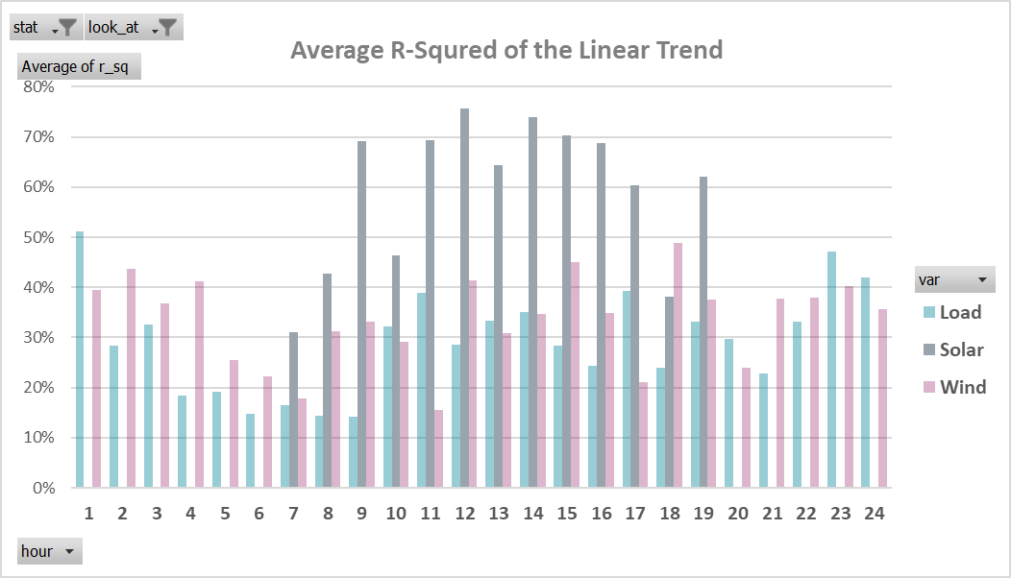
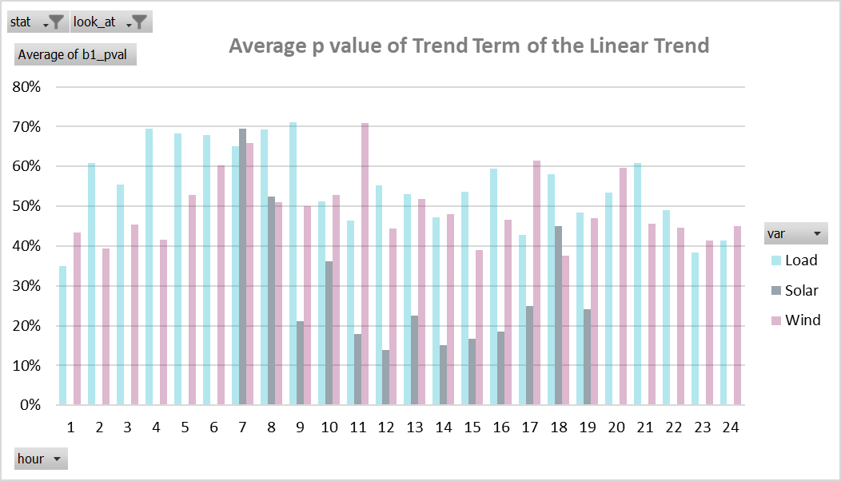
Impact of Load and Renewable Growth on Forecast Error Trends (cont’d)
Solar forecast errors show stronger trends, with high R² (~70%) and low p-values (<20%) during sunlight hours.
Load and wind errors show weak or inconsistent trends, with R² < 40% and p-values between 40 -70%
Adjustment was applied only to solar forecasts, based on statistical significance; no adjustment made for load or wind

Slide 37
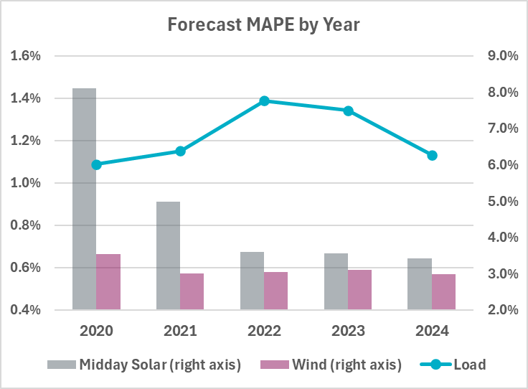
Forecast MAPE Trends
Forecast MAPE* has remained fairly stable over the years for load and wind.
Solar forecast performance prior to 2022 was inconsistent and less reliable, particularly when adjusting the error based on installed capacity.
*MAPE = Mean Absolute Percentage Error
MAPE=avg(|act-forecast|/(installed capacity))×100%

Slide 38
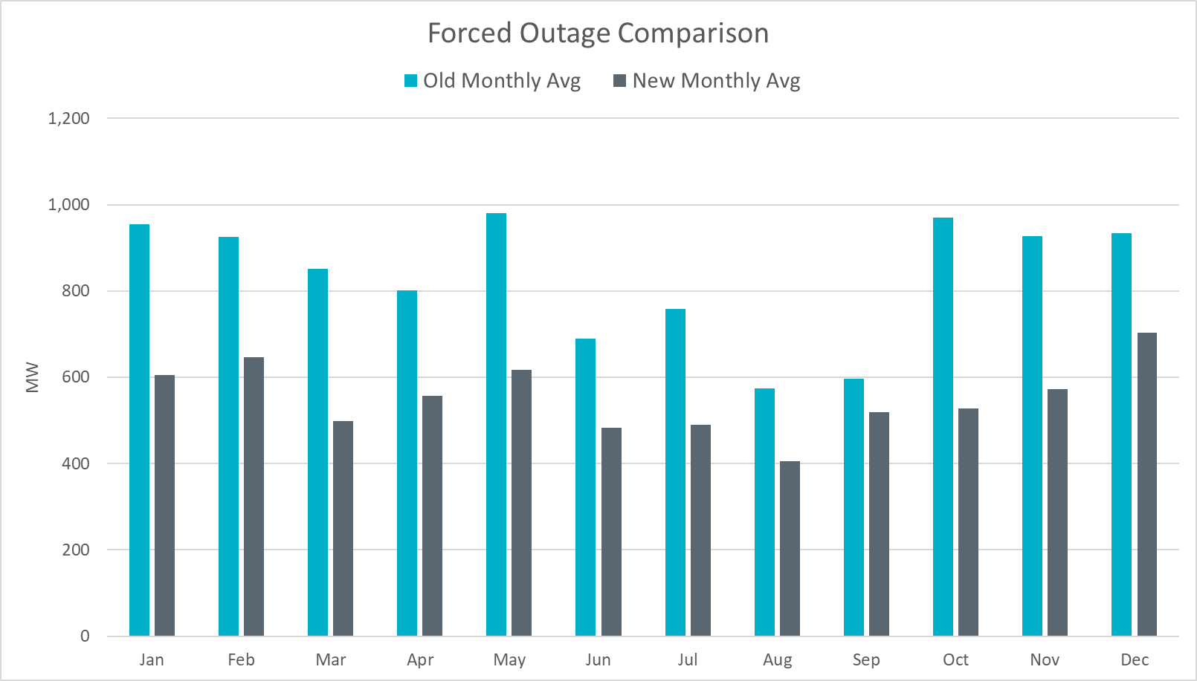
Outage Comparison of Methods
New process shows a decrease on average.
Notes:
4 years of data

Slide 39
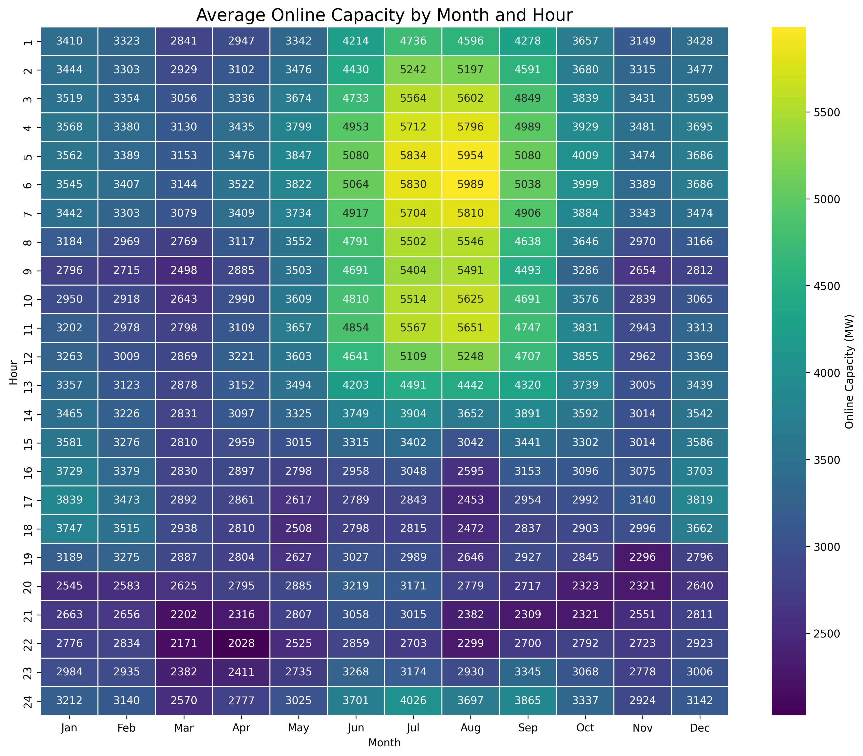
Risk Credit: Average Hourly Online Capacity by Month: 2020–2024

Slide 40
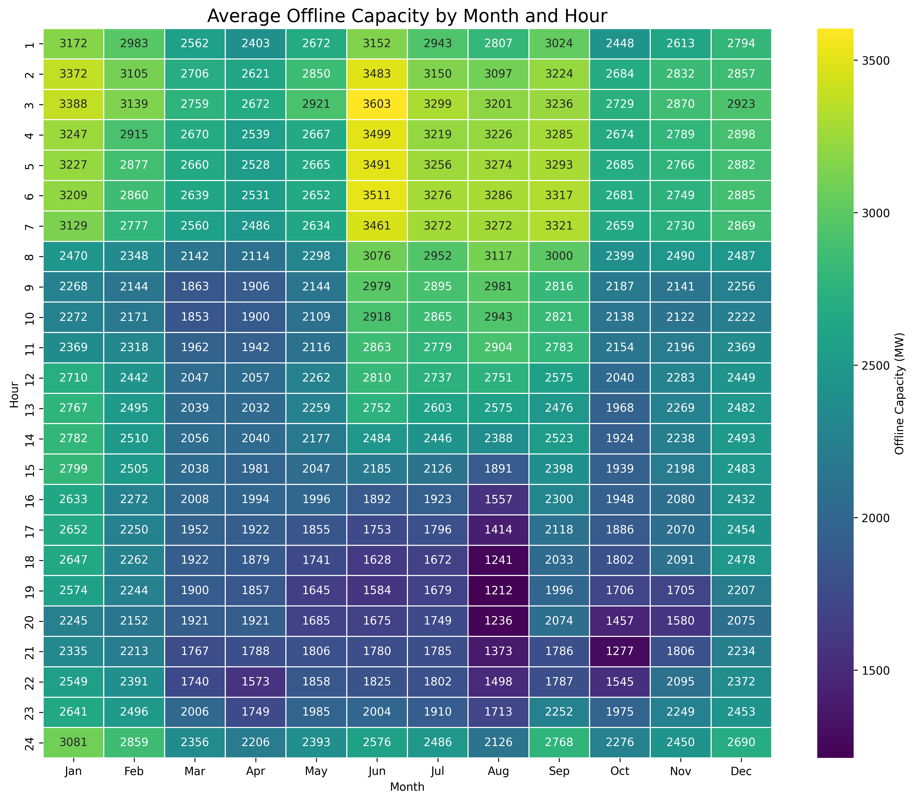
Risk Credit: Average Hourly Offline Capacity by Month: 2020–2024

Slide 41
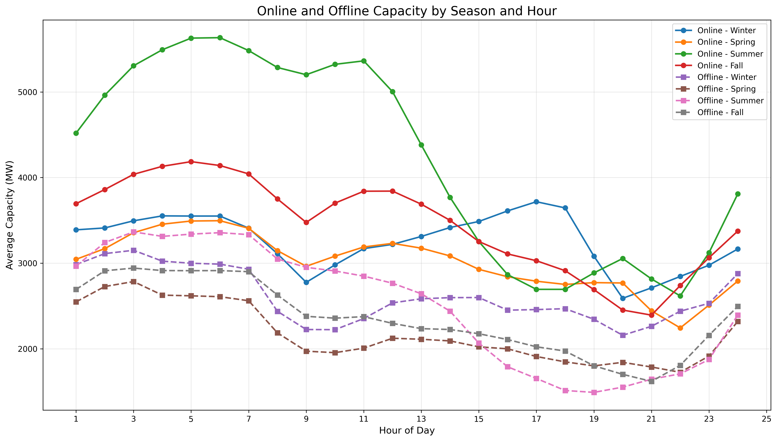
Capacity Trends by Season: Offline and Online

Slide 42
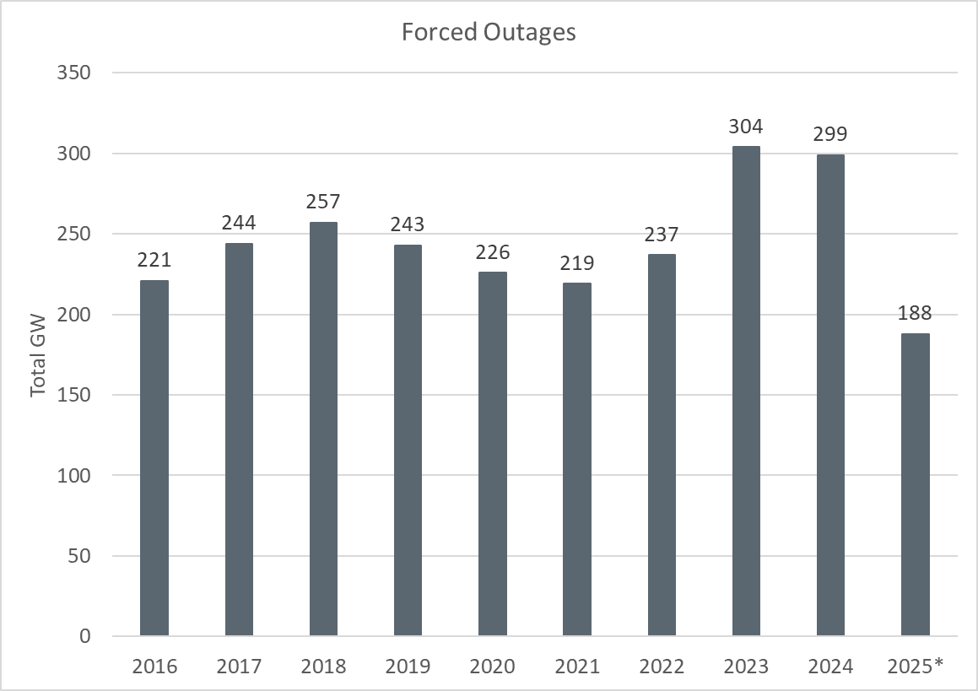
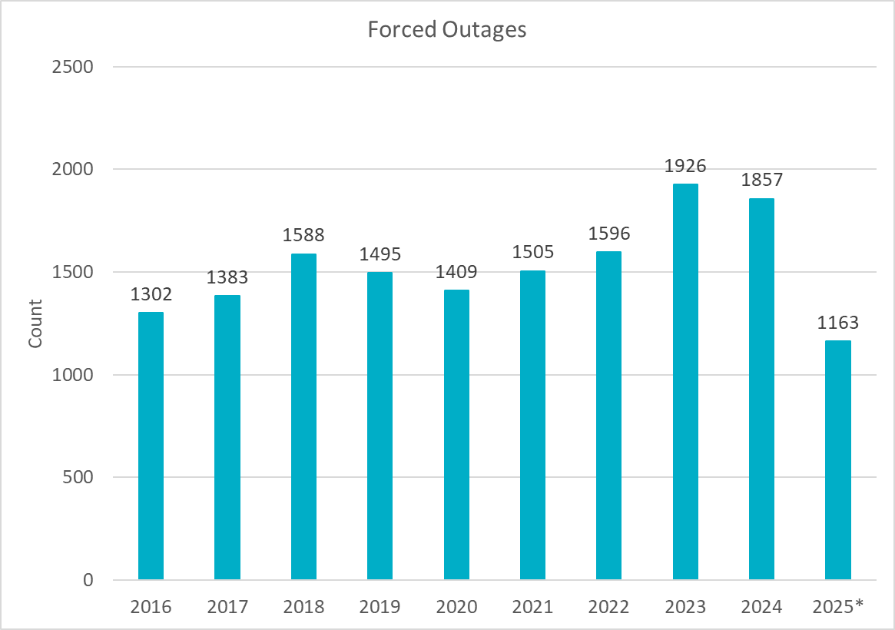
Outage Analysis
Review of outages from 2016 – 2025 doesn’t show a significant change in outages. 2023 and 2024 did show a small increase, but we need more data to ensure an increase trend will continue. This analysis will be reviewed again in the future methodologies.

Slide 43
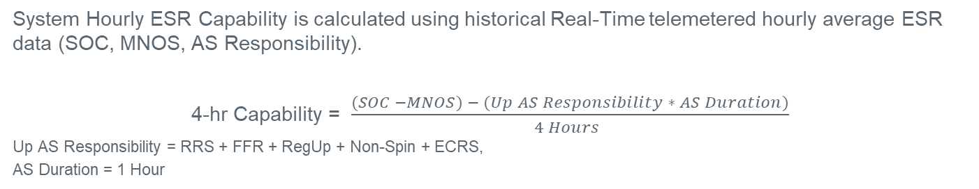
Risk Credit: ESR Energy Capability
System Hourly ESR Capability is calculated using historical Real-Time telemetered hourly average ESR data (SOC, MNOS, AS Responsibility).
4-hr Capability = $\frac{(SOC −MNOS) − (Up AS Responsibility ∗ AS Duration)}{4 Hours }$
Up AS Responsibility = RRS + FFR + RegUp + Non-Spin + ECRS,
AS Duration = 1 Hour

Slide 44
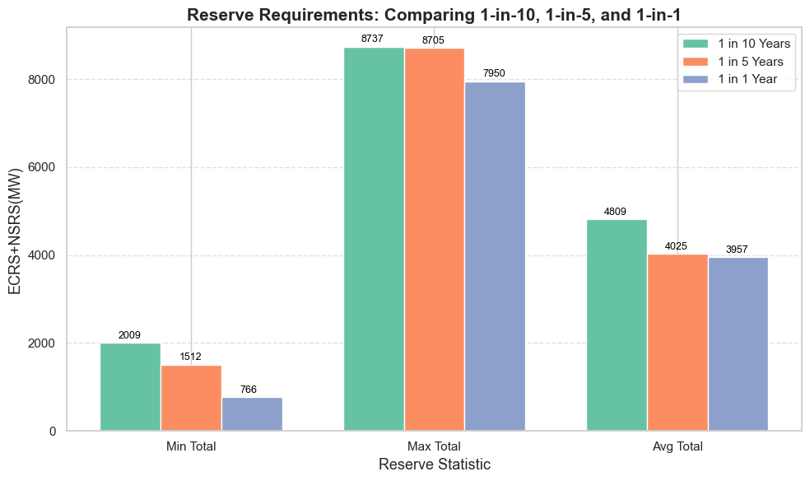
1 in 10 Years vs 1 in 5 Years vs 1 in 1 Year Sensitivity
We ran additional sensitivities with Case 9 and identified that 1 in 10 Years will produce the highest reserve quantity.
*Preliminary Values

Slide 45
Regulation Service

Slide 46
Generation To Be Dispatched (GTBD)
ERCOT has incorporated intra-hour wind/solar forecast- based ramp into GTBD to give SCED an indication of how renewables may ramp.
Predicted Wind Ramp Rate (PWRR) was incorporated in GTBD in Dec.2018
Predicted Solar Ramp Rate (PSRR) was incorporated in GTBD in Jun.2021
In absence of PSRR/PWRR, SCED dispatches uncurtailed solar/wind units to their max output (HSL).
This means that SCED assumes output of uncurtailed solar/wind units will persist for the next 5-min at the unit’s HSL that was telemetered at the start of the interval.
GTBD = Total Gen
+K3*5*PLDRR
+K4*Regulation Deployed
+ K5*ACE Integral
– K6*5*PWRR
+ K7*5*DCTRR
– K8*5*PSRR
5-min Load Ramp Forecast
Previous Reg Deployment
Historical Accumulated ACE
5-min Wind Ramp Forecast
5-min DC Tie Ramp Forecast
5-min Solar Ramp Forecast

Slide 47
Recap – Dynamic PSRR Threshold in GTBD
ERCOT started to apply a dynamic PSRR threshold in GTBD calculation on 6/12/2023
PSRR thresholds change with 4 pre-defined day periods - Night, Sunrise, Sunset and Other
ERCOT started with a threshold of 80MW/min for Sunrise and Sunset periods on 6/12/23 and subsequently increased it to 100MW/min. Today, the threshold is set to 225MW/min.
ERCOT continues to update the thresholds and the definition of day periods seasonally*
Night
* Seasons will be defined by shift in solar ramping patterns
**This image is a visual aid for concept and is not documenting current settings

Slide 48
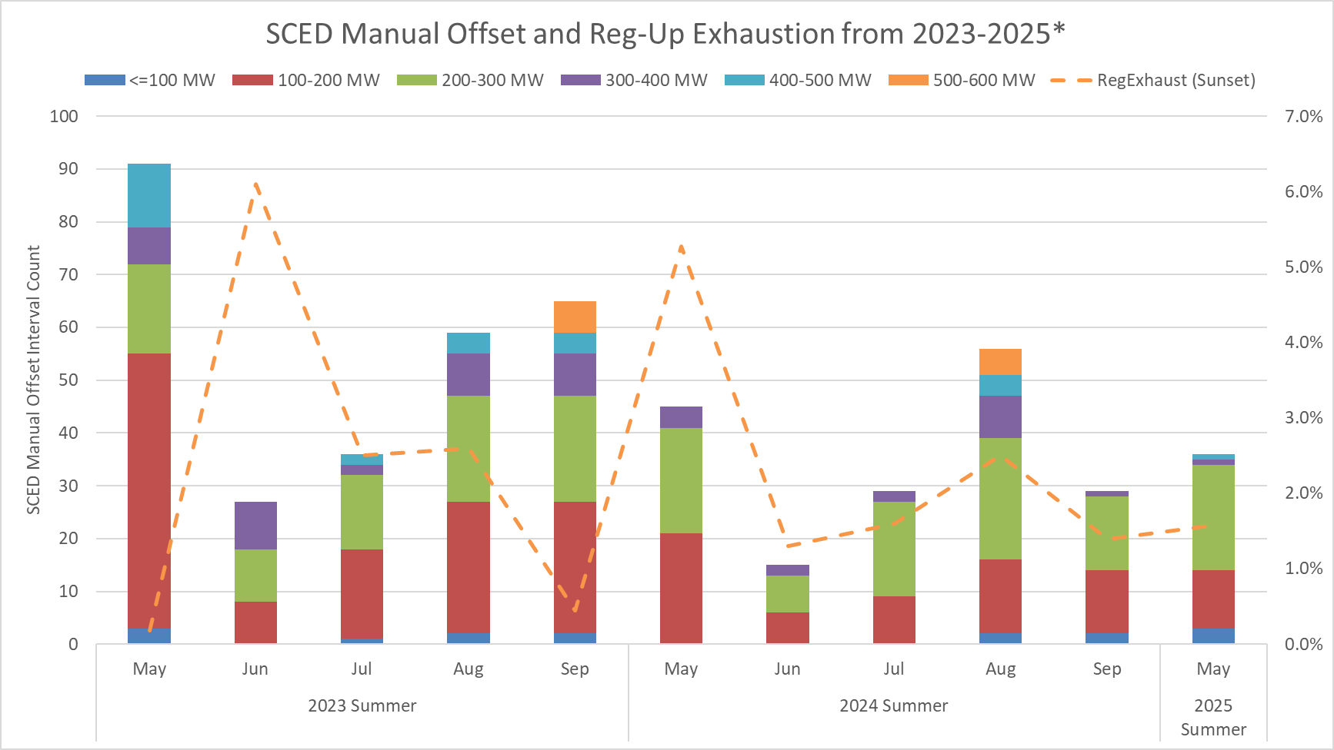
SCED Manual Offset and Reg-Up Exhaustion
This chart combines both the number of Operator Manual Offsets entered along with a focus on Reg-Exhaustion during sunset hours.
Sunset hours: HE 19 - 21

Slide 49
Responsive Reserve Service

Slide 50
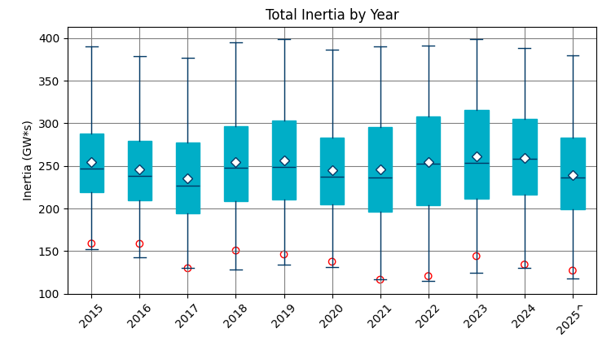
Total Inertia (2015 – 2025.06*)
The average inertia in 2024 was comparable to 2023, but currently 2025 is trending lower than in 2023.
[Total inertia for 2015 - 2025.06*]

