Slide 1
SSWG Report to ROS
July 10, 2025
Chair: Zach Walker (Zachary.Walker2@oncor.com)
Vice Chair: Chris Ramirez (cramirez@wettllc.com)

Slide 2
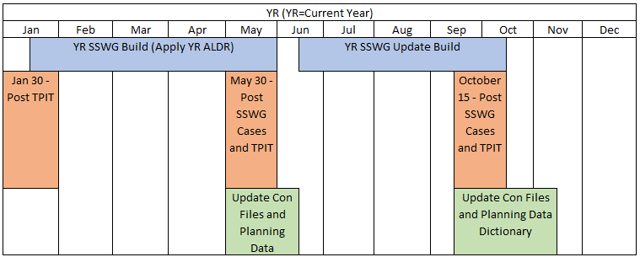
SSWG Report
Key Updates
SCR 831
Joint meeting with NDSWG and SPWG held on June 9th
SSWG intends to endorse approval of SCR 831
Still gathering feedback from TSPs
25SSWG Case Build #1
Final postings on hold until further notice (as of 7/2/25)
Only Case Set 3 (all OLL out of service) will be posted
25SSWG U1 Incremental Update has begun
SSWG Procedure Manual Revisions
Minor language updates to reflect current processes and Planning Guide requirements (PGR115) to be submitted for approval by September ROS Meeting
Review still ongoing for Peak Net Load cases to be added to biannual SSWG case builds
Case Set | OLL Status | Case State
1 | All OLL in service | Most cases do not solve Voltage collapse in several areas around OLL’s
2 | Some OLL out of service | Solves in base case Some OLLs removed to avert voltage collapse Doesn't solve when running contingencies
3 | All OLL out of service | - Official Case Set
SSWG Report to ROS External

