Slide 1
RTC + B
Day-Ahead Market (DAM)
Alfredo Moreno
Forward Market Operations
March 25, 2025

Slide 2
Agenda
DAM Timeline
Ancillary Service Obligations
Ancillary Service Demand Curves (ASDCs)
Ancillary Service (AS) Insufficiency
AS Submissions:
AS-only Offers
Resource-Specific AS Offers
Self-Arranged AS
Energy Storage Resource (ESR)

Slide 3
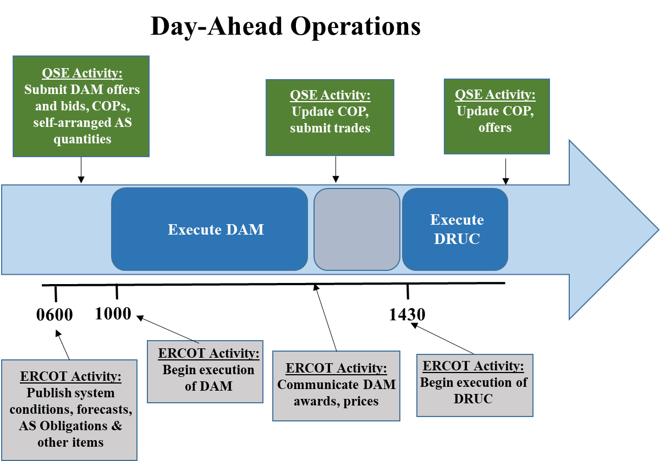
DAM Timeline

Slide 4
Ancillary Service Obligations
Current Structure
AS Obligations are calculated, using the AS plan and Load-Serving Entities (LSE) Load-Ratio Share (LRS), and posted by 0600 in the day-ahead
The minimum obligation is 1MW
RTC+B Structure
Advisory AS Obligations are calculated, using the AS plan and Load-Serving Entities (LSE) Load-Ratio Share (LRS), and posted by 0600 in the day-ahead
No minimum obligation
Final AS Obligations are calculated, using DAM Awards + Self-Arrangement, and sent to Settlements
Self-Arrangement over Final AS Obligation will be paid-out to QSE

Slide 5
Ancillary Service Demand Curves (ASDCs)
Current Structure
AS requirement derived from AS Plan minus Self-Arranged AS
AS penalty costs calculated using the System-Wide Offer Cap (SWCAP)
RTC+B Structure
Initial DAM ASDCs will be the same as Real-Time (RT) ASDCs
ASDCs will shift requirements based on self-arranged AS
Negative self-arranged AS will shift curve to the right
AS penalty costs will no longer be used in the optimization

Slide 6
Ancillary Service (AS) Insufficiency
Current Structure
AS insufficiency is analyzed for each AS type per hour
If AS insufficiency is identified
Run AS insufficiency procedure and then reopen the market for minimum 30 minutes to receive additional AS offers
Re-close DAM and re-run
If AS insufficiency still exists, complete the run and then run the pricing run
SASM and RUC will attempt to procure the insufficient quantities
RTC+B Structure
AS insufficiency will no longer be needed as RT will procure the AS

Slide 7
AS Submissions: AS-only Offers
Current Structure
AS-Only Offers don’t currently exist
RTC+B Structure
AS-only Offers will be a new submission type that will not require a Resource link. AS qualifications will not be required for either Resource or Qualified Scheduling Entity (QSE)
AS-only Offers will be procured against their respective ASDCs
Multi-hour and fixed blocks will not be permitted
5 offer blocks will be allowed for single part AS-Only Offers
REGUP
REGDN
RRSPFR
Online NSPIN
Online ECRS
Quantity minimum of 0.1MW; Pricing between $0/MW and DAM SWCAP
New Credit Exposure calculation

Slide 8
AS Submissions: Resource-Specific AS Offers
Current Structure
Procurement against AS requirement while considering AS penalty costs
Resource linked AS Offers require Resource and QSE AS qualifications
AS Offers may be inclusive or exclusive of each other or Energy Offer Curve (EOC); 5 blocks available
Quantity minimum of 0.1MW; Pricing between $0/MW and SWCAP
FRRS qualified Resources have a system-wide limit for Up and Down
RTC+B Structure
Procurement against DAM ASCDs
Pricing between $0/MW and DAM SWCAP
FRRS will not longer be a valid option

Slide 9
AS Submissions: Self-Arranged AS
Current Structure
Self-Arranged AS subtracted from AS plan to determine AS requirement
Submissions exceeding the AS Obligation is allowed (up to)
Regulation: 25MW
RRS and ECRS: 100 MW
NSPIN: 50 MW
RTC+B Structure
Self-arrangement AS exceeding their advisory AS Obligation will no longer be allowed
Negative Self-Arranged AS will be considered price takers on each respective ASDC
Self-Arranged AS beyond the final AS Obligation will be paid at it’s corresponding AS MCPC
AS trades submitted above their Self-Arrangement will be charged if not corrected by the end of the Adjustment Period

Slide 10
Energy Storage Resource (ESR)
Current Structure
ESR/DESR modeled as a combo model: Generator and Controllable Load Resource (CLR) and offered independently
RTC+B Structure
Single model Resource will incorporate both charging and discharging characteristics
COP and EOCs will allow for negative values to represent charging
Energy Bid/Offer Curves will be new submissions in the DAM
Energy Curves shall be considered inclusive of Resource-Specific AS Offers
Considered Self-Committed
No Make-Whole payments
Resource-Specific AS Offers may be inclusive or exclusive of each other
Offline reserves, RRSUFR, or ECRSMD will not be allowed
New Credit Exposure calculations
Bid portion (charging) like Energy Bid credit exposure
Offer portion (discharging) like TPO credit exposure

Slide 11
DAM transition
Energy Offers & Bids
Co-optimized DAM
Energy Awards
Energy Offers & Bids
Co-optimized DAM
Energy Awards
Point-to-Point (PTP) Obligation Bids
Point-to-Point (PTP) Obligation Bids
PTP Obligation Awards
PTP Obligation Awards
AS Offers
(include AS-only)
AS Offers
AS Awards
AS Awards
Energy Bid/Offer Curves
Resource and Network Constraints
Resource and Network Constraints
DAM ASDCs

Slide 12
Questions?

