Slide 1
Load Resource Overview and Changes Introduced With the Real-Time Co-Optimization
Anthony Pataray
Demand Integration
June 9th, 2025
ERCOT Public

Slide 2
Introduction
Key changes implemented with the RTCB project affecting Load Resources (LRs), their Resource Entities, and Qualified Scheduling Entities (QSEs)
New Terms and Concepts
Introduction to Self-Provision
Day-Ahead Market (DAM) Changes
Telemetry Changes for NCLRs and CLRs
Real-Time Market (RTM) and Operational Changes
Deployment and Recall of Load Resources
Performance Analysis
Monthly Reports
Real Time Self-Provision Examples
This is not an all-encompassing review of changes – Focus is on LRs

Slide 3
Introduction to Self-Provision
What is self provision?
  Self-provision is a new concept in RTC+B where QSEs have the option to cover their Ancillary Service (AS) position with load resources that operate with an Under Frequency Relay (UFR)
    If the QSE has a responsibility at the end of the adjustment period, the QSE can telemeter self-provision amount to ensure AS responsibility are awarded/met in real time
    (Day Ahead AS Awards + Day Ahead Self Arranged AS + net of AS Trades Sold – AS Trades Purchased)
  *Different than self-arrangement*
Who does self-provision apply to?
  NCLRs that are qualified for AS that operate utilizing an armed UFR:
    RRS UFR
    RRS FFR
    ECRS resources with a UFR
When can a Load Resource that is not a Controllable Load Resource (CLR) self-provide AS?
  Self-provision is resource-specific and managed in real time through telemetry, which is set by the QSE.
Why was self-provision created?
  Self-provision was introduced in response to Market Participant concerns about frequent AS reassignments during real-time operations. It was developed to prevent the constant arming and disarming of UFRs

Slide 4
Self-Arrangement vs Self-Provision
Self-Arrangement
  Applies to the Day-Ahead Market (DAM)
  Allows QSEs with Ancillary Service (AS) obligations to procure AS on their own
  Prevents ERCOT from purchasing AS on their behalf in DAM
  Process remains unchanged under Real-Time Co-Optimization (RTC)
Self-provision
  Self-provision in the Real-Time Market (RTM) applies to AS suppliers using under-frequency relays
  Intended to reduce AS reassignments during real-time operations
  Helps avoid the need to frequently arm or disarm relays
  New concept under Real-Time Co-optimization (RTC)

Slide 5
Day-Ahead Market (DAM) Changes
Existing qualification limits to provide AS will be retained for all LRs, but new Resources will be required to demonstrate their capability through a qualification test
  No additional testing for existing LRs
ASDCs will be added to the DAM optimization and will be used in the determination of the AS quantities procured and the MCPCs
QSEs then prepare COPs to show projected Resource availability and their AS capability for each AS Type coming out of DAM
  AS Responsibility field is replaced by AS Capability by each AS Type
No Changes Required
  AS Plan posted by 06:00 in the Day-Ahead for LSE QSEs
  After DAM runs, AS Awards are published based on the DAM AS procurement
  Participation of CLRs in DAM will be similar to Generation Resources

Slide 6
Telemetry Changes for NCLRs and CLRs
Resource status for NCLRs or CLRs will either be ONL or OUTL.
  Eliminated Statuses
    ONRGL, FRRSUP, FRRSDN, ONCLR, ONRL, ONECL, and ONFFRRRSL.
Resource specific AS Responsibility and AS Schedule will be eliminated
QSE telemeters current capability to provide Reg Up, Reg Down, RRS, ECRS and Non-Spin:
  Self-provided capacity for RRS-UFR and ECRSM w/ UFR showing as Armed
  NCLR telemeters its RRS capability as a MW value
  NCLR telemeters its ECRS capability in the form of a 10-minute blended ramp rate measured as MW/min
    i.e. 6.0 MW/min = 60 MW of capability
  NCLR telemeters its Non-Spin capability in the form of a blended 30-minute Ramp Rate measured as MW/min
    i.e. 2.0 MW/min = 60 MW of capability
ERCOT sends AS Awards via ICCP after every SCED execution
For CLRs, the UDBP is replaced by the UDSP
  Updated Desired Set Point (UDSP)—UDSP will be a single value that is the sum of two components: Base Ramp and Resource-specific Regulation Service instruction.
See RTC Telemetry Changes on RTC+B Training webpage
ERCOT Nodal ICCP Communications Handbook RTC+B v4.03

Slide 7
Self-Provision Achieved via Telemetry Points for NCLRs
LEGEND
QSEs will be able to self-provide in real-time via telemetered ICCP points
ICCP Change Request Example RTC+B V1.4 on RTC ERCOT webpage

Slide 8
RTC Dispatch of Ancillary Services by Resource Type
Current AS Qualification for Resources will carry over into RTC
All AS Dispatch will be Resource Specific
Resource abbreviations:
Gen = Generation
CombCycle = Combined Cycle
Sync Cond = Synchronous Condenser
ESR = Energy Storage Resource (Battery)
CLR = Controllable Load Resource
NCLR = Non-Controllable Load Resource

Slide 9
RTM and Operational Changes for CLRs
NPRR1244 - All Controllable Load Resources capable of providing Primary Frequency Response(PFR) shall provide PFR, i.e., the CLRs that are qualified for Regulation and/or RRS
Need to submit offers for real-time to cover telemetered AS capabilities if showing ONL status, otherwise ERCOT calculates and will use a proxy offer for energy and AS
Awards and deployments will respect operating limits including MPC, LPC and ramp rates
In general, participate like a conventional Generator
No Deployment or Recall Changes for CLRs

Slide 10
RTM and Operational Changes for NCLRs
Telemetry is critical
  NPC, LPC, Resource Status and Ramp Rates are key input data used in the procurement process.
Awards for AS will be subject to limits/constraints for each service type; e.g. additional awards for RRS-UFR
Supplemental Ancillary Service Market Process or SASM has been eliminated
NCLRs may self-provide RRS and ECRS subject to validation rules:
  Under-frequency relays must be armed
  Load Resources are validated against telemetered AS capabilities
  The amount of RRS and ECRS a QSE self-provides must not be more than the QSEs total Ancillary Service position (including awards, self-arranged amounts, and trades)
Note that awards can be partial amounts of AS (e.g. 20 MW offer; 20 MW capability; 10 MW award)
QSEs can update AS offers for the operating hour in the operating hour
SCED will use a proxy offer for AS if NCLR is showing status of ONL, has headroom, and no offer submitted or offer does not cover the amount of AS available from the NCLR
AS Awards published is the sum of self provided AS and any extra AS Award subject to headroom availability

Slide 11
Deployment and Recall for NCLRs
No Group Assignments for deployment or recall
Manual deployment for Non-Spin, ECRS and RRS is done similarly today:
  Operator dials in a MW value, e.g. 500 MW, and then the AS Deployment manager issues resource specific instructions:
    Non-Spin
    ECRSM – No relay or relay not armed, then
    ECRSM – UFR armed, then
    ECRSM and RRS-UFR – both deployed at the same time when NCLR has an armed UFR, then
    RRS-UFR
The 3-hour return to service was a compliance metric that has been eliminated
  AS positions for future hour are financial, so this compliance metric is no longer applicable
Conditions not affected by RTC:
  Deployment instructions are resource specific and done by XML instruction
  NCLRs need to remain deployed until recalled
  Once deployed, NCLRs are subject to an Imbalance charge similar to today
  Once recalled, it’s important to cover AS financial position by returning to service or covering any shortage thru allowed substitution or market trades

Slide 12
Performance Analysis for CLRs
CLR is evaluated against UDSP instead of UDBP
Performance is based on CLREDP methodology in Section 8 of the Protocols (no change)
Evaluated for PFR response to FMEs if qualified for RRS and/or Regulation (no change)
No change to compliance metrics

Slide 13
Performance Analysis for NCLRs Overview
No Change with RTC but reminder:
Evaluate QSE level and Resource Specific event performance from time of deployment to recall instruction
Baseline capacity uses a 5 min average of NPF prior to instruction date/time stamp
Instructed capacity is part of the XML instruction
Resource deployment performance must be greater than 95% of instructed value
Evaluation also looks at over-performance and should be less than 150% of instructed value
Failures fall into the following categories
  Fail to deploy based on ramp time limit
  Fail to meet the 95% minimum requirement
  Exceed the 150% limit particularly for RRS and ECRS (excess UFR response)
  Fail to remain deployed/return to service prior to getting a recall instruction
Suspensions remain the same (2 failures with 365 days and the NCLR may be suspended)

Slide 14
Reports
NCLR Deployment Performance Report for AS (NSRS, ECRS and RRS) are done monthly
  QSE Level Report is done on a pass/fail basis for each event– secure report
    Individual report for all QSEs for RRS and ECRS and then a 2nd Report for Non-Spin
  Resource specific report done for each QSE on a pass/fail basis – certified report
    Individual report for each QSE for RRS and ECRS and then a 2nd report for each QSE showing all NCLRs providing Non-Spin
CLR Deployment Performance Report for AS (NSRS, ECRS and RRS) are done monthly
  Monthly report on CLREDP performance
  Event Performance for FMEs and PFR response from CLRs (if required)
Market Participation Report for all Load Resource
  Monthly report for LR Awards in RTM providing AS, broken down by type (NCLR and CLRs), CMZ and Delivery Hour

Slide 15
Self-Provision Scenarios
For the next few example scenarios, please assume the following:
  All load resources are fully qualified for RRS UFR, RRS FFR and ECRS operating with a UFR
  All load resources have standard/acceptable offers submitted to SCED in real time
  All ECRS Awards in this set of scenarios are for ECRS operating with a UFR

Slide 16
Scenario 1
NCLR_1 has a 15 MW RRS AS Position, 10 MW from DAM award and 5 MW from RRS Trade
Scenario ** Assume AS qualified for All Headroom (NPF-LPC) | MPC | NPF | LPC | RST | UFR | Self-provided RRS UFR(MW) | Self-provided ECRS (MW) | Current Capability to provide UFR (MW) | ECRS (10min) Ramp Rate (MW/min) | RRS UFR AS Award | ECRS AS Award | Notes
NCLR_1 is qualified to provide 15 MW. DAM awards NCLR_1 with 10MW RRS. QSE also has additional 5MW RRS Position via RRS Trades. | 15 | 15 | 0 | ONL | Arm | 15 | 0 | 15 | 0 | 15 | 0 | NCLR_1 Telemetry needs to show: Status = ONL, MPC >= NPF >= 15 MW, NPF-LPC >= 15 MW, RRS capability >= 15 MW, RRS self-provided telemetry = 15 MW SCED will respect the 15 MW self-provided RRS and award the resource 15 MW RRS UFR.
QSE to ERCOT Telemetry
ERCOT to QSE ICCP

Slide 17
Scenario 2 and 3
NCLR_2 has AS Positions of 25 MW RRS and 10 MW of ECRS with no additional room to provide AS.
NCLR_3 has AS Positions of 10 MW RRS and 25 MW of ECRS with additional headroom to provide AS.
Scenario ** Assume AS qualified for All Headroom (NPF-LPC) | MPC | NPF | LPC | RST | UFR | Self-provided RRS UFR(MW) | Self-provided ECRS (MW) | Current Capability to provide UFR (MW) | ECRS (10min) Ramp Rate (MW/min) | RRS UFR AS Award | ECRS AS Award | Notes
NCLR_2 has NO HEADROOM and the following AS positions: 25 MW of RRS 10 MW of ECRS | 35 | 35 | 0 | ONL | Arm | 25 | 10 | 25 | 1 | 25 | 10 | NCLR_2 is telemetering enough capability (NPF-LPC) to cover its self-provided amounts, and enough capability to meet its self-provided telemetered amounts. The resource is awarded 25 MW of RRS and 10 MW of ECRS.
NCLR_3 HAS headroom and the following AS positions: 10 MW of RRS 25 MW of ECRS | 50 | 50 | 0 | ONL | Arm | 10 | 25 | 25 | 2.5 | 10~25 | 25 | NCLR_3 has 15 additional MW of capacity. The resource will be awarded at least 10 MW of RRS as it is self-providing 10 MW. In this scenario the resource is awarded 10-25 MW of RRS due to additional capacity telemetered. NCLR_3 is awarded 25 MW of ECRS as it is telemetering 25 MW of capability and self-providing 25 MW of ECRS.
QSE to ERCOT Telemetry
ERCOT to QSE ICCP

Slide 18
Scenario 4
QSE 1 is awarded 50 MW of RRS UFR in the Day Ahead. QSE 1 has 3 Load Resources with 100 MW of capability in its portfolio to spread the 50 MW obligation across.
Scenario ** Assume AS qualified for All Headroom (NPF-LPC) | MPC | NPF | LPC | RST | UFR | Self-provided RRS UFR(MW) | Self-provided ECRS (MW) | Current Capability to provide UFR (MW) | ECRS (10min) Ramp Rate (MW/min) | RRS UFR AS Award | ECRS AS Award | Notes
NCLR_4 carries 30 MW of self-provision | 45 | 45 | 5 | ONL | Arm | 30 | 0 | 30 | 0 | 30 | 0 | NCLR_4 was awarded 30 MW of RRS while self-providing 30 MW. The resource has additional headroom, but the capability to provide RRS UFR is set to 30 MW. The resource will be awarded 30 MW.
NCLR_5 does not self-provide RRS | 15 | 15 | 0 | ONL | Dis-Arm | 0 | 0 | 15 | 0 | 0 | 0 | Despite telemetering 15 MW RRS capability, NCLR_5 is not awarded RRS due to UFR status set to dis-armed.
NCLR_6 carries 20 MW of self-provision | 40 | 40 | 10 | ONL | Arm | 20 | 0 | 30 | 0 | 20~30 | 0 | NCLR_6 telemetered a RRS capability of 30MW and self-provided 20MW of RRS. The resource will be awarded at least 20 MW, due to self-provided telemetry of 20 MW, and up to 30 MW as its capability to provide RRS UFR is set to 30 MW and has ample capacity.
QSE to ERCOT Telemetry
ERCOT to QSE ICCP

Slide 19
Questions and for more info contacts
Demand Integration
ERCOTLRandSODG@ercot.com
Mark Patterson
Anthony Pataray
Donald House
Franky Wong

Slide 20
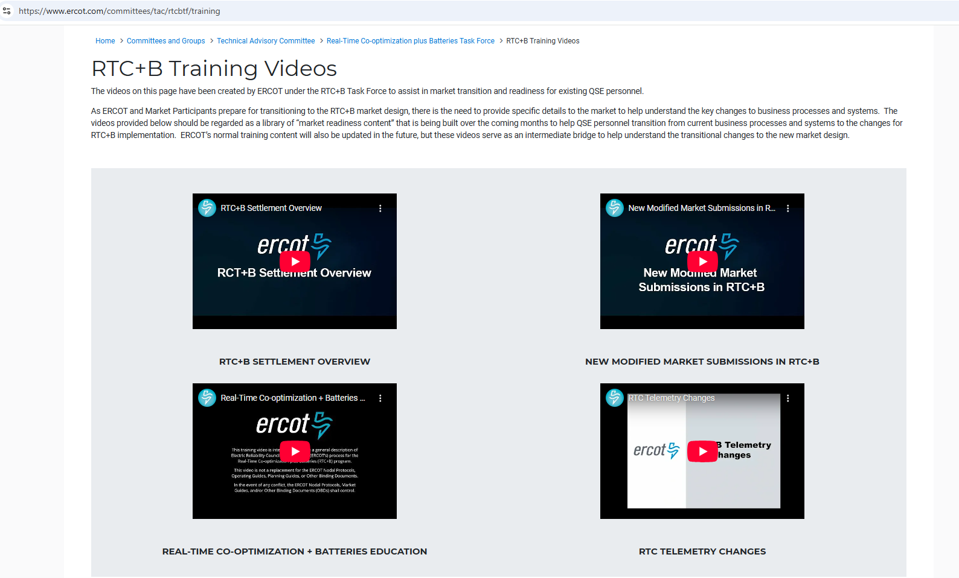
RTC+B Training videos
See RTC Training Webpage

Slide 21
Appendix - Acronyms
Ancillary Services (AS)
Ancillary Service Demand Curve (ASDC)
Controllable Load Resource (CLR)
Current Operating Plan (COP)
Day-Ahead Market (DAM)
ERCOT Contingency Reserve Service (ECRS)
High Sustained Limit (HSL)
Load Frequency Control (LFC)
Load Resource (LR)
Load Serving Entity (LSE)
Locational Marginal Price (LMP)
Low Power Consumption (LPC) = (LSL in EMS)
Low Sustained Limit (LSL)
Max Power Consumption (MPC) = (HSL in EMS)
Market Clearing Price for Capacity (MCPC)
Net Power Consumption (NPC)
Nodal Protocol Revision Request (NPRR)
Non-Spinning Reserve Service (Non-Spin)
Operating Reserve Demand Curve (ORDC)
Qualified Scheduling Entity (QSE)
Real-Time Co-optimization (RTC)
Real-Time Market (RTM)
Regulation Down (Reg-Down)
Regulation Up (Reg-Up)
Resource Limit Calculator (RLC)
Responsive Reserve Service (RRS)
Security-Constrained Economic Dispatch (SCED)
Supplemental Ancillary Service Market (SASM)
System-Wide Offer Cap (SWOC)
Under-Frequency Relay (UFR)
Value of Lost Load (VOLL)

