Slide 1
RTC+B Telemetry Changes
ERCOT Staff
6/14/2024

Slide 2
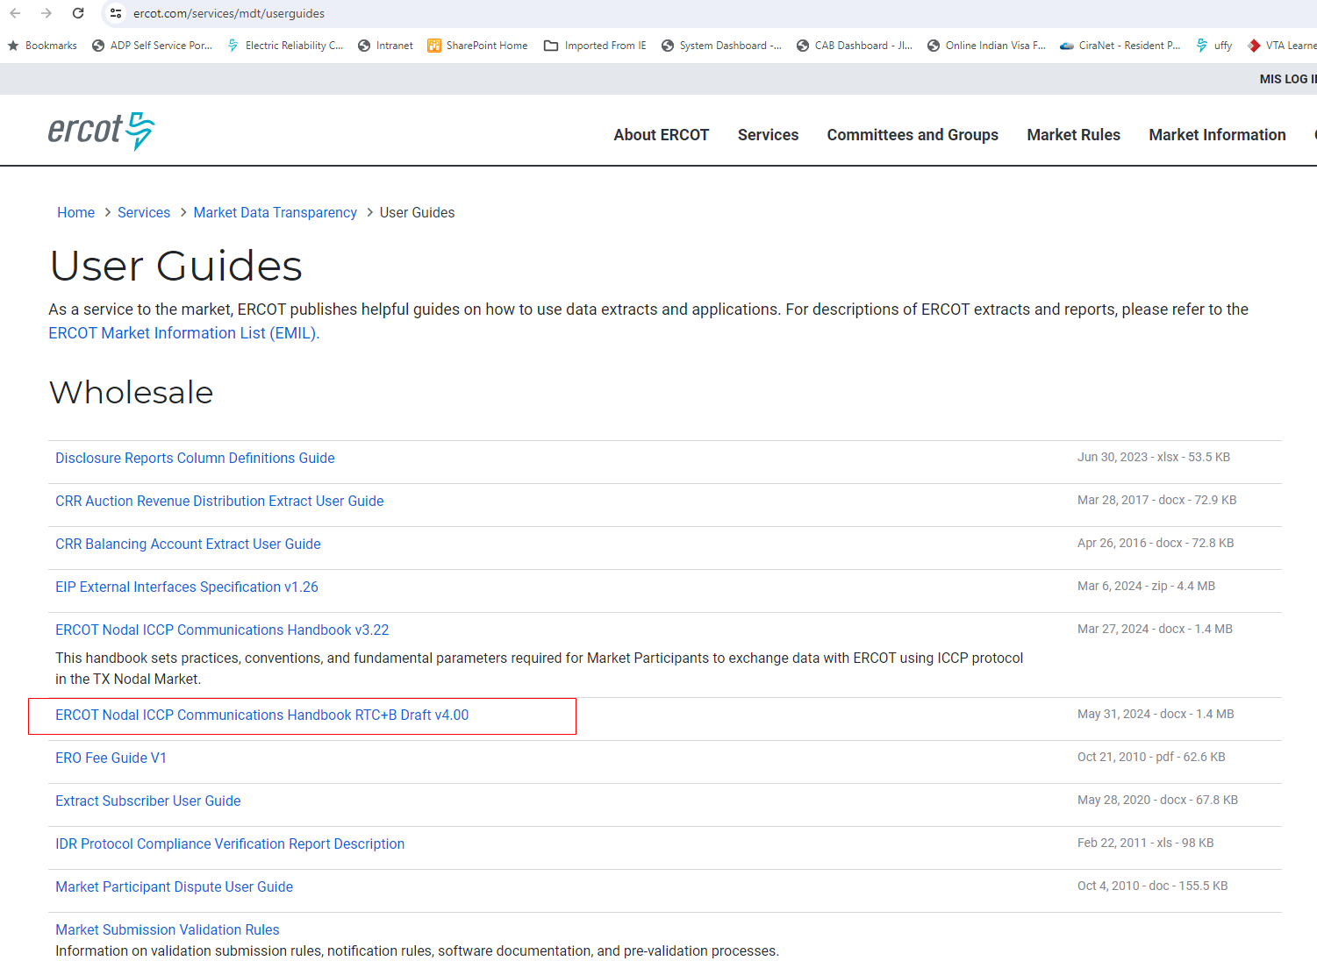
RTC+B ICCP Handbook Updates
ICCP Handbook draft version with RTC+B ICCP Telemetry points modeling was published to ERCOT website (https://www.ercot.com/services/mdt/userguides) on 05/31/2024

Slide 3
High-level overview of Telemetry From/To QSE in RTC (Updated 2/19/2024)
Resource Specific From QSE
Unit Related |  |  | A/S Related
High/Low Sustained Limits (HSL, LSL) | AVR Status (AVR) |  | FRRS Up/Down Participation Factor (FUPF, FDPF)
High/Low Emergency Limit (HEL, LEL) | Dynamically Scheduled Resource Schedule (DSRS)[Gen] |  | FRRS Up/Down Responsibility (FURS, FDRS)
Energy (Normal) Up/Down Ramp Rate (NURR, NDRR) | Lower/Raise Block Status (LBST, RBST) [Gen] |  | Regulation Up/Down Participation Factor (RUPF, RDPF)
Emergency Up/Down Ramp Rates (EURR, EDRR) | PSS Status (PSS) |  | Regulation Up/Down Responsibility (RURS, RDRS)
Net MW/MVAR (MW (aka NPF for CCP), MVAR) | POI kV Measurement/Target (KVM, KVT) |  | Responsive Reserve Responsibility/Schedule (RRRS, RRSC)
Gross MW/MVAR (GMW, GMV) | Scheduled Power Consumption (SPC, SPC2) [CLR] |  | High Set Under Frequency Relay (HSUF) [NCLR]
Resource Status (RST) | Storage Resource Charge/Discharge Data (MXCP, MXDP, MXOD, SOC) |  | Non-Spin Responsibility/Schedule (NSRS, NSSC)
CCP Config No (CCC) | IRR MET Data (DEG, IRAD, MPH, PRES, PTMP, TEMP) |  | Regulation Up/Down Ramp Rate (based on 5-min blended)
Non Frequency Responsive Capacity (NFRC) | IRR Turbine/Panel Availability (NTOF, NTON, NTUN) |  | RRS PFR/FFR/UFR Capability
Load Resource Breaker Status (LRCB) [NCLR] | CCP Frequency Responsive Capacity High/Low Limit, Frequency Responsive Factor |  | Non-Spin Ramp Rate (based on 30-min blended)
Max/Low Power Consumption (MPC, LPC) [CLR, NCLR] | Inactive Power Augmentation Capacity |  | ECRS Ramp Rate (based on 10-min blended)
Resource Breaker Status (Gen’s and ESRs) | SoC, Max Soc, Min SoC, MXDP, MNDP(ESRs) |  | RRS-UFR/RRS-FFR/ECRS Self Provision (based on DAM Award and AS trades) [NCLR]
 | Retain ESR-GR Telemetry for ESR single model |  | ECRS Responsibility, Schedule
 | RRS-FFR deployment
 | ONSC RRS/ECRS deployment
Resource Specific To QSE
Unit Related |  | A/S Related
Base Point (BP) |  | Non-Spin Deployed (NDPL)
Locational Marginal Price (LMP) |  | RRS Deployed (RDPL) [NCLR]
Curtailment (SBBH) |  | Regulation Up Award, Regulation Down Award
SCCT Status (SCCT) |  | Responsive Reserve PFR/FFR/UFR Award
Updated Desired BP (UDBP) |  | ECRS Award, Non-Spin Award
 |  | Regulation Up Deployment, Regulation Down Deployment (Not to be used)
 |  | Updated Desired SP (UDSP:Includes Base Ramp and Regulation Instruction)
 |  | System wide MCPCs for all Ancillary Services
QSE Specific To QSE
A/S Related
Regulation Up/Down MW (REGU, REDG)
FRRS Up/Down MW (FURQ, FDRQ)
Responsive Reserve PFR/ONRR/FFR
ECRS Deployment (Gen, ONECRS)
*Base telemetry list in this table has been created using ERCOT Nodal ICCP Communications Handbook
**RTC related changes that are identified in this list (reflected in red color) are based on KP1.3, 1.4, 1.5.

Slide 4
Resource Ancillary Service Telemetry from QSE
The following new telemetry to be submitted by QSEs to inform ERCOT of the current physical capability of a qualified resources to provide
Ancillary Services. The telemetry points will be used as additional limits on Ancillary service awards below what could be awarded given
the Resource’s other constraints such as HSL, HDL, LDL and LSL.
Product or Sub-product | Unit | Description | References
Regulation Up Ramp Rate | MW/Minute | 5-Minute blended ramp rate that reflects the current physical capability of the qualified resource to provide Regulation Up. In addition to the Resource Limits and Regulation Up qualified MW, limits amount of Regulation Up that SCED can award to the Resource. | 1. RTC Key Principle 1.4 https://www.ercot.com/mktrules/puctDirectives/kp1p4 2. RTCBTF refresher, as presented in RTCBTF on 9/7/2023 https://www.ercot.com/files/docs/2023/09/01/2_refresher-on-real-time-co-optimization-key-principles-rtcbtf-090823_v2.pptx 3. NPRR1010 6.5.5.2 (2) (q) 4. NPRR1010 6.5.5.2 (5) (m)
Regulation Down Ramp Rate | MW/Minute | 5-minute blended ramp rate that reflects the current physical capability of the qualified resource to provide Regulation Down. In addition to the Resource Limits and Regulation Down qualified MW, limits the amount of Regulation Down that SCED can award to the Resource.
ECRS Ramp Rate | MW/Minute | 10-minute blended ramp rate that reflects the current physical capability of the qualified resource to provide ECRS. In addition to Resource limits and ECRS qualified MW, limits the amount of ECRS that SCED can award to the Resource. This value will be the ten-min output change capability of the Resource divided by 10. For NCLRs, the ECRS capability telemetry includes the self-provided MWs.
Non-Spin Ramp Rate | MW/Minute | 30-minute blended ramp rate that reflects the current physical capability of the qualified resource to provide Non-Spin. In addition to Resource limits and Non-Spin Qualified MW, limits the amount of Non-Spin that SCED can award the Resource. This value will be the 30-minute output change capability of the Resource divided by 30.

Slide 5
Resource Ancillary Service Telemetry from QSE
Product or Sub-product | Unit | Description | References
Current Capability to Provide RRS-PFR | MW | Reflects the current capability of the qualified resource to provide RRS from PFR via Governor response. In addition to Resource Limits and qualification, limits the amount of RRS-PFR that SCED can award to the Resource. | 1. RTC Key Principle 1.4 https://www.ercot.com/mktrules/puctDirectives/kp1p4 2. RTCBTF refresher, as presented in RTCBTF on 9/7/2023 https://www.ercot.com/files/docs/2023/09/01/2_refresher-on-real-time-co-optimization-key-principles-rtcbtf-090823_v2.pptx 3. NPRR1010 6.5.5.2 (2) (p) 4. NPRR1010 6.5.5.2 (5) (l)
Current Capability to Provide RRS-FFR | MW | Reflects the current capability of the qualified resource to provide Fast Frequency Response. In addition to the Resource limits and Qualified MW, limits the amount of RRS-FFR that SCED can award to the Resource. For NCLRs, the RRS-FFR capability telemetry includes the self-provided MWs.
Current Capability to Provide RRS-UFR | MW | Reflects the current capability of the qualified resource to provide RRS via UFR. In addition to Resource Limits and Qualified MW, limits the amount of RRS-UFR that SCED can award to the Resource. For NCLRs, the RRS-UFR capability telemetry includes the self-provided MWs.

Slide 6
Resource Ancillary Service Telemetry from QSE
Non-Controllable Load Resources that have UFR relay armed shall submit self-provision MW quantities based on Day-Ahead Market (DAM)
awards, self-arranged and AS trades submitted by end of the adjustment period.
Product or Sub-product | Unit | Description | References
Self-Provided RRS-UFR | MW | Self-provided RRS-UFR for Non-Controllable Load Resources that have UFR relay armed, limited by the DAM Awards, self-arranged and AS trades. | 1. RTC Key Principle 1.3 https://www.ercot.com/mktrules/puctDirectives/kp1p3 2. RTCBTF refresher, as presented in RTCBTF on 9/7/2023 https://www.ercot.com/files/docs/2023/09/01/2_refresher-on-real-time-co-optimization-key-principles-rtcbtf-090823_v2.pptx 3. NPRR1010 6.4.9.1.1 (3) 4. NPRR1010 6.5.5.2 (5) (f)
Self-Provided RRS-FFR | MW | Self-provided RRS-FFR for Non-Controllable Load Resources that have UFR relay armed, limited by the DAM Awards, self-arranged and AS trades.
Self Provided ECRS | MW | Self-provided RRS-UFR for Non-Controllable Load Resources that have UFR relay armed, limited by the DAM Awards, self-arranged and AS trades.

Slide 7
Resources with capacity that is not Frequency Responsive
The following telemetry is for Generation Resources that have Capacity that is not frequency responsive and not eligible for frequency responsive Ancillary Service Awards.
Telemetry | Unit | Description | References
Inactive Power Augmentation Capacity | MW | Power Augmentation capacity that is not On-Line for Resources that have power augmentation capacity included in HSL. This is used in SCED to determine the portion of the Non-Spin award that will be provided by power augmentation capacity that is not active and deployed as offline Non-Spin. | 1. RTC Key Principle 1.3 https://www.ercot.com/mktrules/puctDirectives/kp1p3 2. RTCBTF refresher, as presented in RTCBTF on 9/7/2023 https://www.ercot.com/files/docs/2023/09/01/2_refresher-on-real-time-co-optimization-key-principles-rtcbtf-090823_v2.pptx 3. NPRR1010 6.5.5.2(2) (j)&(o)
High Frequency Responsive Capacity Limit | MW | High limit of the Resource’s capacity that is frequency responsive, used in SCED to ensure frequency responsive Ancillary Service awards are on frequency responsive capacity.
Low Frequency Responsive Capacity Limit | MW | Low limit of the Resource’s capacity that is frequency responsive, used in SCED to ensure frequency responsive Ancillary Service awards are on frequency responsive capacity.
Frequency Responsive Capacity Factor |  | Maximum amount of total Base Point provided by the frequency responsive capacity of the resource, used in SCED to ensure frequency responsive Ancillary Service awards are on frequency responsive capacity.

Slide 8
Resource level telemetry from ERCOT to QSEs
Telemetry | Unit | Description
Regulation Up Award | MW | Regulation Up award from each SCED execution. | 1. RTC Key Principle 1.3 https://www.ercot.com/mktrules/puctDirectives/kp1p3 2. RTC Key Principle 1.5 https://www.ercot.com/mktrules/puctDirectives/kp1p5 3. RTCBTF refresher, as presented in RTCBTF on 9/7/2023 https://www.ercot.com/files/docs/2023/09/01/2_refresher-on-real-time-co-optimization-key-principles-rtcbtf-090823_v2.pptx 4. NPRR1010 6.5.7.4.1 5. NPRR1010 6.5.7.6.2.1 (8) (9) & (10) 6. NPRR1010 6.4.9.1.1
Regulation Down Award | MW | Regulation Down award from each SCED execution.
RRS-PFR Award | MW | RRS-PFR award from each SCED execution.
RRS-FFR Award | MW | RRS-FFR award from each SCED execution.
RRS-UFR Award | MW | RRS-UFR award from each SCED execution.
ECRS Award | MW | ECRS award from each SCED execution.
Non-Spin Award | MW | Non-Spin award from each SCED execution.
UDSP | MW | UDSP = Base Ramp + Regulation Instruction; Base Ramp will be a 4-min ramp to the new Base Point, starting MW of the Base Ramp is expected MW output of the resource using previous Base Point and last Resource specific Regulation Instruction from LFC. Ending MW of the Base Ramp is the new Base Point.
Regulation Up Instruction | MW | The calculated system level Regulation Up requirement will be allocated to each resource proportionate to their Regulation Up awards and Resource limits. This telemetry is information only, Resource level Regulation Up Instruction is included in UDSP.
Regulation Down Instruction | MW | The calculated system level Regulation Down requirement will be allocated to each resource proportionate to their Regulation Down awards and Resource limits. This telemetry is information only, Resource level Regulation Down Instruction is included in UDSP.
ONSC RRS/ECRS Deployment Instructions |  | Resource level RRS and ECRS deployment instructions from ERCOT for the Resources that have RRS or ECRS awards
RRS-FFR Deployment Instruction |  | Resource level RRS and ECRS deployment instructions from ERCOT for the SCED dispatchable Resources that have RRS-FFR awards.

Slide 9
Other telemetry from ERCOT to QSEs
Telemetry | Unit | Description
MCPC for Regulation Up | $/MW | System wide market clearing price for capacity for Regulation Up | 1. RTC Key Principle 1.5 https://www.ercot.com/mktrules/puctDirectives/kp1p5 2. RTCBTF refresher, as presented in RTCBTF on 9/7/2023 https://www.ercot.com/files/docs/2023/09/01/2_refresher-on-real-time-co-optimization-key-principles-rtcbtf-090823_v2.pptx 3. NPRR1010 6.5.7.3
MCPC for Regulation Down | $/MW | System wide market clearing price for capacity for Regulation Down
MCPC for RRS | $/MW | System wide market clearing price for capacity for RRS
MCPC for ECRS | $/MW | System wide market clearing price for capacity for ECRS
MCPC for Non-Spin | $/MW | System wide market clearing price for capacity for Non-Spin

