Slide 1
Real-Time Co-optimization + Batteries Education
David Maggio
Principal, Market Design & Analytics
ERCOT Public
Fall ‘24

Slide 2
Agenda
Why is the Real-Time Co-optimization plus Batteries (RTC+B) project so important?
What does it mean to “co-optimize?”
What components of the market are changing with Real-Time Co-optimization (RTC)?
How is this impacting communications between ERCOT and Market Participants?
What is the “plus Batteries” part of the project?
What is the timeline for testing and implementation of the project?

Slide 3
Why is the RTC+B project so important?

Slide 4
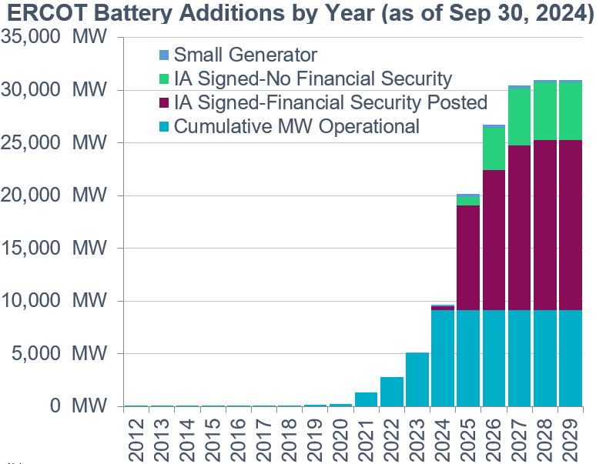
What are the benefits of RTC+B to the market and consumers within the region?
In 2018, the Independent Market Monitor (IMM) for the ERCOT market released a report that included its evaluation of the impacts of RTC. Studying 2017, their findings included reductions in:
Energy costs - $1.6B or approximately $4/MWh
Ancillary Service costs - $155M
Congestion costs -$257M
Effective integration of batteries is vital
ERCOT also released a study showing some additional impacts of RTC to supplement the IMM report
More timely procurement of Ancillary Services
1
RTC
Benefits
More effective congestion management
2
Reduction in manual operations
3
Improved management of Resource-specific capabilities
4

Slide 5
What does it mean to “co-optimize?”

Slide 6
Under RTC, energy and Ancillary Services are “co-optimized,” but what does it mean to co-optimize?
Currently
Gen 1
Gen 2
Ancillary Service Capacity
$/MWh
$/MWh
300
50
20
150
10
80
MW
MW
200
300
400
50
150
250
$20/MWh
$150/MWh
$10/MWh
$10/MWh
The placement of Ancillary Services on Resources across the ERCOT System is assumed.

Slide 7
Under RTC, energy and Ancillary Services are “co-optimized,” but what does it mean to co-optimize?
Under RTC
Gen 1
Gen 2
Ancillary Service Capacity
$/MWh
$/MWh
300
50
20
150
10
80
MW
MW
200
300
400
50
150
250
Ancillary Service offer $10/MWh
Ancillary Service offer $20/MWh
$60/MWh
$10/MWh
By awarding the Ancillary Services to another Resource, overall costs are reduced.

Slide 8
What components of the market are changing with RTC?

Slide 9
Today’s market is designed to reflect scarcity through a process that is outside of the optimization
Currently
Energy Offers
Security- Constrained Economic Dispatch (SCED)
Base Points
Telemetry
Locational Marginal Prices (LMPs)
Constraints
Combined to form Settlement Point Prices
Operating Reserve Demand Curve (ORDC)
Reserve Pricing
Price Adders

Slide 10
The ORDC sets the value of ERCOT System reserves
ORDC Price Adders determined based on level of reserves

Slide 11
RTC is also designed to reflect scarcity, but now it occurs within the optimization
Under RTC
Energy & Ancillary Service Offers
SCED
Base Points
Form Settlement Point Prices
Telemetry
LMPs
Constraints
Ancillary Service Awards
Ancillary Service Demand Curves (ASDCs)
Ancillary Service Prices

Slide 12
Unlike today’s market, the cost of Ancillary Services is factored directly into LMPs
Today, the need for an additional MWh of energy results in the price of energy (i.e., the LMP) going from $30/MWh to $50/MWh
The next MW would come from Gen 2
Ancillary Service Offer
= $10/MWh
Ancillary
Service Capacity
Ancillary Service Offer = $20/MWh
Energy Offer = $30/MWh
Energy Offer = $50/MWh
Gen 1
Gen 2

Slide 13
Unlike today’s market, the cost of Ancillary Services is factored directly into LMPs
Example: With RTC, Ancillary Services can be reallocated to access cheaper energy from Gen 1. However, this has the effect of increasing Ancillary Services cost.
This means the LMP goes to $40/MWh ($30/MWh for the energy from Gen 1 plus the $10/MWh of additional Ancillary Service cost)
Ancillary Service Price: $10/MWh → $20/MWh
Ancillary Service Offer
= $10/MWh
Ancillary
Service
Capacity
Ancillary
Service
Capacity
Ancillary Service Offer = $20/MWh
Energy Offer = $30/MWh
Energy Offer = $50/MWh
Gen 1
Gen 2

Slide 14
Instead of using the ORDC, under RTC, scarcity pricing and the value of reserves is set by individual ASDCs
Sufficient remaining capacity and offers
Insufficient remaining capacity or offers
Value of the Ancillary Services

Slide 15
ASDCs will be based on the shape and pricing outcomes of the current ORDC mechanism

Slide 16
Having individual ASDCs allows RTC to better distinguish and prioritize between various Ancillary Service products
The prioritization is set by the AS Demand Curve price
Non-Spinning and ERCOT Contingency Reserve Service (Non-Spin and ECRS) will be exhausted before Regulation Up and Responsive Reserve Service (REGUP and RRS) are exhausted.

Slide 17
While the primary focus is the Real-Time Market, changes to other parts of the wholesale market are also part of RTC
DAM
RUC
RUC
SASM
Hour-Ahead
Operating Hour
Reporting
Performance Monitoring
Settlement
Day-Ahead Operations
Adjustment Period
Operating Period
Post Real-Time

Slide 18
Reliability Unit Commitment (RUC), like Real-Time, currently takes Ancillary Service assignment to individual Resources as a known input
Ancillary
Service Capacity
Ancillary Service capacity is assigned to Resources by Market Participants to fulfill Ancillary Service Supply Responsibilities
Available for Energy Dispatch
RUC attempts to meet forecasted demand and solve transmission congestion with remaining capacity, not reserved for AS
System Capacity
Currently

Slide 19
To better reflect and plan for Real-Time grid conditions with RTC, RUC will also be modified to co-optimize energy and Ancillary Services
Available for Energy Dispatch
or
Ancillary
Services
RUC attempts to meet forecasted demand, solve transmission congestion, and meet system Ancillary Service needs using the full capability of Resources planned to be available
System Capacity
Under RTC

Slide 20
The current Day-Ahead Market (DAM) fundamentally stays the same with the implementation of RTC
Energy Offers & Bids
DAM
Energy Awards
Point-to-Point (PTP) Obligation Bids
PTP Obligation Awards
Ancillary Service Offers*
Ancillary Service Awards
ASDCs
* With RTC, “virtual” Ancillary Service Offers will be allowed.

Slide 21
The current Supplemental Ancillary Services Market (SASM) process will be eliminated with the implementation of RTC
SASM allows ERCOT to fill Ancillary Service gaps that appear after completion of the DAM
Failure to provide
Infeasible Ancillary Service capacity
More Ancillary Service capacity needed
Insufficient Ancillary Service offers in the DAM
SASM
Ancillary Service
Awards
Under RTC, a co-optimized RUC and the Real-Time Market fulfill this role.

Slide 22
How is this impacting communications between ERCOT and Market Participants?

Slide 23
With RTC, there will be several changes in the data flow between ERCOT and Qualified Scheduling Entities (QSEs)
Currently
Under RTC
Ancillary Service Resource Responsibilities
Ancillary Service Resource Capabilities & Real-Time Ancillary Service Awards
Ancillary Service-Specific Resource Statuses
More General Resource Statuses
Regulation Service Participation Factors/QSE-Level Deployments
Resource-Specific Regulation Deployments
Updated Desired Base Points
Updated Desired Set Points
ORDC Price Adders
Real-Time Ancillary Service Prices

Slide 24
There will also be changes to many reports, extracts, and dashboards
Examples:
New
Ancillary Service Disclosure reports for Real-Time
Real-Time Ancillary Service prices
ASDCs
Going Away
SASM reports
ORDC reports
Ancillary Service Supply Responsibility reports and notifications
Modified
Other Disclosure reports
Performance Monitoring reports
Market submission validation rules
Short-term system adequacy reports
Ancillary Service capacity monitor

Slide 25
What is the “plus Batteries” part of the project?

Slide 26
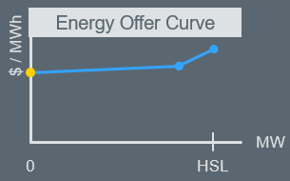
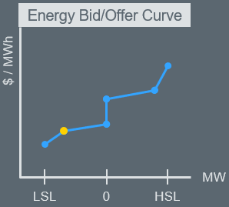
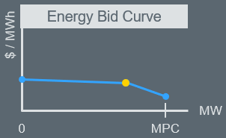
Energy Storage Resources (ESRs) will now be fully seen as a single device within ERCOT’s systems
Currently
Future
High Sustained
Limit (HSL)
Ancillary Services
HSL
Ancillary Services
Discharge
Generation Resource
Ancillary Services
Discharge
Ancillary Services
0
0
Controllable Load Resource
Charge
No extra coordination needed
Reduced administration for ERCOT and QSEs
Real-time market and RUC systems will change to capture capabilities and characteristics of ESRs.
Charge
Ancillary Services
Ancillary Services
Max Power Consumption (MPC)
Low Sustained Limit (LSL)
2 Current Operating Plans
2 sets of telemetry
Submission dependencies
2 Resources

Slide 27
What is the timeline for testing and implementation of the project?

Slide 28
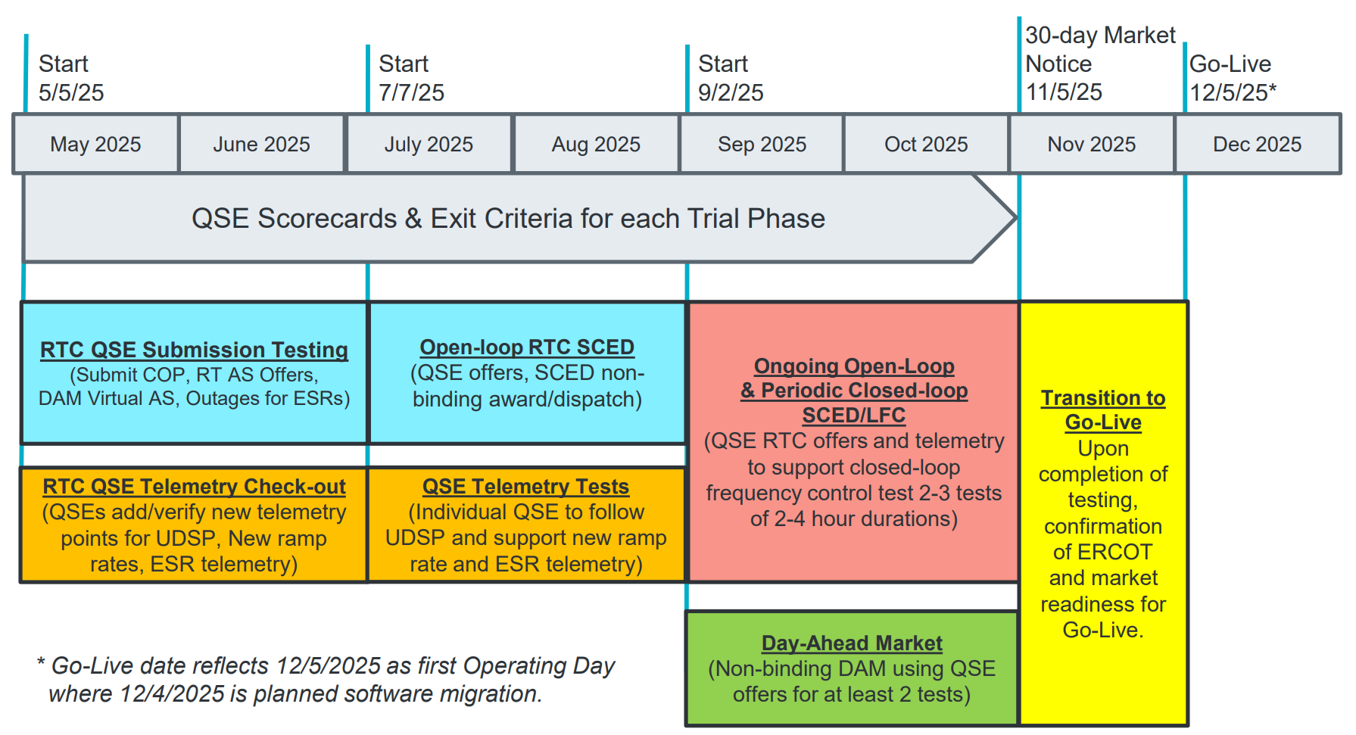
There are several testing activities planned for ERCOT and QSEs prior to implementation of the project

Slide 29
Thank You!

