Slide 1
Review of 2026 AS Methodology Probabilistic Quantities and Sensitivities
ERCOT Staff
ERCOT Operations Analysis
Probabilistic Workshop # 2
June 30, 2025

Slide 2
Background and Introduction
Purpose of today’s workshop is to review the probabilistic framework ERCOT is considering to use to compute ERCOT Contingency Reserve Service (ECRS) and Non-Spinning Reserve Service (Non-Spin) requirements in 2026. ERCOT originally shared an introduction to the framework at the 2026 AS Workshop #1 in May. Additionally, we will cover Regulation, RRS, and ECRS frequency recovery preliminary quantities previously shared with PDCWG.
Agenda for Today
  Recap/Overview from Workshop #1
    PUC’s AS Study and their findings as they apply to AS Methodology
    Probabilistic Framework and additional details on concepts
  Review of preliminary quantities using the probabilistic method and sensitivities
    Inputs, data conditioning, Criteria to determine reserves, the optimization engine and reserve determination approach.
  Review Regulation, RRS, and ECRS frequency recovery preliminary quantities which are calculated using similar 2025 AS Methodology.
  Summary and What to expect at the next round of meetings.
ERCOT requests stakeholders to provide feedback on these topics.

Slide 3
PUC’s Ancillary Service Study: Summary
The Public Utility Commission of Texas (PUCT) initiated the Ancillary Services Study (Study) to meet the requirements of PURA § 35.004(g) (enacted in Senate Bill 3 (87 R.S.)).
The PUCT collaborated with ERCOT and the Independent Market Monitor (IMM) on this effort.
ERCOT was asked to review the existing Ancillary Service products, including an analysis of the purpose for each of the products and a more thorough review of the methodologies used to determine Ancillary Service quantities. ERCOT was also asked to evaluate if any additional Ancillary Service products are needed.
ERCOT produced a white paper that responds to those requests
PUCT used inputs from stakeholders, ERCOT, IMM and PUC Commissioners. PUC filed its findings and final report on January 14, 2025.
The PUCT has also included it in their biennial agency report to the Texas State Legislature in January 2025.
PUC’s Findings are summarized in slides # to #

Slide 4
PUC’s Findings Related To AS Methodology
Topic | Finding | Next Steps
PROVIDING ADEQUATE INCENTIVES FOR DISPATCHABLE GENERATION | The reliability standard rule (16 TAC § 25.508) has defined a process for assessing and ensuring resource adequacy. | The first holistic reliability standard assessment in 2026 will include an assessment of whether incentives are adequate to support a sustainable level of dispatchable generation, and ERCOT should incorporate the impact of new market features such as Texas Energy Fund, DRRS, and real-time co-optimization plus batteries (RTC+B) into this assessment.
APPROPRIATE CRITERION FOR AS PROCUREMENT QUANTITIES | ERCOT's current posture of maintaining AS quantities that minimize the chance of Entering the pre-emergency operational condition of an Operational Watch should be maintained in order to balance system improvements made since Winter Storm Uri until additional data is available to support further Commission evaluation of this operating posture. | ERCOT should develop the capability to provide current estimates of costs and probabilities of experiencing a Watch, Emergency Alert, and Load Shed for several potential alternative target reserve levels as soon as practicable and no later than to support the Commission setting an objective, data-based procurement criteria for the 2027 AS Methodology.
PROBABALISTIC MODELING TO DETERMINE AS QUANTITIES | ERCOT's current practice to determine AS quantities relies on a statistical analysis using historical operating conditions and outcomes. This methodology is no longer sufficient as myriad changes to the wholesale markets and operating conditions continue to impact reasonable forecasting needs. Changes such as incorporation of an unknown amount of TEF-supported capacity, how new large loads are integrated into grid operations, or the impact of new market designs present uncertainty for forecasting tools based exclusively on historical data. | ERCOT should develop a suitable probabilistic, forward-looking modeling capability, provide regular updates to TAC, and present options that can be incorporated no later than the 2027 AS Methodology.
DYNAMIC DETERMINATION OF AS QUANTITIES | Tradeoffs exist between the certainty provided to market participants by calculating AS quantities primarily on an annual basis (as is done currently) and the efficiency of calculating some portion of AS quantities closer to the operating day. | ERCOT should work with stakeholders to explore a dynamic AS methodology that best Balances these trade-offs.

Slide 5
Recap: Full Statistical Analysis OPEN Questions
How should the available headroom/capacity that is not providing AS be accounted in this analysis? | For example, weather forecast errors typically cause corresponding errors in load, wind, and solar forecasts, but are generator trips correlated to forecast errors, also? Further, should historic headroom capacity be accounted for in this analysis? If so, is the historic headroom capacity of the online generation fleet correlated to other factors?
How should increases in variability and uncertainty due to wind, solar, and load growth, as well as future changes in generator commitment patterns be accounted for in the methodology? | Historically, as the Intermittent Renewable Resource (IRR) fleet’s installed capacity has increased, both variability and uncertainty in net load have increased, and relying on historic error alone may not sufficient.
What event/criteria should each AS be setup to cover? | Is the criteria simply a matter of avoiding loss of load? Or should there be criteria related to avoid entering into an Energy Emergency Alert (EEA) or a Watch due to insufficient reserves? How should avoiding the need for manual operator actions be included in the criteria?
How should temporal constraints and cumulative factors be accounted? | The possibility of multiple generator trips across multiple hours (as occurred on May 13, 2022, for example) presents a risk that needs to be covered by AS. (Cumulative forced outages) AS is needed until other generators can be started or until the conditions causing the need for the reserves from AS change. How should this be considered in the analysis? (Event duration/temporal constraints) Increasingly, AS is being provided by duration-limited resources (battery energy storage). There is some risk that battery energy storage resources providing AS deplete their storage capacity during a multi-hour forecast error event, even if they are meeting all applicable requirements. Should not being able to charge be accounted as a risk in this analysis? (lack of energy considerations)
How much can other types of AS reserves be counted on to address risks for a given AS product? | For example, should some or all of ECRS be counted towards meeting the reserve needs covered by Non-Spin?
Key Takeaway: ERCOT is generally supportive of doing a “full statistical” probabilistic analysis to determine AS quantities. Several key questions that have to be carefully considered to setup the appropriate model for this analysis. Responses to these questions directly impact the volume of reserves procured and operational actions needed to continue operations. As an example, setting reserves too low could result in lower self commitment and tools like Unit Commitment may be necessary to cover the overall expected operational risk on such days. For proper balance Stakeholder and potentially policymaker input on these is essential.

Slide 6
Probabilistic Framework Overview (Recap)

Slide 7
Flow Diagram

Slide 8
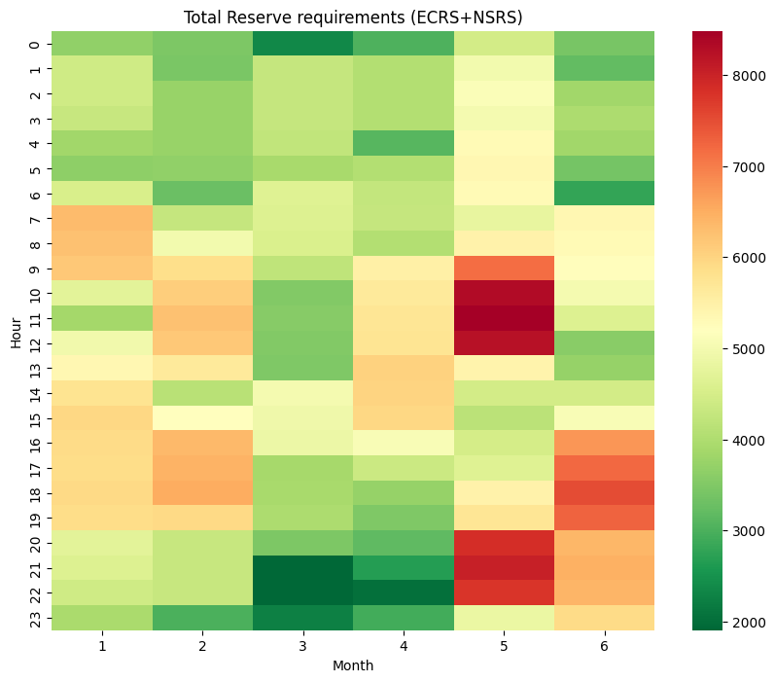
Optimization Workflow
Iterative process - Least Reserves for Target Reliability
If Current Reliability meets Target
Reserve Requirements
Analyze violations and Reliability Check
  Using the current reserve values, the process identifies the hours with the highest number of violations.
  If these reserve levels fail to meet the criteria, the process proceeds to the reserve adjustment phase.
  To initiate the optimization process, set initial reserve values which are allocated to cover the identified net risk
If Current Reliability does not meet Target Reliability
  If reliability falls short of the criteria, reserves are proportionally increased during the hours with the highest violation rates.
  If reliability exceeds the criteria, the required reserve values are proportionally reduced.
Initial Reserve
Get New Violations and do Another round of reliability Check with adjusted reserves
Reserve Adjustment

Slide 9
Monte Carlo Resampling
  Monte Carlo Resampling is a statistical technique for estimating distribution of a statistic (e.g. mean)
  It resamples from original data with replacement and statistic is calculated using the resample
  Distribution of the statistic is formed by the calculated statistics from the resamples
  forms distribution of avg

Slide 10
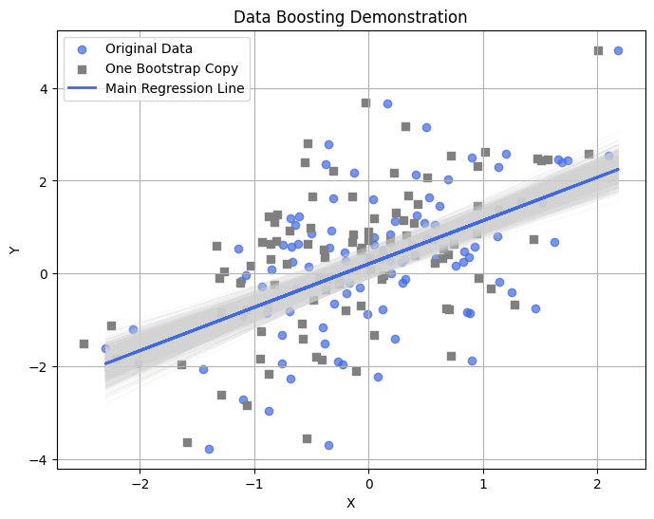
Monte Carlo Resampling (cont'd...)
another example
  A single dataset (scatter) with a best-fit regression line (in blue).
  Each gray line is a regression line created from a resampled data
  The spread of the gray lines illustrates how the best fit line can vary
  The grey points represent a copy of the simulated points, showing a similar spread to the original data (blue points). All such copies (not shown) collectively form a boosted sample of the original dataset.

Slide 11
Monte Carlo Resampling for Data Boosting
  The resamples (before calculating the stats) can be used to “boost” the parent sample
  However, it will not eliminate the choppiness and repetitive problem as same data points will show up in the boosted distribution
  To handle this, the original algorithm was slightly modified
    For the parent sample, z-scores were calculated using mean and standard deviation
    From each resample, mean and standard deviation (std) were calculated
    Using z-scores from the parent sample and mean and std from resample, new data points were synthesized
  The technique was tested for different kinds of distributions

Slide 12
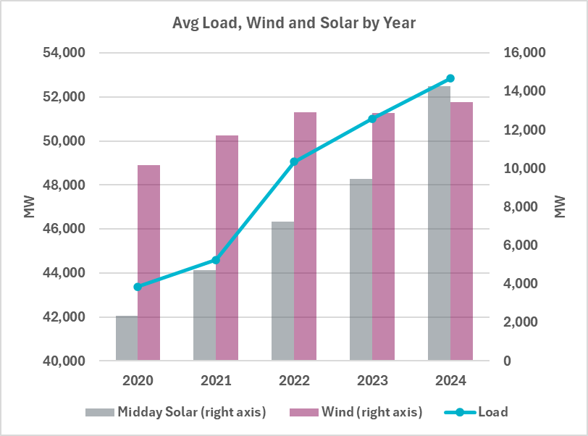
Impact of Load and Renewable Growth on Forecast Error Trends
Installed capacity for solar and wind is increasing over time.
Electric load is also growing consistently.
Intuition: As the base value (capacity or load) increases, so might the forecast error
Key Question:
Does the growth in load or renewables affect the magnitude of forecast errors?

Slide 13
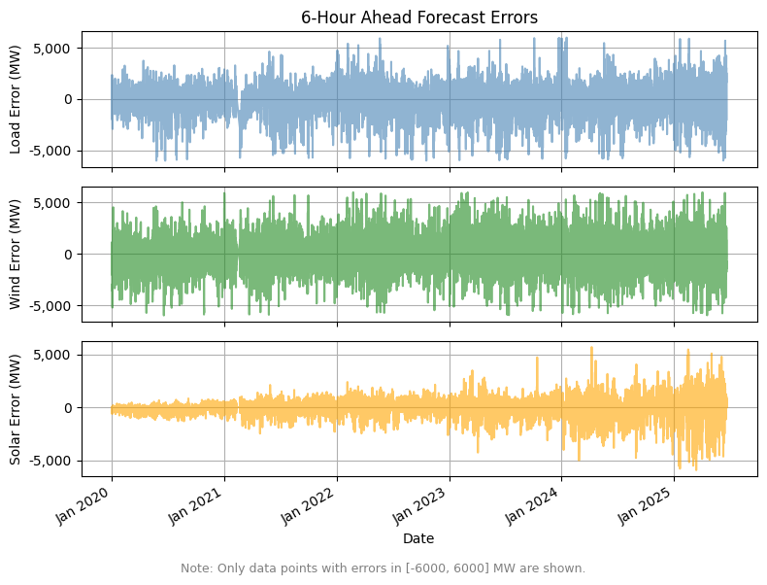
Impact of Load and Renewable Growth on Forecast Error Trends (cont’d)
Errors for Load and Wind remain relatively stable in both magnitude and spread over time.
Solar forecast errors display a noticeable increase in variability throughout the period.

Slide 14
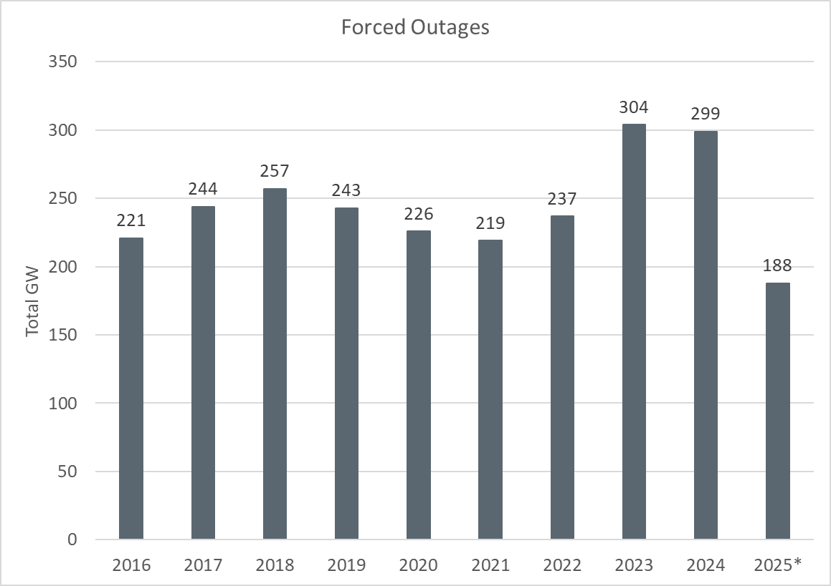
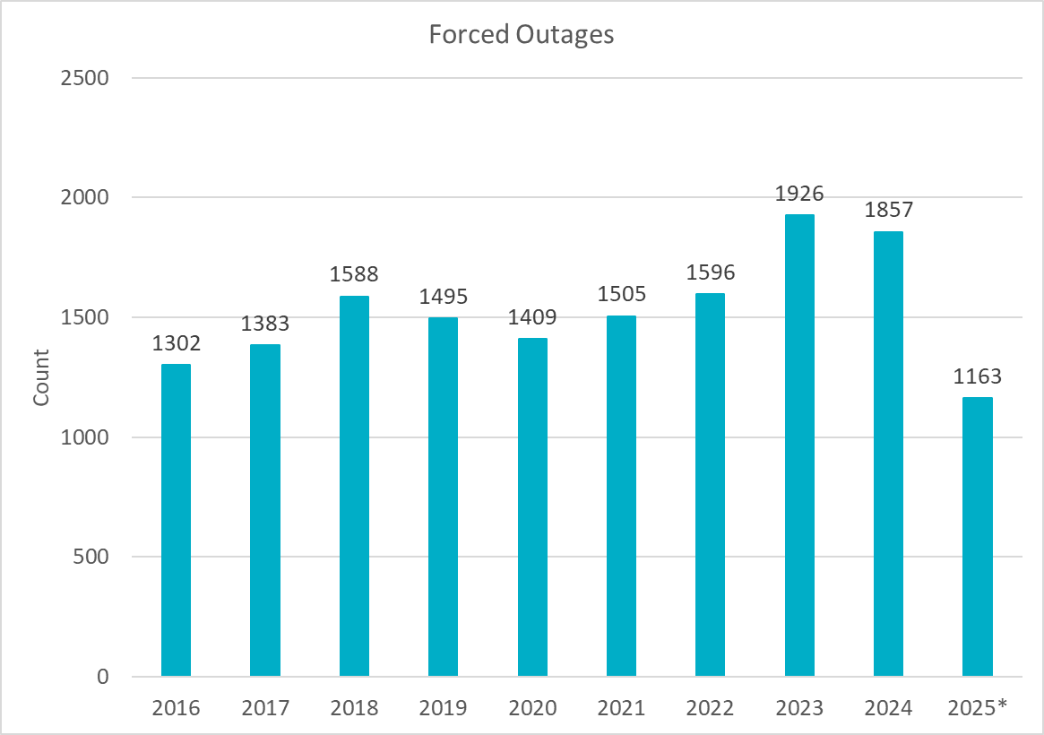
Outage Analysis
Review of outages from 2016 – 2025 doesn’t show a significant change in outages. 2023 and 2024 did show a small increase, but we need more data to ensure an increase trend will continue. This analysis will be reviewed again in the future methodologies.

Slide 15
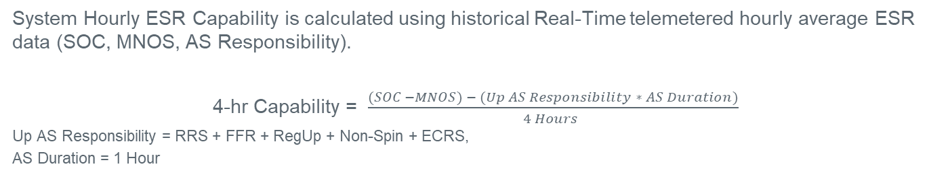
ESR Energy Capability (New)
System Hourly ESR Capability is calculated using historical Real-Time telemetered hourly average ESR data (SOC, MNOS, AS Responsibility).
4-hr Capability = $\frac{(SOC −MNOS) − (Up AS Responsibility ∗ AS Duration)}{4 Hours }$
Up AS Responsibility = RRS + FFR + RegUp + Non-Spin + ECRS,
AS Duration = 1 Hour

Slide 16
Probabilistic Quantities and Sensitivities for ECRS and NSRS

Slide 17
Upon completion of the iterative optimization process, the Total Reserves (ECRS + NSRS) are determined for each Month-Hour Combination
Iterative process - Least Reserves for Target Reliability
If Current Reliability meets Target
Reserve Requirements
Analyze violations and Reliability Check
  Using the current reserve values, the process identifies the hours with the highest number of violations.
  If these reserve levels fail to meet the criteria, the process proceeds to the reserve adjustment phase.
  To initiate the optimization process, set initial reserve values which are allocated to cover the identified net risk
If Current Reliability does not meet Target Reliability
  If reliability falls short of the criteria, reserves are proportionally increased during the hours with the highest violation rates.
  If reliability exceeds the criteria, the required reserve values are proportionally reduced.
Initial Reserve
Get New Violations and do Another round of reliability Check with adjusted reserves
Reserve Adjustment

Slide 18
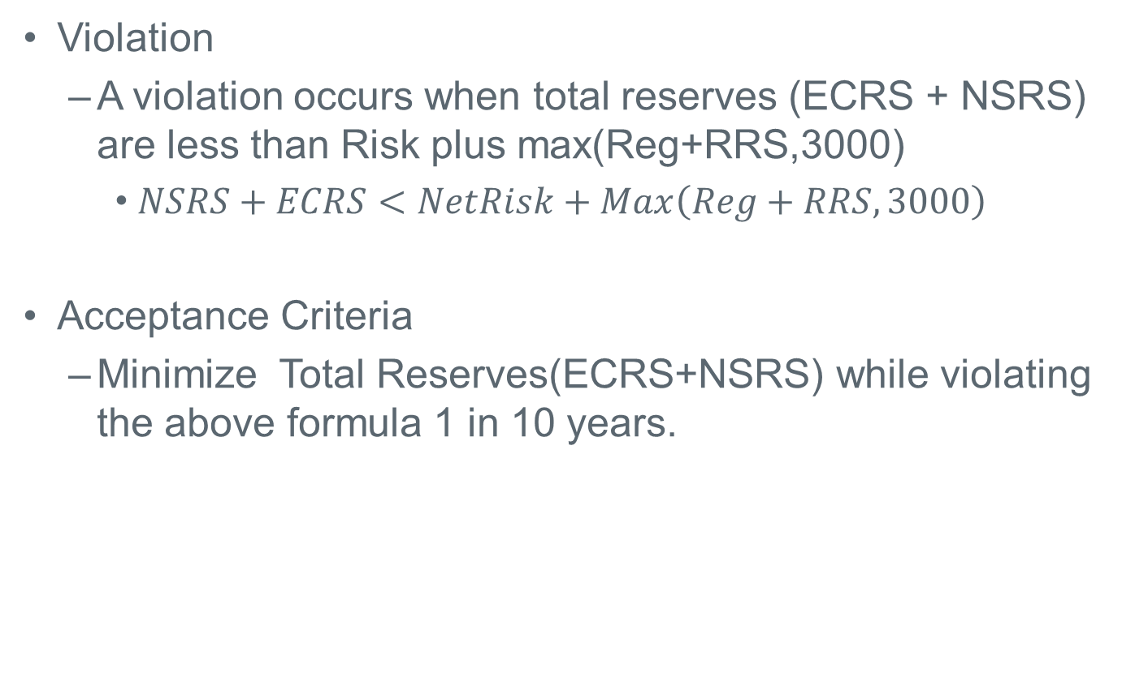
Violation and Acceptance Criteria
Violation
  A violation occurs when total reserves (ECRS + NSRS) are less than Risk plus max(Reg+RRS,3000)
    $NSRS+ECRS<NetRisk+Max\left(Reg+RRS,3000\right)$
Acceptance Criteria
  Minimize Total Reserves(ECRS+NSRS) while violating the above formula 1 in 10 years.

Slide 19
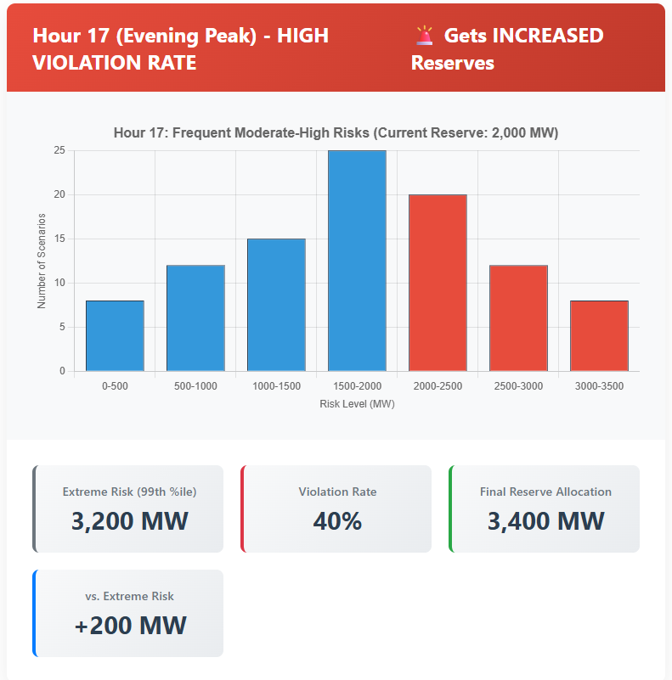
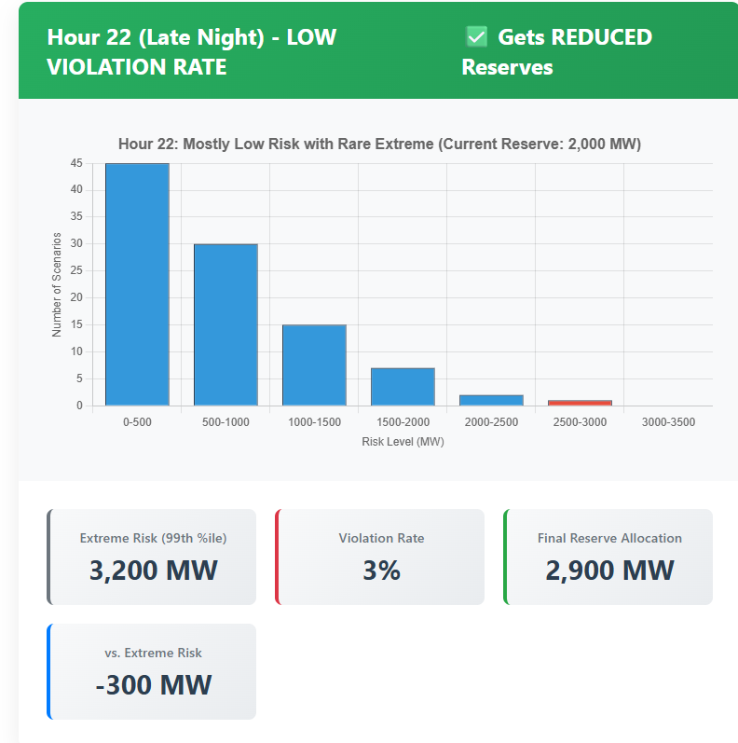
Simplified Optimization Example – Identical Maximum Risk Across Two Hours
Both hours have identical worst-case scenarios
Hour 17 Risk level frequently exceeds reserves;
Hour 22 rarely does
Reserves get increased for Hour 17 while Hour 22 Reserve either stays the same or gets decreased
Not a real example

Slide 20
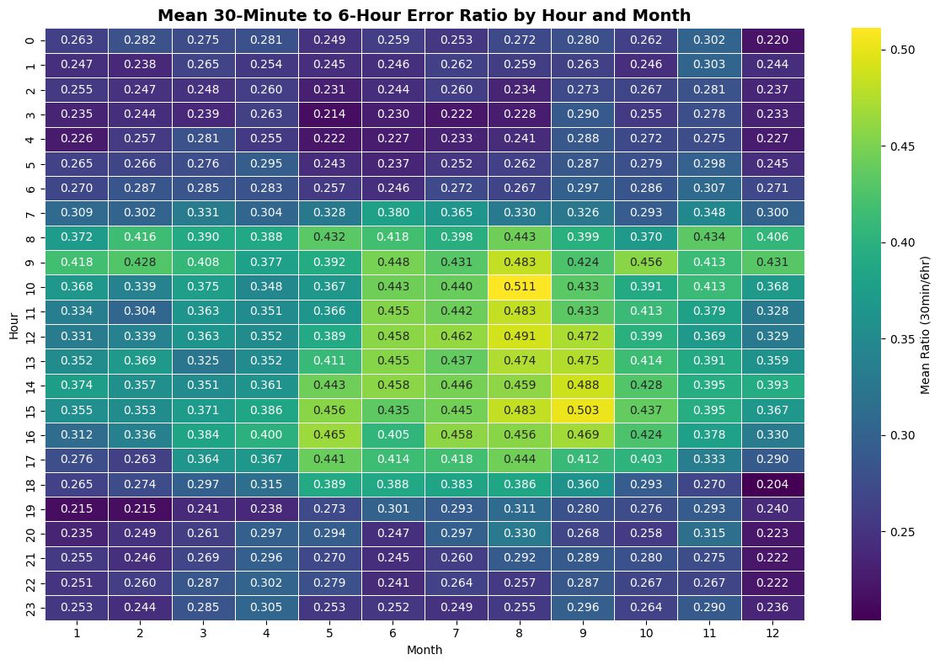
Allocating the Individual ECRS and NSRS quantities from Total Reserves
Each hour has 12 five-minute 30-min ahead errors and one 6-hour ahead error
For each 30-min under-forecast error, calculate the ratio to the 6-hour ahead error for that same hour
Group results by Month-Hour to compute average ratio for each Month-Hour
Set Initial ECRS = Frequency Recovery Requirement
Allocate Secondary ECRS:
  Secondary ECRS = Total Reserves × (ECRS %)
If Total Reserves < Minimum ECRS:
  ECRS = Minimum ECRS (Frequency Portion)
  NSRS = Total Reserves
  This Scenario only happens in only extreme cases – Excess Risk Credits
Else:
  ECRS = max(Initial ECRS, Secondary ECRS)
  NSRS = Total – ECRS

Slide 21
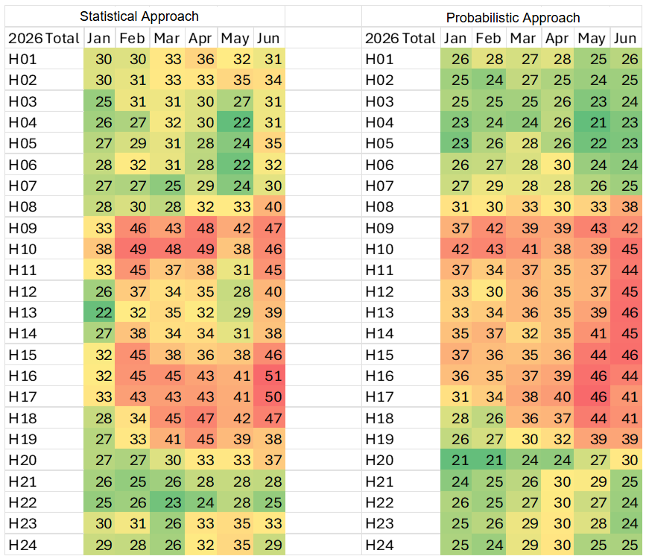
ECRS Share of (ECRS+NSRS): Comparison to 2025 Method for 2026

Slide 22
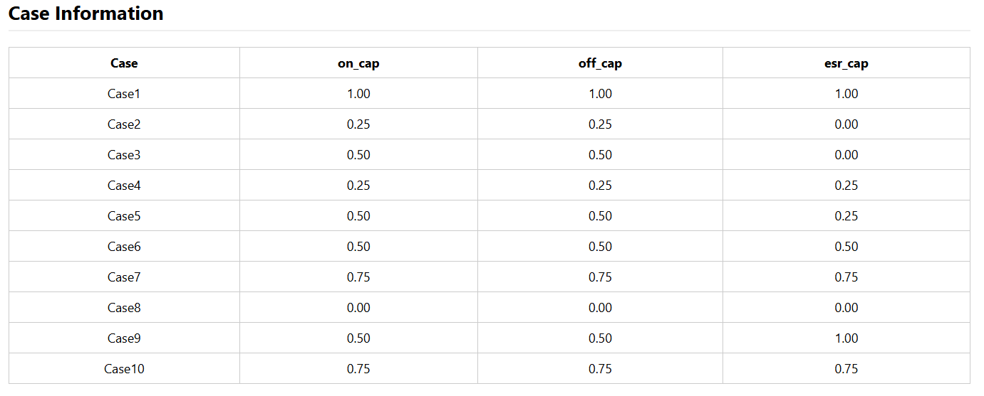
Sensitivity Study – Risk Credits
Multiple cases were run with different combinations of Online, Offline, and ESR Capacity.
Case 1: Considers all available capacity as risk credits..
Case 8: Optimization does not take risk credits into account and procures reserve quantities to account for forecast error and forced outages

Slide 23
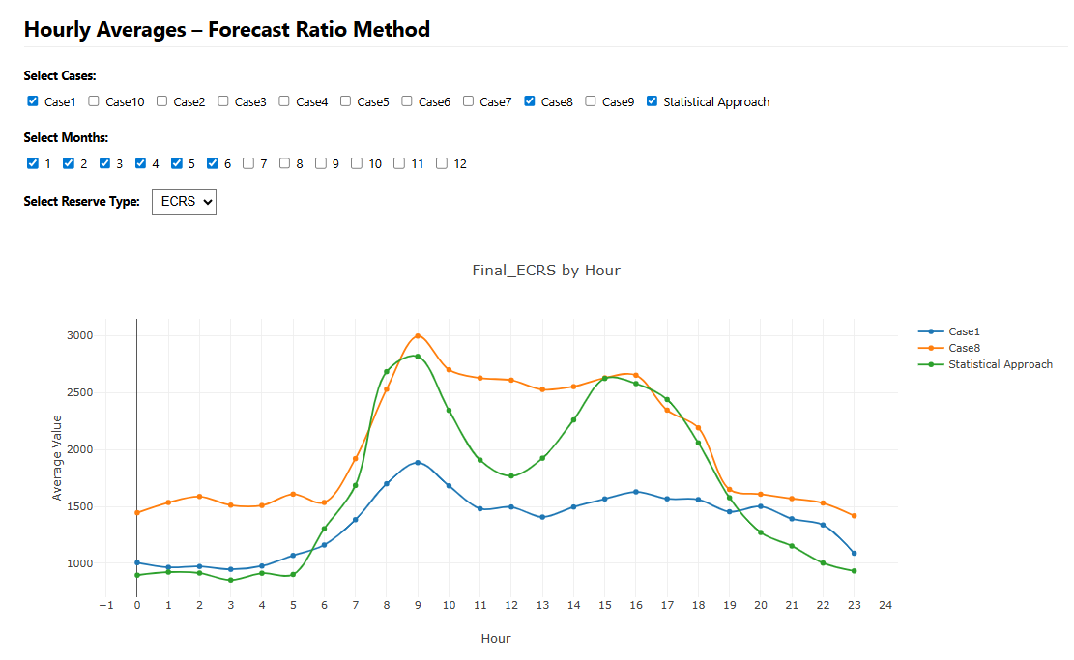
ECRS – Case 1 vs Case 8 vs Statistical Approach
Row Labels | Min of Final_ECRS | Max of Final_ECRS | Average of Final_ECRS
Case1 | 727 | 2524 | 1363
Case8 | 988 | 3907 | 2032
Statistical | 698 | 3475 | 1655
Grand Total | 698 | 3907 | 1683
Preliminary Values

Slide 24
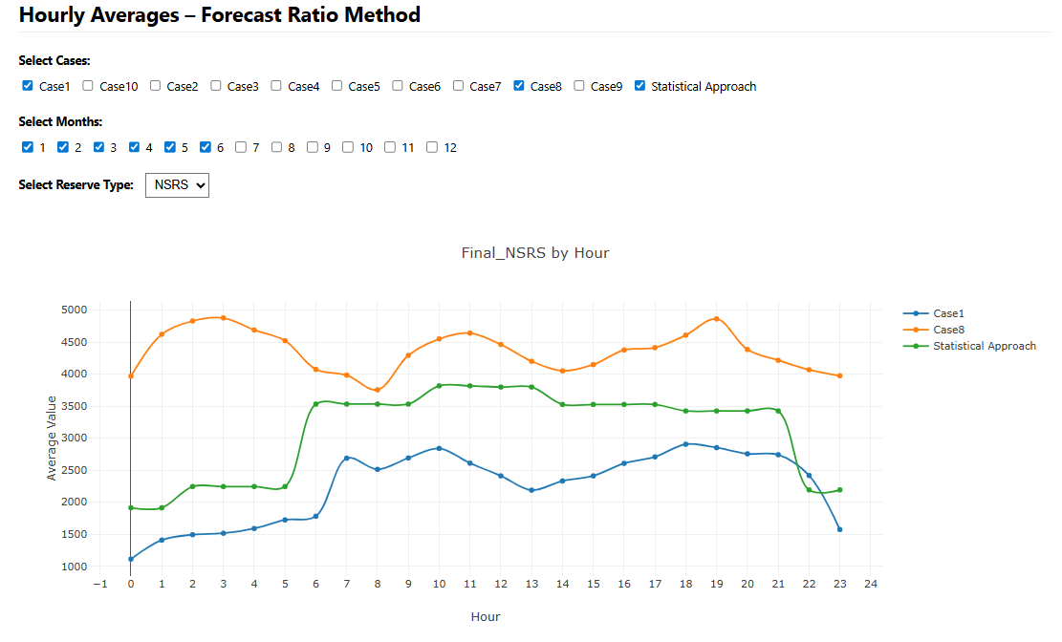
NSRS – Case 1 vs Case 8 vs Statistical Approach
Row Labels | Min of Final_NSRS | Max of Final_NSRS3 | Average of Final_NSRS2
Case1 | 364 | 5057 | 2245
Case8 | 1891 | 6696 | 4357
Statistical | 1714 | 5117 | 3098
Grand Total | 364 | 6696 | 3234
Preliminary Values

Slide 25
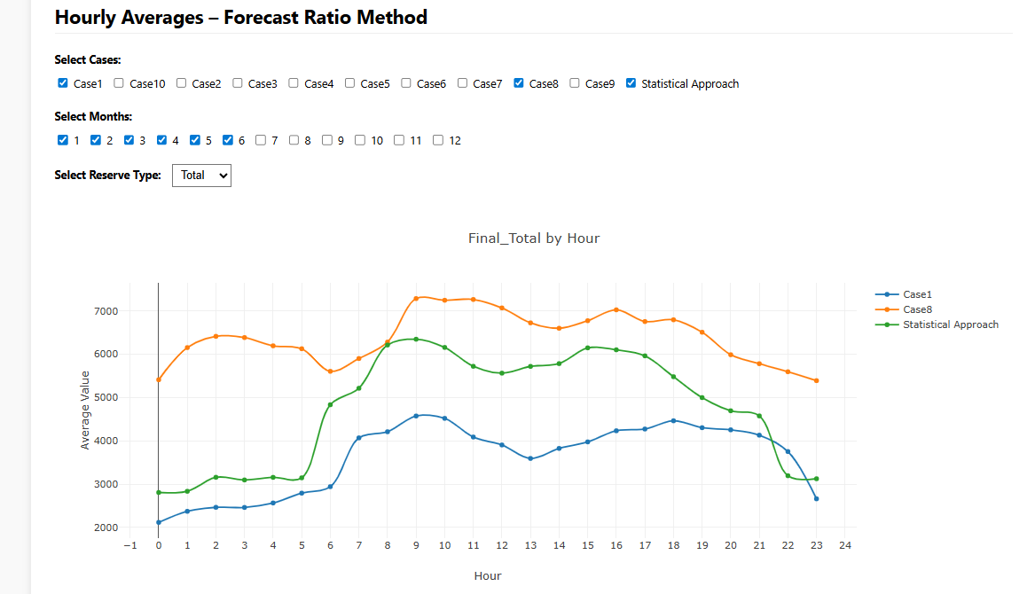
ECRS+ NSRS – Case 1 vs Case 8 vs Statistical Approach
Preliminary Values

Slide 26
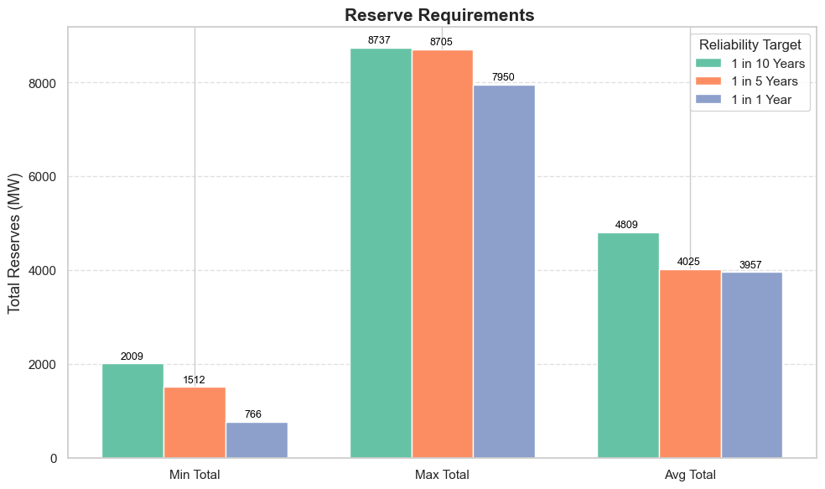
Acceptance Criteria Sensitivities
We ran Case 9 with three different Acceptance Criteria.
Preliminary Values

Slide 27
Discussion

Slide 28
Review of Regulation and RRS

Slide 29
Regulation and RRS Methodologies
This presentation will discuss the approaches ERCOT is considering to determine Ancillary Service (A/S) quantities for 2026.
  ERCOT is considering one change in the methodology used to compute the Regulation Service for 2026.
  NERC’s preliminary BAL-003 Interconnection Frequency Response Obligation (IFRO) assessment for ERCOT for the 2026 Operating Year (OY) has not yet been published. Therefore, this analysis used the minimum RRS-PFR limit of 1,365 MW for 2025.
The Ancillary Service (A/S) quantities for 2026 contained in this presentation are based on the methodology that was approved in December 2024. The quantities for 2026 reflect moving forward the historic data on which these are based, unless otherwise noted.

Slide 30
Regulation Service

Slide 31
Regulation Service Methodology
Methodology
  ERCOT is considering some change in the methodology used to compute the minimum Regulation Service requirements in 2026.
  The preliminary Regulation quantities for January 2026 through April 2026 in subsequent slides have been computed using current methodology (2023 and 2025 five-minute net load variability), updated Wind Adjustment tables and the updated Solar Adjustment tables.
Considerations
  ERCOT will be removing the FRRS Component of the methodology as this product will be retired with the Implementation of Real Time Co-Optimization plus Batteries (RTCB)
  ERCOT is also conducting analysis for Large Loads to determine if any other adjustment should be considered for regulation impacts.

Slide 32
Regulation Up/Down Methodology 2026
 | 2024 Methodology | 2025 Methodology
Data Input | 5-min SCED Netload Forecast Error (2- yr) | No Change
Calculation Method | 95th of 5-min SCED Netload Forecast Error | No Change
Wind/Solar Adjustment | GE Table - Increased wind/solar forecast error per 1,000 MW installed capacity increase | No Change
FRRS Component | 95th of historical FRRS Deployment (2-yr) | Remove
ACE Integral Component | Average of ACE Integral Change (2-yr) | No Change
Load Adjustment (LFL Ramps) | No Adjustment | No Change

Slide 33
Generation To Be Dispatched (GTBD)
ERCOT has incorporated intra-hour wind/solar forecast- based ramp into GTBD to give SCED an indication of how renewables may ramp.
  Predicted Wind Ramp Rate (PWRR) was incorporated in GTBD in Dec.2018
  Predicted Solar Ramp Rate (PSRR) was incorporated in GTBD in Jun.2021
In absence of PSRR/PWRR, SCED dispatches uncurtailed solar/wind units to their max output (HSL).
  This means that SCED assumes output of uncurtailed solar/wind units will persist for the next 5-min at the unit’s HSL that was telemetered at the start of the interval.
GTBD = Total Gen
+K3*5*PLDRR
+K4*Regulation Deployed
+ K5*ACE Integral
– K6*5*PWRR
+ K7*5*DCTRR
– K8*5*PSRR
5-min Load Ramp Forecast
Previous Reg Deployment
Historical Accumulated ACE
5-min Wind Ramp Forecast
5-min DC Tie Ramp Forecast
5-min Solar Ramp Forecast

Slide 34
Recap – Dynamic PSRR Threshold in GTBD
ERCOT started to apply a dynamic PSRR threshold in GTBD calculation on 6/12/2023
PSRR thresholds change with 4 pre-defined day periods - Night, Sunrise, Sunset and Other
ERCOT started with a threshold of 80MW/min for Sunrise and Sunset periods on 6/12/23 and subsequently increased it to 100MW/min. Today, the threshold is set to 225MW/min.
ERCOT continues to update the thresholds and the definition of day periods seasonally*
Night
* Seasons will be defined by shift in solar ramping patterns

Slide 35
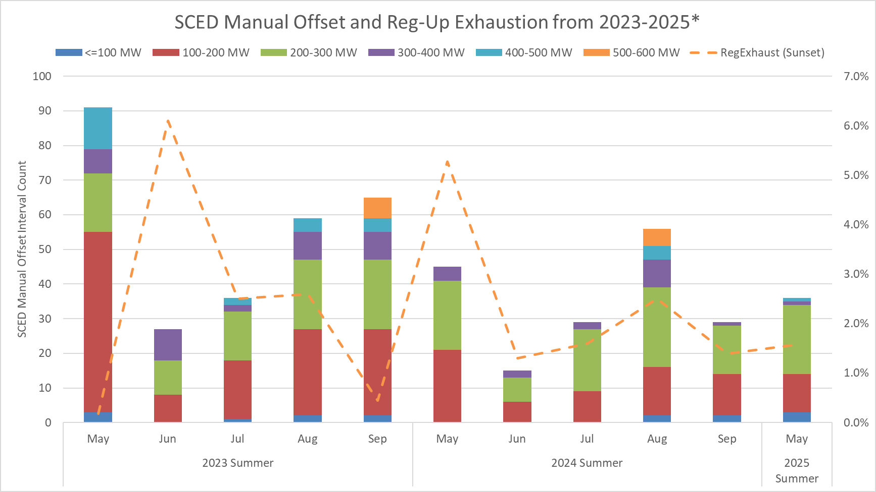
SCED Manual Offset and Reg-Up Exhaustion
This chart combines both the number of Operator Manual Offsets entered along with a focus on Reg-Exhaustion during sunset hours.
Sunset hours: HE 19 - 21
Notes:
FME: Frequency Measurable Event

Slide 36
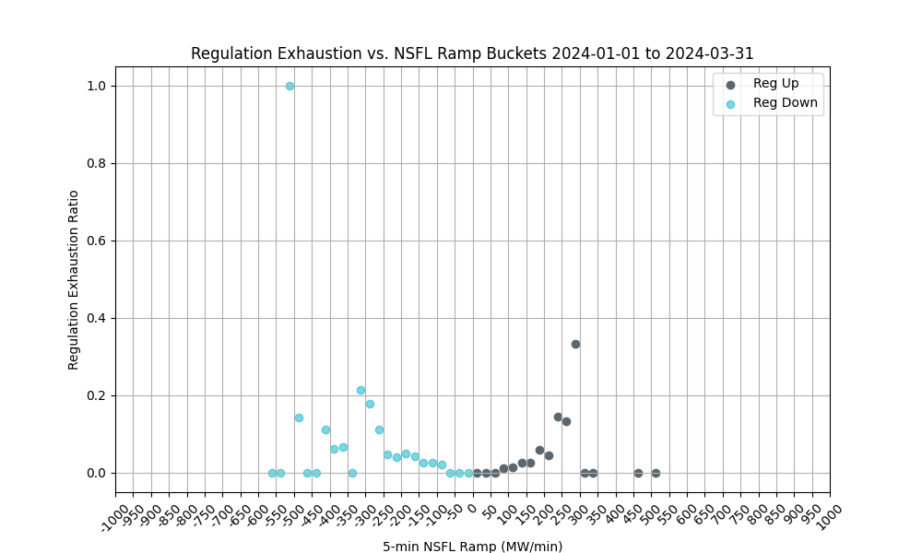
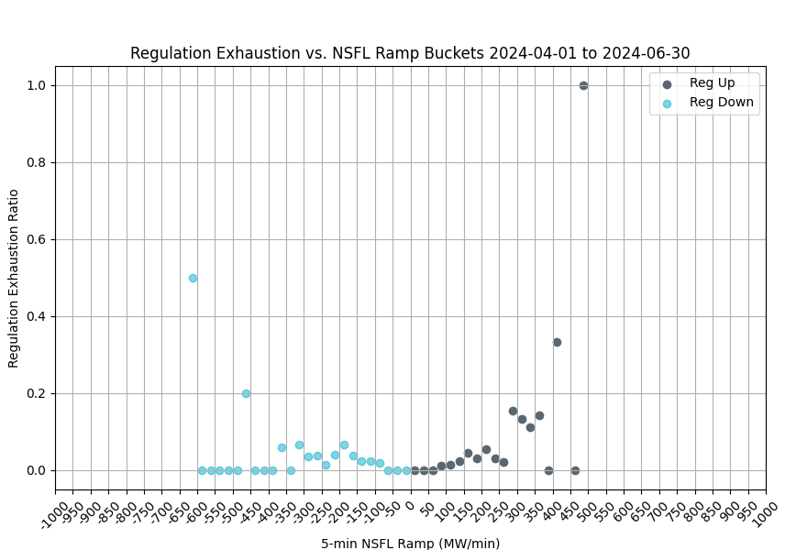
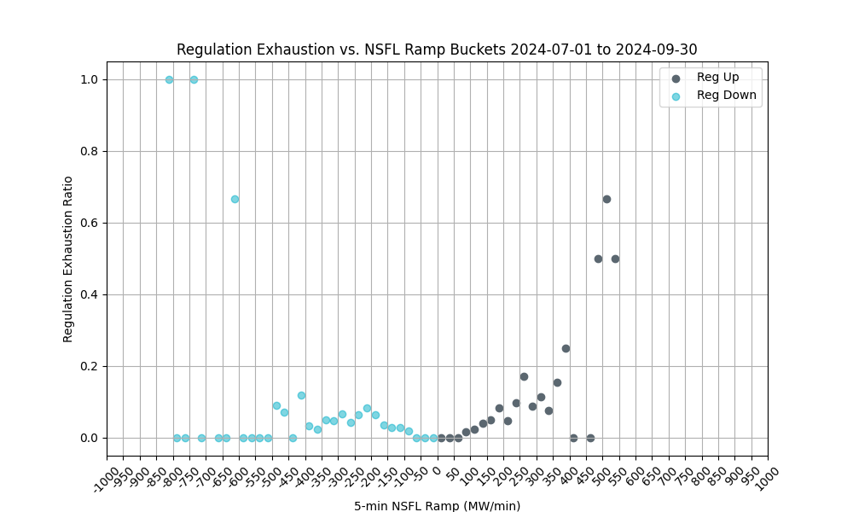
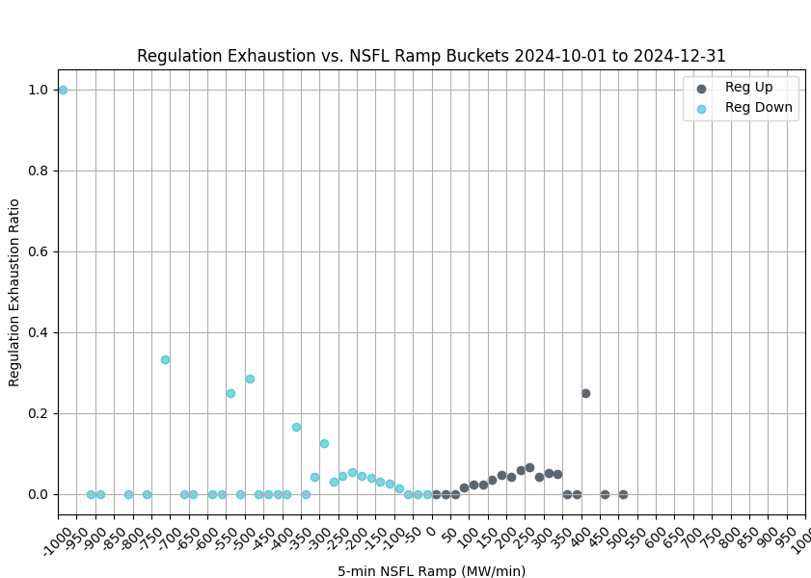
Regulation Exhaustion by Quarter - 2024
These charts use 1-minute data to evaluate regulation exhaustion from 5-minute NSFL* ramps. 5-minute ramps of 75 MW or larger are considered.
Reg exhaustion is flagged using the PDCWG criteria, less than 5 MW reg remaining over a 5-minute average.
Reg exhaustion is evaluated between 5 and 10 minutes from the time of the ramp.
*NSFL = Large Loads and steel mill loads that are not following SCED dispatch.

Slide 37
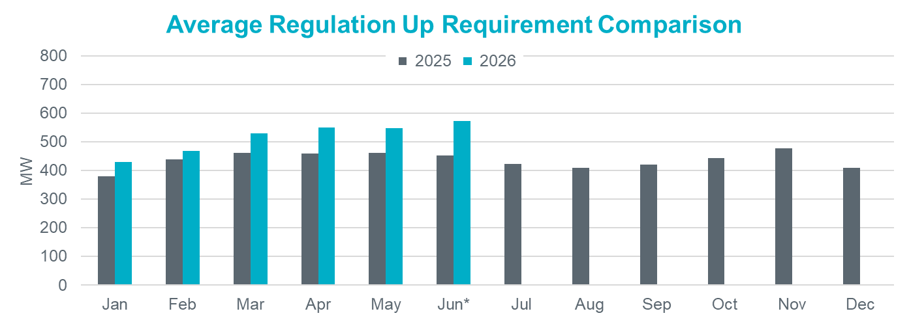
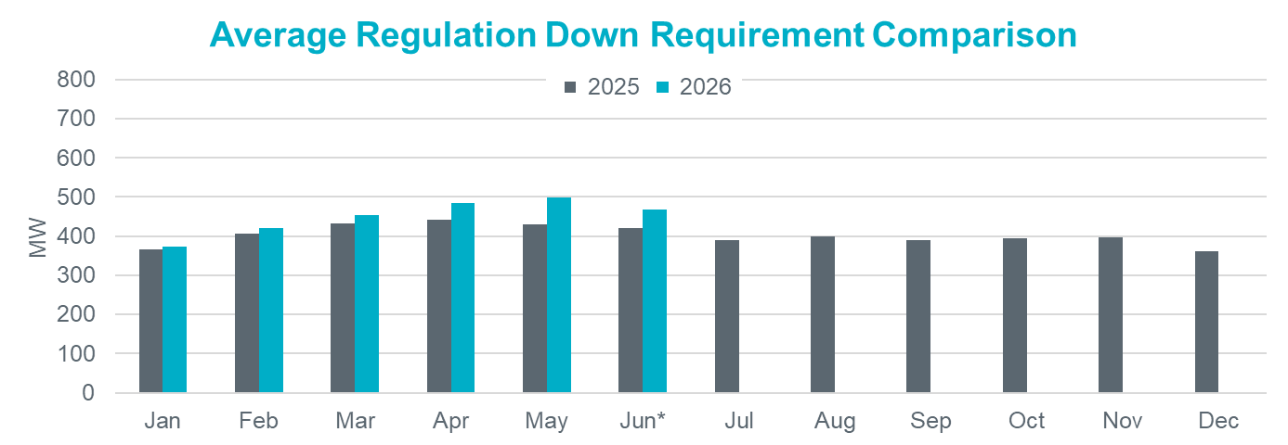
Hourly Average Regulation Comparison
Reg-Up 2026:
On avg. 74 MW increase from prev. year
Largest increase is in Jun* by 120 MW
Reg-Down 2026:
On avg. 33 MW increase from prev. year
Largest increase is in May by 70 MW

Slide 38
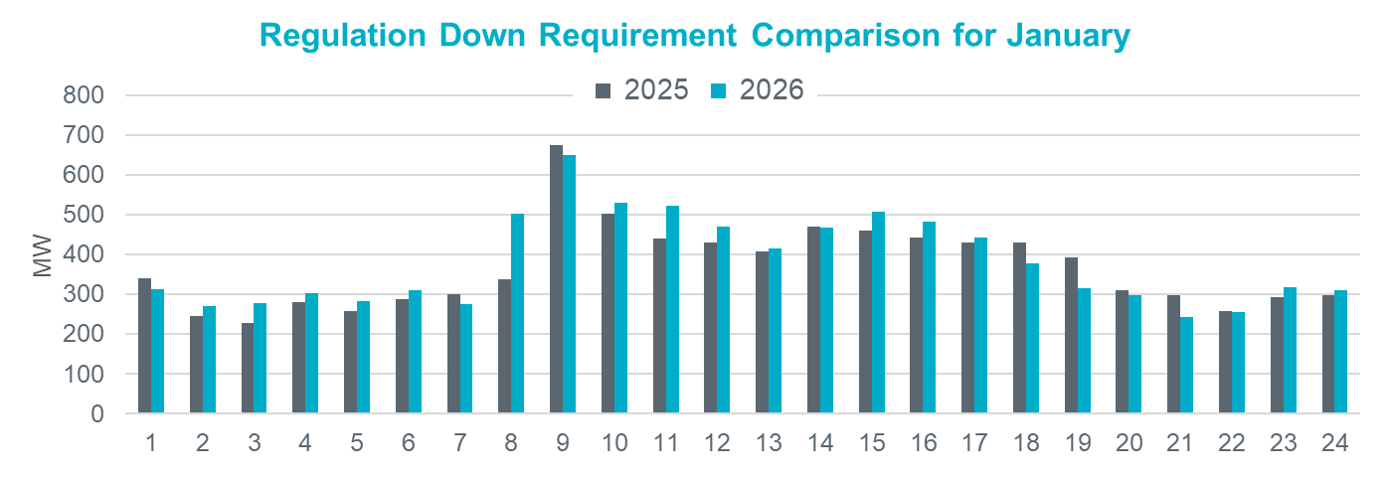
Regulation Comparison January
2026 Reg-Up:
Range: 294 – 694 MW;
Avg: 445 MW (66 MW increase from prev. year)
2026 Reg-Down:
Range: 243 – 649 MW;
Avg: 381 MW (14 MW increase from prev. year)

Slide 39
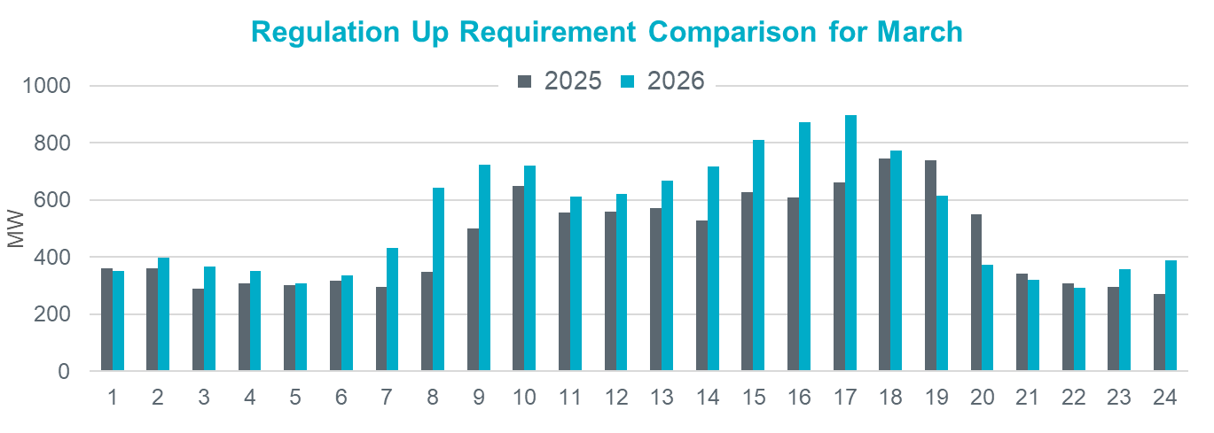
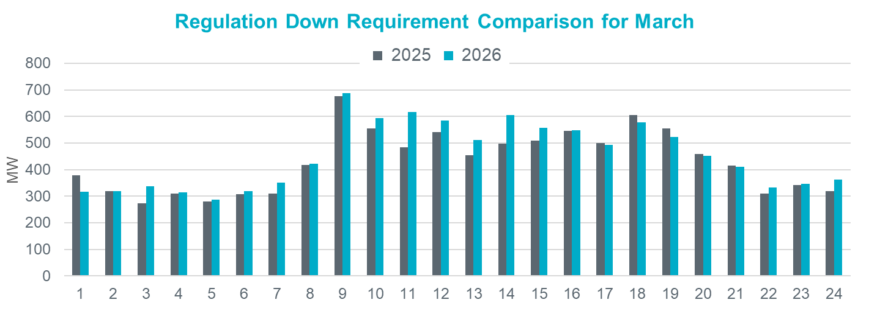
Regulation Comparison March
2026 Reg-Up:
Range: 292 – 896 MW;
Avg: 540 MW (78 MW increase from prev. year)
2026 Reg-Down:
Range: 286 – 687 MW;
Avg: 453 MW (21 MW increase
from prev. year)

Slide 40
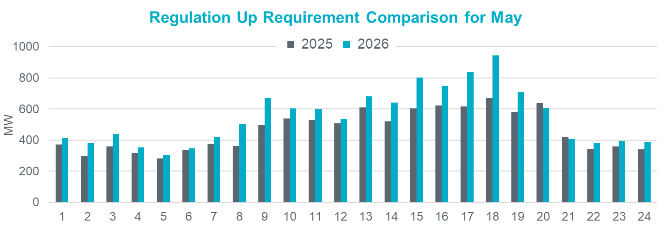
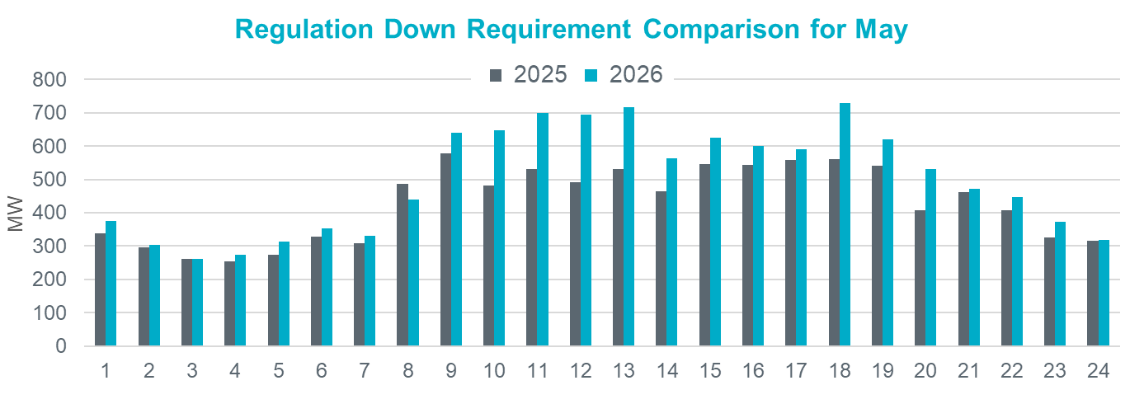
Regulation Comparison May
2026 Reg-Up:
Range: 304 – 944 MW;
Avg: 546 MW (84 MW increase from prev. year)
2026 Reg-Down:
Range: 261 – 728 MW;
Avg: 497 MW (68 MW increase
from prev. year)

Slide 41
Responsive Reserve Service

Slide 42
Responsive Reserve Service (RRS) Methodology
NERC’s preliminary BAL-003 Interconnection Frequency Response Obligation (IFRO) assessment for ERCOT for the 2026 Operating Year (OY) has not yet been published. Therefore, this analysis used the minimum RRS-PFR limit of 1,365 MW for 2025.
The preliminary RRS quantities for January 2026 through May 2026 in subsequent slides have been computed using 2024 and 2025 system inertia conditions and 2025 RRS table.
  The RRS table tracks RRS requirements for different inertia conditions. This table uses a minimum RRS-PFR limit of 1,365 MW for 2025, and the table will be updated for 2026.

Slide 43
2025 RRS Table
Scenario | 1 | 2 | 3 | 4 | 5 | 6 | 7 | 8 | 9 | 10 | 11 | 12
LR/PFR | 2.35:1 | 2.2:1 | 2.06:1 | 1.94:1 | 1.83:1 | 1.74:1 | 1.65:1 | 1.58:1 | 1.51:1 | 1.44:1 | 1.39:1 | 1.33:1
Inertia (GW∙s) | 130 | 140 | 150 | 160 | 170 | 180 | 190 | 200 | 210 | 220 | 230 | 240
PFR Req. (no LR) (MW) | 5,960 | 5,563 | 5,200 | 4,892 | 4,622 | 4,329 | 4,114 | 3,920 | 3,744 | 3,522 | 3,314 | 3,139
*RRS Curr IFRO (MW) | 3,320 | 3,273 | 3,227 | 3,183 | 3,145 | 3,068 | 3,031 | 2,982 | 2,941 | 2,863 | 2,767 | 2,699
**RRS Upd IFRO (MW) | - | - | - | - | - | - | - | - | - | - | - | -
Scenario | 13 | 14 | 15 | 16 | 17 | 18 | 19 | 20 | 21 | 22 | 23 | 24 | 25
LR/PFR | 1.28:1 | 1.24:1 | 1.19:1 | 1.15:1 | 1.12:1 | 1.08:1 | 1.04:1 | 1.01:1 | 1:1 | 1:1 | 1:1 | 1:1 | 1:1
Inertia (GW∙s) | 250 | 260 | 270 | 280 | 290 | 300 | 310 | 320 | 330 | 340 | 350 | 360 | 370
PFR Req. (no LR) (MW) | 3,004 | 2,890 | 2,784 | 2,686 | 2,595 | 2,510 | 2,421 | 2,353 | 2,290 | 2,230 | 2,173 | 2,119 | 2,068
*RRS Curr IFRO (MW) | 2,645 | 2,595 | 2,558 | 2,514 | 2,463 | 2,425 | 2,380 | 2,343 | 2,290 | 2,230 | 2,173 | 2,119 | 2,068
**RRS Upd IFRO (MW) | - | - | - | - | - | - | - | - | - | - | - | - | -
*RRS quantity is calculated for RCC of 2,805 with limit of 60% limit on LRs and min RRS-PFR limit of 1,365 MW.
**The 2026 IFRO assessment has not yet been reported back from NERC, preventing the calculation of RRS quantity.
***Red font in table above identifies study scenario where RRS needed < 2,300 MW. RRS requirement during these is based on the applicable floor.

Slide 44
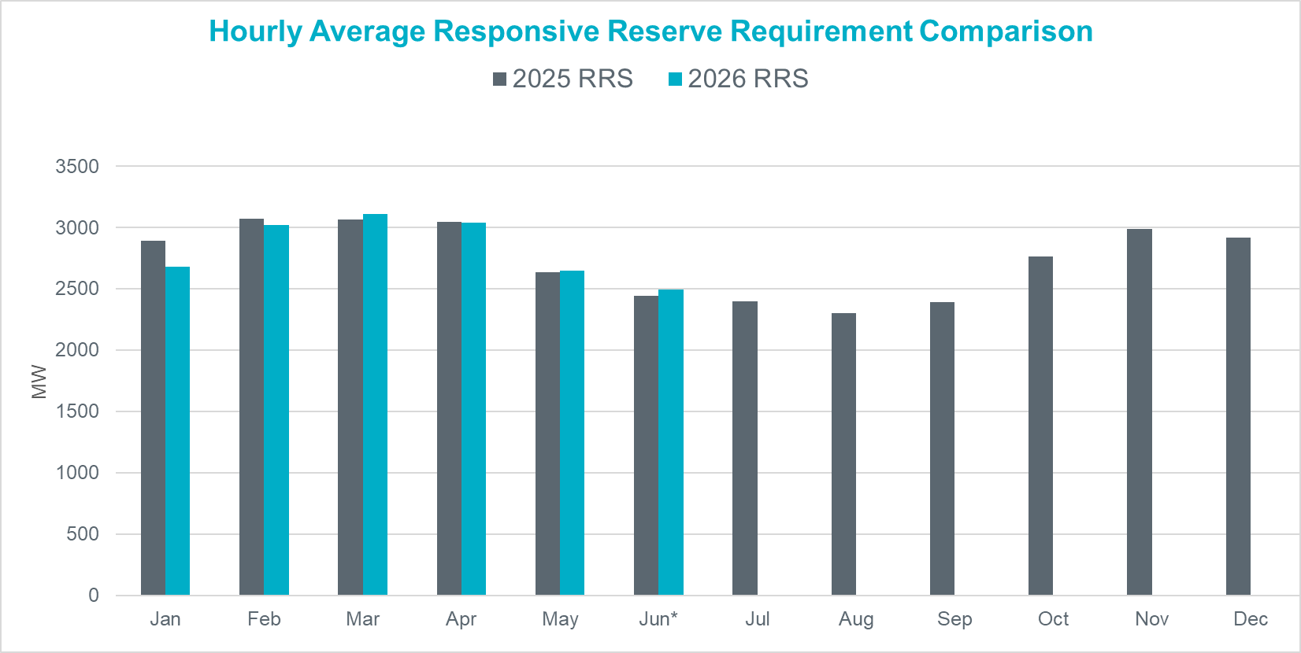
Hourly Average RRS Comparison
2026 RRS:
On avg. 26 MW decrease from prev. year
Largest increase is in Mar by 46 MW
Largest decrease is in Jan by 212 MW
*2026 RRS quantities are calculated using the 2025 minimum RRS-PFR limits (to be updated).

Slide 45
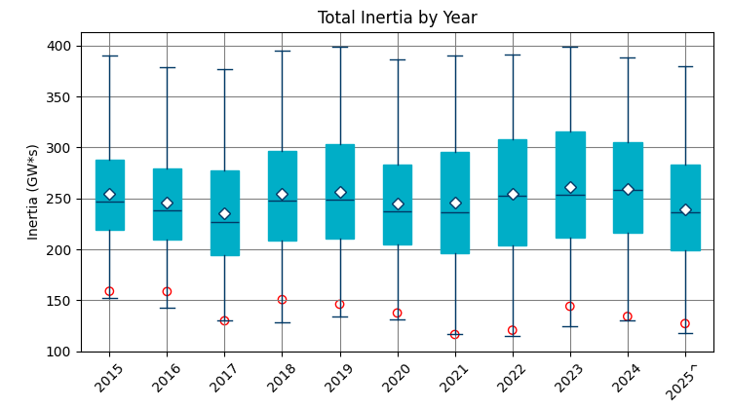
Total Inertia (2015 – 2025.05)
The average inertia in 2024 was comparable to 2023, but currently 2025 is trending lower than in 2023.
[Total inertia for 2015 - 2025.06*]

Slide 46
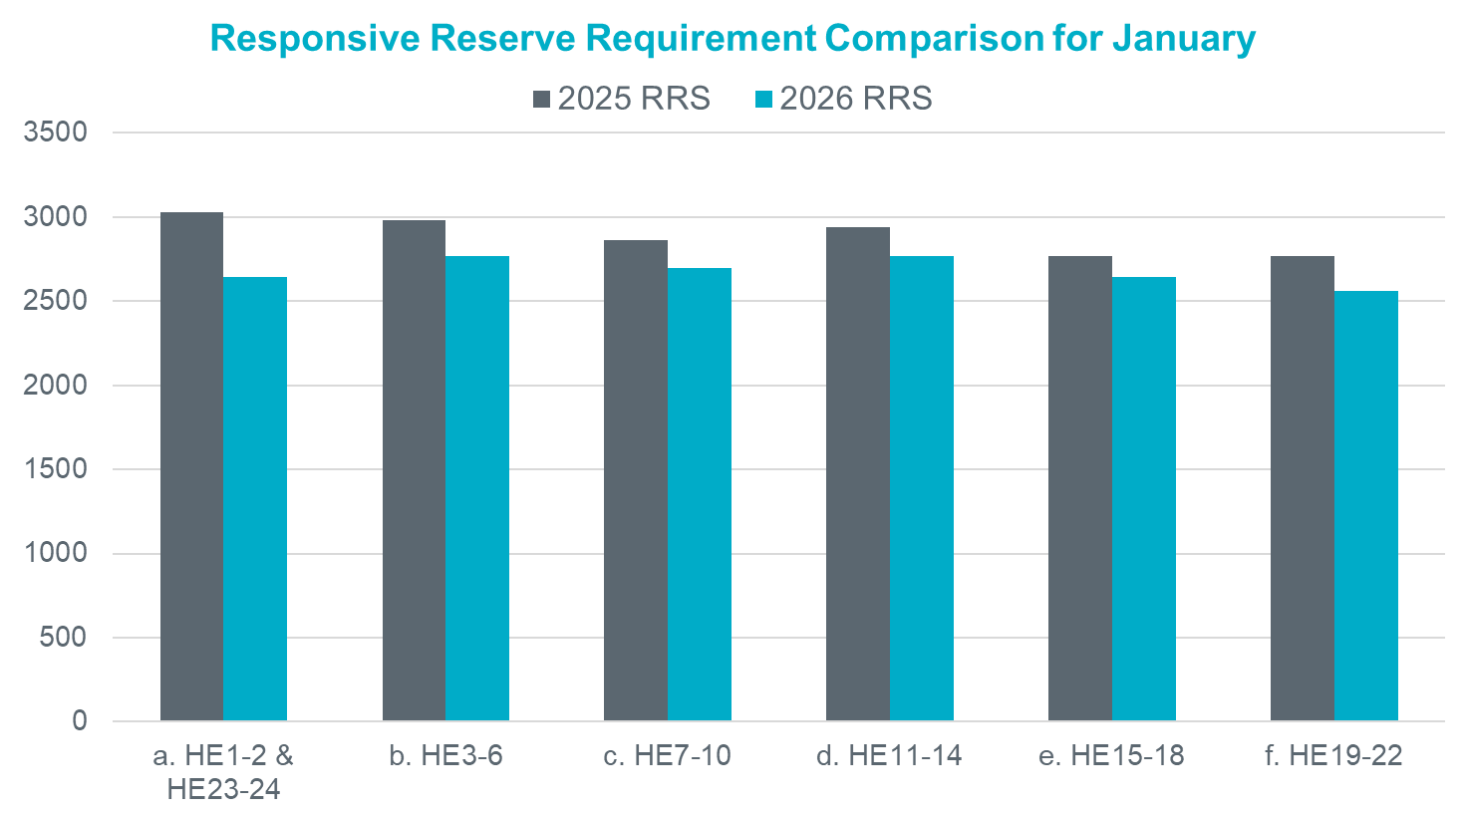
RRS Comparison January
2026 RRS:
Range: 2,558 – 2,767 MW;
Avg: 2,680 MW (212 MW decrease from prev. year)
*2026 RRS quantities are calculated using the 2025 minimum RRS-PFR limits (to be updated).

Slide 47
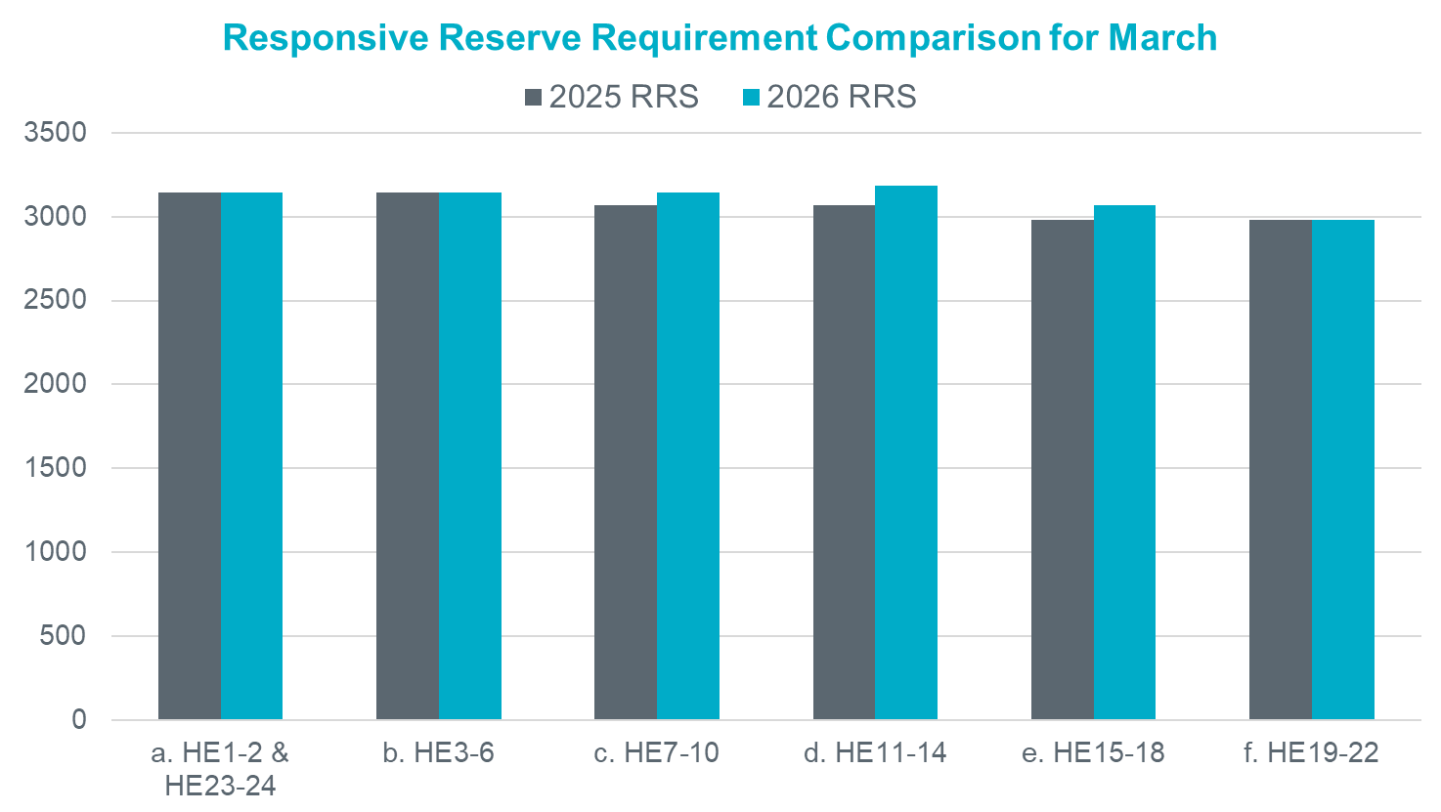
RRS Comparison March
2026 RRS:
Range: 2,982 – 3,183 MW;
Avg: 3,111 MW (46 MW increase from prev. year)
*2026 RRS quantities are calculated using the 2025 minimum RRS-PFR limits (to be updated).

Slide 48
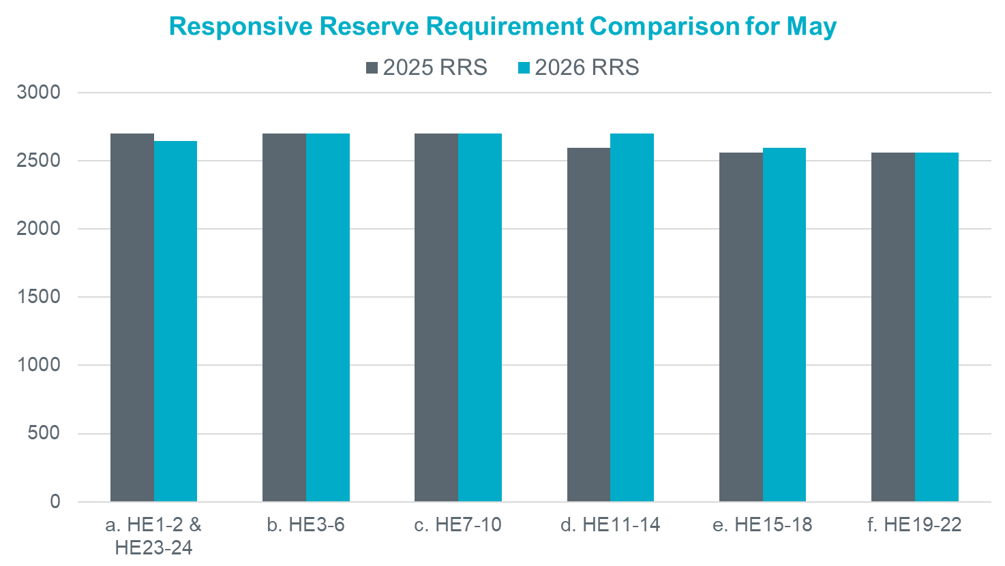
RRS Comparison May
2026 RRS:
Range: 2,558 – 2,699 MW;
Avg: 2,649 MW (14 MW increase from prev. year)
*2026 RRS quantities are calculated using the 2025 minimum RRS-PFR limits (to be updated).

Slide 49
AS Study Timeline
Potential 2026 Methodology Review Timeline
April 23, 2025 – TAC Kickoff
May 19, 2025 – Workshop #1
June 20, 2025 – PDCWG
June 30th – Workshop #2
July 07, 2025 – WMWG (Proposed)
July 15, 2025 – OWG (Proposed)
July 22, 2025– PDCWG (Proposed)
August 04, 2025 – Workshop # 3 (New)
August 06, 2025 – WMS
August 07, 2025 – ROS
August 28, 2025 – TAC
September 23, 2025 – BoD
Oct, Nov, Dec 2025 – PUC
ERCOT has now hosted two workshops related to the 2026 Ancillary Service Methodology.
The proposed timeline for this review is included in the image alongside. Per NPRR1222, which the ERCOT BoD approved, this timeline incorporates the PUC’s review/approval into the review process.
This year ERCOT will be sharing changes to the AS Methodology related to the use of a probabilistic method for quantifying AS as discussed in 2024. ERCOT plans to provide all relevant details on the proposed methodology during the workshops and working group discussions and provide just a summary of the proposed changes during the August/September discussions.
Interested Stakeholders are requested to attend the workshop and working group meetings to provide any feedback on the AS Methodology.

Slide 50

Questions
?

Slide 51
Appendix

Slide 52
Impact of Load and Renewable Growth on Forecast Error Trends (cont’d)
Monthly forecast errors over multiple years were analyzed.
Monthly forecast errors were summarized as standard deviation (SD), mean absolute error (MAE).
Monthly summaries were modeled as linear function of time (year).
From the model, we extracted
    R-squared – to assess model fit
    p-value of the year variable – to evaluate the strength of trend
      high R² + low p-value is desired – indicates strong, reliable model
The goal is to determine whether there is a meaningful trend in forecast error over time.

Slide 53
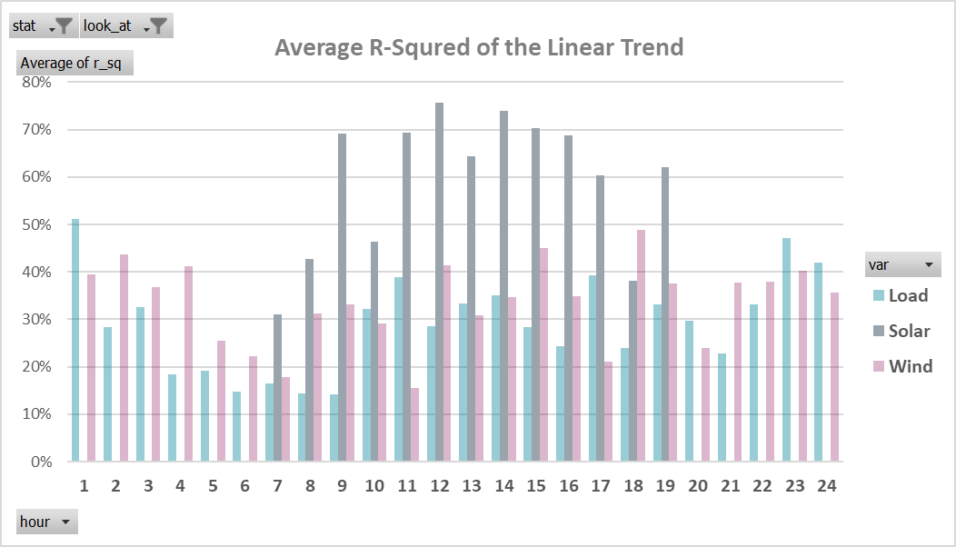
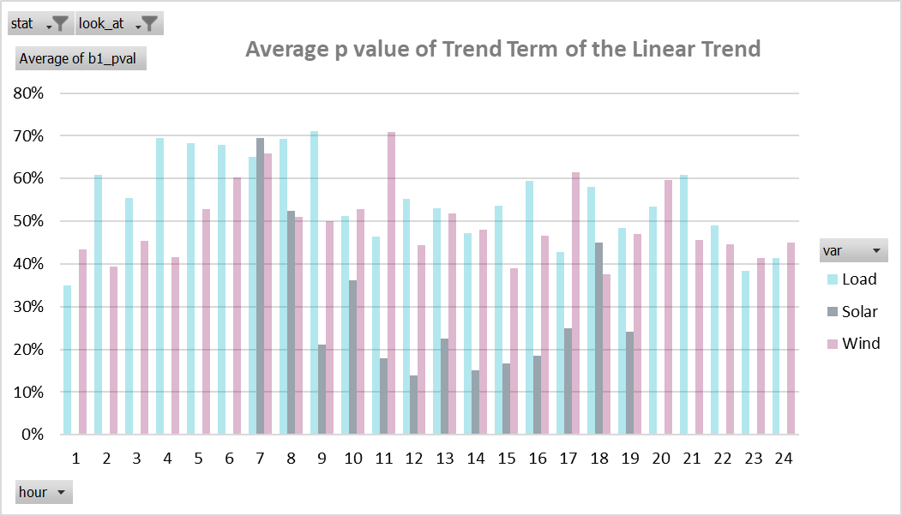
Impact of Load and Renewable Growth on Forecast Error Trends (cont’d)
Solar forecast errors show stronger trends, with high R² and low p-values during sunlight hours.
Load and wind errors show weak or inconsistent trends, with low R² and high p-values
Adjustment was applied only to solar forecasts, based on statistical significance; no adjustment made for load or wind
Note: The initial linear models were used primarily to identify any significant trends and to support visual observations. For the solar adjustment process, a more detailed model was applied to capture both trends and seasonality.

Slide 54
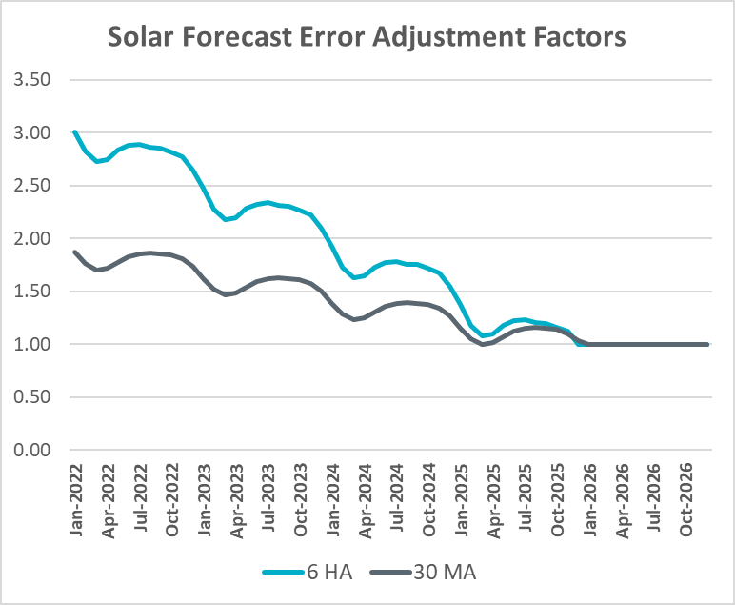
Solar Adjustment Factors Derivation
Monthly forecast error (standard deviation) is modeled against capacity
  Separate models are used for different times of the day
  Seasonality is incorporated into the modeling process
Only stable, well-performing models (based on an R² threshold) are retained for further analysis
The error trend is calculated from the models and extended through 2026
Forecast quality trend is derived from historical Mean Absolute Percentage Error (MAPE) and a smoothed MAPE trend is computed
The error trend and MAPE trend are combined to produce solar error adjustment factors relative to projected 2026 solar capacity

Slide 55
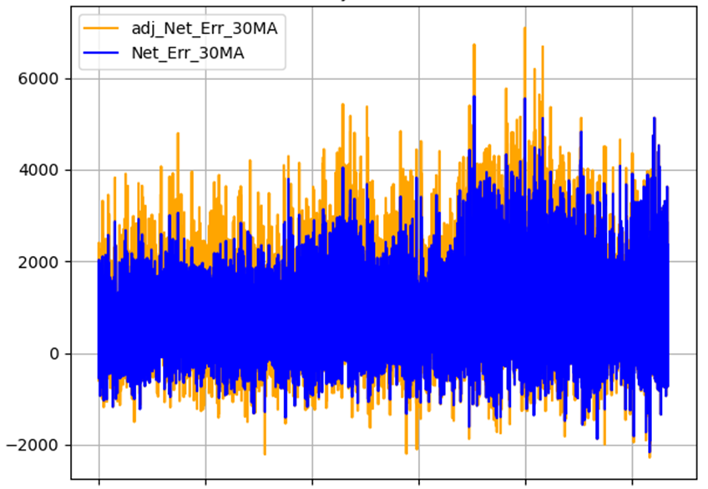
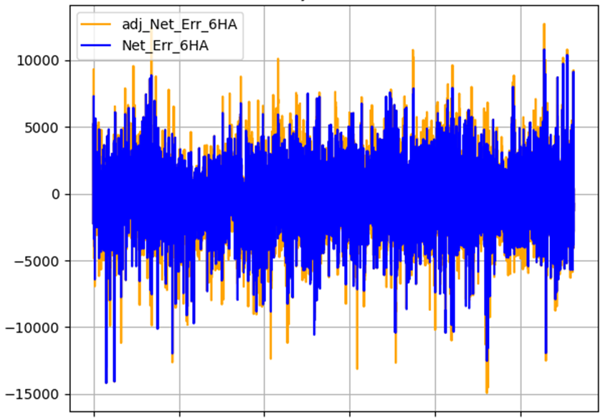

Solar Adjustment Net Error
Charts show Raw and Solar Adjusted Net Error from 1/1/2022 to 6/20/2025
Adjusted Net Error = Raw Net Forecast Error + Raw Solar Forecast Error – Adjusted Solar Forecast Error
Raw Load Forecast Error – Raw Solar Forecast Error – Raw Wind Forecast Error

Slide 56
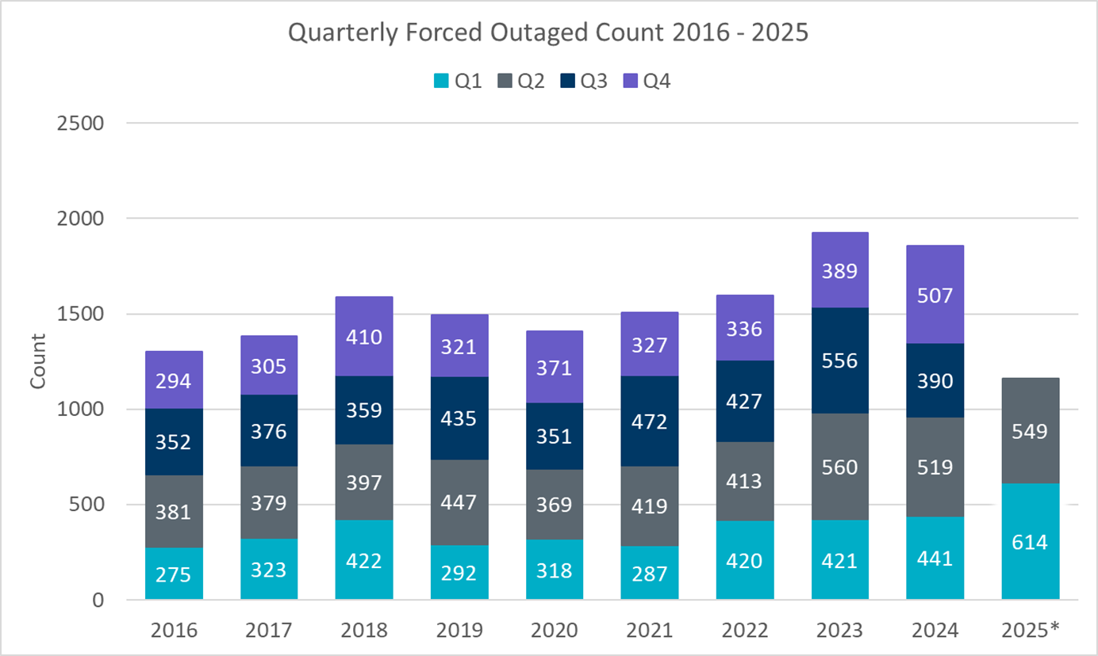
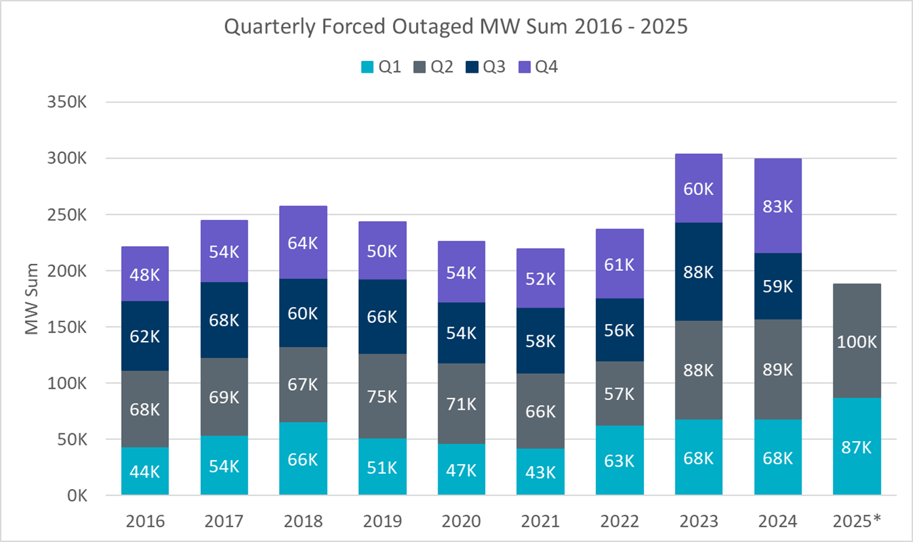
Outage Analysis Cont.
Year | 2016 | 2017 | 2018 | 2019 | 2020 | 2021 | 2022 | 2023 | 2024 | 2025*
Count | 1227 | 1308 | 1511 | 1391 | 1346 | 1434 | 1507 | 1842 | 1786 | 1131
Average MW | 170 | 177 | 162 | 163 | 160 | 146 | 148 | 158 | 161 | 161
Median MW | 148 | 150 | 108 | 132 | 101 | 83 | 85 | 139 | 116 | 143

Slide 57
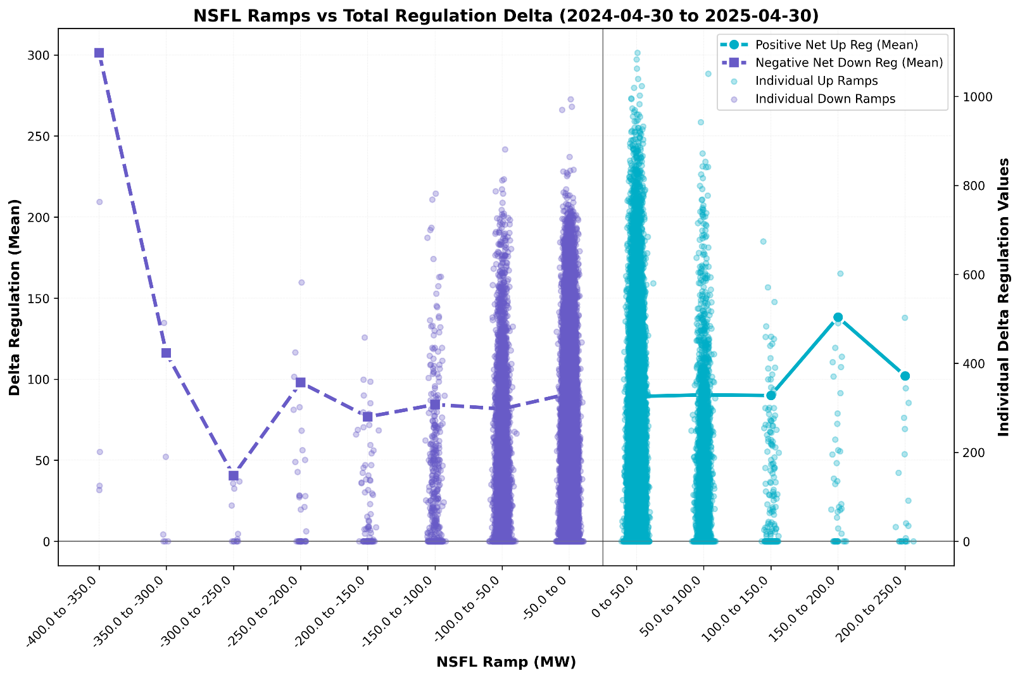
Large Load Ramping vs Total Regulation Deployment
This chart plots the 10-minute total regulation deployment corresponding with 1-minute NSFL Ramp buckets.
The change in regulation deployment (Delta Reg) can be used as an indicator of regulation usage for NSFL Ramps.
Delta Reg Down Ramps = Reg Up Recall + Reg Down Deployment
Delta Reg Up Ramps = Reg Down Recall + Reg Up Deployments
Key Takeaway: The largest Delta Regulation values fall in the smaller ramp buckets. There many factors on the grid which may cause regulation usage, but NSFL ramping can be one component.

Slide 58
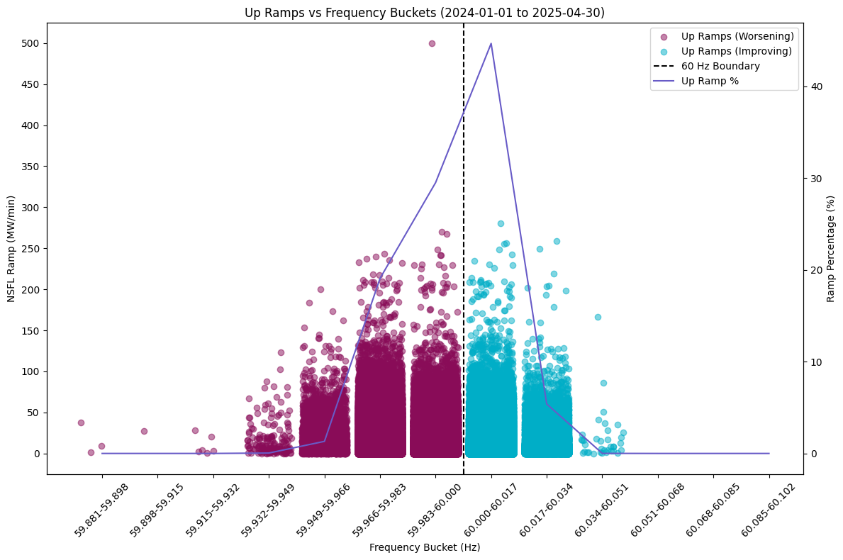
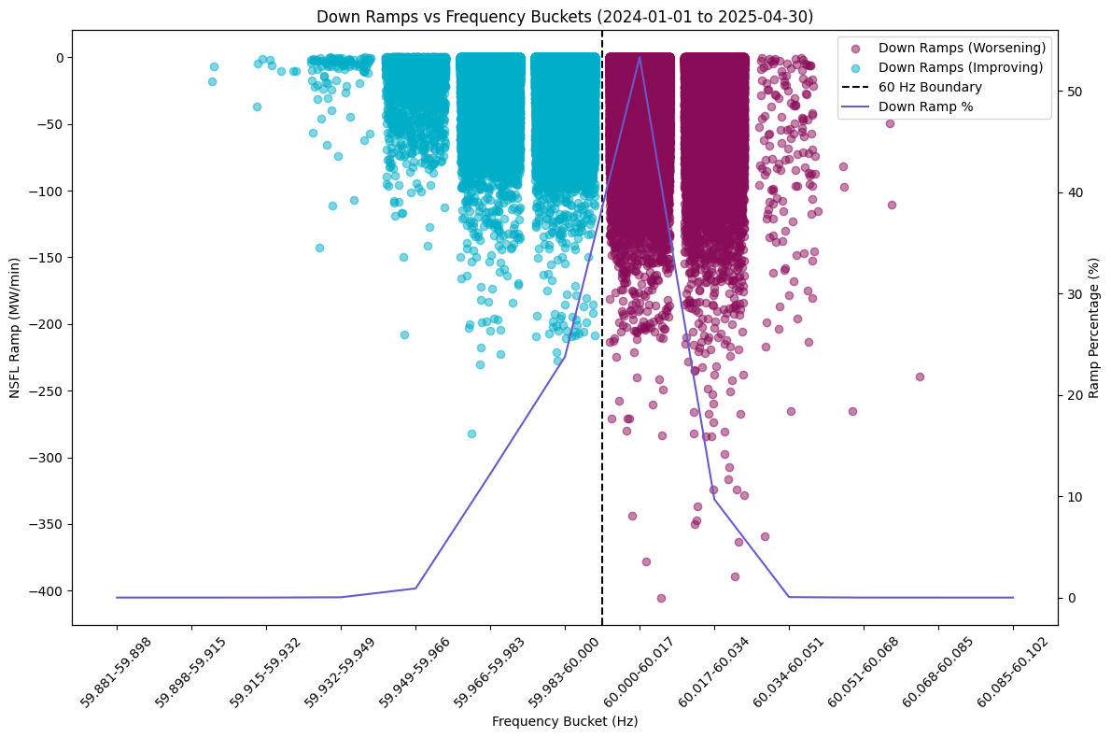
NSFL Ramp by Frequency Bins
These charts show 1-minute NSFL Ramps in both directions plotted in frequency buckets representing the system frequency at the time of the ramp.
Ramps in the opposite direction of frequency will impact regulation usage.
Smaller ramps are generally less of a reliability risk but may consume regulation intended for net load ramping.

Slide 59
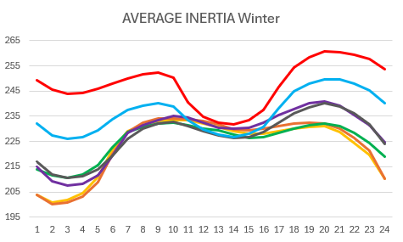
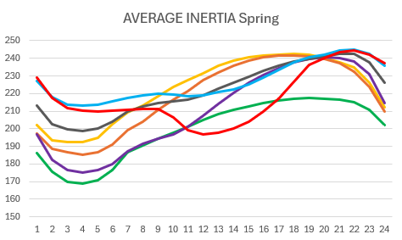
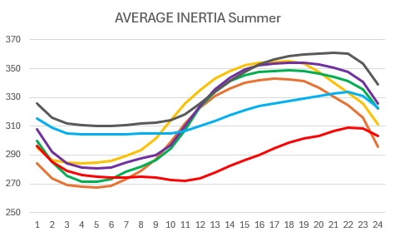
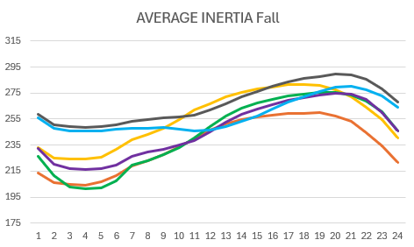
Seasonal Average Inertia by Hour 2019-2025*
Inertia (GW*s)
Hour

Slide 60
2-Hour ESR Capability

Slide 61
6-Hour ESR Capability

Slide 62
8-Hour ESR Capability

Slide 63
ECRS Methodology 2025
 | 2025 Methodology
Data Input | 30-MA Netload Forecast Error (2-yr)
Calculation Method | 80th - 95th percentile of 30-MA Netload Forecast Error (2-yr) Calculate Netload Up Ramp Risk factor Assign a coverage (80th-95th percentile) based in risk factor
Solar Adjustment | GE Table- Increased wind/solar forecast error per 1,000 MW installed capacity increase
Frequency Recovery | Expected capacity needed to recover frequency following a supply-side trip (2-yr, 70th percentile coverage)
Calculation | Max(NLFE+SolarAdjustment, Frequency Recovery)

Slide 64
NSRS Methodology 2025
 | 2025 Methodology
Data Input | 6HA Netload Forecast Error (3-yr)
Calculation Method | 68th - 95th percentile of for each 4-hr block per month (3-yr) Calculate Netload Up Ramp Risk factor (75th-95th percentile) Assign a coverage (68th-95th percentile) based in risk factor
Wind and Solar Adjustment | GE Table- Increased wind/solar forecast error per 1,000 MW installed capacity increase
Forced Outages | Expected capacity needed to recover frequency following a supply-side trip (2-yr, 70th percentile coverage)
Calculation | Max(NLFE+SolarAdjustment, Frequency Recovery)

