Slide 1
Project Status for the 2026 Reliability Assessment
Pete Warnken
Resource Adequacy
Supply Analysis Working Group
June 27, 2025

Slide 2
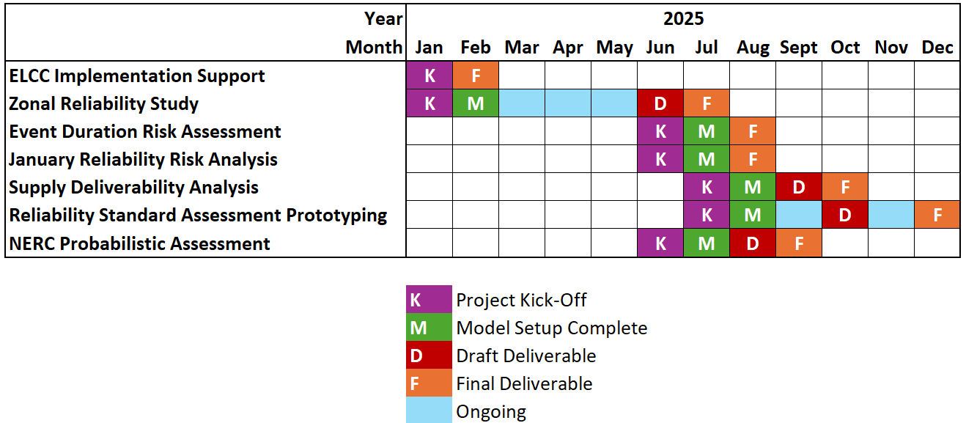
Project Schedule

Slide 3
Project Status
ELCC Implementation Support: PowerGem helped validate ELCCs for the May 2025 CDR
Zonal Reliability Study: Working with PowerGem to finalize clusters (“zones”) and transmission limits before setting up the Strategic Energy & Risk Valuation Model (SERVM) zonal topology
Event Duration Risk Assessment: PowerGem is analyzing 2024 Generating Availability Data System (GADS) data to augment 2020-to-2023 outage history
January Reliability Risk Analysis: Working on load/wind/solar shifting analysis to update SERVM
Supply Deliverability Analysis: kick off in July
Reliability Standard Assessment Prototyping: kick off in July
NERC Probabilistic Assessment: Long Term Reliability Assessment (LTRA) data submitted to NERC; will load data into SERVM

