Slide 1
Weekly
RTC+B Market Trials Update
ERCOT Staff
June 23, 2025

Slide 2
Outline
Antitrust Admonition
Reminder of Key Document Postings
Expectations of QSEs for the Week
Provide Update of Cumulative QSE Scorecards
Communicate any known Issues within On-going Trial
Support any Technical and/or Business Questions

Slide 3
WebEx Meeting reminders (same as other ERCOT forums):
Please keep line muted
If you have a question, please use the chat feature to either:
Type in your question, or
Type in “Question” and wait to be recognized to state question

Slide 4
Sequence and Dates for Market Trials to Go-Live
Market trials are a progression of activities to mitigate the risk for Go-Live on new systems and processes for both the Market Participants & ERCOT.
30-day Market Notice
11/5/25
March/April
2025
Start
5/5/25
Start
7/7/25
Start
9/2/25
Go-Live
12/5/25*
May 2025
June 2025
July 2025
Aug 2025
Sep 2025
Oct 2025
Nov 2025
Dec 2025
QSE Scorecards & Exit Criteria for each Trial Phase
#1 RTC QSE Submission Testing
(Submit COP, RT AS Offers,
DAM Virtual AS, Outages for ESRs)
#3 Open-loop RTC SCED
(QSE offers, SCED non-binding award/dispatch)
#5 Ongoing Open-Loop
& Periodic Closed-loop SCED/LFC
(QSE RTC offers and telemetry to support closed-loop frequency control test 2-3 tests of 2-4 hour durations)
Transition to Go-Live
Upon completion of testing, confirmation of ERCOT and market readiness for Go-Live.
QSE/Vendor Submission Sandbox and Telemetry Points added Prod EMS model.
#2 RTC QSE Telemetry Checkout (QSEs add/verify new telemetry points for UDSP, New ramp rates, ESR telemetry)
#4 QSE Telemetry Tests
(Individual QSE to follow UDSP and support new ramp rate and ESR telemetry)
#6 Day-Ahead Market
(Non-binding DAM using QSE offers for at least 2 tests)
* Go-Live date reflects 12/5/2025 as first Operating Day
where 12/4/2025 is planned software migration.

Slide 5
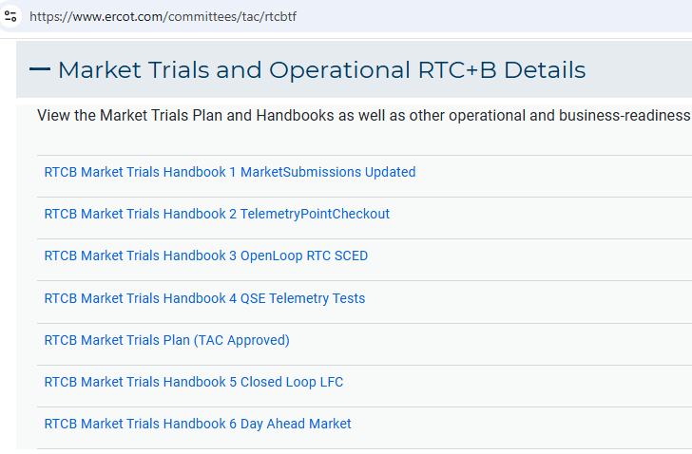
Market Trials
TAC Approved the Market Trials Plan in October 2024
Discussions with RTC+B Task Force have shaped the Handbooks
Handbook #1- QSE Submission Testing
Handbook #2- QSE Telemetry Tests
Handbook #3- Open Loop SCED
Handbook #4- QSE Telemetry Tests
Handbook #5- Close-Loop LFC Tests (draft)
Handbook #6- Day-Ahead Market Tests (draft)
All are posted on the
RTCBTF Homepage
under Market Trials banner

Slide 6
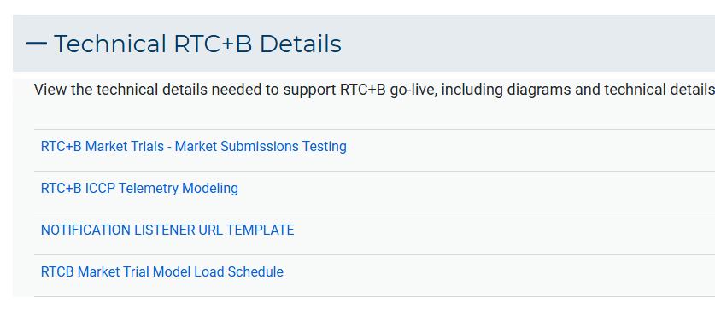
Market Trials
Detailed discussions with TWG have provided technical content details
Digital Certificate details
Connectivity/URL details to User Interfaces and APIs
Reminder of how to submit new ICCP requests
RTC and Production Telemetry connectivity
Network Model Load Schedule
All are posted on the
RTCBTF Homepage
under Technical Details banner

Slide 7
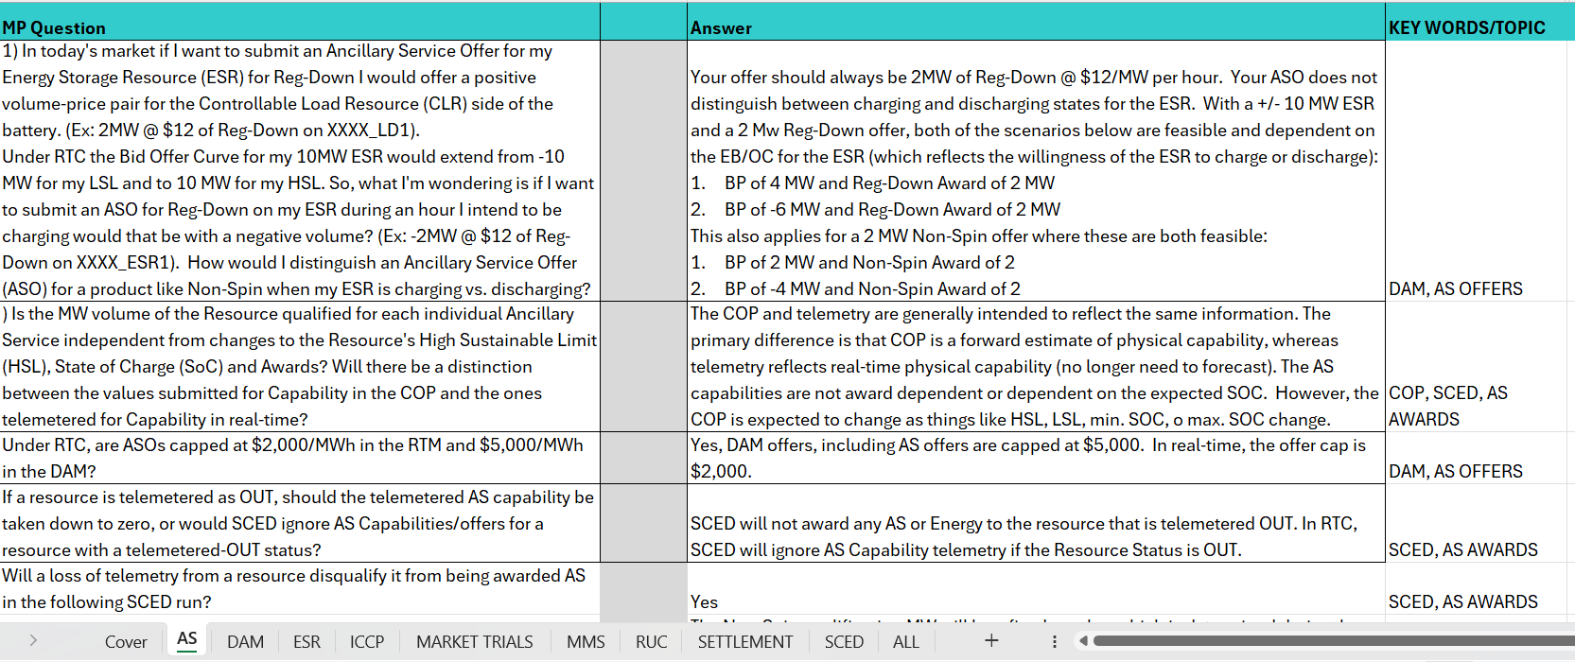
RTC+B FAQ has been updated 6/13
Posted on RTCBTF Home Page under Key Documents
Common questions/responses in Excel Workbook (target weekly updates)
Search workbook for Key Words
Worksheets for categories

Slide 8
Resources for May-June Market Trials
Everything needed for current market trials is on RTCBTF home page

Slide 9
Summary of Market Trial activities for this week and following weeks
QSE connectivity and market submissions
Submit to Market Management System and Outage Scheduler
Goal to submit at least one successful transaction for each requested transaction type per QSE once during the 8-week period
QSE telemetry set-up and check-out
Submit all ICCP requests to ERCOT to add telemetry points
Check-out will be for a sampling of resources within the QSE portfolio to ensure data flowing between ERCOT/QSE
Scoring continues

Slide 10
Scorecards for this Market Trials
Handbook Book 1: ERCOT will publish 3 scores, one for each type of Resource: Generation, Load Resources, ESR
Green: all submissions types completed at least once during the trial
Yellow: some submissions types completed at least once during the trial
Red: no submissions received
Handbook 2: ERCOT will publish 2 scorecards:
Complete all telemetry additions
Green: all new telemetry added (100%)
Yellow: some telemetry added
Red: no new telemetry added
Check-out complete
Green: Check-out successfully completed (for sample of Resources)
Yellow: Check-out scheduled, but not yet complete
Red: No check-out activity

Slide 11
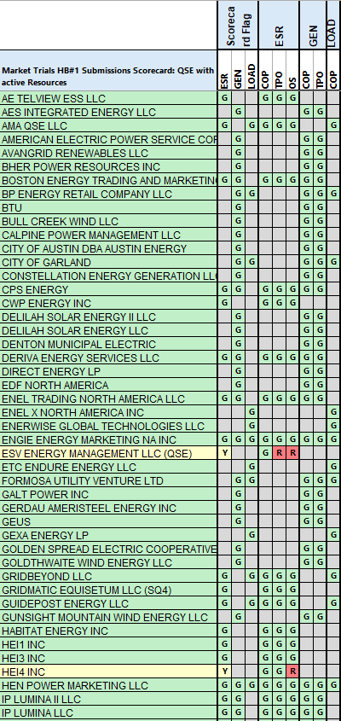
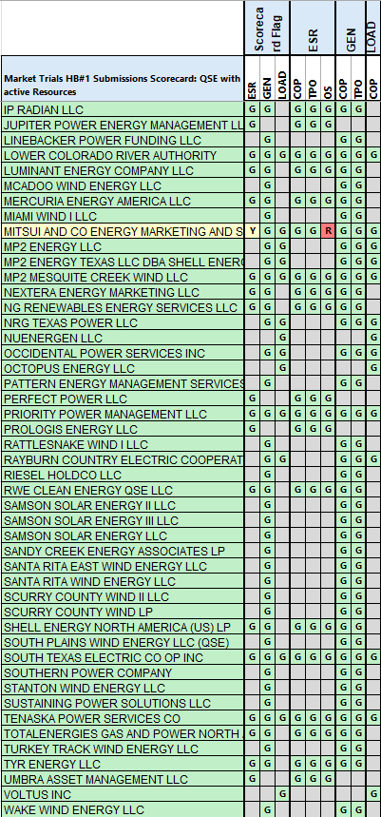
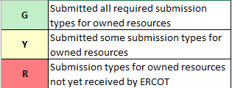
Scorecard 1 for Handbook 1- Market submissions:
6/23 Scores for QSEs with Resources – successful submissions for resource types specified in Handbook 1
Scoring:

Slide 12
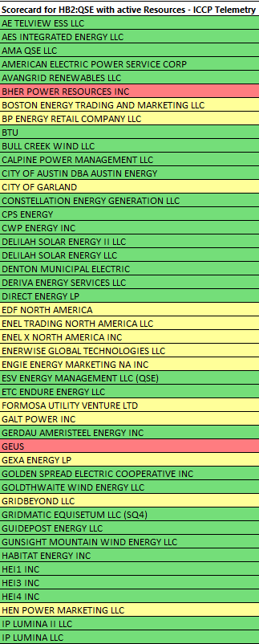
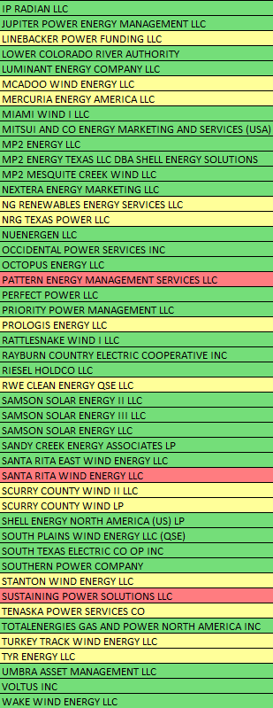
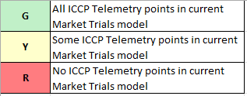
Scorecard 2A for Handbook 2- 100% of ICCP Telemetry points added by QSE:
6/23 Scores for QSE with Resources - ICCP Telemetry points added in current model.
Scoring:

Slide 13
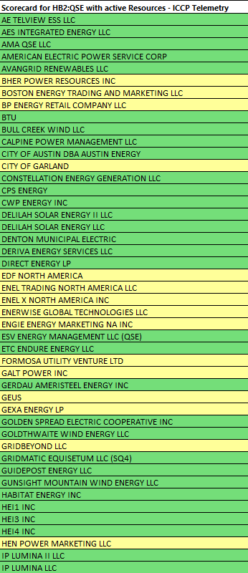
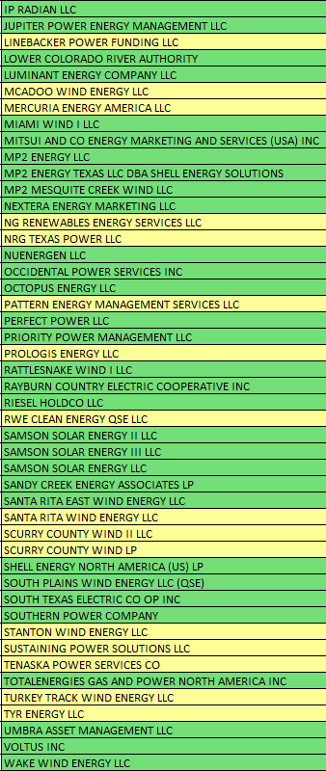
Scorecard 2A for Handbook 2- 100% of ICCP Telemetry points added by QSE:
6/23 Scores for QSE with Resources - ICCP Telemetry points added in current model.
Scoring:
Board Version

Slide 14
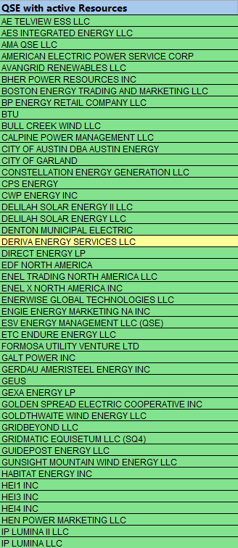
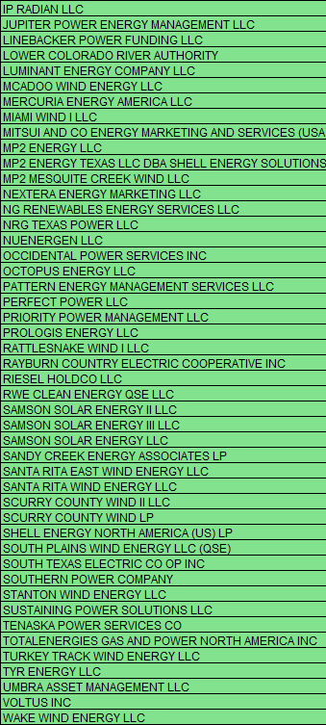
Scorecard 2B for Handbook 2- Telemetry checkout meetings completed with ERCOT staff for sample of live data transfer capability
6/23 Scores for QSEs with Resources – Scheduling Check-out and Check-out complete
Scoring:

Slide 15
This Week in Market Trials
Current topics:
Error experienced when querying Resource Parameters via API call
No workaround; Resource Parameters not in scope of this phase of Market Trials
Outage Schedule for ESR
Single model resources have new Equipment IDs. For outage submissions on the OSUI, only equipment name is needed and Equipment ID is not needed. If the Equipment ID is unknown and needed for API submission testing, use the Outage Scheduler UI (OSUI) to submit an outage for the ESR, and on the outage details/history file, the Equipment ID can be seen. If still experiencing issues, request help from RTCB@ercot.com.
JUNE_ML2 network model loaded into Market Trials environment on 6/13

Slide 16
Wrap-Up and Questions
Remainder of meeting time to take questions each week-
First round of questions specifically about this Market Trial period
Second round of questions for more general RTC+B as time allows
Can always email the RTC+B Program mailbox: RTCB@ercot.com
FAQ is also a resource for questions that other have asked.
Thanks for your support!
Before we wrap up, we want to preview July/August trials.

Slide 17
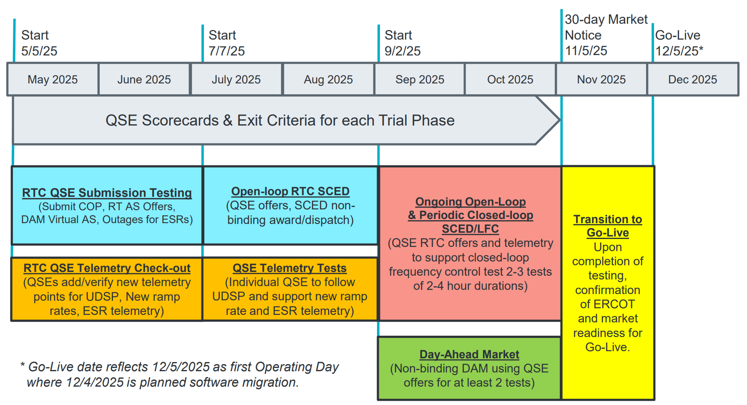
July & August:
Initial Real-Time Market execution and verify QSE ability to follow ERCOT frequency signals
QSE will support “parallel production” 2days/week by entering $bids/offers for non-binding RTC energy and A/S awards and dispatch (Open-loop test)
Scorecard goal for 100% of QSEs to demonstrate successful submissions and telemetry reflective of production, and mitigation plans in place for any outliers.
Coordination of individual QSE tests on subset of resources to ensure resources can follow new UDSP telemetry point from ERCOT.
Scorecard goal is for 98% of QSEs to successfully demonstrate, and mitigation plans in place for remaining 2% to address in next trial phase.

Slide 18
July/August Market Trials Summary
Dual entry two days per week
Production and Market Trials environments for
Submissions (TPO/COP/ASOffer etc.)
Telemetry (current and new telemetry points)
Tuesdays/Thursdays 9AM – 5PM
Scoring for each day starting Operating Day 7/22
Coordinated QSE Tests for following UDSP
ERCOT will schedule meetings with all QSEs
Please contact ERCOT if you are ready to test early in the trials window

Slide 19
RTC+B Market Submissions - Systems configurations
Start
03/2025
Start
05/2025
Start
07/2025
Start
09/2025
Go-Live
12/5/25*
Feb 2025
Mar 2025
Apr 2025
May 2025
June 2025
July 2025
Aug 2025
Sep 2025
Oct 2025
Nov 2025
Dec 2025
Optional: RTC QSE/Vendor Developer
Submission Testing
RTC QSE
Submission Testing
Open-loop
RTC SCED
Ongoing Open-Loop
& Periodic Closed-loop SCED/LFC
Certificate: Current MOTE
Env: ERCOT RTC Market Trial
URL: RTC MIS MOTE URL
Certificate: Current Production
Env: ERCOT RTC Market Trial
URL: RTC MIS Market Trial
Cert: Production
Env: Prod
URL: MIS Prod
QSE/Vendor developer can use MOTE certificates & RTC MIS MOTE API URL to test the submissions until end of submission testing phase (end of June) as needed. At the start of the Open Loop testing, RTC MOTE MIS URLs will be disabled.
URL links: RTC MOTE and Market Trial URL links to be used for MMSUI, OSUI and API submissions. Actual links are provided in next slide.
For notifications/responses to MPs from RTC Market Trials environment, MP will need to provide the listener URL to ERCOT

Slide 20
RTC+B Market Submissions - Systems configurations (Updated with URLs)
RTC+B Market Trials and Go-live
RTC Phase | Digital Certificate | MMSUI / OSUI URL | API / WAN URL
Vendor/QSE Submissions Testing | Current MOTE | RTC MOTE MIS URLs https://testmarkettrials.ercot.com/mmsui/mmsui/displayTradesLanding.action https://testmarkettrials.ercot.com/osrui/osrui/Summary.action | RTC MOTE API/WAN URL https://testmarkettrialsapi.ercot.com/NodalAPI/EWS/ https://testmarkettrialsapi.wan.ercot.com/NodalAPI/EWS/
Open Loop and Closed Loop Testing | Current Production | RTC Market Trial URL https://markettrials.ercot.com/mmsui/mmsui/displayTradesLanding.action https://markettrials.ercot.com/osrui/osrui/Summary.action | RTC Market Trial API/WAN URL https://markettrialsapi.ercot.com/NodalAPI/EWS/ https://markettrialsapi.wan.ercot.com/NodalAPI/EWS/
From RTC Go-live onwards | Current Production | Current Prod MIS URL mis.ercot.com/mmsui mis.ercot.com/osui | New Production API/WAN URL

Slide 21
RTC+B Market Submissions - Systems configurations Public Key Update for WAN/API submissions
For API/WAN submissions into Market Trials environments, need to download public keys and place into the keystore location in system being used for RTC+B submissions.
No change to digital user certificates – continue to use existing MOTE and Production Certificates
Market Trail API Public key location: https://www.ercot.com/services/mdt/webservices

