Slide 1
2026 Ancillary Service Methodology
Discussion
Ancillary Services & Operations Analytics
ERCOT

Slide 2
Stakeholder Discussion Timeline
April 23, 2025 – TAC Kickoff
May 19, 2025 – Workshop #1
June 20, 2025 – PDCWG
June 30th – Workshop #2
July 07, 2025 – WMWG (Proposed)
July 15, 2025 – OWG (Proposed)
July 22, 2025– PDCWG (Proposed)
August 06, 2025 – WMS
August 07, 2025 – ROS
August 28, 2025 – TAC
September 23, 2025 – BoD
Oct, Nov, Dec 2025 – PUC

Slide 3
Discussion Scope for Today
This presentation will discuss the approaches ERCOT is considering to determine Ancillary Service (A/S) quantities for 2026.
ERCOT is considering one change in the methodology used to compute the Regulation Service for 2026.
NERC’s preliminary BAL-003 Interconnection Frequency Response Obligation (IFRO) assessment for ERCOT for the 2026 Operating Year (OY) has not yet been published. Therefore, this analysis used the minimum RRS-PFR limit of 1,365 MW for 2025.
ERCOT is considering moving to a probabilistic method used to compute ERCOT Contingency Reserve Service, and Non-Spinning Reserve Service requirements for 2026. The probabilistic approach builds on the discussion that were conducted last year during PUC’s AS Study effort. 2026 AS Workshop #1 held on 5/19/25 to introduce the probabilistic framework.
The Ancillary Service (A/S) quantities for 2026 contained in this presentation are based on the methodology that was approved in December 2024. The quantities for 2026 reflect moving forward the historic data on which these are based, unless otherwise noted.

Slide 4
Regulation Service

Slide 5
Regulation Service Methodology
Methodology
ERCOT is considering some change in the methodology used to compute the minimum Regulation Service requirements in 2026.
The preliminary Regulation quantities for January 2026 through April 2026 in subsequent slides have been computed using current methodology (2023 and 2025 five-minute net load variability), updated Wind Adjustment tables and the updated Solar Adjustment tables.
Considerations
ERCOT will be removing the FRRS Component of the methodology as this product will be retired with the Implementation of Real Time Co-Optimization plus Batteries (RTCB)
ERCOT is also conducting analysis for Large Loads to determine if any other adjustment should be considered for regulation impacts.

Slide 6
Regulation Up/Down Methodology 2026
 | 2024 Methodology | 2025 Methodology
Data Input | 5-min SCED Netload Forecast Error (2- yr) | No Change
Calculation Method | 95th of 5-min SCED Netload Forecast Error | No Change
Wind/Solar Adjustment | GE Table - Increased wind/solar forecast error per 1,000 MW installed capacity increase | No Change
FRRS Component | 95th of historical FRRS Deployment (2-yr) | Remove
ACE Integral Component | Average of ACE Integral Change (2-yr) | No Change
Load Adjustment (LFL Ramps) | Not considered | TBD

Slide 7
Generation To Be Dispatched (GTBD)
ERCOT has incorporated intra-hour wind/solar forecast- based ramp into GTBD to give SCED an indication of how renewables may ramp.
Predicted Wind Ramp Rate (PWRR) was incorporated in GTBD in Dec.2018
Predicted Solar Ramp Rate (PSRR) was incorporated in GTBD in Jun.2021
In absence of PSRR/PWRR, SCED dispatches uncurtailed solar/wind units to their max output (HSL).
This means that SCED assumes output of uncurtailed solar/wind units will persist for the next 5-min at the unit’s HSL that was telemetered at the start of the interval.
GTBD = Total Gen
+K3*5*PLDRR
+K4*Regulation Deployed
+ K5*ACE Integral
– K6*5*PWRR
+ K7*5*DCTRR
– K8*5*PSRR
5-min Load Ramp Forecast
Previous Reg Deployment
Historical Accumulated ACE
5-min Wind Ramp Forecast
5-min DC Tie Ramp Forecast
5-min Solar Ramp Forecast

Slide 8
Recap – Dynamic PSRR Threshold in GTBD
ERCOT started to apply a dynamic PSRR threshold in GTBD calculation on 6/12/2023
PSRR thresholds change with 4 pre-defined day periods - Night, Sunrise, Sunset and Other
ERCOT started with a threshold of 80MW/min for Sunrise and Sunset periods on 6/12/23 and subsequently increased it to 100MW/min. Today, the threshold is set to 225MW/min.
ERCOT continues to update the thresholds and the definition of day periods seasonally*
Night
* Seasons will be defined by shift in solar ramping patterns

Slide 9
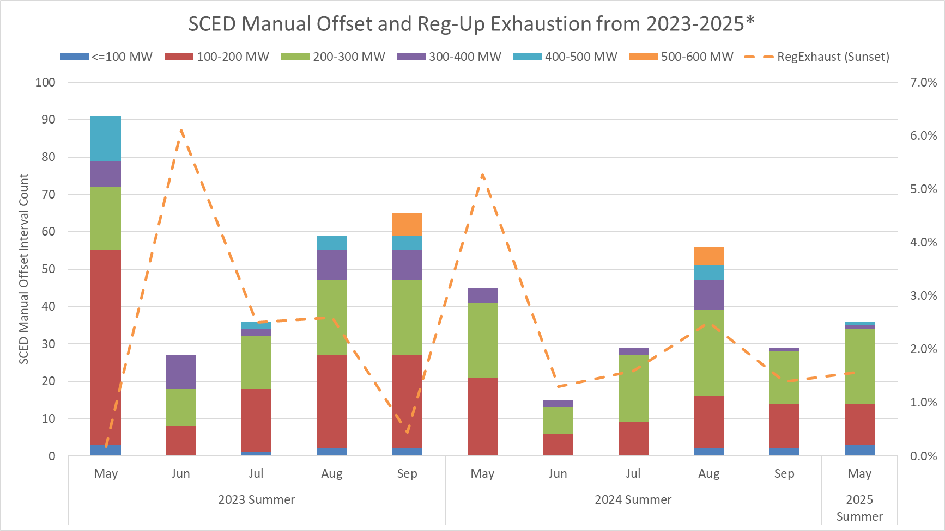
SCED Manual Offset and Reg-Up Exhaustion
This chart combines both the number of Operator Manual Offsets entered along with a focus on Reg-Exhaustion during sunset hours.
Sunset hours: HE 19 - 21
Notes:
FME: Frequency Measurable Event

Slide 10
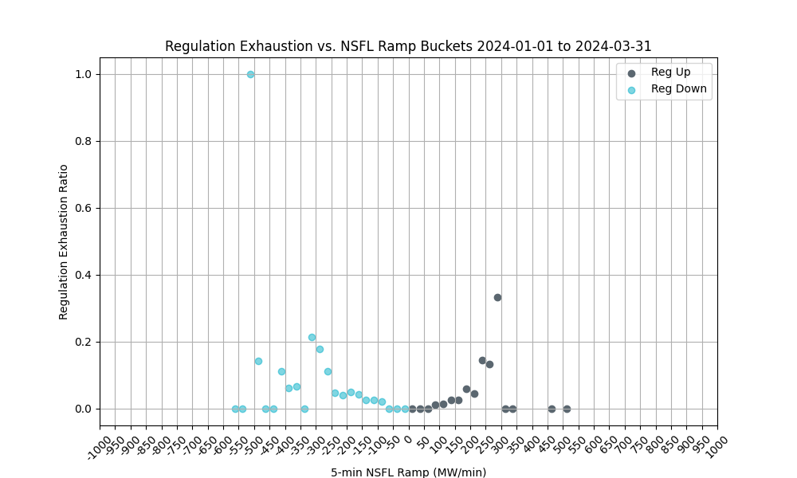
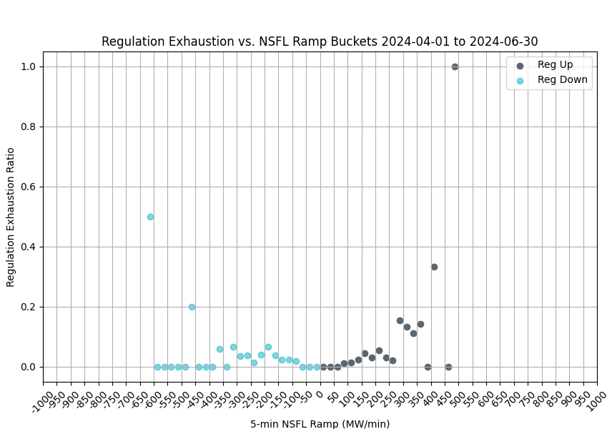
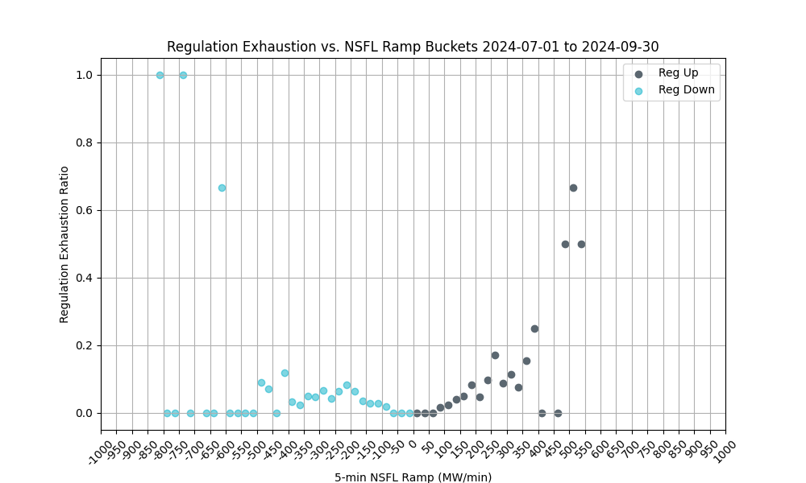
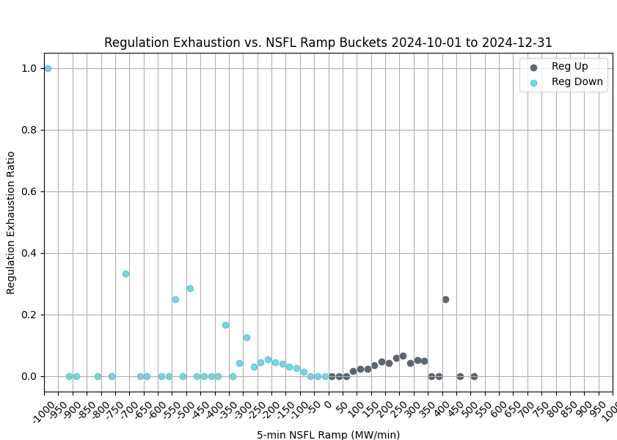
Regulation Exhaustion by Quarter - 2024
These charts use 1-minute data to evaluate regulation exhaustion from 5-minute NSFL* ramps. 5-minute ramps of 75 MW or larger are considered.
Reg exhaustion is flagged using the PDCWG criteria, less than 5 MW reg remaining over a 5-minute average.
Reg exhaustion is evaluated between 5 and 10 minutes from the time of the ramp.
*NSFL = Large Loads and steel mill loads that are not following SCED dispatch.

Slide 11
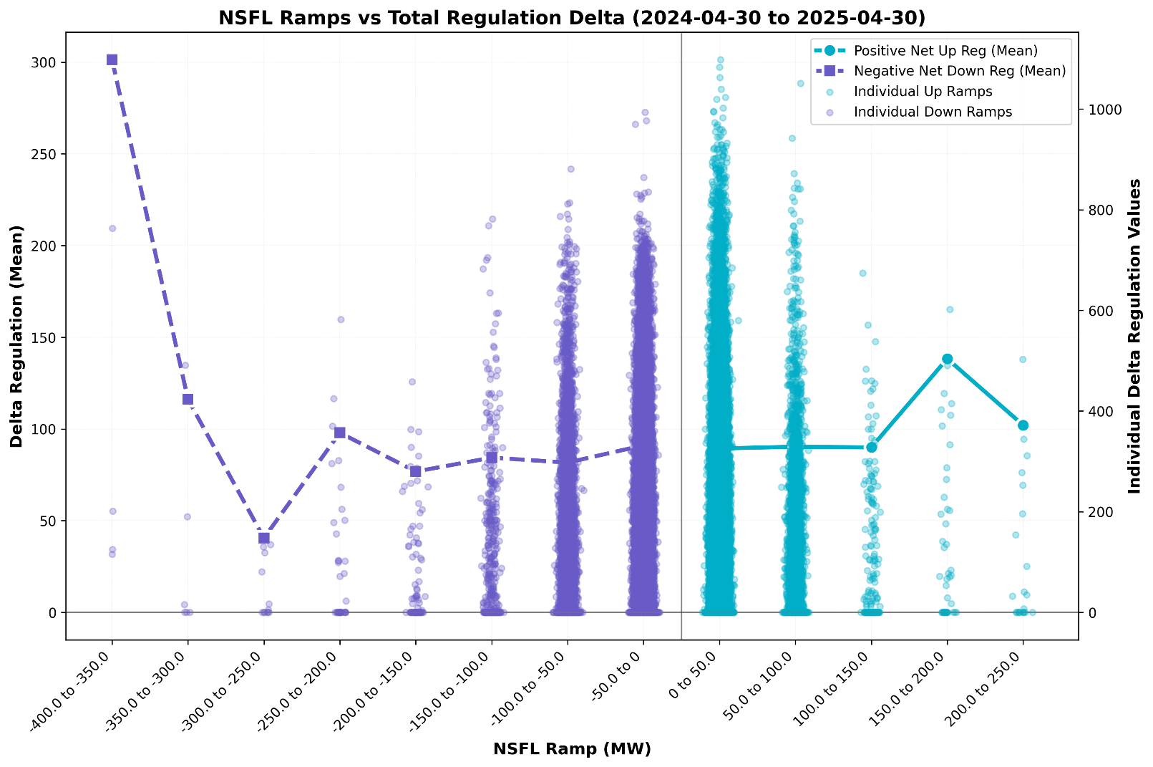
Large Load Ramping vs Total Regulation Deployment
This chart plots the 10-minute total regulation deployment corresponding with 1-minute NSFL Ramp buckets.
The change in regulation deployment (Delta Reg) can be used as an indicator of regulation usage for NSFL Ramps.
Delta Reg Down Ramps = Reg Up Recall + Reg Down Deployment
Delta Reg Up Ramps = Reg Down Recall + Reg Up Deployments
Key Takeaway: The largest Delta Regulation values fall in the smaller ramp buckets. There many factors on the grid which may cause regulation usage, but NSFL ramping can be one component.

Slide 12
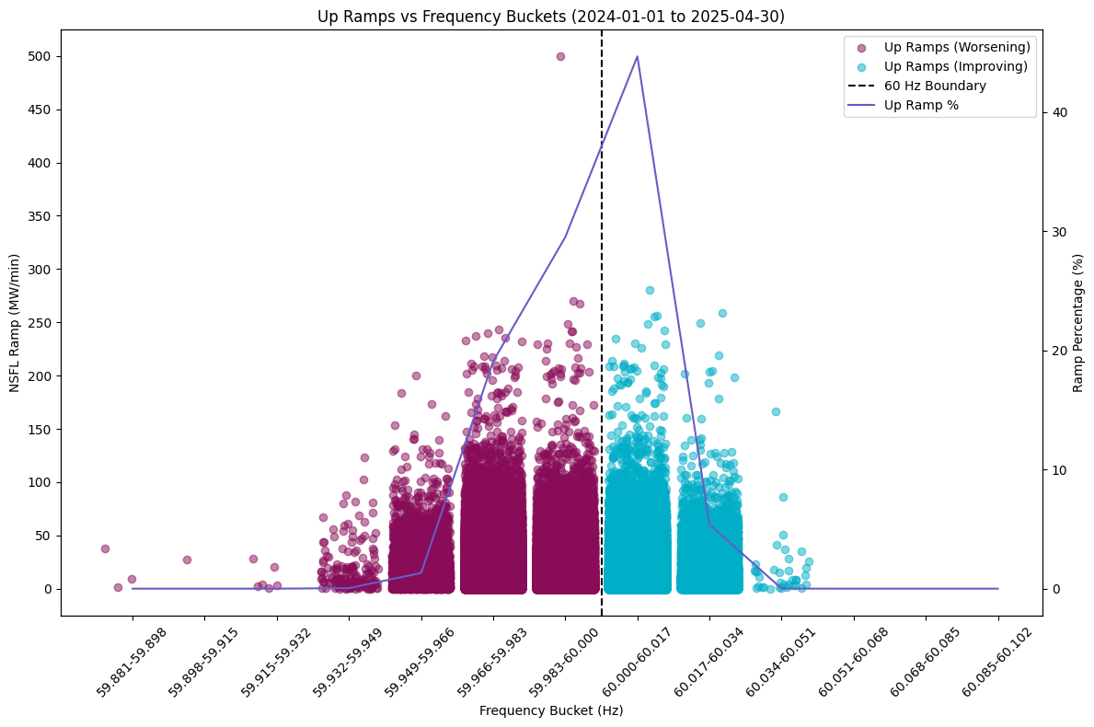
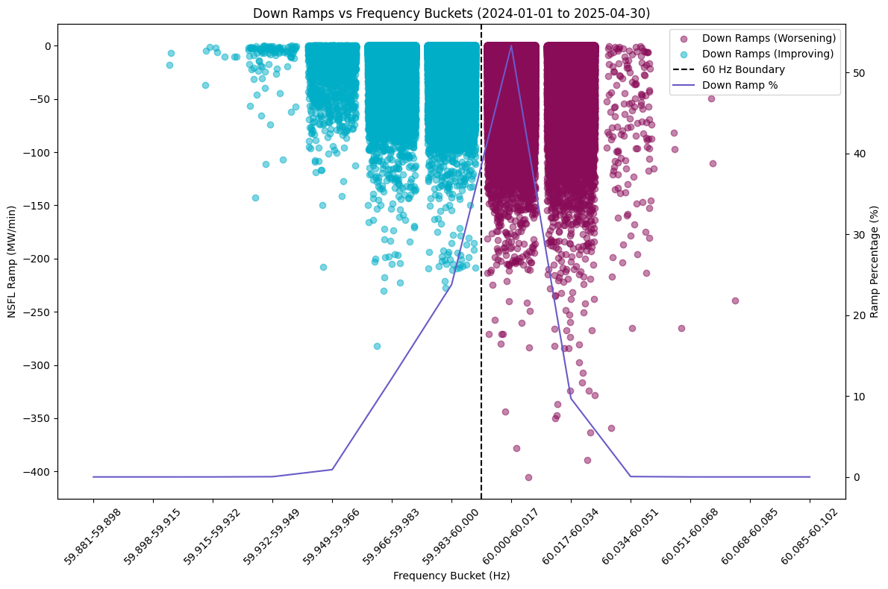
NSFL Ramp by Frequency Bins
These charts show 1-minute NSFL Ramps in both directions plotted in frequency buckets representing the system frequency at the time of the ramp.
Ramps in the opposite direction of frequency will impact regulation usage.
Smaller ramps are generally less of a reliability risk but may consume regulation intended for net load ramping.

Slide 13
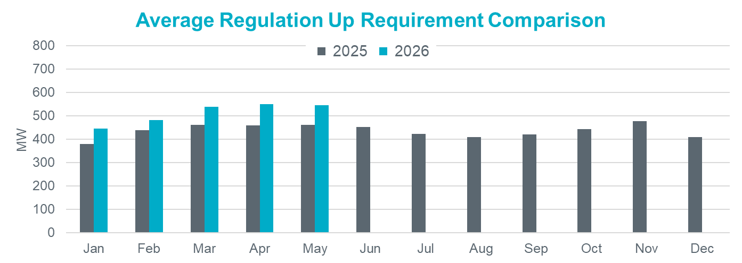
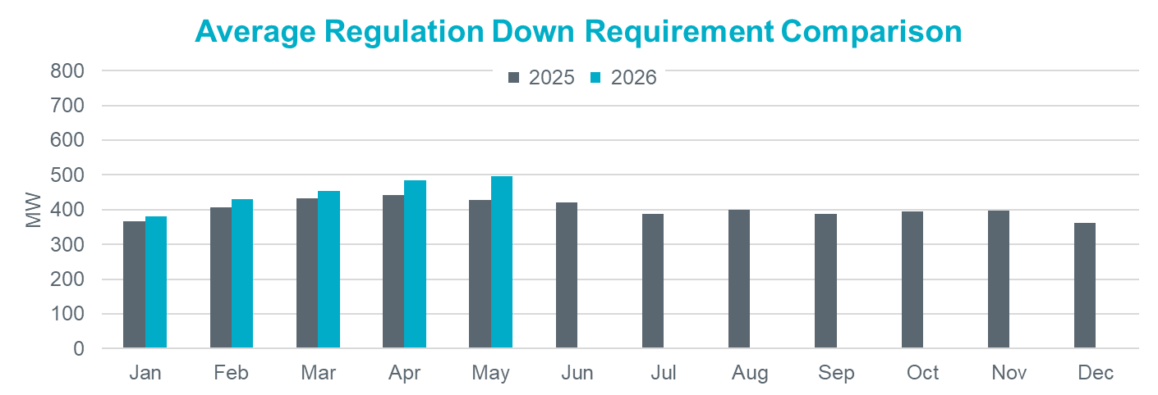
Hourly Average Regulation Comparison
Reg-Up 2026:
On avg. 72 MW increase from prev. year
Largest increase is in Apr by 93 MW
Reg-Down 2026:
On avg. 34 MW increase from prev. year
Largest increase is in May by 68 MW

Slide 14
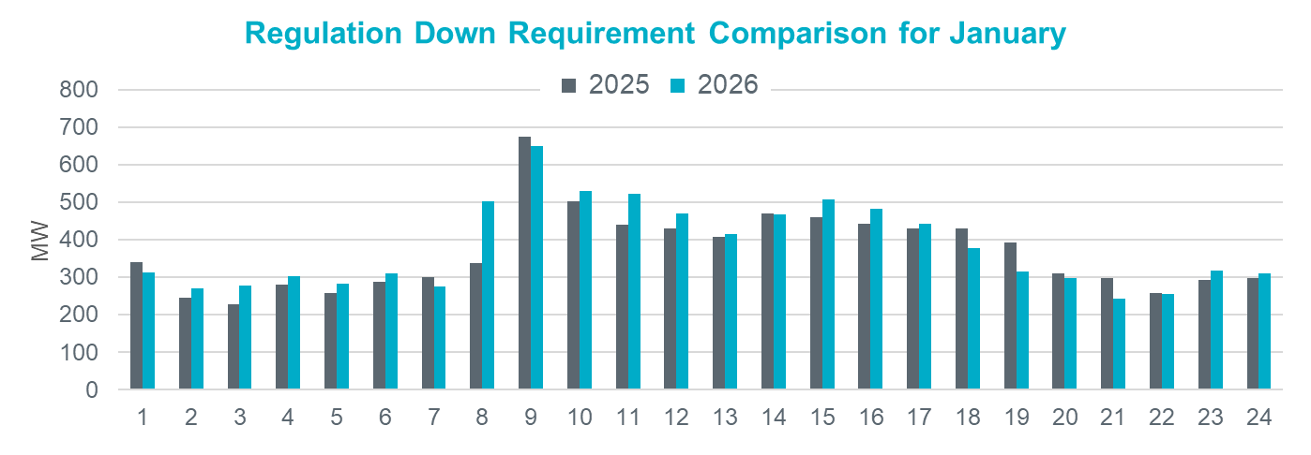
Regulation Comparison January
2026 Reg-Up:
Range: 294 – 694 MW;
Avg: 445 MW (66 MW increase from prev. year)
2026 Reg-Down:
Range: 243 – 649 MW;
Avg: 381 MW (14 MW increase from prev. year)

Slide 15
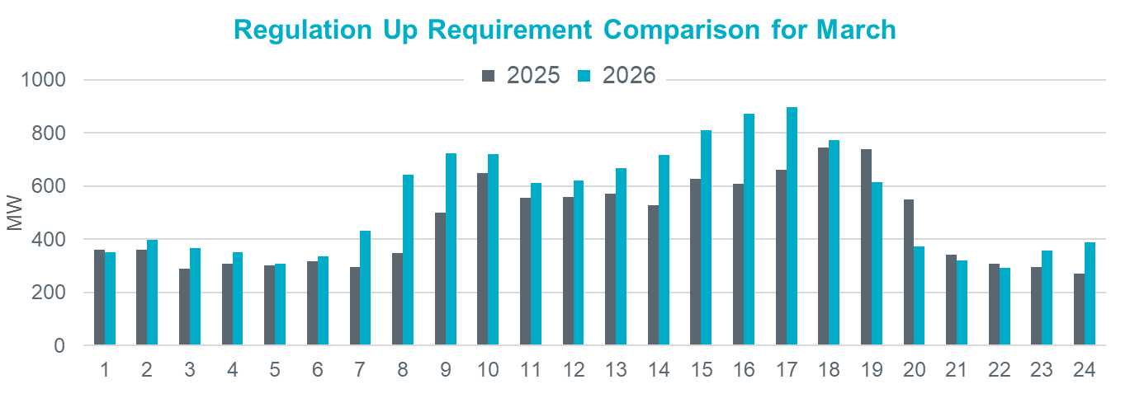
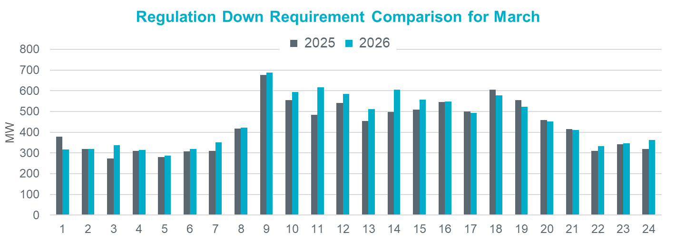
Regulation Comparison March
2026 Reg-Up:
Range: 292 – 896 MW;
Avg: 540 MW (78 MW increase from prev. year)
2026 Reg-Down:
Range: 286 – 687 MW;
Avg: 453 MW (21 MW increase
from prev. year)

Slide 16
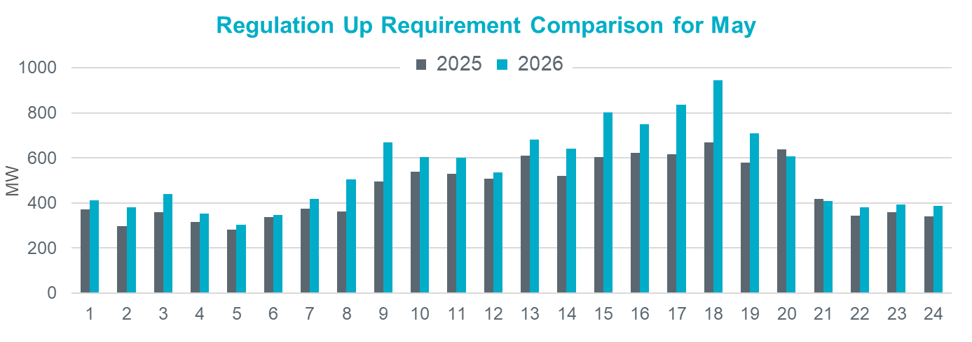
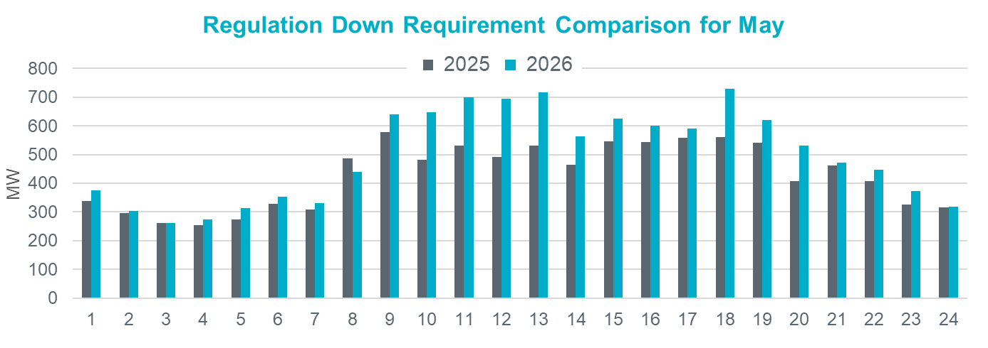
Regulation Comparison May
2026 Reg-Up:
Range: 304 – 944 MW;
Avg: 546 MW (84 MW increase from prev. year)
2026 Reg-Down:
Range: 261 – 728 MW;
Avg: 497 MW (68 MW increase
from prev. year)

Slide 17
Responsive Reserve Service

Slide 18
Responsive Reserve Service (RRS) Methodology
NERC’s preliminary BAL-003 Interconnection Frequency Response Obligation (IFRO) assessment for ERCOT for the 2026 Operating Year (OY) has not yet been published. Therefore, this analysis used the minimum RRS-PFR limit of 1,365 MW for 2025.
The preliminary RRS quantities for January 2026 through May 2026 in subsequent slides have been computed using 2024 and 2025 system inertia conditions and 2025 RRS table.
The RRS table tracks RRS requirements for different inertia conditions. This table uses a minimum RRS-PFR limit of 1,365 MW for 2025, and the table will be updated for 2026.

Slide 19
2025 RRS Table
Scenario | 1 | 2 | 3 | 4 | 5 | 6 | 7 | 8 | 9 | 10 | 11 | 12
LR/PFR | 2.35:1 | 2.2:1 | 2.06:1 | 1.94:1 | 1.83:1 | 1.74:1 | 1.65:1 | 1.58:1 | 1.51:1 | 1.44:1 | 1.39:1 | 1.33:1
Inertia (GW∙s) | 130 | 140 | 150 | 160 | 170 | 180 | 190 | 200 | 210 | 220 | 230 | 240
PFR Req. (no LR) (MW) | 5,960 | 5,563 | 5,200 | 4,892 | 4,622 | 4,329 | 4,114 | 3,920 | 3,744 | 3,522 | 3,314 | 3,139
*RRS Curr IFRO (MW) | 3,320 | 3,273 | 3,227 | 3,183 | 3,145 | 3,068 | 3,031 | 2,982 | 2,941 | 2,863 | 2,767 | 2,699
**RRS Upd IFRO (MW) | - | - | - | - | - | - | - | - | - | - | - | -
Scenario | 13 | 14 | 15 | 16 | 17 | 18 | 19 | 20 | 21 | 22 | 23 | 24 | 25
LR/PFR | 1.28:1 | 1.24:1 | 1.19:1 | 1.15:1 | 1.12:1 | 1.08:1 | 1.04:1 | 1.01:1 | 1:1 | 1:1 | 1:1 | 1:1 | 1:1
Inertia (GW∙s) | 250 | 260 | 270 | 280 | 290 | 300 | 310 | 320 | 330 | 340 | 350 | 360 | 370
PFR Req. (no LR) (MW) | 3,004 | 2,890 | 2,784 | 2,686 | 2,595 | 2,510 | 2,421 | 2,353 | 2,290 | 2,230 | 2,173 | 2,119 | 2,068
*RRS Curr IFRO (MW) | 2,645 | 2,595 | 2,558 | 2,514 | 2,463 | 2,425 | 2,380 | 2,343 | 2,290 | 2,230 | 2,173 | 2,119 | 2,068
**RRS Upd IFRO (MW) | - | - | - | - | - | - | - | - | - | - | - | - | -
*RRS quantity is calculated for RCC of 2,805 with limit of 60% limit on LRs and min RRS-PFR limit of 1,365 MW.
**The 2026 IFRO assessment has not yet been reported back from NERC, preventing the calculation of RRS quantity.
***Red font in table above identifies study scenario where RRS needed < 2,300 MW. RRS requirement during these is based on the applicable floor.

Slide 20
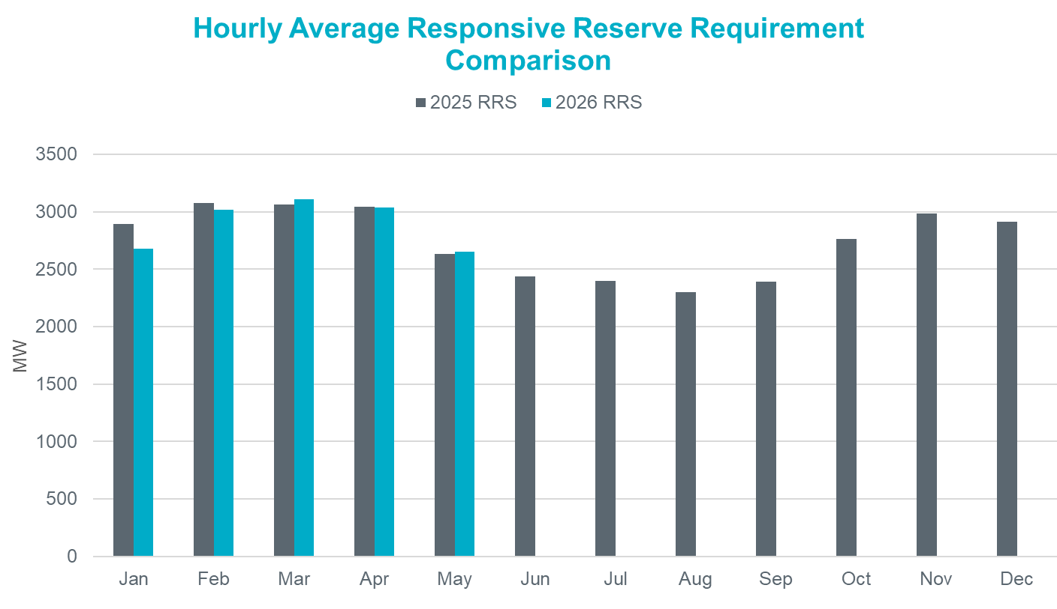
Hourly Average RRS Comparison
2026 RRS:
On avg. 42 MW increase from prev. year
Largest increase is in Mar by 46 MW
Largest decrease is in Jan by 212 MW
*2026 RRS quantities are calculated using the 2025 minimum RRS-PFR limits (to be updated).

Slide 21
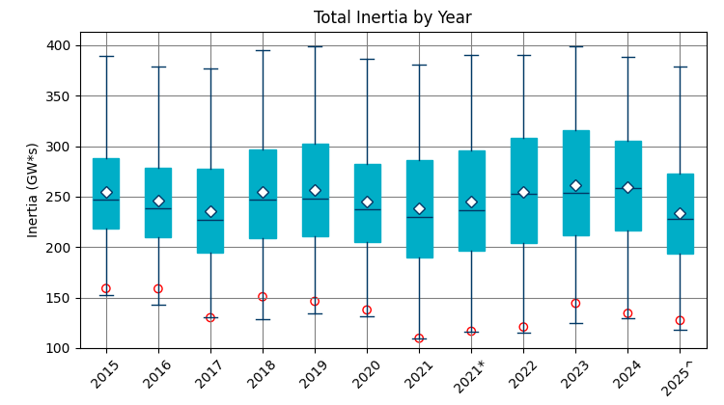
Total Inertia (2015 – 2025.05)
The average inertia in 2024 was comparable to 2023, but currently 2025 is trending lower than in 2023.
[Total inertia for 2015 - 2025.05]

Slide 22
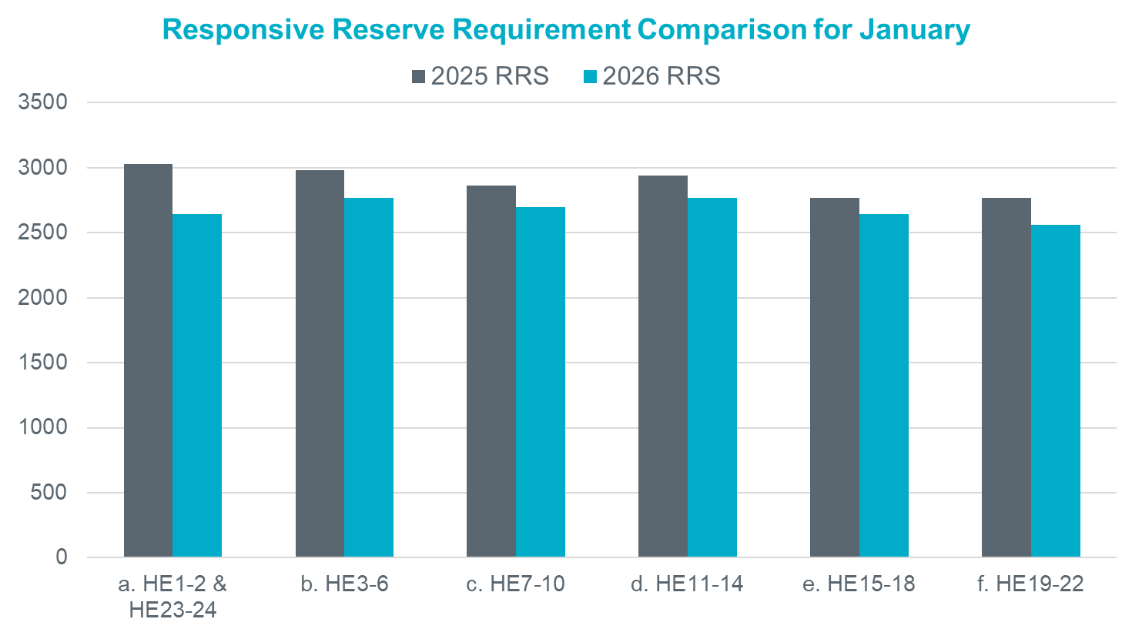
RRS Comparison January
2026 RRS:
Range: 2,558 – 2,767 MW;
Avg: 2,680 MW (212 MW decrease from prev. year)
*2026 RRS quantities are calculated using the 2025 minimum RRS-PFR limits (to be updated).

Slide 23
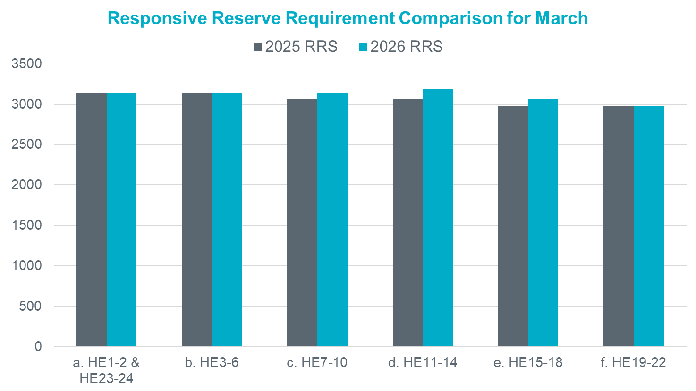
RRS Comparison March
2026 RRS:
Range: 2,982 – 3,183 MW;
Avg: 3,111 MW (46 MW increase from prev. year)
*2026 RRS quantities are calculated using the 2025 minimum RRS-PFR limits (to be updated).

Slide 24
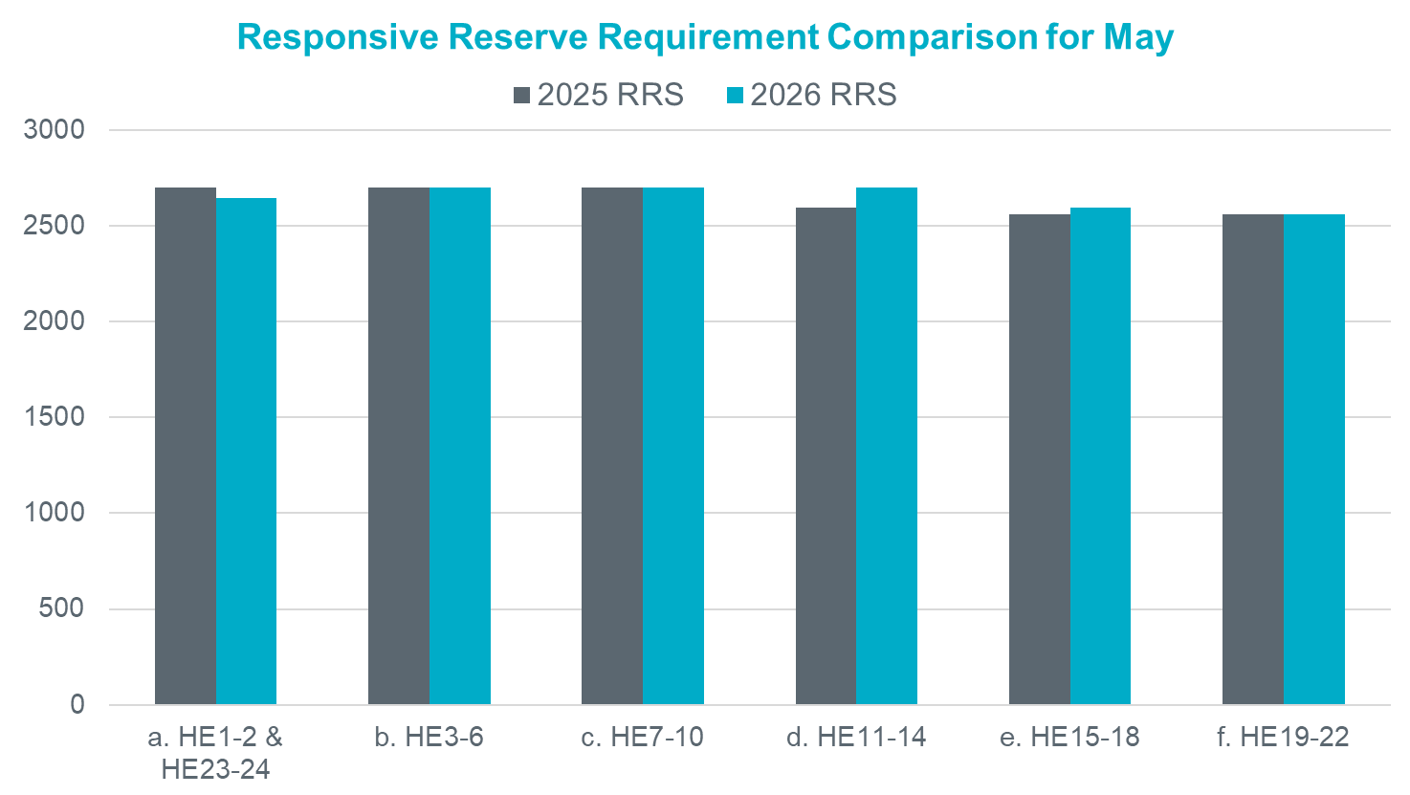
RRS Comparison May
2026 RRS:
Range: 2,558 – 2,699 MW;
Avg: 2,649 MW (14 MW increase from prev. year)
*2026 RRS quantities are calculated using the 2025 minimum RRS-PFR limits (to be updated).

Slide 25
ERCOT Contingency Reserve
Service & Non-Spinning Reserve Service
(In Progress)

Slide 26
ECRS & Non-Spinning Methodologies
ERCOT is working on a probabilistic method to calculate ECRS and Non-Spinning Quantities.
ECRS is reserved capacity that can respond in 10 minutes to recover frequency, cover forecast errors or ramps and replace deployed reserves.
ERCOT is not considering any change to the methodology used to compute the minimum ECRS Frequency requirements in 2026. Frequency Recovery quantities will be utilized as an input to the probabilistic framework.
Non-Spin is reserved capacity that can be started in 30 minutes to cover forecast errors, ramps or forced outages and replace deployed reserves until additional resources can be committed.
ERCOT held a 2026 AS Methodology Workshop on 5/19/25 to introduce the probabilistic framework. ERCOT encourages Stakeholders to review the workshop material to familiarize themselves with the concepts that will be shared going forward.
ERCOT has a second workshop schedule for 6/30/25 to review and discuss the probabilistic methodology, preliminary quantities, and sensitivities.

Slide 27
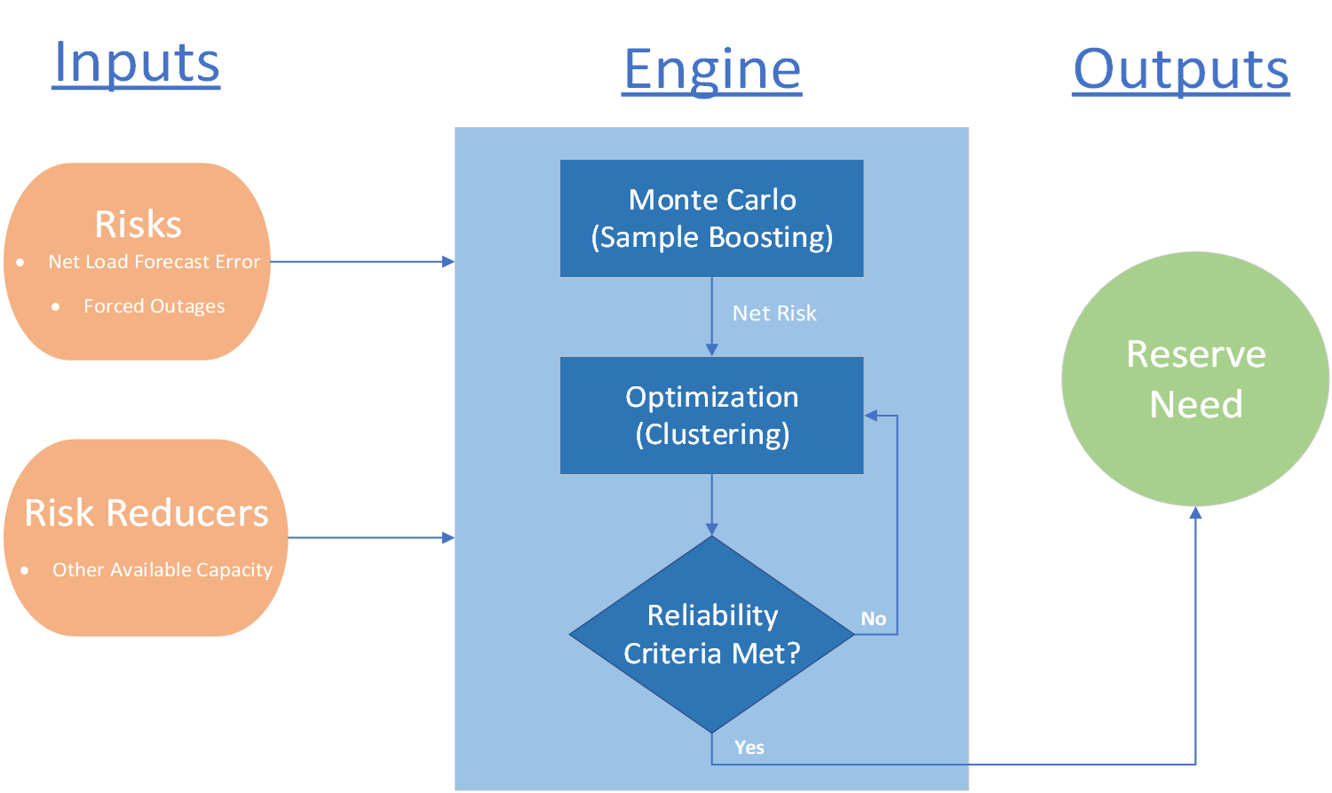
What is changing for ECRS and Non-Spin?
Current Methodology
2026 Methodology
Net Load Forecast Error
X Percentile based on Assumed Hourly Risk
Forced Outages
X Percentile based on Assumed Hourly Risk
Reserve Need

Slide 28
Summary
Based on the analysis ERCOT has conducted thus far,
ERCOT is not considering any changes in the methodologies used to compute Responsive Reserve Service requirements for 2026.
ERCOT is considering some changes in the methodology used to compute the Regulation Service while also considering a probabilistic approach to compute the ECRS and Non-Spin requirements for 2026.
The proposed timeline for this review is included alongside.
Interested Stakeholders are requested to attend the upcoming workshop working group meetings to provide any feedback on the proposed 2026 AS Methodology.
2026 Methodology Review Timeline
June 30th – Workshop #2
July 07, 2025 – WMWG (Proposed)
July 15, 2025 – OWG (Proposed)
July 22, 2025 – PDCWG (Proposed)
August 06, 2025 – WMS
August 07, 2025 – ROS
August 28, 2025 – TAC
September 23, 2025 – BoD
Oct, Nov, Dec 2025 – PUC

Slide 29
Suggestions?

