Slide 1
Load Loss Threshold Analysis
Luis Hinojosa
Operations Analysis
6/20/2025

Slide 2
Background and Introduction
There is a growing demand for power in ERCOT primarily due to large-scale computing facilities such as data centers and cryptocurrency mining operations. ERCOT is tracking an increasing amount of large load in various stages of development.
ERCOT has observed several events wherein multiple large loads have tripped during transmission faults due to their inability to ride through the subsequent voltage dip.
The large load loss may cause issues such as system frequency overshoot or voltage overshoot leading to a cascading effect.
  Frequency overshoot and rate of change could lead to operational impacts, potentially triggering over-speed protections and/or ROCOF protections.
ERCOT staff performed a study to analyze the impact of load loss on the system.

Slide 3
Case Selection and Study
Several aspects were considered to identify a historical real-time system condition where frequency responsive capability was constrained for which to perform this analysis. Considerations include review of Inertia, available “footroom” and generation mix.
“Footroom” is the capacity available to respond to a high frequency event based on generation output, lower operating limits, and generation droop characteristics. This can also be thought of as down Physical Responsive Capability (PRC).
As such, the base case (power flow) from a previous operation condition on 03/12/2024 2:47 AM is used and modified to study different scenarios with different set(s) of loads to trip.
Case:
  Selected power flow case utilizes currently available dynamic models from Market Participants.
Study:
  Run dynamic simulation in TSAT for 20 second duration by simulating a 3-ph fault in West Texas (contingency) at 1 sec and clearing the fault after 4 cycles.
  Each simulation incrementally adds loads which include load trip settings which mimic the ITIC curve. After the fault event, loads trip due to the protection settings.
  Load loss scenarios and sensitivities range from ~1GW up to ~4GW.
Base PF Case | Inertia (GW*s) | Load (MW) | Total Generation (MW) | Thermal Generation (MW) | Wind Generation (MW) | Solar Generation (MW) | Battery Generation (MW)
12-MAR-2024 2:47:54 AM | 169,748 | 41,806 | 44,105 | 15,558 | 22,582 | 0 | 582

Slide 4
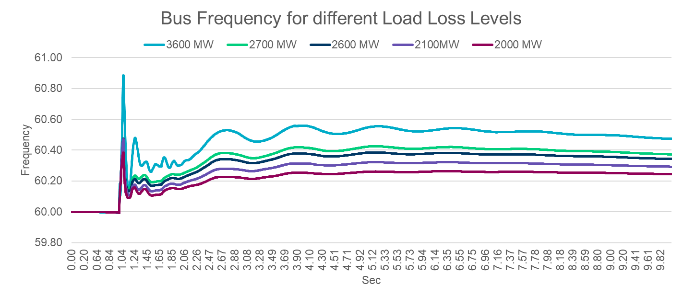
Frequency Chart – Observation 1
MW Load Loss | Steady State Freq
~3,600 | 60.58
~2,700 | 60.42
~2,600 | 60.37
~2,100 | 60.27
~2,000 | 60.25
Key Takeaway: DWG has used a 60.4 Hz threshold in the overshoot studies conducted in 2002 and 2009 based on feedback from generator operations (see page 19 of this DWG report*). Respecting this limit would set a threshold approximately around ~2,600 MW.
*Increasing the overfrequency limit above 60.4 Hz should not be done without coordination with plant operators and a detailed study of plant equipment in the ERCOT system.
Notes:
https://www.ercot.com/files/docs/2009/05/06/09._2008_2009_laars_study_draft04_24_09.doc

Slide 5
Voltage Sensitivity Analysis – Observation 2
Following sensitivity analyses are performed using voltage rise criteria 1.2 pu for 0.5 sec as this puts IBRs in a may trip zone.
The voltage issues become more severe showing a wider area issue around 2,450 MW load loss.
Scenario (Load Loss Level - MW) | Status
~3,600 | Insecure - Wide Area Voltage Issues
~2,600 | Insecure - Wide Area Voltage Issues
~2,450 | Insecure - Wide Area Voltage Issues
~2,100 | Insecure - Local Voltage Issues
~2,000 | Insecure - Local Voltage Issues
~1,950 | Secure
Key Takeaway: In this study, local voltage issues were observed starting at a load loss around ~2,000 MW and wide area voltage issues arose around ~2,450 MW which indicates more severe case conditions around this load loss. Note that, this specific historical case was selected based on the most limiting frequency response characteristics. Potentially, additional analysis is needed to understand this observation better.

Slide 6
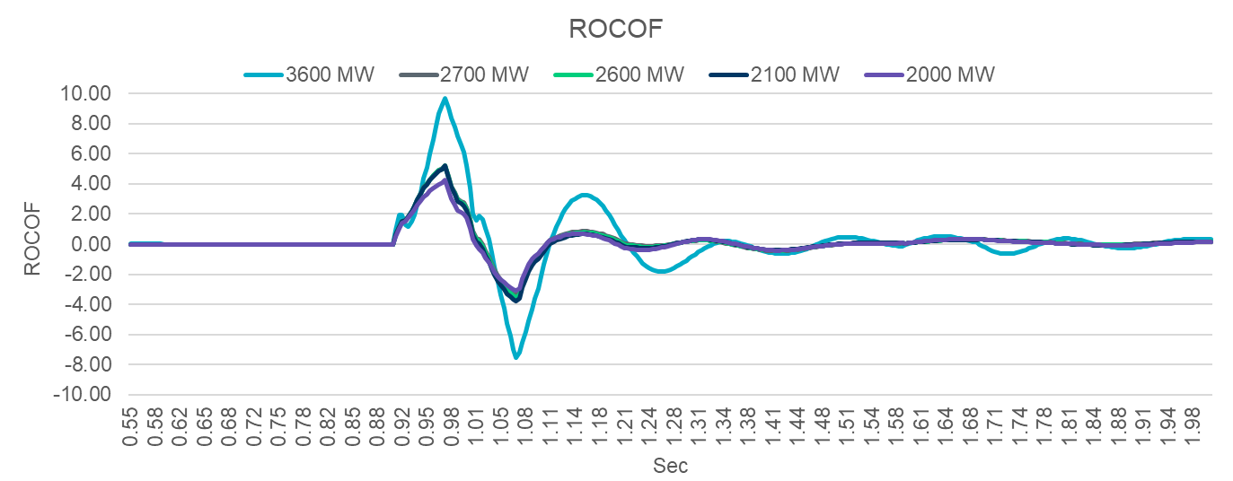
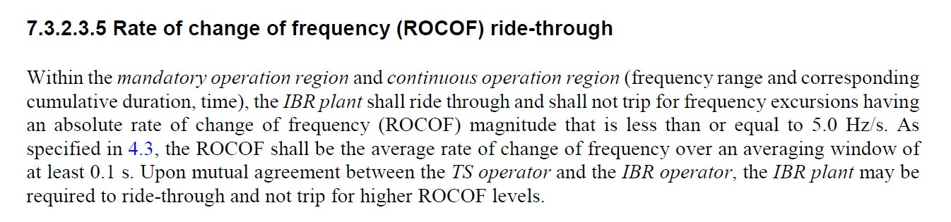
ROCOF using Rolling 0.1s – Observation 3
IEEE 2800
MW Level | Max Absolute ROCOF
~3600 | 9.70
~2700 | 5.23
~2600 | 5.21
~2100 | 5.18
~2000 | 4.25
Key Takeaway: Utilizing IEEE 2800 definition of ROCOF over 0.1s window we see that potentially there is a ROCOF limitation above ~2,000 MW related to IBRs. ERCOT will continue to work with industry experts and software SMEs to determine the validity of these observations.

Slide 7
Summary & Next Steps
Based on the frequency stability analysis (system-wide), ERCOT will propose a 2,600 MW of load loss in PGRR122 and a system operating limit for conditions similar to those discussed in this study.
Based on the voltage stability analysis, ERCOT believes the West Texas system operating limit is approximately 2,000 MW of load loss. ERCOT will implement processes to monitor this constraint in Planning and Operations studies and take appropriate actions.
ERCOT held a Large Load Workshop on 6/13/25 to provide a Large Electronic Load (LEL) voltage ride-through overview and discuss additional next steps.
ERCOT will continue to work on potential mitigations and will keep the Market updated on progress.

Slide 8
Thank You
Questions?

