Slide 1
ERCOT IBRWG: NERC and Other Industry Updates
Julia Matevosyan
Associate Director and Chief Engineer
ESIG
06/20/2025

Slide 2
NERC Milestone 3 Standards Update
NERC Reliability Standards Under Development
Project 2020-06 – Verifications of Models and Data for Generators
  MOD-026; MOD-027; FAC-002
  Posted for ballot with voting period June 6 through June 18
Project 2021-01 – System Model Validation with IBRs
  MOD-033
  Initial Ballot closed 05/21/21: 57%
Project 2022-02 – Uniform Model Framework for IBR
  MOD-032; TOP-003; IRO-010
  Initial Ballot closed 05/16/2025
  MOD-032: 39%; TOP-003: 34%; IRO-010: 41%;
Related: Project 2022-04 - Electromagnetic Transient Modeling
  MOD-032; FAC-001; FAC-002

Slide 3
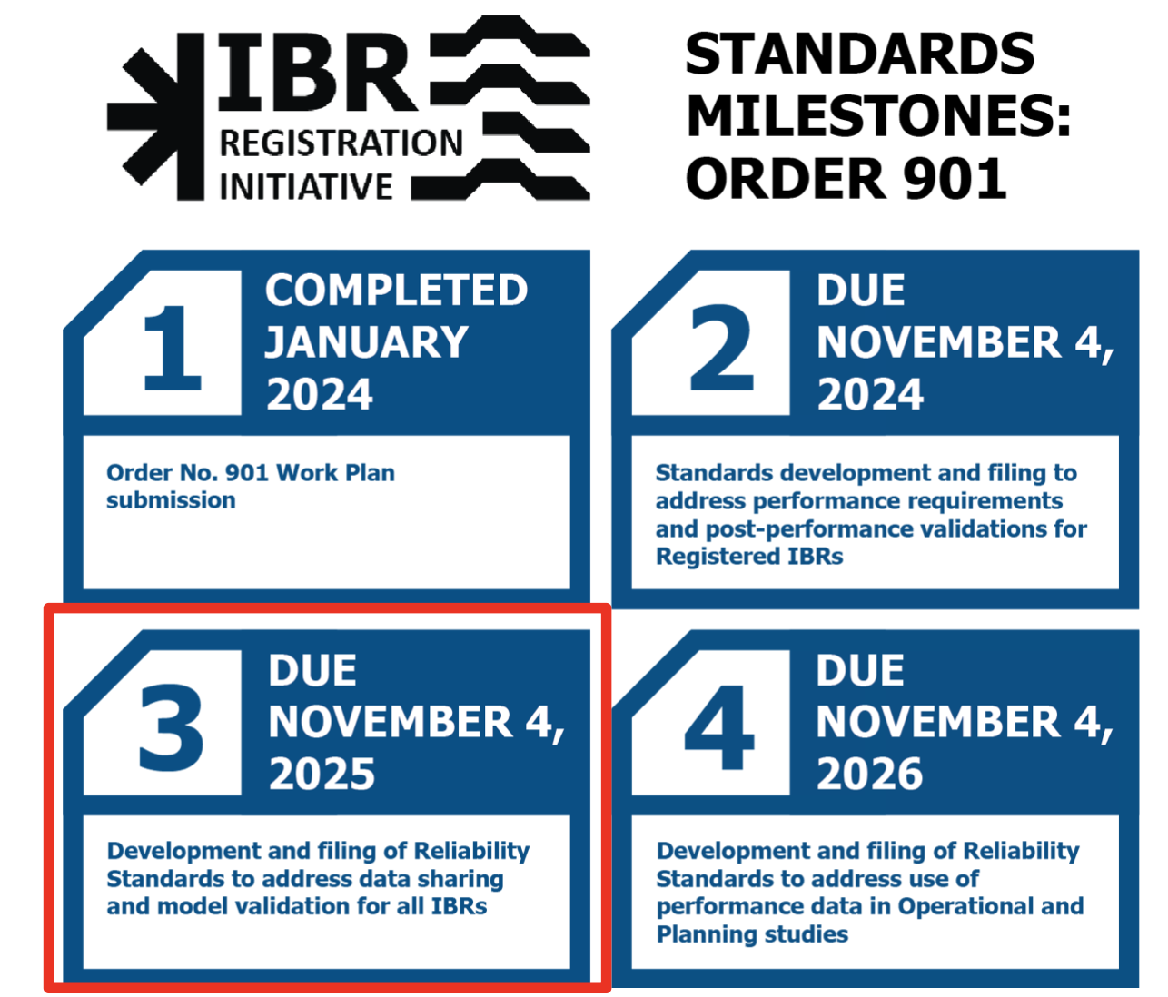
NERC Order 901 Timeline Simplified
Source: NERC

Slide 4
NERC ​​​Industry Engagement Workshop for Reliable IBR Integration and Milestone 3
Day 1 – Industry Panels on Modeling Topics
Day 2 – Standard Drafting Team Leadership went through submitted comments
Materials are posted on the NERC “Reliability Standards Under Development” page here https://www.nerc.com/pa/Stand/Pages/Standards-Under-Development.aspx
This webpage also has links to each respective Standard Drafting Team page

Slide 5
NERC Project 2022-04 (Not Milestone 3 but Related)
NERC Project 2022-04 team held a webinar on their standards revision efforts related to EMT modeling and studies. The draft FAC-002-5 revisions include the following:
Each TP and PC must have specific EMT modeling requirements including a documented process for collecting models and the necessary documentation to support EMT model review.
Each TP and PC must also establish and maintain a process to determine the necessity of various studies for evaluating reliability impacts (i.e., when and where to use certain model types.
Each GO (or TO) must provide EMT models following established modeling requirements set by the TP and PC.
Each GO (or TO) must also issue a final attestation stating that the EMT models studied match the control modes, settings, protections, and performance of the installed equipment; including a report demonstrating that testing or monitoring matches EMT model response.
Each TP and PC must review the EMT models submitted to verify that they meet the requirements set forth.
The proposed implementation plan is 24 months after the effective date of the future standard.
The team is planning to request authorization from the NERC Standards Committee (SC) to post the draft standard and implementation plan on July 16. A 45-day formal comment period would then follow through Sept 11. The ballot pools form through Sept.
Source: LinkedIn post by Elevate

Slide 6
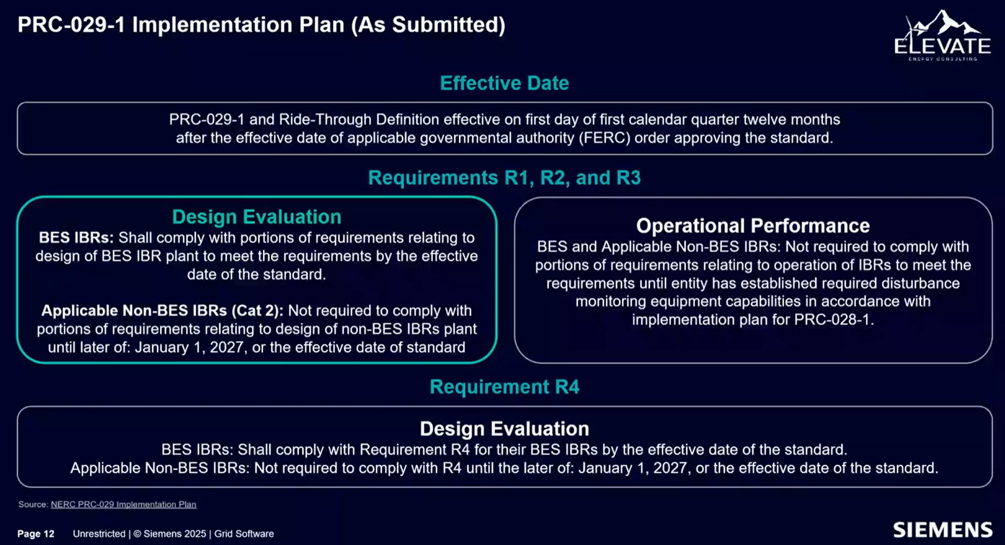
Siemens Webinar Series: NERC PRC-029 Ride-Through Assessments (6/17/2025)
Webinar 1: NERC PRC-029 Ride-Through Assessments
Siemens PSS/E and Elevate Energy Consulting delved into the intricacies of NERC PRC-029 ride-through assessments and how PSS/E can be utilized to conduct IBR ride-through verification testing, ensuring compliance with NERC standards.
Webinar 2: Data Center Modeling – 7/8, 11 am ET
Webinar 3: DER and Load Modeling and Model Validation, 8/12, 11 am ET
https://www.siemens.com/global/en/products/energy/grid-software/planning/pss-software/pss-e/webinar-series-navigating-modern-grid-requirements.html#Registration

Slide 7
Other NERC Updates (from Mark Henry, TRE)
PRC-029 is still in review at FERC, and PRC-028 and -030 implementation depend in part of effective date of PRC-029. A couple of late comments were submitted to FERC;
No action yet on Category 2 GO IBR registration. It will have less impact in TRE/ERCOT than elsewhere
NERC IRPS moved their meeting to June 26. Agenda items relevant to ERCOT IBRWG:
  Maximizing Ride-through Capability of Existing IBRs – Ryan Quint
  Comparison of IEEE 2800 with PRC-029 and PRC-028 – Manish Patel
NERC EMTWG is seeking volunteers for a white paper focused on best practices for benchmarking IBR plant models. The goal is to explore and document industry practices for comparing EMT models with positive sequence phasor domain (PSPD) models, and to provide technical guidance, examples, and considerations for validating aggregate plant models. Request volunteers of all types with relevant experience by June 30 (email: Aung.Thant@nerc.net)
Notes:
Comment from Mark on PRC-029 comments: one entity is concerned about DC chopper circuits which have thermal limitations for long duration events and would like the standard to be rewritten to accommodate them, instead of seeking hardware exclusions – I don’t think we have any of these in ERCOT, most are associated with offshore wind.

Slide 8
Other NERC Updates (from Mark Henry, TRE)
EMTWG got RSTC approval last week to post two whitepapers for industry comments:
  EMT Modeling Adoption for Interconnection and Planning Studies – An Industry Survey
  EMT Analysis in Operations Planning
On ERCOT-related matters, PUCT will decide on the exemption process for ERCOT Technical Standards (Project No. 57374) at their open meeting today.
This is the overall process for handling any reliability-related exemptions and extensions, not specific technical matters related to NOGRR245.
Notes:
As of 6/18 EMTWG paper have not yet been posted for industry comments
The first EMTWG White paper is on: Case Study on Adoption of EMT Modeling and Studies in Interconnection and Planning Studies for BPS-connected IBRs
Assessment of The Need for EMT Modeling and Simulation in Offline Operation Studies and Requirements

Slide 9

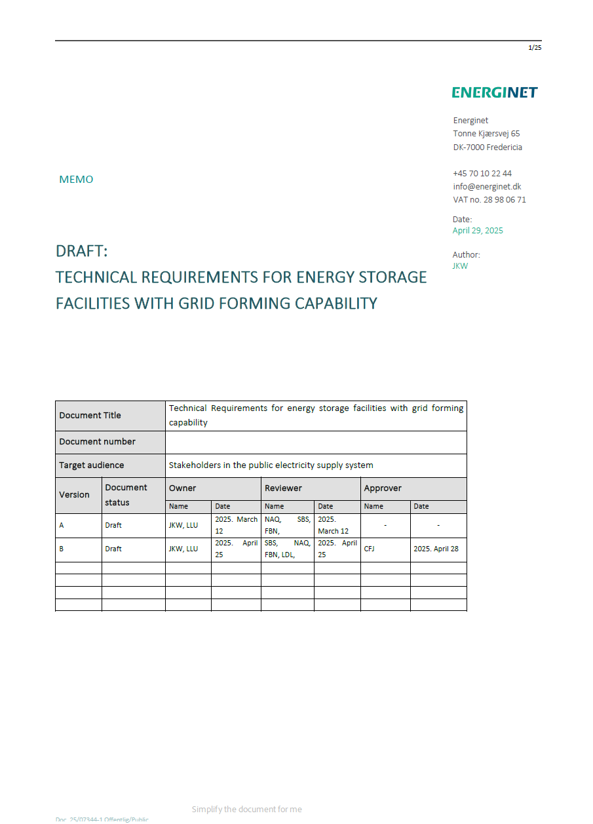
Danish System Operator Energinet is Developing GFM BESS Requirements
In 2023, study to reduce gaps on the deployment of new technology and engage industry partners to get deeper insight of GFM BESS technology
Knowledge gained from the study fed into development of GFM requirements
Version 2 is under preparation, looking at GFM from wind, PV, hybrids
Currently, the focus is on developing GFM BESS requirements
Implementation is the next step (i.e. market product or mandatory). In the meantime – voluntary requirements
Requirements only apply to future BESS, if existing one wants to retrofit, they need to notify Energinet and work with them.
If an existing BESS is undergoing a significant modification, Energinet may determine GFM is required (or procured) depending on location.
Energinet held two stakeholder meetings to introduce draft requirements and to address submitted industry comments
Next step is to publish an updated GFM BESS Requirements draft in early fall
Notes:
65% of energy annually in Denmark comes from wind and solar, number of HVDC interconnectors between two parts of Denmark and other countries (UK, Germany, and Norway).
Existing and future weak grid issues and local high RoCoF issues is what they are trying to address by GFM
Available to download : https://en.energinet.dk/about-our-reports/reports/towards-astable-and-sustainable-future-with-grid-forming-technologies/

Slide 10
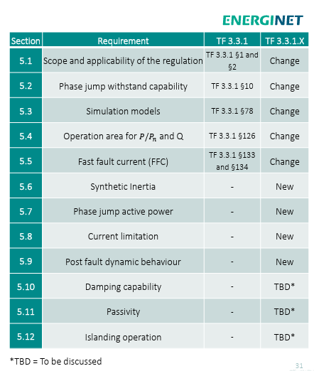
Danish System Operator Energinet is Developing GFM BESS Requirements

Slide 11

VDE FNN Guideline for Grid Forming Properties
In July 2024, the technical regulator for power grids in Germany VDE FNN published the guideline “Technical Requirements for Grid-Forming Properties, Including the Provision of Instantaneous Reserve”. With that Germany established harmonized requirements for GFM units, ensuring the stability with rapidly-growing shares of IBRs.
The industry has been since awaiting formal verification and certification processes.
This was published in May 2025 with an updated version of the VDE FNN guideline. The new guideline for grid-forming properties establishes a clear framework and pathway for the certification and market approval of GFM units in Germany.
By providing detailed definition of compliance procedures, it paves the way for the widespread adoption of this essential technology for the energy transition.
https://energynautics.com/en/new-vde-guideline-for-grid-forming-properties/

Slide 12
German inertia market model (BNetzA’s draft)
A market with unlimited volume & fix regional prices* (over 2-10 years) for different product types:
* The regional price for each product is proportional to the offered inertia constant of power plants.
Minimum availability over a year
1. Positive inertia „Basic Product“
2. Positive inertia „Premium Product“
3. Negative inertia „Basic Product“
4. Negative inertia „Premium Product“
30 %
90 %
30 %
90 %
Source: “Requirements and verification procedures for gridforming units – the German approach to ensure power system stability under very high penetration of inverter-based sources”, presented by K. Malekian, E. Quitmann (Enercon), T. Bülo (SMA), J. Massmann (Amprion), M. Schmieg (DigSilent), C. Wulkow (VDE FNN), 23rd Wind & Solar Integration Workshop, Helsinki, Finland, October 8-11th

Slide 13
Meeting the system needs with the help of three pillars
Today
2025
2030
TSO-Assets (VINKs)
1
Goal: Further development of the state
of technology of TSO assets and
Reactive power compensation units
will have grid forming properties
and short-term storages
Amprion will build approx. 10 units
(with 2,1 GVAr and 15 GWs)
contributing towards inertia and
system strength until 2030
2
Market based procurement of inertia
Goal: Accelerate the market maturity of
generation units, storages and loads with
grid forming properties and inertia
Implementation of a bonus system
Differentiation between positive and
negative inertia
Close monitoring of procured quantities
and delivery levels
FNN will define technical requirements
and verification/compliance procedures
3
Grid Code Requirements
Goal: Contribution from generation units,
storages and loads
Implementation of amended European
Guidelines (RfG, HVDC)
Source: “Requirements and verification procedures for gridforming units – the German approach to ensure power system stability under very high penetration of inverter-based sources”, presented by K. Malekian, E. Quitmann (Enercon), T. Bülo (SMA), J. Massmann (Amprion), M. Schmieg (DigSilent), C. Wulkow (VDE FNN), 23rd Wind & Solar Integration Workshop, Helsinki, Finland, October 8-11th

Slide 14

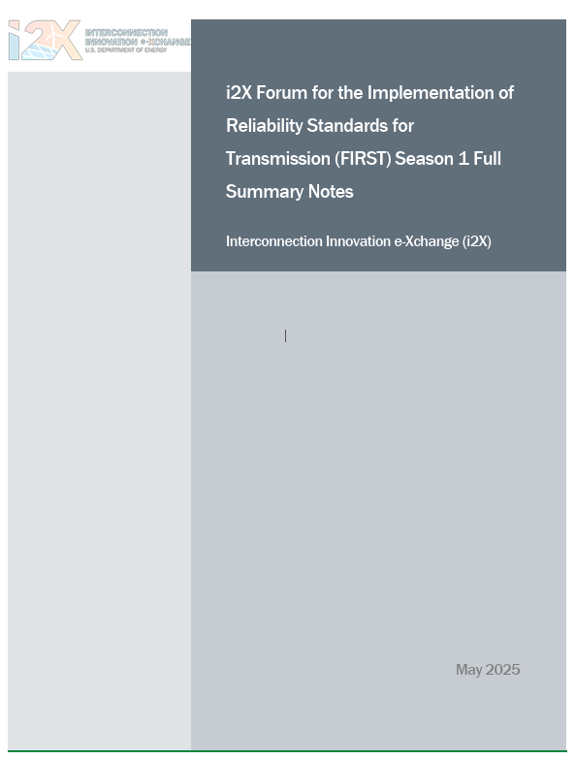
DOE Forum for the Implementation of Reliability Standards for Transmission (i2X FIRST)
Reactive Power – Voltage Control Requirements (continued) |April 29, 2025
  Nighttime Reactive Power Support from Solar Inverters: Aminul Huque, EPRI
  Communication of Capability and Status of Online IBRs at 0 MW Output: Alex Lee, ERCOT
  Reactive Power – Voltage Control Requirements, Developer's Perspective: Divya Kurthakoti Chandrashekhara, Orsted
Presentation and recording of Season 1 are posted here

Slide 15
DOE Forum for the Implementation of Reliability Standards for Transmission (i2X FIRST) – Season 2
May 27, 2025, 11 a.m. - 1 p.m. ET – Season 2 Kick-Off
June 24, 2025, 11 a.m.- 1 p.m. ET – NERC Milestone 3 Standards
July 22, 2025, 11 a.m.- 1 p.m. ET – IBR Plant Design Evaluation with Applicable Requirements I
August 26, 2025, 11 a.m.- 1 p.m. ET – IBR Plant Design Evaluation with Applicable Requirements II
September 23, 2025, 11 a.m.- 1 p.m. ET – IBR Plant Modeling Requirements and Best Practices
October 21, 2025, 11 a.m.- 1 p.m. ET – Challenges with IEEE2800-2022, Planned Revisions
November 25, 2025, 11 a.m.- 1 p.m. ET – Change of Management during IBR Plant Interconnection Process and Commissioning, How to Maintain Conformity
December 16, 2025, 11 a.m.- 1 p.m. ET – IBR Plant Commissioning Best Practices I
January 27, 2026, 11 a.m.- 1 p.m. ET – IBR Plant Commissioning Best Practices II
February 24, 2026, 11 a.m. - 1 p.m. ET – Grid Forming IBR Specifications and Testing Requirements I
March 16, 2026, hybrid event during ESIG Spring Workshop: Grid Forming IBR Specifications, Testing Requirements, Lessons Learned
Sign up for all future i2X FIRST Season 2 Meetings here
Follow ESIG i2X FIRST website https://www.esig.energy/i2x-first-forum/ for meeting materials & recordings and for future meeting details & agendas

Slide 16
Julia Matevosyan
julia@esig.energy

