Slide 1
Update on ESR Qualification Amounts for post RTC Go-Live
ERCOT Staff
PDCWG
June 20, 2025

Slide 2
Ancillary Service Qualification under ESR Single model
ERCOT has sent RFIs to the Market Participants to share the Ancillary Service Qualified MWs for Regulation, ECRS, RRS-FFR and Non-Spin that will apply to each ESR post implementation of Real Time Co-Optimization with Battery Single Model(RTC+B.)
ERCOT has based the AS Qualified MWs with the existing qualified MWs for the ESR’s injection side(ESR-GR), ESR’s charging side and submitted data during the AS qualification process.
ERCOT has also shared how each ESR’s qualified MWs for Regulation and ECRS may be further adjusted if the TAC approved version of NPRR1282:Ancillary Service Duration under Real-Time Co-Optimization were to be approved by PUC.

Slide 3
RRS-PFR Qualification approach for ESRs
Under RTC+B, ERCOT’s expectation is that the droop characteristic of an ESR is based on its full range, i.e. LSL to HSL. For instance, a 1% droop response would be such that if ESR were to be charging at LSL, when frequency drops to 59.4 Hz(i.e. a 1% change from nominal frequency), the ESR will provide 100% response by moving from LSL to HSL.
An ESR that is set up to meet the expectations as described in this example is considered as 1% response ESR and will be qualified for RRS-PFR up to 100% of their HSL to LSL range.
ERCOT understands that some ESRs likely are not setup to follow droop characteristics described above and absent a control system change may move from LSL to 0 in the example above.
Such ESRs are considered as an effective 2% response ESR and will be qualified for RRS-PFR up to 50% of their HSL to LSL range. The QSE have the option of keeping the same settings or change the control system such that they can meet 1% droop characteristics.
ERCOT’s review showed that all Governor Frequency Response tests submitted for ESRs currently use ESR base load as HSL. In the RFI, ERCOT requested QSEs to determine the option they would like to use and re-submit the Governor Frequency Response tests in the ERCOT NDCRC application for each ESR with Base Load set to HSL-LSL.
ERCOT intends to use these resubmitted forms to update each ESRs RRS % Limit.

Slide 4
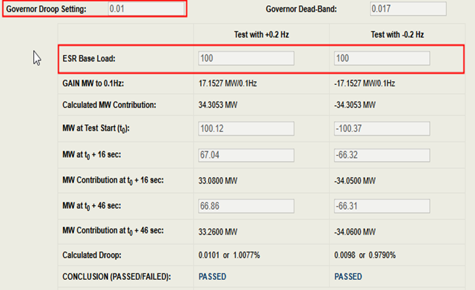
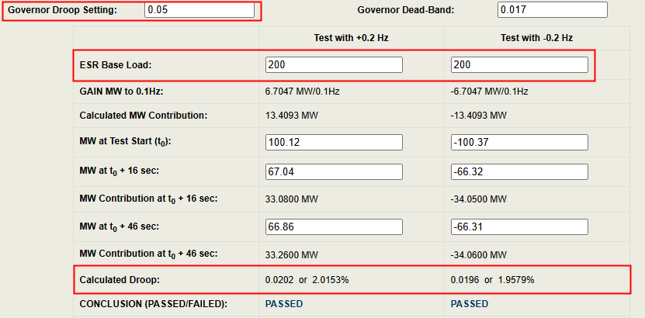
Example1
±100 MW ESR is tuned to provide 100% of HSL response with 1% droop for 1% change in frequency and ESR intends to keep this tuning. Effective droop for such ESRs with Base Load set to full range is 2%.
Existing Test
Expected Test with ESR Base Load set to full range
Note: The Maximum Droop setting per ERCOT Nodal Operating Guide is 5%

Slide 5
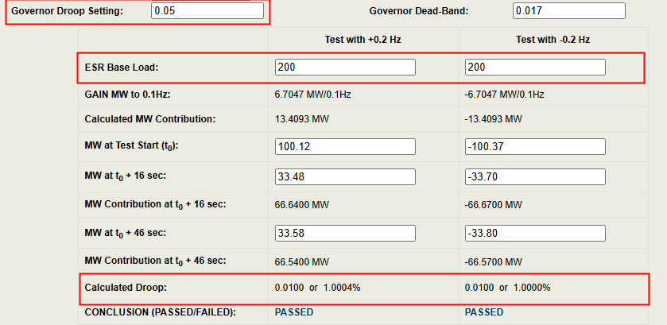
Example2
±100 MW ESR is already tuned to provide 100% of HSL to LSL response for 1% change in frequency or ESR is tuned to 100% of HSL response for 1% change in frequency and intends to change control settings to meet HSL to LSL expectation

Slide 6
Discussion

