Slide 1
RTC+B Task Force
Update
Matt Mereness
RTCBTF
June 18, 2025

Slide 2
Outline
Discussion today:
Update on RTCBTF Issues List
Update on NPRRs
Market Trials Update
Rest of Today’s Agenda

Slide 3
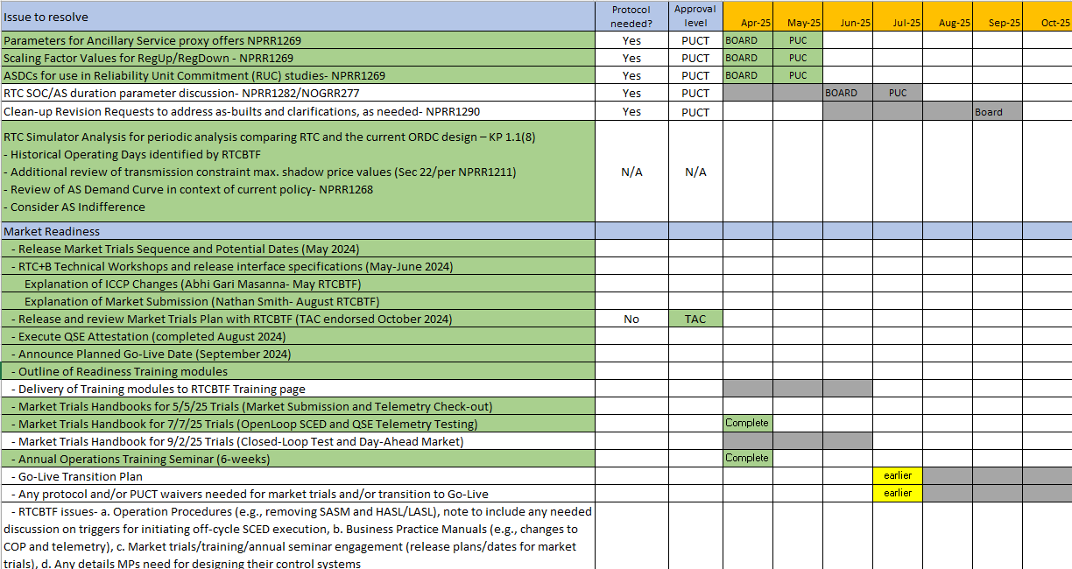
RTCBTF Issues List
Revisions- NPRR1282/NOGRR277 (June) and final Clean-Up NPRR1290 (September)
Implementation - Completing handbooks and initiating transition plan details
Market Trials

Slide 4
Summary and Timeline of NPRRs
NPRRs set for PUCT May 15 Open Meeting (PUCT approved)
NPRR1268 for ASDC Modifications (IMM sponsor)
NPRR1269 for 3 Parameter/Policy Changes (ERCOT sponsor)
NPRR1270 for AS Qualification details (ERCOT sponsor)
AS Duration / State of Charge (NPRR1282 / NOGRR277)
At Board next week
Final Clarifying NPRR1290 –Target Sep Board
Review today from Dave and discussion of Shams proposal
There will be an accompanying NOGRR
Remaining Stakeholder path to Board Meetings before Go-Live:
PRS May 14 > TAC May 28 > Board June 24
PRS Aug 13 > TAC Aug 28 > Board Sep 23

Slide 5
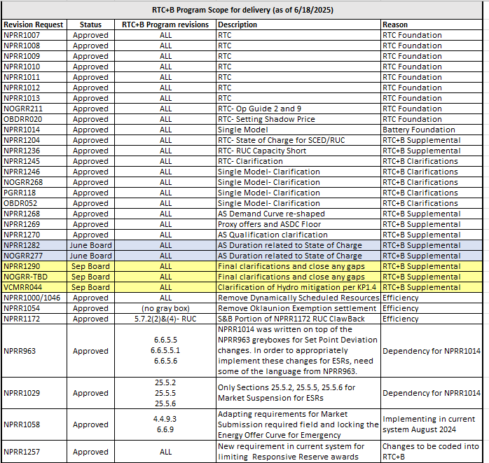
RTC+B Scope
Final 2025 Refinements for Go-Live
Related NPRRs
within Program

Slide 6
Sequence and Dates for Market Trials to Go-Live
30-day Market Notice
11/5/25
March/April
2025
Start
5/5/25
Start
7/7/25
Start
9/2/25
Go-Live
12/5/25*
May 2025
June 2025
July 2025
Aug 2025
Sep 2025
Oct 2025
Nov 2025
Dec 2025
QSE Scorecards & Exit Criteria for each Trial Phase
RTC QSE Submission Testing
(Submit COP, RT AS Offers,
DAM Virtual AS, Outages for ESRs)
Open-loop RTC SCED
(QSE offers, SCED non-binding award/dispatch)
Ongoing Open-Loop
& Periodic Closed-loop SCED/LFC
(QSE RTC offers and telemetry to support closed-loop frequency control test 2-3 tests of 2-4 hour durations)
Transition to Go-Live
Upon completion of testing, confirmation of ERCOT and market readiness for Go-Live.
QSE/Vendor Submission Sandbox and Telemetry Points added Prod EMS model.
RTC QSE Telemetry Check-out (QSEs add/verify new telemetry points for UDSP, New ramp rates, ESR telemetry)
QSE Telemetry Tests
(Individual QSE to follow UDSP and support new ramp rate and ESR telemetry)
Day-Ahead Market
(Non-binding DAM using QSE offers for at least 2 tests)
* Go-Live date reflects 12/5/2025 as first Operating Day
where 12/4/2025 is planned software migration.

Slide 7
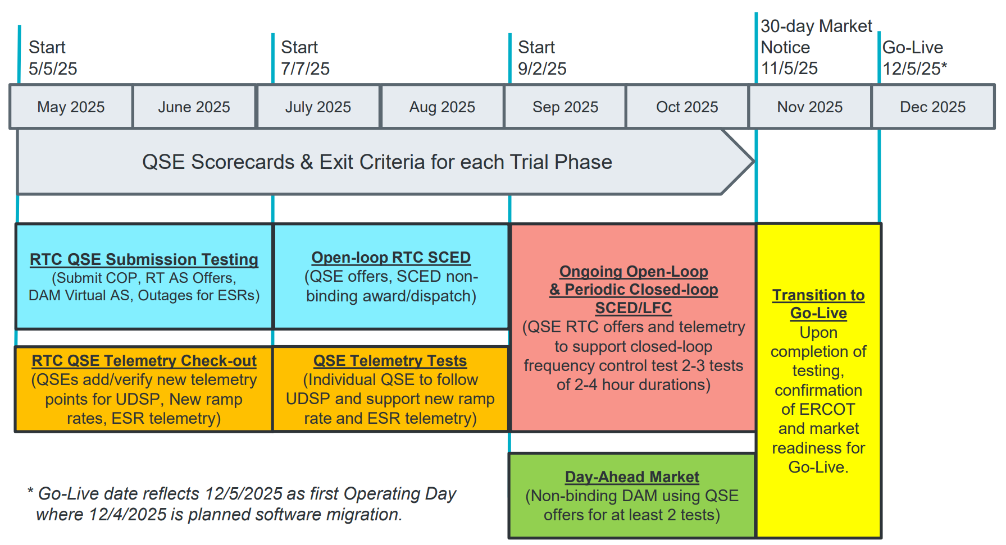
May & June:
Establishing Connectivity
QSE will test their market submissions for defined subset transactions that are new or modified by RTC+B.
Scorecard goal is for 95% of QSEs to demonstrate successful submissions and have mitigation plans in place for remaining 5% to address in next trial phase.
QSE will add telemetry points for Energy Management System (EMS) system interface with ERCOT (such as Updated Desired Set Points (UDSP), New Ramp Rates, and ESR Telemetry)
Scorecard goal is for 98% of QSEs to demonstrate successful telemetry additions, and mitigation plans in place for remaining 2% to address in next trial phase. (Note 3-week lag in telemetry migrating through network model validation and into trials environment).

Slide 8
July & August:
Initial Real-Time Market execution and verify QSE ability to follow ERCOT frequency signals
QSE will support “parallel production” 2days/week by entering $bids/offers for non-binding RTC energy and A/S awards and dispatch (Open-loop test)
Scorecard goal for 100% of QSEs to demonstrate successful submissions and telemetry reflective of production, and mitigation plans in place for any outliers.
Coordination of individual QSE tests on subset of resources to ensure resources can follow new UDSP telemetry point from ERCOT.
Scorecard goal is for 98% of QSEs to successfully demonstrate, and mitigation plans in place for remaining 2% to address in next trial phase.

Slide 9
Sep & Oct:
Required live-production test to ensure effective frequency dispatch and control.
Sep & Oct:
Optional Day-Ahead Market
Voluntary Day-Ahead Market for all QSEs will be conducted at least 2 times.
QSE can test their market submissions for Day-Ahead AS Self-Arrangement, AS Only Offers, Trades and normal submissions.
DAM participation is strongly encouraged but not required in Readiness metrics since RTC procures AS in Real-Time.
Participation includes much broader QSE population (marketers and load-only QSEs).
ERCOT and QSEs will conduct live-production tests of RTC-SCED and Load Frequency Control (LFC) prior to go-live.
RTC-SCED and frequency control dispatch during the tests will be binding to manage the reliable operations of the grid for2-4 hours.
ERCOT will coordinate with QSEs on how to submit RTC offers and telemetry for Energy and AS for the two systems (current and RTC system).
ERCOT will provide a summary of the test and use analysis and engineering judgement to assess if the test was successful in controlling frequency.

Slide 10
Weekly Market Trials update
Trials meeting every Monday 10-10:30am until December
Standalone calendar page each week with WebEx
RTCBTF Home Page houses all market trials documentation
Averaging 150-175 participants
Weekly presentation walk-through with Q&A
Weeks 1&2 were educational
Week 3 scoring was initiated
Heavy use of RTCB@ercot.com email -> FAQ
Quick walkthrough of this week’s meeting

Slide 11
Transitioning into July/August
Trials meeting every Monday 10-10:30am until December
Standalone calendar page each week with WebEx
RTCBTF Home Page houses all market trials documentation
Averaging 150-175 participants
Weekly presentation walk-through with Q&A
Heavy use of RTCB@ercot.com email -> FAQ
Quick walkthrough of this week’s meeting

Slide 12
Other Updates
Readiness engagement update:
Developed new folders on RTCBTF home page (done)
Market Trials folder: Handbooks and supporting materials
Technical Support folder: Key TWG technical materials
RTCB@ercot.com mailbox for support of stakeholder implementation questions
Established FAQ document and posted on RTCBTF home page
Target to add more training videos in next 30 days (in process)
Operations / Load Resources / RTC Worksheet Solver Walkthrough
Day-Ahead Market / Battery
Following guidance from RTCBTF to engage DSWG separately (done 4/17/25)
Outreach to Operator Training Seminar and Spring GCPA (complete next Wednesday)
Closed-Loop LFC planning (critical for market feedback- workshop?)
ERCOT evaluating approach to protocol waivers for LFC and Cutover
Internal work on Transition/Cutover Plan Handbook
Weekly Market Trials in flight
Next TWG meeting is June 26 (technical side of RTCBTF)
Next 2 slides are key to upcoming access changes

Slide 13
RTC+B Market Submissions - Systems configurations
Start
03/2025
Start
05/2025
Start
07/2025
Start
09/2025
Go-Live
12/5/25*
Feb 2025
Mar 2025
Apr 2025
May 2025
June 2025
July 2025
Aug 2025
Sep 2025
Oct 2025
Nov 2025
Dec 2025
Optional: RTC QSE/Vendor Developer
Submission Testing
RTC QSE
Submission Testing
Open-loop
RTC SCED
Ongoing Open-Loop
& Periodic Closed-loop SCED/LFC
Certificate: Current MOTE
Env: ERCOT RTC Market Trial
URL: RTC MIS MOTE URL
Certificate: Current Production
Env: ERCOT RTC Market Trial
URL: RTC MIS Market Trial
Cert: Production
Env: Prod
URL: MIS Prod
QSE/Vendor developer can use MOTE certificates & RTC MIS MOTE API URL to test the submissions until end of submission testing phase (end of June) as needed. At the start of the Open Loop testing, RTC MOTE MIS URLs will be disabled.
URL links: RTC MOTE and Market Trial URL links to be used for MMSUI, OSUI and API submissions. Actual links are provided in next slide.
For notifications/responses to MPs from RTC Market Trials environment, MP will need to provide the listener URL to ERCOT

Slide 14
RTC+B Market Submissions - Systems configurations (Updated with URLs)
RTC+B Market Trials and Go-live
RTC Phase | Digital Certificate | MMSUI / OSUI URL | API / WAN URL
Vendor/QSE Submissions Testing | Current MOTE | RTC MOTE MIS URLs https://testmarkettrials.ercot.com/mmsui/mmsui/displayTradesLanding.action https://testmarkettrials.ercot.com/osrui/osrui/Summary.action | RTC MOTE API/WAN URL https://testmarkettrialsapi.ercot.com/NodalAPI/EWS/ https://testmarkettrialsapi.wan.ercot.com/NodalAPI/EWS/
Open Loop and Closed Loop Testing | Current Production | RTC Market Trial URL https://markettrials.ercot.com/mmsui/mmsui/displayTradesLanding.action https://markettrials.ercot.com/osrui/osrui/Summary.action | RTC Market Trial API/WAN URL https://markettrialsapi.ercot.com/NodalAPI/EWS/ https://markettrialsapi.wan.ercot.com/NodalAPI/EWS/
From RTC Go-live onwards | Current Production | Current Prod MIS URL mis.ercot.com/mmsui mis.ercot.com/osui | New Production API/WAN URL

Slide 15
Focus for remainder of RTCBTF today:
3. NPRR1290 updates and discussion (D. Maggio)
Potential ERCOT modifications/additions
HEN presentation on System Lambda capping
4. Energy Storage Update (no discussion planned at this meeting)
NPRR1282/NOGRR277 (at Board June 24)
Discussion of AS Deployment Factors (July RTCBTF)
5. Market Readiness
Edits to Handbook 4- QSE Telemetry Tests
Review Handbook 5- Closed-Loop LFC Test - Round 3 review (M. Mereness)
Review Handbook 6- Day-Ahead Market Tests - Round 3 review (A. Moreno)
Initial Transition Plan (July RTCBTF)
Initial subset of Operating Procedures changes (Aug RTCBTF)

