Slide 1
NDSWG Meeting
June 2025

Slide 2
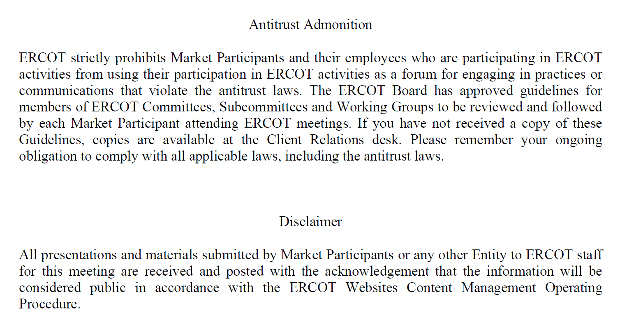
Antitrust Admonition

Slide 3
Topics
SCR 831 Discussion– Short Circuit Model Integration
NPRR 1265 Status - Unregistered Distributed Generator
Load End Use Classification Implementation
Change Request Submission Update
NOMCR Business Change on Additional Action Required Status
Manual Contingency Review
Other Topics

Slide 4
Topics
SCR 831 Discussion– Short Circuit Model Integration
NPRR 1265 Status - Unregistered Distributed Generator
Load End Use Classification Implementation
Change Request Submission Update
NOMCR Business Change on Additional Action Required Status
Manual Contingency Review
Other Topics

Slide 5
NPRR 1234 Load End Use Classification Categories
Load End-Use Classification Categories.
Cryptocurrency Mining
Data Centers (non-crypto)
Government and Medical
Hydrogen and Electrofuel Production
Oil and Chemical Refining
Oil and Gas Production, Processing, and Transmission
Steel and Aluminum Manufacturing
Transportation
Other Industrial

Slide 6
NPRR 1234 Load End Use Classification Categories
Email to be sent on the week of June 23 2025

Slide 7
NPRR 1234 Load End Use Classification
Nodal Protocols 3.107.2(14)

Slide 8
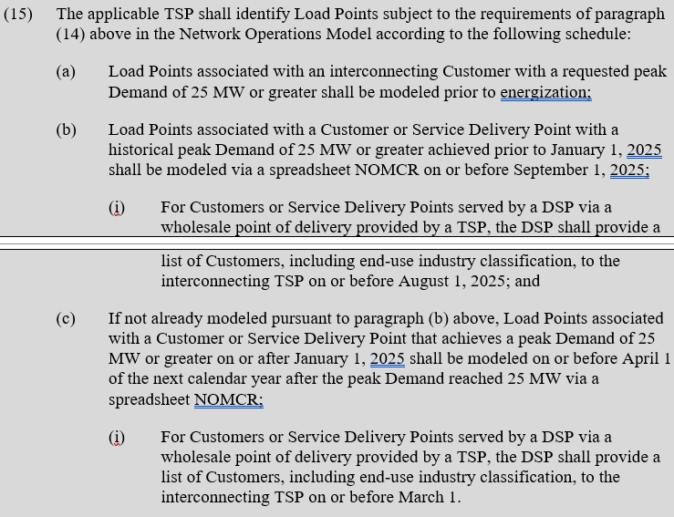
NPRR 1234 Load End Use Classification
Nodal Protocols 3.107.2(15)

Slide 9
Topics
SCR 831 Discussion– Short Circuit Model Integration
NPRR 1265 Status - Unregistered Distributed Generator
Load End Use Classification Implementation
Change Request Submission Update
NOMCR Business Change on Additional Action Required Status
Manual Contingency Review
Other Topics

Slide 10
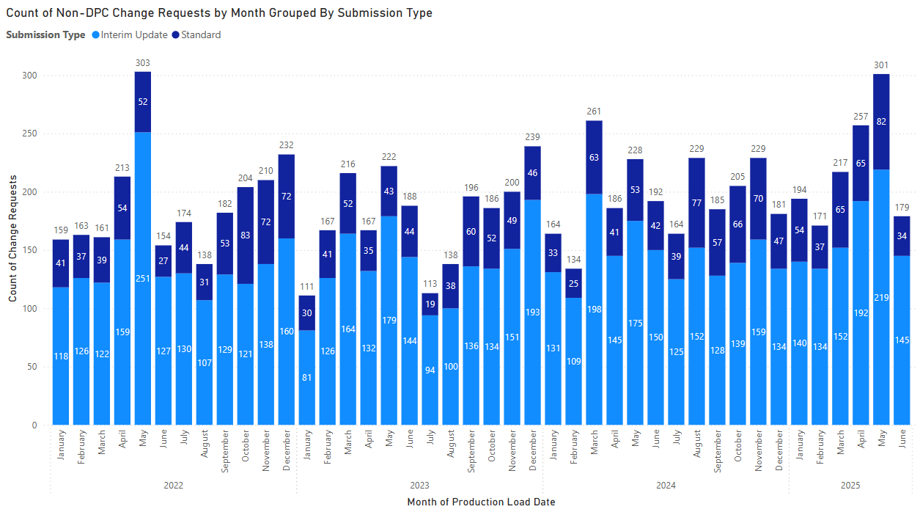
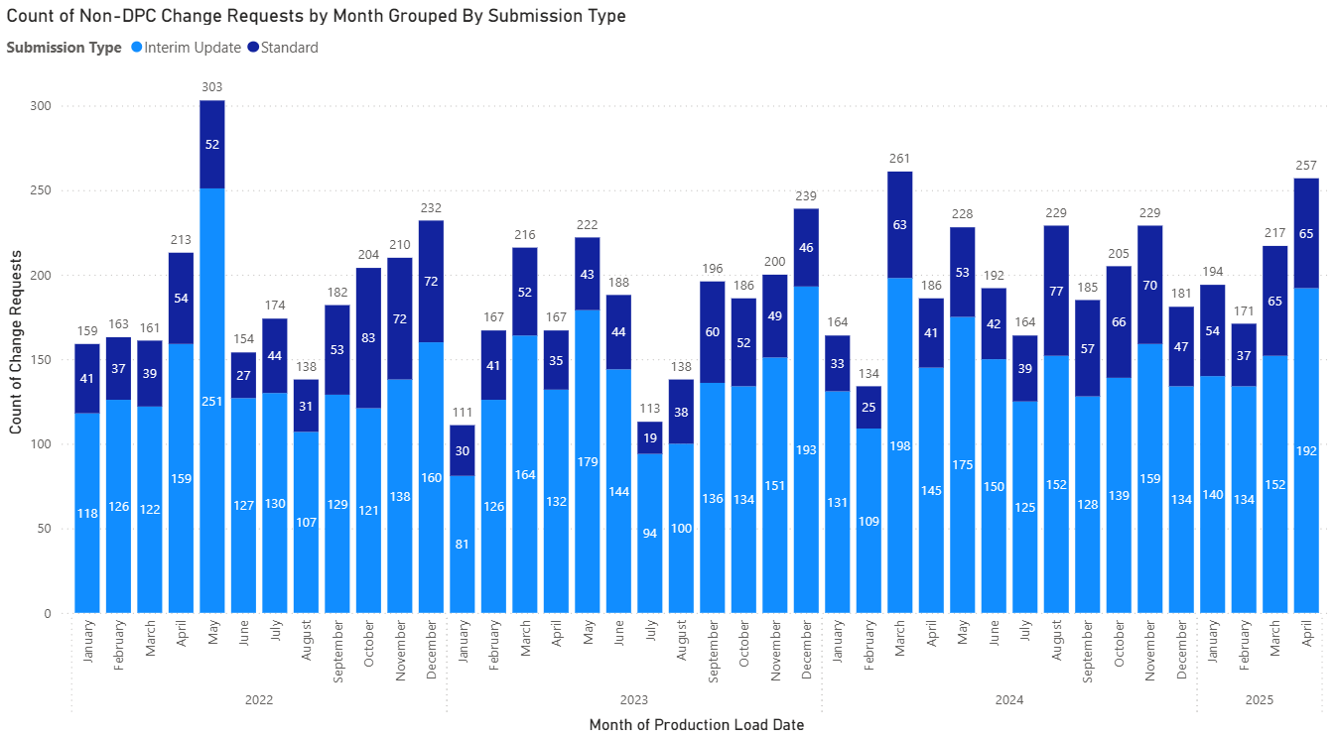
Non-DPC Change Request Submissions

Slide 11
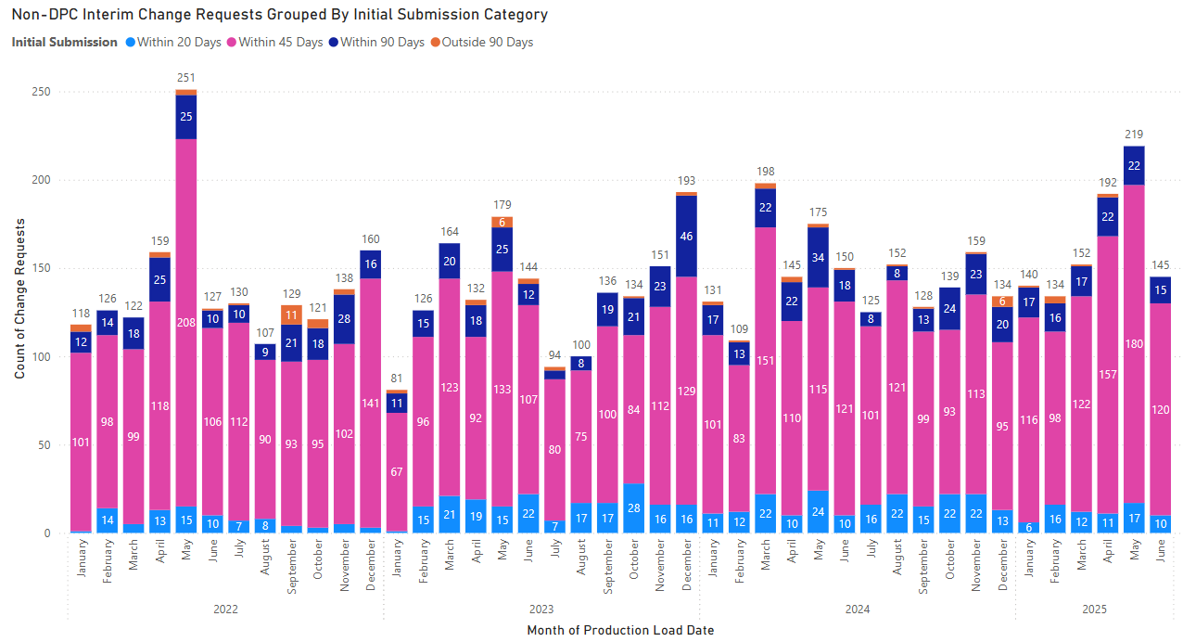
Non-DPC Interim Change Requests

Slide 12
Topics
SCR 831 Discussion– Short Circuit Model Integration
NPRR 1265 Status - Unregistered Distributed Generator
Load End Use Classification Implementation
Change Request Submission Update
NOMCR Business Change on Additional Action Required Status
Manual Contingency Review
Other Topics

Slide 13
Additional Action Required (AAR)
New business rule to be implemented on June 1 2025 to relieve the last-minute submissions
TSP has 3 days to respond to an AAR status on a NOMCR or CAMR after which it may be subject to rejection
Further dialogue can happen based on the response received which will be subject to a 3-day response limit
Contingency group and modeling group should be in communication with each other to make this a smooth process
No changes accepted after Interim Period 2 deadline

Slide 14
Topics
SCR 831 Discussion– Short Circuit Model Integration
NPRR 1265 Status - Unregistered Distributed Generator
Load End Use Classification Implementation
Change Request Submission Update
NOMCR Business Change on Additional Action Required Status
Manual Contingency Review
Other Topics

Slide 15
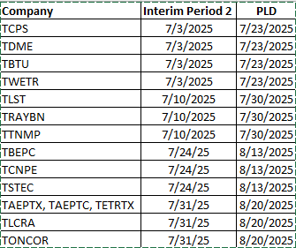
Manual Contingency Review - 2025
Email sent on June 10, 2025
Schedule for TSP submissions
Note:
If no changes are needed, please submit an ICR stating changes are not required.
All breakers and disconnects should be included in the manual contingency.

Slide 16
Topics
SCR 831 Discussion– Short Circuit Model Integration
NPRR 1265 Status - Unregistered Distributed Generator
Load End Use Classification Implementation
Change Request Submission Update
NOMCR Business Change on Additional Action Required Status
Manual Contingency Review
Other Topics

Slide 17
Other Topics
Open Discussion…

