Slide 1
ADVANCED GRID SERVICES – CONSIDERATIONS FOR NPRR 1278 AND NOGRR 272
JUNE 2025

Slide 2
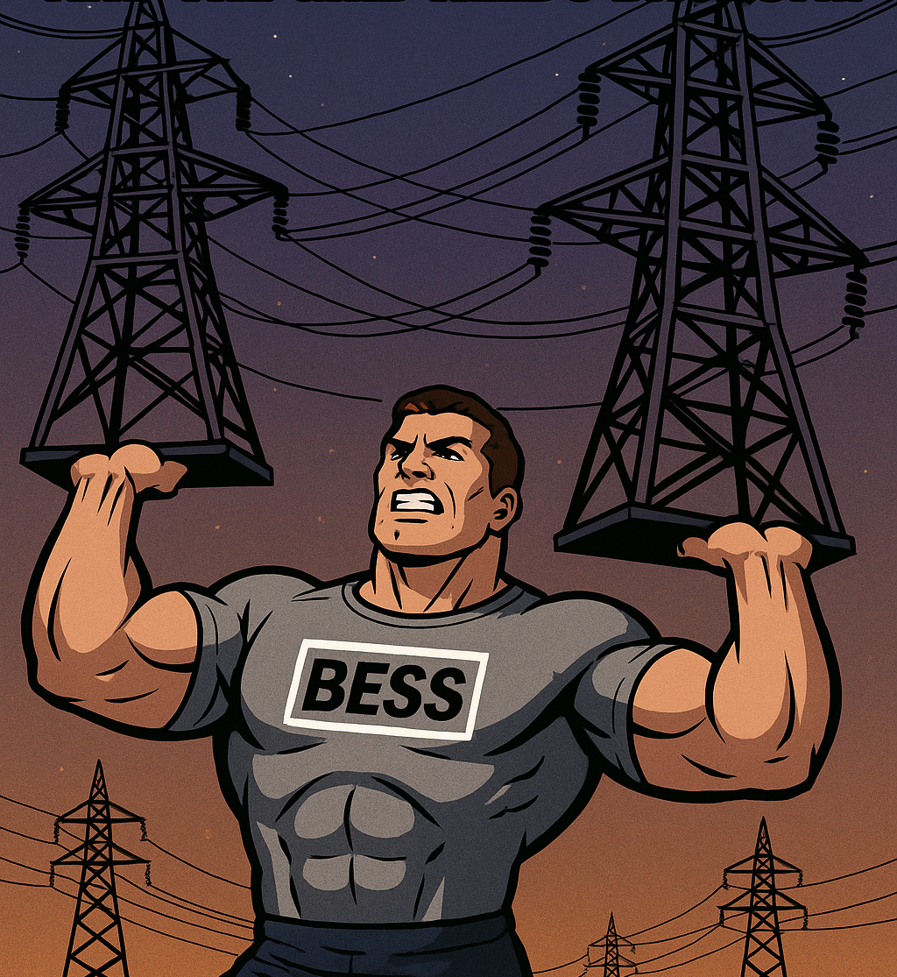
WE SHARE THE SAME GOAL
TO MAKE THE ERCOT GRID MORE RESILIENT AND RELIABLE
We all want the same outcome: A stronger, more stable ERCOT grid.
This isn’t a debate about reliability. It’s about how to implement grid-forming capabilities.
Our assets already support ERCOT’s reliability needs through:
Voltage and frequency response
Fast, flexible operation across a range of system conditions
2

Slide 3
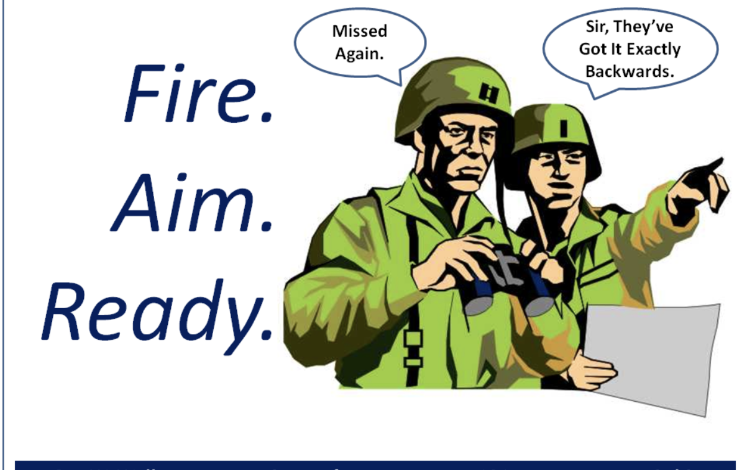
FIRE, AIM, READY
Cor
NREL DECK
TERM CONFUSION
CORE ISSUE
Recommendations in original NREL presentation are contradictory and potentially dangerous
The ERCOT grid conflates voltage phasor/frequency support and grid forming services.
NO NEED IDENTIFIED
IGNORES COSTS
The ERCOT proposal ignores real costs associated with new and existing BESS if grid forming services are the ultimate ask
Need, location, and performance requirements must be identified to avoid stability issues and maximize reliability
3
Notes:
400 × 200

Slide 4
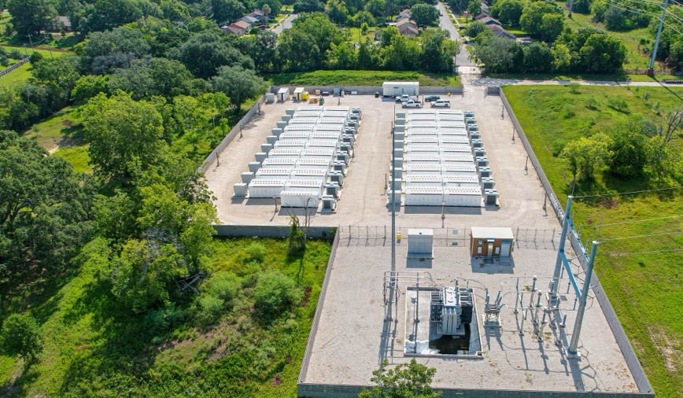
THE NOGRR 272 ASK
New BESS must be capable of advanced grid support – What is actually required?
ERCOT says voltage phasor support only via software
Undefined performance and compliance
ERCOT appears to believe this is a “set and forget” function
Existing BESS may receive one time compensation to be capable
Some BESS can provide voltage and frequency response through firmware
Need to know what is required to be “capable”
Modeling and testing are costly and ongoing
GAMBIT Angleton, Texas
What is needed to achieve the goal of NOGRR 272?
Complete initial and ongoing dynamic stability studies to ensure controls coordination
Clearly defined performance requirements
Ongoing cost recovery for requirement are compensated across technologies
4

Slide 5
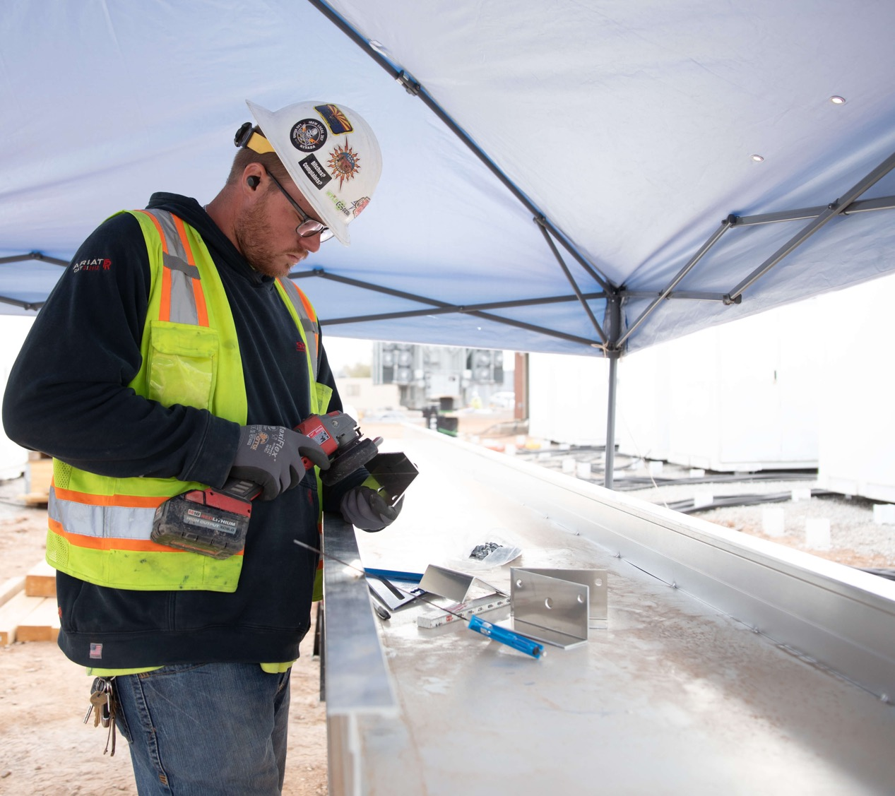
VOLTAGE PHASOR SUPPORT COSTS ARE REAL AND ONGOING
NEW BESS COSTS
ERCOT Cost Considerations
REQUIREMENTS SET USE CASE/OPTIONS
Models and tests are LOCATION, OEM, and ERCOT collaboration dependent
REQUIREMENTS WILL INFORM WARRANTIES
Each model and test will not be able to be reused
MODELING AND TESTING
Each location will need review from ERCOT for compliance
TUNING AND COMPLIANCE
Models/testing will have to be updated at least every 10 years but most likely more often.
FIRST OF A KIND ALWAYS COSTS MORE
Studies have to be performed to potentially coordinate controls
5

Slide 6
EXISTING BESS CHALLENGES FOR VOLTAGE SUPPORT
CAPABILITY DEPENDS ON ERCOT DETERMINED REQUIREMENTS
REQUIREMENTS COULD CHALLENGE USE CASE CONTRACTS AND WARRANTIES
MODELING AND TESTING ARE UNIT, OEM, SITE, AND ERCOT REQUIREMENT DEPENDENT
OPPORTUNITY COSTS AND LOSS OF REVENUE OCCUR WHEN OFFLINE FOR TESTING AND TUNING
6
2. OSHA: Occupational Safety and Health Administration

Slide 7
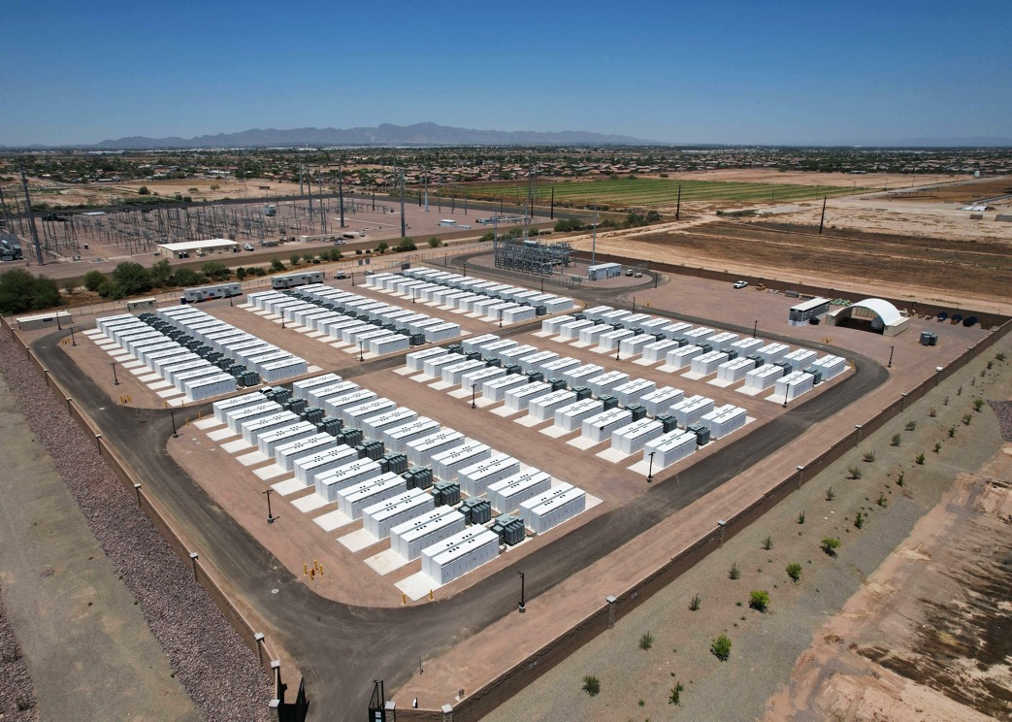
MISO
CASE STUDY

Slide 8
MISO – GFM REQUIREMENT CASE STUDY
In January 2024, MISO launched the PAC‑2024‑2 effort through its Interconnection Process Working Group (IPWG) to determine GFM requirements for new BESS.
Managed project through interconnection committee
Provided stakeholders with a 21-month runway
Performed no less than four studies in preparation for the draft proposal
Identified amount of GFM inverters needed on MISO system (11-31%)
After 18 months of stakeholder work, FERC accepted MISO’s proposed performance standards for inverter-based resources connecting to the grid after their DPP 2023 cycle.
Exempted GFM BESS from any voltage ride-through requirements
Clearly outlined requirements and criteria for successful compliance
Identified too many GFM inverters in one location would lead to over-reaction and instability issues
MISO is using the studies, models, and testing in PAX-2024-2 as baseline for ancillary/GFM market build-out
8
Notes:
UBS (https://www.ubs.com/sg/en/assetmanagement/insights/asset-class-perspectives/infrastructure/articles/decarbonization-with-energy-storage.html)

Slide 9
REQUEST FOR RESPONSIBLE ACTION
ESTABLISH REQUIREMENTS
Gambit – Angleton, Texas
GAMBIT ENERGY STORAGE
ANGLETON, TEXAS
IDENTIFY NEED
Perform at least 2 studies – transient stability and reliability assessment to determine need amount and location for all GFM services
Work with stakeholders to establish clear performance and compliance metrics; reconcile with existing ERCOT controls and risk factors
RECOGNIZE COSTS
THIS IS STEP 1
Enabling capability as ERCOT has suggested is not cost-free for new or existing BESS
Take the studies performed and requirements established into a GFM/AS market buildout
Request follows MISO case study and recommendations by Agora Energiewende
9

Slide 10
REVISED NOGGR 272 + NPRR 1278 = RELIABLE SOLUTION
This process would follow the well-established Black Start market initiative.
PERFORM STUDIES TO IDENTIFY AND JUSTIFY NEED
Study results will determine need for all GFM/AS services
ESTABLISH PERFORM-ANCE REQUIRE-MENTS
RECOGNIZE COSTS TO BE CAPABLE ARE REAL AND SIGNIFICANT
BUILD OUT TECH NEUTRAL GFM AND ANCILLARY SERVICE MARKET STRUCTURE
If you build the market, they will come.
ESRs must know require-ments before they can be capable
Assess one time payment for existing resources to become capable
DETERMINE MARKET PRICING
Allow market to establish cost to provide service like other ancillary services

Slide 11
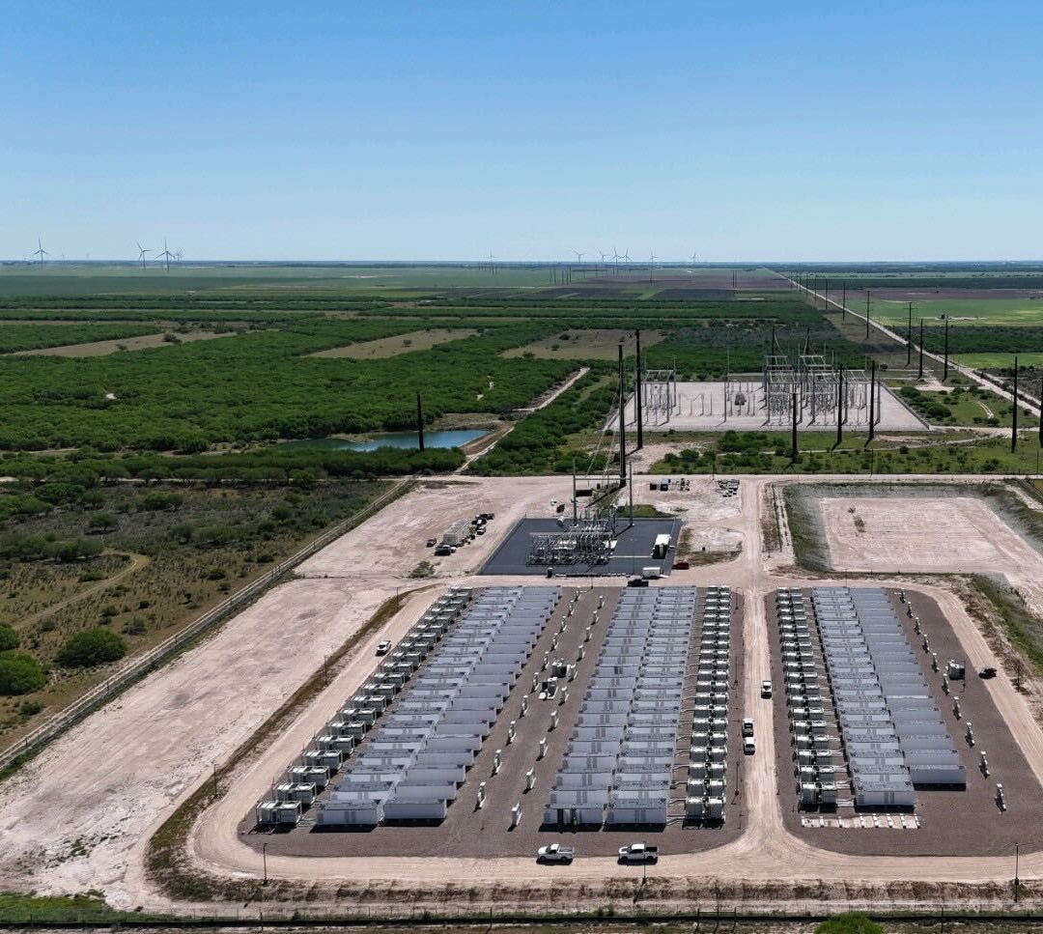
1780 Hughes Landing Boulevard, Suite 675
The Woodlands, TX 77380
910.465.1370
mmeadors@pluspower.com
CONTACT US

