Slide 1
Large Electronic Load (LEL) Voltage Ride-Through Overview
Jeff Billo
Director, Operations Planning
Large Load Workshop
ERCOT Public
June 13, 2025

Slide 2
Numerous Large Electronic Load (LEL) Ride-Through Events
Key Takeaway: ERCOT System continues to see a large number of LELs that are not riding through relatively common occurrences on the grid. As the number and size of affected load continues to grow, the risk of a major event increases.

Slide 3
What is Voltage Ride-Through?
Transient voltage
Current Ride Through Capability
distance from fault
Location of the fault
Area affected by voltage dip resulting from the fault
Equipment located outside the area of voltage dip
Equipment located inside the area of voltage dip (may trip if unable to ride-through)

Slide 4
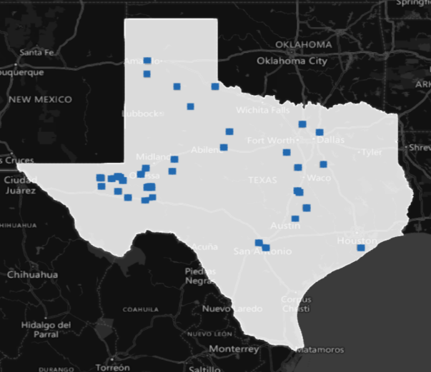
LEL Ride-Through Studies
Due to the number of large electronic load (LEL) trips, ERCOT performed a dynamics study of severe fault in West Texas and the Panhandle
Study showed voltage dip < 0.70 p.u. for more than 20ms (Information Technology Industry Council (ITIC) curve) impacting a wide area
This dip would result in reduction of ~1500 MW of the approximately 3000 MW LELs in West Texas/ Panhandle in the study case (if their ride-through is as good as the ITIC curve) for a particular fault location (could be worse)
As the volume of LELs in West Texas continues to grow, the MW of reduction for a single fault is expected to grow as well
Result would be different under other operating conditions
3,055 MW of Large Loads in WTX study case
Key Takeaway: If the volume of LELs that cannot ride-through system faults continues to increase, it could result in a significant loss of load for a single event.

Slide 5
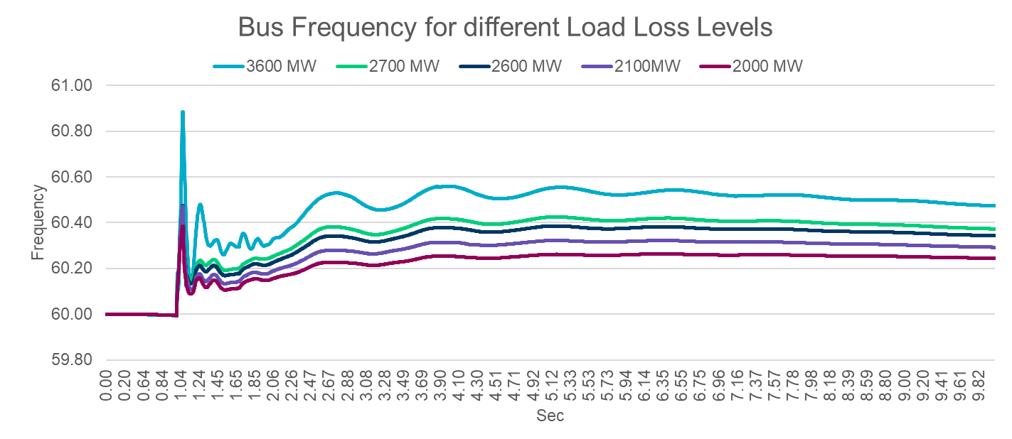
LEL Ride-Through Studies
ERCOT has also performed a study of system frequency response to a significant LEL (multiple LELs in same area) trip
Under certain critical conditions, the loss of more than 2600 MW of LELs* would cause system frequency to increase to a level (60.4Hz) at which conventional generators are concerned that they might not ride through, which may lead to an uncontrolled cascading event
Key Takeaway: If the volume of LELs that cannot ride-through system faults continues to increase, it could result in a major event.
* limit represents combined voltage sensitive, consequential and non-consequential LEL loss

Slide 6
All System Risks are Not the Same
Controlled Loadshed due to Insufficient Resources or Transmission
Uncontrolled Load Loss due to Instability or Cascading
Higher Potential for Grid Collapse
Hours-Minutes
Speed of Occurrence
Seconds-Cycles
Key Takeaway: Dynamic events are a higher risk for uncontrolled grid collapse than issues that can be resolved by controlled loadshed, and they happen much faster.
Notes:
Things on the lefthand side of this spectrum generally manifest operationally over minutes to hours; things on the righthand side happen in seconds, without the opportunity for operator action.
While we don’t yet know mechanism that resulted in Iberian Peninsula event, it was almost certainly something from the right-hand side.

Slide 7
Summary of Problem Statement
If the quantity of LELs that cannot ride-through a fault in the area affected by the fault exceeds 2,600 MW under worst-case inertia and foot-room conditions, it could cause system-wide frequency instability if not mitigated.

Slide 8
Summary of Problem Statement and Potential Mitigations
Potential Mitigations
Plan and Timeline
If the quantity of LELs that cannot ride-through a fault,
In the area affected by the fault,
Exceeds 2,600 MW under worst-case inertia and foot-room conditions,
It could cause system-wide frequency instability if not mitigated.
Establish voltage ride-through standards for LELs, such that more loads remain connected and continue consuming power from the grid during normal system disturbances
LELs can voluntarily design their protection systems to ride-through common grid disturbances
Vendor solution presentations at July 11 LLWG meeting
Draft voltage ride-through standard at Q3 2025 LLWG meeting

Slide 9
Improved Ride-Through Capability will Reduce Risk
If the amount of LELs affected by the voltage dip is too high, it may cause instability or cascading if it does not ride through
Improvement of ride-through capability at each facility will reduce aggregate risk
Transient voltage
Current Ride Through Capability
Strong Grid with Dense Installations
distance from fault
Transient voltage
Improved Ride Through Capability
Strong Grid with Dense Installations
Key Takeaway: Improved Ride-Through Capability is needed.
distance from fault

Slide 10
Summary of Problem Statement and Potential Mitigations
Potential Mitigations
Plan and Timeline
If the quantity of LELs that cannot ride-through a fault,
In the area affected by the fault,
Exceeds 2,600 MW under worst-case inertia and foot-room conditions,
It could cause system-wide frequency instability if not mitigated.
Implement transmission upgrades such as synchronous condensers, grid-forming STATCOMS, E-STATCOMS, FACTS devices and/or new transmission circuits to strengthen the grid
RUC synchronous generation in weak areas
New synchronous generation additions in weak areas
ERCOT LEL ride-through study showed synchronous condensers provided some improvement in West Texas
Six new synchronous condensers in West Texas are scheduled to come online by 2027
ERCOT Planning and Operations are conducting joint study to evaluate benefits of already planned projects and cost/ benefit of additional transmission upgrades – Timeline TBD
ERCOT is evaluating potential RUC procedure for weak areas – Q4 2025

Slide 11
Significant Impacts may be Widespread or Localized
Stronger Grid with Dense Concentration of Voltage-Sensitive Equipment
Weaker Grid
Stronger Grid
Strengthening the grid reduces the area affected by voltage dip during a fault
The area affected by the voltage dip is the same size, but there is more equipment concentrated in that area
Location of the fault
Area affected by voltage dip resulting from the fault
Equipment located outside the area of voltage dip
Equipment located inside the area of voltage dip (may trip if unable to ride-through)
Key Takeaway: System upgrades can limit the area impacted by a fault, but there may still be a problem if too many loads in an area cannot ride through.

Slide 12
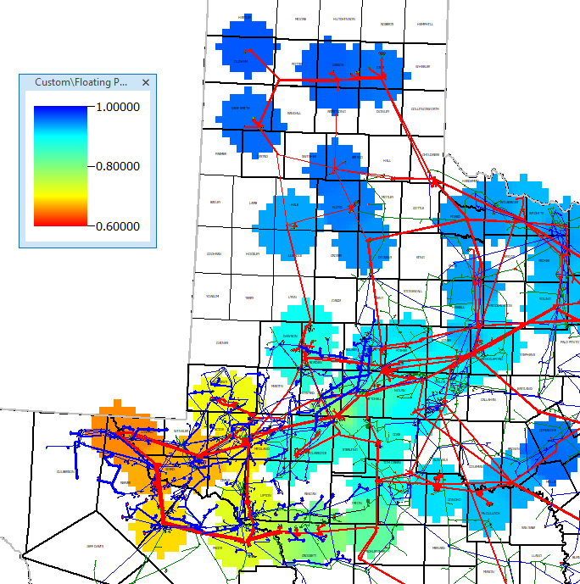
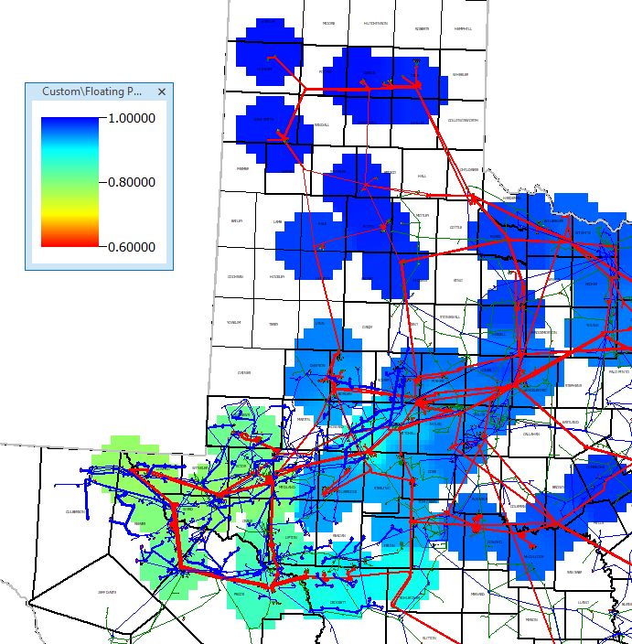
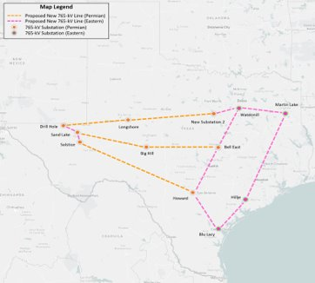
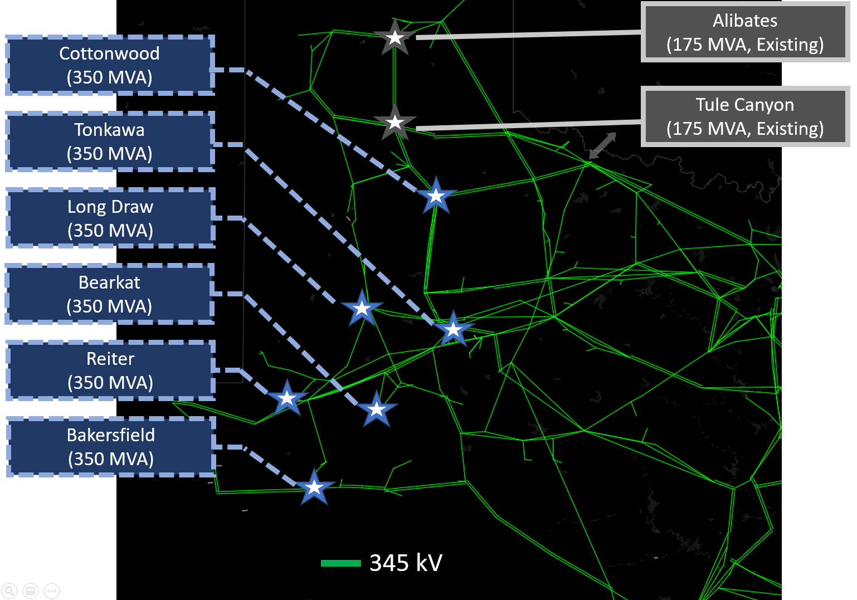
Improving Grid Strength
Synchronous Condenser Projects
765kV Transmission Plan
Late
2022
Study
Existing system
With 6 new Synchronous Condensers
One new synchronous condenser in-service in 2026; most in 2027
Key Takeaway: Several grid improvements are underway that will help strengthen the system. However, these improvements cannot fully mitigate all of the risk

Slide 13
Summary of Problem Statement and Potential Mitigations
Potential Mitigations
Plan and Timeline
If the quantity of LELs that cannot ride-through a fault,
In the area affected by the fault,
Exceeds 2,600 MW under worst-case inertia and foot-room conditions,
It could cause system-wide frequency instability if not mitigated.
ERCOT is conducting a study to evaluate potential increase in 2,600 MW limit for higher foot-room and/ or inertia conditions – Q1 2026 LLWG Meeting
ERCOT is evaluating the benefits of a potential new Ancillary Service – Q1 2026 LLWG Meeting
Establish new Ancillary Service to preserve frequency responsive foot-room on Resources
Establish higher critical inertia level*

Slide 14
Inertia vs. Frequency Responsive “Foot Room”
Key Takeaway: Worst-case grid conditions from a loss of load perspective is when resource down-frequency response capability is at a minimum. Low inertia conditions are not necessarily the worst-case. Efforts to improve worst-case conditions will need to prioritize increasing down-frequency response over increasing inertia, though inertia is still a factor.
Lowest inertia is when frequency will move the most for a load-generation imbalance, but is also when there is highest amount of down-frequency response capability from wind and solar generation
Worst case is relatively low (but not lowest) level of inertia and minimum amount of down-frequency response from resources
High inertia is when frequency will move the least for a load-generation imbalance and is also when there is a high amount of down-frequency response capability from thermal generation
Key Concept: Foot Room = the Down-Frequency response capability of resources; or the MW difference between the output of a resource and its lowest sustainable output level, accounting for verified governor droop characteristics, similar to PRC.
Resource Foot Room
Inertia

Slide 15
Summary of Problem Statement and Potential Mitigations
Potential Mitigations
Plan and Timeline
If the quantity of LELs that cannot ride-through a fault,
In the area affected by the fault,
Exceeds 2,600 MW under worst-case inertia and foot-room conditions,
It could cause system-wide frequency instability if not mitigated.
Establish new Interconnection Reliability Operating Limit (i.e., NERC SOL/ IROL) to maintain system stability
Create control room procedures and displays to monitor and control to IROL
Large Load Interconnection Process changes to ensure reliable connection of new LELs
ERCOT is evaluating need for IROL and control room procedures and monitoring – Q3 2025
Subsequent workshop presentations today will cover LLI process changes

Slide 16
Need Coordinated Requirements between System and Users
As a bridge needs to meet in the middle, the System Planning and Operating Criteria need to “handshake” with the requirements for LEL capability and performance
If there is a gap, it could result in LEL loss and, potentially, systemwide outages
It does not appear to be feasible to sufficiently mitigate all of these dynamic issues from the grid side of the bridge
Grid Improvements
LEL Capability/Performance Improvements
Key Takeaway: Both grid upgrades and load capabilities are needed to adequately address weak grid issues and avoid/mitigate dynamic events.

Slide 17
Building the Bridge
LEL Capability/
Performance Improvements
Ride Through Reqs for LEL
Improved Models
Others
Grid Improvements
Synchronous Condensers
765kV Projects
Others
Operating Procedures
Operating Limits
Additional Studies
Commitment Patterns
Others
Key Takeaway: By continuing to resolve identified issues and implement grid solutions AND improved capabilities by Large Loads, we can maintain system reliability while supporting continued changes to the grid.

Slide 18
Questions?

Slide 19
Ride Through Impacts on the Large Load Interconnection Process
Agee Springer
Sr. Manager, Grid Interconnections
Large Load Workshop – June 13, 2025

Slide 20
Preface
With the identified and growing risk to system reliability from Large Electronic Load (LEL) ride-through behavior, additional information will be collected as part of the Large Load Interconnection Study (LLIS) process
Information on operational LELs will be collected via RFI
This information will be used in ERCOT studies of LEL ride-through capability and assessments of SOL/IROL violation risk prior to Initial Energization
The requirements in this section apply to Large Electronic Loads (LEL). These are facilities where the majority of the energy consumption is from compute-based load – mainly data centers and cryptomining loads. Other types of loads are not impacted at this time.

Slide 21
Agenda
Collection of information on LEL ride-through capability
Overview of the interim LEL ride-through evaluation process
Next steps for operational LELs and LELs in the interconnection process

Slide 22
RFI for LEL Ride-Through Performance
On or before June 30, ERCOT will issue an RFI to all relevant Transmission Service Providers (TSPs) requesting information related to all operational LELs and any proposed LELs that have been approved for energization by ERCOT
The RFI will require submission of the following for each applicable LEL in the TSP’s service territory
The DWG Large Load Survey
Updated dynamic models that accurately reflect the ride-through performance of the LEL
RFI responses should be sent back to ERCOT by August 31

Slide 23
Information on Ride-Through Performance from Proposed LELs
LELs that have not received approval to energize by ERCOT will be required to complete the DWG Large Load Survey and provide facility-specific dynamic models as part of the LLIS process

Slide 24
Interim LEL Ride-Through Evaluation Process
ERCOT will utilize the DWG survey responses to conduct an interim assessment of LEL ride-through capabilities
For existing LELs, the updated dynamic model information will further inform ERCOT’s assessment of potential SOL/IROL violations resulting from LEL ride-through performance
For new LELs, the dynamic model will be used to assess LEL ride-through capability and risk of SOL/IROL violations prior to Initial Energization
The evaluation process is shown on the next slide

Slide 25
Interim LEL Ride-Through Evaluation Process
ILLE
Coordinate with TSP to fill out DWG LEL Survey and provide updated PSSE model
LEL elects to change settings and/or equipment to improve ride through performance
TSP
Submit Survey and Model to ERCOT
Yes
ERCOT
Review Survey Responses and Model
Perform Assessment
Questions?
No
OR
LEL may proceed to Energization when ERCOT tools and procedures are in place and will be curtailed under some conditions
Does the LEL ride through?
Does RT performance cause SOL/IROL violation?
No
Yes
LEL may proceed to Energization
Yes
LEL may proceed to Energization but may be curtailed in the future under some conditions to prevent SOL/IROL exceedance
No

Slide 26
Categories of Impacted Data Center and Cryptomining Loads
Operational LELs that are energized up to the amount approved by ERCOT with no additional load requested
Approved to energize/operational LELs that have not yet energized up to the amount approved by ERCOT
Operational LELs energized up to a limit established by ERCOT with additional approved LEL contingent on transmission system upgrades
Proposed LELs with approved planning studies that have not yet requested approval to energize
Proposed LELs with a stability study that is in-progress or not started

Slide 27
Next Steps for Impacted LELs
1. Operational LELs that are energized up to the amount approved by ERCOT with no additional load requested
Work with their TSP to complete the DWG Large Load Survey and provide updated dynamic models as described on slide 22
LEL must work with their TSP to complete the DWG Large Load Survey and provide updated dynamic models as required by the RFI
There will be no change to ERCOT approved consumption amount. However, the LEL may be curtailed under some conditions if a SOL/IROL violation is identified in the future and the LEL dynamic model shows it cannot ride through

Slide 28
Next Steps for Impacted LELs
2. Approved to energize/operational LELs that have not yet energized up to the amount approved by ERCOT
Work with their TSP to complete the DWG Large Load Survey and provide updated dynamic models as described on slide 22
LEL must work with their TSP to complete the DWG Large Load Survey and provide updated dynamic models as required by the RFI
There will be no change to ERCOT approved consumption amount and the LEL may continue to increase consumption up to that limit. However, the LEL may be curtailed under some conditions if a SOL/IROL violation is identified in the future and the LEL dynamic model shows it cannot ride through

Slide 29
Next Steps for Impacted Loads
3. Operational LELs energized up to a limit established by ERCOT with additional approved load contingent on transmission upgrades
Work with their TSP to complete the DWG Large Load Survey and provide updated dynamic models as described on slide 22
LEL must work with their TSP to complete the DWG Large Load Survey and provide updated dynamic models as required by the RFI
No changes to approved consumption amount for the load currently operational. However, the LEL may be curtailed under some conditions if a SOL/IROL violation is identified in the future and the LEL dynamic model shows it cannot ride through
Additional load must go through ERCOT’s interim Large Load ride-through evaluation process described on slide 25 before it will be given approval to energize

Slide 30
Next Steps for Impacted LELs
4. Proposed LELs with approved planning studies that have not yet requested approval to energize
Work with their TSP to complete the DWG Large Load Survey and provide updated dynamic models as described on slide 23
If the TSP stability study was previously approved and the model is changed, it may need to re-done with the updated dynamic models
The LEL must then go through ERCOT’s interim LEL ride through assessment process described on slide 25 before it will be given approval to energize

Slide 31
Next Steps for Impacted LELs
5. Proposed LELs with a stability study that is in-progress or not started
Work with their TSP to complete the DWG Large Load Survey and provide facility-specific dynamic models as described on slide 23 prior to studies may start
If the TSP stability study is already in progress, it must be restarted with the updated dynamic models
The LEL must then go through ERCOT’s interim LEL ride through assessment process described on slide 25 before it will be given approval to energize

Slide 32
Questions?

Slide 33
Large Load Dynamic Model and Survey
Sun Wook Kang
Sr. Manager, Grid Planning
Large Load Workshop – June 13, 2025

Slide 34
Some Challenges and Large Load Model Survey Document
Appropriate dynamic load models are essential since the behavior of LELs during grid events can create critical conditions
As the size of individual large loads and the number of large load interconnection (LLI) requests to the ERCOT grid continues to grow, the need for accurate modeling and enhancing stability study process becomes even more critical
Dynamics Working Group (DWG) has developed Large Load Data Survey document that is posted on the DWG website, based on the TSP’s practice and NERC recommendations
TSPs will share it prior to initiating the LL interconnection study process
Continued collaboration is crucial to improve dynamic load models and stability studies
DWG Large Load Data Survey

Slide 35
Action Items for TSPs with Large Electronic Loads (LELs)
RFI seeking completion of survey will initially be sent to the TSPs that have ILLEs with LELs that are in operation or have received approval to energize
Other ILLEs will be requested to complete survey later but nevertheless will need to complete and potentially update stability studies before approval to energization will be provided
Upon issuance of the RFI to the TSP, TSP and ILLE should collaborate to address questions in the survey document, particularly those related to the ride-through capability of a LEL
TSP submits the survey document. If the dynamic data is expected to differ from those used in the original studies, need to provide updated dynamic model with a clear explanation of the differences
Once your submission is deemed complete, ERCOT will review the survey responses and dynamic models. ERCOT may request additional supporting information as needed
ERCOT Sends RFI to TSPs
Collaboration Between TSP and ILLE
TSP Submits Response to ERCOT
ERCOT Review

Slide 36
Questionnaires – Ride-Through Capability
Questions focusing on ride-through capability
Q51 through Q58, Q60, and Q61 under Protection Setting Section
Q36 under Dynamic Model Section (note: Q37 is optional but submit PSCAD model if available)
Q39 through Q42 under Back Up Section
Q17 if it is behind the existing generation, under Basic Load Information Section
Example questions
Voltage sag levels and timing (sec) where the load is disconnected or transferred to UPS or Backup Generation?
Voltage swell levels and timing (sec) where the load is disconnected or transferred to UPS or Backup Generation?
Voltage sag levels and timing (sec) where the cooling system is disconnected or transferred to UPS or Backup Generation?

Slide 37
Questionnaires – Ride Through Capability
Do the LELs automatically reconnect when voltage returns to normal? Immediately? With delay? Describe conditions and methodology
If reconnection with a stagger or ramp, please explain
Count of voltage disturbances monitored at POI within a time period before the load is disconnected or transferred to UPS or Backup Generation?
Is there backup power such as a generator or battery UPS? Describe the size, type.
If load has UPS, what is the UPS operating scheme? Include triggers and timings for switching to UPS (ex. reached a voltage level of 0.75 pu for 3 cycles). Include criteria and timing for reconnection to the grid. Is it automatic or manual?

Slide 38
Next Step
ERCOT will send RFIs by end of June
TSPs should submit the RFI responses back to ERCOT by end of August
If the submitted data including ride-through characteristics differ from the original study assumptions, the TSP must determine if a stability restudy is needed for a planned LEL in the interconnection process, per PG Section 9.2.3(2)
ERCOT plans to assess system impacts under the assumption that planned or operational LELs in West Texas and Panhandle have protection set in accordance with the ITIC curve or updated models provided by TSPs

Slide 39
Questions?
?

Slide 40
ERCOT Voltage Ride-Through Assessment
Fred Huang
Director, Operations Support
Large Load Workshop – June 13, 2025

Slide 41
ERCOT Large Electronic Load (LEL) Ride Through Assessment
Objective:
Identify large electronic load (LEL) reduction due to voltage dip or overshoot caused by credible transmission events
Identify potential mitigation options if the total LEL reduction exceeds the SOL/IROL
Driver:
Provided dynamic models do not always reflect the actual performance as observed in the operational events
Want to include all existing and planned LELs in the assessment

Slide 42
Assessment Scope
Study Condition
DWG High Renewable, Minimum Load (HRML) case will be used as the start base case
Adjustments may be considered to reflect the projected study year, for example, year 2025
LEL
All the existing operational LELs at approved MW, and
LELs with approved interconnection studies and projected to connect by end of 2025
Ride-though assumptions
ITIC curve will be used as default ride-through capability for LELs
Note: ITIC is not ERCOT’s proposed ride-through standard but is used as a conservative placeholder based on observed response until further update by the LEL survey response and updated models
Expected result
Location and magnitude of LEL reduction under tested credible transmission events

Slide 43
Next Step
LEL survey response review and model update
Potential regular LEL ride-through re-assessment with updated ride-through capability and models will be needed until an LEL ride-through standard is established
ERCOT is considering developing a cluster assessment to be performed on an ongoing basis and earlier in the interconnection process

Slide 44
Questions?
?

