Slide 1
Credit Exposure Update
Market Credit Work Group
ERCOT Public
June 18, 2025

Slide 2
Monthly Highlights: April 2025 – May 2025
Market-wide average Total Potential Exposure (TPE) slightly decreased from $1.78 billion in April to $1.74 billion in May
  There were no significant movement in prices and forward adjustment factors
    Discretionary Collateral is defined as Secured Collateral in excess of TPE,CRR Locked ACL and DAM Exposure
  Average Discretionary Collateral slightly increased from $3.73 billion in April to $3.84 billion in May
No unusual collateral call activity

Slide 3
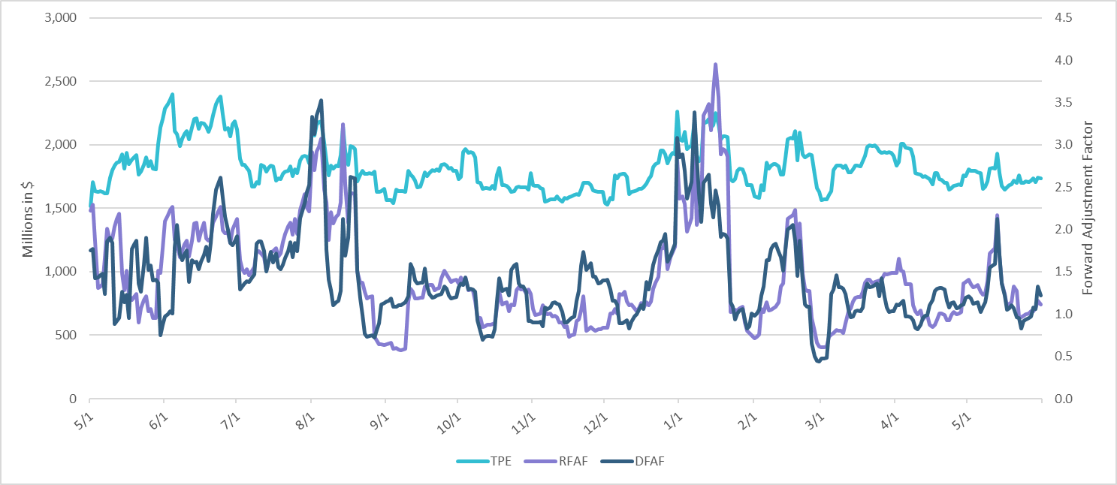
TPE and Forward Adjustment Factors: May 2024 – May 2025

Slide 4
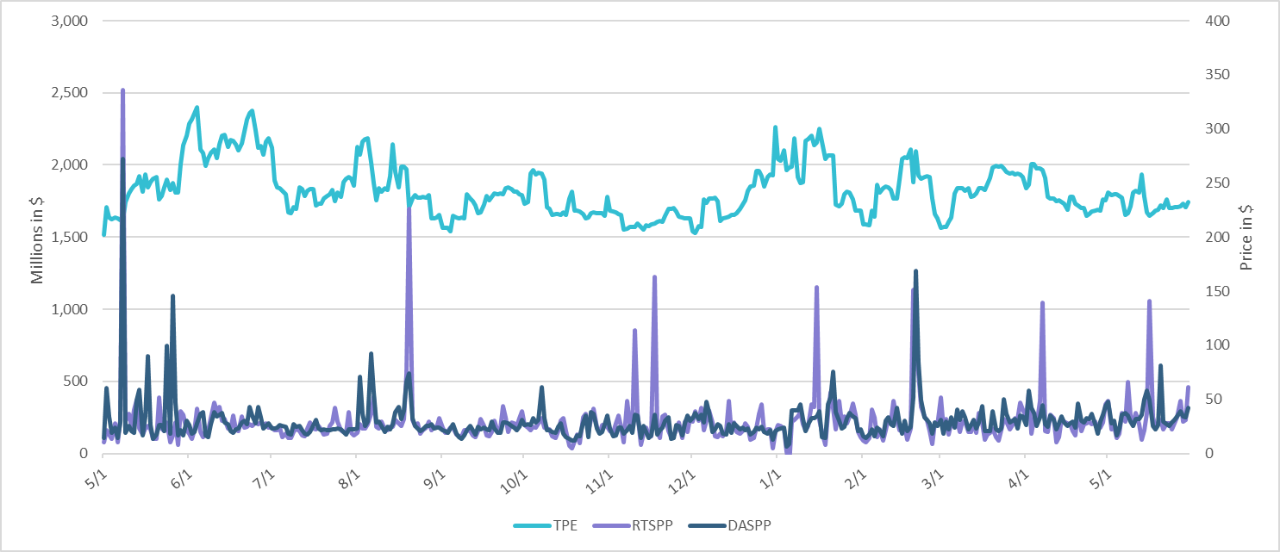
TPE/Real-Time & Day-Ahead Daily Average Settlement Point Prices for HB_NORT:H May 2024 – May 2025

Slide 5
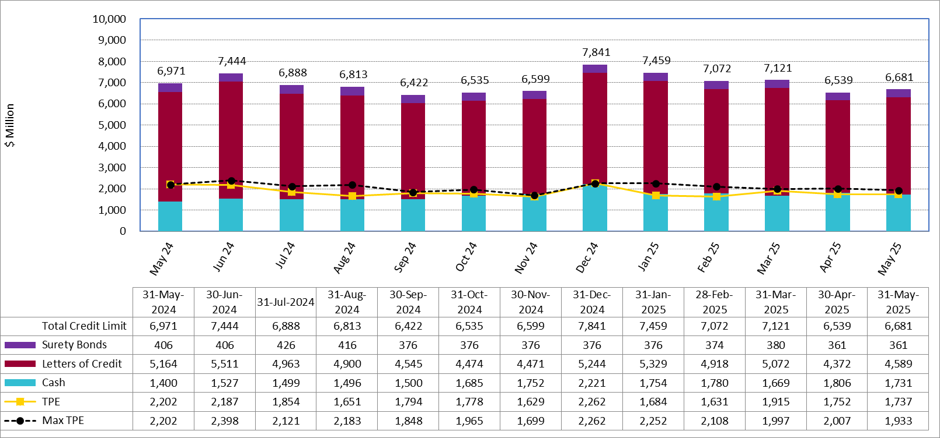
Available Credit by Type Compared to Total Potential Exposure (TPE):
May 2024 – May 2025
Numbers are as of month-end except for Max TPE
Max TPE is the highest TPE for the corresponding month

Slide 6
Issuer Credit Limits vs Total LC Amounts Per Issuer: End-May 2025
As of May 31, 2025
There are a total of 36 banks that have issued LCs.

Slide 7
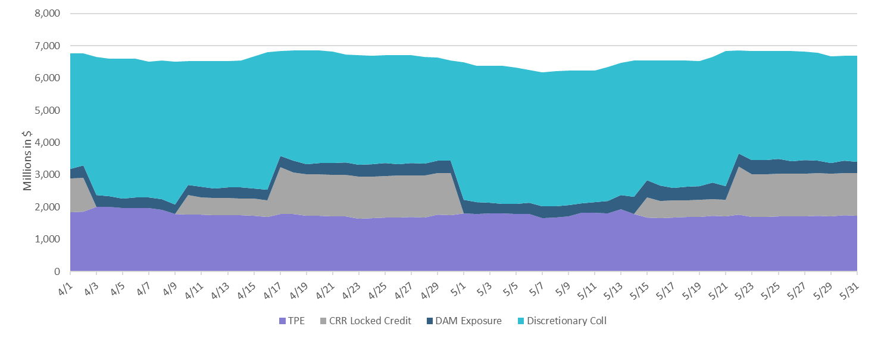
Discretionary Collateral April 2025 – May 2025

Slide 8
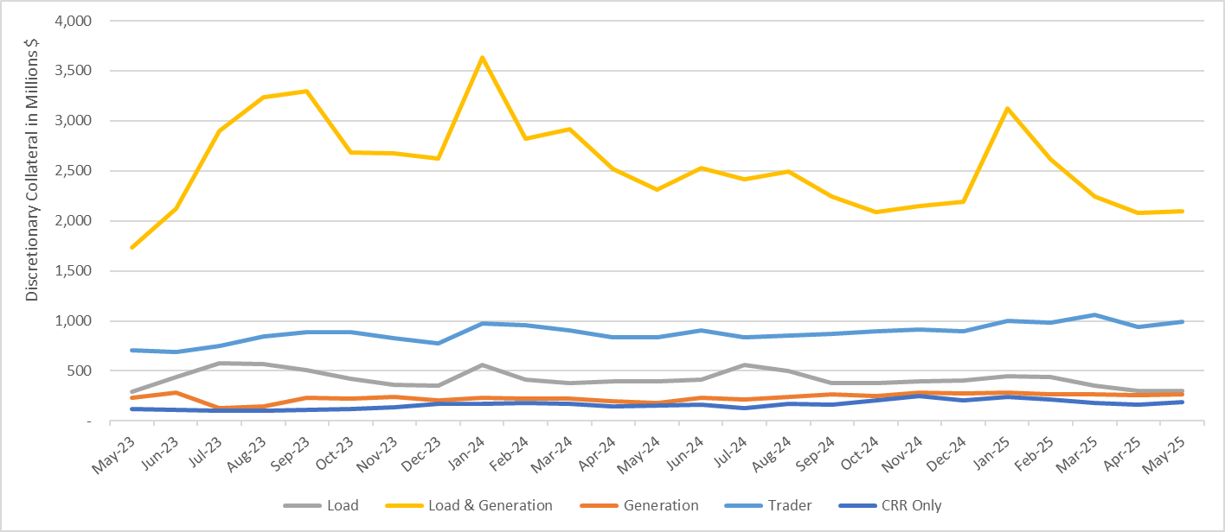
Discretionary Collateral by Market Segment May 2023 - May 2025
* Discretionary Collateral adjusted to exclude short pay amounts eliminating data skew

Slide 9
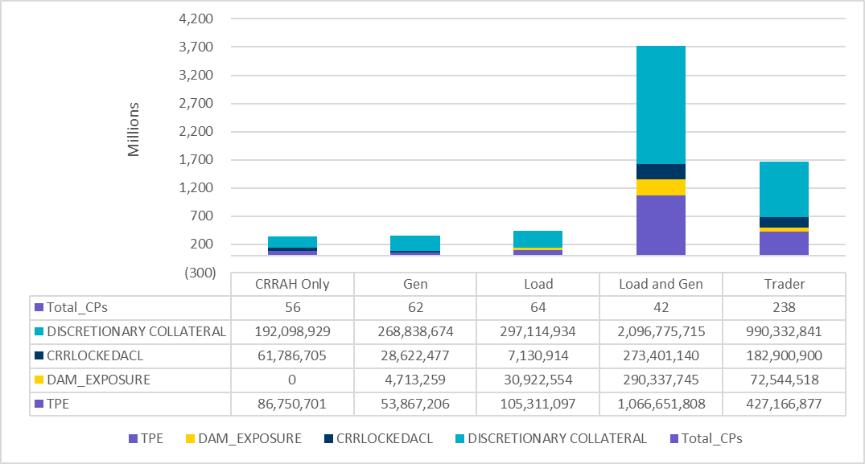
TPE and Discretionary Collateral by Market Segment - May 2025
Load and Generation entities accounted for the largest portion of discretionary collateral

Slide 10
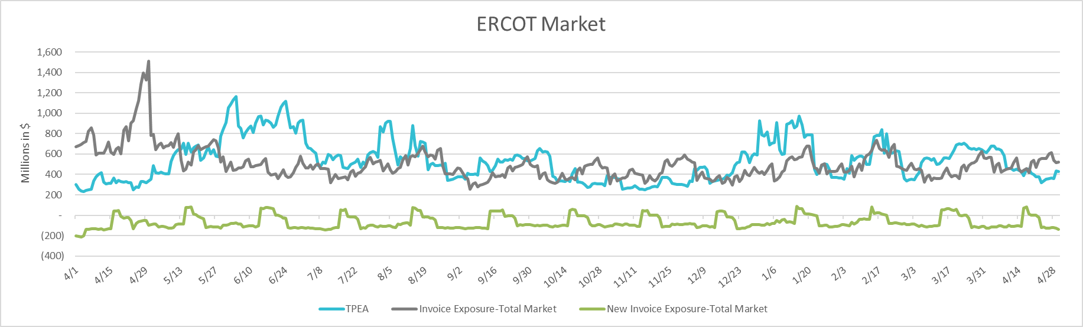
TPEA Coverage of Settlements April 2024 - April 2025
Invoice Exposure | Historical | Future
Existing Invoice Exposure | RTLCNS + UDAA | M1 Days (including current day) Forward Charge Invoice Amounts
New Invoice Exposure | 7 Days Back Net Invoice Amounts (Charges & Credits) | M1 Days (including current day) Forward Net Invoice Amounts (Charges & Credits); Excluding: 1) Securitization Invoices; 2) CRR Auction Invoices; and 3) Subchapter N Funds Distribution Invoice
TPEA closely approximates actual/invoice exposure

Slide 11
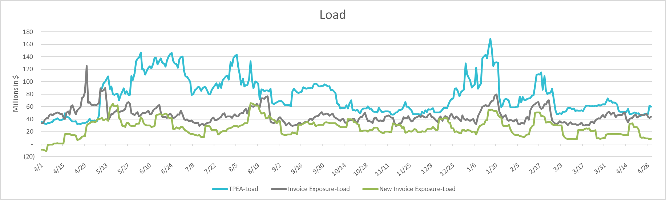
TPEA Coverage of Settlements April 2024 - April 2025
Invoice Exposure | Historical | Future
Existing Invoice Exposure | RTLCNS + UDAA | M1 Days (including current day) Forward Charge Invoice Amounts
New Invoice Exposure | 7 Days Back Net Invoice Amounts (Charges & Credits) | M1 Days (including current day) Forward Net Invoice Amounts (Charges & Credits); Excluding: 1) Securitization Invoices; 2) CRR Auction Invoices; 3) Subchapter N Funds Distribution Invoice
*TPEA exceeds invoice exposure

Slide 12
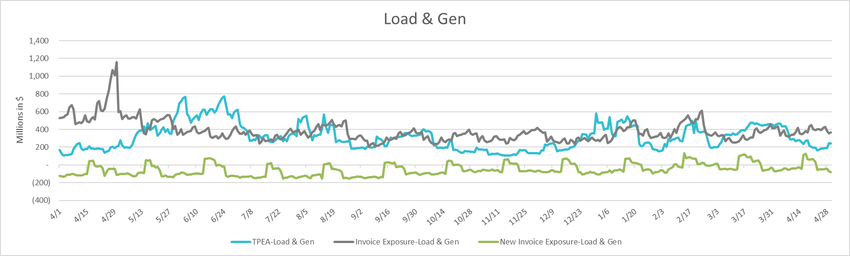
TPEA Coverage of Settlements April 2024 - April 2025
Invoice Exposure | Historical | Future
Existing Invoice Exposure | RTLCNS + UDAA | M1 Days (including current day) Forward Charge Invoice Amounts
New Invoice Exposure | 7 Days Back Net Invoice Amounts (Charges & Credits) | M1 Days (including current day) Forward Net Invoice Amounts (Charges & Credits); Excluding: 1) Securitization Invoices; 2) CRR Auction Invoices; 3) Subchapter N Funds Distribution Invoice
Invoice exposure generally exceeds TPEA

Slide 13
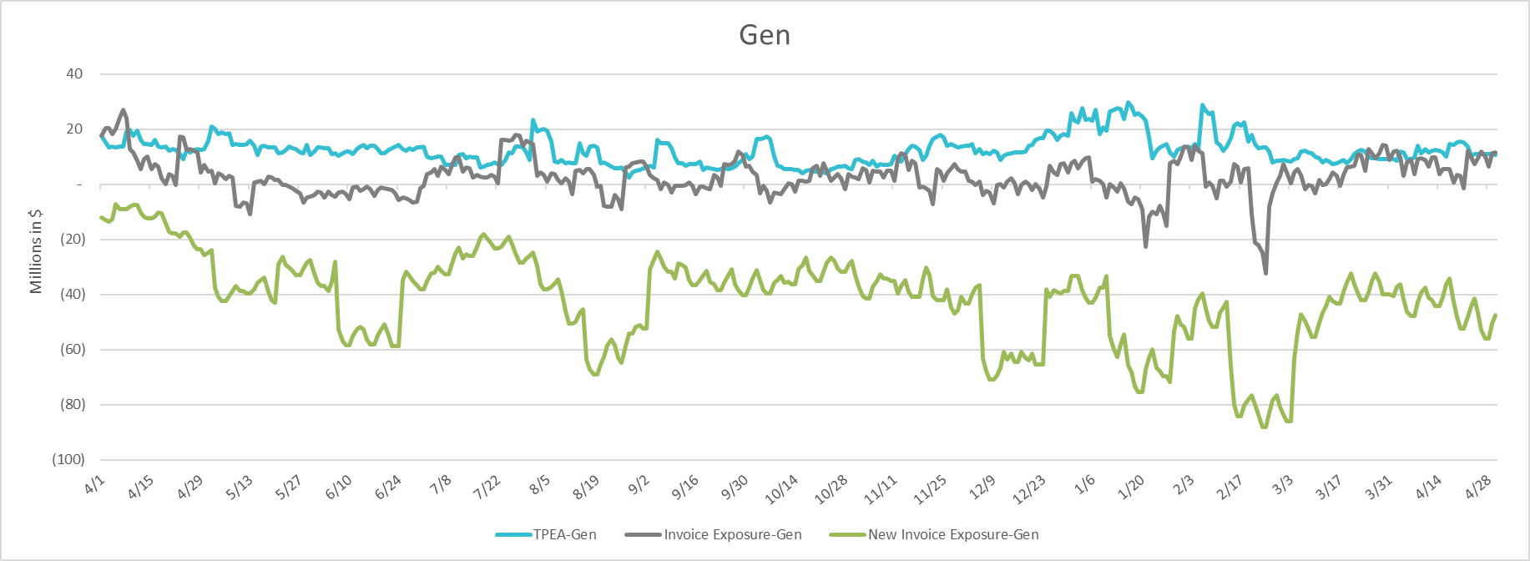
TPEA Coverage of Settlements April 2024 - April 2025
Invoice Exposure | Historical | Future
Existing Invoice Exposure | RTLCNS + UDAA | M1 Days (including current day) Forward Charge Invoice Amounts
New Invoice Exposure | 7 Days Back Net Invoice Amounts (Charges & Credits) | M1 Days (including current day) Forward Net Invoice Amounts (Charges & Credits); Excluding: 1) Securitization Invoices; 2) CRR Auction Invoices; 3) Subchapter N Funds Distribution Invoice
* TPEA generally exceeds Invoice exposure

Slide 14
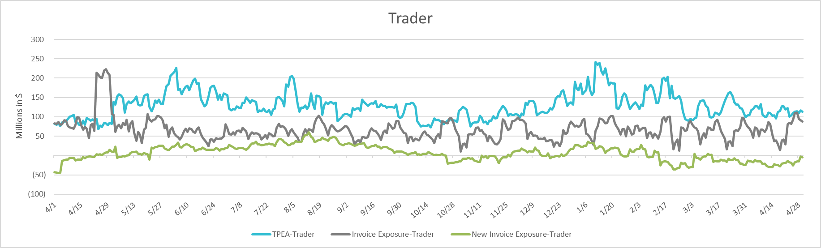
TPEA Coverage of Settlements April 2024 - April 2025
Invoice Exposure | Historical | Future
Existing Invoice Exposure | RTLCNS + UDAA | M1 Days (including current day) Forward Charge Invoice Amounts
New Invoice Exposure | 7 Days Back Net Invoice Amounts (Charges & Credits) | M1 Days (including current day) Forward Net Invoice Amounts (Charges & Credits); Excluding: 1) Securitization Invoices; 2) CRR Auction Invoices; 3) Subchapter N Funds Distribution Invoice
*TPEA generally exceeds invoice exposure

Slide 15
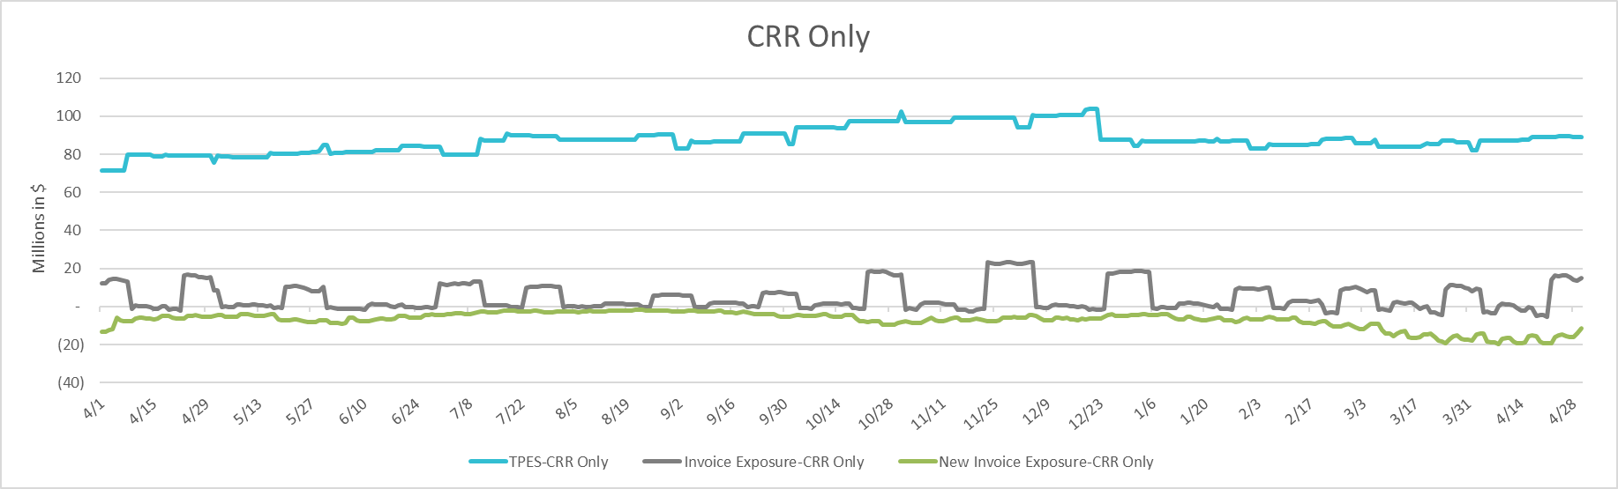
TPEA Coverage of Settlements April 2024 - April 2025
Invoice Exposure | Historical | Future
Existing Invoice Exposure | RTLCNS + UDAA | M1 Days (including current day) Forward Charge Invoice Amounts
New Invoice Exposure | 7 Days Back Net Invoice Amounts (Charges & Credits) | M1 Days (including current day) Forward Net Invoice Amounts (Charges & Credits); Excluding: 1) Securitization Invoices; 2) CRR Auction Invoices; 3) Subchapter N Funds Distribution Invoice
*TPES exceeds actual/invoice exposure

Slide 16
Questions

