Slide 1
TDTMS Update
Leadership 2025:
Chair - Sheri Wiegand, Vistra
Vice Co-Chairs – Monica Jones, CNP
Sam Pak, Oncor
RMS
June 12th, 2025

Slide 2
TDTMS
ERCOT Report
System Instances – All April SLAs met. MarkeTrak performance remains well within SLO. MarkeTrak volumes remain relatively flat.
MarkeTrak & Siebel Upgrade – scheduled for July 2025 to align with extended retail release the weekend of 7/26 to 7/27 where outage may need to commence at 2PM on Saturday (operational hours)
MIS Re-Write – Project vs Issues Log – does the market need to compile a list of requests via an SCR or can issues be presented with smaller, lower level of efforts. Examples:
Request for MIS list of reject codes hyperlinked to Find Transactions
ESI listed on escalation email in MarkeTrak

Slide 3
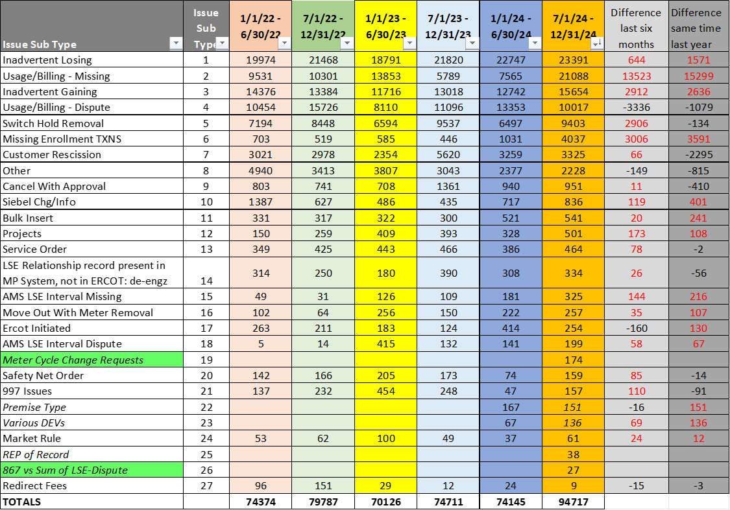
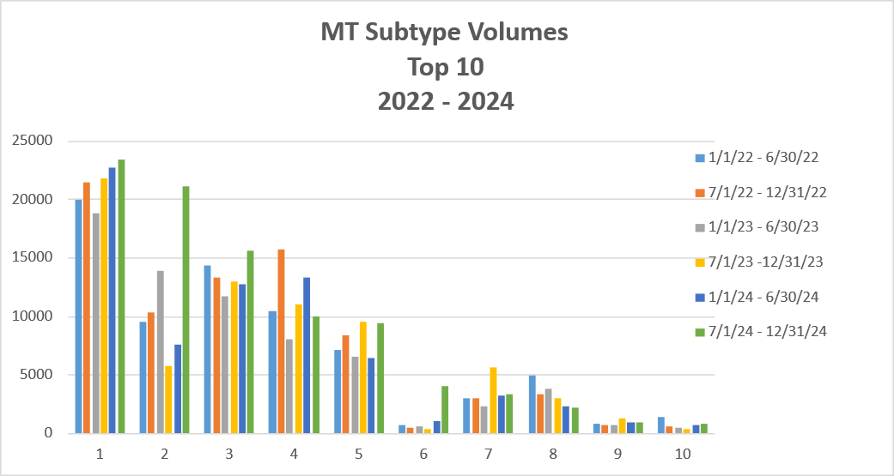
TDTMS
MarkeTrak Subtype Volumes – Biannual Review
Increases in Usage & Billing – Missing, Missing Enrollment Transactions, AMS LSE Missing, and Siebel Changes are due to the onboarding of LP&L
Inadvertent Losing continues to increase
Usage & Billing – Dispute increases are storm related and LP&L entrance
Switch Hold Removal remains seasonal

Slide 4
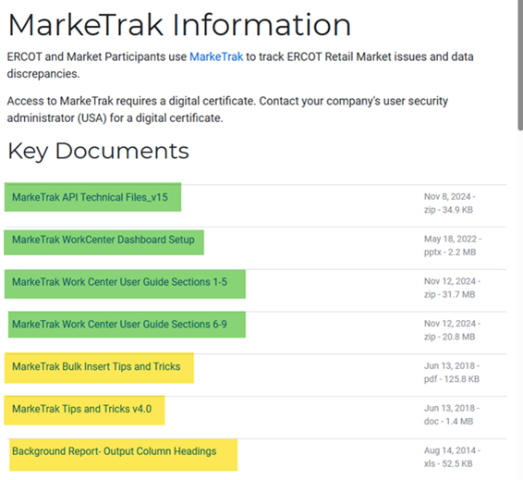
TDTMS
MarkeTrak Information Page
TDTMS will determine the documents to remain, those to be reviewed/revised, and those to be removed.

Slide 5
TDTMS
Next Meeting – TBD
DRAFT Agenda:
Posting of MT analysis data on main TDTMS page – IAG, IAL
System Instances & MT Performance
Extended Release - July
MIS – Retail API & UI
MarkeTrak Information Page
MarkeTrak Subtype Volumes – further deep dive
Follow up on Action Items
TAC Structural Review
ERCOT Reports
Listserv
Enhancements – reject code listing in MIS, ESI in MT escalation email

